Slide 1
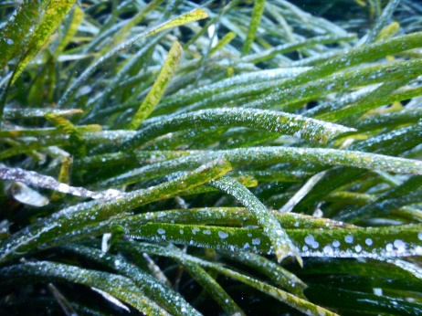
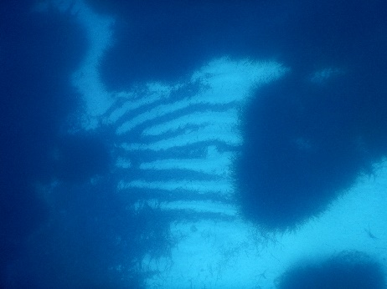
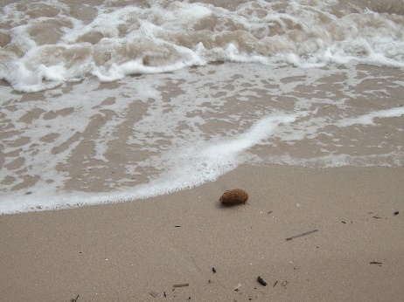
University of Liege
Oceanology laboratory
How does the endophytic fungal transform the Posidonia oceanica (L.) Delile (1813) meadow into the aegagropiles ?
Communication for the Centre Inter Universitaire de Biologie Marine (CIBIM)
Laurence LEFEBVRE, Sylvie Gobert
Notes:
Hello everyone,
My name is Laurence Lefebvre

Slide 2
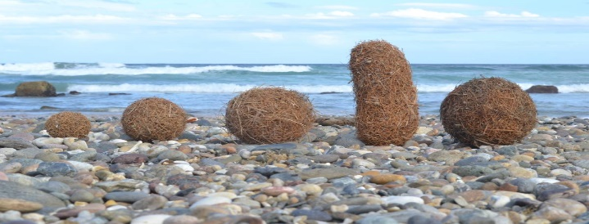
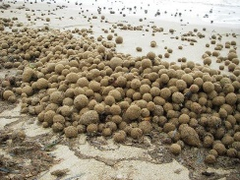
Introduction Aims Methods Results and discussion Conclusion
While walking along the beaches of the Mediterranean Sea,
?
…You can met agglomerate of plant fibres more or less spherical.
1
Notes:
While walking along the beaches of the Mediterranean Sea, You must have already met agglomerate of plant fibres more or less spherical.
You probably asked you :
what it it?
Is it a waste? How were it formed?
Does it have a name?

Slide 3
Introduction Aims Methods Results and discussion Conclusion
IT’S NATURAL !
2
Notes:
It’s not a waste, it’s a natural phenomenon

Slide 4
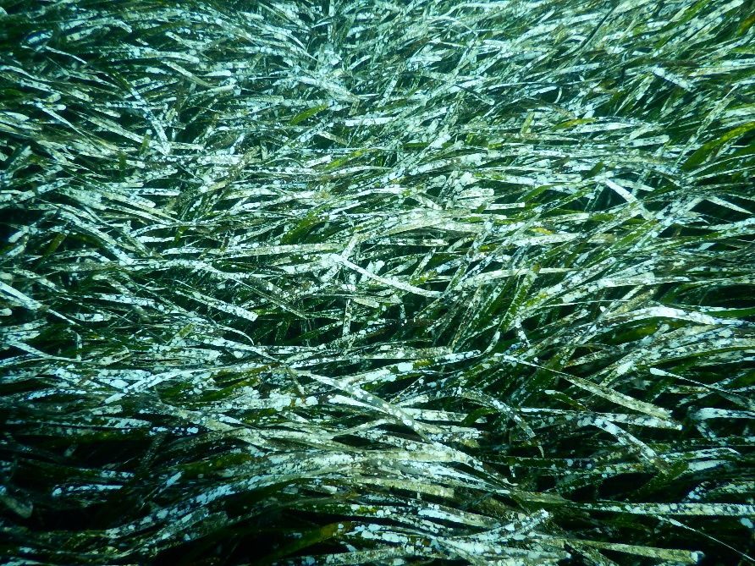
Introduction Aims Methods Results and discussion Conclusion
Not far from the beaches…
The Posidonia oceanica meadows
Fragmented Posidonia organs rolling in the ripples marks.
3
Notes:
Not far from these beaches of the Mediterranean, under water we have the meadows of posidonia and the plant debris of it in the ripples marks

Slide 5
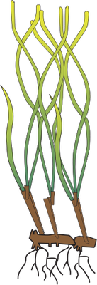
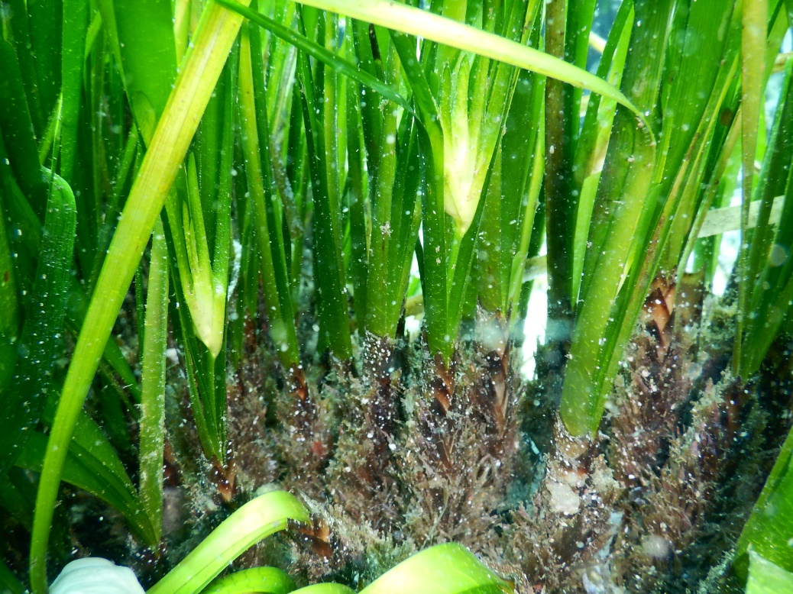
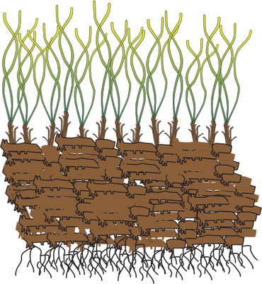
Introduction Aims Methods Results and discussion Conclusion
Introduction
The Posidonia meadows
Morphology of P.oceanica
Seagrass endemic to the Mediterranean Sea
Leaves
Orthotropic rhizome
Plagiotropic rhizome
Root
4
Notes:
the Posidonia meadow is composed of flowering plants
the morphology of this plant is:
roots of maximum 70cm
elongated leaves of 1cm wide
stems called rhizomes growing vertically or horizontally

Slide 6
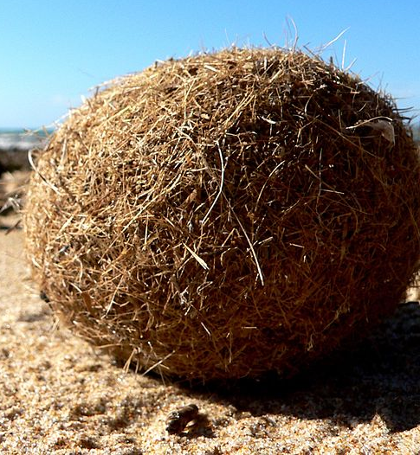
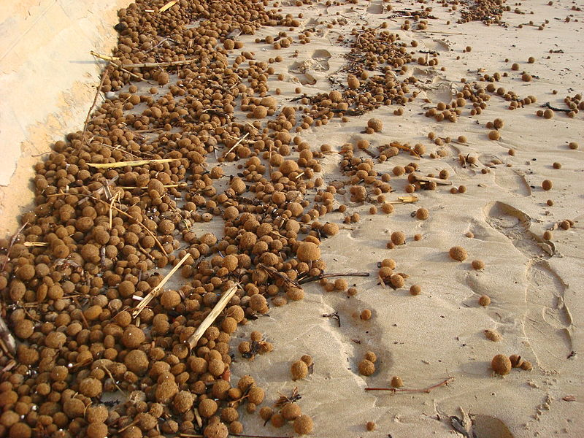
Introduction Aims Methods Results and discussion Conclusion
Introduction
What is it?
Conglomeration of fibres?
?
5
Notes:
So the question is, what is it?

Slide 7
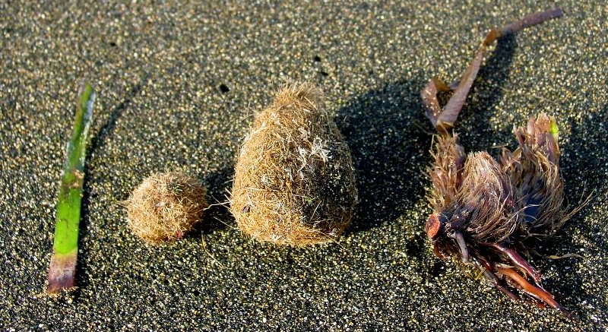
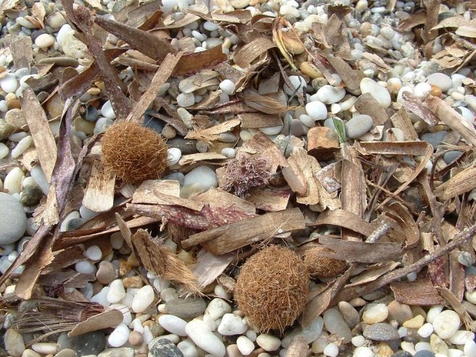
Introduction Aims Methods Results and discussion Conclusion
Introduction
It ‘s aegagropile of Posidonia oceanica
On the Mediterranean beaches
Aggregation of plant debris
Different size
6
Notes:
The name of this conglomerate of plant fibre is the aegagropiles of p.oceanica
The knowledge about it was very low.
We know that these mysterous balls were found along the beaches in Mediterannean
Their sizes and shapes were variables: from ellipsoid to spheroid and from millimeter to centimeter

Slide 8
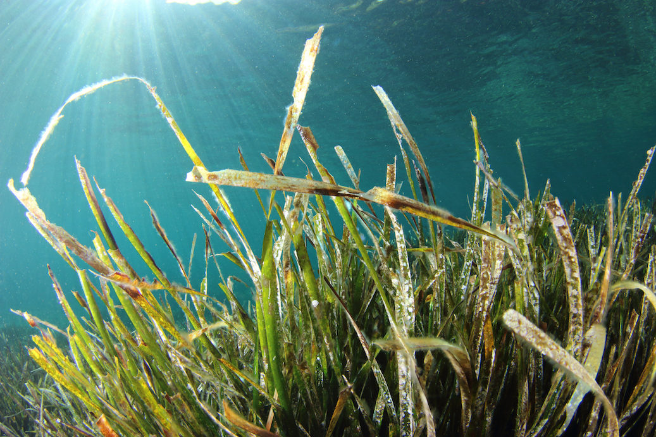
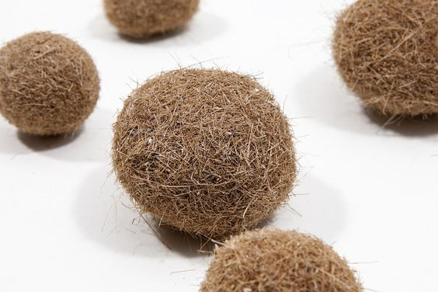
Introduction Aims Methods Results and discussion Conclusion
Introduction
How leaves becomes the fibres composing the Aegagropiles of Posidonia oceanica?
7

Slide 9
Introduction Aims Methods Results and discussion Conclusion
Introduction
Objectifs
1. How leaves becomes the fibres composing the Aegagropiles of Posidonia oceanica?
Internal organization
Composition
Origin
Macroscopic and microscopic studies
Only P.oceanica? Microscopic studies
What organs, what minerals?
Microscopic studies
8
Notes:
In order to answer these different questions
we have put together different research question to understand:
The Origin
the composition
The internal organization of these balls of fibres
all this information will perhaps allow us to understand how they were formed

Slide 10
Introduction Aims Methods Results and discussion Conclusion
2. How does this aegagropiles form?
9

Slide 11
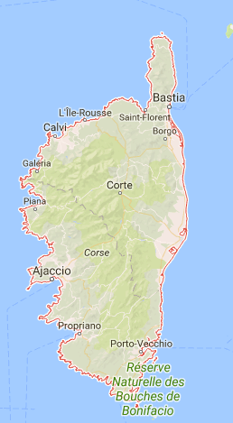
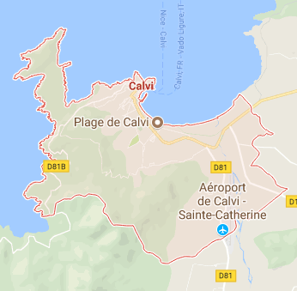
Introduction Aims Methods Results and discussion Conclusion
Introduction
Objectifs
Echantillonnage
In this study, aegagropiles were collected:
Corsica
159 aegagropiles collected
Calvi
10
Notes:
The sampling of this work was done in Corsica in Calvi
a total of 159 agagropiles were collected

Slide 12
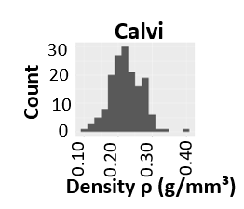
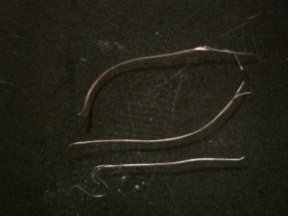
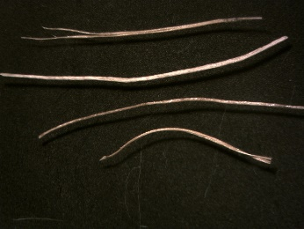
Introduction Aims Methods Results and discussion Conclusion
Characterization of the shape
Density ρ (mean 0.2 g / cm³)
Spheroid
Ellipsoid
Characterization of the different classes of fibres on the basis of width
Fine fibre
Wide fibre
Intermediate fibre
5mm
3mm
3mm
11
Notes:
In the first place, macroscopic studies have been carried out.
Determination of the density of aegagropiles
Determination of preferentially recovered shapes
Characterization of the fibers composing its aegagropiles into three classes: fine?, intermediate and Wide

Slide 13
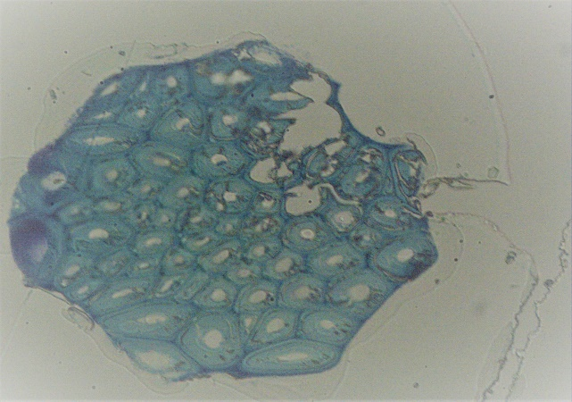
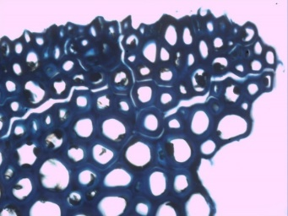
Introduction Aims Methods Results and discussion Conclusion
Identification of plant debris
Identification: histological comparison with fresh organs of P.oceanica
(F.F.)
(F.I.)
(F.W.)
10µm
10µm
10µm
12
Notes:
The plant debris composing the aegagropiles were identified.
The three types of fibers could be identified by comparisons with histological sections made on fresh organs of P.oceanica.
Fine fibers are bundles of fibrous cells from the rhizome: highly lignified
Intermediate fibers are bundles of sclerenchyma cells from epidermis pieces of leaves or P.oceanica sheath with or without epidermal cells.
Wide fibers are larger and composing of several cell layers like the parenchyma (possibly it was the root, stem or leaf)

Slide 14
Introduction Aims Methods Results and discussion Conclusion
Identification of plant debris
Identification: histological comparison with fresh organs of P.oceanica
ALL fibres come from Posidonia oceanica organs!
(F.F.)
(F.I.)
(F.W.)
10µm
10µm
10µm
12
Notes:
The plant debris composing the aegagropiles were identified.
The three types of fibers were treated with osmium and glutaraldehyde, then included in resin, they could be cut into fine histological slides with microtome.
The three types of fibers could be identified by comparisons with histological sections made on fresh organs of P.oceanica.
Fine fibers are bundles of fibrous cells from the rhizome: highly lignified
Intermediate fibers are bundles of sclerenchyma cells from epidermis pieces of leaves or P.oceanica sheath with or without epidermal cells.
Wide fibers are larger and composing of several cell layers like the parenchyma (possibly it was the root, stem or leaf)

Slide 15
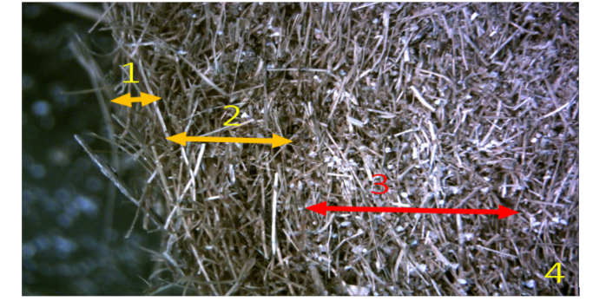
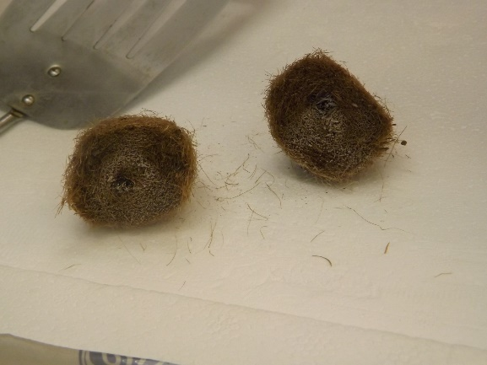
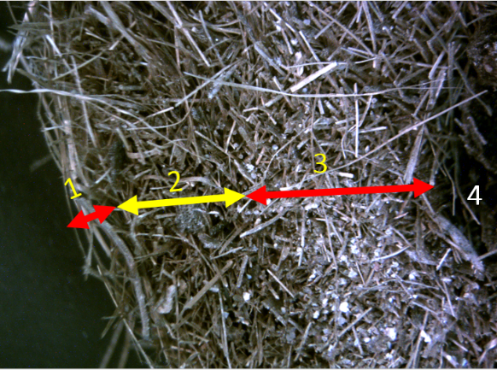
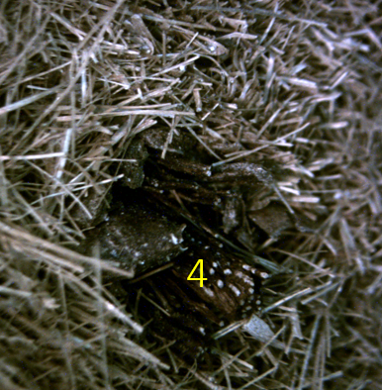
Introduction Aims Methods Results and discussion Conclusion
Determination of the internal organization
Aegagropile with the dense nucleus
Liquid nitrogen fracture (LN2)
Transversely cut
Aegagropile with the rhizomic nucleus
13
Notes:
Two morphotypes appeared, one with a black nucleus, the rhizome which is the stem of the plant and the other nucleus is pale where there are fibers fines strongly grouped at one point.
In the two cases: 4 successive circular layers were observed, where the third layer is more pale because composed of minerals forming a biociment consolidating the nucleus
No correlation between shape and nucleus type

Slide 16
Introduction Aims Methods Results and discussion Conclusion
Determination of the internal organization
Aegagropile at the dense nucleus
Liquid nitrogen fracture (LN2)
Transversely cut
No relation between the shape
and the nature of the nucleus
Aegagropile at the rhizomic nucleus
13
Notes:
The fracture with liquid nitrogen allowed to keep intact the structure of the aegagropile which is not possible in the open air.
The samples were placed in liquid nitrogen and cut transversely to observe the internal organization.
Two morphotypes appeared, one with a black nucleus, the rhizome which is the stem of the plant and the other nucleus is pale where there are fibers fines strongly grouped at one point.
In the two cases: 4 successive circular layers were observed, where the third layer is more pale because composed of minerals forming a biociment consolidating the nucleus
No correlation between shape and nucleus type

Slide 17
Introduction Aims Methods Results and discussion Conclusion
Introduction
But at this time we have not answered this question yet:
“ How leaves becomes the fibres composing the Aegagropiles of Posidonia oceanica? “
14

Slide 18
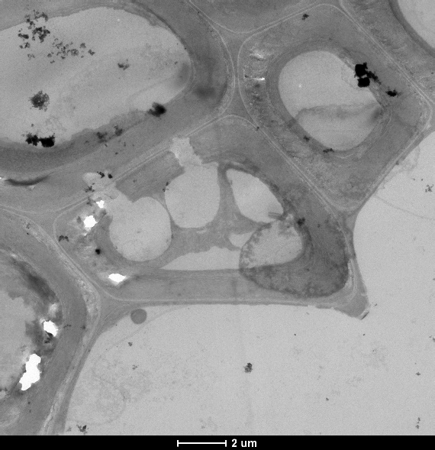
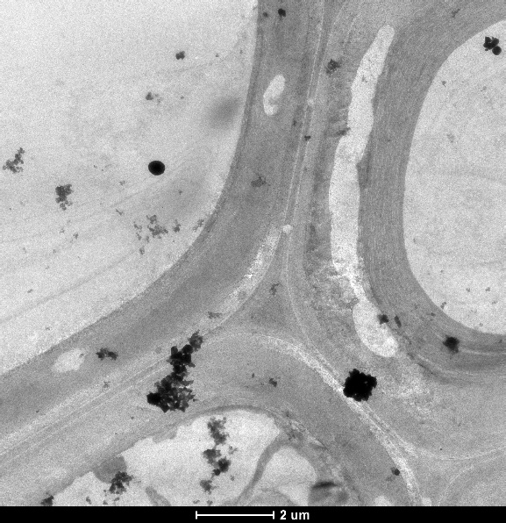
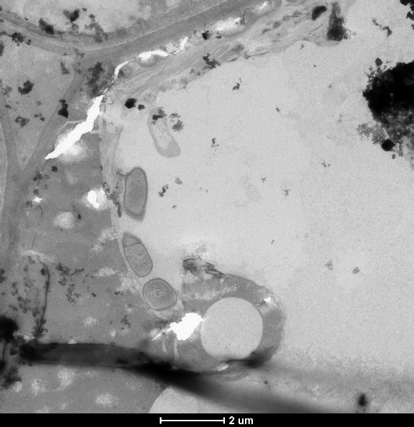
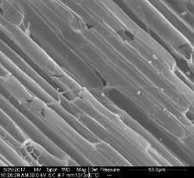
Introduction Aims Methods Results and discussion Conclusion
In the footsteps of the fungi
Perforation in the cell walls
Degradation of the middle lamella
2µm
2µm
2µm
10µm
10µm
25µm
15

Slide 19
Introduction Aims Methods Results and discussion Conclusion
In the footsteps of the fungi
Perforation in the cell walls
Degradation of the middle lamella
2µm
2µm
2µm
10µm
10µm
25µm
15

Slide 20
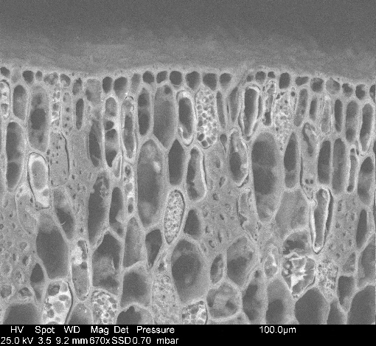
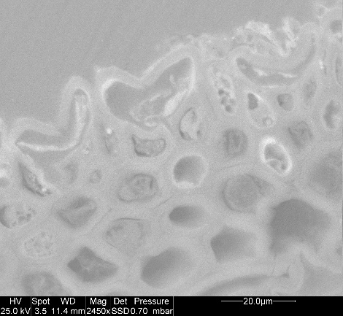
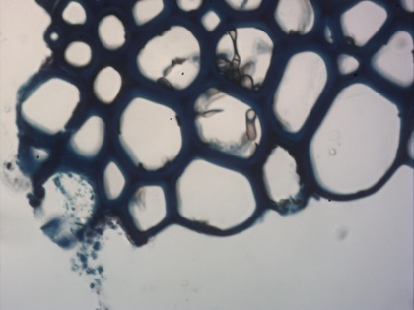
Introduction Aims Methods Results and discussion Conclusion
In the footsteps of the fungi
Hyphes of black fungi septate in the light of several cells (Ascomycete, Aigialaceae)
Micro-sclerotia of septal black fungi
Rhizome
Root
Wide fibre
5µm
100µm
20µm
16
Notes:
We have seen traces of biotic degradation probably due to a black fungus septate
it precisely attacks the middle lamella of plant cells

Slide 21
Introduction Aims Methods Results and discussion Conclusion
In the footsteps of the fungi
Cell membrane
Nucleus
Hyphes of black fungi septate in the light of several cells (Ascomycete, Aigialaceae)
Micro-sclerotia of septal black fungi
Pore
False partition
Rhizome
Root
Wide fibre (F.W.)
5µm
100µm
20µm
16

Slide 22
Introduction Aims Methods Results and discussion Conclusion
Establishment of the different hypothesis steps to the formation of P. oceanica aegagropiles
17
Notes:
Conclusion: formation, organisation , composition
The formation of these mysterious balls found on the beaches would be this:
1) fine fibers (origin rhizome and rigid nature) accumulating in the ripple marks or a piece of complete rhizome. Then minerals add up to form a dense and hard nucleous
2) more flexible fibers (leaf or sheath origin) intertwine / intertwine with the nucleus
3) the fibers form an elongated structure where the majority of the fibers are in the same direction
4) Then, this elongated shape separate into several small pieces under the movements of the swell
5) These pieces with the movements of the swell formed aegagropiles with the average density of 0.2g / cm3

Slide 23
Introduction Aims Methods Results and discussion Conclusion
Aegagropiles are…
Origin
Initial step
Sucessive steps
Coming from the Posidonia oceanica meadows
Composed of fibres of plant and sand
The result of the biological degradation
Formed by the hydrodynamism
18

Slide 24
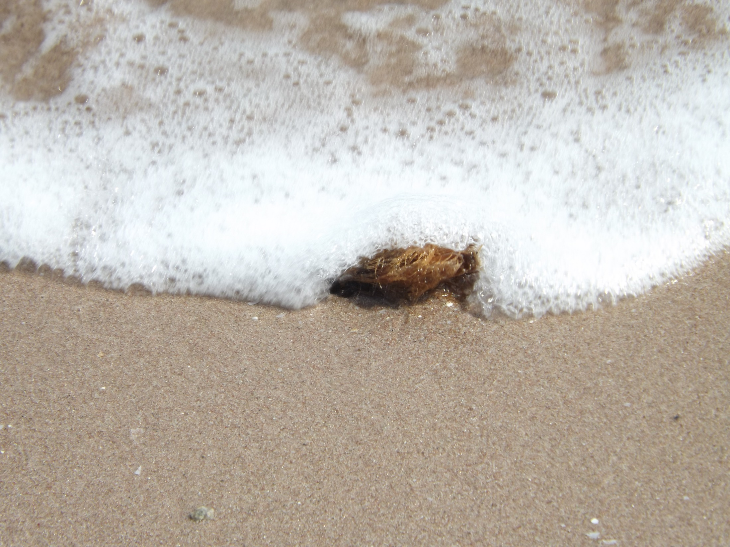
Thanks for your attention

