Slide 1


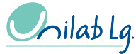
Urine sediment analysis: comparison of three automated analyzers
V. Castiglione & R. Gadisseur
CHU de Liège
Clinical chemistry
Siemens Academy Day
08/10/2018
Notes:
14h30-15h15 (30min pres + 15min QR)

Slide 2
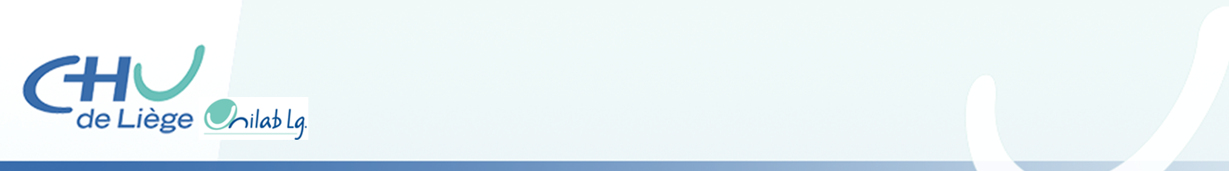
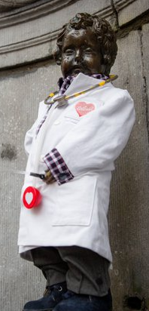
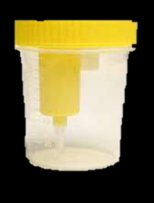
Urine, what for ?
Urine is a precious human collection as well as blood, CSF…
Different diagnoses made thanks to URINE collection :
  Metabolic
  Genetic
  Toxic
  Urinary tract infection
  HTA
  …
Diagnosis, prognosis, follow-up of diseases
Urinalysis plays a key role as an aid in the differential diagnosis of many renal and urologic diseases.

Slide 3
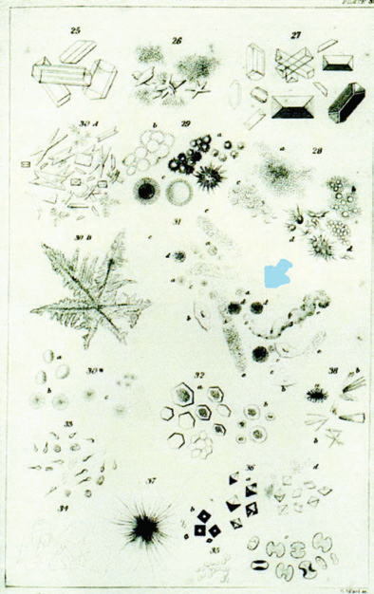
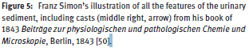
Some history
During the Middle Ages, numerous quacks and charlatans practiced “pisse prophecy,” claiming to be able to tell patients’ fortunes based on examination of their urine
Birth of microscope and microscopy: 1580–1700
Urine sediment described: 1840–1900
Introduction of phase contrast microscopy in the 1930s
First automated instrument : 1985
J. Stewart Cameron* -A history of urine microscopy -Clin Chem Lab Med 2015; 53(Suppl): S1453–S1464

Slide 4
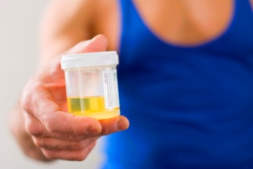
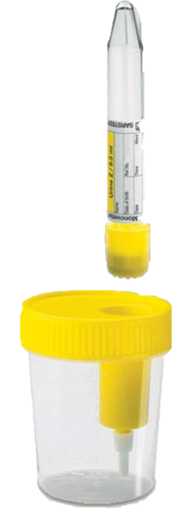
Pre-analytical phase
In order to standardize urinalysis, the European Confederation of Laboratory Medicine has published the European Urinalysis Guidelines, which provide specific instructions for urinary sediment analysis.
The original primary sample should be divided into different smaller aliquots for morphological, microbiological and chemical analyses to decrease the risk of contamination.
For reducing the risk of errors and contamination, commercially available vacuum systems have been developed, allowing direct sample aspiration into a secondary container.
Must be performed within two hours of collection

Slide 5
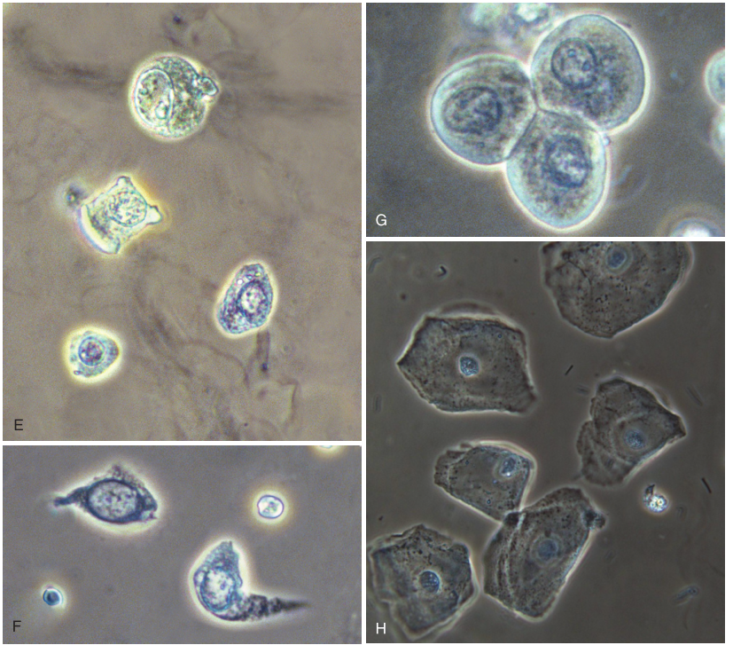
Microscopy
Manual analysis procedures are standardized and, even by trained technologists :
  ☹ Traditional microscopy of the urinary sediment is labor-intensive, time-consuming, imprecise and has wide variability
It remains the Gold Standard.
Qualitative urinalysis includes visual inspection of urine, chemical analysis and microscopic analysis of urinary sediment
Attempts have been made to reduce the variation of manual analysis involving the use of uncentrifuged samples and automation of urinalysis.
More feasible for the high-volume laboratory workload
Picture from Fogazzi GB. Urinalysis. Fourth Edi. Elsevier Inc. 2010.

Slide 6
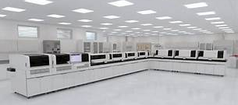
From manual to full automation
Urinalysis is an integral part of routine laboratory work
  Around 200 specimen/day at CHU of Liège
Automated urinalysis systems can be connected to a reagent strip chemistry analyzer to provide a fully integrated chemical and microscopic urinalysis workstation
Which philosophy ?
  Urine sediment in a microbiology lab or integrated into a Corelab
    ☺ Must evolve to Corelab activities
    ☹ BUT, urine culture : short turnaround/ need to get correct aliquots at the beginning
  Dipstick positive results generate urine analysis : reflex tests
  Better sample flow on a lab track
  Actually mainly stand alone… but evolution in the near future ?

Slide 7
Computer Software
Reducing the number of urine microscopic analyses by screening the urine samples with urine strips and performing microscopy on the samples that give positive results
  ☹ Has been reported to produce significant losses in diagnostic yields.
Need to get an expert system
  interpretation of the urine strip and sediment results
    concordance between the strip and sediment results ?
  then generates suggestive interpretative messages (flags), which may be used as review rules for manual microscopy

Slide 8
Proteins/Creatinine
Proteins/Creatinine ratio on strip: traces are important because of high rate of highly positive results when measured with the routine quantitative method
  Résimont, et al, SFNDT, 2018
Dilution factor

Slide 9
From manual to full automation
There are some needs :
  To collect users images of individual urinary sediment particles, which are considered of particular interest for their morphology and/or their clinical meaning.
  To have an educational tool to stimulate the interest in and knowledge of urinary sediment, in order to improve the quality of this diagnostic tool.

Slide 10
Our study
Pre-analytical consideration
  Urine spot
  In- and out-patients, from several departments (emergency, nephrology, …) at CHU de Liège
  Aliquot for urine culture and chemical analysis
  SediMAX (routine)
  Atellica and U-NEXT
  Microscope
  Analysis within 2 hours
  2 trained techinicians

Slide 11
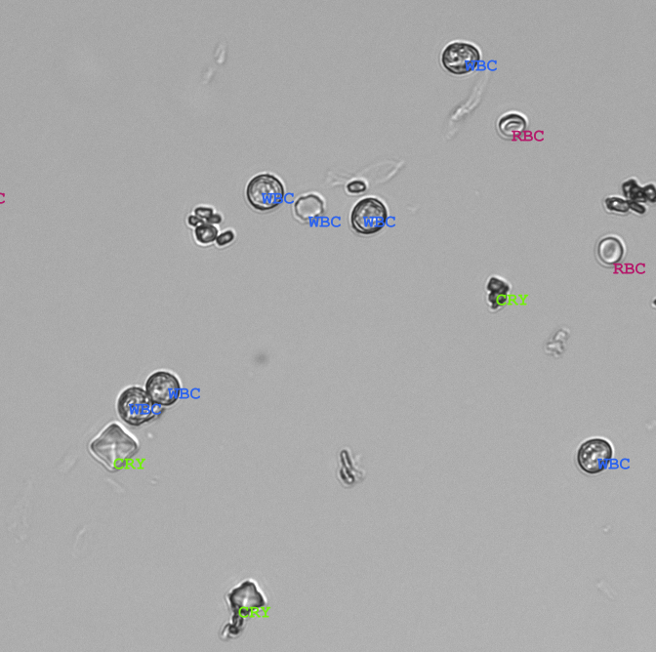
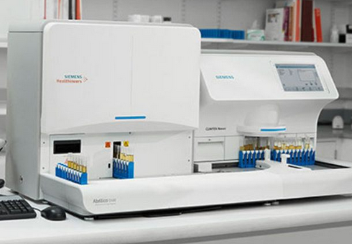
Attelica
CLINITEK Novus: strip measurement
Automated microscopy (15 pictures)
Reviewing of pictures
Notes:
Strips: reflectance photometry

Slide 12
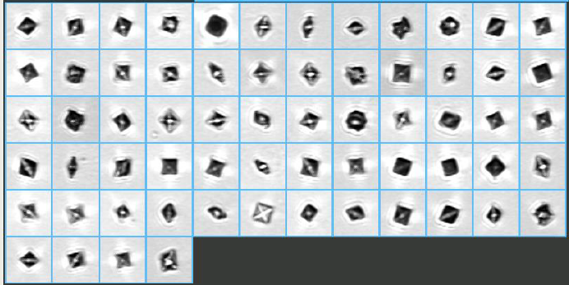
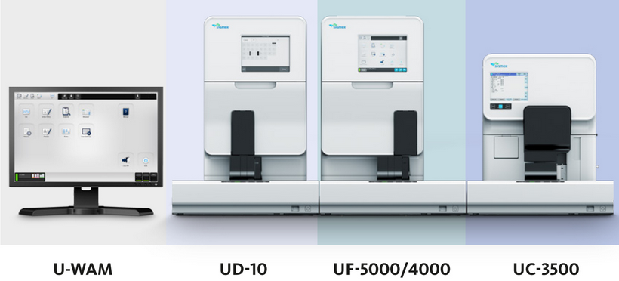
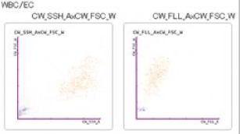
U-NEXT
UC-3500: Strip measurement
Fluorescence flow-cytometry
  Scattergram
UD-10: element reviewing

Slide 13
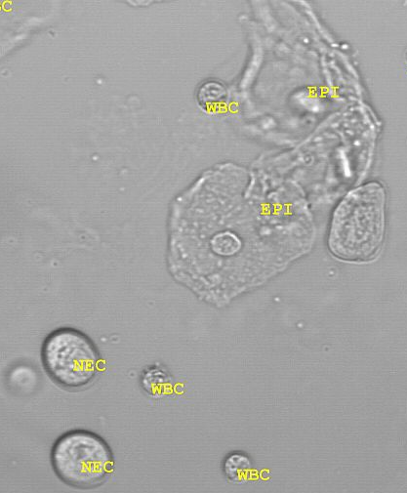
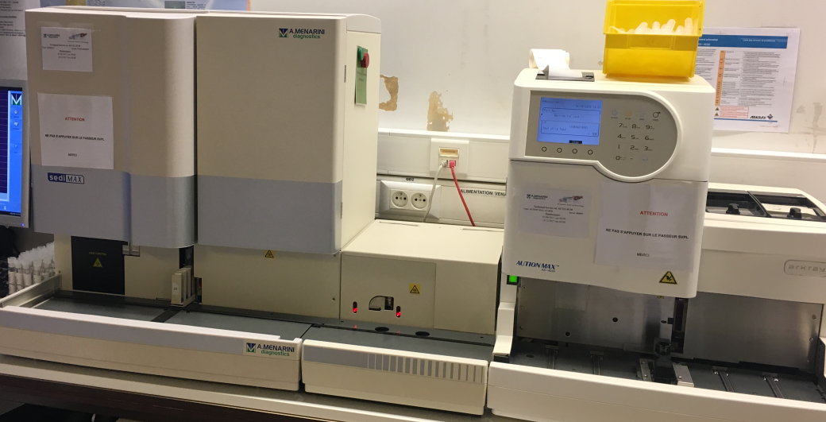
SediMAX
AutionMAX: strip measurement
Automated microscopy (15 pictures)
Reviewing of pictures

Slide 14
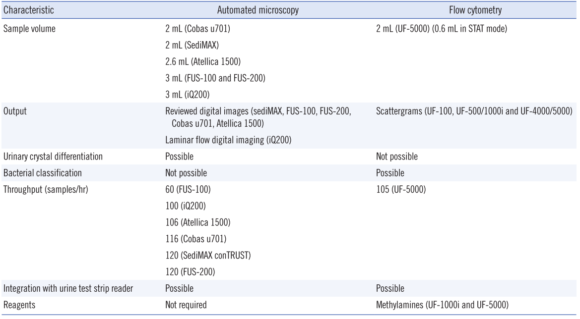
Workflow
From Oyaert M, Delanghe J. Progress in Automated Urinalysis. Ann Lab Med 2019

Slide 15
Validation
Intra-run precision: 5 levels x20 in a row
Between-run precision: 2 levels quality-controls 2x/day for 10d
Linearity : 5 decreasing levels from stock sample 3x
Carry-over
Notes:
Stock solution

Slide 16
Intra-run precision
 |  | UF-4000 |  | Atellica |  | SediMAX
 | Level | Range (p/µL) | CV (%) | Range (p/µL) | CV (%) | Range (p/µL) | CV (%)
RBC | 1 | 3.7 | 16.7 | 6.9 | 40.6 | 1.0 | 56.9
 | 2 | 24.9 | 6.3 | 19.2 | 24.7 | 52.8 | 16.9
 | 3 | 98.6 | 3.0 | 133.0 | 19.4 | 128.5 | 9.9
 | 4 | 173.3 | 4.6 | 379.9 | 5.5 | 425.0 | 5.7
 | 5 | 35405.4 | 1.2 | 1497.2 | 5.0 | 775.3 | 4.1
WBC | 1 | 2.0 | 22.2 | 11.7 | 24.9 | 12.7 | 21.6
 | 2 | 22.2 | 12.3 | 46.5 | 19.1 | 31.6 | 14.9
 | 3 | 64.1 | 6.1 | 195.7 | 9.1 | 153.2 | 4.7
 | 4 | 125.0 | 3.4 | 422.6 | 4.9 | 315.9 | 8.6
 | 5 | 835.4 | 2.6 | 634.0 | 5.4 | 952.3 | 1.5
Bact-eria | 1 | 350.4 | 5.1 | 38.7 | 8.1 | 49.7 | 11.0
 | 2 | 630.4 | 5.7 | 135.4 | 6.0 | 127.5 | 14.7
 | 3 | 1758.6 | 4.7 | 248.4 | 7.1 | 237.8 | 3.5
 | 4 | 6787.7 | 1.9 | 1212.4 | 4.8 | 4131.6 | 5.7
Notes:
NCCLS

Slide 17
Inter-run precision
QC provided for each analyzer by supplier
 |  | UF-4000 |  | Atellica |  | SediMAX
 | Level | Range (p/µL) | CV (%) | Range (p/µL) | CV (%) | Range (p/µL) | CV (%)
RBC | Low | 4 | 0 | 4.0 | 0.0 | 0.0 | 0.0
 | High | 199.6 | 4.2 | 165.6 | 23.4 | 122.7 | 24.1
WBC | Low | 3.0 | 0.0 | 3.0 | 0.0 | 3.6 | 41.7
 | High | 803.5 | 2.5 | 89.3 | 22.5 | 72.0 | 11.9

Slide 18
Linearity
 | UF-4000 |  |  | Atellica |  |  | SediMAX
 | Slope | intercept | R² | Slope | intercept | R² | Slope | intercept | R²
RBC | 0.940 | 11.429 | 1.000 | 0.838 | 75.791 | 0.988 | 0.958 | 72.261 | 0.999
WBC | 0.946 | 25.829 | 0.999 | 0.996 | -7.919 | 0.999 | 0.967 | 87.067 | 0.996
Bacteria | 1.092 | -141.040 | 1.000 | 1.220 | 4.896 | 1.000 | 1.133 | 97.852 | 0.987

Slide 19
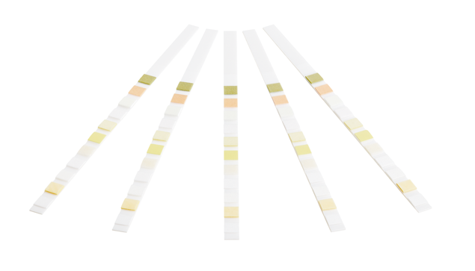
Strip measurement
Glucose, proteins, albumin and creatinine
Reflectance photometry
VS Cobas 8000 (Roche)
284 samples stored for 1 month at -80°C
Notes:
Glu: enzym, Alb, creat: colo

Slide 20
Strip measurement
Creat: establishment of reference range?
 | Glucose |  |  | Protein |  |  | Albumin |  | Creatinine
 | UC-3500 | Novus | AutionMAX | UC-3500 | Novus | AutionMAX | UC-3500 | Novus | UC-3500 | Novus
TP (n) | 15 | 12 | 16 | 37 | 38 | 39 | 86 | 88 | 233 | 240
FP (%) | 0.7 | 0.4 | 0.7 | 6.5 | 4.2 | 7.8 | 17.6 | 20.5 | 7.9 | 8.1
FN (%) | 0.7 | 1.8 | 0.0 | 2.9 | 3.2 | 2.8 | 3.3 | 2.9 | 2.5 | 1.8
SE (%) | 88 | 71 | 100 | 82 | 81 | 83 | 91 | 92 | 97 | 98
SP (%) | 99 | 100 | 99 | 92 | 95 | 91 | 73 | 69 | 42 | 41
PPV (%) | 88 | 92 | 89 | 67 | 76 | 64 | 64 | 61 | 91 | 91
NPP (%) | 99 | 98 | 100 | 96 | 96 | 96 | 94 | 94 | 70 | 76

Slide 21
Sediment comparison
359 samples
Compared to manual microscopy (400x)
  Bright field
  Contrast phase
  Polarized light
Uriglass
Within 2 hours
2 blinded operators 1/10 samples

Slide 22
Sediment comparison
 |  | TP (n) | FP (%) | FN (%) | SE (%) | SP (%) | PPV (%) | NPP (%)
RBC | UF-4000 | 66 | 11,4 | 6,6 | 74 | 85 | 62 | 91
 | UAS 800 | 62 | 4,2 | 7,3 | 70 | 94 | 81 | 91
 | SediMAX | 40 | 1,9 | 8,0 | 61 | 97 | 87 | 90
WBC | UF-4000 | 106 | 2,6 | 9,1 | 77 | 96 | 92 | 86
 | UAS 800 | 103 | 2,3 | 9,9 | 75 | 96 | 93 | 86
 | SediMAX | 83 | 1,9 | 14,4 | 65 | 97 | 93 | 80
EC | UF-4000 | 78 | 6,8 | 4,3 | 84 | 91 | 76 | 94
 | UAS 800 | 71 | 7,1 | 6,5 | 76 | 90 | 74 | 91
 | SediMAX | 60 | 3,2 | 8,7 | 69 | 96 | 86 | 89
NEC | UF-4000 | 22 | 31,9 | 0,6 | 92 | 66 | 16 | 99
 | UAS 800 | 9 | 5,9 | 4,0 | 39 | 94 | 30 | 96
 | SediMAX | 7 | 5,8 | 4,5 | 33 | 94 | 28 | 95
NEC: UF is better at identification?

Slide 23
Sediment comparison
 |  | TP (n) | FP (%) | FN (%) | SE (%) | SP (%) | PPV (%) | NPP (%)
HYA | UF-4000 | 4 | 2,0 | 4,8 | 19 | 98 | 36 | 95
 | UAS 800 | 11 | 4,8 | 2,8 | 52 | 95 | 39 | 97
 | SediMAX | 9 | 2,6 | 3,5 | 45 | 97 | 53 | 96
PAT | UF-4000 | 1 | 1,7 | 2,0 | 13 | 98 | 14 | 98
 | UAS 800 | 5 | 6,5 | 1,1 | 56 | 93 | 18 | 99
 | SediMAX | 3 | 3,5 | 1,9 | 33 | 96 | 21 | 98
CRY | UF-4000 | 17 | 2,6 | 4,0 | 55 | 97 | 65 | 96
 | UAS 800 | 22 | 11,9 | 1,7 | 79 | 87 | 34 | 98
 | SediMAX | 15 | 7,7 | 2,9 | 63 | 92 | 38 | 97
YEA | UF-4000 | 2 | 3,7 | 0,6 | 50 | 96 | 13 | 99
 | UAS 800 | 2 | 1,4 | 0,6 | 50 | 99 | 29 | 99
 | SediMAX | 2 | 1,6 | 0,6 | 50 | 98 | 29 | 99

Slide 24
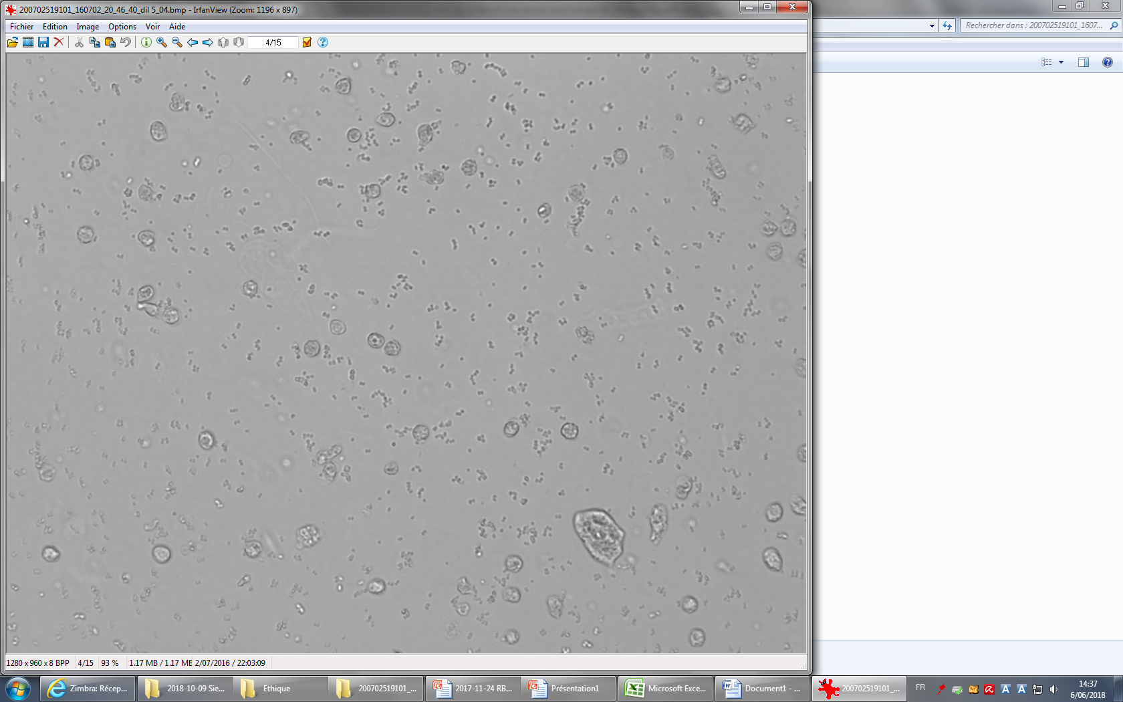
Bacteria
Compared to urine culture
324 samples
10µl blood and CLED agar plates at 36°C for 24 h
Positive: >10⁴ CFU/ml
+/- Leukocytes
  UF-4000 : GP - GN
  UAS 800 : rod - cocci.
Notes:
Ten to the power four / 10 000

Slide 25
Bacteria
 | Bacteria |  |  | Bacteria + Leukocyte Esterase
 | UF 4000 | UAS 800 | SediMAX | UF 4000 | UAS 800 | SediMAX
FP (%) | 29.8 | 45.3 | 15.7 | 9.8 | 24.2 | 6.0
FN (%) | 0.3 | 3.8 | 6.4 | 6.8 | 6.0 | 9.3
SE (%) | 98.3 | 78.9 | 66.7 | 63.2 | 66.7 | 51.9
SP (%) | 63.1 | 44.8 | 80.6 | 88.0 | 70.5 | 92.5
PPV (%) | 38.6 | 23.8 | 45.0 | 54.5 | 33.0 | 62.2
NPP (%) | 99.4 | 90.7 | 91.0 | 91.3 | 90.6 | 89.0

Slide 26
Bacteria
 | UF 4000 |  | UAS 800
 | Gram+ | Gram- | Cocci | Rod
FP (%) | 7.0 | 3.2 | 54.0 | 3.1
FN (%) | 30.4 | 15.2 | 0.0 | 7.8
SE (%) | 28.4 | 45.5 | 100.0 | 68.1
SP (%) | 87.9 | 95.6 | 44.8 | 95.9
PPV (%) | 63.3 | 80.0 | 3.8 | 84.2
NPP (%) | 62.5 | 82.0 | 100.0 | 90.3

Slide 27
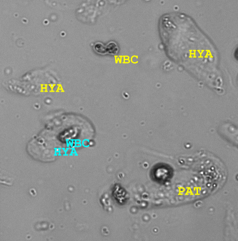
Reviewing
Directly thanks to pictures on Atellica and SediMAX
With scattergrams or UD-10
Rules from our lab
  Validated on the SediMAX!

Slide 28
Reviewing
Reviewing rate (%) | UN-SERIES | Atellica | SediMAX
Samples needing review | 54.5 | 55.6 | 45.2
BLD+ RBC- | 4.3 | 6.8 | 9.9
BLD- RBC+ | 15.4 | 4.8 | 1.9
LEU+ WBC- | 2.0 | 18.1 | 6.4
LEU- WBC+ | 13.1 | 3.4 | 4.5
Proteins+ WBC- | 6.8 | 7.1 | 11.2
Nitrites+ Bacteria- | 0.0 | 0.6 | 0.6
NEC + | 38.2 | 8.5 | 8.0
HYA + | 3.1 | 7.9 | 5.4
PAT + | 2.0 | 7.9 | 4.5
CRY + | 7.4 | 18.1 | 12.5
YLC + | 4.3 | 2.0 | 2.2

Slide 29
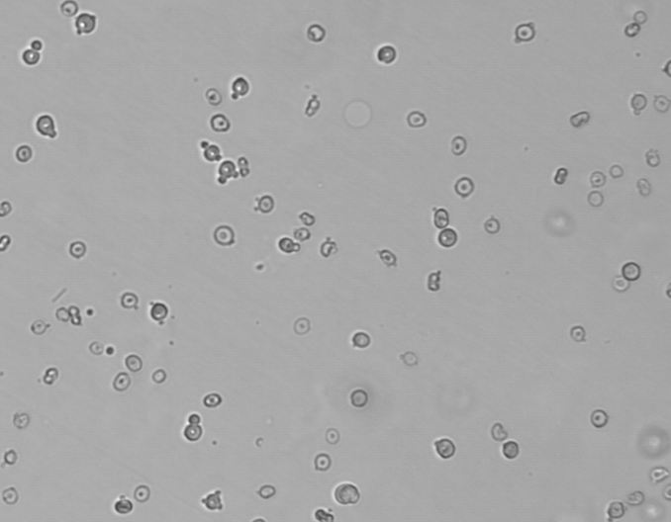
Reviewing
Is microscopy the gold-standard?

Slide 30
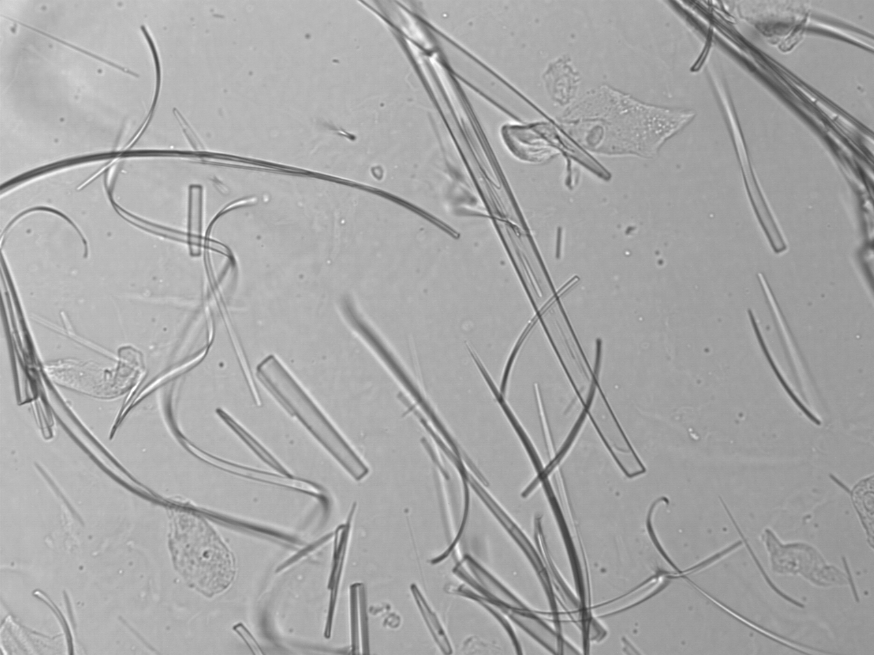
What’s your guess?
Notes:
ACV

Slide 31
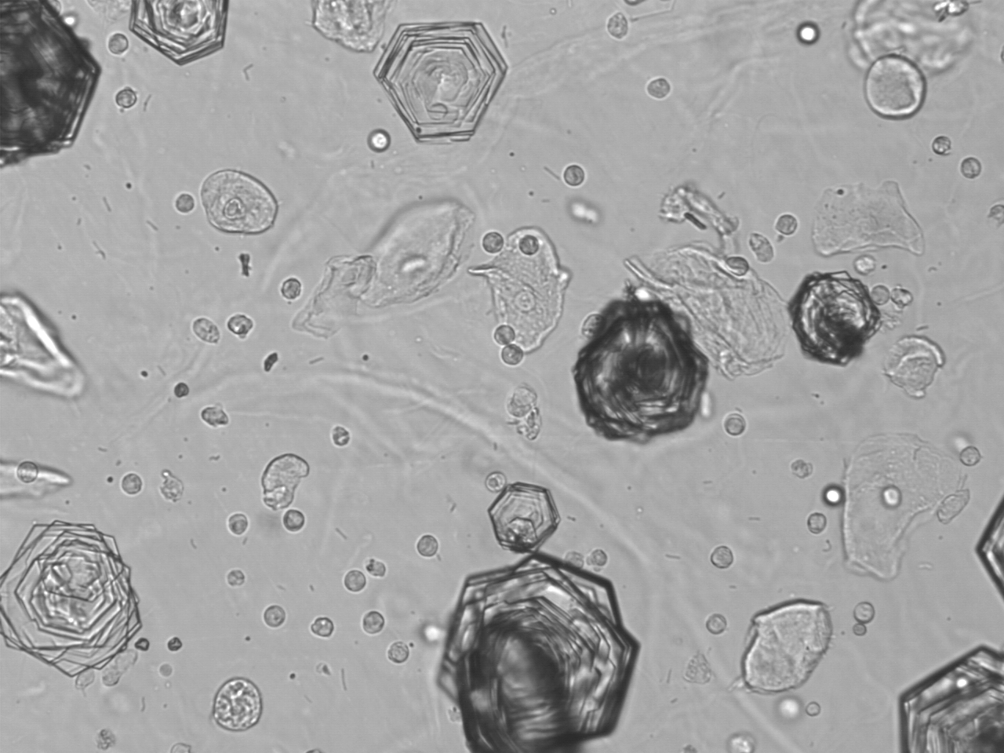
What’s your guess?
Notes:
CIPRO squashed crystals

Slide 32
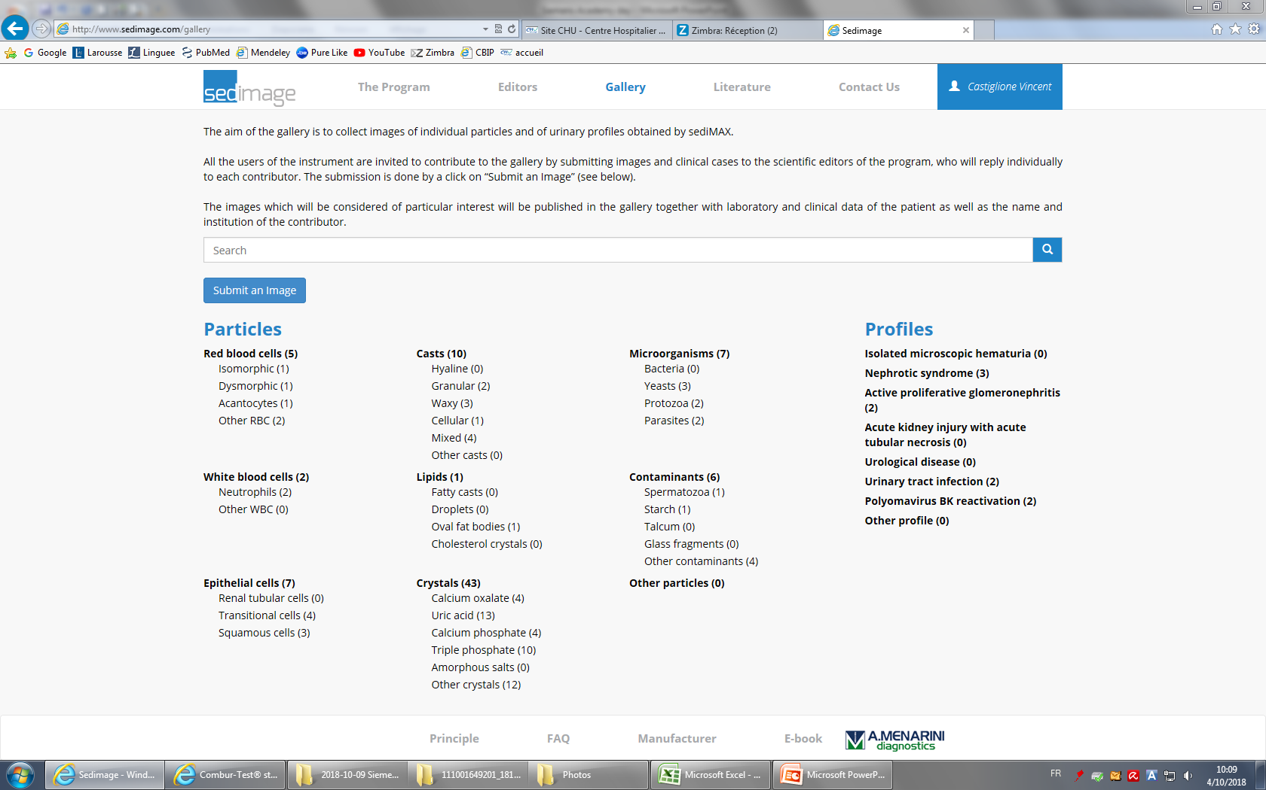
Networking
Repository accessible for the users
Directly accessible on the analyzer?

Slide 33
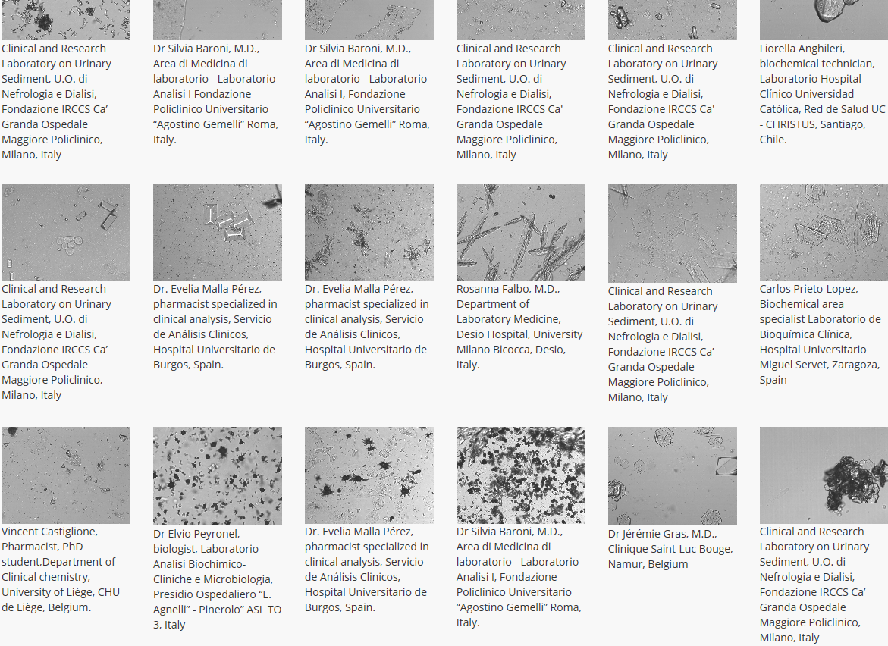
Networking

Slide 34
Thank you

