Slide 1
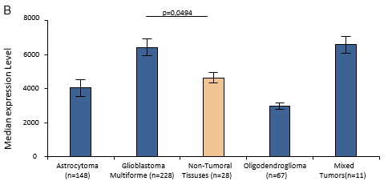
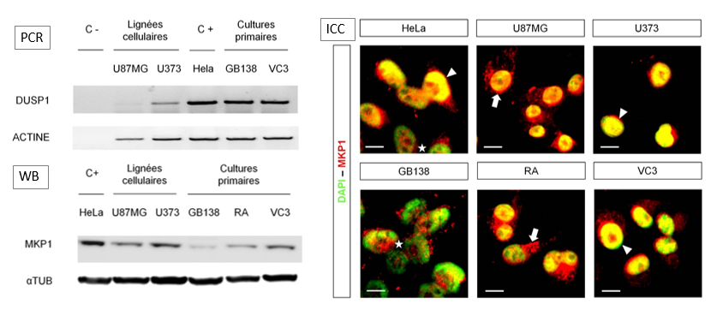
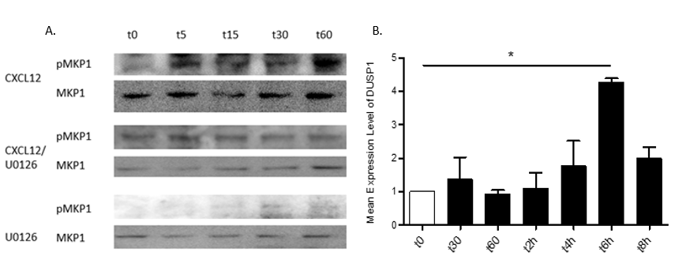
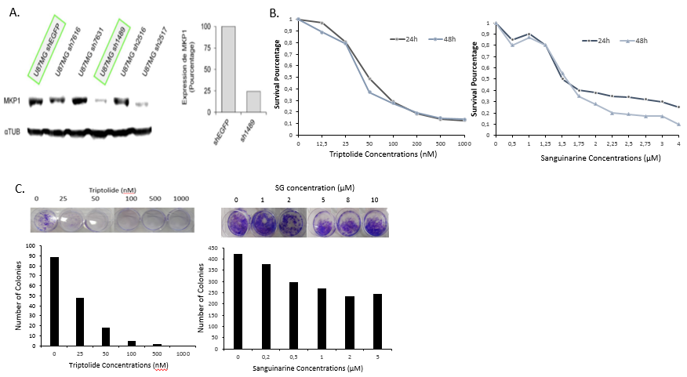
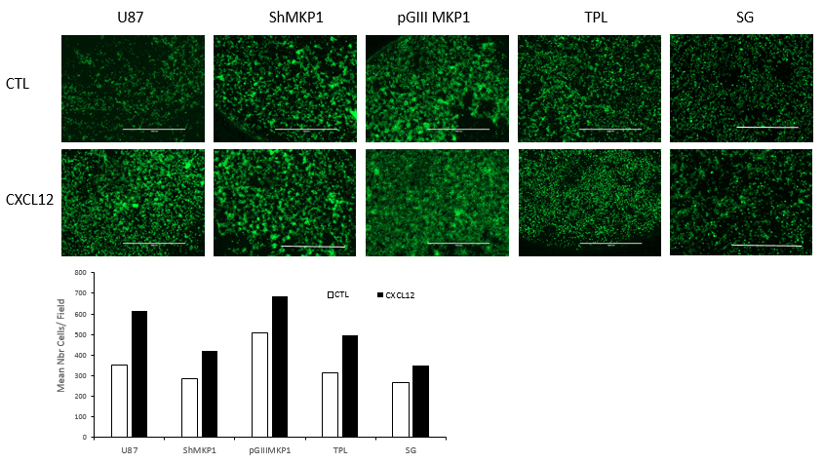
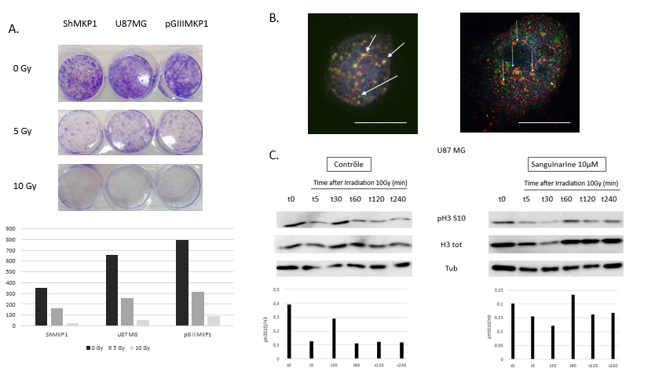
Possible Role of MKP-1 in Glioblastoma cells radioprotection following CXCL12 activation
Matthias Dedobbeleer¹, Nicolas Goffart¹, Estelle Willems¹, Emmanuel Di Valentin², Bernard Rogister^{1,3,4}
¹ Nervous System Diseases and Treatments, GIGA-Neurosciences Research Center, University of Liège, Liège, Belgium
²GIGA-Viral Vector Plateform, University of Liège, Liège, Belgium.
³Department of Neurology, CHU and University of Liège, Liège, Belgium.
⁴GIGA – Development, Stem Cells and Regenerative Medicine, University of Liège, Liège, Belgium.
Introduction
In patients with glioblastoma multiform (GBM), recurrence is the rule despite continuous advances in surgery, radio- and chemotherapy. Within these most frequent primary brain tumors, glioblastoma stem cells or initiating cells (GIC) have recently been described and were shown to be involved in these recurrences. Our lab recently demonstrated that GIC, once injected into the striatum of immunodeficient nude mice, exhibit a tropism for the subventricular zones (SVZ), one of the adult neurogenic niches bringing them an appropriate molecular and cellular environment to growth. After irradiation of these mice, we still discovered cells inside the SVZ. We then questionned the role of the CXCL12/CXCR4 pathway in radioprotection phenotype. After demonstrating that CXCL12 could play a radioprotective role, we wanted to know by which mechanism it happens. Knowing that MKP1, the major regulator of the MAP kinase pathway, shown a higher phosphorylation profile after CXCL12 stimulation, and that this protein is involve in many cancers and that its role in glioblamstoma remain unclear, we wanted to know could have a radioprotective role link or not to the CXCL12/CXCR4 signalling pathway.
1. Migration of GBM Cells to the SVZ
Results
A
2. Expression of MKP1 in GBM cells
B
A
Increase > 2,5-fold :
BAD MKP1 ERK1 SMD5
SVZ
TM
Decrease > 2.5-Fold
GRB2 PLCγ IKKγ AurA CD2AP TUBα1 AKT
JNK1 mTOR STAT3 LC8 RAB7 Rb HRC
C
C
Figure 1 : A) Migration of the cells from the tumour mass to the sub-ventricular zone via the corpus callosum B) Identification of CXCl12 on the environment of the cells in the sub-ventricular zone. C) Identification of CXCR4 signalling pathway leading to the migration of GBM cells to the sub-ventricular zone
3. Regulation of MKP1 in U87MG cells following CXCL12 stimulation
Figure 2 : A) Results of the phosphoproteome assays obtain from the Mass Spectrometry analysis of the phosphorylated proteins following the activation of CXCR4 after an hour of stimulation by CXCL12 in U87MG cells B) Rembrandt Database showing different levels of DUSP1 expression in Glioblastoma samples and other cancers from the central nervous system. C) Results obtained from PCR, Western Blott and immunocyto labelling showing the expression of MKP1 in different cell lines and primary cell cultures of glioblastoma (Scale bar: 2µm)
4. Inhibition of MKP1 in U87MG cells
Figure 3 : Results showing the regulation of MKP1 after different stimulations of U87MG with CXCL12 (12,5nM). A) Western Blott showing the different phosphorylation profiles of MKP1 in U87MG cells, stimulated by CXCL12 and/or with the inhibitor of MAPK ERK, U0126 (1µM). B) Expression profil of MKP1 transcritp obtained by QRT-PCR in U87MG cells, stimulated by CXCL12.
5. Effect of MKP1 on U87MG cells migration
Figure 4 : Results showing the inhibition of MKP1 by ShRNA and with two different drugs: Triptolide and Sanguinarine. A) Western Blott showing the decrease of expression of MKP1 in U87MG cells transfected with different ShRNA. B) MTT assays realized ioon U87MG cells to analyze the toxic dose of the drug. C) Results obtained from Colonies assays to analyze the effects of the drugs on the proliferation of U87MG cells
6. Effect of MKP1 on U87MG cells radioprotection
Figure 5 : Results showing the effect of the inhibition of MKP1 by ShRNA and with two different drugs on migration. On the top, representation of the field of different migration assays where U87MG cells are in presence or not with CXCL12 (250nM). In the bottom, graph presenting the number of cells for each conditions. (TPL: 1µM/ SG 10µM)
Perspectives
MKP1
P _{P}
Number of colonies per filed
MKP1
P _{P}
P
MKP1
P
P
JNK
Figure 6 : First Results obtained on the role of MKP1 in radioprotection of U87MG cells. A) Clonogenic Assays on the top with the counting of the number of colonies at the bottom for U87MG cells, ShMKP1 (invalidated) or pGIIIMKP1 (overexpressing). B) Co-immunocyto labelling (shows by darts) of MKP1 and pH3S10 (green) in U87MG (red) 5min after irradiation (Scale bar: 1µm). C) Western Blott of pH3S10 phosphorylation profile in U87MG cells irradiated and inhibited with Sanguinarine (on the right).
H2AX
H 3
Futher investigations with 2 different hypothesis of radioprotection mechanisms will be study with the JNK-docking pathway and the Histone H3-H2AX pathway, in order to clarify the radioprotective role of MKP1 in glioblastoma.
Contact : mdedobbeleer@ulg.ac.be
FRIA

