Slide 1
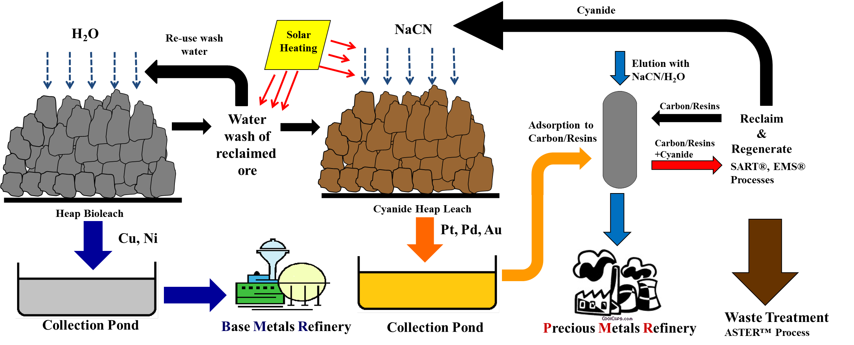
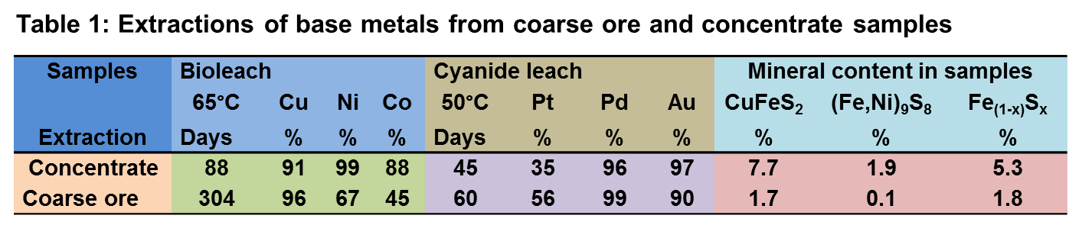
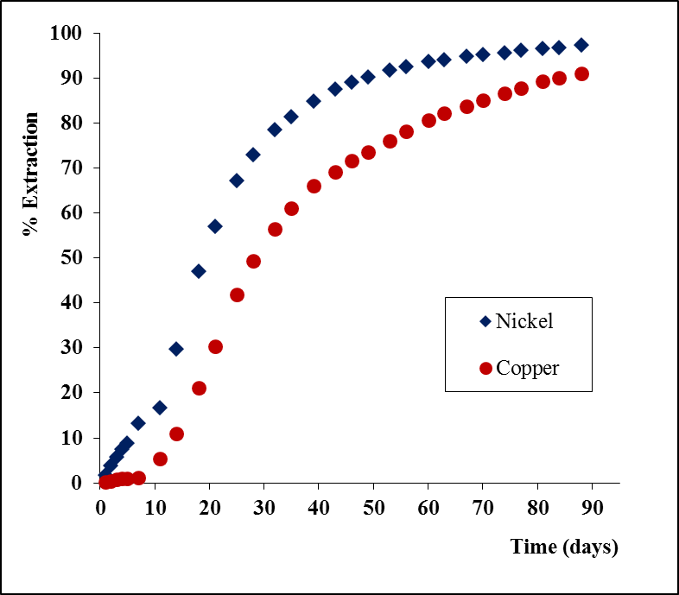
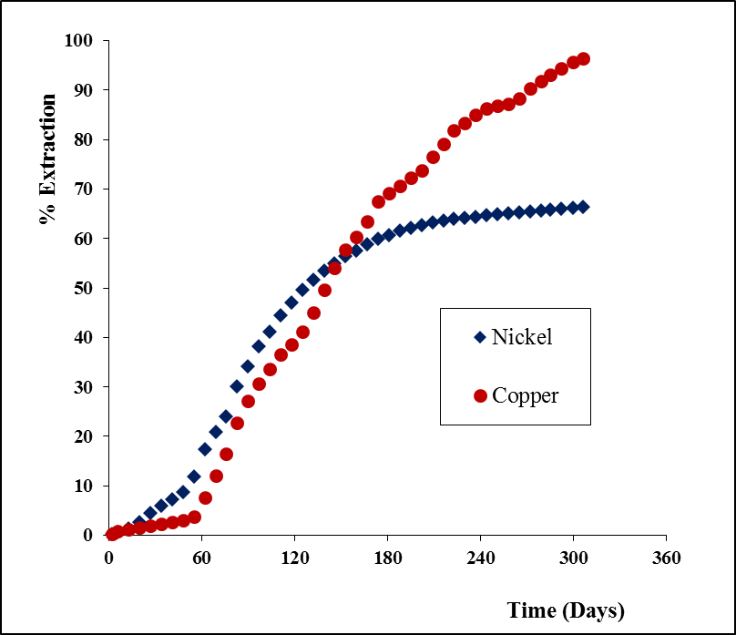
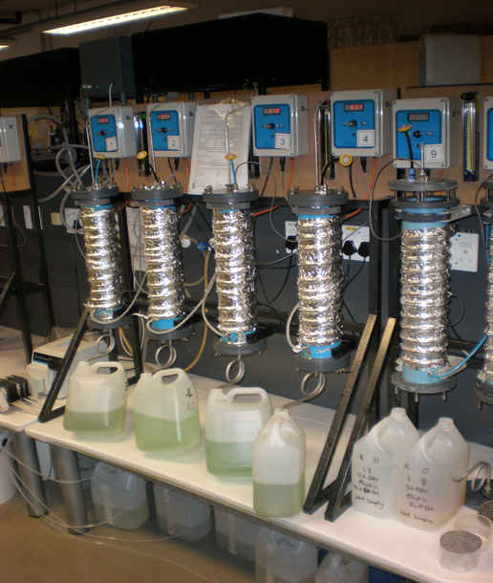
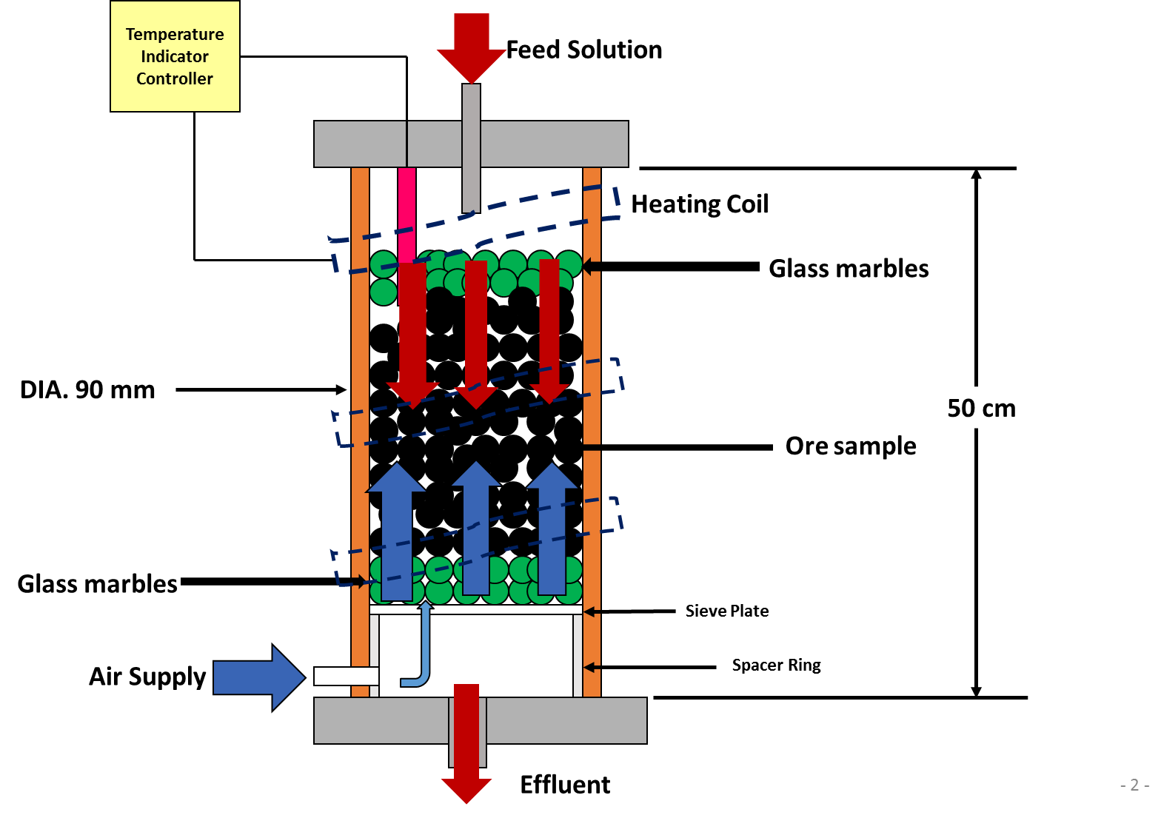
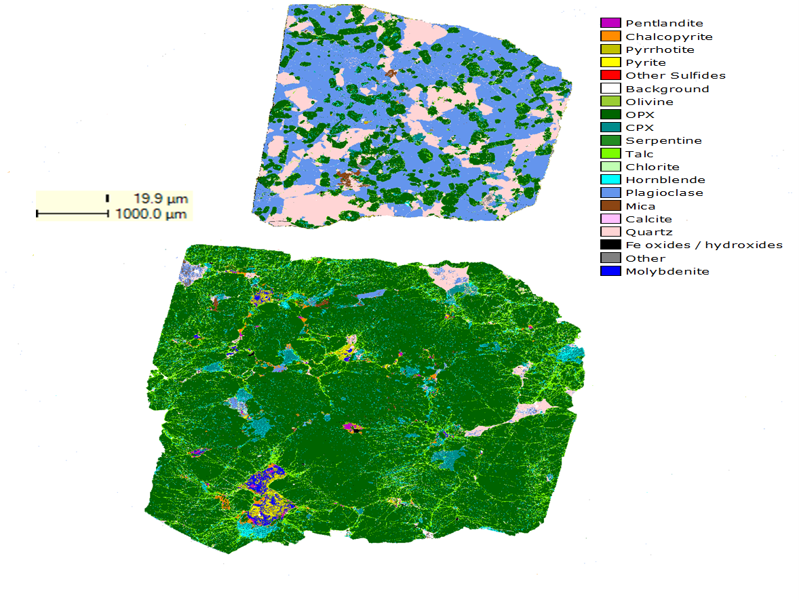
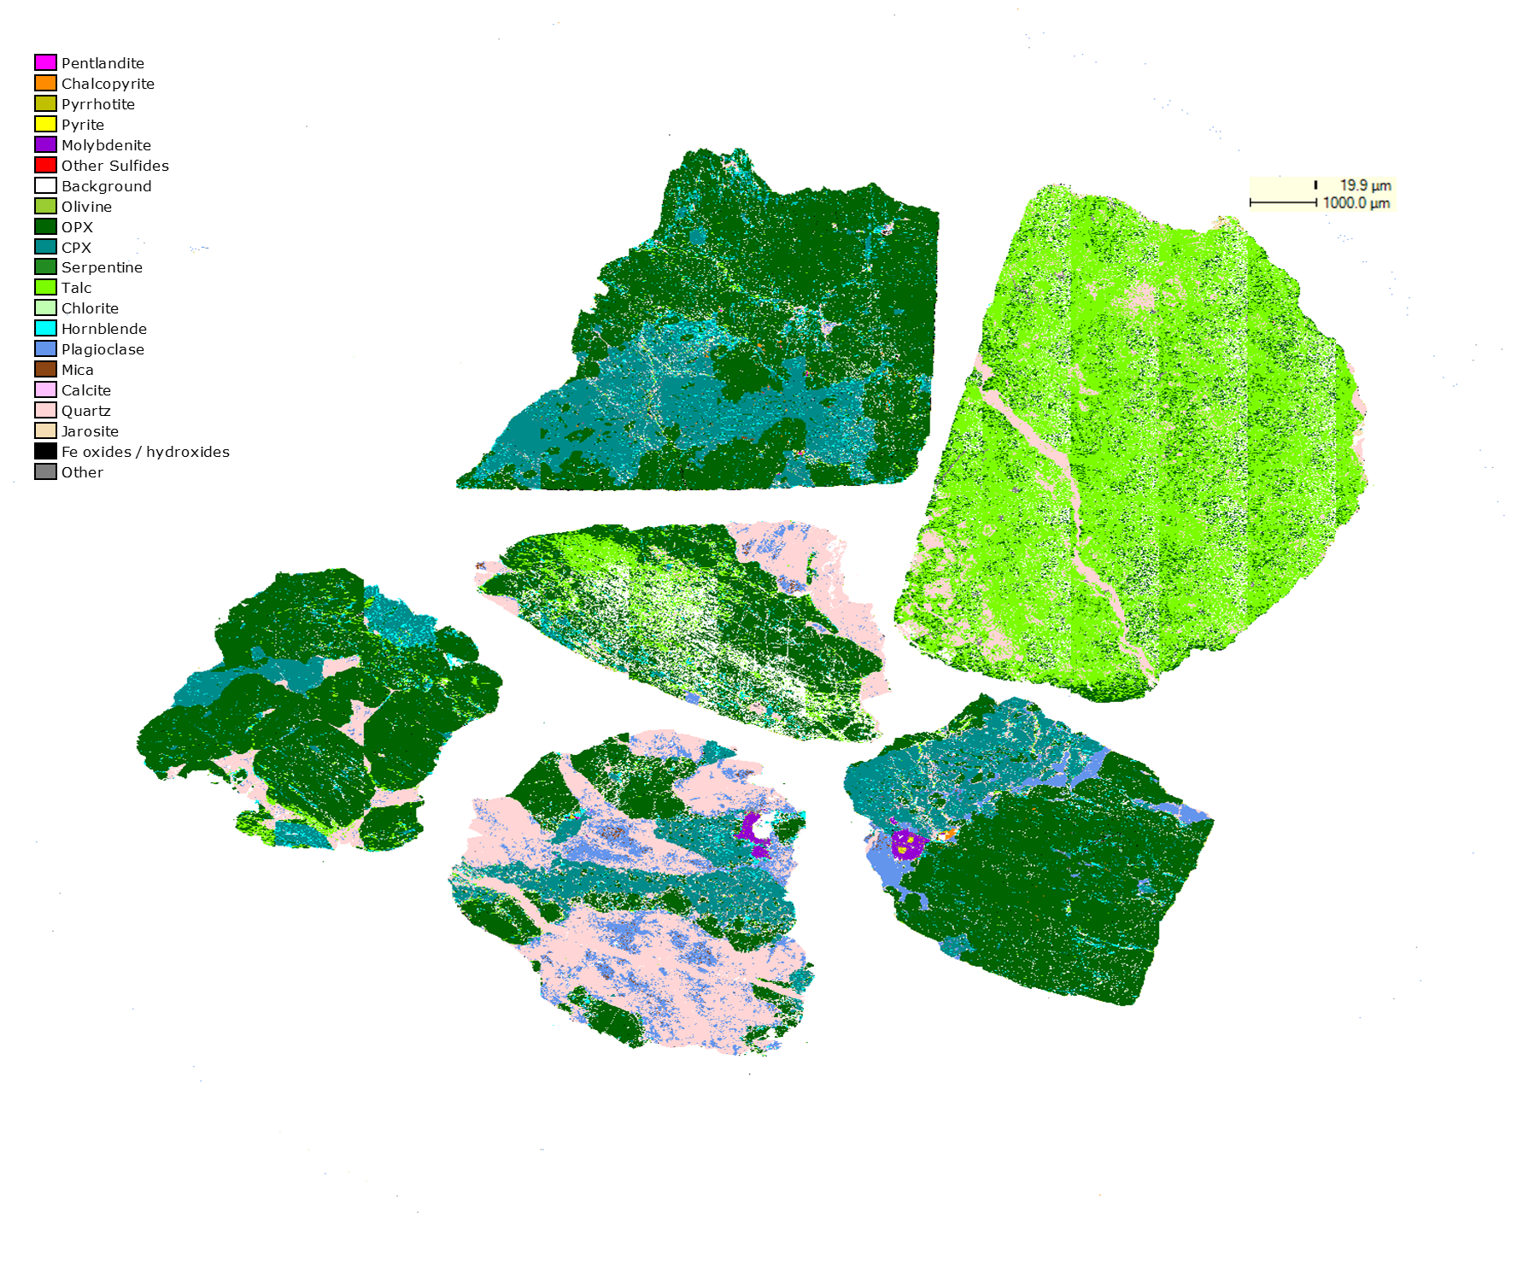

The use of heap bioleaching as a pre-treatment for platinum group metal leaching
James M. Mwase, Jochen Petersen†
Hydrometallurgy Group, Department of Chemical Engineering, University of Cape Town, Rondebosch, South Africa
1. INTRODUCTION
2. OBJECTIVE
Determine the feasibility of using bioleaching as a pre-treatment method to platinum group metal leaching. Explore this specifically for heap leaching scenarios using laboratory-scale column reactors and representative drill core Platreef coarse ore and flotation concentrate samples.
The majority of platinum group metals (PGMs) are recovered from Ni-Cu smelter mattes produced from PGM bearing ores after concentration, and a small quantity is recovered from spent catalysts and copper anode slimes. A critical step in the process is a pressure oxidation leach (in either sulfuric acid or ammonia solution) to leach base metals from the matte, prior to a more aggressive chloride leach to leach the residual PGMs. This approach is not feasible for leaching lower grade and secondary materials. The aim of this study is to investigate the use of heap bioleaching, in a simulated environment, as a pre-treatment to PGM leaching from low grade materials to solubilise base metals and liberate PGM bearing minerals for recovery in a secondary leach step (Figure 1).
Figure 1: Patented Two-Stage Heap Leaching Process
3. EXPERIMENTAL APPROACH
4. RESULTS
Cylindrical column reactors (Figures 2 & 3) used to simulate heap leaching.
Bioleaching done with a microorganism called Metallosphaera hakonensis.
Coarse ore sample (-6 mm +1mm) and flotation concentrate (83% passing 38 µm) coated onto support media were leached.
Metal extractions determined by AAS analyses of effluent solution.
S-LECO combustion and QEMSCAN conducted on residual samples
Samples were retrieved, washed and re-packed in identical columns to be leached with cyanide solution.
Figure 2: Columns
Figure 3: Schematic Drawing
5. CONCLUSIONS
Heap bioleaching has shown to be a promising route to further explore at pilot scale for pre-treating PGM ores and concentrates (Table 1).
Extraction of base metals such as Cu and Ni (Figures 4 & 5) not only removes elements that would otherwise increase cyanide consumption, but also produces commercial value.
The use of a mixed culture of both Fe and S oxidising microorganisms is recommended to facilitate complete sulphur oxidation especially in cases where cyanide leaching succeeds bioleaching as the means of PGM extraction.
QEMSCAN Image of ore particles after bioleaching experiment
Hydrometalurgy Group
Department of Chemical Engineering
University of Cape Town, Rondeosch 7701
†Email: jochen.petersen@uct.ac.za

