Slide 1





Master’s dissertation
“Formulation of a macro-element for suction caisson foundations under axial tensile load”
Student: | Supervisors: |  | 8th of December, 2017
Gilles CORMAN | Prof. A. BEZUIJEN | UGent
 | Prof. F. COLLIN | University of Liège
 | B. CERFONTAINE | University of Liège
Student:
Gilles CORMAN

Slide 2

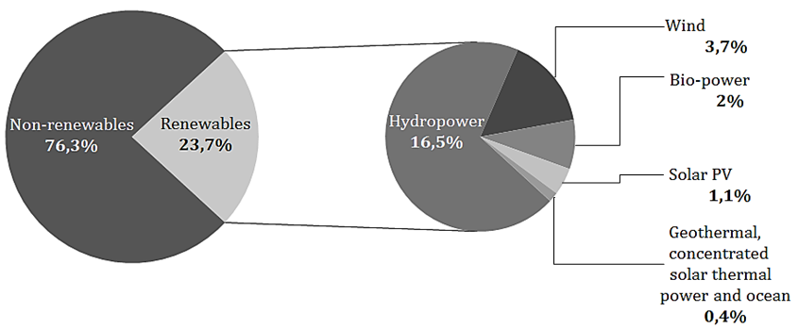
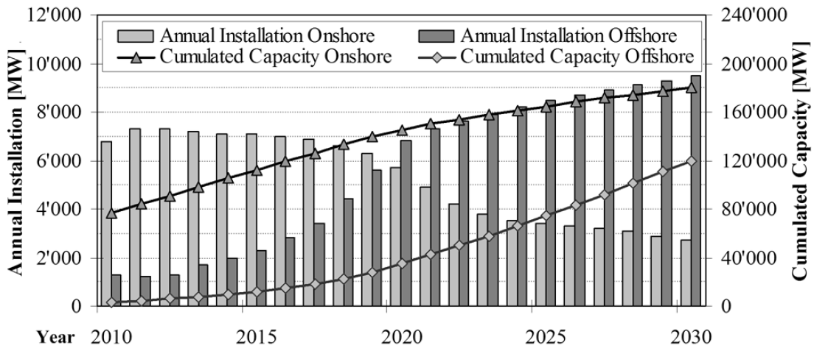
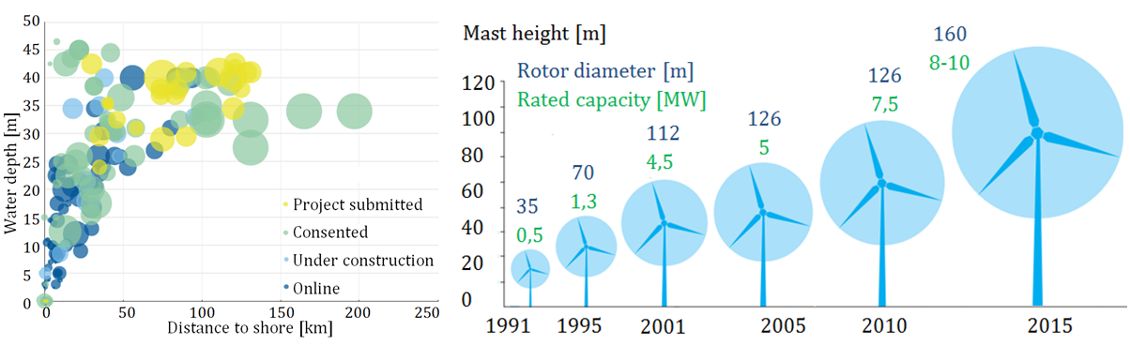
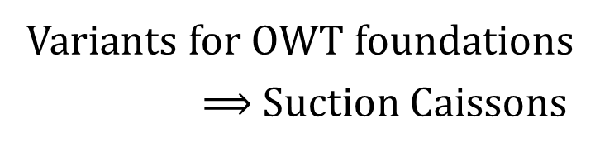
Context
CORMAN Gilles
Master Thesis
December 2017
Need for renewable energy
Introduction
Context
Suction caissons
Description of the FE model
Drained simulations
Partly drained simulations
Conclusion
Onshore vs Offshore
REN 21, 2015
Variants for OWT foundations
$⟹$Suction Caissons
Schaumann P et al, 2011
EWEA, 2017

Slide 3
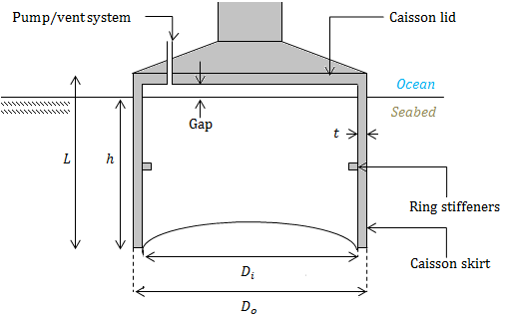
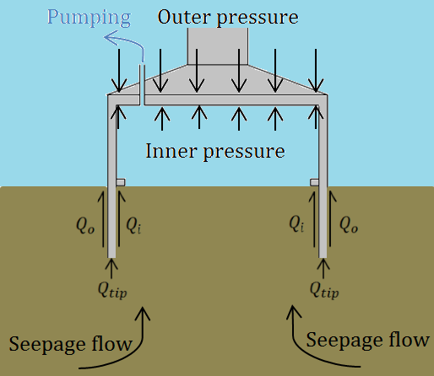
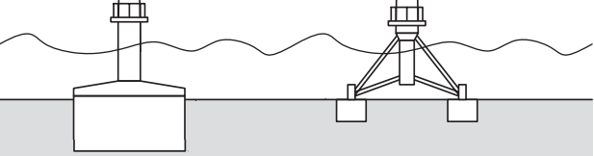
Suction caissons
CORMAN Gilles
Master Thesis
December 2017
Introduction
Context
Suction caissons
Description of the FE model
Drained simulations
Partly drained simulations
Conclusion
Houlsby et al. 2005
Foundation system for OWT’s
Hollow steel cylinder open towards the bottom
Monopod or tetra/tri-pod superstructure
Two-step installation by pressure differential
Cheaply, silently and quickly installed, reusable

Slide 4
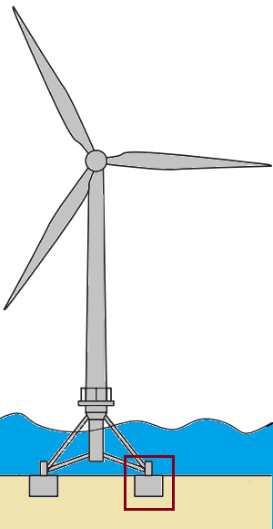
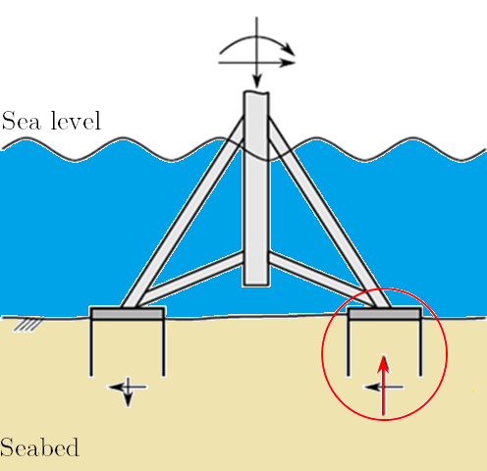
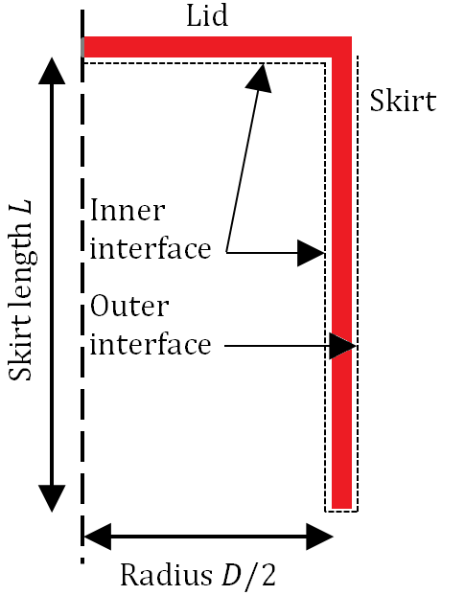
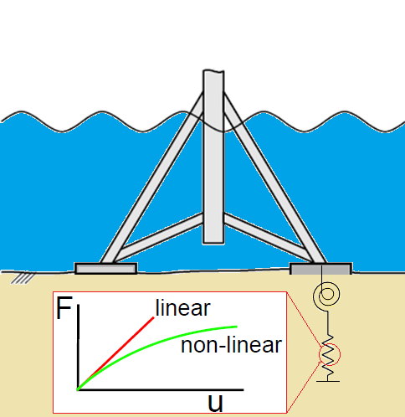
Problem statement
CORMAN Gilles
Master Thesis
December 2017
Introduction
Description of the FE model
Problem statement
Geometry
Interface elements
Initial loading state
Case studies
Drained simulations
Partly drained simulations
Conclusion
Houlsby et al. 2005
One single caisson
Part of a tripod
Uniaxial tensile load
Use of rheological elements
Approximation of the stiffness
2D axisymmetric
Displacement imposed

Slide 5
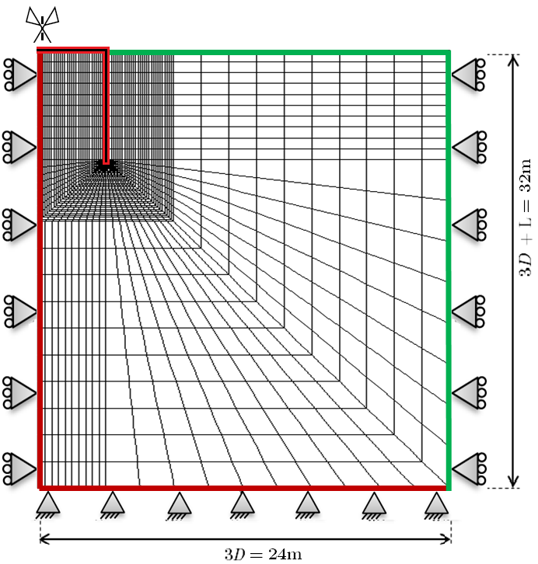
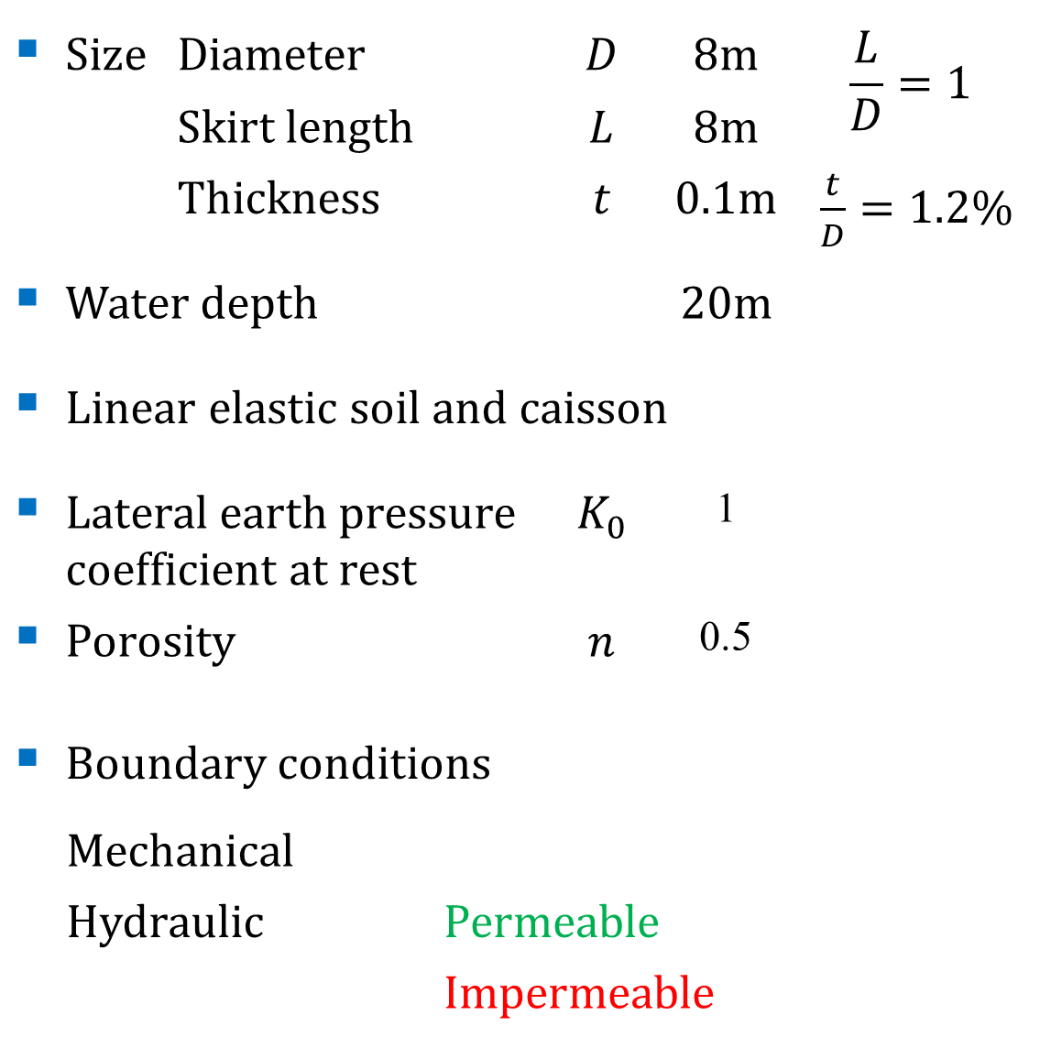
Geometry
CORMAN Gilles
Master Thesis
December 2017
Size | Diameter |  | $$D$$ | 8m | $$\frac{L}{D}=1$$
 | Skirt length |  | $$L$$ | 8m
 | Thickness |  | $$t$$ | 0.1m | $\frac{t}{D}=1.2$%
Water depth |  |  |  | 20m
Linear elastic soil and caisson
Lateral earth pressure coefficient at rest |  |  | $$K_{0}$$ | 1
Porosity |  |  | $$n$$ | 0.5
Boundary conditions
Mechanical
Hydraulic |  | Permeable
 |  | Impermeable
Introduction
Description of the FE model
Problem statement
Geometry
Interface elements
Initial loading state
Case studies
Drained simulations
Partly drained simulations
Conclusion

Slide 6
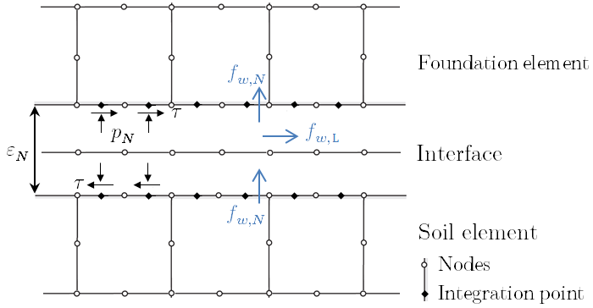
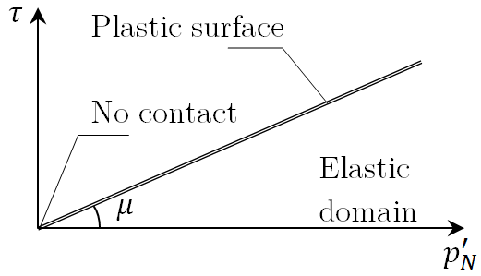
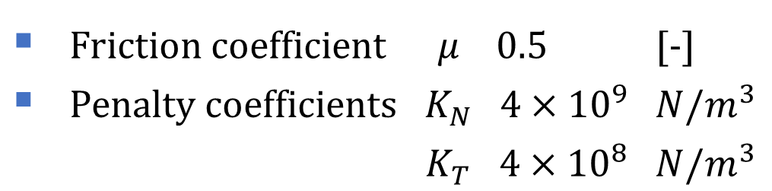
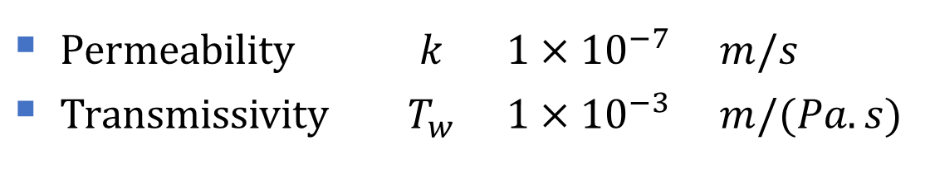
Interface elements
CORMAN Gilles
Master Thesis
December 2017
Mechanical behaviour
Coulomb dry friction law
Flow behaviour
Introduction
Description of the FE model
Problem statement
Geometry
Interface elements
Initial loading state
Case studies
Drained simulations
Partly drained simulations
Conclusion
Friction coefficient | $$μ$$ | 0.5 | [-]
Penalty coefficients | $$K_{N}$$ | $$4×{10}^{9}$$ | $$N/m^{3}$$
 | $$K_{T}$$ | $$4×{10}^{8}$$ | $$N/m^{3}$$
Permeability | $$k$$ | $$1×{10}^{−7}$$ | $$m/s$$
Transmissivity | $$T_{w}$$ | $$1×{10}^{−3}$$ | $$m/(Pa.s)$$
Hydro-mechanical couplings

Slide 7
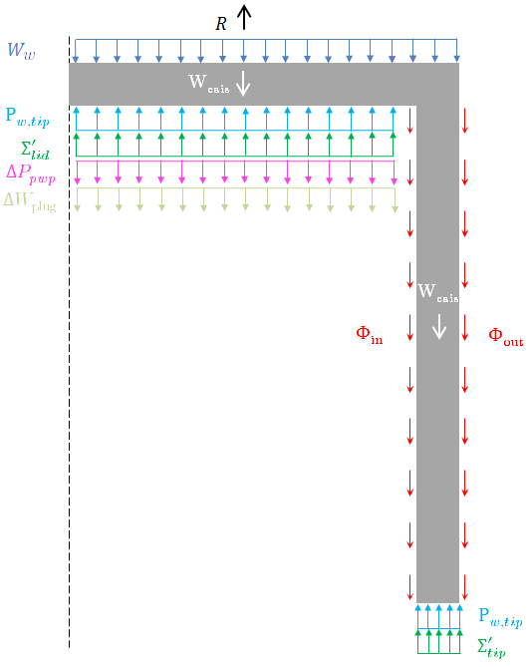

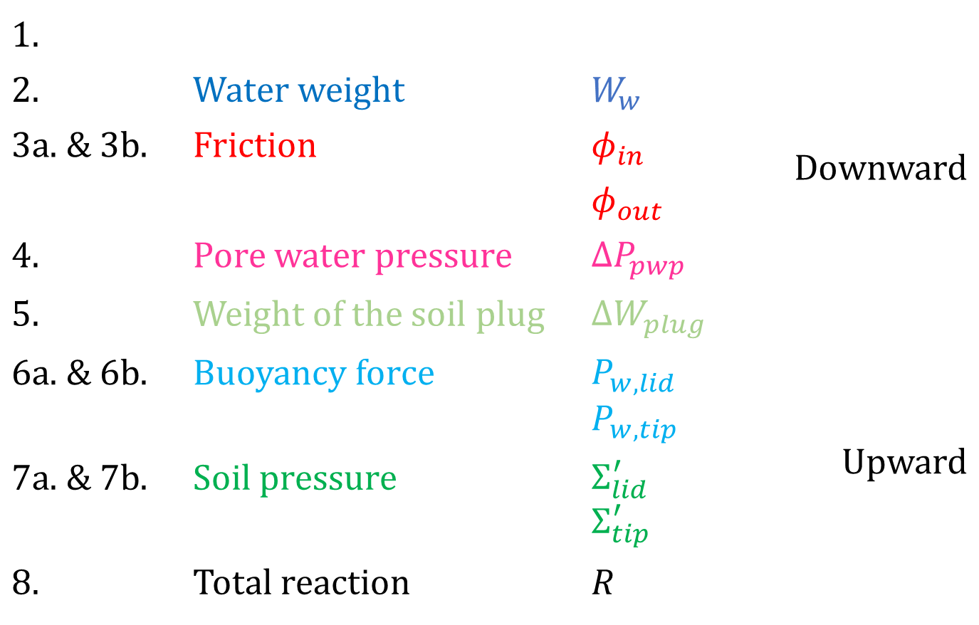
Initial loading state
CORMAN Gilles
Master Thesis
December 2017
Identification of components of reaction
$$W_{cais}$$
1. |  |  | Downward
2. | Water weight | $$W_{w}$$
3a. & 3b. | Friction | $$φ_{in}$$
 |  | $$φ_{out}$$
4. | Pore water pressure | $$ΔP_{pwp}$$
5. | Weight of the soil plug | $$ΔW_{plug}$$
6a. & 6b. | Buoyancy force | $$P_{w,lid}$$ $$P_{w,tip}$$ | Upward
7a. & 7b. | Soil pressure | $$Σ_{lid}^{′}$$ $$Σ_{tip}^{′}$$
8. | Total reaction | $$R$$
Caisson weight
Introduction
Description of the FE model
Problem statement
Geometry
Interface elements
Initial loading state
Case studies
Drained simulations
Partly drained simulations
Conclusion
State of equilibrium
$$W_{cais}+W_{w}+\underset{=0}{\underbrace{Φ_{in}}}+\underset{=0}{\underbrace{Φ_{out}}}+\underset{=0}{Δ\underbrace{P_{pwp}}}+\underset{=0}{\underbrace{ΔW_{plug}}}=Ρ_{w,lid}+\underset{≈0}{\underbrace{Σ_{lid}^{′}}}+Ρ_{w,tip}+Σ_{tip}^{′}+R$$

Slide 8

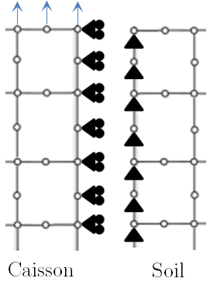
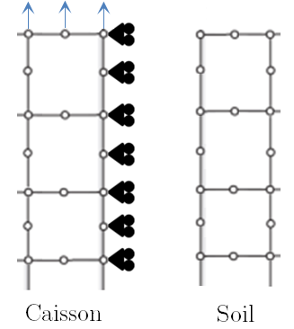
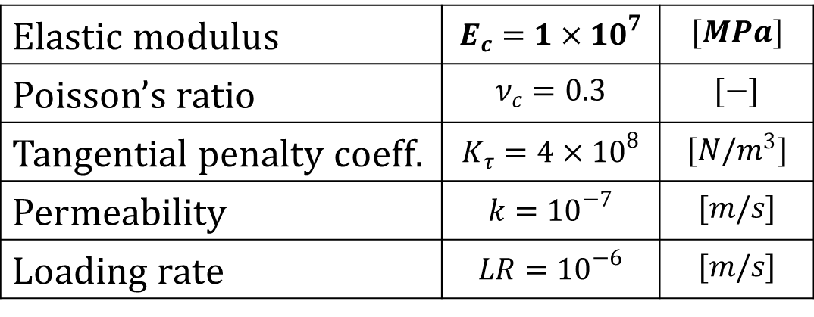
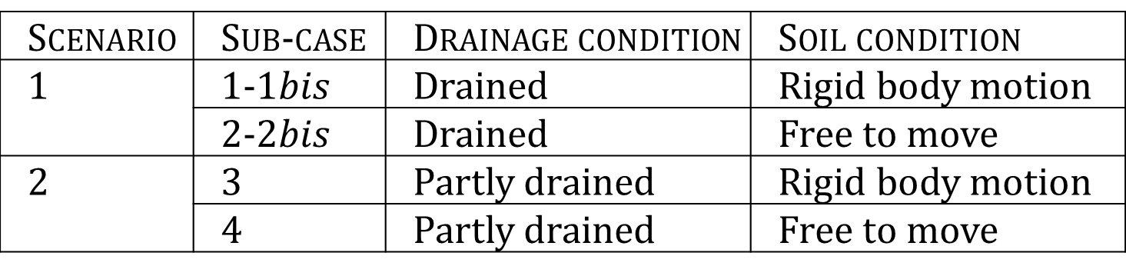
Case studies
CORMAN Gilles
Master Thesis
December 2017
Simulations
Scenario | Sub-case | Drainage condition | Soil condition
1 | 1-1$bis$ | Drained | Rigid body motion
 | 2-2$bis$ | Drained | Free to move
2 | 3 | Partly drained | Rigid body motion
 | 4 | Partly drained | Free to move
Introduction
Description of the FE model
Problem statement
Geometry
Interface elements
Initial loading state
Case studies
Drained simulations
Partly drained simulations
Conclusion
Reference parameters
Elastic modulus | $$E_{c}=1×10^{7}$$ | $$[MPa]$$
Poisson’s ratio | $$ν_{c}=0.3$$ | $$[−]$$
Tangential penalty coeff. | $$K_{τ}=4×{10}^{8}$$ | $$[N/m^{3}]$$
Permeability | $$k={10}^{−7}$$ | $$[m/s]$$
Loading rate | $$LR={10}^{−6}$$ | $$[m/s]$$

Slide 9
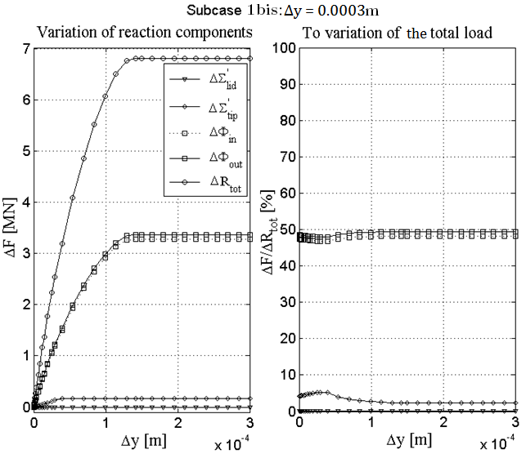
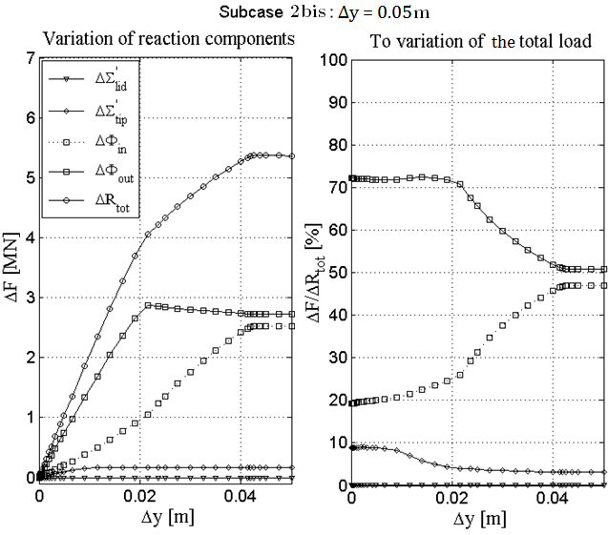
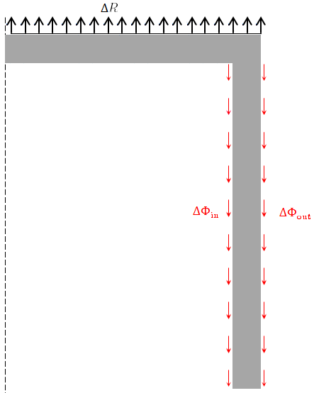




Reaction modes
Rigid body motion
Soil free to move
CORMAN Gilles
Master Thesis
December 2017
$$ΔR_{tot}$$
Introduction
Description of the FE model
Drained simulations
Reaction modes
Numerical-Analytical
Macro-element
Partly drained simulations
Conclusion
$$ΔΦ_{in}$$
$$ΔΦ_{out}$$
$$ΔR_{tot}≈ΔΦ_{in}+ΔΦ_{out}$$
[1a] [2a]
[1b] [2b]

Slide 10
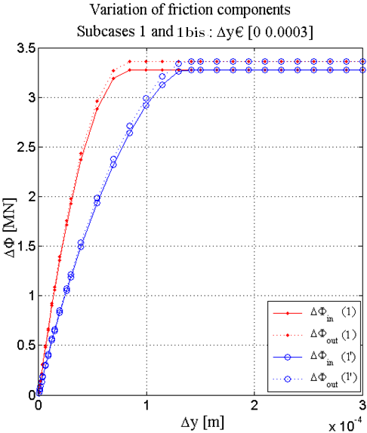
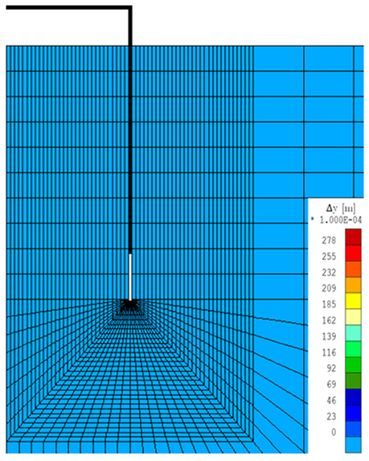
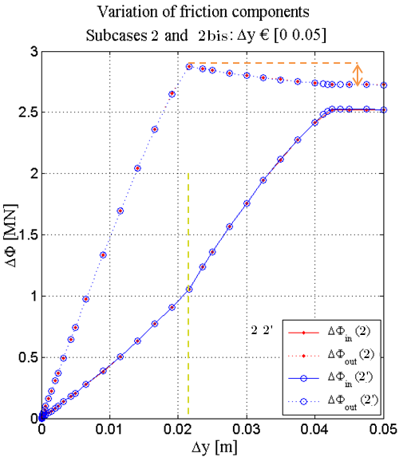
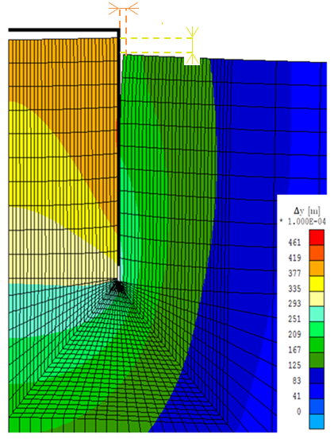
Reaction modes (2)
Rigid body motion
Soil free to move
CORMAN Gilles
Master Thesis
December 2017
Introduction
Description of the FE model
Drained simulations
Reaction modes
Numerical-Analytical
Macro-element
Partly drained simulations
Conclusion

Slide 11
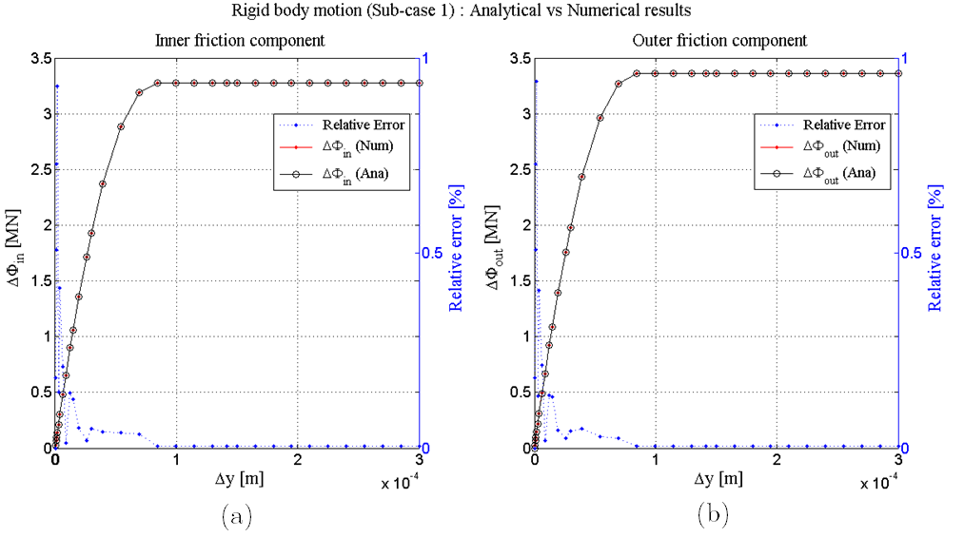
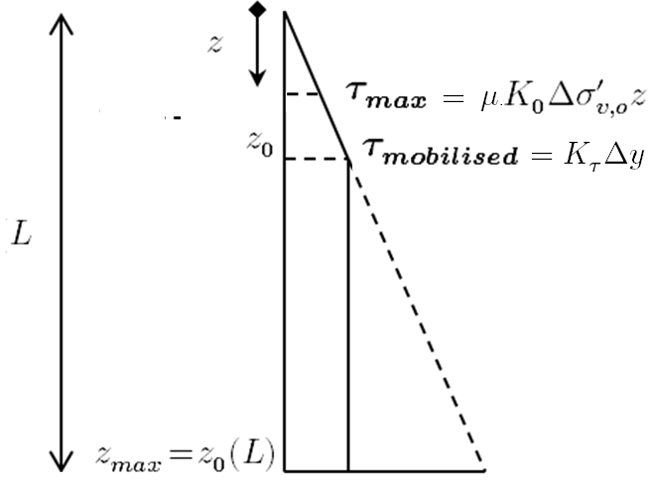
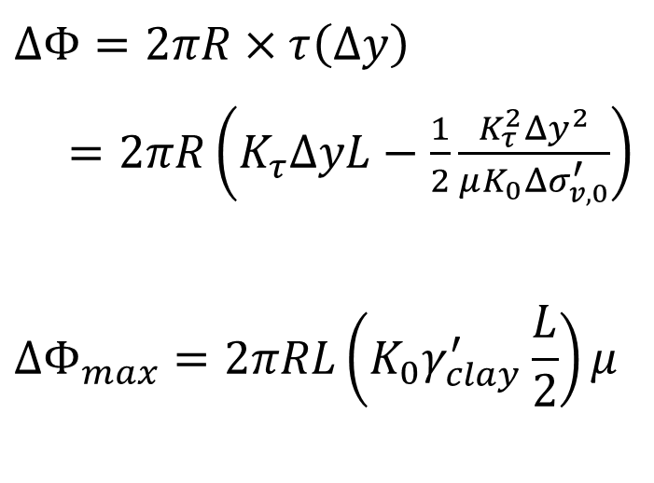
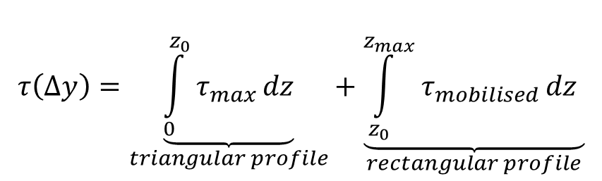
Numerical vs Analytical
Rigid body motion
CORMAN Gilles
Master Thesis
December 2017
Integration of the shear distribution
$$τ\left(Δy\right)=\underset{triangular profile}{\underbrace{\int_{0}^{z_{0}}{τ_{max}}dz}}+\underset{rectangular profile}{\underbrace{\int_{z_{0}}^{z_{max}}{τ_{mobilised}}dz }}$$
Introduction
Description of the FE model
Drained simulations
Reaction modes
Numerical-Analytical
Macro-element
Partly drained simulations
Conclusion
Friction components [1a & 2a]
$$ΔΦ=2πR×τ\left(Δy\right)$$
$=2πR\left(K_{τ}ΔyL−\frac{1}{2}\frac{K_{τ}^{2}Δy^{2}}{μK_{0}Δσ_{v,0}^{′}}\right)$
$${ΔΦ}_{max}=2πRL\left(K_{0}γ_{clay}^{′}\frac{L}{2}\right)μ$$

Slide 12
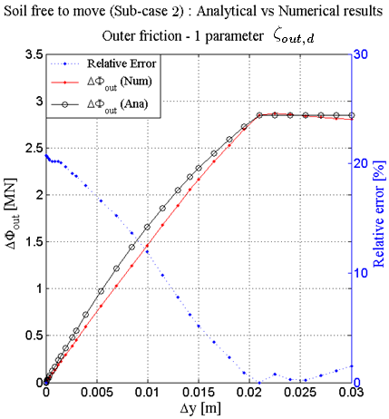
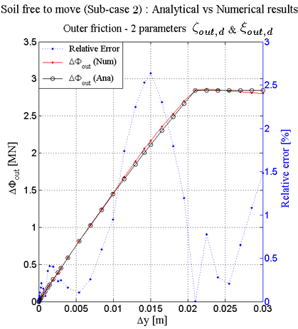
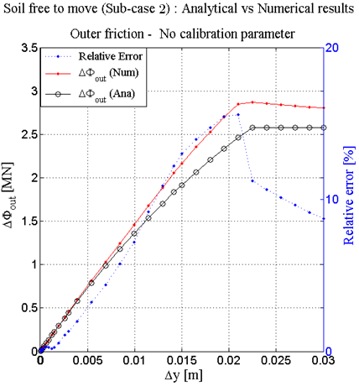
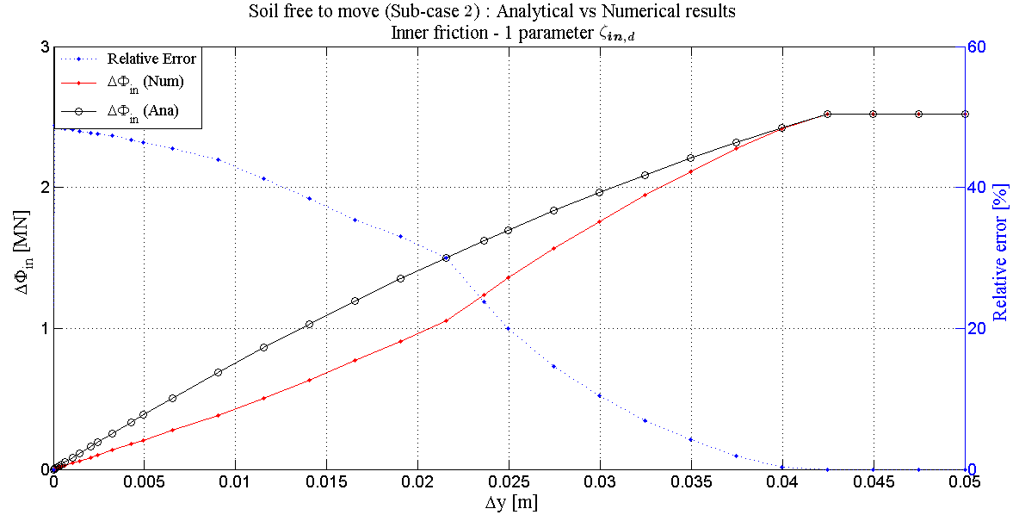
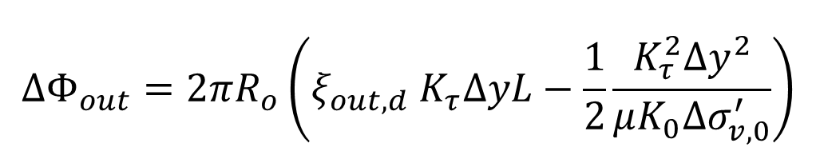

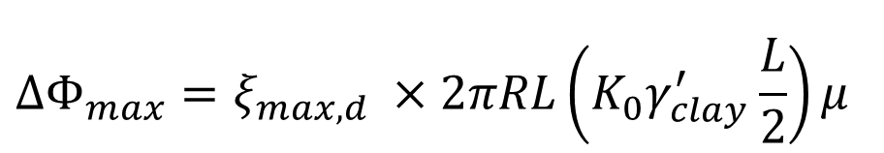
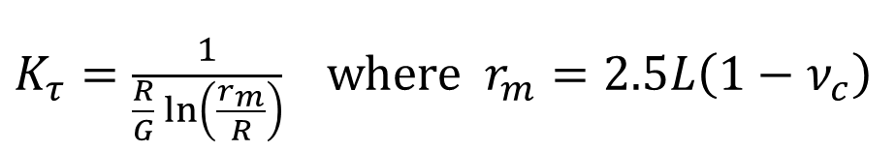
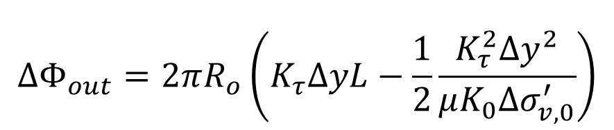
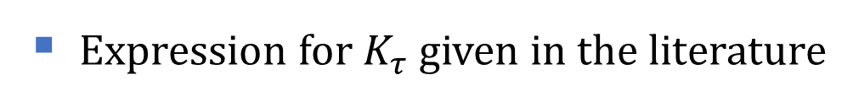

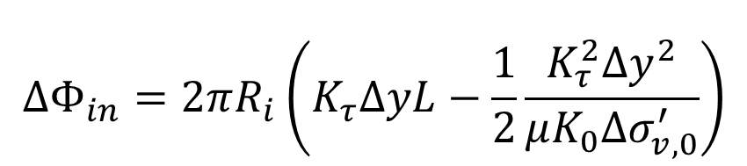
Numerical vs Analytical (2)
Soil free to move
CORMAN Gilles
Master Thesis
December 2017
Expression for $K_{τ}$ given in the literature
$K_{τ}=\frac{1}{\frac{R}{G}\ln\left(\frac{r_{m}}{R}\right)}$ where $r_{m}=2.5L\left(1−ν_{c}\right)$
$$r_{m}=2.5L ς_{in,d} \left(1−ν_{c}\right)$$
$$r_{m}=2.5L ς_{out,d} \left(1−ν_{c}\right)$$
Introduction
Description of the FE model
Drained simulations
Reaction modes
Numerical-Analytical
Macro-element
Partly drained simulations
Conclusion
Randolph & Wroth, 1978
Friction components [1b & 2b]
$$ΔΦ_{out}=2πR_{o}\left({ξ_{out,d} K}_{τ}ΔyL−\frac{1}{2}\frac{K_{τ}^{2}Δy^{2}}{μK_{0}Δσ_{v,0}^{′}}\right)$$
$$ΔΦ_{out}=2πR_{o}\left(K_{τ}ΔyL−\frac{1}{2}\frac{K_{τ}^{2}Δy^{2}}{μK_{0}Δσ_{v,0}^{′}}\right)$$
$$ΔΦ_{in}=2πR_{i}\left(K_{τ}ΔyL−\frac{1}{2}\frac{K_{τ}^{2}Δy^{2}}{μK_{0}Δσ_{v,0}^{′}}\right)$$
$${ΔΦ}_{max}=ξ_{max,d} ×2πRL\left(K_{0}γ_{clay}^{′}\frac{L}{2}\right)μ$$

Slide 13
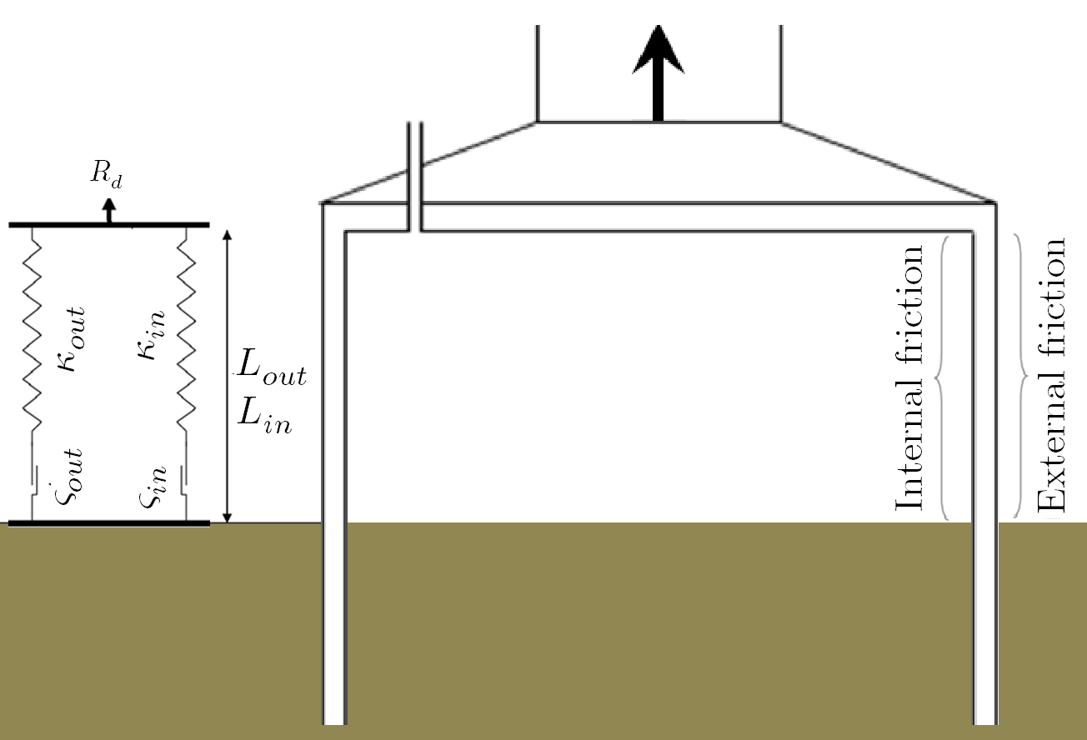

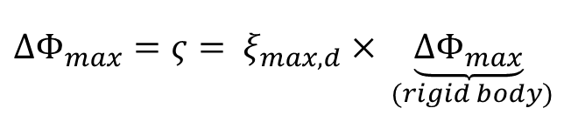

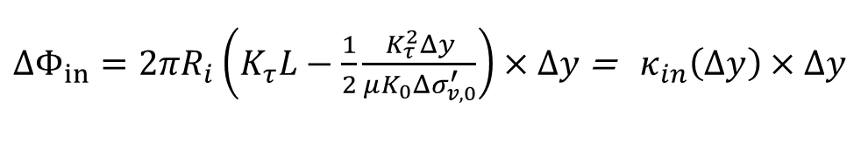
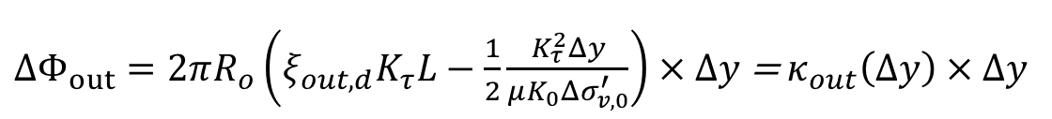
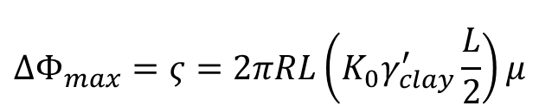
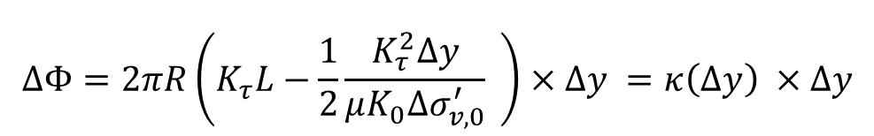

Macro-Element
CORMAN Gilles
Master Thesis
December 2017
${ΔR}_{tot}=ΔΦ_{out}+ΔΦ_{in}$=$\underset{springs}{\underbrace{κ_{out}Δy+κ_{in}Δy}}\underset{sliders}{\underbrace{ −{ ς}_{out}−ς_{in}}}$
Introduction
Description of the FE model
Drained simulations
Reaction modes
Numerical-Analytical
Macro-element
Partly drained simulations
Conclusion
$$ΔΦ=2πR\left(K_{τ}L−\frac{1}{2}\frac{K_{τ}^{2}Δy}{μK_{0}Δσ_{v,0}^{′}} \right)×Δy =κ\left(Δy\right) ×Δy$$
$${ΔΦ}_{max}=ς=2πRL\left(K_{0}γ_{clay}^{′}\frac{L}{2}\right)μ$$
Rigid body motion
[1a & 2a]
$ΔΦ_{out}=2πR_{o}\left(ξ_{out,d}K_{τ}L−\frac{1}{2}\frac{K_{τ}^{2}Δy}{μK_{0}Δσ_{v,0}^{′}}\right)×Δy$ =${ κ}_{out}\left(Δy\right)×Δy$
$${ΔΦ}_{max}={ς= ξ}_{max,d}×\underset{ (rigid body)}{\underbrace{{ΔΦ}_{max}}}$$
Soil free to move
[1b & 2b]
$$→ς_{out,d}$$
$ΔΦ_{in}=2πR_{i}\left(K_{τ}L−\frac{1}{2}\frac{K_{τ}^{2}Δy}{μK_{0}Δσ_{v,0}^{′}}\right)×Δy$ = ${ κ}_{in}\left(Δy\right)×Δy$
$$→ς_{in,d}$$

Slide 14










Reaction modes
Rigid body motion
Soil free to move
CORMAN Gilles
Master Thesis
December 2017
$$ΔR_{tot}$$
Introduction
Description of the FE model
Drained simulations
Partly drained simulations
Reaction modes
Numerical-Analytical
Macro-element
Conclusion
$$ΔP_{pwp}$$
$$ΔW_{plug}$$
$$ΔΦ_{in}$$
$$ΔΦ_{out}$$
$$ΔR_{tot}≈ΔΦ_{in}+ΔΦ_{out}+ΔP_{pwp}+ΔW_{plug}$$
$$ΔR_{tot}≈ΔΦ_{in}+ΔΦ_{out}+ΔP_{pwp}$$
[1b] [2b] [3b] [4b]
[1a] [2a] [3a]

Slide 15

Reaction modes (2)
Rigid body motion
Soil free to move
CORMAN Gilles
Master Thesis
December 2017
Introduction
Description of the FE model
Drained simulations
Partly drained simulations
Reaction modes
Numerical-Analytical
Macro-element
Conclusion

Slide 16




Reaction modes (3)
Rigid body motion
Soil free to move
CORMAN Gilles
Master Thesis
December 2017
Introduction
Description of the FE model
Drained simulations
Partly drained simulations
Reaction modes
Numerical-Analytical
Macro-element
Conclusion
$$k={10}^{−5}\frac{m}{s} \& LR={10}^{−6}\frac{m}{s}$$
$$k={10}^{−7}\frac{m}{s} \& LR={10}^{−6}\frac{m}{s}$$

Slide 17








Numerical vs Analytical
Rigid body motion
PWP component [3a]
CORMAN Gilles
Master Thesis
December 2017
Friction components [1a & 2a]
$$v=\frac{Δy}{Δt}=k×i$$
$$ΔΦ=2πR\left(K_{τ}ΔyL−\frac{1}{2}\frac{K_{τ}^{2}Δy^{2}}{μK_{0}Δσ_{v,0}^{′}}\right)$$
$${ΔΦ}_{max}=2πRL\left(K_{0}γ_{clay}^{′}\frac{L}{2}\right)μ$$
Darcy’s law
Hydraulic gradient
Seepage length
$$ΔP_{pwp}=A_{base,i}×\left[\frac{L_{s}γ_{w}}{k}\frac{Δy}{Δt}\right]$$
Introduction
Description of the FE model
Drained simulations
Partly drained simulations
Reaction modes
Numerical-Analytical
Macro-element
Conclusion
$$i=\frac{s}{L_{s}γ_{w}}$$
Similar to the drained simulation
$$L_{s}=1+0.2{\left(\frac{L}{D}\right)}^{−0.9}$$
$→$ $L_{s}=1+0.2{\left(\frac{L}{D}\right)}^{−0.9} ξ_{pwp,u,I}{\left(\frac{Δy}{d}\right)}^{0.5}$
Senders M. & Randolph M.F, 2009

Slide 18








Numerical vs Analytical (2)
Soil free to move
CORMAN Gilles
Master Thesis
December 2017
Outer friction component [1b]
$$ΔΦ_{out}=2πR_{o}\left({ K}_{τ}ΔyL−\frac{1}{2}\frac{K_{τ}^{2}Δy^{2}}{μK_{0}Δσ_{v,0}^{′}}\right)$$
$$ΔΦ_{out}=2πR_{o}\left({ξ_{out,u} K}_{τ}ΔyL−\frac{1}{2}\frac{K_{τ}^{2}Δy^{2}}{μK_{0}Δσ_{v,0}^{′}}\right)$$
Introduction
Description of the FE model
Drained simulations
Partly drained simulations
Reaction modes
Numerical-Analytical
Macro-element
Conclusion
Expression for $K_{τ}$ similar to the drained simulation
$K_{τ}=\frac{1}{\frac{R}{G}\ln\left(\frac{r_{m}}{R}\right)}$ where $r_{m}=2.5L ς_{out,u} \left(1−ν_{c}\right)$
$K_{τ}=\frac{1}{\frac{R}{G}\ln\left(\frac{r_{m}}{R}\right)}$ where $r_{m}=2.5L \left(1−ν_{c}\right)$

Slide 19






Numerical vs Analytical (3)
Soil free to move
CORMAN Gilles
Master Thesis
December 2017
Inner friction component [2b]
Expression for $K_{τ}$ similar to the drained simulation
$$ΔΦ_{in}=2πR_{i} ξ_{in,u} \left(K_{τ}ΔyL−\frac{1}{2}\frac{K_{τ}^{2}Δy^{2}}{μK_{0}Δσ_{v,0}^{′}}\right) \left(1−\frac{s}{s_{crit}}\right)$$
$K_{τ}=\frac{1}{\frac{R}{G}\ln\left(\frac{r_{m}}{R}\right)}$ where $r_{m}=2.5L \left(1−ν_{c}\right)$
$$ΔΦ_{in}=2πR_{i} \left(K_{τ}ΔyL−\frac{1}{2}\frac{K_{τ}^{2}Δy^{2}}{μK_{0}Δσ_{v,0}^{′}}\right)$$
Introduction
Description of the FE model
Drained simulations
Partly drained simulations
Reaction modes
Numerical-Analytical
Macro-element
Conclusion
Linear reduction due to plug uplift
Senders M, 2008

Slide 20




Numerical vs Analytical (4)
Soil free to move
CORMAN Gilles
Master Thesis
December 2017
PWP component [3b]
$$v=\frac{Δy}{Δt}=k×i$$
Darcy’s law
Hydraulic gradient
Seepage length
$$ΔP_{pwp}=A_{base,i}×\left[\frac{L_{s}γ_{w}}{k}\frac{Δy}{Δt}\right]$$
Introduction
Description of the FE model
Drained simulations
Partly drained simulations
Reaction modes
Numerical-Analytical
Macro-element
Conclusion
$$i=\frac{s}{L_{s}γ_{w}}$$
$$L_{s}=1+0.2{\left(\frac{L}{D}\right)}^{−0.9}$$
$→$ $L_{s}=1+0.2{\left(\frac{L}{D}\right)}^{−0.9} ξ_{pwp,u,II}{\left(\frac{Δy}{d}\right)}^{0.75}$
Senders M. & Randolph M.F, 2009

Slide 21







Numerical vs Analytical (5)
Soil free to move
CORMAN Gilles
Master Thesis
December 2017
Plug uplift component [4b]
Iterative process
Principle of the mechanical work :
Generated work during $Δt$ :
Romp R.H, 2013
$$ΔW\left(t\right)=s\left(t\right)A_{base,i}×ΔL_{plug}$$
$$ΔW_{plug}=ξ_{plug,u}×(A_{base,i} γ_{clay}^{′}L_{plug})$$
Introduction
Description of the FE model
Drained simulations
Partly drained simulations
Reaction modes
Numerical-Analytical
Macro-element
Conclusion
$ΔL_{plug} → ΔW_{plug}=A_{base,i}{ γ}_{clay}^{′}L_{plug}$
$$ΔW\left(t\right)=Δs\left(t_{−1}\right)×ΔV_{plug}\left(t_{−1}\right)$$

Slide 22






Macro-element Rigid body motion
CORMAN Gilles
Master Thesis
December 2017
$R_{tot}=ΔΦ_{out}+ΔΦ_{in}+ΔP_{pwp}$
$=\underset{springs}{\underbrace{κ_{out}Δy+κ_{in}Δy}} \underset{sliders}{\underbrace{−ς_{out}−ς_{in}}}+ \underset{dashpot}{\underbrace{ηΔ{\dot{y}}^{\frac{1}{N}}}}$
Introduction
Description of the FE model
Drained simulations
Partly drained simulations
Reaction modes
Numerical-Analytical
Macro-element
Conclusion
$$ΔΦ=2πR\left(K_{τ}L−\frac{1}{2}\frac{K_{τ}^{2}Δy}{μK_{0}Δσ_{v,0}^{′}}\right)×Δy=κ\left(Δy\right)×Δy$$
Friction component
[1a & 2a]
$$ΔΦ_{}^{max}=ς=2πRL\left(K_{0}γ_{clay}^{′}\frac{L}{2}\right)μ$$
$$ΔP_{pwp}=\underset{η}{\underbrace{A_{base,i}×L_{s}×\frac{γ_{w}}{k}}}×\underset{Δ{\dot{y}}^{\frac{1}{N}}}{\underbrace{\frac{Δy}{Δt}}}$$
PWP component
[3a]
$$→ξ_{pwp,u,I}$$

Slide 23







Macro-element Soil free to move
CORMAN Gilles
Master Thesis
December 2017
$$R_{tot}=ΔΦ_{out}+ΔΦ_{in}+ΔP_{pwp}+ΔW_{plug}$$
$$=\underset{springs}{\underbrace{κ_{out}Δy+κ_{in}Δy}} \underset{sliders}{\underbrace{−ς_{out}−ς_{in}}}+\underset{dashpot}{\underbrace{ηΔ{\dot{y}}^{\frac{1}{N}}}}+\underset{spring}{\underbrace{κ_{plug}L_{plug}}}$$
Introduction
Description of the FE model
Drained simulations
Partly drained simulations
Reaction modes
Numerical-Analytical
Macro-element
Conclusion
Friction components
[1b & 2b]
$ΔΦ_{out}=ξ_{out,u} 2πR_{o}\left(K_{τ}L−\frac{1}{2}\frac{K_{τ}^{2}Δy}{μK_{0}Δσ_{v,0}^{′}}\right)×Δy= κ_{out}\left(Δy\right)$ $×Δy$
$$ΔΦ_{in}=ξ_{in,u} 2πR_{i}\left(K_{τ}L−\frac{1}{2}\frac{K_{τ}^{2}Δy}{μK_{0}Δσ_{v,0}^{′}}\right)\left(1−\frac{s}{s_{crit}}\right)×Δy=κ_{in}\left(Δy\right)×Δy$$
$$ΔΦ_{}^{max}=ς=ξ_{max,u}× 2πRL\left(K_{0}γ_{clay}^{′}\frac{L}{2}\right)μ$$
PWP component
[3b]
$$ΔP_{pwp}=\underset{η}{\underbrace{A_{base,i}×L_{s}×\frac{γ_{w}}{k}}}×\underset{Δ{\dot{y}}^{\frac{1}{N}}}{\underbrace{\frac{Δy}{Δt}}}$$
$$→ξ_{pwp,u,II}$$
Plug component
[4b]
$$ΔW_{plug}=ξ_{plug,u}×(A_{base,i} γ_{clay}^{′})×L_{plug}= κ_{plug}×L_{plug}$$

Slide 24


Conclusion
CORMAN Gilles
Master Thesis
December 2017
Scenario | Sub-case | Drainage condition | Soil condition | Resistance
1 | 1-1$bis$ | Drained | Rigid body motion | $$Φ_{out}−Φ_{in}$$
 | 2-2$bis$ | Drained | Free to move | $$Φ_{out}−Φ_{in}−(W_{plug})$$
2 | 3 | Partly drained | Rigid body motion | $$Φ_{out}−Φ_{in}−P_{pwp}$$
 | 4 | Partly drained | Free to move | $$Φ_{out}−Φ_{in}−P_{pwp}−W_{plug}$$
Introduction
Description of the FE model
Drained simulations
Partly drained simulations
Conclusion

Slide 25

Thank you for your attention
Notes:
As you may know, the main purpose of this assignment is to design an artificial island and harbour in the north sea.

