Slide 1
Measuring and Comparing
Planning Cultures:
Risk, Trust and Co-operative Attitudes in Experimental Games
K. Li, P. Dethier, A. Eika, A. Samsura, E. Van der Krabben, B. Nordahl, JM. Halleux
Keyang Li PhD Candidate
Department of Geography, Planning and Environment
28-9-2018 @ 2018 SimsCity Oslo Meeting
Notes:
(Planning) cultural characteristics? Individual and social preferences
- Give general introduction

Slide 2
Gaps in comparative planning cultures studies
Lack of systematic comparison due to conceptual fuzziness (Booth, 2011; De Vries, 2015; Taylor, 2013; Buitelaar & Bregman, 2016)
Lack of empirical evidence of planning actors’ behaviour in interaction (Fürst, 2009; Ernste, 2012; Getimis, 2012; Othengrafen, 2014; Reimer & Blotevogel, 2012)

Slide 3
Goal of research
To make planning cultures measurable and comparable
An operational definition of planning culture:
a set of values and attitudes shared by planning actors that is learned and sustained through the planning process.
Operational variables: attitudes towards risk, trust and co-operation
Importance to (interactive) planning decisions
Established experimental methods
Available comparative data among countries and between public-private

Slide 4
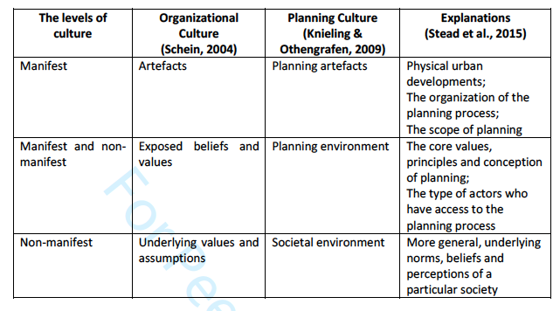
Operationalization – based on Culturized Planning Model (Knieling & Othengrafen, 2009)

Slide 5
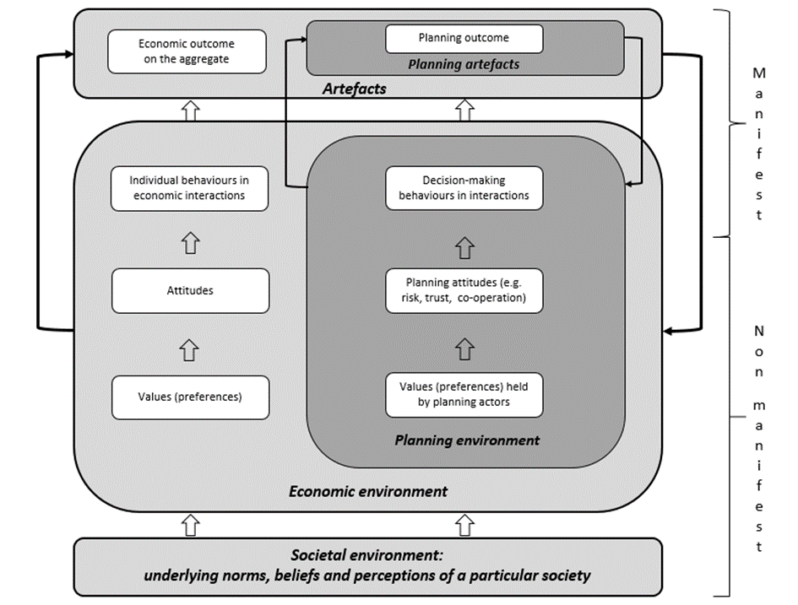
Operationalization – based on Culturized Planning Model

Slide 6

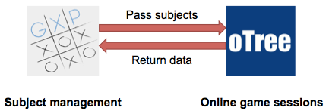



Method – learn from experimental economics
Experiments with planning practitioners in Belgium, The Netherlands and Norway from June 2016 – June 2017
Three one-shot games with planning context
  Bomb risk elicitation task (Crosetto & Filippin, 2013)
  Trust game (Berg et al., 1995)
  Public goods game (Ledyard, 1995)
  Experimental platforms
    Invite planning practitioners from both public and private sectors
    Both online platforms and conferences
Notes:
Practitioners: a person actively engaged in an art, discipline, or profession, especially medicine.
One-shot: Players can only infer others’ behavior and expectations from their life experience, and these beliefs subsequently shape motivation and choice

Slide 7
Game 1 – Bomb Risk Elicitation Task (BRET) – Risk
You choose how many plots of land you want to buy from a field composed of 25 plots.
20 points per plot.
However,1/25 is a contaiminated plot. If the containimated plot is within your choice, your earnings become 0; otherwise, your earnings equal the number of plots you buy times 20
A field of 5*5 plots of land
Trade-off
Notes:
The trade-off between the amount of money that can be earned and the likelihood of obtainning it
L= 0 k/100
Or L = rk 100-k/100

Slide 8
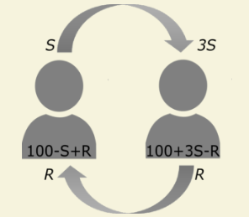
Game 2 – Trust game - Trust
2-player game: a sender and a receiver
Both are given 100 points to start the game.
Four treatments:
  M => P
  P => M
  M =>M
  P =>P
Send amount: trust
Return amount: reciprocity

Slide 9
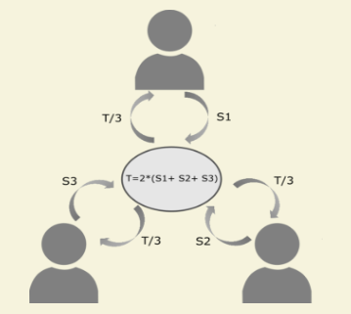
Game 4 – PGG – Co-operation
3-player game: 3 developers in a neighbourhood
An endowment of 100 points, invest simulteneously
The total contribution will be doubled, and then evenly shared by all 3 players
Earnings from this game equal the share from the group benefits plus the points player kept for his/herself
Four treatments: MPP, PPP, MMM, PPM

Slide 10
Game 1 – Risk attitudes
Table 1 Risk Categories in Belgium, the Netherlands and Norway

Slide 11
Game 2 – Trust attitudes
Table 2 Trust levels in Belgium, the Netherlands and Norway

Slide 12
Game 3 – Co-operative attitudes
Table 3 Co-operation levels in Belgium, the Netherlands and Norway

Slide 13
Discussions
The whole spectrum of planning cultures is too rich to be fully captured. We capture the attitudinal part of planning cultures.
Experiment is a promising way: a controlled environment, cheap, fast, broader subject pool, easy to compare (internationally), easy for replication
A balance between rich and abstract context is always challenging to any planning experiments

Slide 14
Conclusion
Gaps
Vague comparisons of planning cultures
Goal
Make planning cultures measurable and comparable
Methods
Conduct experimental games with planning practitioners in Belgium, The Netherlands and Norway
Contribution
Introduce experimental games as a systematic measurement tool
Notes:
Challenges ---
Goal of our research:
---
Conclusion --- Planning cultures can measured and compared systematically through risk, trust and co-operative

Slide 15
Q&A
Thank you for your attention!
Are there any questions?
Keyang Li
Culture, Institution and Planning Behaviour
k.li@fm.ru.nl

Slide 16

Background (1/4) – Urban (re)development in Public land development model: WW II – 1994
Public Sector-led
Land Development Model
Private land ownership
Municipality’s quest for control
Comprehensive top-down
Acquire
Service
Reparcel
Sell
Notes:
Dutch urban transformation
Typical urban transformation projects may concern the transformation of brownfield sites, the redevelopment of inner-city shopping areas, waterfront and dockland redevelopment projects and the renovation of post-war social housing blocks.
Why?
The required subdivision for the new development does not match up with the existing owneship structure.
The modern public land development model
came into practice after WW2, when there was a huge demand for new housing and also land for industrial use. To assure that sufficient land would be available M took up the task themselves.
The main reason that they adopted this leading role is that they want to steer development in a pro-active way and they want to earn money to finance the costs of public works like streets, sewage systems and public space that are necessary for new unban development.
The ductch M have always felt responsible for the development of land.
The proactive planning remained for a long time for several reasons:
M’s quest for control. They wanted to have gaurantees that their land-use plans would be implemented in the way they envisioned them. As the land owner they could sell the building land to selected buyers for sepecific purposes. Social housing, housing associations.
Make a profit from land development. If negetive outcome, adjust the plan (higher densities, less social housing)
3. Be facilitated by financial system. Banks offer attractive low interest loans for M.
4. Private sector appreciated the land developement role of M.
Supportive conditions
Economies of scale, acceptable for M
Compulsory purchase/ eminent domain powers
Services: roads, water, electricity, and so on. Preperration of land to have good building conditions

Slide 17
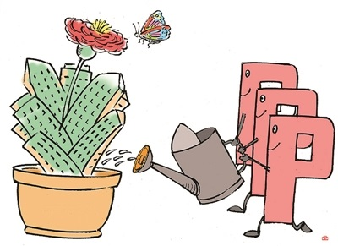
Background (2/4) - Alternative land development models and challenges: 1994-2008
Public-Private Partnership (PPP)
Active planning without initial municipal land ownership
Only because developers want it
For joint fact-finding, not for joint responsibility and joint decision-making (Klijn & Teisman, 2010)
Notes:
Since around 1994, price of developded buildings increase greatly, so the average value of building land increased greatly. Buying unserviced land become profitable and commercial developers werer attracted into the land market.
New ways of pro-active planning without initial municipal land ownership (Needham):
Building claim model: commercial developers buy land in the plan area and then sell it, voluntarily, to the municipality, on condition that he will be able to buy back a certain amount of serviced land for a certain number of houses at a certain price and in certain locations.
The joint-venture model: a private limited liability company (land development company) is set up by developers and municipality together.
The concession model: the land is acquried, serviced, and built upon by one or more commercial developers.
Organic development (Buitelaar)
The outbreak of the global financial crisis in 2008 and the subsequent decline of property and housing markets induced a reduction in demand, which make it cruitial for most M and D to revise their ways of developing and collaborating. With the adoption of the spatial planning ACT of 2008, guiding urban development, cost recovery and securing social housing trough public law have improved sustantially, making public land ownership a redundant means to those ends.

Slide 18
Background (3/4) – Implementation obstacles and challenges for public sector, espcially in brownfield development
Implementation obstacles
Challenges for public sector
Barriers to the assembly of land and properties
  Fragmented land and property ownership
Difficulty to the cost recovery of public works
  High redevelopment costs (acquisition, demolishment, servicing)
Incresased complexity of projects
  Wide range of stakeholders involved who often have contradictory interestes
Negotiation takes long time
Highly risky investment in times of economic downturn
Free-rider problem
Notes:
e.g. In 2005, 12% of local government income came from land development
Stakeholders:
Landowners, municipalities, investors, property developers, contstruction companies, infrastructure providers, housing cooprations, residents
Free-rider:
M lack legal powers to make property owners that benefit from the redevelopment contribute to the redevelopment costs. If a property owner can benefit from the redevelopment without having to contribute financially, he will try to remain outside the process.
Challenges for which period?

Slide 19
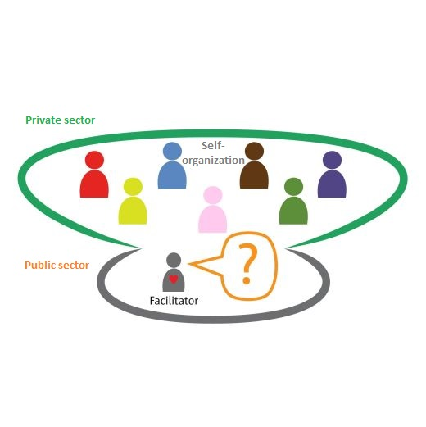
Background (4/4) - Alternative land development models and challenges Since 2008
Private Secor-led Model
Stakeholders’ willingness to collaboration is unclear
a variaty of stakeholders
Self-organizing bottom-up
Notes:
Since around 1994, price of developded buildings increase greatly, so the average value of building land increased greatly. Buying unserviced land become profitable and commercial developers werer attracted into the land market.
New ways of pro-active planning without initial municipal land ownership (Needham):
Building claim model: commercial developers buy land in the plan area and then sell it, voluntarily, to the municipality, on condition that he will be able to buy back a certain amount of serviced land for a certain number of houses at a certain price and in certain locations.
The joint-venture model: a private limited liability company (land development company) is set up by developers and municipality together.
The concession model: the land is acquried, serviced, and built upon by one or more commercial developers.
Organic development (Buitelaar) WHY?
The outbreak of the global financial crisis in 2008 and the subsequent decline of property and housing markets induced a reduction in demand, which make it cruitial for most M and D to revise their ways of developing and collaborating. With the adoption of the spatial planning ACT of 2008, guiding urban development, cost recovery and securing social housing trough public law have improved sustantially, making public land ownership a redundant means to those ends.

Slide 20
Planning culture
It is not easy to define (conceptual fuzziness)
  The collective ethos and dominant attitudes of planners regarding the appropriate role of the state, market forces, and civil society in influencing the social outcome. (Sanyal 2005, page XXI)
  A set of informal institutions that guide, and are reproduced by, decisions by government, private actors, and citizens on the ends and means of planning. (Buitelaar et al 2011)
  The way in which a society possesses institutionalized or shared planning practices. It emerges as the result of the accumulated attitudes, values, rules, standards and beliefs shared by the group of people involved. (Knieling & Othengrafen 2009, page 43)
  The attitudes and mutual expectations of public planners and private developers regarding each other’s role in urban development investment decision-making processes. (Current research)

Slide 21
Gap in research
Lack of quantitative emprical evidence
Empirical evidence analytical methods | Advantages | Limitations
Case study | In depth; complete | Context-specific
Interview | Direct | Costly in time and money
Expert discourses | Comprehensive; comparative | Subjective
Survey | Aggregated and representative opinions | Self-reported data is different from real behavior
Experiment | Controlled enviroment; Easy for repetition and comparasion | External validity
Notes:
External validity: the extent to which the results of a study can be generalized to other situations and to other people.
The experiment is a complement
How institutional incentives combine to affect individual behavior and outcomes

