Slide 1
Measuring planning cultures for co-housing development
Perrine Dethier and Jean-Marie Halleux

Slide 2
Co-housing
« Co-housing is a type of collaborative housing in which residents actively participate in the design and operation of their own neighbourhoods. Co-housing residents are consciously committed to living as a community. The physical design encourages both social contact and individual space » (The Cohousing Association of the United States, n.d.)
2 notions: building together and sharing spaces
Increasing all over Europe since the 2000s

Slide 3
Co-housing in Belgium
French-speaking Belgium (Wallonia and Brussels): the evolution remains limited (around 500).
Many obstacles: land acquisition, planning permission, time investment…
Planning culture is also limiting: Acceptability of consultants and cooperation between co-owner and perception of co-housing

Slide 4
Experimental economics
Definition: Experiments motivated by economics questions
2 experiments + 1 survey
Trust game (Acceptability of consultants)
Minimum-effort game (Cooperation for co-housing development)
Survey (Co-housing perception)
3 Regions:
French-speaking Belgium
France
North of Europe
Participants
577 students

Slide 5
Demographic
Nationality | Number | Percentage of women | Average age
Belgium | 390 | 58.97% | 23.50
France | 102 | 65.69% | 25.15
North Europe (English, German, Dutch, Norwegian) | 56 | 53.57% | 26.18
Other | 29
=> Belgian are significantly younger

Slide 6
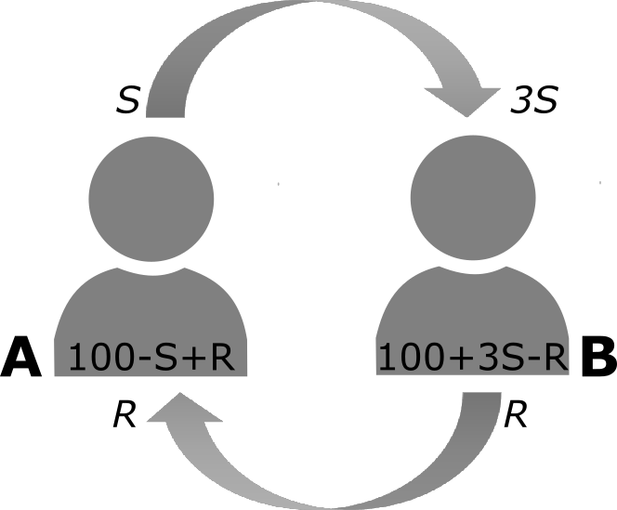
Trust GAME
Berg. J.. Dickhaut. J.. & McCabe. K. (1995)

Slide 7
Trust GAME
Amount sent (S)
 | With a consultant | With a co-owner | Total
Belgian | 44.26 | 48.67 | 46.54
France | 45.50 | 48.43 | 47.40
North Europe | 47.12 | 51.56 | 48.95
Total | 44.96 | 48.87 | 46.83
Notes:
Pas de différence significative entre les pays
Pas de différence significative entre consultant ou copropriétaire

Slide 8
Trust GAME
Amount sent (S) – For Belgium
The difference is nearly significant (p=0.052)

Slide 9
Trust GAME
Results depend on the question about trust (p<0,0001)
Generally speaking. would you say that most people can be trusted or that you can’t be too careful in dealing with people?
Correlation with age is really low (r=0.09)
 | Most people can be trusted | EVS (2008)
Belgian | 37.24 % | 26 %
France | 56.63 % | 27 %
North Europe | 62.5 % | 75% ~ 39%

Slide 10
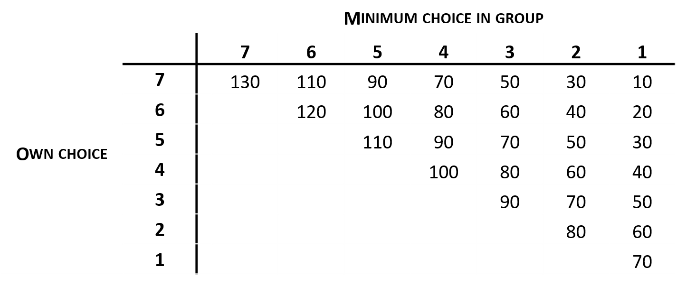
Cooperation GAME
Minimum-effort game
Van Huyck. J. B.. Battalio. R. C.. & Beil. R. O.. 1990

Slide 11
Cooperation GAME
Notes:
Pas de difference significative

Slide 12
Survey
Difference significant between regions.
Differences significant depending on the skills (urbanism vs others)
Differences between universities (for Belgium)
 | Yes
Liege | 39,15%
Namur | 57,89%
Louvain | 66,67%
Notes:
Beaucoup pense que l’habitat groupé est synonyme de la colocation (un seul habitat pour les ménages). Peu de gens pense que l’habitat est réservé au personne seule ou souffrant de précarité

Slide 13
Survey
For the housing of your future family, you see yourself rather
1
2
3
4
5
Collectively
Individually
Notes:
Différence significative entre BE/NO et Fr/NO

Slide 14
Survey
For the housing of your future family, you see yourself rather
1
2
3
4
5
Collectively
Individually
Notes:
Difference significative entre BE/No et FR/No

Slide 15
Survey
For the housing of your future family, you see yourself rather
1
2
3
4
5
Collectively
Individually
Notes:
Pas de difference

Slide 16
Survey
For the housing of your future family. you see yourself rather
Difference significant between countries (Belgium is the most individualistic)
Belgium are more concerned to lose their privacy
Many people are anxious about the collaborate with the rest of the group (consensus and free riding)
More informed people are concerned about the expertise needed, the time consuming and the legislation.
No difference between the 3 questions, but the green space is what most people will accept to share
Differences significant between Universities (in Belgium): Liege is the most individualistic

Slide 17
Survey
Have you ever live in a shared housing (flatshare, co-housing, co-linving…)?
 | Yes
Belgium | 57,18%
France | 72,55%
North Europe | 80,36%
Do not influence other responses (game 1, game 2, survey)

Slide 18
ConclusioN
Methodology
Difficulties:
To recruit participant: issues of data privacy and security
Balance between contextualization and complexity
Co-housing
Lack of knowledge
In Belgium, distrust of consultants

