Slide 1




From the Sidelines to Center Stage?
‘Implementing’ Responsible Research and Innovation (RRI)
in Radiation Protection Research
Michiel van Oudheusden, Catrinel Turcanu, Susan Molyneux-Hodgson
NUCLEAR FUTURES
Re-­making sociotechnical research agendas Seminar 6
10-11th September 2018
Sheffield

Slide 2
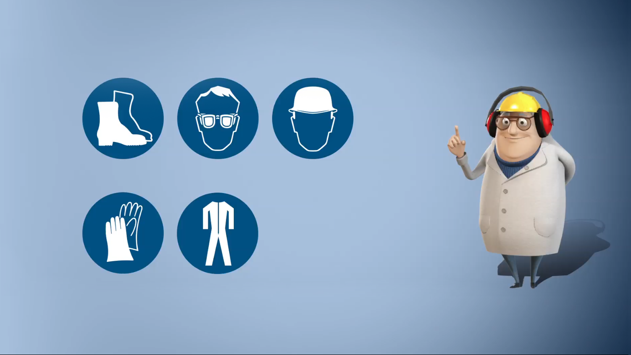
Radiation Protection (RP)
Radiation protection
  Radiobiology
  Epidemiology
  Dosimetry
  Radioecology
  …
“to enhance research for the protection of people from harmful effects of exposure to ionizing radiation and the means for achieving this” (IAEA 2016)
1928: °International Commission on Radiologiocal Protection (ICRP)
Socio-technical context:
    changing understandings of the health effects of low radiation doses;
    increasing use of ionizing radiation in medical applications;
    growing attention to decommissioning and environmental remediation projects;
    ongoing issues related to nuclear accidents;
    …

Slide 3

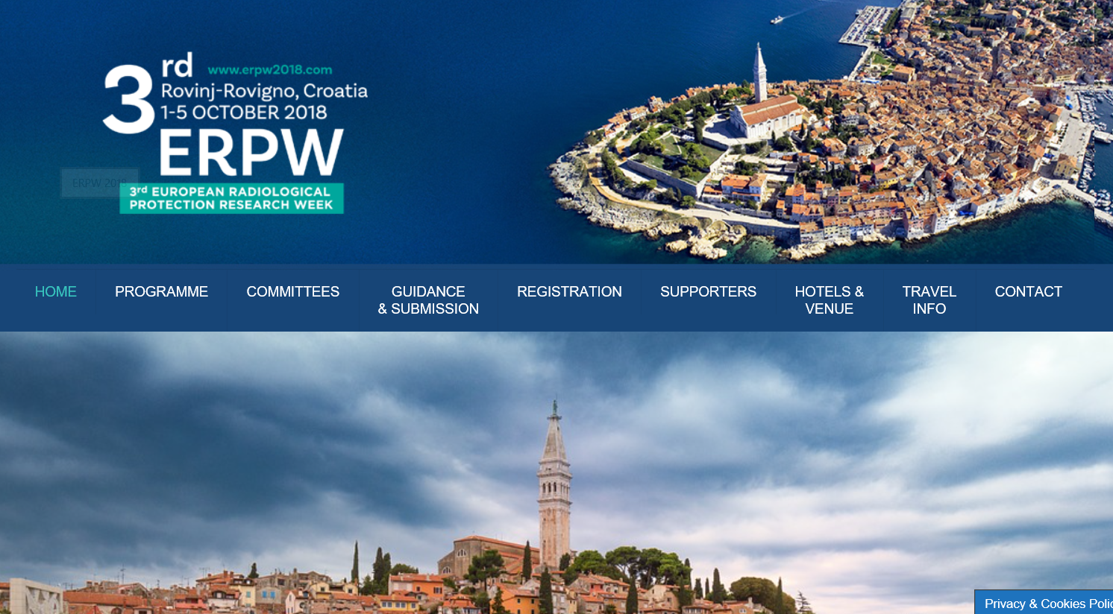
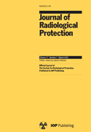
Radiation Protection Research network

Slide 4

Responsibility in nuclear S&T
Longer tradition of responsibility
  Principles and Codes of Conduct
    e.g. Precautionary principle
  Participatory approaches
    e.g. “Partnership approach” for siting LILW
  Ethics, risk communication included in Euratom FP6-7 calls
  …
Now stronger focus in Euratom on meeting societal challenges, inclusion and societal uptake

Slide 5

‘Opening up’ RP with SSH researchers
“CONCERT will develop research priorities, align them with priorities from participating Member States and will seek further input from society and stakeholders. It will reach out to engage the wider scientific community in its projects, aiming to answer the needs in radiation protection for the public, occupationally exposed people, patients in medicine, and the environment.”
“Collaborate with SSH researchers to identify and address the needs in radiation protection for the public.” (Internal Strategic Document ‘European Radiation Protection Research: Outcome of Euratom integration policy and future perspectives’ 2017)

Slide 6


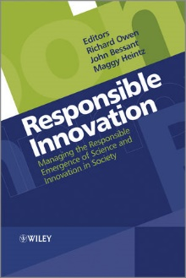

Enter Responsible Research and Innovation (RRI)
European Research Agenda & Horizon 2020 initiative:
  “Research and innovation must respond to the needs and ambitions of society, reflect its values and be responsible”
  “We need to involve civil society very upstream”
  (O. Quintana, Director European Research Area)
  Explore and prioritise social, ethical and
  environmental issues now and in the future
  Ongoing involvement of society
  Openness and transparency in the research
  process

Slide 7
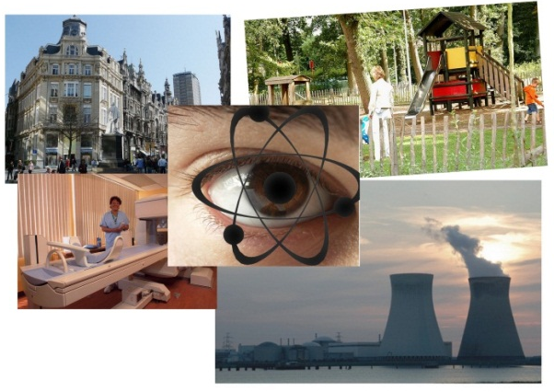
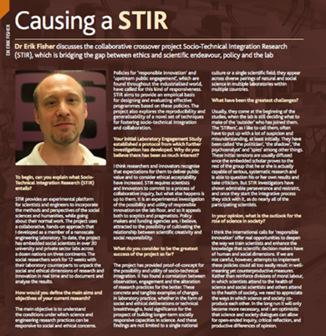
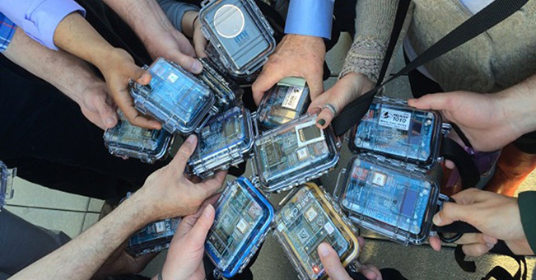
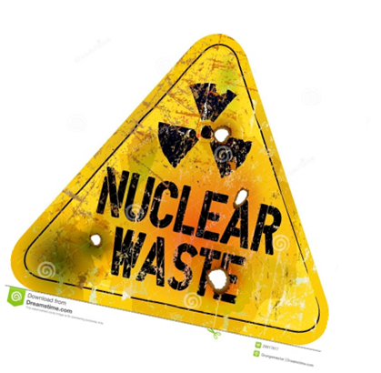

PISA: Program for the Integration of Social Aspects into nuclear research
Program line ‘implementing’ RRI in radiation protection research and policymaking
Program initiated in the late 90s

Slide 8
Reception and negotiation
Conversations between nuclear R&D directors, scientists and technologists, and (other) SSH researchers.
  e.g. Drafting of 2015 Ricomet Declaration:
  “Appeal to implement Responsible Research and Innovation in Euratom nuclear research, development and activities”
“The impact of research activities on the values and choices made by radiation protection researchers in their communities should be examined. This includes giving due consideration to societal and ethical implications of research agendas, processes, and outputs, in line with the European-wide calls for Responsible Research and Innovation.”
EJP-CONCERT - European Joint Programme for the Integration of Radiation Protection Research H2020 – 662287 D 3.4 – First joint roadmap draft 2017

Slide 9



RRI from sitting on the sidelines to entering sideways
Our awareness of its absence, or our practical efforts to include/exclude it, render it present, and that presence is disruptive, perturbing the processes of ordermaking (Horst & Michael 2011).
Its “imagined presence” facilitates or constrains our moves as SSH researchers.

Slide 10
Tasks and roles for SSH researchers?
NF theme 3
Carefully consider how RRI is received and how we “move with” RRI in/through radiation protection research.
  ‘Implement’ RRI? Or: Ask how innovation is made responsible?
  How to involve industry?
  Define RRI? Constitutive ambiguity?
  How to do interdisciplinary work?
    e.g. TERRITORIES project
Beyond SSH:
  Plurality of disciplines, agendas, instruments
  RRI hybridizes disciplines into specialist subfields (e.g. risk communication, technology assessment, citizen science)
  Work is fleeting, fragmented, diffused: Cannot speak with one voice
  RRI draws us together and pulls us apart

Slide 11
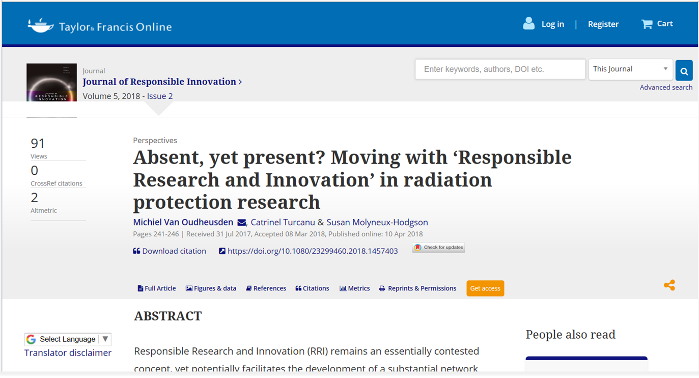
Journal of Responsible Innovation

Slide 12
Legal notice
This research was partially supported by the EC CONCERT project, funded through the H2020 Euratom research and training programme 2014–2018 under grant agreement No 662287; and in part by the UK Economic and Social Research Council funded grant ‘Nuclear Futures: a seminar series to re-make sociotechnical research agendas’ 2015–2018 [grant number ES/N009444/1].
The CONCERT EJP receives funding from the Euratom research and training programme 2014-2018 under grant agreement No 662287. The Euratom research and training programme 2014-2018 is complementary to Horizon 2020. CONCERT EJP is a co-funded action. Further funding is received by member states via specifically appointed national programme manager institutions.
Disclaimer: This presentation reflects only the authors’ view. Responsibility for the information and views expressed therein lies entirely with the authors. The European Commission is not responsible for any use that may be made of the information it contains.

Slide 13
Copyright © 2018 - SCK•CEN
PLEASE NOTE!
This presentation contains data, information and formats for dedicated use only and may not be communicated, copied, reproduced, distributed or cited without the explicit written permission of SCK•CEN.
If this explicit written permission has been obtained, please reference the author, followed by ‘by courtesy of SCK•CEN’.
Any infringement to this rule is illegal and entitles to claim damages from the infringer, without prejudice to any other right in case of granting a patent or registration in the field of intellectual property.
SCK•CEN
Studiecentrum voor Kernenergie
Centre d'Etude de l'Energie Nucléaire
Belgian Nuclear Research Centre
Stichting van Openbaar Nut
Fondation d'Utilité Publique
Foundation of Public Utility
Registered Office: Avenue Herrmann-Debrouxlaan 40 – BE-1160 BRUSSELS
Operational Office: Boeretang 200 – BE-2400 MOL

