Slide 1
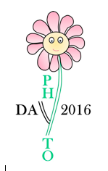
Screening of Mahoran plants for cosmetic applications
Saive M.¹, Frederich M.², Fauconnier M-L.¹
¹ Laboratory of general and organic chemistry (Gembloux Agro-Bio Tech, University of Liège, Belgium)
² Laboratory of pharmacognosy, institute of pharmacy, (University of Liège, CHU, Belgium)

Slide 2
Presentation
Introduction
Chemotaxonomic study
Ethnobotanical study
Sampling and sample preparation
Biological activity assessment
Results
Perspectives

Slide 3
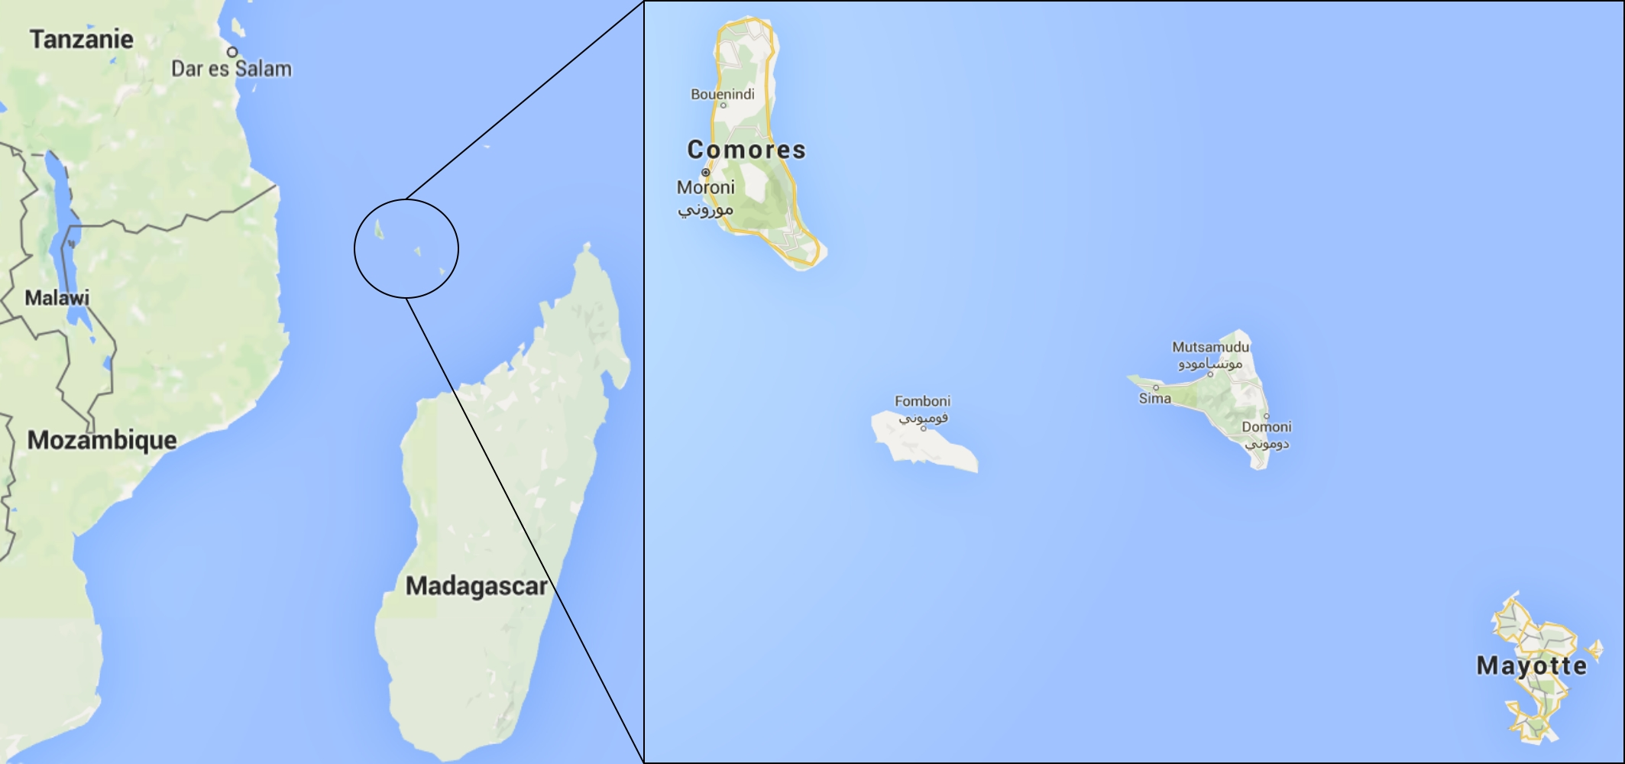
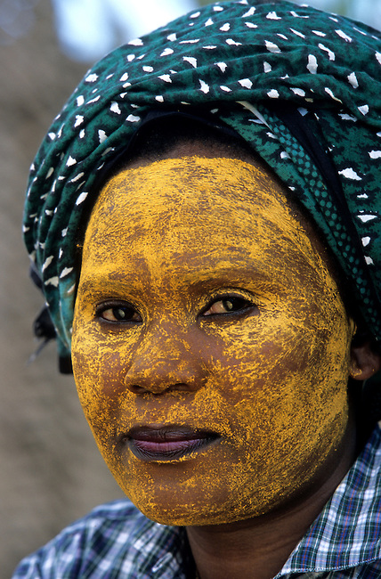
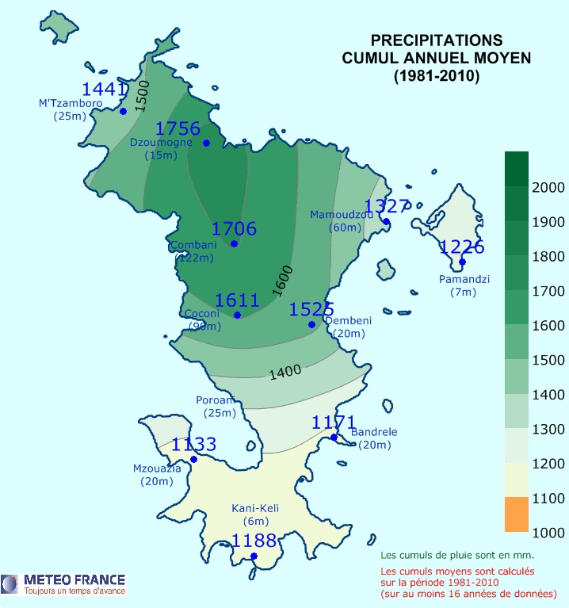
Introduction
Location
374 km²
350 km Mozambique
250 km Madagascar
Population (INSEE – 2012)
212 600
570 inhabitant/km²
50 % < 18 years old
Economy (INSEE – 2015)
453 €/inhabitant/month
Climate
Tropical insular
1000 – 2000 mm/year
Culture
Swahili
Islam
Two language

Slide 4
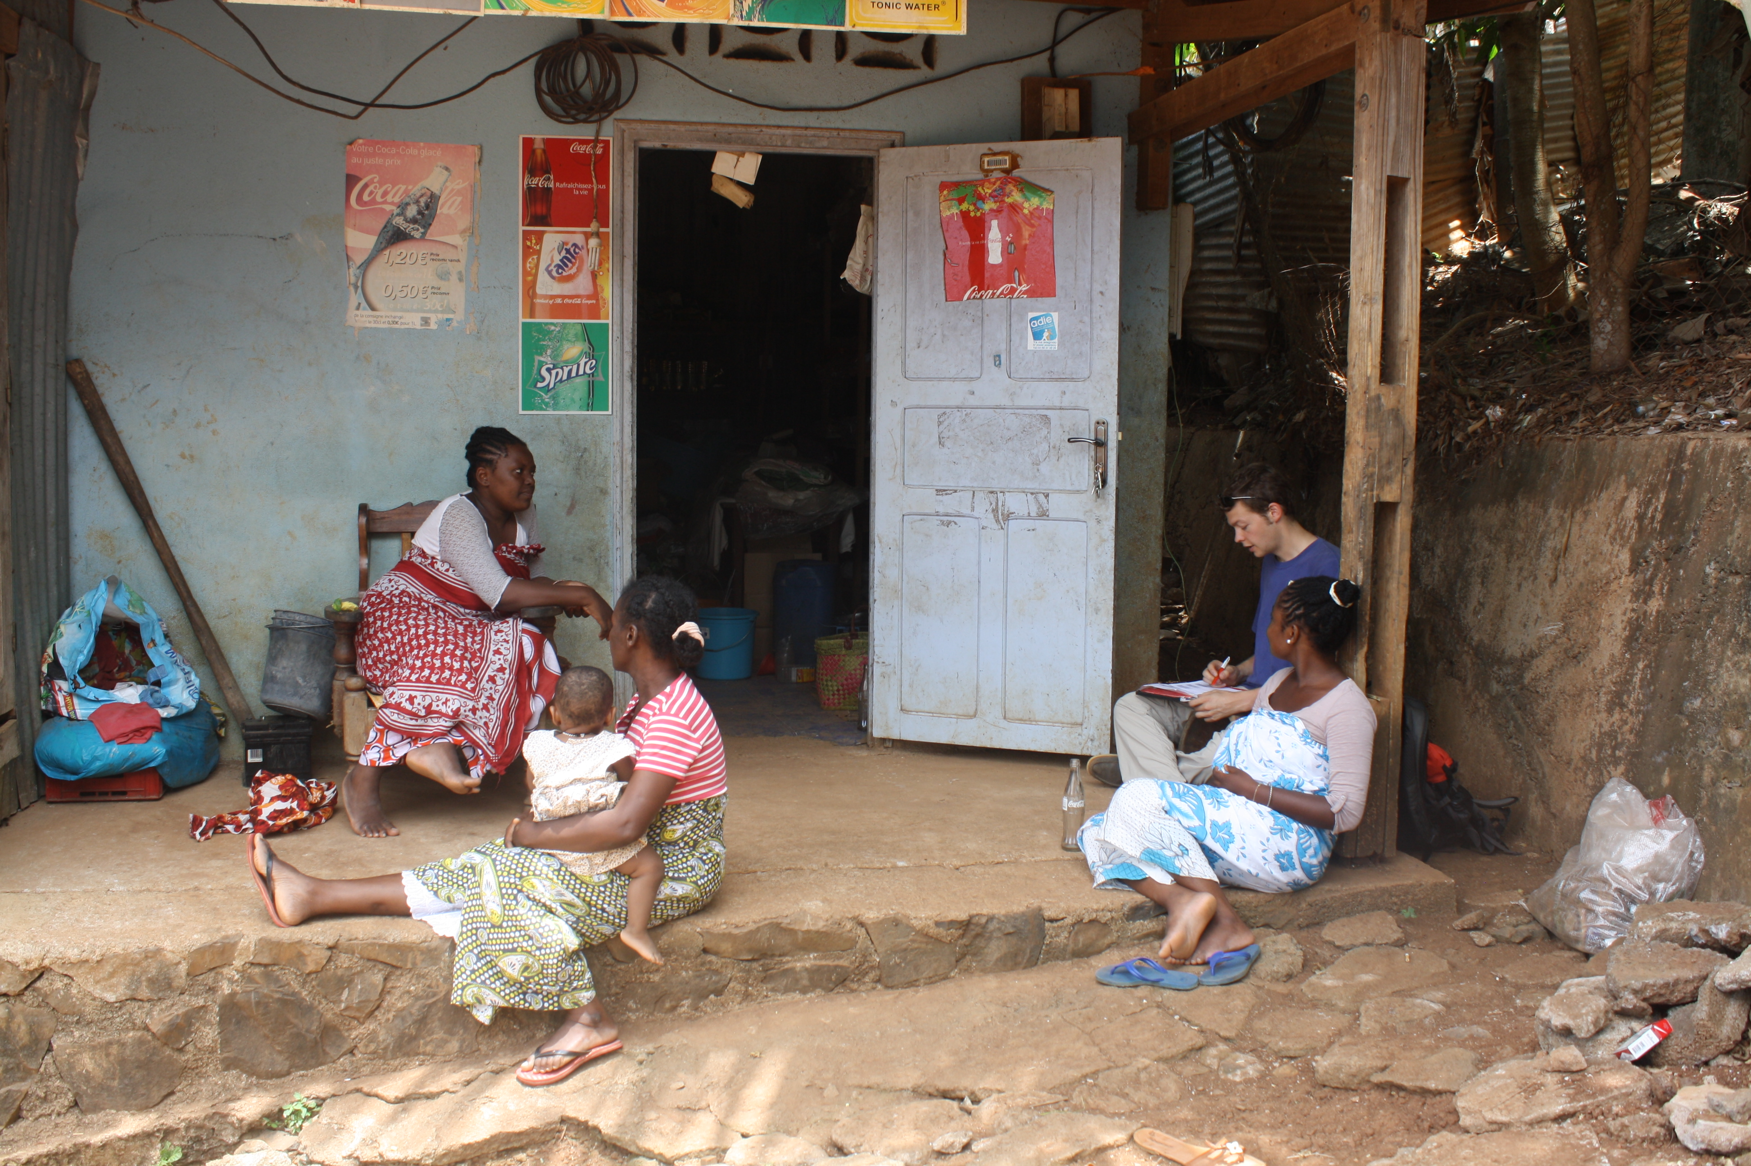
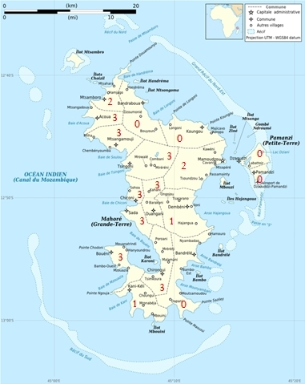
Preliminary studies
Chemotaxonomic
Seychelles, Madagascar, La Reunion
108 species frequently encountered
35 species used in a topical manner
24 species found in Mayotte
5 species nor well studied
Ethnobotanical
30 informants
Foundi, masseuse, esthetician
274 entries
121 different vernacular appellations
94 different species

Slide 5
Sampling
April – May 2015
Rise of the sun (6 AM)
All organs available
Mascarin National Botanical Conservatory
Latin name | Latin name | Latin name
Acalypha hispida Bum. F. | Kalanchoe pinnata (Lam.) Pers. | Paullinia pinnata L.
Acalypha wilkesiana Müll. Arg. | Lantana camara L. | Pandanus mayotteensis H. St. John
Adansonia digitata L. | Lawsonia inermis L. | Persea americana Mill.
Aloes mayottensis A. Berger | Leea guineensis G. Don | Sesamum indicum L.
Cananga odorata (Lam.) Hook. f. & Thomson | Litchi chinensis Sonn. | Syzygium aromaticum (L.) Merr. & L.M. Perry
Erythroxylum corymbosum Boivin ex. Baill. | Litsea glutinosa (Lour.) C. Rob. | Tamarindus indica L.
Erythroxylum lanceum Bojer. | Myristica fragans Houtt. | Zingiber zerumbet (L.) Sm.

Slide 6
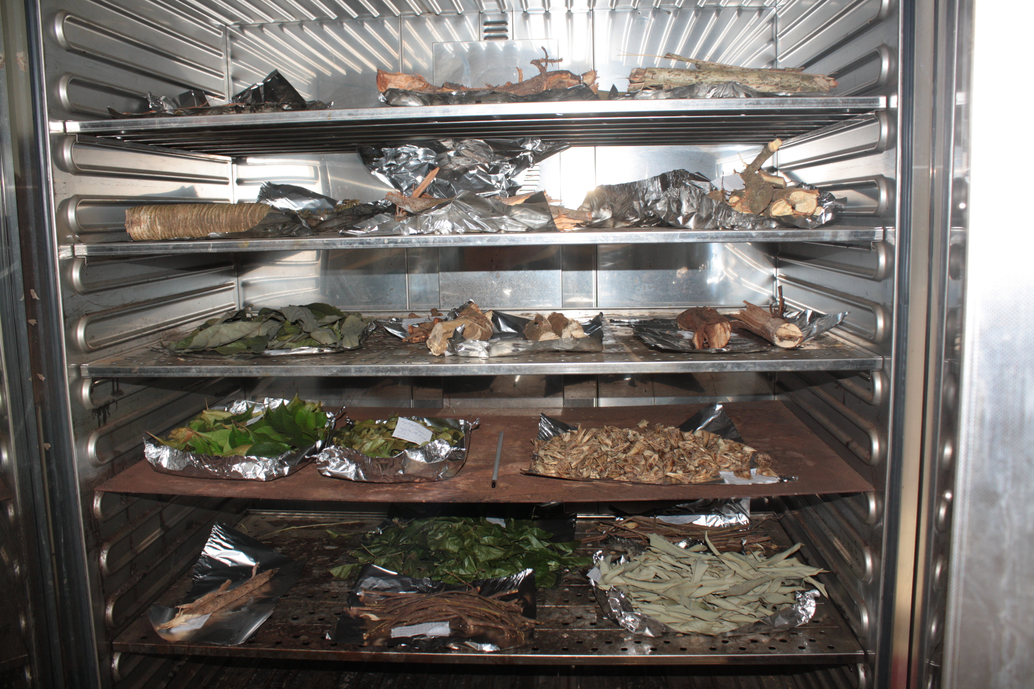
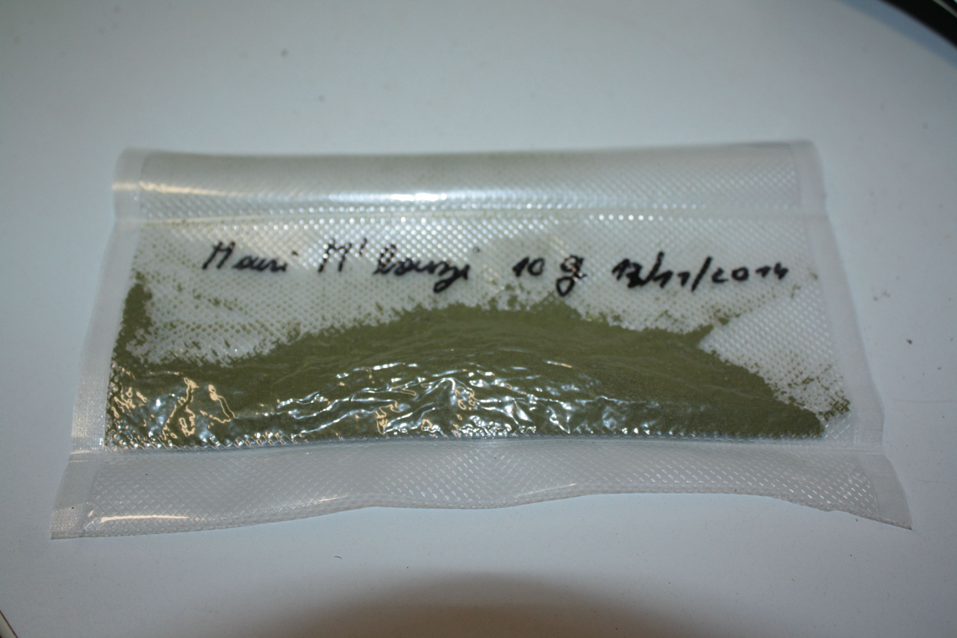
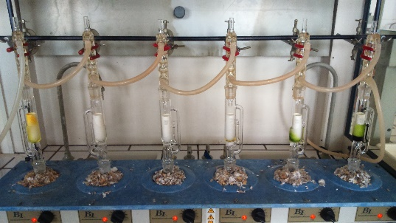
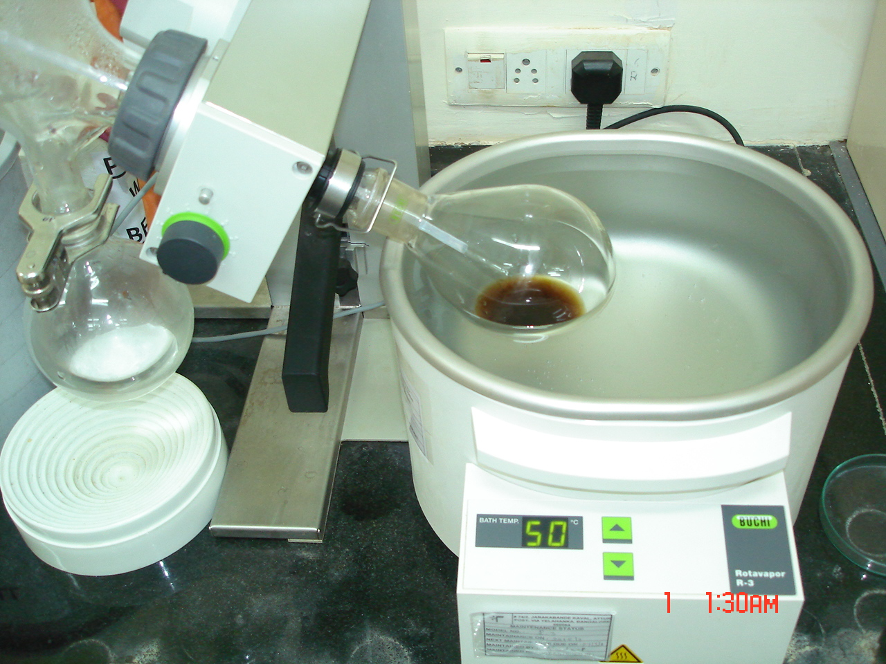
Preparation and extraction
Preparation
Fresh material soxhlet extraction
Drying (72h 55 ± 1 °C)
Powdering
Vacuum sealed
Storage at -18 ± 1 °C
Dry material soxhlet extraction
Solvent replacement (dry and fresh)
Storage -18 ± 1 °C
Soxhlet extraction
3h30
10 g fresh – 5 g dry
60 ml acetone
Replacement solvent : Methanol

Slide 7
Biological activity assessment
3 repetitions – 4 concentrations
Skin protection
Antioxidant activity
α,α-diphenyl-β-picrylhydrazyl (DPPH)
Reference : 6-Hydroxy-2,5,7,8-tetramethylchromane-2-carboxylic acid (TROLOX)
Skin soothing
Anti-inflammatory activity
Lipoxygenase (EC 1.13.11.12) pathway
Substrate : Linoleic acid
9 and 13 HPOD synthesis inhibition
Reference Nordihydroguaiaretic acid
Skin complexion
Whitening activity
Tyrosinase (EC 1.14.18.1) pathway
Substrate : L-DOPA
Dopachrome synthesis inhibition
Reference : Kojic Acid

Slide 8
Results
 |  | Average IC50 (g/L) |  |  |  |  | Average IC50 (g/L)
Species | Organ | DPPH | Lipoxygenase | Tyrosinase | Species | Organ | DPPH | Lipoxygenase | Tyrosinase
Acalypha hispida Burm. F. | Fresh leaves | 0,434 |  |  | Myristica fragrans Houtt. | Dry seeds |  | 1,209
 | Dry flowers | 1,350 |  | 85,707 | Paullinia pinnata L. | Dry leaves | 1,343
 | Fresh flowers | 0,485 |  |  |  | Dry liana | 1,786
 | Dry leaves |  | 187,134 |  |  | Dry aerial roots | 1,439
Acalypha wilkesiana Müll. Arg. | Fresh leaves | 0,396 |  | 31,750 | Persea americana Mill. | Fresh leaves | 0,889
Cananga odorata (Lam.) Hook. f. et Thomson | Fresh flowers |  | 6,700 |  |  | Dry leaves | 0,860 | 0,981
 | Dry leaves |  |  | 7,355 |  | Fresh kernel | 2,164 |  | 68,460
Erythroxylum corymbosum Boivin ex Baill. | Dry leaves | 0,538 |  |  |  | Dry kernel | 2,043 | 35,725
 | Dry wood |  |  | 2,498 |  | Dry roots | 0,956 |  | 16,674
Kalanchoe pinnata (Lam.) Pers. | Fresh leaves | 1,175 |  |  | Syzygium aromaticum (L.) Merr. et L.M. Perry | Fresh leaves | 0,455
Lantana camara L. | Fresh leaves | 1,589 |  | 87,800 |  | Dry leaves | 0,562 |  | 11,364
 | Dry leaves | 1,666 |  |  |  | Dry wood | 0,532
Lawsonia inermis L. | Fresh leaves | 0,562 |  |  |  | Dry roots | 3,228 |  | 11,369
 | Dry leaves | 0,906 |  |  | Tamarindus indica L. | Dry leaves
 | Dry roots | 0,958 |  |  |  | Fresh leaves |  |  | 8,300
Leea guineensis G. Don | Fresh leaves | 0,281 |  | 7,575 | Zingiber zerumbet (L.) Sm. | Dry leaves |  | 4,060 | 36,552
 | Dry leaves | 0,607 | 2,710 | 0,374 |  | Dry flowers |  | 11,191
 | Dry fruits | 1,410 |  | 10,108 |  | Fresh rhizom |  | 15,440
 | Dry roots | 0,815 |  |  |  | Dry rizhom |  | 3,565
Litchi chinensis Sonn. | Fresh leaves | 1,670 |  |  |  | Dry stem |  | 11,380 | 487,320
 | Dry leaves | 0,499 | 2,050 | 2,746 | Kojic acid |  |  |  | 0,33814
 | Dry wood | 0,446 |  |  | Nordihydroguaiaretique acid |  |  | 0,07169
 | Dry roots | 0,363 |  | 4,033 | 6-hydroxy-2,5,7,8-tetramethylchroman-2-carboxylique acid |  | 0,00062

Slide 9
Conclusion and perspectives
Most effective plants extracts :
Antioxidant : Fresh leaves from Leea guineensis G. Don
Anti-Inflammatory : Dried leaves from Persea Americana Mill.
Anti-tyrosinase : Dried leaves from Leea guineensis G. Don
Following steps :
Thin Layer Chromatography
Mobile phase profiling
Major components identification
Alkaloids
Terpenes
Phenolic compounds
Active compound identification
Crude extract pretreatments
Pre-fractionation
Preparative HPLC
Plant extracts fractionation
Fraction’s biological activities evaluation
Synergistic effects
Antagonistic effects
Analytical HPLC
Molecular characterization
Green extraction process
Supercritical gazes
Microwave assisted extraction
Hydro distillation
…
Cosmetic formulation

Slide 10
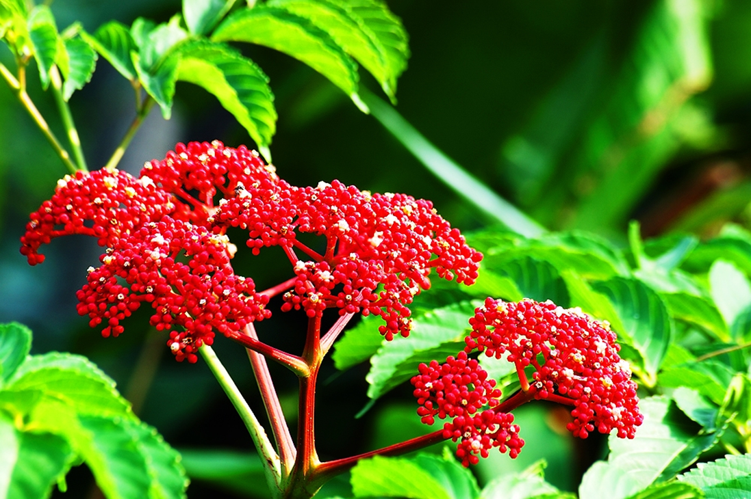
Thank you for your attention

