Slide 1
Turning Wallonia into a lab When economic strategies meet creativity and experimentation dynamics
Hadrien MACQ
SPIRAL Research Center, University of Liège, Belgium
EASST Conference
Lancaster, July 28 2018

Slide 2
Introduction
Lab participation (Bogner 2012)
Organized by professional participation specialists;
Under controlled conditions;
Disconnected from public controversies or political concerns.
Vocabulary of experiments applied to the ‘participatory turn’ (Laurent 2016)
‘Public engagement in science’ as ‘a long standing experimental practice’ (Lezaun et al. 2016: 196-197)
STS research tend to remain focused on deliberative participation
New experiments of participation are emerging;
Extension of lab participation to collective experiments where technologies are tested and developed with/by publics (e.g. Living Labs, Fab Labs, Hackathons);
Changing relationship between science, politics, and publics.

Slide 3
A co-productionist approach to public participation
The ‘who’, the ‘how’ and the ‘what’ are co-produced in participatory exercises (Chilvers and Longhurst 2016)
The ‘why’ of participation is rarely addressed in a co-productionist perspective
What is participation for? Why is this new class of experiments in participation emerging? Why is participation valued by actors?
Connect situated participatory experiments to the political machine to understand their effects on the organization of democratic life (Felt and Fochler 2010; Jasanoff 2011; Laurent 2016; Lezaun et al. 2016)
Co-production of participatory experiments and the broader political-economic context in which they take place

Slide 4
Methods and data
Discourse analysis
Ethnographies
Macro level
Oral and written discourse, both formal (policy documents, official reports, etc.) and informal (blog, informal conversations, etc.).
Micro level
Combination of participant observations, documentary analysis and semi-structured interviews with sponsors, facilitators, and participant.
Walloon Region

Slide 5
Co-creation in Wallonia…
“Creative Wallonia” (2010) : framework programme that:
“… places creativity and innovation at the heart of the Walloon project. (…) promotes a Walloon society and economy which are transforming and contributing to value creation by intensively and positively exploiting creativity”.
Concepts central to Creative Wallonia: design thinking; co-creation, makers, etc.
Setting up of sites of co-creation in the territory: Creative Hubs, Fab Labs, Living Labs, Hackathons.

Slide 6
… facing a central tension?
“I am convinced today that Creative Wallonia is an experience that is currently in a bad pass (…) we wanted that (…) universities, companies, and research centers could work with the local fabric, within Hubs, that these people could have a Fab Lab at their disposal, that they could make experimentations in social economy, etc. etc. All this have been overlooked, it has been perverted. There has really been a monopoly of the economic component.”
“Now we have Living Labs (…) but this is something far more sectorial, micro, limited to a single domain. (…) The initial ambition was stronger (…) it was to turn Wallonia into a Living Lab, an innovation lab”.

Slide 7
The economic ambition of co-creation
Upperground (Big companies, public sector)
Middleground (Creative Hubs, Living Labs, Fab Labs, Co-working spaces)
Underground (Artists, makers, citizens)
“Exploiting the creative potential of all this ‘breeding ground’ to stimulate innovation”
“Make Wallonia a creative and innovative society”

Slide 8
Situated impacts of the tension
Fab Labs have to show economic viability
Reorient themselves and their targeted audience (citizens, makers, and… companies).
Living Labs eliminate critique and conflict (focus on the quantitative maximization of ideas)
“In a Living Lab, there is no power (…) a Living Lab actually works like a private company, they are asked to create innovation with users. (…) [There is no] debate on societal aspects or on public decisions”
Hackathons are thought as a mix between a programming competition, a participatory experiment, and a start-up camp

Slide 9
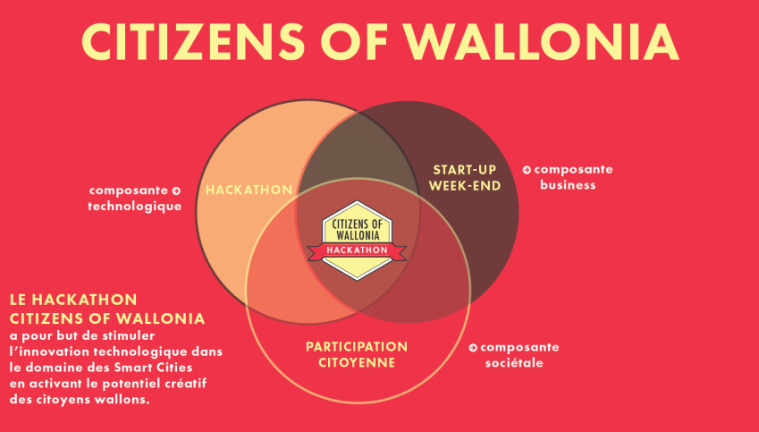
Situated impacts of this tension
Fab Labs have to show economic viability
Reorient themselves and their targeted audience (citizens, makers, and… companies).
Living Labs eliminate critique and conflict (focus on the quantitative maximization of ideas)
“In a Living Lab, there is no power (…) a Living Lab actually works like a private company, they are asked to create innovation with users. (…) [There is no] debate on societal aspects or on public decisions”
Hackathons are thought as a mix between a programming competition, a participatory experiment, and a start-up camp

Slide 10
Discussion (1)
Particular projected socio-technical order
Globalized competition of territories → “There is a train to catch”
Industrial redeployment of a disaster region through digital technologies → ‘Technological solutionism’ (Morozov 2013)
‘Recuperation’ of makers/hackers movement in a new Spirit of Capitalism (Boltanski & Chiapello 1999; Delfanti and Söderberg forthcoming)
Valuation of an entrepreneurial citizenship
Particular mode of governance (of innovation)
Participation based on ‘projects’
Elimination of conflict, elimination of power
Participation as productive (from decision-making to innovation making)

Slide 11
Discussion (2)
The overarching imperative of economic performance veils important democratic questions
‘Democratization’ is conceived as “allowing everyone to make innovation”
Who is to take part to the experiment? Who is not?
Who is to take part to the definition of public issues? Who is not?
What is to be experimented? What is not?
Post-political democratic experiments? (Mouffe 2016)

Slide 12
Thank you!
Hadrien Macq
hadrien.macq@uliege.be

