Slide 1
[Summer school hydrogeophysics 2018 - Jülich]
ELECTRICAL RESISTIVITY TOMOGRAPHY

Slide 2
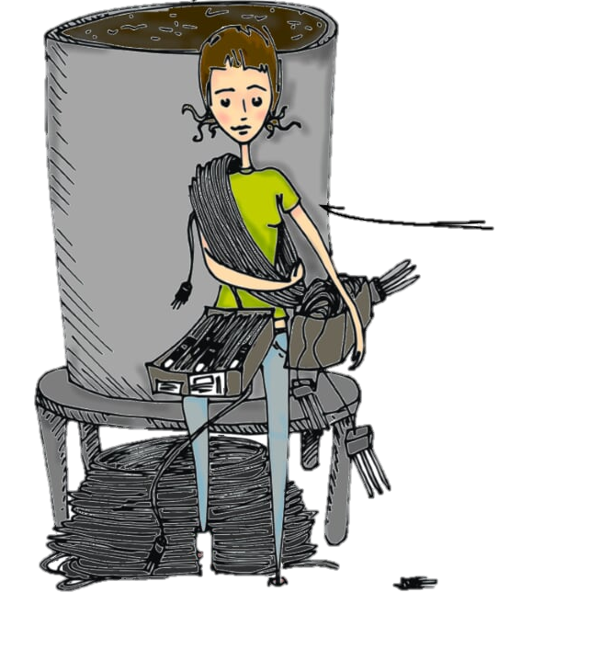
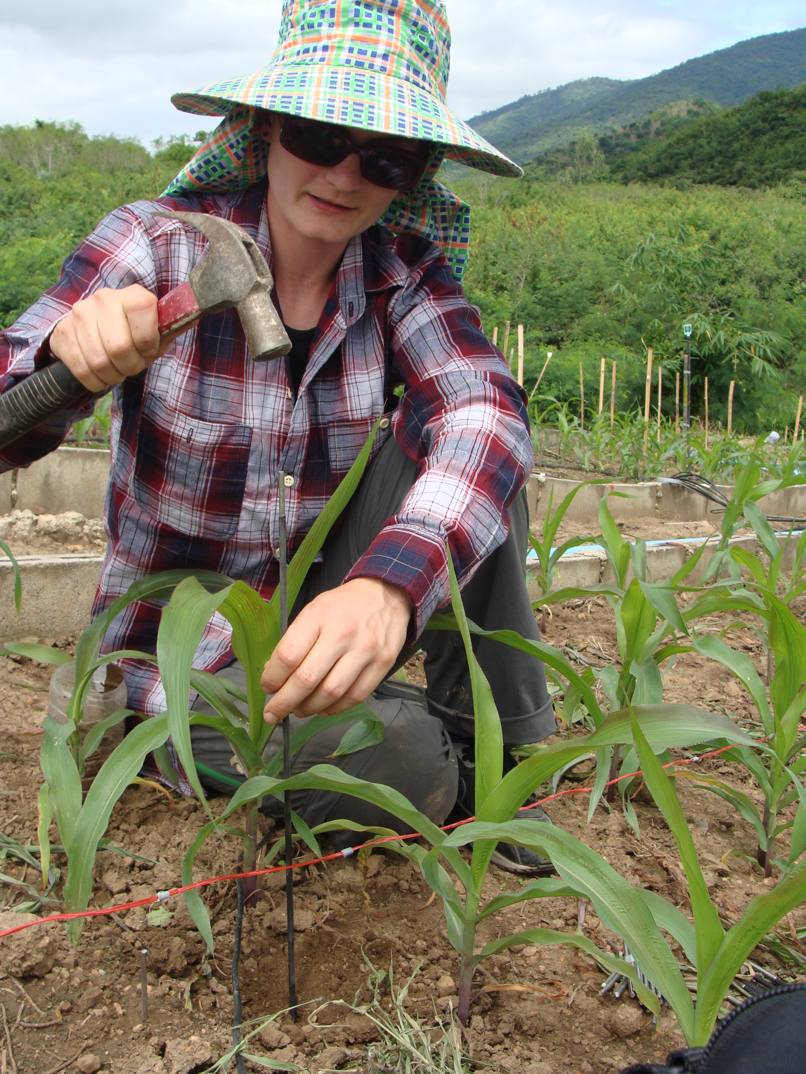

Who is Sarah Garré?
#ERT #lysimeter #waterflow #soluteTransport #field #intercropping #stableIsotopes #multidisciplinaryScience #temperateAgriculture
2007-2010
PhD in Jülich
Measuring soil-plant interactions with ERT on lysimeters
2010-2012
postdoc KULeuven in Thailand
ERT and isotopes for competition in intercropping systems
2012-2014
Coordination AgricultureIsLife platform, Gx-ABT
Multi-disciplinary PhD platform for agriculture

Slide 3



Who is Sarah Garré? (2)
Keep in touch!
sarahgarre
2014-now
Professor Gx-ABT, ULiège
Soil-plant interactions, hydrogeophysics, soil physics
Also integrated in team Frédéric NGUYEN, ULiège (Hydrogeophysics)

Slide 4
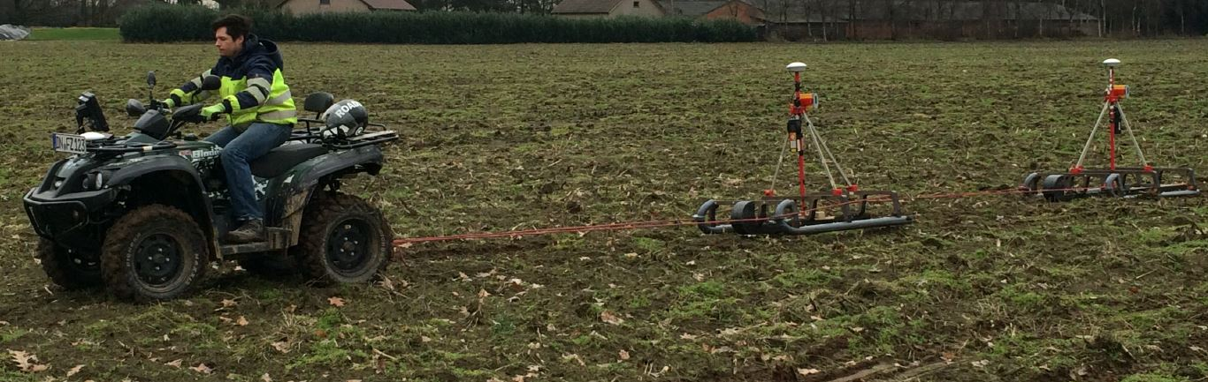
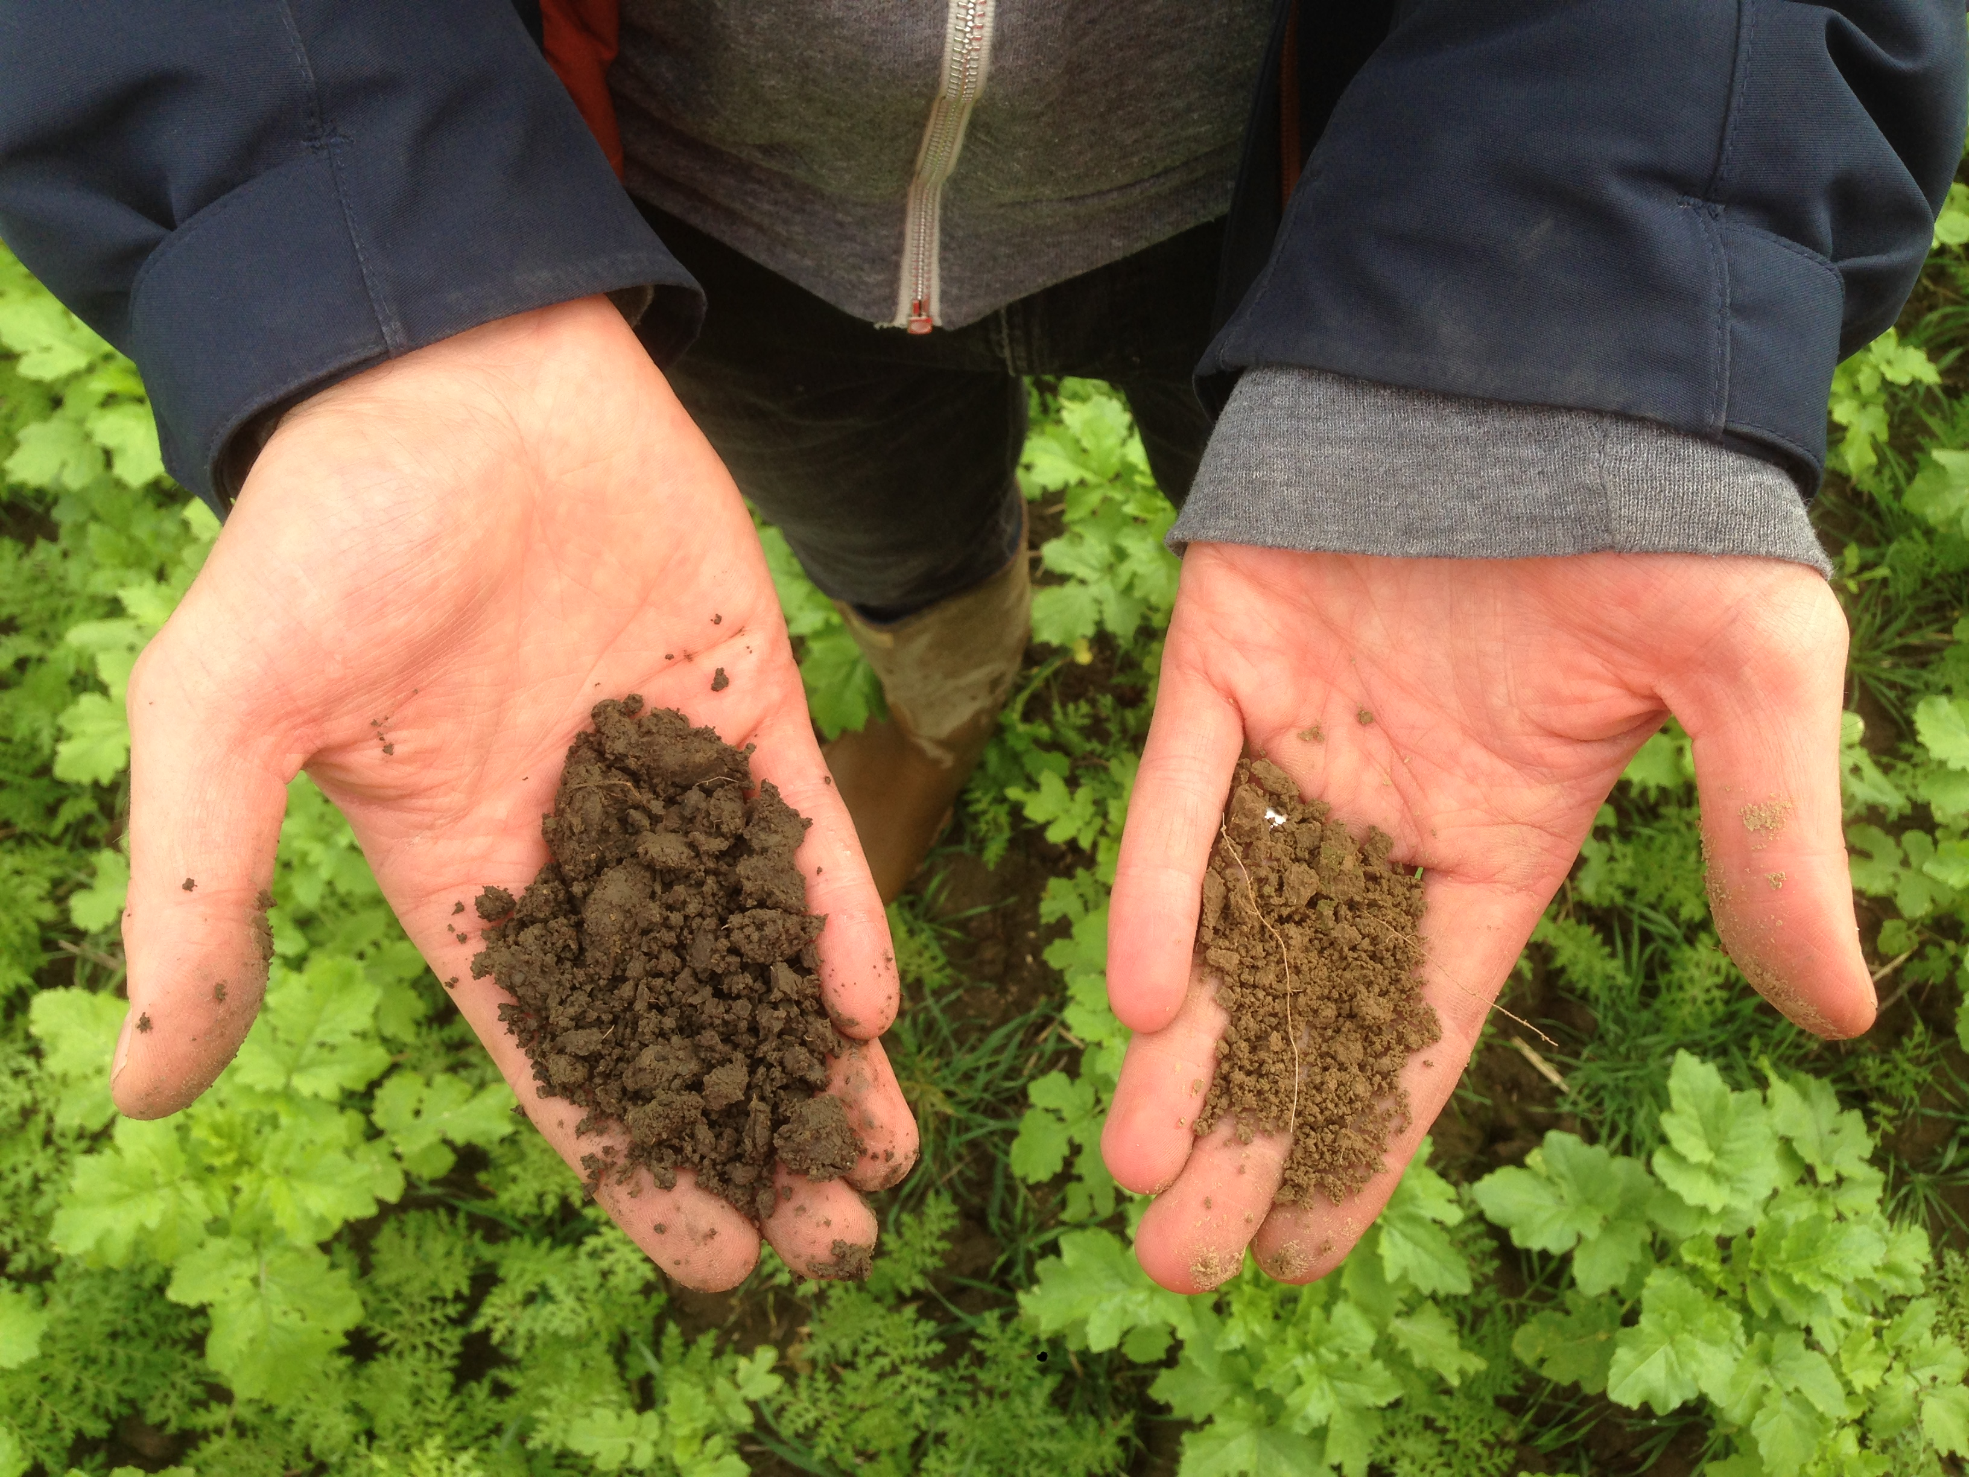
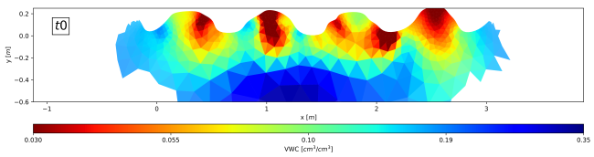
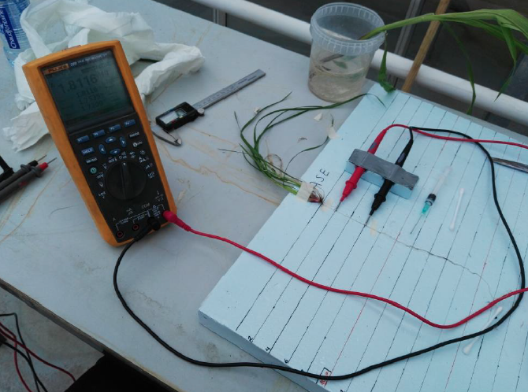

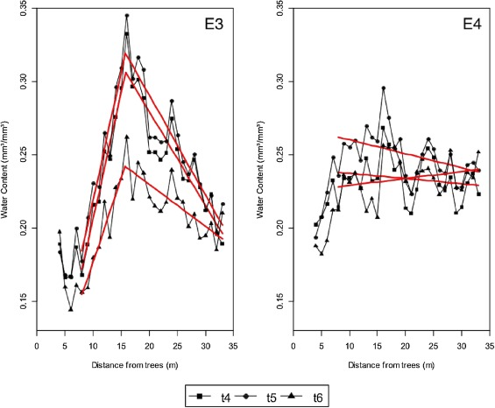
POTENTIAL project
#potatoe
#precision farming
#EMI,ERT, remoteSensing
CHAR project
#biochar #agronomy #RWU #soilStructure
eROOT project
PROJECTS
Green roof research
AgroforestryVlaanderen.be
#roots #electricalSignature
#ERT, IP
#competition
#ERT #water
#agroforestry
#greenRoof
#vegetationDynamics
#abiotic environment

Slide 5
A practical example of application for ERT
Hermans et al., 2012 (J.Hydrol.)

Slide 6
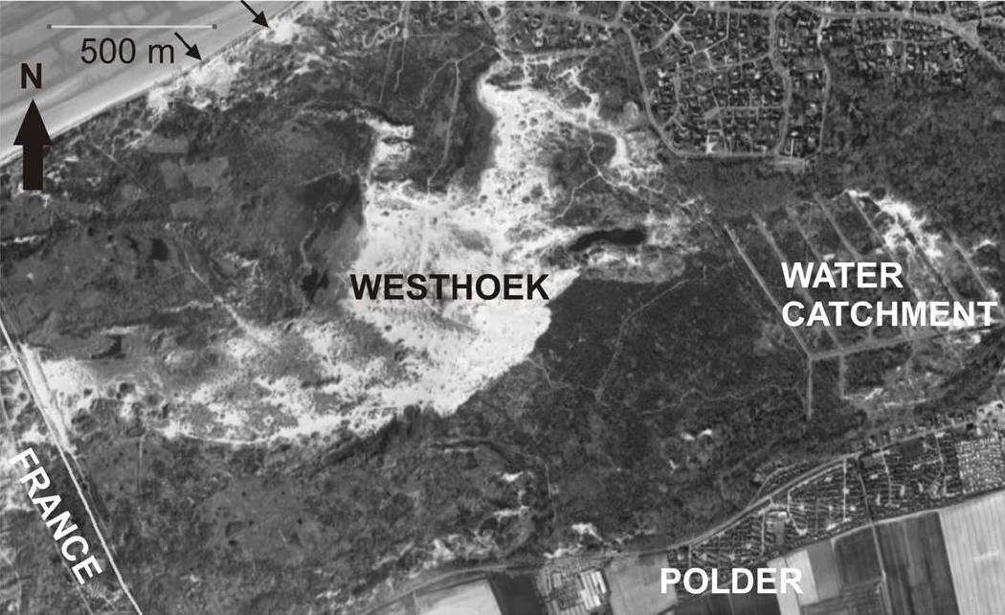
Salt water intrustion in the Westhoek, Flanders, BE
An inlet allows inundation by salty water (ca 35000 mg/L) in order to maintain a specific fauna and flora in the natural reserve. At the same time, a groundwater well is situated nearby.
For comparison: drinking water 30 (Spa) – 5000 (St-Yorre) mg/L
Notes:
34000-35000 mg/L

Slide 7
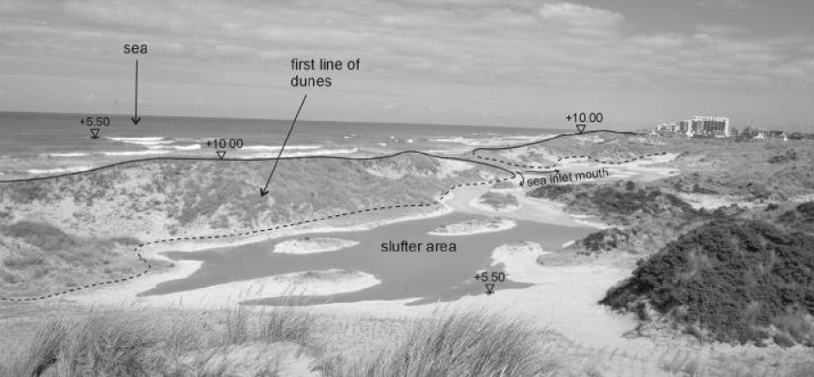
Sea water infiltration at high tide

Slide 8
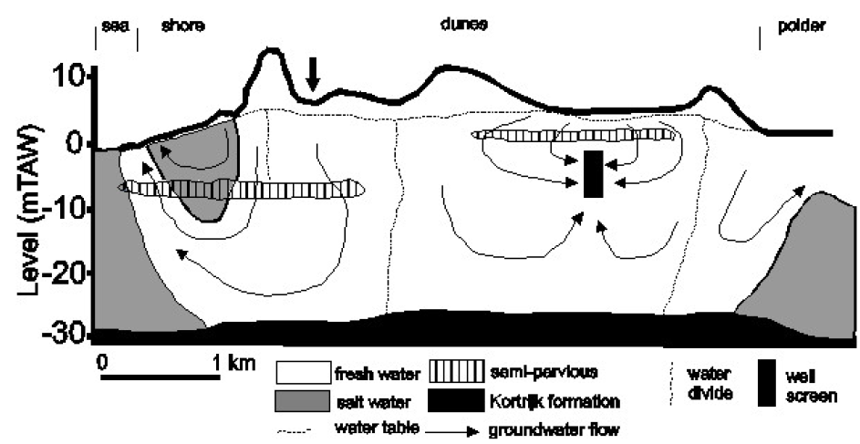
Conceptual scheme of water flow
Part of the water infiltrates, part of it goes back to the sea, part of it goes to the hinterland or is extracted by the well. Clay lenses influence the water flow.
Notes:
Hydrogeology of the study site. This schematic cross-section describes the geology of the site, groundwater flows, the fresh/salt water distribution and the position of water divides before infiltration. The black arrow indicates the position of the inlets. The volume
investigated by this method is much smaller (the vertical sensitivity is about 50 cm and the lateral sensitivity about 1 m than the one investigated by one ERT data point, leading to a more accurate description of the vertical conductivitydistribution. However, the volume investigated by one EM39 measurement
is not that different of the one of one cell of the inversion
grid, we thus assume that the vertical variogram can be used to
constrain the ERT inversion

Slide 9
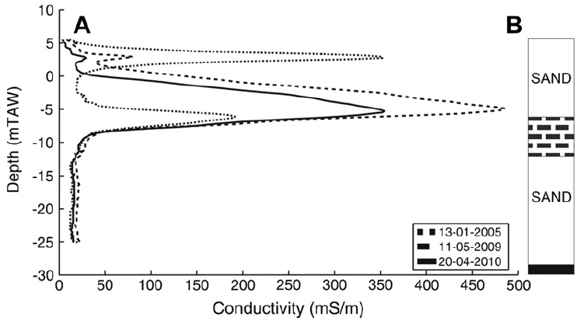
Point sampling
Well samplings show the presence and evolution of salt water over time, but spatial information is limited.
Notes:
EM39 measurements. EM39 measurements carried out in well P11 at different time between 2005 and 2010 shows an increase in electrical conductivity where saltwater occurs (a), the position of the salt water is correlated with a high clay content layer highlighted by borehole logs (b).

Slide 10
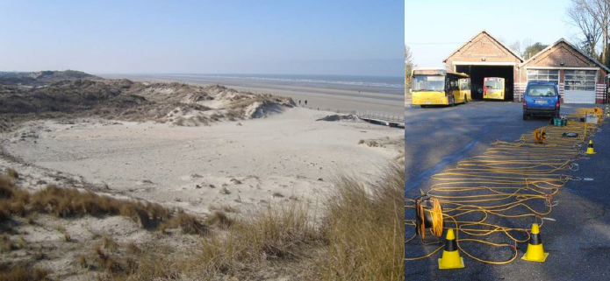
General view on the infiltration area and tomography system

Slide 11
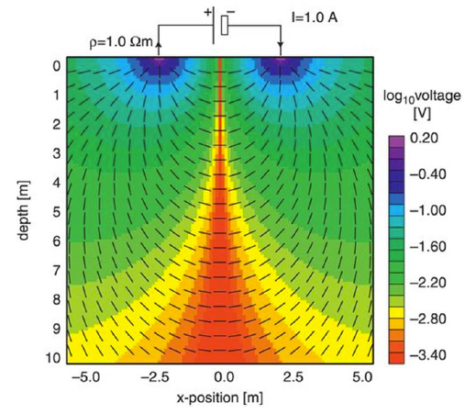
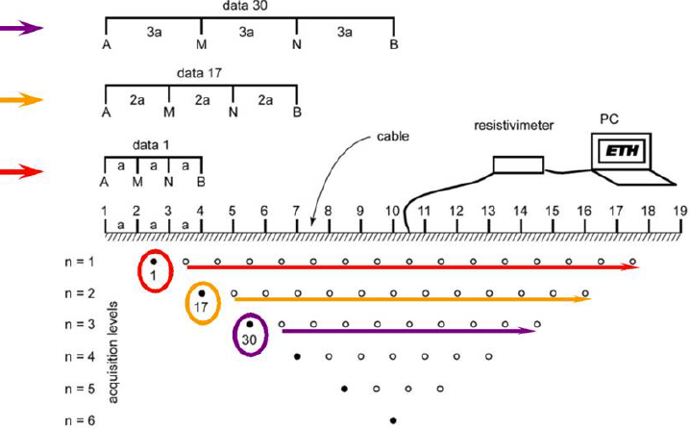
Electrical resistivity tomography
Notes:
Une mesure s'eectue en injectant du courant dans le sous-sol a l'aide
d'electrodes et en mesurant la dierence de potentiel resultante.
Un grand nombre de mesure de dierence de potentiel (mV) et
d'injection de courant (A) est realise.

Slide 12
General view on the infiltration area and tomography system

Slide 13
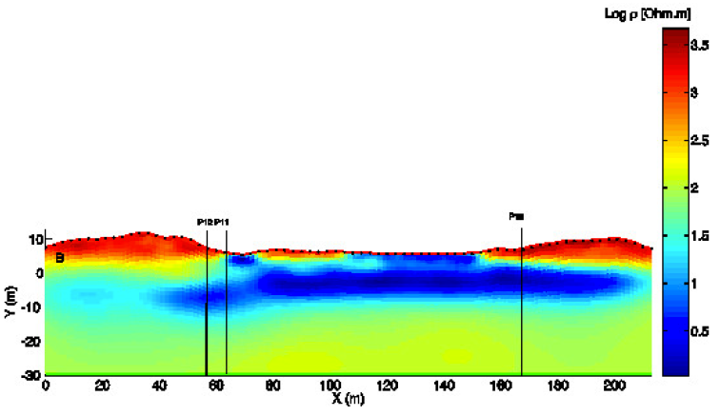

Electrical resistivity distribution
This large number of measurements d will allow us to calibrate a model ρ(x,z) of resistivity distribution (Ωm) of the subsurface using the physical laws f() governing the current propagation.
Notes:
The solution obtained with geostatistical regularization and a homogeneous prior model deduced from borehole data

Slide 14
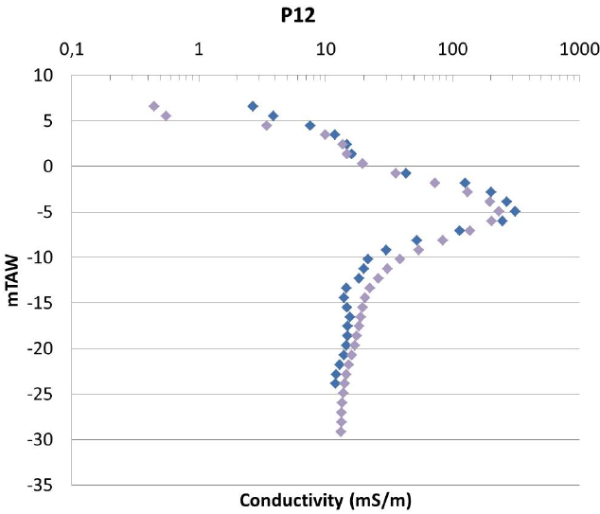
Results from well (EMI) confronted with ERT results
EM
ERT
Notes:
Comparison with EM39 measurements.
The volume investigated by the EM39 is much smaller (the vertical sensitivity is about 50 cm and the lateral sensitivity about 1 m
(McNeill, 1986)) than the one investigated by one ERT data point, leading to a more accurate description of the vertical conductivity distribution. However, the volume investigated by one EM39 measurement is not that different of the one of one cell of the inversion grid, we thus assume that the vertical variogram can be used to constrain the ERT inversion.

Slide 15
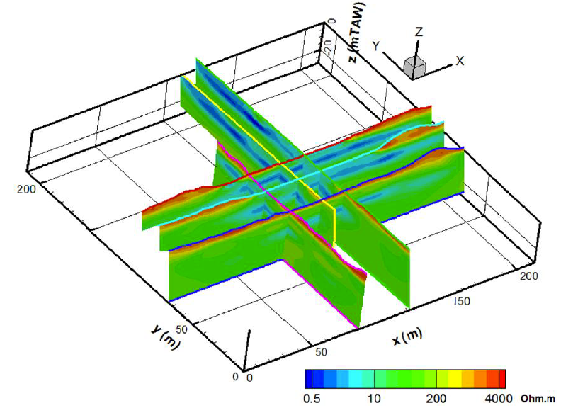
3D acquisition result
A repetition of the different profiles allows us to obtain a 3-D visualisation of the saline zone in the subsurface without the need to drill any wells.
Notes:
The electrical resistivity distribution can be appreciated for all six profiles. The extensions of the plume are observable in all directions.

Slide 16

But can we know the salt concentration and its distribution?

Slide 17
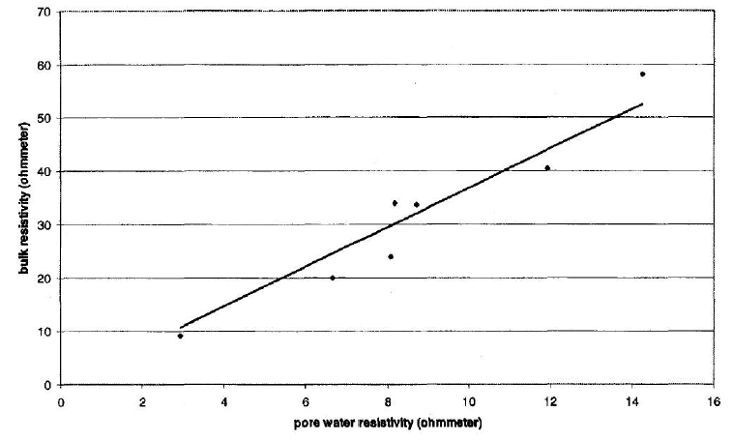
Yes! : from ρ_{b} to ρ_{w} through a formation factor
Well number | ρ_{w}(Ω.m) | ρ_{b}(Ω.m) | F
SB2 | 11.93 | 40.39 | 3.38
SB3 | 8.71 | 33.65 | 3.86
SB7 | 14.24 | 58.06 | 4.08
SB9 | 8.17 | 33.98 | 4.16
SB6 | 6.66 | 19.91 | 2.99
SB10 | 8.08 | 23.85 | 2.95
SB13 | 2.93 | 9.22 | 3.14
Van meir and Lebbe (2003)
Bulk soil resistivity (Ω.m)
Calculation of formation factor from LN resistivity measurements
Pore water resistivity (Ω.m)
Notes:
LN log normal resistivity loggings.
Van Meir, N., Lebbe, L., 2003. Deriving TDS values in coarse sediments from long normal and electromagnetic logs. Ground Water 41 (1), 33–40.

Slide 18
… and from ρ_{w} to salt concentration
Well nr | TDS (mg/L) from EM39 | Total sum of ions (mg/L) | σ_{b} (mS/m) | F | TDS/(F. σ_{b})
SB9 | 19.843 | 19.848 | 0.56696 | 3.5 | 10
SB11 | 27.046 | 29.524 | 0.77273 | 3.9 | 9.8
SB13 | 28.319 | 28.682 | 0.80909 | 3.5 | 10.1
Comparison between TDS values calculated from EM39 and from laboratory analyses. Proportionality between TDS (mg/L) from laboratory and σ_{w} (=F. Σ_{b}).
Van meir and Lebbe (2003)
Notes:
I do not understand where the sigma b values in the bottom table come from. They are not the same as the ones shown the table slide.
We can use this relationship to image the salt concentrations with ERT

Slide 19
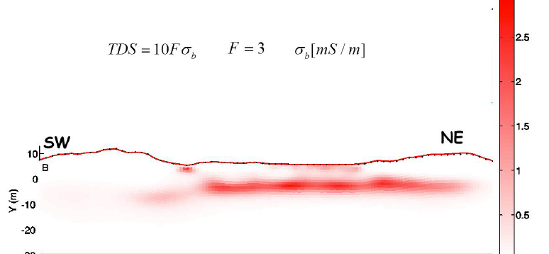
Final result: concentration map
Notes:
The petrophysical law used here allows us to transform bulk resistivity from ERT to salt concentration.

Slide 20
Summary of case-study
Best-case scenario
Homogeneous medium (sands with some clay lenses)
Easy logistics
"Simple" petrophysics
"Simple" contamination : sea water
Available borehole

Slide 21
ELECTRICAL RESISTIVITY TOMOGRAPHY

Slide 22

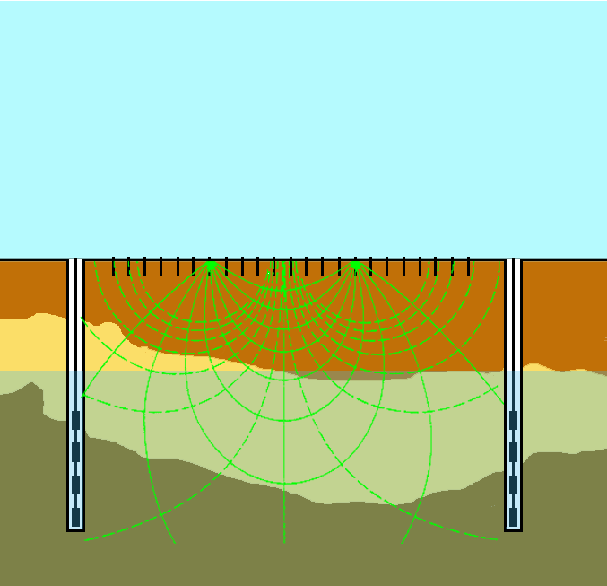
Definition
Study the lateral, vertical and temporal variations of electrical properties of the subsurface using the injection of a DC current
I > 5-10 mA
Notes:
Corps conducteur concentrent le courant, corps résistif inverse.

Slide 24
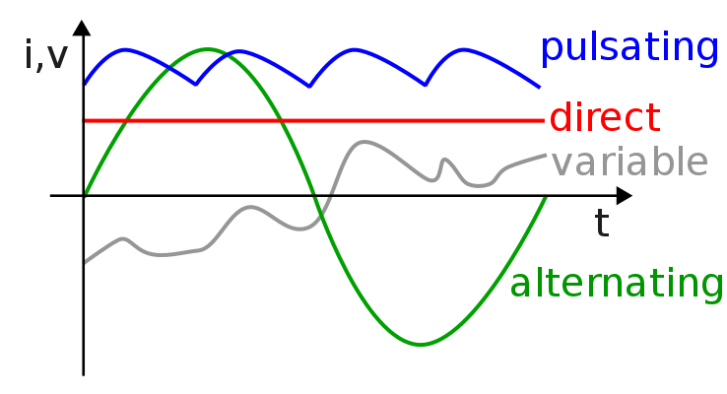
Direct current?

Slide 25
In practice: semi-DC

Slide 26
Principles
Charge transport
Charge polarisation
Resistivity
SP
IP
EM induction
GPR
10⁰ 10¹ 10² 10³ 10⁴ 10⁵ 10⁶ 10⁷ 10⁸ 10⁹ Hertz
Electrical resistivity
Spontaneous potential
Induced polarisation
Complex resistivity

Slide 27
History
Four electrode systems (early 20th century)
Multi-electrode systems with multiplexer (1990)
Multi-channel systems (2000)
Hybrid systems (2010)
  Wireless
  Multi current injection
Parallel development:
better IP measurement, increased autonomous capabilities, emphasis on monitoring, better inverse codes
Notes:
Ask public about multi-channel systems:
•Standard system measures one set of potentials
•Multi-channel system measures multiple potentials for one current injection
•Typical systems have 8-12 channels
Why?
•Speeds up acquisition
•Speed increase dependent on array geometry and reciprocity need
•Highest speed increase is maximum number of channels

Slide 28
Basics: current conduction

Slide 29
Conduction of electrical current? Types of materials?

Slide 30
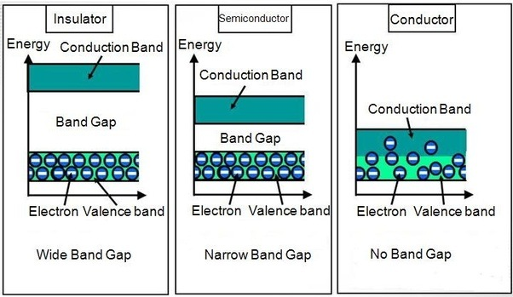
Conduction of electrical current? Types of materials?
Conductors Semi-conductors Insulators
Metals E.g. silicon E.g. diamond
Free electrons Exchange of Atomic bond
Dissolved salts electrons, Lattice Salt crystals
Free ions structure, defect Ionic bond
«electron» holes

Slide 31
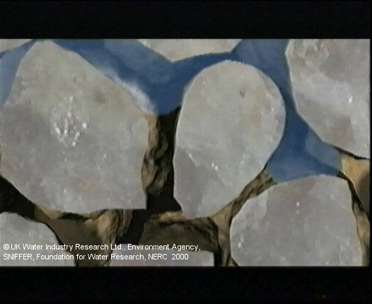
What conducts electricity in rocks?
Material Conductivity in Sm⁻¹
Conductor (> 10⁵)
High number of free electrons
Semi-conductor (10⁵ > σ > 10⁻⁸)
Energetic barrier slightly superior to available energy by thermal activity at ambiant temperature
Isolator (< 10⁻⁸)
Energetic barrier high, forbidding the electrons to act as charge carrier
Electrolytes
Free ions in solution
fluid
Grains
Pores

Slide 32
Minerals
Conductors (Native metals; Cu, Au, C): 10⁻⁸ – 10⁻⁵ Ohm.m
Semi-conductors ( Sulfides; pyrite, galena; Oxides; hematite): 10⁻⁶ – 10⁻¹¹ Ohm.m
Isolators (Silicates; quartz; carbonates; calcite): >10⁹ Ohm.m
Isolators (Non native metals; diamond): >10⁷ Ohm.m
Rare
Main rock forming minerals
Rare
Impurities cause variations (ex. Pyrite 10⁻⁶ – 10² Ohm.m)
Function of the temperature
Metallic conduction → Temperature ↑ Conductivity ↓
Semi-conduction → Temperature ↑ Conductivity ↑

Slide 33
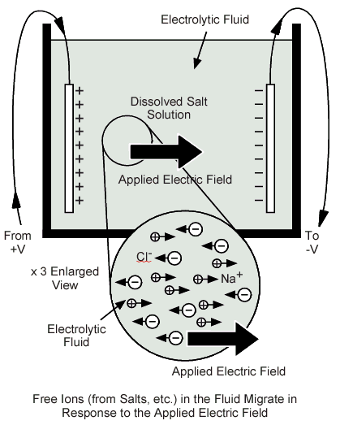
Fluids filling pores
Gas and oil:
non conductors (air, 10¹⁴ Ohm.m; hydrocarbons, 10⁹ – 10¹⁶ Ohm.m)
Acqueous solution :
ionic conductor (electrolyte)
- Concentration
- Charge, mobility, hydratation
- Temperature
- Interactions
Notes:
Ce qui va conducter principalement c’est le fluides entre les graines.
Attention: hydrocarbures: normalement très résistif, mais activité microbienne très important ce qui peut resulter en un signal très conducteur.

Slide 34
Acqueous solution
Water | ρ (Ω.m)
Pure | 2.80 E+05
In igneous rocks | 0.5 - 150
In sedimentary rocks | 1 - 100
Sea water | 2.00 E-01
Sea water 3% | 1.50 E-01
Sea water 20% | 5.00 E-02
Total dissolved content
(K+, Cl- or Na+)
increases water EC
T ↑ → Electrical conductivity ↑

Slide 35
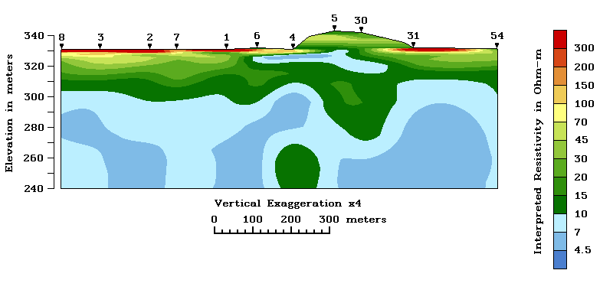
Plume with higher salinity can be detected with ERT …
Notes:
Message of this slide?? Titre?

Slide 36
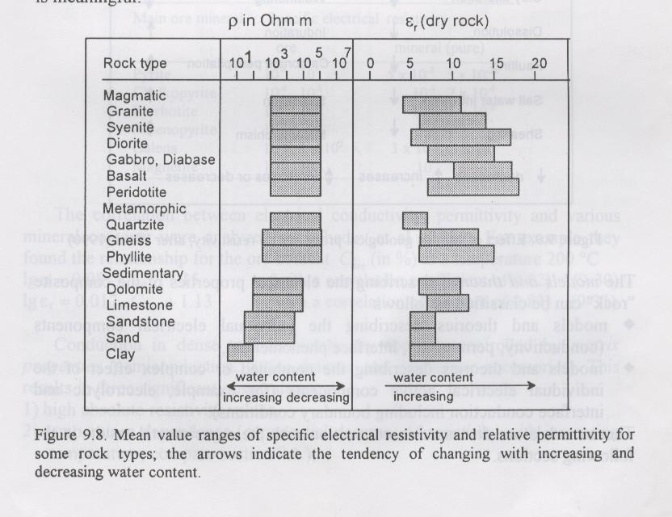
Ranges of electrical signatures
„…mixing water with geological materials is the greatest cause of variation in the electrical behaviour of rocks…“
Magmatic (ρ >>) metamorphic (ρ >) Sedimentary (ρ <<)
But with water and geological processes → overlap
➔ Discrimination between lithologies difficult
Notes:
Il y a des contrastes énormes naturelles. Par contre pour une seul valeur de résistivité il y a une multitude de matériaux qui peuvent le causer… Il faut donc dans des sites pollué bien comprendre le signal de la géologie (en dehors du site par exemple) pour pouvoir distinguer ou intervient la pollution sur le site.

Slide 37
Electrical conductivity of rocks
Mechanisms?
Electrolytic conduction
Surface conduction
Metallic conduction or electronic semi-conduction
fluid
Grains
e⁻
Pores
Notes:
Minérale argilleux: sur le bord: charge minérale => double couche éléctrique => agit comme un chemin parallèle de conduction = conduction de surface

Slide 38
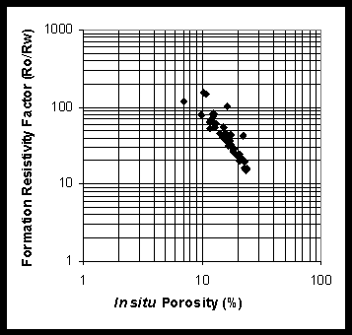
Porous media without surface conduction
Archie‘s petrophysical law (1942):
The EC of the rock is proportional to the cond. of the electrolyte
The formation factor F represents the effect of the matrix (lowers the elec. cond.)
In saturated media S_{w} =1
Allows to link bulk EC and the porosity (if the fluid EC is known)
Empirical but widely used
Notes:
Voici de nouveau ce facteur F (facteur de formation). Aussi lié à la porosité.
Valide pour un cas ou il n’y a pas d’argile.
R0 = bulk, Rw = water

Slide 39
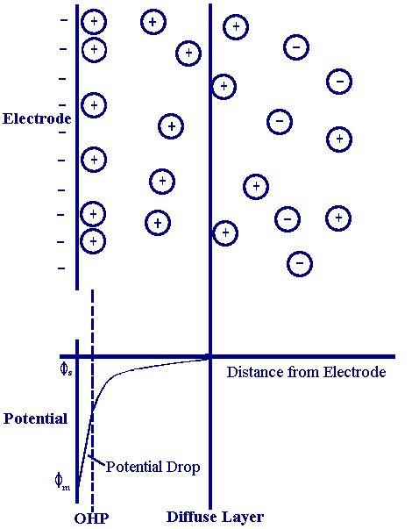
Porous media with surface conduction
At the grain-fluid interface: electrical double layer.
Negative surface charges attract cations. An equilibrium between the diffusion forces and the electrical attraction forces is reached.
Close to the surface ↑ ions concentration: parallel path for electrical conductivity.
Clay
Surface conductivity also exist in clay-free rocks
Notes:
Pour le cas ou il y a de l’argile

Slide 40
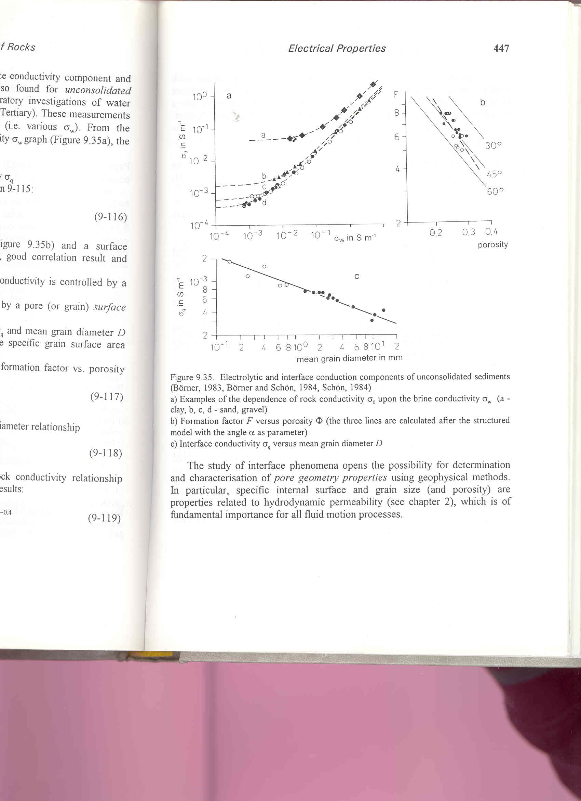
Surface conduction : rises start σ level
Clay
σ_{s} in S.m⁻¹
Gravels, sands
σ_{w} in S.m⁻¹

Slide 41






Consequence: from resistivity to variable of interest can be complex!
pore water composition
soil structure
resistance
electrical resistivity
?
soil moisture
R
ρ
temperature

Slide 42
Basics: measurement principles

Slide 43
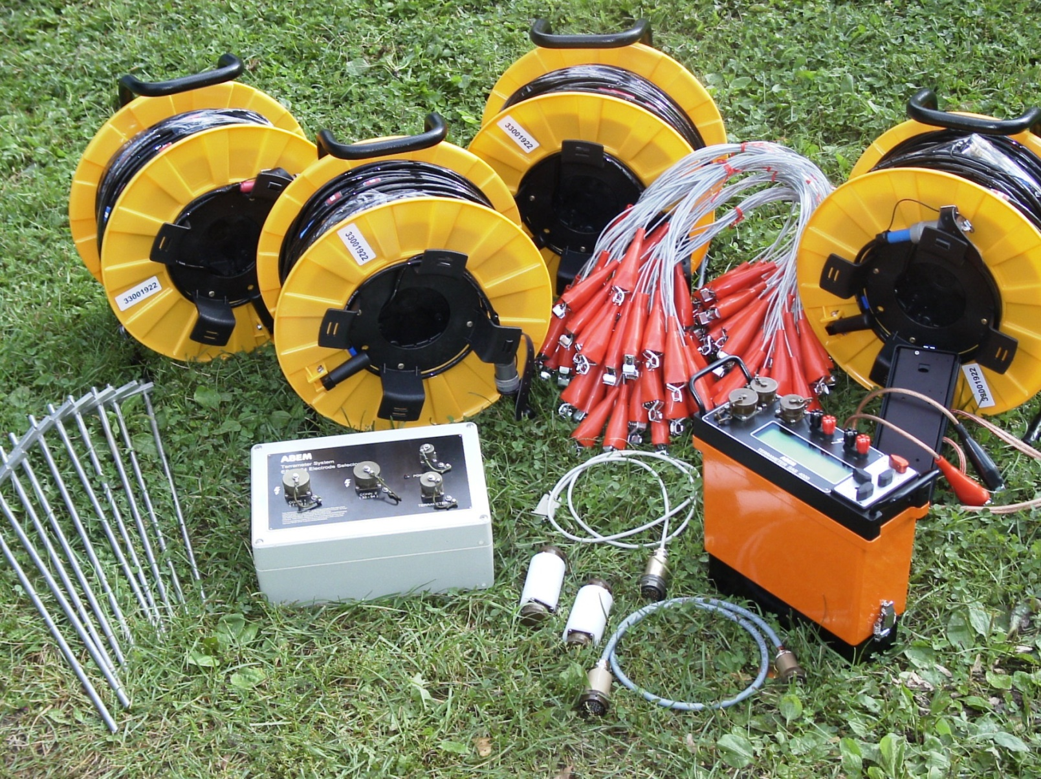
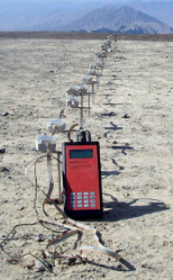
Instrumentation: some examples
ABEM
Lippmann
4-point light
MPT-DAS

Slide 44
Resistivity meter
Current sources: 12V batteries
Specifications | RM (archeol.) | RM (geol.)
Output current | 0.1-10 mA | 1-200 mA
Output voltage | 50V max | 200V max
Frequency | 0.1-150 Hz | DC/100 Hz max
Potential range | 20-200-2000 mV | 20-200-2000 mV
Resolution: 1mV
Accuracy: <1%
Notes:
L’ordre de grandeur de prix pour faire faire une tomographie : 2000 euros
Source du tableau?
=> In small soil column you do not need the same current magnitude as in field soil!! All depends on materials, DOI and noise levels.

Slide 45
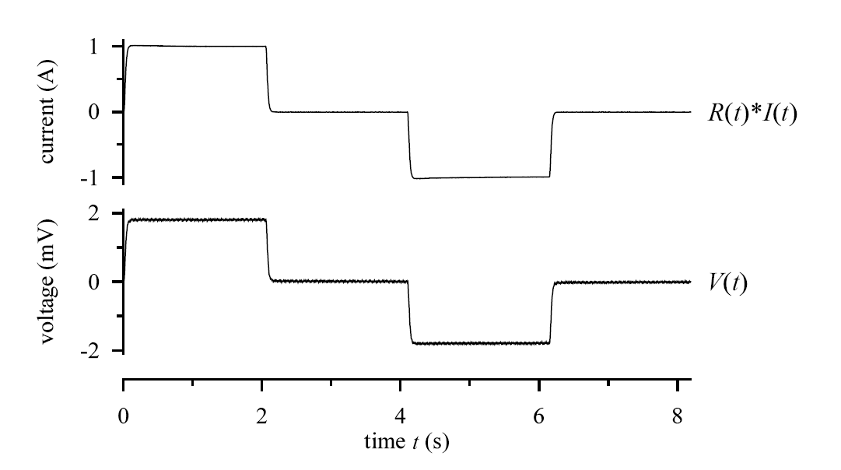
DC current injection
Notes:
On est de l’ordre de quelques mV

Slide 46
From potential to resistance: Ohm’s law
! Resistance & resistivity
s
dL
Notes:
Resistance dépend de la taille et géométre de l’objet ou le courant passe. La résistivité pas.

Slide 47
I
current
flow lines
Current density:
Electrical field:
Potential/Voltage:
equi-potential
surface
- at any spherical surface S at distance r from origin, current I flows radially
- surface area is 2p r² (half sphere) current density at distance r is

Slide 48
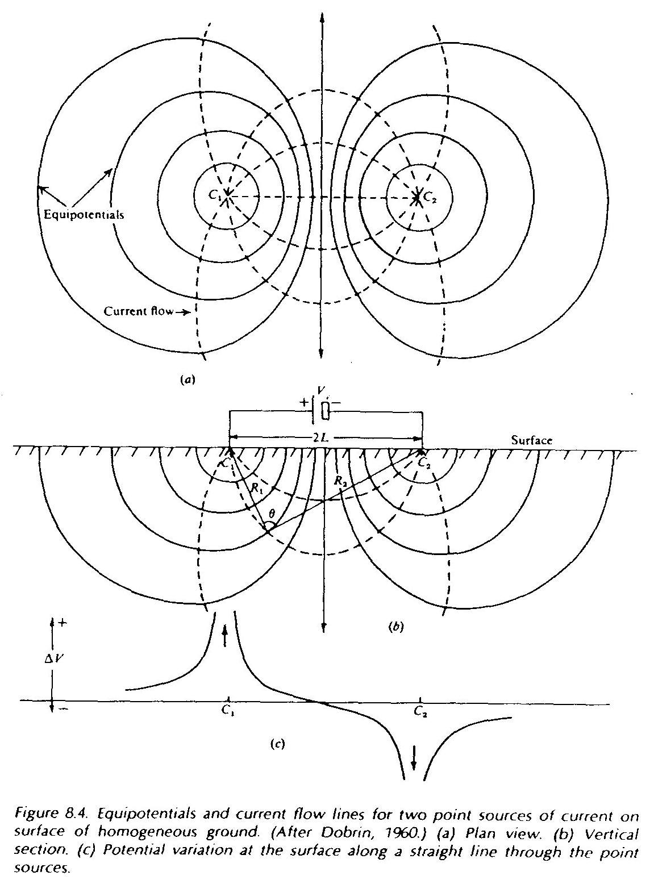
Principle of superposition
To compute the potential due to several electrodes, we use the principle of superposition.
Notes:
Si on s’éloigne de la source, on diminue le signal par 1/r.
On peut avoir des effets 3D qui viennent perturber l’image 2D. Sera discuté par après.
Equipotentials and current flow lines for two point sources of current on surface of homogeneous ground. (a) plan view, (b) vertical section, © potential variation at the surface along a straight line through the point sources.

Slide 49
Potential difference in a four-electrode setup
with: r₃ distance N - A, r₄ distance N- B (sign!)

Slide 50
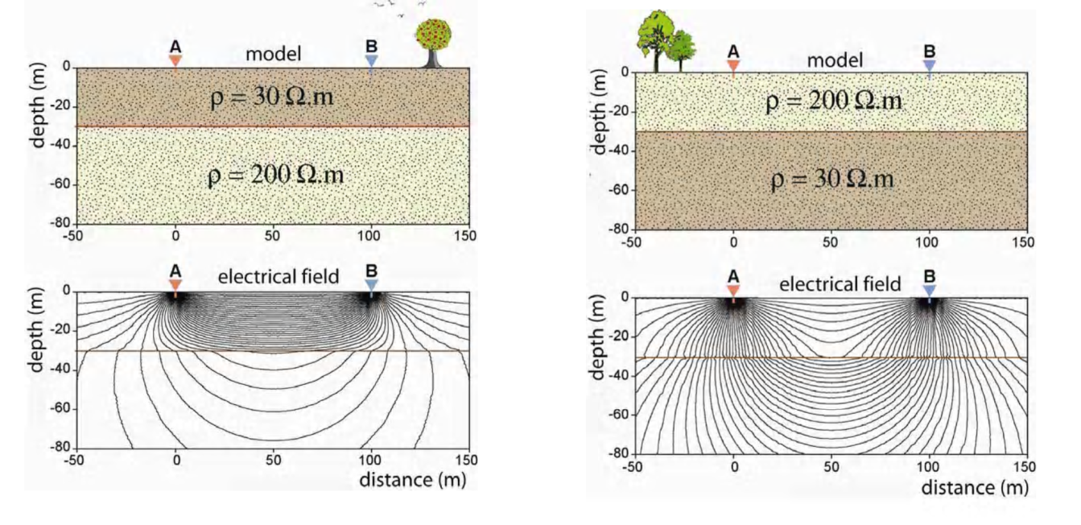
Heterogenous media
For a horizontal stratification
Current lines
Notes:
Profondeur d’investigation dépend de la distribution de la resistivité électrique du milieu investigé.

Slide 51
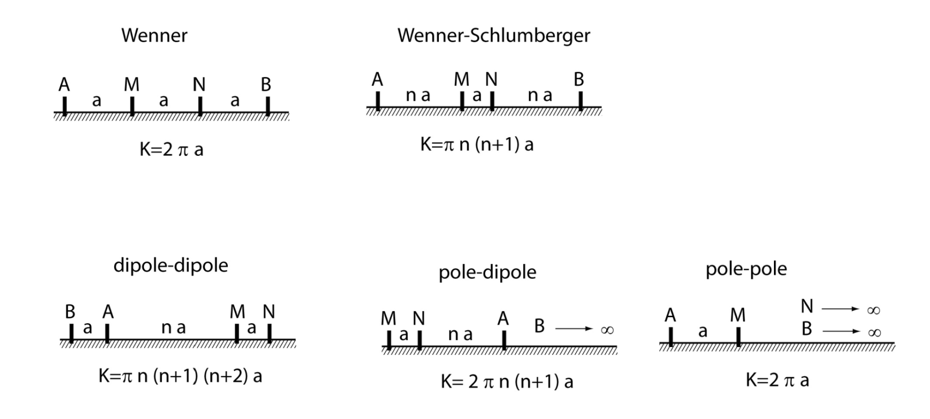
Electrode configuration and geometric factor
This is the APPARENT electrical resistivity

Slide 52
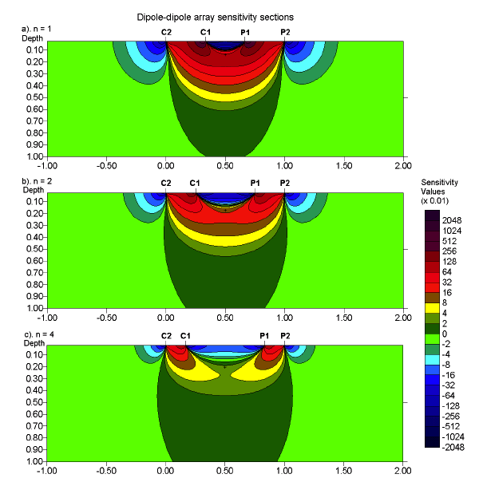
Dipole-dipole array sensitivity

Slide 53
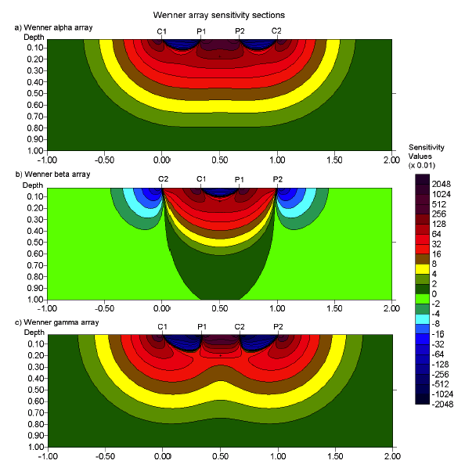
Wenner array sensitivity

Slide 54
Basics: measurement modes

Slide 55
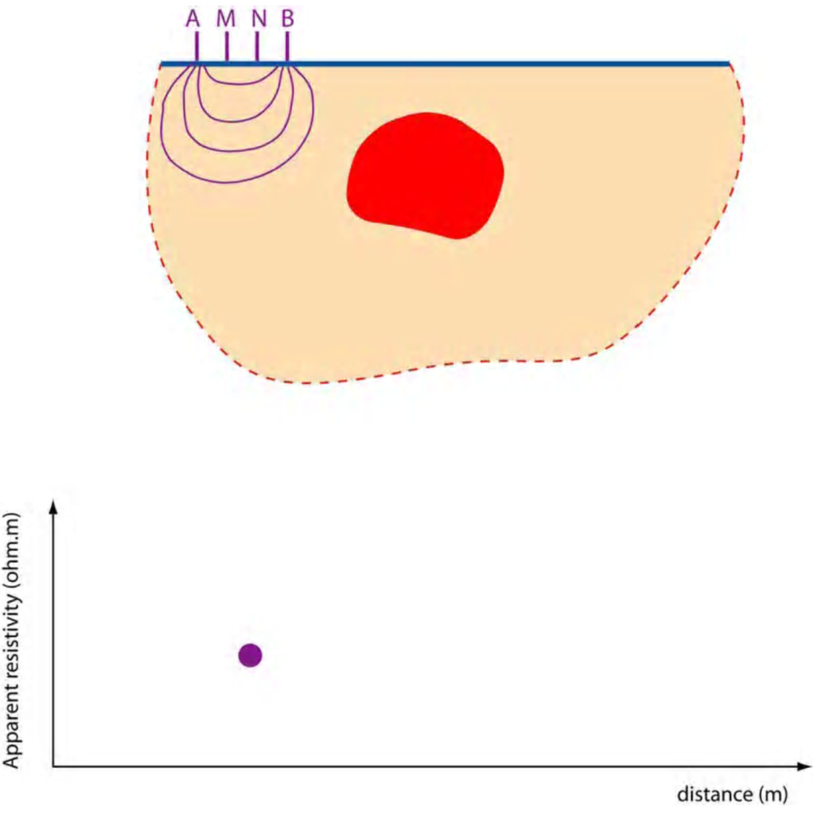
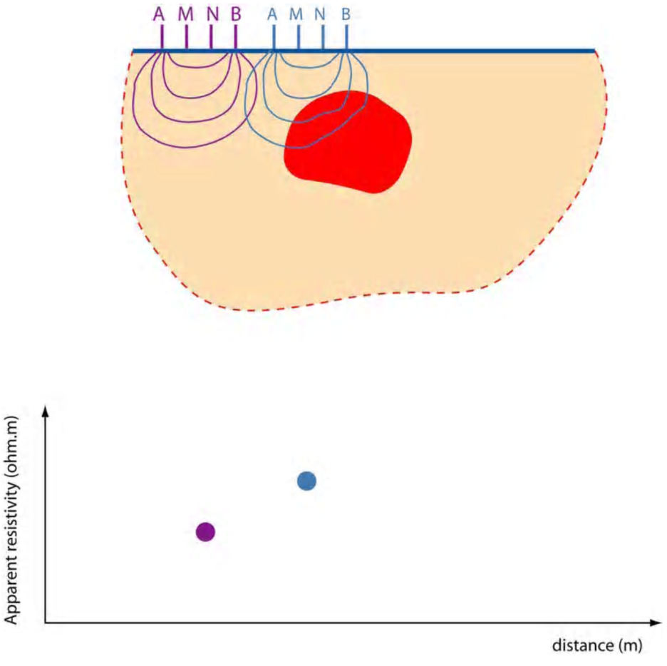
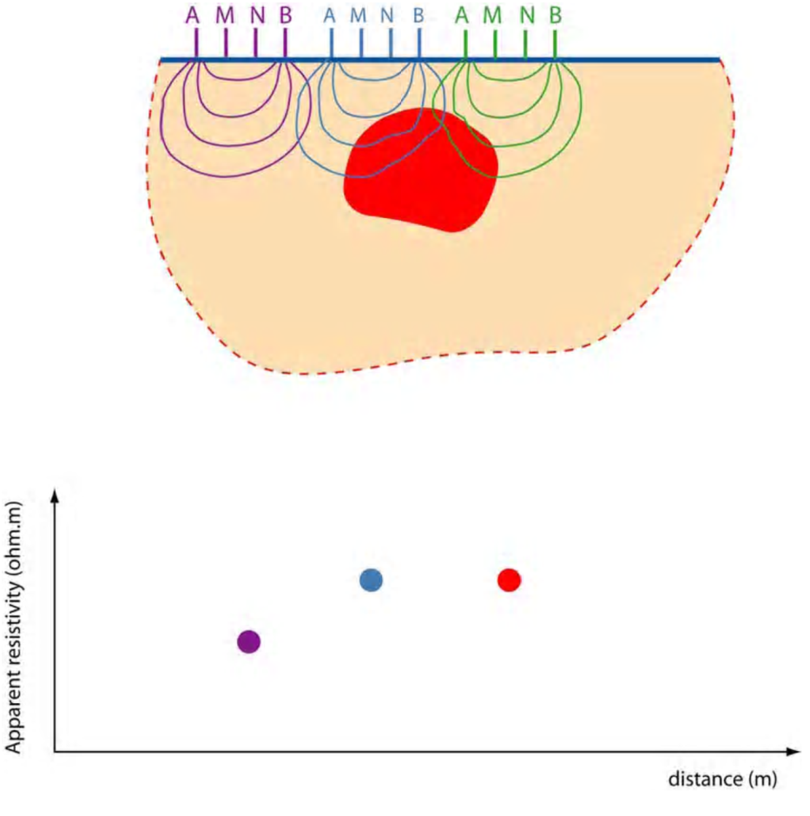
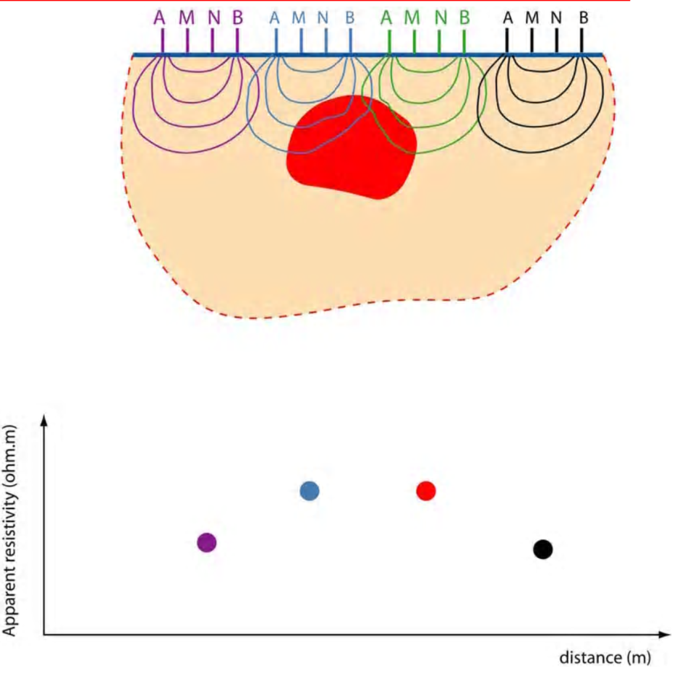
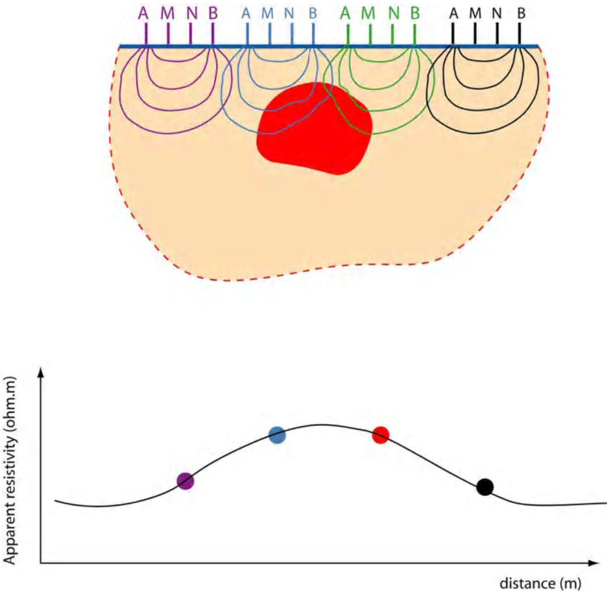
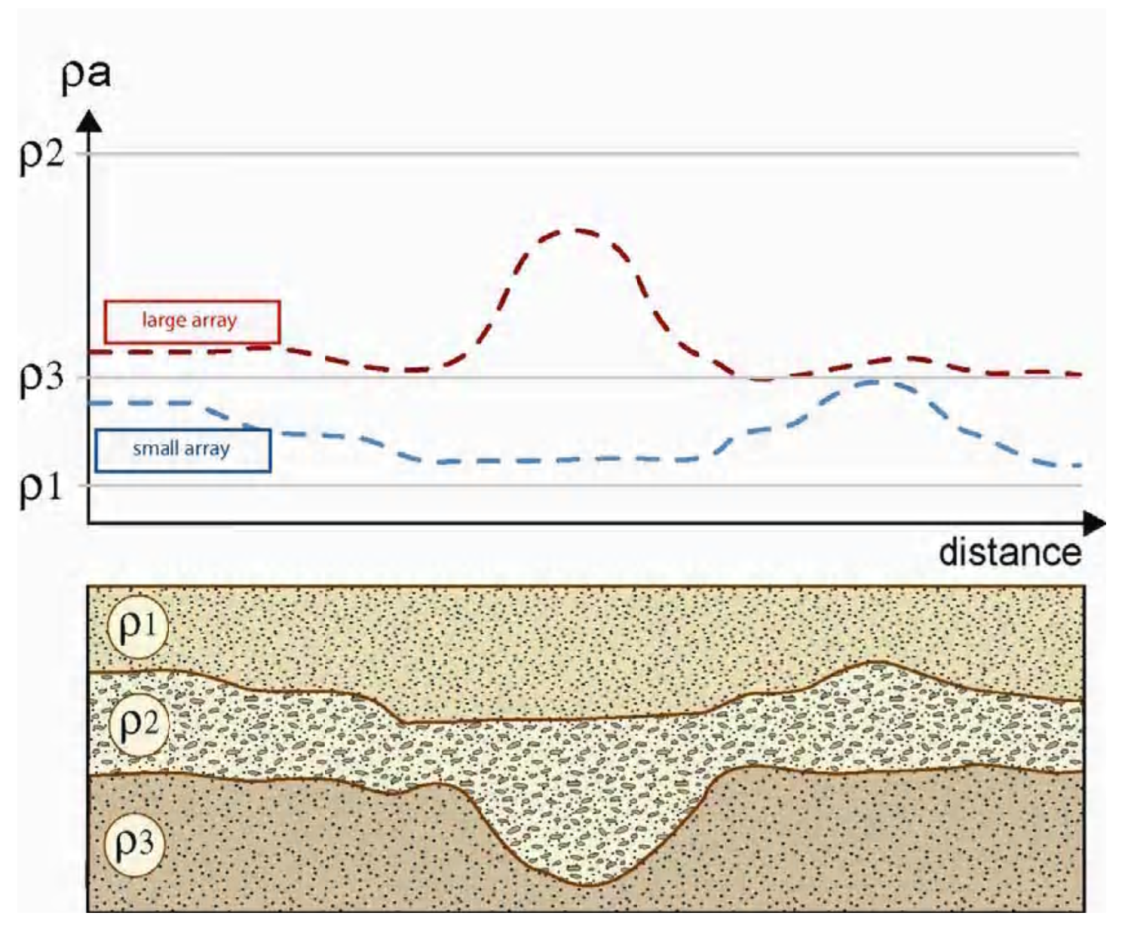
Electrical profile

Slide 56
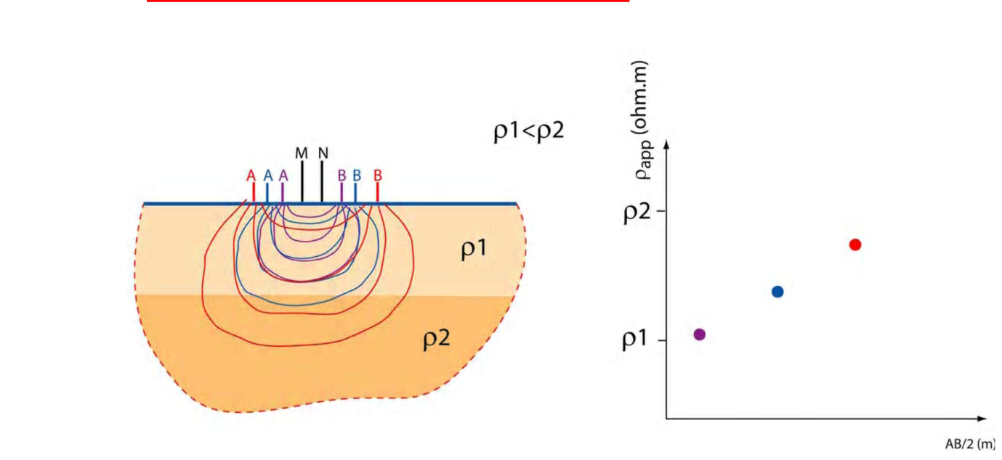
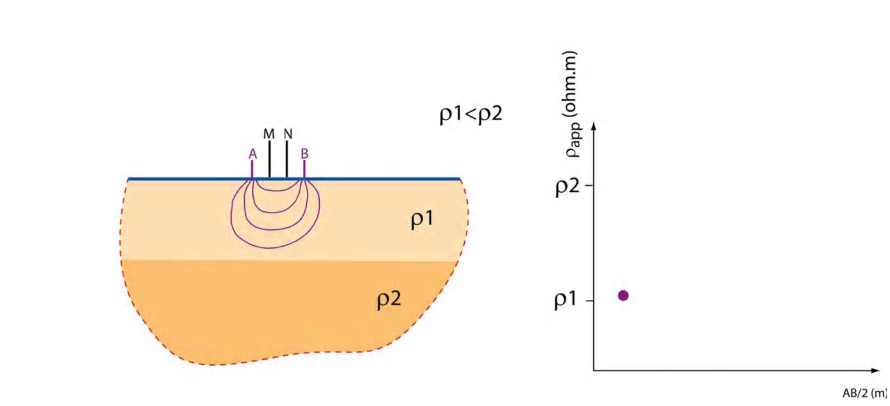
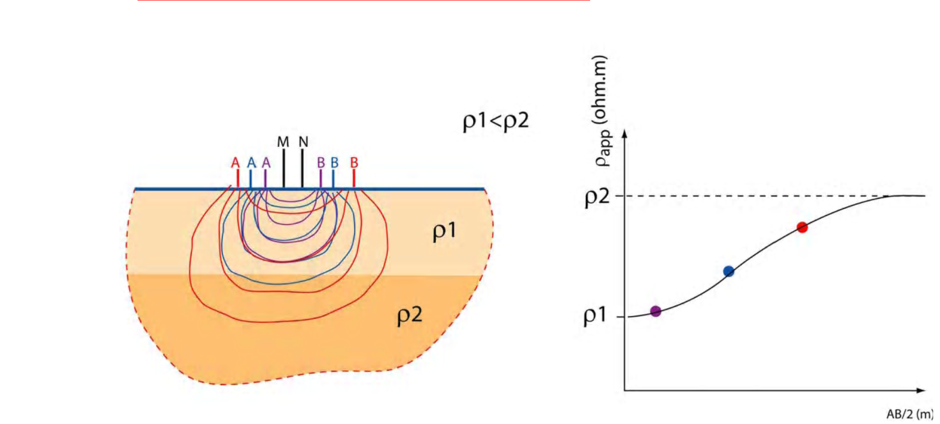
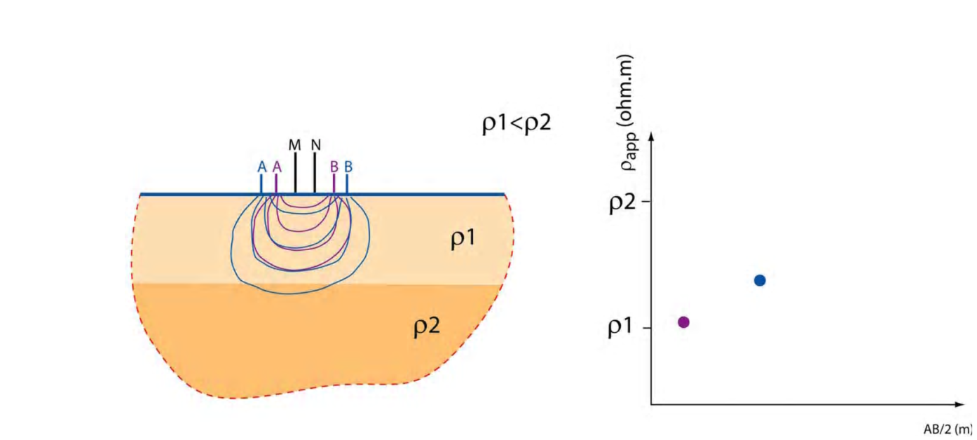
Electrical sounding

Slide 57
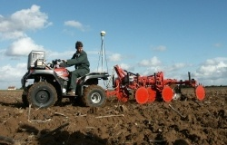
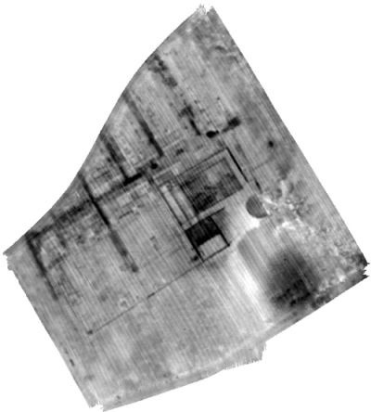
Mapping systems

Slide 58
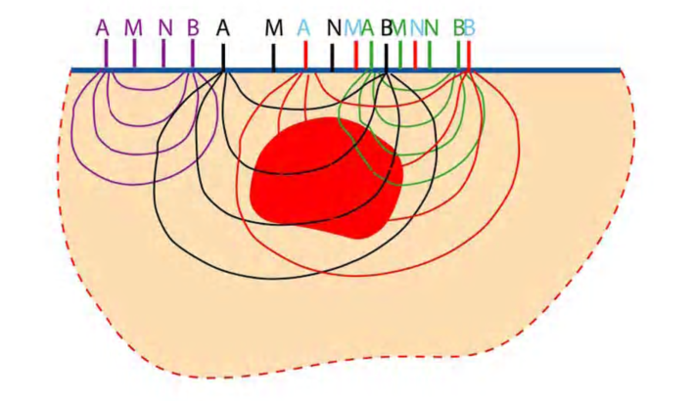


Electrical resistivity tomography

Slide 59



Tomography
Notes:
Enlever HCl et le mettre en solution va augmenter la conductivité.
Ceci vient d’ou??

Slide 60
Inversion

Slide 61

What exactly is the problem?
The vertical axis represents the measurement distance n, NOT the real depth.
Pseudosection of dipole-dipole data
a: distance between current and between potential electrodes (a=2m)
n.a: distance between the second current electrode and the first potential electrode (n = 4)

Slide 62

When the substrate is homogeneous, the apparent resistivity is a good approximation for the real resistivity and can be directly interpreted.
In reality, this is almost never the case

Slide 63


Slide 64


Sensitivity and pseudosection DIPOLE-DIPOLE
Conductive body
Resistive body
Animations produced by Florian Wagner (UniBonn) using PyGimli and Matplotlib

Slide 65

So what is the solution?

Slide 66

Tomography
We have a series of measurements at different electrode distances and distances between current and potential dipoles generating information on different measurement volumes.
➔ Collection of ‘blocks’ with a certain resistance
➔ But we want to obtain a distribution of the real resistivity

Slide 67


Geophysical inversion

Slide 68

Geophysical inversion

Slide 69

Geophysical inversion

Slide 70
Geophysical inversion
Estimation of the stratigraphy and physical properties of the substrate
FORWARD MODEL
+ Ohms and Laplaces law
+ Known electrode array
SYNTHETIC DATA
Simulated measurements for the chosen array
REAL DATA
Real experimental ERT data
correspondance?!
x iterations

Slide 71

Geophysical inversion

Slide 72

Geophysical inversion: mathematical expressions
ɸ_{d} = data functional
ɸ_{m} = model functional
λ = regularisation parameter
Notes:
Explain what epsilon is…
Wd Constraint matrix: The weigthts of gradient matrices in all directions will determine whether lateral or vertical model changes are enforced. the selection of the regularization parameter with respect to the data quality and the definition of image appraisal indicators still remains a challenge. Uncertainty quantification of ERT-derived results often relies on data-error propagation around the inverse solution. Given the inherent non-uniqueness of the problem, both mathematically but also from a pedological point of view, challenges for stochastic approaches lie in providing realistic uncertainty estimation, encompassing all uncertainties (e.g. prior, pedophysics or data error).

Slide 73

Geophysical inversion: mathematical expressions
m = model vector
d = data vector
W_{d} = data weighting matrix
f = forward model
ε_{i} = error
ɸ_{d} = data functional
ɸ_{m} = model functional
λ = regularisation parameter
m = model, m⁰=reference model
W_{m} = model constraint matrix
Notes:
Explain what epsilon is…
Wd Constraint matrix: The weigthts of gradient matrices in all directions will determine whether lateral or vertical model changes are enforced. the selection of the regularization parameter with respect to the data quality and the definition of image appraisal indicators still remains a challenge. Uncertainty quantification of ERT-derived results often relies on data-error propagation around the inverse solution. Given the inherent non-uniqueness of the problem, both mathematically but also from a pedological point of view, challenges for stochastic approaches lie in providing realistic uncertainty estimation, encompassing all uncertainties (e.g. prior, pedophysics or data error).
In the inversion, log 10-transformed resistances are used as data d and log 10-transformed resistivity (of lumped finite-element cells)
as parameters m to account for the typically large range of resistivity values for soil

Slide 74

ERROR ESTIMATION: RECIPROCAL ERROR
Systematic component
Random component
Error ε
Hermans et al. (2012)
Notes:
Injection of heated water => colours: timesteps after injection
Error model equation: slater et al 2000

Slide 75
ERROR ESTIMATION: ERROR MODEL
Hermans et al. (2012)
Notes:
Injection of heated water => colours: timesteps after injection
Error model equation: slater et al 2000

Slide 76
Geophysical inversion: mathematical expressions
m = model vector
d = data vector
W_{d} = data weighting matrix
f = forward model
ε_{i} = error
ɸ_{d} = data functional
ɸ_{m} = model functional
λ = regularisation parameter
m = model, m⁰=reference model
W_{m} = model constraint matrix
Notes:
Explain what epsilon is…
Wd Constraint matrix: The weigthts of gradient matrices in all directions will determine whether lateral or vertical model changes are enforced. the selection of the regularization parameter with respect to the data quality and the definition of image appraisal indicators still remains a challenge. Uncertainty quantification of ERT-derived results often relies on data-error propagation around the inverse solution. Given the inherent non-uniqueness of the problem, both mathematically but also from a pedological point of view, challenges for stochastic approaches lie in providing realistic uncertainty estimation, encompassing all uncertainties (e.g. prior, pedophysics or data error).

Slide 77

SPATIAL DISTRIBUTION: model constraints
  Smoothness constraint inversion (de Groot-Hedlin and Constable, 1990)
Maloteau et al. (under review)

Slide 78
DIFFERENT TYPES OF MODEL CONSTRAINTS POSSIBLE
Saltwater intrusion in dune area
  Caterina et al., 2014
Notes:
Type of constraints possible:
Smoothness constraint inversion (de Groot-Hedlin and Constable, 1990)
Blocky inversion (Farquharson and Oldenburg, 1998)
Structural inversion (Doetsch et al., 2012)
Minimum support and gradient support functionals (Blaschek et al., 2008)
Prior incorporation methods(Caterina et al., 2014)

Slide 79
TEMPORAL CHANGES?
Bulk electrical resistivity distribution and differences from reference date
Notes:
Bulk electrical resistivity distribution on 31 May 2016 (t0) and distribution of the differences in resistivity between reference day t0 and 17 June (t1), 19 July (t3), 2 Aug. (t4), 17 Aug. (t5) and 20 Sep.(t6); for the reference zone (E4) and the trees zone (E3).

Slide 80
TIMELAPSE INVERSION
t
Estimation of the stratigraphy and physical properties of the substrate
FORWARD MODEL
+ Ohms and Laplaces law
+ Known electrode array
SYNTHETIC DATA
Simulated measurements for the chosen array
REAL DATA
Real experimental data
correspondance?!
t
x iterations
Notes:
Monitoring data allows further elements to constrain the inverse problems, data can be replaced by data difference and regularization may incorporate the temporal dimension for instance.
However, such constraints require their compatibility with the studied temporal process. Whereas the above challenges stay true for monitoring data, several alternative strategies are being developed more specifically, such as coupled hydrogeophysical inversion, with the challenge of addressing the non-stationarity of pedophysical relationships and the accuracy of the conceptual flow and transport model using deterministic approaches. Stochastic approaches allow to a certain extent to tackle those challenges in particular using a prior falsification/validation approach following a Popper-Bayes philosophy.

Slide 81

TIMELAPSE INVERSION: MAIN METHODOLOGIES
- Individual inversion of single time frames and substraction (Ramirez and Lytle, 1986)
$$dn=\left\{logρ_{a}^{n}\right\}\overset{→}{so that }mn= ρn$$
- Inversion of data ratios (Schütze et al., 2002)
$$dn=\left\{{ρ_{a}^{n}}/{ρ_{a}^{0}}\right\}\overset{→}{so that}mn=\left\{{ρ_{}^{n}}/{ρ_{}^{0}}\right\}$$
- Difference inversion, which additionally corrects the misfit at t₀
$\overset{→}{so that}dn=\left\{{ρ_{a}^{n}}/{ρ_{a}^{0}}\right\}f(m0)$ (or n-1 in stead of 0) (Labrecque and Yang, 2001)
- Fully discretized (4D) inversion with constraints in space and time (Kim et al., 2009)
$$dn=\left\{ρ1, ρ2,…,ρn\right\}\overset{→}{so that}mn=\left\{m1,m2, …mn\right\}$$
Notes:
For time-lapse imaging, LaBrecque and Yang (2001) demonstrate that the data-differences inversion method allows reducing
the effect of systematic error present in the data, which cancels out by subtraction. ERT measurements typically present a better repeatability
compared with the data value accuracy, expressly when electrodes are set up at the beginning of the experiment and remain in place during monitoring (LaBrecque and Yang, 2001).
Labrecque’s method is generally the safe choice, but could decrease resolution in case of neglibible systematic errors.
Reference model inversion is very flexible, because no unnecessary reduction of measurements because always the same quadrupoles have to appear.
Ratio inversion can yield problems due to wrong sensitivity matrix.

Slide 82

TIMELAPSE INVERSION: DIFFERENCE INVERSION
- Individual inversion of single time frames and substraction
- Inversion of data ratios
- Difference inversion, which additionally corrects the misfit at t₀
$\overset{→}{so that}dn=\left\{{ρ_{a}^{n}}/{ρ_{a}^{0}}\right\}f(m0)$ (or n-1 in stead of 0)
- Fully discretized (4D) inversion with constraints in space & time
Notes:
Labrecque’s method is generally the safe choice, but could decrease resolution in case of neglibible systematic errors.
Reference model inversion is very flexible, because no unnecessary reduction of measurements because always the same quadrupoles have to appear.
Ratio inversion can yield problems due to wrong sensitivity matrix.

Slide 83


STATIC INVERSION DIFFERENCE INVERSION
Data functional:
or m^{i} in stead of m⁰
Model functional:

Slide 84

TIMELAPSE INVERSION: DATA WEIGHTING MATRIX
Estimation of the error level!
Notes:
Data functional: Wd: error weighting of the data set => different ways to do that
Model functional: For the inversion of time-lapse data sets a time-lapse regularization term can be used. Such approach attempts to reduce the weighting in the inversion from the data noise characterization and to add consistency in the computed solution, by searching for models with defined spatiotemporal variations (i.e., regularization). The equation can define spatial smoothness constraint (𝛼=0,𝑚_(0,𝑠𝑝𝑎𝑐𝑒)=0), reference model constraint with spatial smoothness constraint on the model changes (𝛼≠0,𝑚_(0,𝑠𝑝𝑎𝑐𝑒)=𝑚_(0,𝑡𝑖𝑚𝑒)≠0) or without it (𝛼≠0,𝑚_(0,𝑡𝑖𝑚𝑒)≠0,𝑚_(0,𝑠𝑝𝑎𝑐𝑒)=0).

Slide 85

Example: Error-weighting in TL approaches
Background image
TL differences
Slater et al., 2000
Lesparre et al., 2017
Notes:
Furthermore, classical data error estimation
procedures using reciprocal measurements are not adapted
to the time-lapse measurement scheme. For instance, data with large
geometric factors are characterized by low signal-to-noise ratio and
often associated with larger weights because the classical error model
applied for background inversion presents an increase of the error
level with increasing resistances (Slater et al., 2000). Hence, the difference
inversion with classic error estimation procedure typically
leads a reduced influence of such measurements, or a severe smoothing
in the concerned sensitive regions. To improve the difference inversion
scheme, an adequate fitting to the data differences and their
associated error needs to be performed for weighting adequately the
data in the inversion.

Slide 86
Example: Error-weighting in TL approaches (2)
24h
71h
144h
Lesparre et al., 2017
Notes:
il y a plusieurs modèles de bruits qui ont été appliqués aux figures illustrant 3 inversions TL avec ces modèles de bruit.
L'idée c'est de montrer que l'on cherche des variations de quelques % à quelques dizaines de % donc il est important de pondérer correctement les données pour favoriser celles qui sont le moins susceptibles d'être erratiques.
L'exemple des différents résultats d'inversion montre que si le modèle sur-estime l'erreur (courbe pointillée constante), on a une image trop lissée, on ne voit rien...
si le modèle sous-estime l'erreur (courbe tiret-point la plus basse), on a une image pleine d'artefacts, on ne distingue rien non plus...
avec un modèle "correct" (courbe pleine intermédiaire) on distingue bien le panache d'eau chaude en bleu-> réduction de la résistivité ; et la zone de baisse de saturation en rouge (il a plu avant les mesures de background puis le milieu s'est déssaturé en proche surface) -> augmentation de la résistivité au-dessus de la nappe à environ 2m de profondeur...
Tout l'art étant ensuite de trouver ce modèle "correct" ;)

Slide 87
Summary ERT
Advantages
Disadvantages
Simple and robust
Great variability of the electrical resistivity
Not expensive
Sensitive to water content, salinity
Mapping
Depth resolution
Tomography routinely performed
Non-uniqueness
Geological overlap
Inversion is not a push-button process

Slide 88
Case-study discussion

