Slide 1
One Resource Sharing Library to Rule them All
Fabienne Prosmans, François Renaville
http://hdl.handle.net/2268/227174

Slide 2
Abstract
The University of Liège has five libraries, composed of 16 branches spread over 4 campuses. Prior to "go live" with Alma, the interlibrary loan service was processed using a powerful in-house solution developed with APIs. When we went live in February 2015, we decided to manage resource sharing requests in Alma. At first, one site per library was designated as resource sharing library to fulfill discipline-related requests. At the beginning of 2018, we decided to reorganize and centralize our interlibrary loan service. To do this, we have been using the default Resource Sharing library in Alma that is only used for resource sharing and we have deactivated our five resource sharing libraries. This presentation will explain the configuration and workflows set up at the University of Liège, the benefits we found in managing resource sharing in Alma and then centralizing the service. It will also outline our future projects and developments considered for our interlibrary loan service.

Slide 3
Agenda
About us
Prior to go live with Alma
In Alma: step 1
5 Resource Sharing Libraries
In Alma: step 2
1 Resource Sharing Library
Future projects and developments

Slide 4
About us

Slide 5
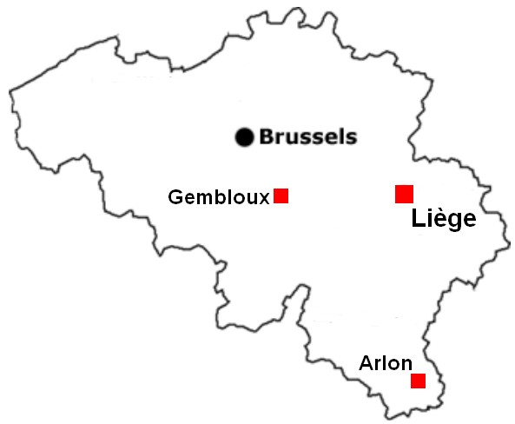
University of Liège Library
5 main libraries
composed of 16 branches
spread on 4 campuses in 3 cities
30,000 users
24,000 students
3,000 professors and researchers
3,000 external users

Slide 6
Resource Sharing at the University of Liège
3,500 borrowing requests/year
Two main platforms used:
Impala (Belgian national ILL service) : 81 %
Subito (German national ILL service) : 16 %
1,500 lending requests/year
One platform used: Impala
Notes:
Impala is the Belgian platform used by more than 600 libraries for resource sharing while Subito is the German platform

Slide 7
Prior to go live with Alma

Slide 8
Prior to go live with Alma
8 libraries
manage ILL services
15 operators

Slide 9
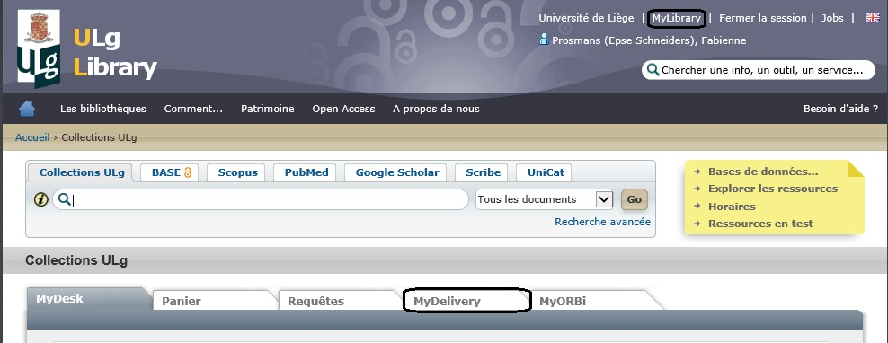
Prior to go live with Alma
ILS = Aleph, no use of the ILL module
Interlibrary Loan service was processed using an in-house solution(MyDelivery) developed with APIs
The form was accessible in Primo MyAccount
Creation, cancellation and tracking options

Slide 10
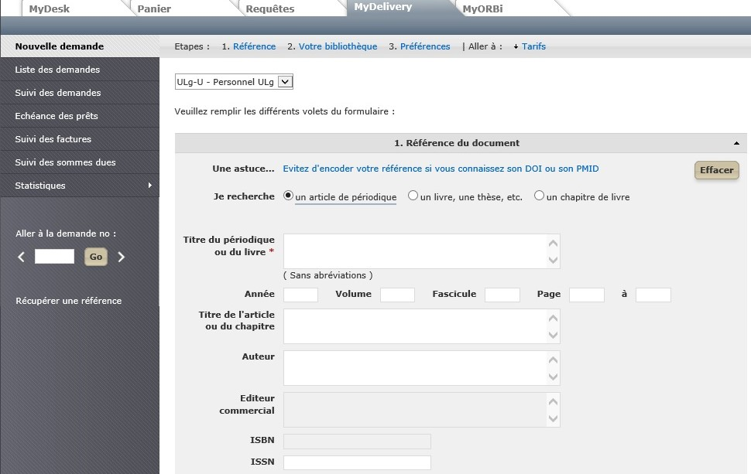
Prior to go live with Alma
MyDelivery form:

Slide 11
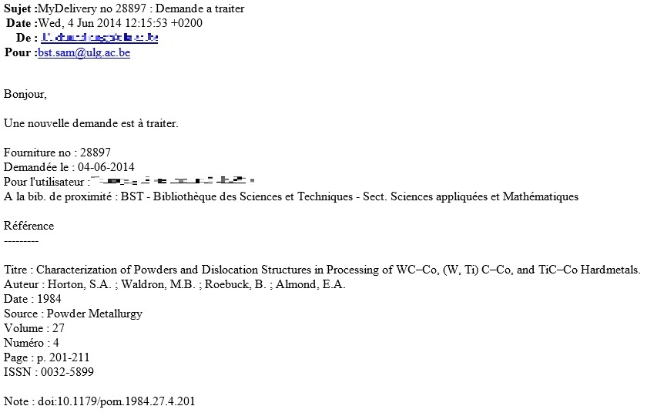
Prior to go live with Alma
Mail received by the ILL operator:
Notes:
- Interlibrary loan operators received an e-mail informing them that a new request had to be processed

Slide 12
In Alma: step 1
5 Resource Sharing Libraries

Slide 13
In Alma: step 1
Go live in February 2015: reduction of the numbers of libraries and operators actively involved in ILL supply
5 libraries
(one by main library)
10 operators
(no FTE!)
manage ILL services
More simplification and standardization
No negative impact noticed on service quality
Large freedom in organization for each RS Library
Service still strongly relying on the library type (STM vs HSS)

Slide 14
Organization
Library A
Operator 1
Operator 2
Library B
Operator 1
Operator 2
Operator 3
Library C
Operator 1
Operator 2
Library D
Operator 1
Library E
Operator 1
Operator 2
Notes:
Large freedom in organization for each RS Library, but also:
Each RS Library saw itself as an independent unit
Very few interaction between operators
Few communication between libraries

Slide 15
Configuration
An existing library is configured as a library that can process interlibrary loan

Slide 16
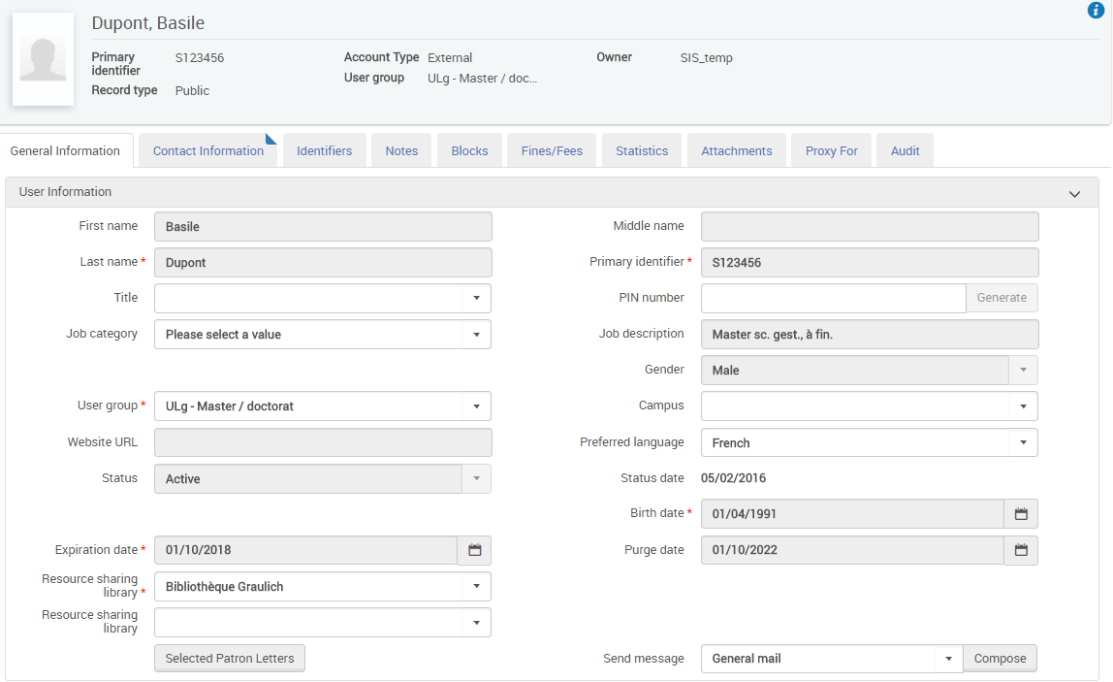
Configuration
The allocation of the Resource Sharing library to users depends on their field of research or studies
Appropriate RS Library assigned with the daily SIS synchronization job
Not always 100% accurate…

Slide 17
Configuration
Two specific locations are created for each RS library:
One for borrowing requests
One for lending requests
Notes:
A physical document that comes from a partner is temporarily located in this location. It receives a temporary barcode. This allows the patron to loan the document
Documents that go to a partner change from location. They leave their original location to be temporarily located in the one created for lending requests

Slide 18
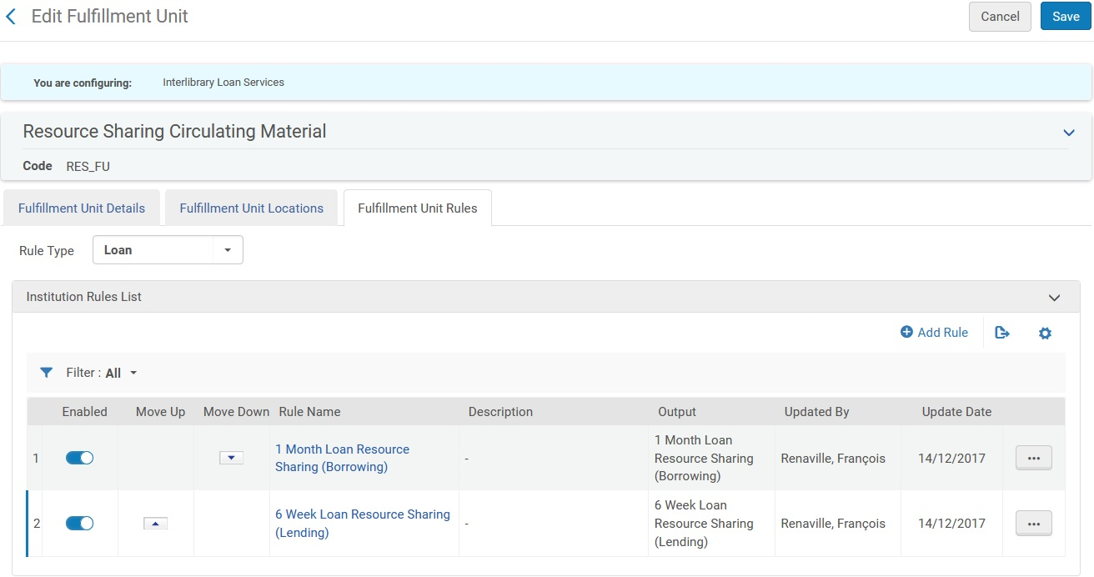
Configuration
One Fulfillment Unit and two Fulfillment Unit Rules (for loan) by library are created (at the library level)
Notes:
- Libraries do not define the same Fulfillment unit rules. Some allow readers to borrow materials from a partner. Others only accept consultation in the reading room

Slide 19
In Alma: partners
Only email profile type
Two workflow profiles are created:
One of borrowing type:
One of lending type:
Notes:
The workflow profile of borrowing type allows staff to manually renew a lending request
The workflow profile of lending type allows staff to manually change the due date for borrowing requests. Users cannot extend RS loans themselves.

Slide 20
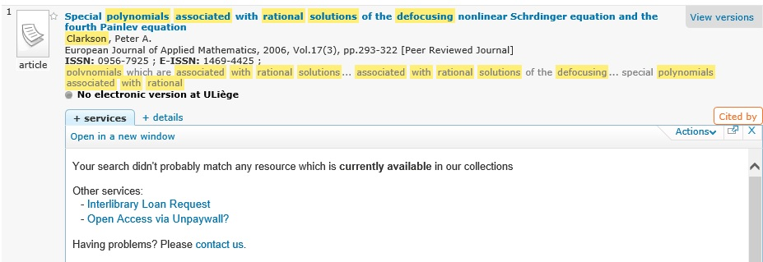
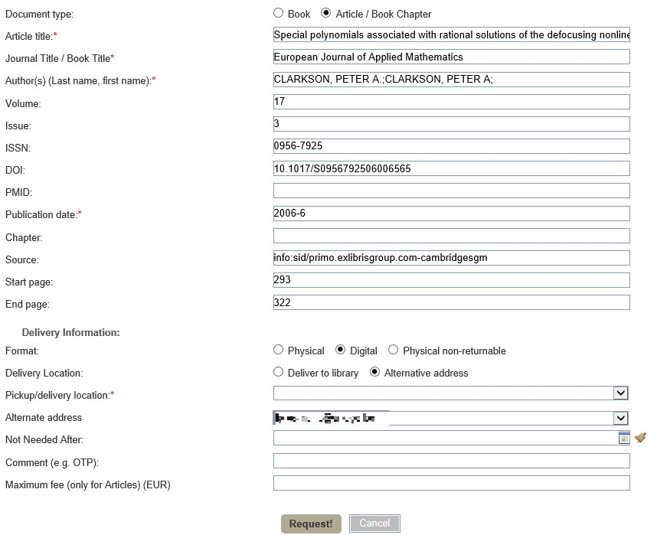
Creation of borrowing requests
In Primo: for a resource not available at ULiège
Notes:
The patron uses the ViewIt or GetIT tab for a PCI record or an unavailable record in Alma. In this case, we use the Ex Libris’s resource sharing form. We have customized this form with the Resource sharing form customization options.
Once the form is submitted, a borrowing request is created in Alma and ILL operators can find it in their task list.

Slide 21
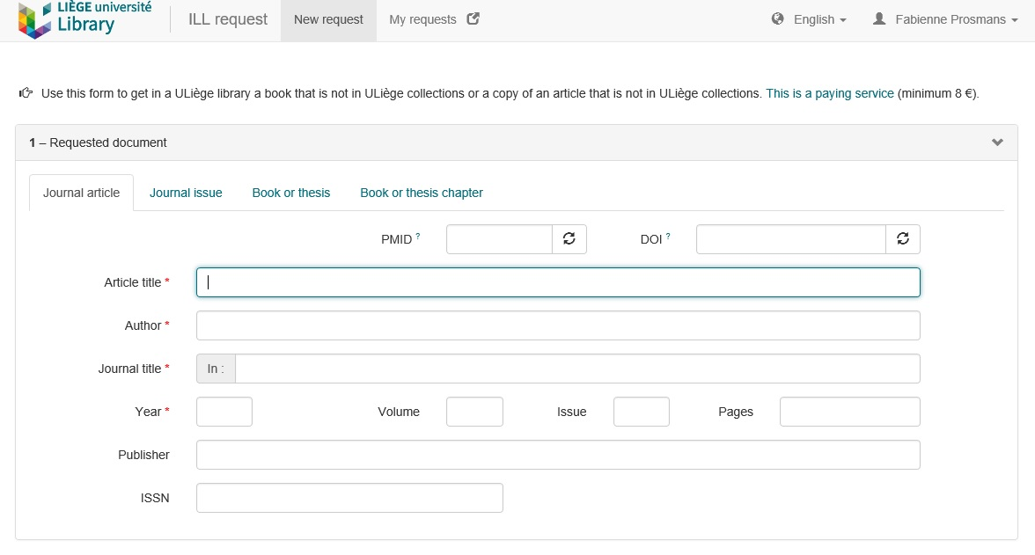
Creation of borrowing requests
In Primo: from an in-house blank form integrated with the Alma APIs
https://developers.exlibrisgroup.com/blog/Configuration-and-main-Perl-scripts-of-the-resource-sharing-request-blank-form-at-ULg
Notes:
A user can also use a blank form for his request. Since we wanted a more customized request form than the one proposed by Ex Libris, we have set up a new blank form and integrated it with the Alma APIs.
Once the form is submitted by the patron, the Alma API creates a borrowing request and RS operators can start working on it
Remarks:
The form can be used:
- for Borrowing Requests created by registered users (staff, students...) and non-registered users
- for Lending Requests created by other libraries/partners

Slide 22
Flexibility with the blank RS form
Also accessible to non-registered users like commercial societies and firms (--> = document delivery to non registered users)
ILL form changes according to the requested material (Journal article, Journal issue, Book or thesis, Book or thesis chapter) and only necessary fields are displayed.
By putting a DOI or PMID, then the form 'Requested document' section is automatically filled in.
Journal title field is interfaced with a locally managed journal database (ca 45,000 journals). That same DB is also interfaced with our institutional repository when scholars archive journal articles.
Depending on the status or user group of the requester, 'Delivery and payment' fields are fully configurable.
In case of physical delivery, selecting a pick up location from the list is mandatory.
Notes:
- Remark: if the patron sends an email or asks for a resource sharing request at the circulation desk of a library, the ILL operator can add manually the borrowing request in Alma

Slide 23
Breakdown of requests by way of creation
Notes:
- Data for borrowing requests processed in 2017.

Slide 24
Resource sharing in Alma: some advantages
Borrowing requests:
Possibility for the patron to loan a book provided by a partner
Sending letters such as On Hold Shelf Letter, Courtesy Letter or Overdue Notice Letter
Possibility to define overdue fine, maximal renewal period
Possibility to add the fines for resource sharing in the user’s account
Lending requests:
Facility to know that a book is sent to a partner for resource sharing
Sending the Borrower Overdue Email Letter
Statistics:
Retrieval of statistics from Analytics
Notes:
- Borrowing: Letters such as courtesy letter or overdue notice letter are sent like those for our documents. Thanks to the terms of use, it is possible to define overdue fine, maximal renewal period and so on.
- Lending: Previously, the operator lent the book in his name. The partner of email type receives the Borrower Overdue Email Letter when the due date is reached.
- Statistics: It is easy to retrieve statistic from Analytics such the number of borrowing requests by user group, the number of borrowing or lending requests by partner or material type

Slide 25
In Alma: step 2
1 Resource Sharing Library

Slide 26
To one unique RS Library
At the beginning of 2018:
Reorganization and centralization of the interlibrary loan service
Deactivation of the existing 5 Resource Sharing libraries
Use of the default Resource Sharing Library in Alma (only used for resource sharing)
Again more simplification and standardization
Not always (easily) accepted by all ILL operators…
1 Resource Sharing Library
7 operators
(no FTE!)
manage ILL services

Slide 27
New organization
Resource Sharing Library
Operator 1
Operator 2
Operator 3
Operators 4
Operator 5
Operator 6
Operator 7
RS Library has a physical address, but
Operators take it in turns to do their RS tasks (shared calendar)
They do it in the library where they are employed
Only some hours RS task per week (not everyone in a week)
Notes:
RS Operators collaborate now more closely. They are all members of a same team (although it does not physically exist).

Slide 28
Configuration
Automatic allocation of the new Resource Sharing library to all users
Creation of two locations (one for borrowing and one for lending requests)
Creation of one Fulfillment Unit and two Fulfillment Unit Rules (for loan)
For partners, usage of the previously defined workflow profiles
Notes:
The locations of the 5 old resource sharing libraries have been removed
The fulfillment unit and the fulfillment unit rules of the five old resource sharing library have also been removed. For borrowing requests, we allow the loan for one month of documents from partners to the students, professors and researchers of the University of Liège. For external users, we allow consultation in the reading room. For lending request, we send the documents to partners for 6 weeks
As a reminder, the workflow profile of borrowing type allows staff to manually renew a lending requests and the workflow profile of lending type allows staff to manually change the due date for borrowing requests. User cannot extend the loan themselves via Primo.

Slide 29
Digitization requests
Lending requests: Creation of digitization requests for articles and book chapters
Requested articles and book chapters are:
always digitized in their owning libraries
automatically associated to the Resource Sharing request for further processing (Send to Partner)
Notes:
- The main workflow difference between the two steps is in lending requests

Slide 30
Encountered difficulties
From 5 to 1 RS Library
RS Library = Preserve of some ILL operators
More transparency across the institution
Pooling of human resources
Cost and profit sharing
Old RS Libraries are still appearing in the Owner drop-down list for Lending requests (SF 00544465)
Change was not easily accepted by some colleagues…
Notes:
Some operators feared having more work; others feared having less work
Some operators feared processing requests for disciplines which they were less familiar with
Some operators regret the loss of conviviality due to the automation of certain tasks (automatic emails for example)

Slide 31
Processsing of Borrowing Requests

Slide 32
Experienced advantages of one RS Library
Automatic allocation of the Resource Sharing Library to all users
In the past:
Not all users had the most appropriate RS Library assigned in their user Record
Some users had no assigned RS Library

Slide 33
Experienced advantages of one RS Library
Reduction in the number of transits of physical documents for borrowing requests
Physical address of the RS = address of the library where a majority of ILL books are requested
So, when the library receives the document from the partner, it has only to be sent to the pick up location.
In the past:
If the pick up location was not one of the RS library, there was one more transit.
Same situation when the document was returned.

Slide 34
Experienced advantages of one RS Library
More collaboration between ILL operators
Assignment of the "Fulfillment Services Manager" role for the RSL to the resource sharing operators
This role allows in particular to manage requests assigned to other operators → more flexibility and cooperation between operators
In the past:
This role could not be given to all ILL staff. Since the scope of the role is the library, it was not possible to allocate it for a library not only used for resource sharing.

Slide 35
Experienced advantages of one RS Library
More fluency in ILL delivery
All RS operators take it in turns to do their RS tasks
No one has a 100% RS activity.
A substitute can easily be found if needed.
NB: 7 operators remain a lot. We could not go lower for sensibility reasons.
In the past:
All RS operators could be out of the office at the same time (sickness, holiday…) and ILL service could be interrupted in a library. (Now the probability that the 7 operators are absent at the same time is almost null.)

Slide 36
Experienced advantages of one RS Library
Harmonization of the practices of the RS operators
One single RS Library implies more standardized practices:
All operators proceed in the same way.
More standardized practices produce consolidated statistics which can be analyzed more easily.
In the past:
Differences in the workflows
For example, some RS libraries allowed loan of documents from partners for some user groups while other only allowed consultation in reading room.
Data provided by Analytics required to be cleaned up

Slide 37
Future projects and developments

Slide 38
Future projects and developments
Partners of ISO profile type
Ongoing testing with
Library of the European Council
Library of the European Commission
Development of an interface between Alma and Impala
Ongoing cost-benefit analysis
Notes:
As we have already mentioned, we only have partners with email profile type. We would like to have partners of ISO profile type for both borrowing and lending requests. One of the goals is to benefit from peer to peer Alma communications. We are currently in the testing phase.
Now operators must encode the borrowing requests twice: once in Alma and once in Impala. For lending requests, operators must monitor the Impala platform to track requests made to our libraries. They must then encode the requests in Alma. It would save a considerable amount of time if Impala and Alma would be interconnected.

Slide 39
Thank you!
Fabienne Prosmans Fulfillment and Resource Sharing Coordinator fprosmans@uliege.be | François Renaville Head of Library Systems francois.renaville@uliege.be
http://hdl.handle.net/2268/227174

