Slide 1



A new method for characterizing the complex electrical properties of root segments
S. Ehosioke, S. Garre, T. Kremer, S. Rao, A. Kemna, J.A Huisman,
E. Zimmermann, M. Javaux and F. Nguyen

Slide 2
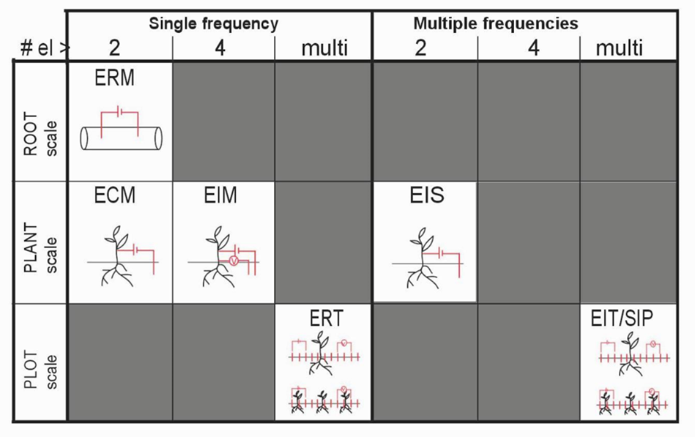
Introduction
Point sampling
Partially satisfactory
Geophysical methods
High resolution
Non-invasive
Applicable in lab and field
EIT/SIP – more promising
Ehosioke et al. 2018
Our Contribution
High resolution characterization of Fine roots at segment scale (1-5 cm)
Spectroscopic approach(1-45 KHz)
Notes:
-ERM and ECM show that conduction and polarization occur in the roots
-EIS showed response from soil-root-stem continuum
-ERT showed response from bulk root mass including soil + water + organic matter
-EIT/SIP showed low frequency polarization of roots but the response of root segments still missing

Slide 3
Objectives
High resolution characterization of root segments
Design a sample holder suitable for root segments
Validation of the measurement set- up
Use the set-up to study roots
Provide answers to these questions
Does electrical response vary within and across species ?
What root properties influence their electrical response ?
Could fine roots be differentiated from soils ?
Notes:
-High resolution characterization of root segment is necessary to optimize the results obtained from EIS and ERT
-Separation of root signal from that of “soil-root-stem continuum” (EIS) or from “soil + water + organic matter” (ERT).

Slide 4
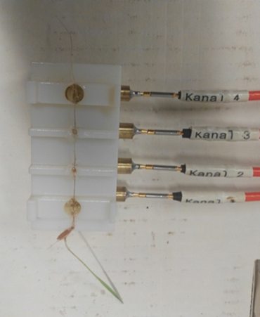
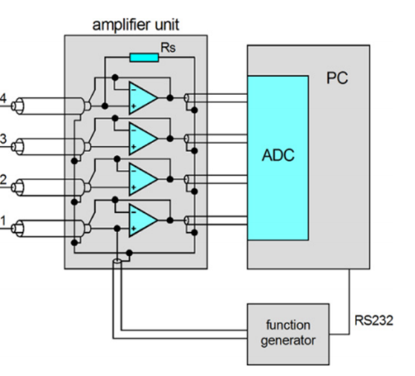
Measurement set-up
Zimmermann et al. (2008)
Measurements were taken near the root collar
Contacts between roots and electrodes were completely covered in gel
Reciprocal measurements always taken before the normal to enable automatic correction
Electrodes were kept out of the current path
Notes:
Set-up comprises
1. Newly designed sample holder
2. 4 electrodes
3. Amplifier unit (ZEA-2-SIP04-V05)
4. Data acquisition card (NI USB-4431)
5. Function generator (Keysight 33511B)
6. Computer

Slide 5
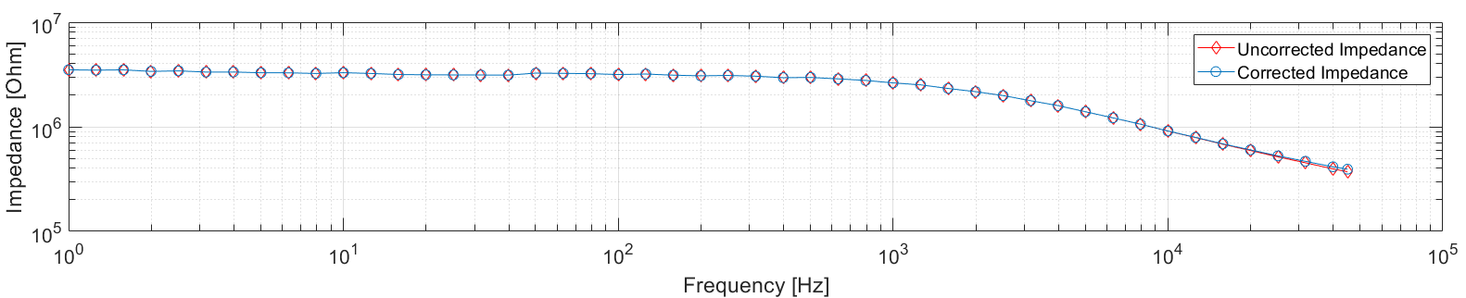
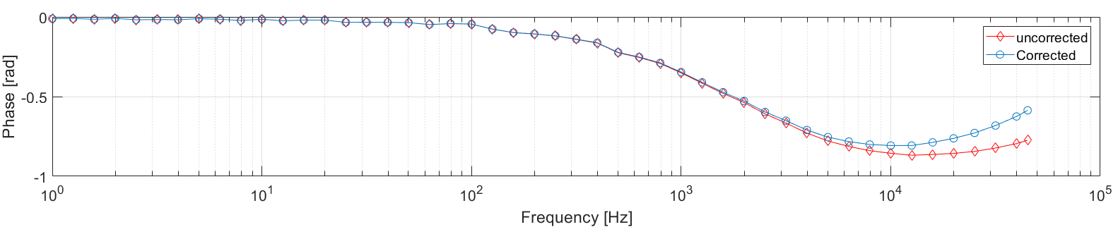
Data Correction
Correction is used to minimize the error due to parasitic leakage currents
By first taking reciprocal measurement before normal, the true excitation current is calculated using a matlab program
With this, true sample impedance is determined
This correction results in high phase accuracy of 0.1 mrad (Zimmermann et al. 2008b)
Notes:
-Leakage currents flow through parasitic impedances between the sample and the ground
-The result is that the injected currents differ from the measured current
-This error is corrected by taking reciprocal measurements before the normal to enable automatic correction using a matlab program
-Correction results in high phase accuracy 0.1 mrad

Slide 6
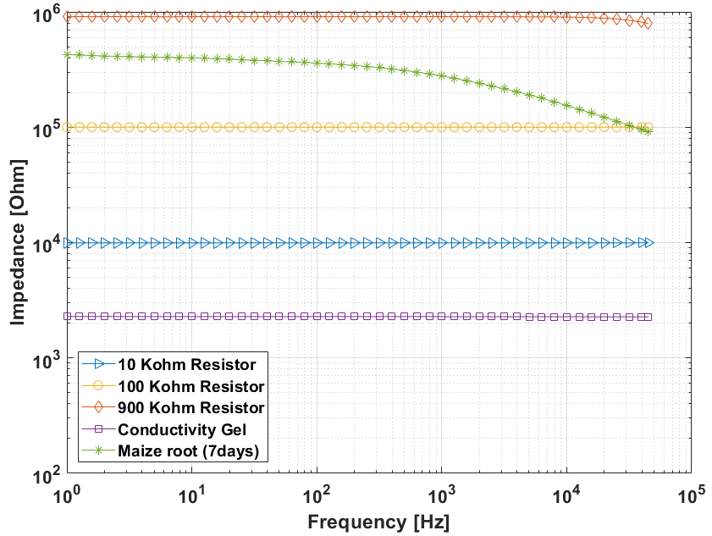
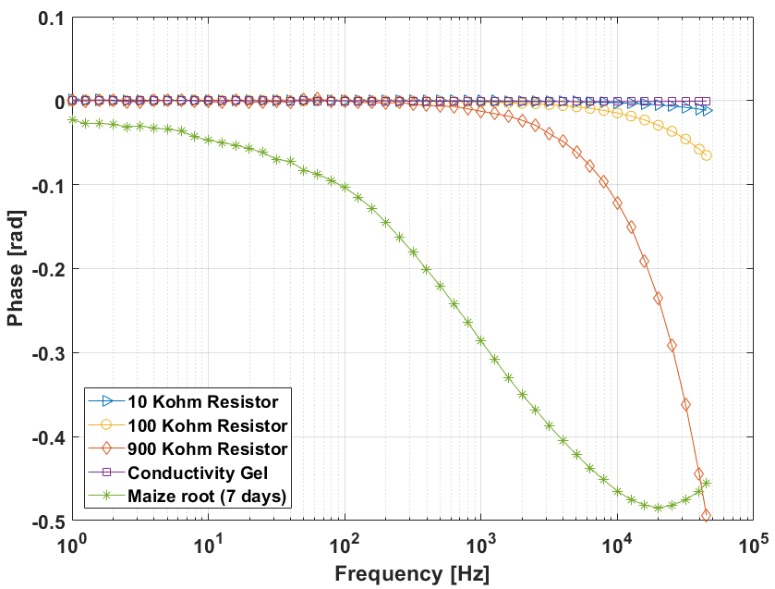
Calibration and Validation
Calibration was performed using three ideal resistors
Calculated impedances (using colour codes) matched the measured values
Ideal resistors showed zero phase response as expected
Polarization of maize root is clearly visible (480 mrad)
The conductivity Gel showed negligible phase response compared to the root
Notes:
-Measured impedance matched the calculated impedance of resistors, also the resistors showed no phase response as expected.
-The effect of EM coupling is visible in the response of 100 and 900 Kohm resistors
-The root impedance close to 900 Kohm but it showed a distinct polarization which is clearly from the root alone
-The polarization of the electrode gel is negligible

Slide 7
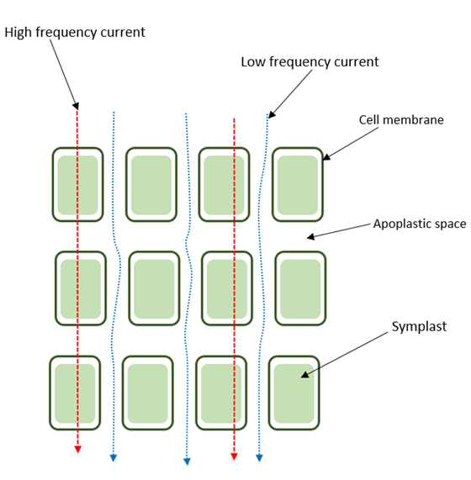

Current passage in roots
Low frequency current
Cell membrane inhibit current passage
Current pass through apoplastic space
Impedance depends on extracellular resistance
High frequency current
Cell membrane becomes conductive
Current pass through entire cells
Impedance depends on both Extra- and Intracellular resistance
Notes:
-Lipid bilayer of cell membrane inhibit current passage at low frequency
-At 10 KHz, we assume that current will pass through all the root cells

Slide 8
Polarization mechanisms in biomaterials
Mechanism | Frequency Range
Counter ion Polarization (α-dispersion) | < 20KHz
Interfacial Polarization (β-dispersion) | KHz- MHz
Dipole polarization (γ-dispersion) | MHz – GHz
Exists in materials that have a heterogeneous microstructure
Where high conductivity zone exists within the matrix of low conductivity material
e.g. cell interiors surrounded by cell membranes).
Notes:
-Polarization signals we observed in roots are in the range of interfacial polarization (10 KHz)
-The measurement also showed low frequency polarization, but it is not so distinct.

Slide 9
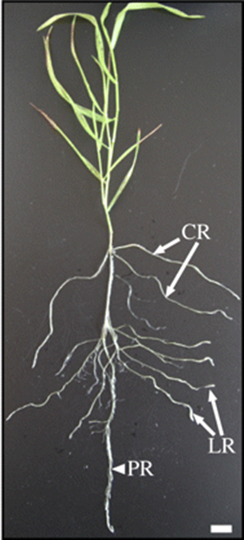
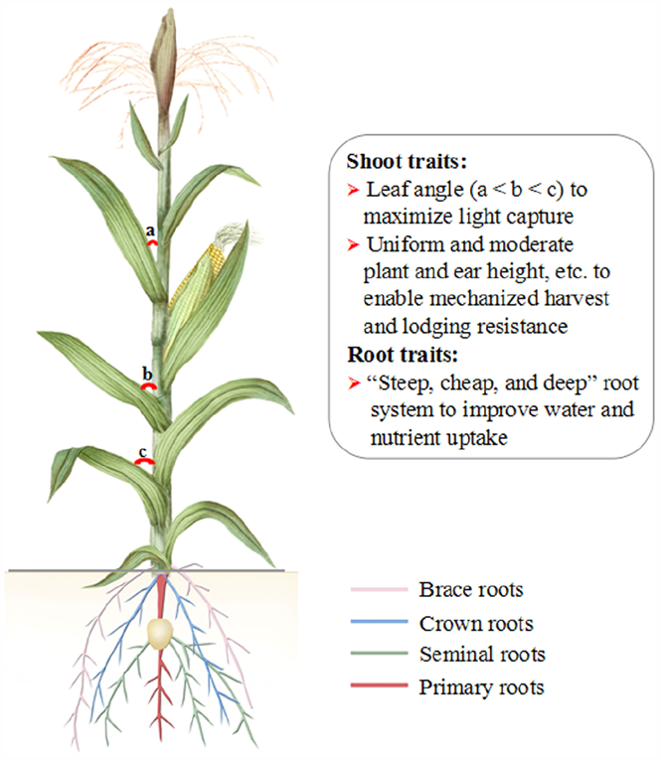
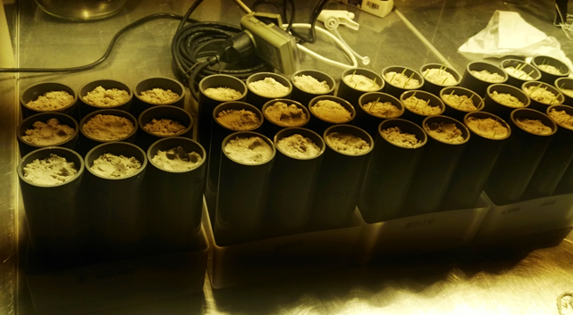
Study Plants
A
B
Plants grown in sand to enable easier cleaning without water
Destructive sampling
Measurement on primary roots close to root collar
Total number of 32 plants were sampled (4*2*4)
Root resistivity calculated using measured impedance and diameter
(A) Brachypodium plant, composed of a primary root(PR), crown roots (CR) and lateral roots (LR) (Pacheco-Villalobos and Hardtke 2012) (B) Maize plant, showing the roots in colour (Gong et al. 2015)
Notes:
-Plants grown in sand to enable easier cleaning without water
-Root diameter was measured with a digital calliper

Slide 10

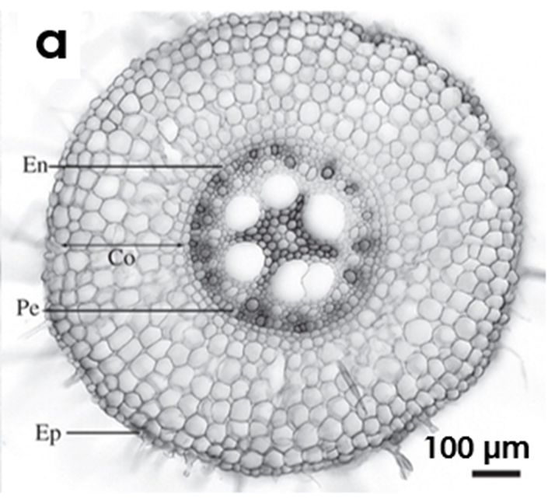

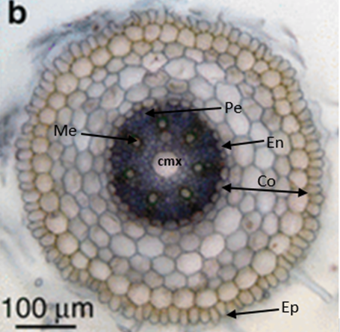
Microscopic sections
Me
Smith and De Smeth 2012
Pacheco-Villalobos and Hardtke 2016
T/S of Maize and Brachypodium primary roots .
Showing: Epidermis (Ep), Cortex (Co), Endodermis (En), Pericycle (Pe), Metaxylem (Me) and Central metaxylem (Cmx).
Brachypodium root is smaller in size, with lesser cells in cortex than maize
Maize is larger in size, with more cortex cells but no central metaxylem
Notes:
-Given the current passage in plant tissues, we assume that the current passes through all cell
-Maize showed lower impedance (KOhm range)
-Brachypodium showed higher impedance (MOhm) range
-Brachypodium is more resistive probably due to thicker cell walls and membranes

Slide 11
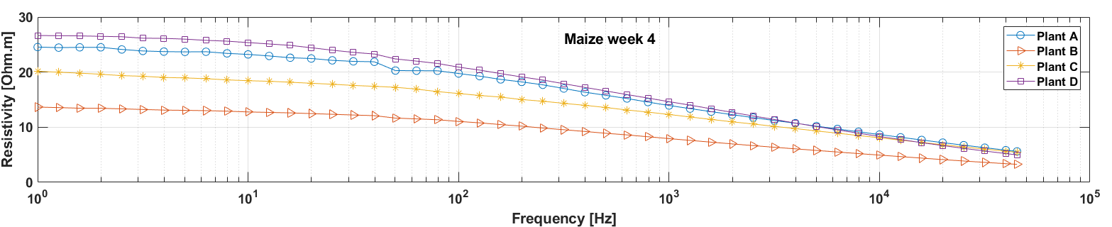
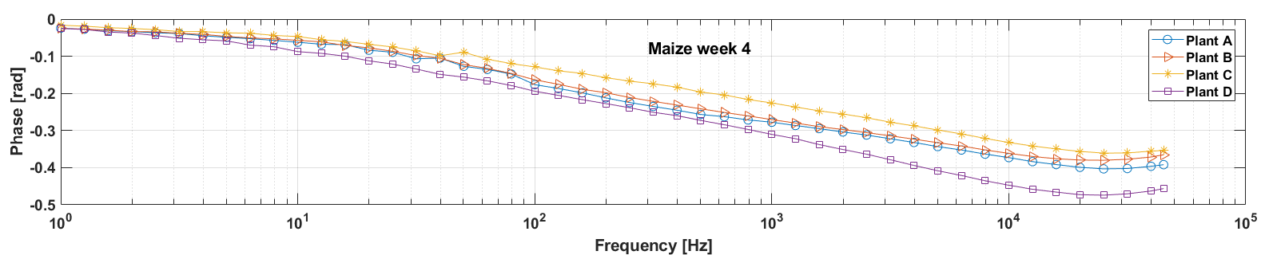
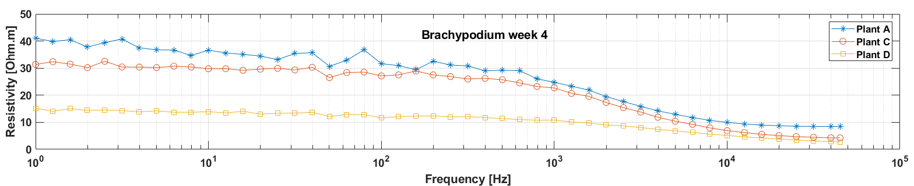
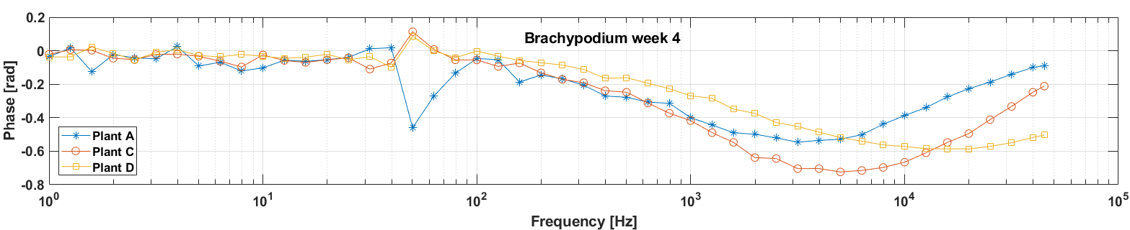
Intra-species variability
Comparing plants A, B, C & D at week 4 (day 27) of maize (top) and brachipodium (bottom).
Notes:
-Variation within species could be seen clearly in both Maize and Brachypodium
-This could be due to the different developmental stages of root segments

Slide 12
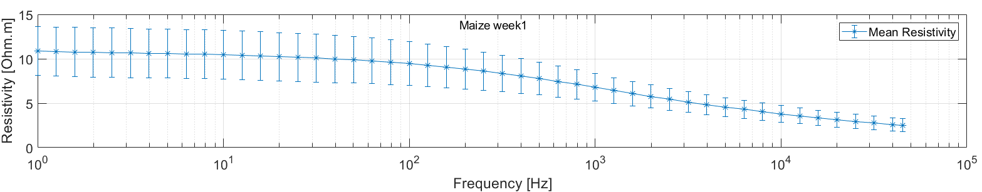
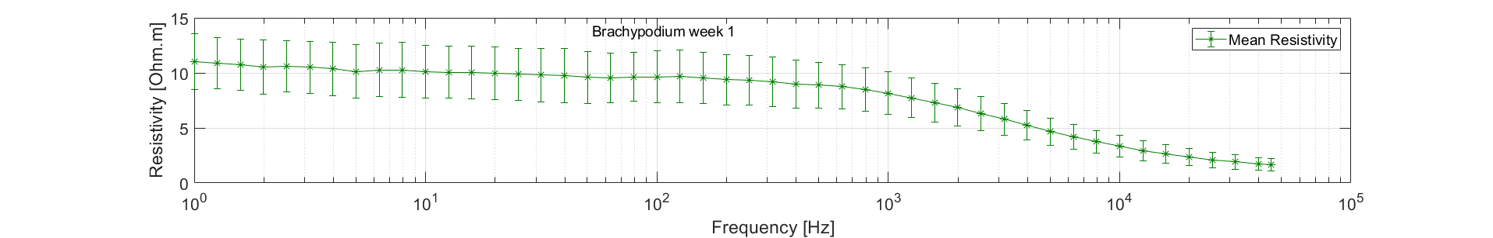
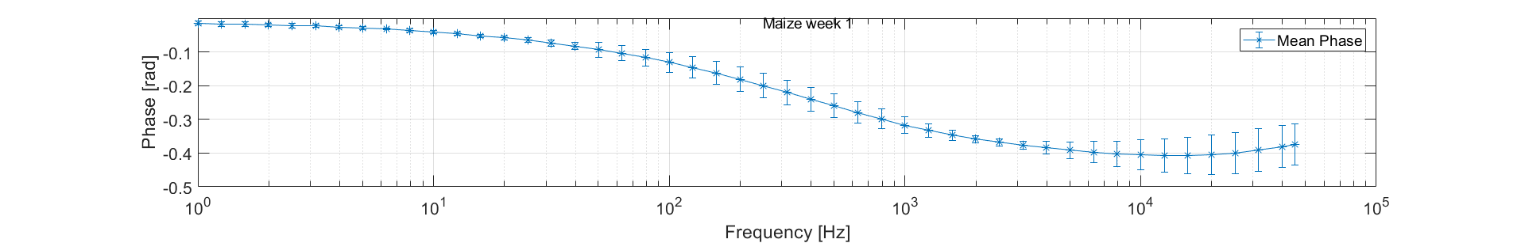
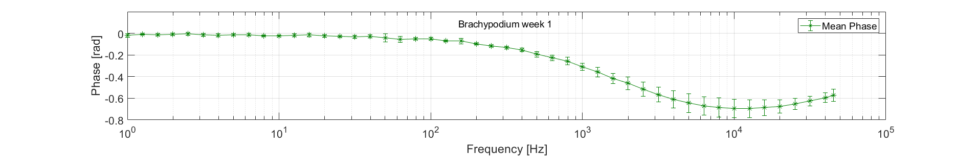
Inter-species variability [Maize vs Brachipodium]
Less variation in resistivity at day 8
Maize shows an average polarization of 430 mrad
while that of Brachipodium is 700 mrad.
Notes:
-Variability between maize and brachypodium species is more visible in their phase response particularly at high frequency (10 KHz)
- This variation could be linked to the anatomical differences between Maize and Brachypodium roots as shown in the T/S of both roots

Slide 13
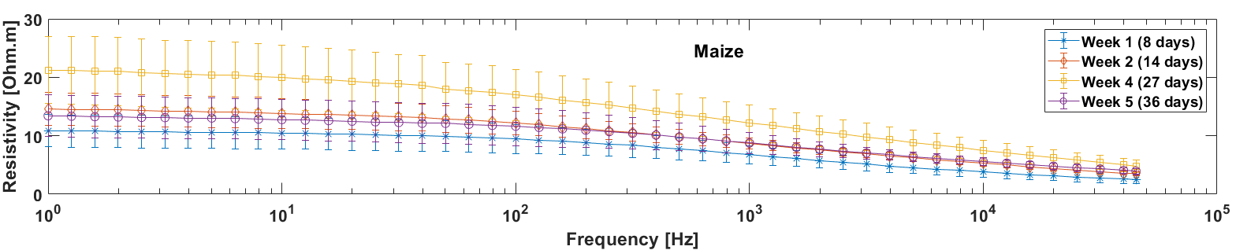
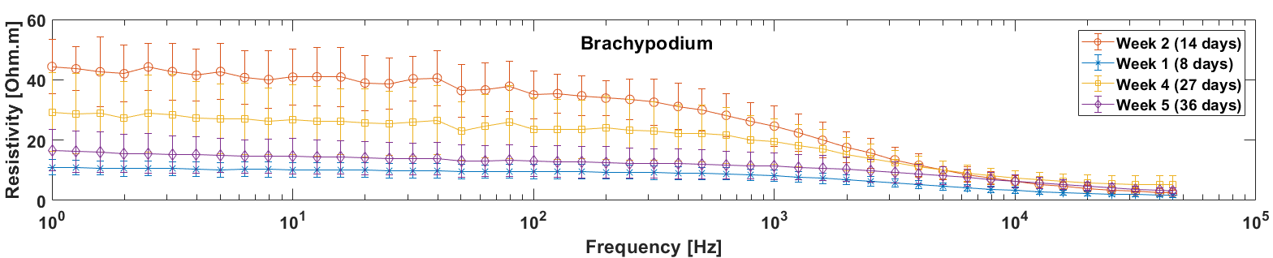
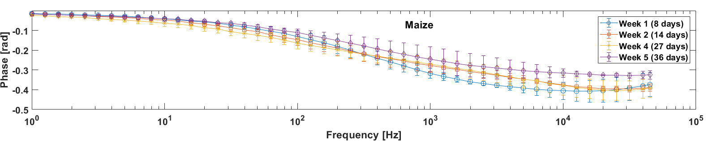
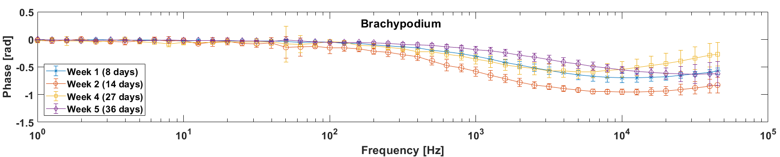
Age effect
Resistivity
Maize: increased from Wk 1 to wk 4 and dropped
Brach: increased from wk 1 to wk 2 and dropped
Phase
Maize: decreased from Wk 1 to 5.
Brach: increased from wk 1 to 2 and then decreased
Notes:
-There is a trend of increase and decrease with age
-This could be due to growth and maturation of the root

Slide 14
Conclusions
Intra- and Inter-species variability
Different plants of each species studied showed variation in their response
Maize and Brachypodium roots showed unique electrical signature which is largely dependent on their anatomy
Root properties
Electrical response of roots depend mainly on their age and anatomy
Root differentiation from soils
The polarization range for various earth materials fall within 0.2-20 mrad
The results suggest that root segments can be differentiated from soils based mainly on their stronger polarization response
Notes:
-most earth material polarize between 0.2-20 mrad
-the polarization observed here is in the range of 430 and 700 mrad for Maize and Brach respectively
-this means we can separate root signal from that of the soil

Slide 15
Next Steps
Microscopic analysis of root sections
to explain the observed variability within and across species
to identify root traits that control the observed response
Proper understanding of the age effect (monitoring)
Hydraulic properties of roots
study hydraulic conductivity in roots using SIP
effect of osmosis on the SIP signal

Slide 16


Thanks

