Slide 1
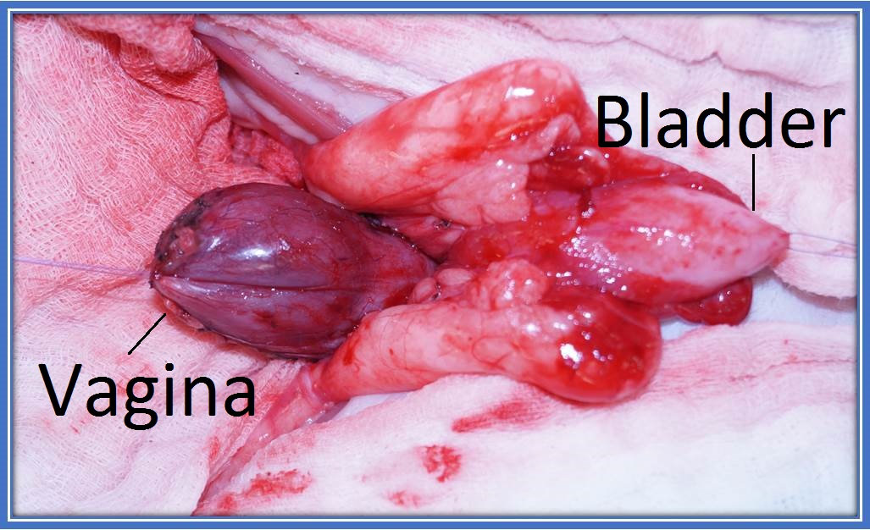
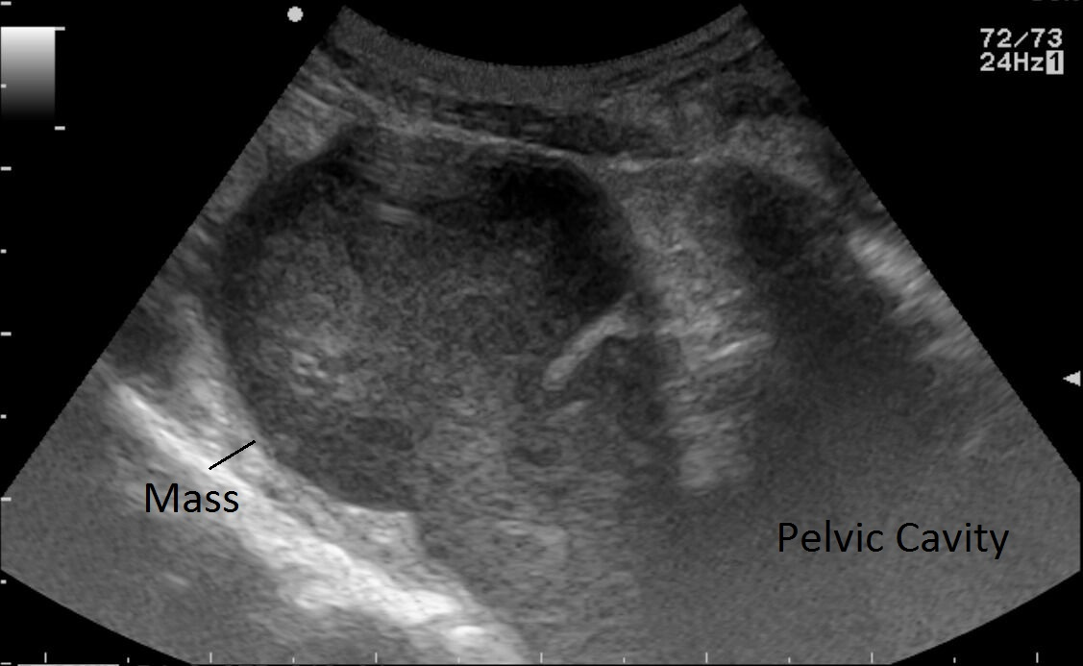
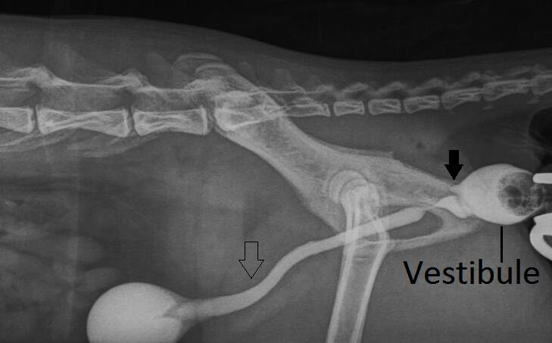
Pyocolpos in a spayed queen with imperforate hymen: a case report
S EGYPTIEN, N SHIMIZU, N ANNE-ARCHARD, F BILLEN, S DELEUZE, S NOEL
Department of Clinical Sciences, Companion animals and Equids, University of Liège, Belgium
Purpose
To describe the clinical reflexion leading to diagnosis and treatment of an imperforate hymen associated with pyocolpos. To highlight the usefulness of retrograde vagino-urethrography in this case and the implication of Enterobacter cloacae in urogenital infections.
Treatment
-Surgery: Subtotal vaginectomy by abdominal approach (Figure 3)
-Antibiotic therapy
Amoxicillin-clavulanic acid (20mg/kg PO BID) for 1 week
Changed for marbofloxacin (5mg/kg SID) for 2 weeks based on culture sensitivity
-Anti-inflammatory therapy: Meloxicam (0,1mg/kg PO SID)
Case
1-year old neutered (at 6 months) European queen
dysuria, stranguria, hematuria and abdominal discomfort
abdominal palpation: painfull, well-circumscribed mass dorsal to the bladder.
No vulvar discharge
Figure 3: Surgical view of the distended vagina
Complementary exams
-Urine analysis:
Cystocentesis
No sediment
Dipstick test: leucocytes, proteins, erythrocytes , pH6
Specific gravity: >1.060
-Abdominal ultrasonography: Figure 1
Caudal abdominal fluid filled structure (5cm X 2.5cm)
Extending into the pelvic cavity
Displacing the colon dorsally and the urethra ventrally
-Retrograde vagino-urethrography (RVU): Figure 2
Mass displacing the urethra ventrally
Contrast visible in vestibule, urethra and urinary bladder but not in the vagina
-Bacteriologic culture on the purulent vaginal content :
Enterobacter cloacae
Sensitive to marbofloxacin, gentamicin
Intermediate to enrofloxacin
Resistant to cefovecin, amoxicillin-clavulanic acid, TMP-S
Diagnosis
Pyocolpos associated with imperforate hymen
Discussion : Enterobacter cloacae¹
Gram – bacteria commensal of gastrointestinal tract
Opportunistic pathogen
Antibiotic sensitivity :
Naturally resistant to : Aminopenicillins, Amoxicillin-clavulanic acid, First and second generation cephalosporins
Naturally sensitive to: Aminosids, Quinolones, Tetracyclins, Trimethoprime-sulfonamides
Multidrug-resistance spreading (humans)
Cephalosporinases
Extended-spectrum β-lactamases
Carbapenemases
Humans: nosocomial epidemics
Veterinary medicine: unknown prevalence and clinical impact
Discussion: Imperforate hymen
Fusion Mülleran ducts -> hymen
Physiologically opens before birth
Usually diagnosed by vaginoscopy in young girls², cows³ and bitches⁴
First description of retrograde vagino-urethrography for diagnosis in the queen
Complication: pyovagina⁵
Treatment: hymenectomy or vaginectomy
Figure 1: Abdominal ultrasonography: caudal abdominal and pelvic fluid filled mass
Figure 2: Retrograde vagino-urethrography: ventral displacement of urethra ( ), absence of contrast in the vagina ( ).
Conclusion
This is the first case report of imperforate hymen in the queen. Retrograde vagino-urethrography associated with ultrasonography are effective tools for imperforate hymen diagnosis. Subtotal vaginectomy is feasible by an abdominal approach in the queen.
References
1. Guerin F. « Infections à Enterobacter cloacae complex: résistance aux antibiotiques et traitement». J. Antinfectieux (Caen), 2015
2. Tardieu S., Appelbaum H. « Microperforate hymen and pyocolpos: A case report and Review of the literature ». J. Pediatr. Adolesc. Gynecol. (New York), 2018
3. Kumar B. et al. « Imperforate hymen and subsequent secondary pyometra, pyocervix and pyovagina in marruah buffalo heifer: a case report ». (Izatnagar), 2016
4. Viehoff F.W., Sjollema B.E. « Hydrocolpos in dogs: surgical treatment in two cases ». J. S. An. Pract. (Utrecht), 2003
5. Van den Berghe F et al. « Pyovagina caused by pyometra and persistent hymen in a 9-year-old bitch ». Poster ESDAR (Berlin), 2013

