Slide 1
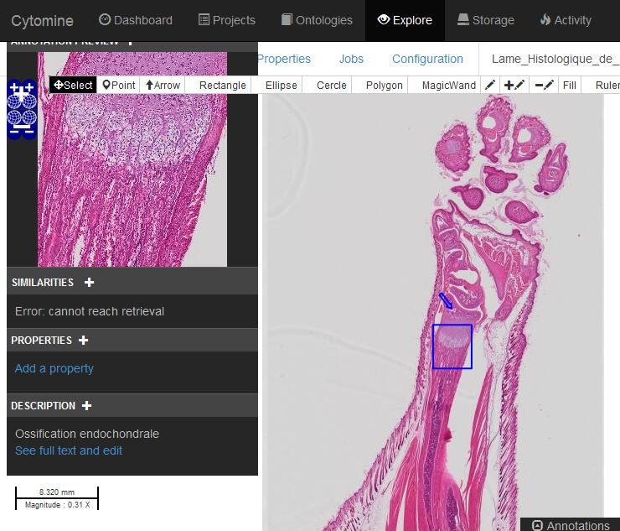
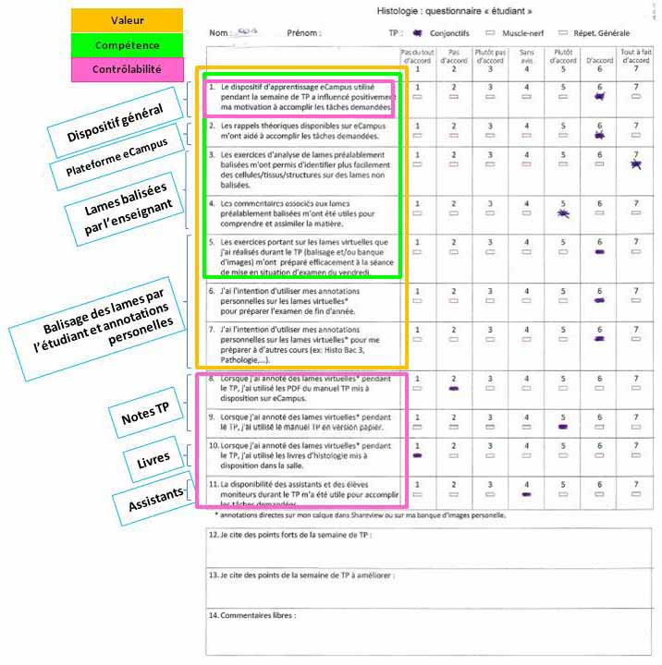
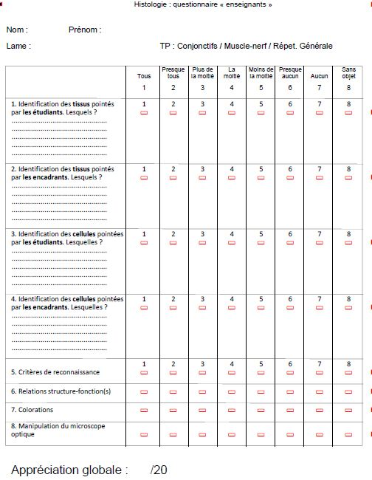
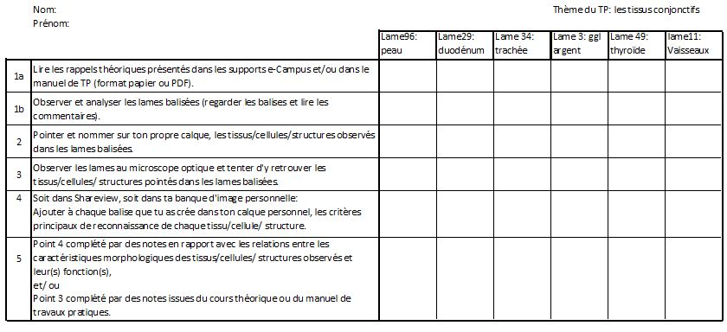
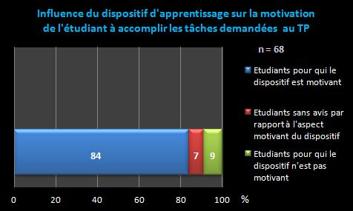
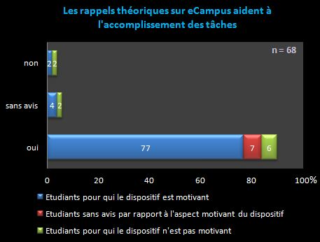
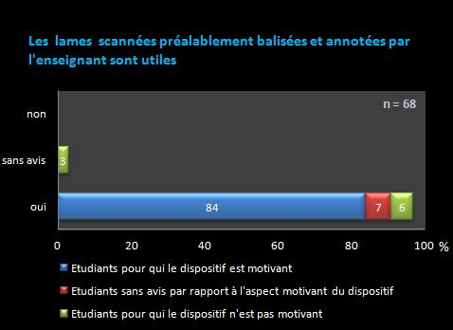
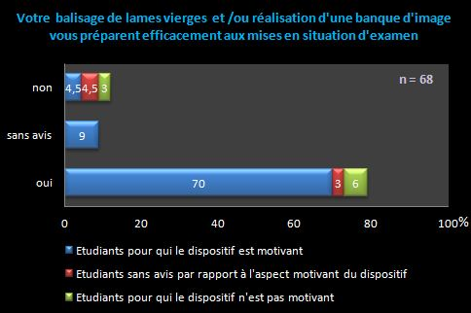
Introducing e-learning and imaging technology into histology practical classes in veterinary medicine: Effects on student motivation and learning quality
Vinciane Toppets ª, Patrick Schaffer ^{b}, Béatrice Lecomte ^{b} , Françoise Jérôme ^{c}, Amory Hélène ^{d} and Nadine Antoine ª.
a. Department of Morphology and Pathology, Faculty of Veterinary Medicine, University of Liege, Belgium
b. eCampus Unit, IFRES, University of Liege, Belgium
c. Formasup Unit, IFRES, University of Liege, Belgium
d. Clinical Department, Faculty of Veterinary Medicine, University of Liege, Belgium
Introduction
Students in veterinary medicine often wrongly regard histology as an abstract science with no relevance to their future professional practice as clinicians. As a consequence, students lack motivation to study histology. In order to arouse their interest in the histology course and to improve their learning, a hybrid environment combining online resources and activities with face-to-face sessions was implemented within practical classes. The online course material consists mainly of the Cytomine-Shareview software, an imaging application displaying high-resolution digitized histological slides. Each practical class session is structured as follows: (i) Theory revision by means of formative and summative online quizzes; (ii) Observation and analysis 1) of histological slides using an optical microscope, 2) of annotated (interesting cells and tissues are already marked and described) digitized histological slides from the Cytomine-Shareview application, 3) of digitized slides without ready annotation (the application is also connected to an interactive interface hosted on the institutional platform eCampusULiège, which enables students to comment each slide and to build up their own database of captioned slides); (iii) Formative assessment in conditions similar to those of the end-of-course examination, i.e. oral presentation in the presence of fellow-students and teachers. During sessions, students have the opportunity to interact / to debate with each other and to get formative feedback on their performance.
The Cytomine-Shareview application enables students to learn by means of digitized histological slides. First, they observe and analyse annotated (comments and theoretical references are related to interesting cells or tissues) slides. Second, they observe and analyse ‘bare’ slides similar to the annotated ones and add captions on their personal Cytomine-Shareview layers.
Aim of the study
This study aims at evaluating the effects of the hybrid environment combining online resources and activities with face-to-face practical class sessions on student motivation and learning strategies regarding histology.
Material and method
Collected data concern a sample of 68 students randomly selected at step 3 (formative assessment) of practical classes.
Motivation
Superficial versus deep learning and long-term retention
Subjective data: A questionnaire was designed in order to evaluate student motivation according to Viau’s motivation determiners. Closed questions probe student perceptions regarding various potential effects of practical classes:
In relation to the perceived value of learning assignments: Estimation of activities in terms of 1) facilitation of histology learning, 2) better preparation for formative and summative assessment, 3) benefits for other courses as well.
In relation to perceived self-efficacy: Estimation of the ability to identify and to describe accurately histological structures.
In relation to perceived self-initiative: Estimation of the extent to which available resources have been used.
Objective data: Tracking of student activity on the eCampusULiege platform.
Subjective data: daily activity report
Objective data: formative assessment
-
+
At the end of each practical class session, students fill in an activity sheet and report on the complexity level of the assignments they carried out during the session. 5 complexity levels are provided. Students have to reach at least level 2. Levels 3 to 5 correspond to deep and long-term learning.
This grid is filled in by two supervisors and supports formative assessment at the end of practical classes.
Results
When asked whether the hybrid environment positively influence their motivation to engage in the assignments of practical classes, 84% of respondents (N=68) answer positively, while 9% answer negatively and the remaining 7% have no opinion.
Student perceptions regarding the hybrid environment:
Positive aspects: Recall of theory at the beginning of each session, annotated digitized slides, availability of supervisors and instructors during face-to-face sessions, formative assessment in conditions similar to those of end-of-course examination.
Aspects to be improved: Lack of time to carry out requested assignments during face-to-face sessions (especially regarding time-consuming tasks such as using the optical microscope), occasional instability of the Cytomine-Shareview application, possibility of computer / network glitch on the days preceding end-of-course examination.
Frequently made comments: Instead of annotating ‘bare’ slides during face-to-face sessions, some students collect at home annotated slides and claim the annotations to be their own. Only a few students say they will attend the free session dedicated to observing histological slides with the optical microscope.
Regarding the perceived value of various components of the hybrid environment and self-efficacy perceptions in relation to histology, a large majority of students (including some of those who declared that the hybrid environment had no positive influence on their motivation) claimed that theoretical resources, annotated digitized slides (97% of respondents found them useful) and the assignments consisting in annotating ‘bare’ slides’ and building up a personal database helped them to understand and assimilate histology course contents.
Data related to self-initiative perceptions are currently being analysed.
Superficial versus deep learning and long-term retention:
Data analysis is not yet finalized. However, current findings seem to indicate that many students
- content themselves with achieving assignments at the requested complexity levels 1 and 2;
- prefer to resort to virtual microscopy instead of optical microscopy.
The average score obtained by students in relation to formative assessment is 10,5/20.
Conclusions
The results of this study tend to indicate that the hybrid environment has on the whole a positive influence on student motivation to engage in the prescribed assignments. Students especially value the online resources and activities and become more self-confident regarding their ability to identify and to describe histological structures. The analysis still underway of activity reports suggests that the environment promotes deep learning and long-term retention only for a minority of students. However, the environment enables most students to reach basic learning levels 1 and 2 and thus to pass the end-of-course examination.

