Slide 1
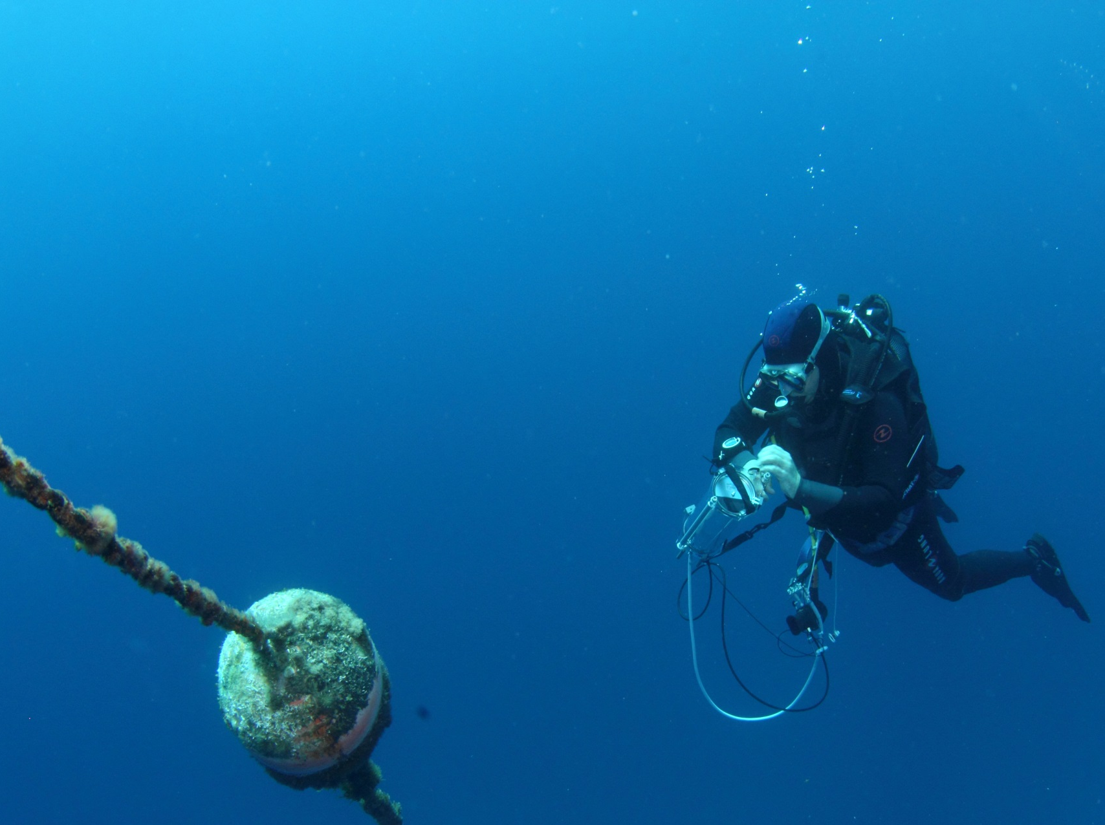
Etude de la photosynthèse de Posidonia oceanica par fluorimétrie modulée
Richir J., Abadie A., Borges A., Champenois W., Lepoint G., Santos R., Silva J., Walz S., Lejeune P., Engels G. & Gobert S.
10-04-2018,
Stareso

Slide 2
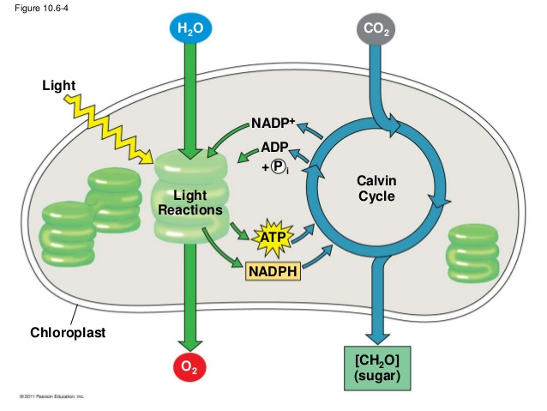
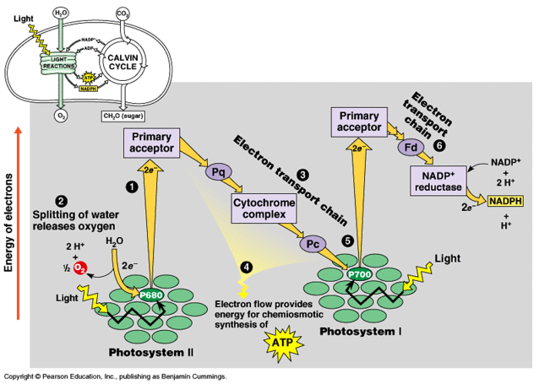
The light reactions
Chemical equation of photosynthesis:
6CO₂ + 6H₂O → C₆H₁₂O₆ + 6O₂
_{Light energy}
Campbell & Race, © Pearson Education Inc.

Slide 3
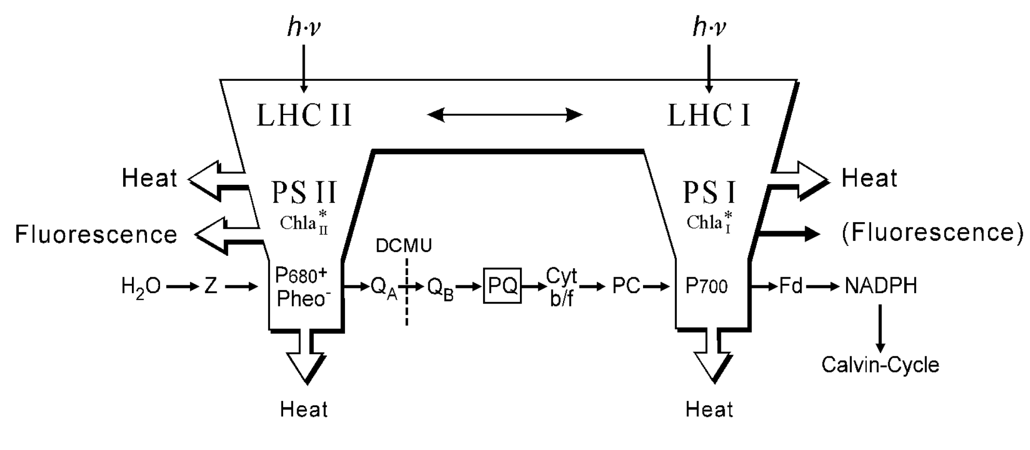
Fluorescence emission
© Walz Inc.
Fluorescence emission is complementary to the alternative pathways of
de-excitation, which are photochemistry and heat dissipation.

Slide 4
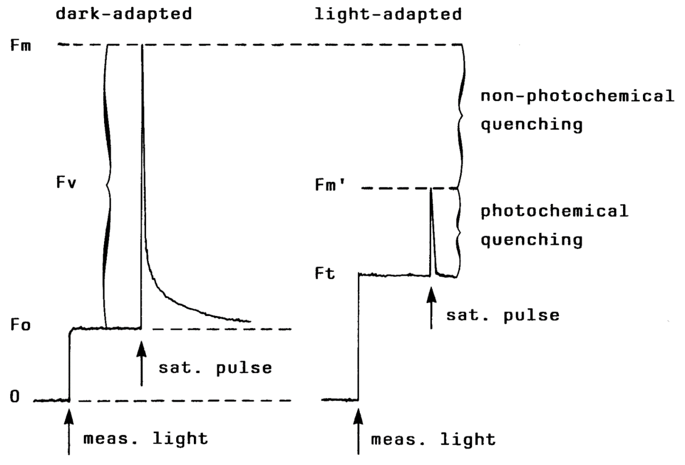
Fluorescence measurement
Dark adapted YIELD = (Fm-F0)/Fm = Fv/Fm
maximum photochemical efficiency
Light adapted YIELD = (Fm’-Fm)/Fm' = ΔF/Fm’
effective photochemical efficiency
© Walz Inc.

Slide 5
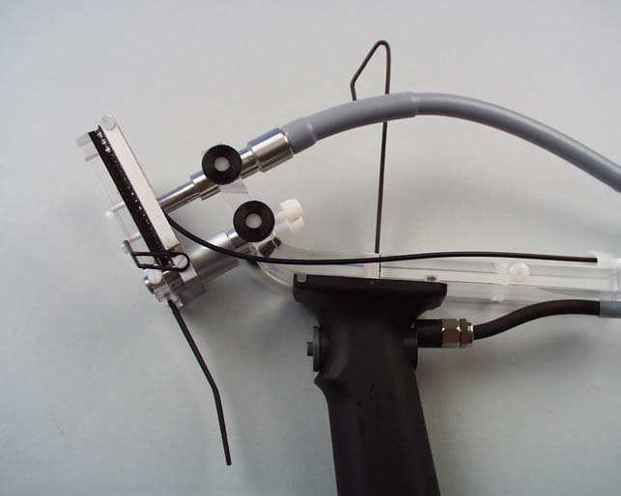
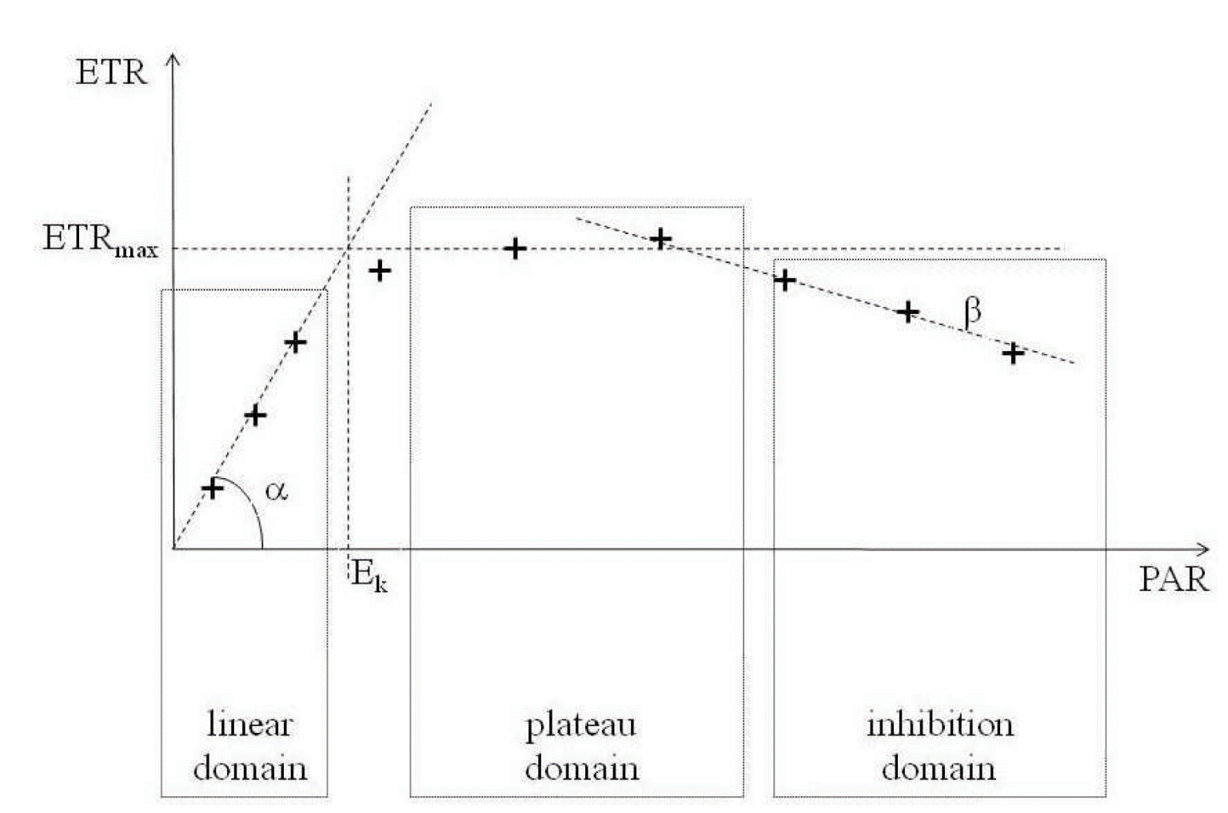
ETR - RLC
Relative Electron Transfert Rate : ETR = YIELD x PAR x 0.5 x ETR-factor
Rapid Light Curve : photosynthetic flexibility with which a sample can adapt its photosynthetic aparatus to rapid changes of ligh intensity
ETR_{max} = maxixmum electron tranport rate
E_{k} = compensation irradiance
(Lassauque, 2008)

Slide 6
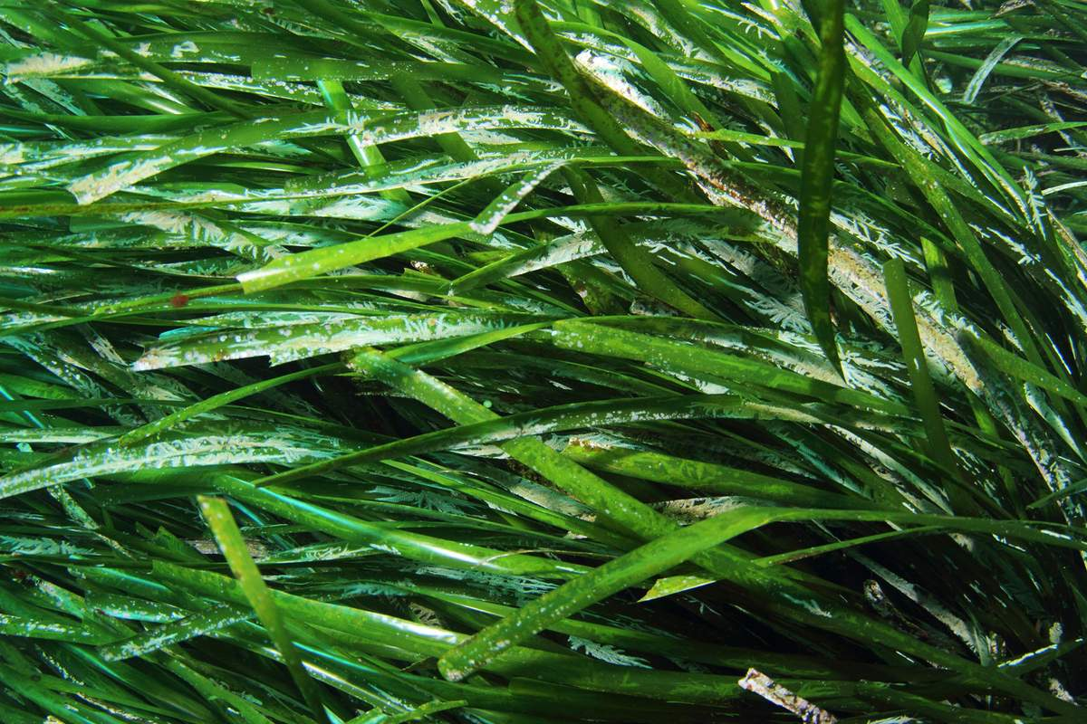
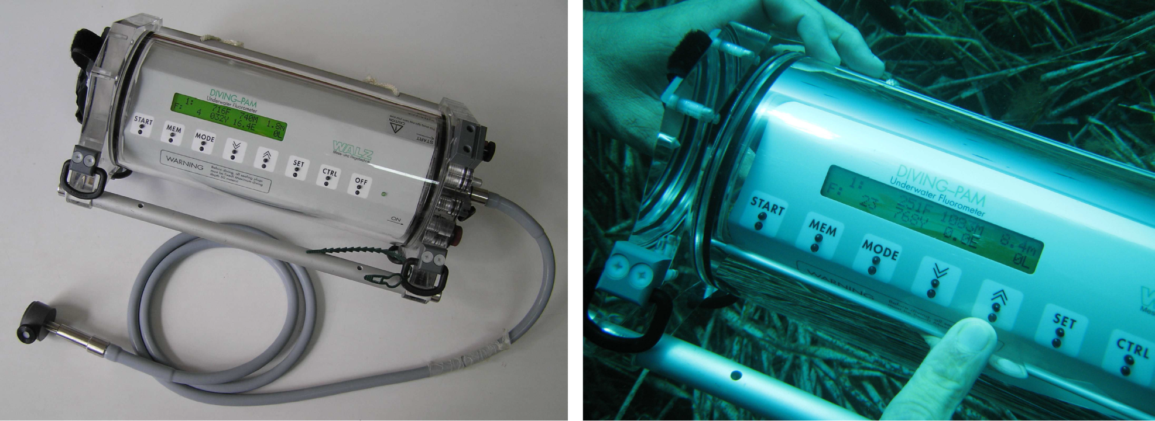
Diving-PAM
Underwater study of in situ photosynthesis
Optimized to determine the effective quantum yield of photosynthetic energy conversion, ΔF/Fm’
Arnaud Abadie
Julien Lassauque

Slide 7
Objectives
"With our present understanding of seagrass photosynthetic responses to anthropogenic stress, it would be ill advised to employ PAM as anything but a complementary tool to validate environmental stress derived with other, more robust methodologies." (Gera et al., 2012)
A more in-depth knowledge of the natural and stressful causes of variability of P. oceanica photosynthetic responses is a prerequisite to any surveys relying on that time and cost-effective method.
This work aimed to determine the influence of :
plant-ecophysiological characteristics: pigments, carbohydrates, C/N/P, micronutrients, DMSP/DMSO,
environmental parameters: light, temperature, nutrients,
stress-conditions : metal toxicity, shading
…. on photosynthetic responses : Yield, ETR, RLC of P. oceanica.

Slide 8
Preliminary work (2011-2012)
Essential to develop a consensual protocol to publish reliable and comparable results :
to perform measurements at the zenith;
at 10-15 m depth (and depth profile for physiological adaptation to reduced light conditions);
on the middle part of the 3rd leaf, highly photosynthetic, little epiphyted.

Slide 9
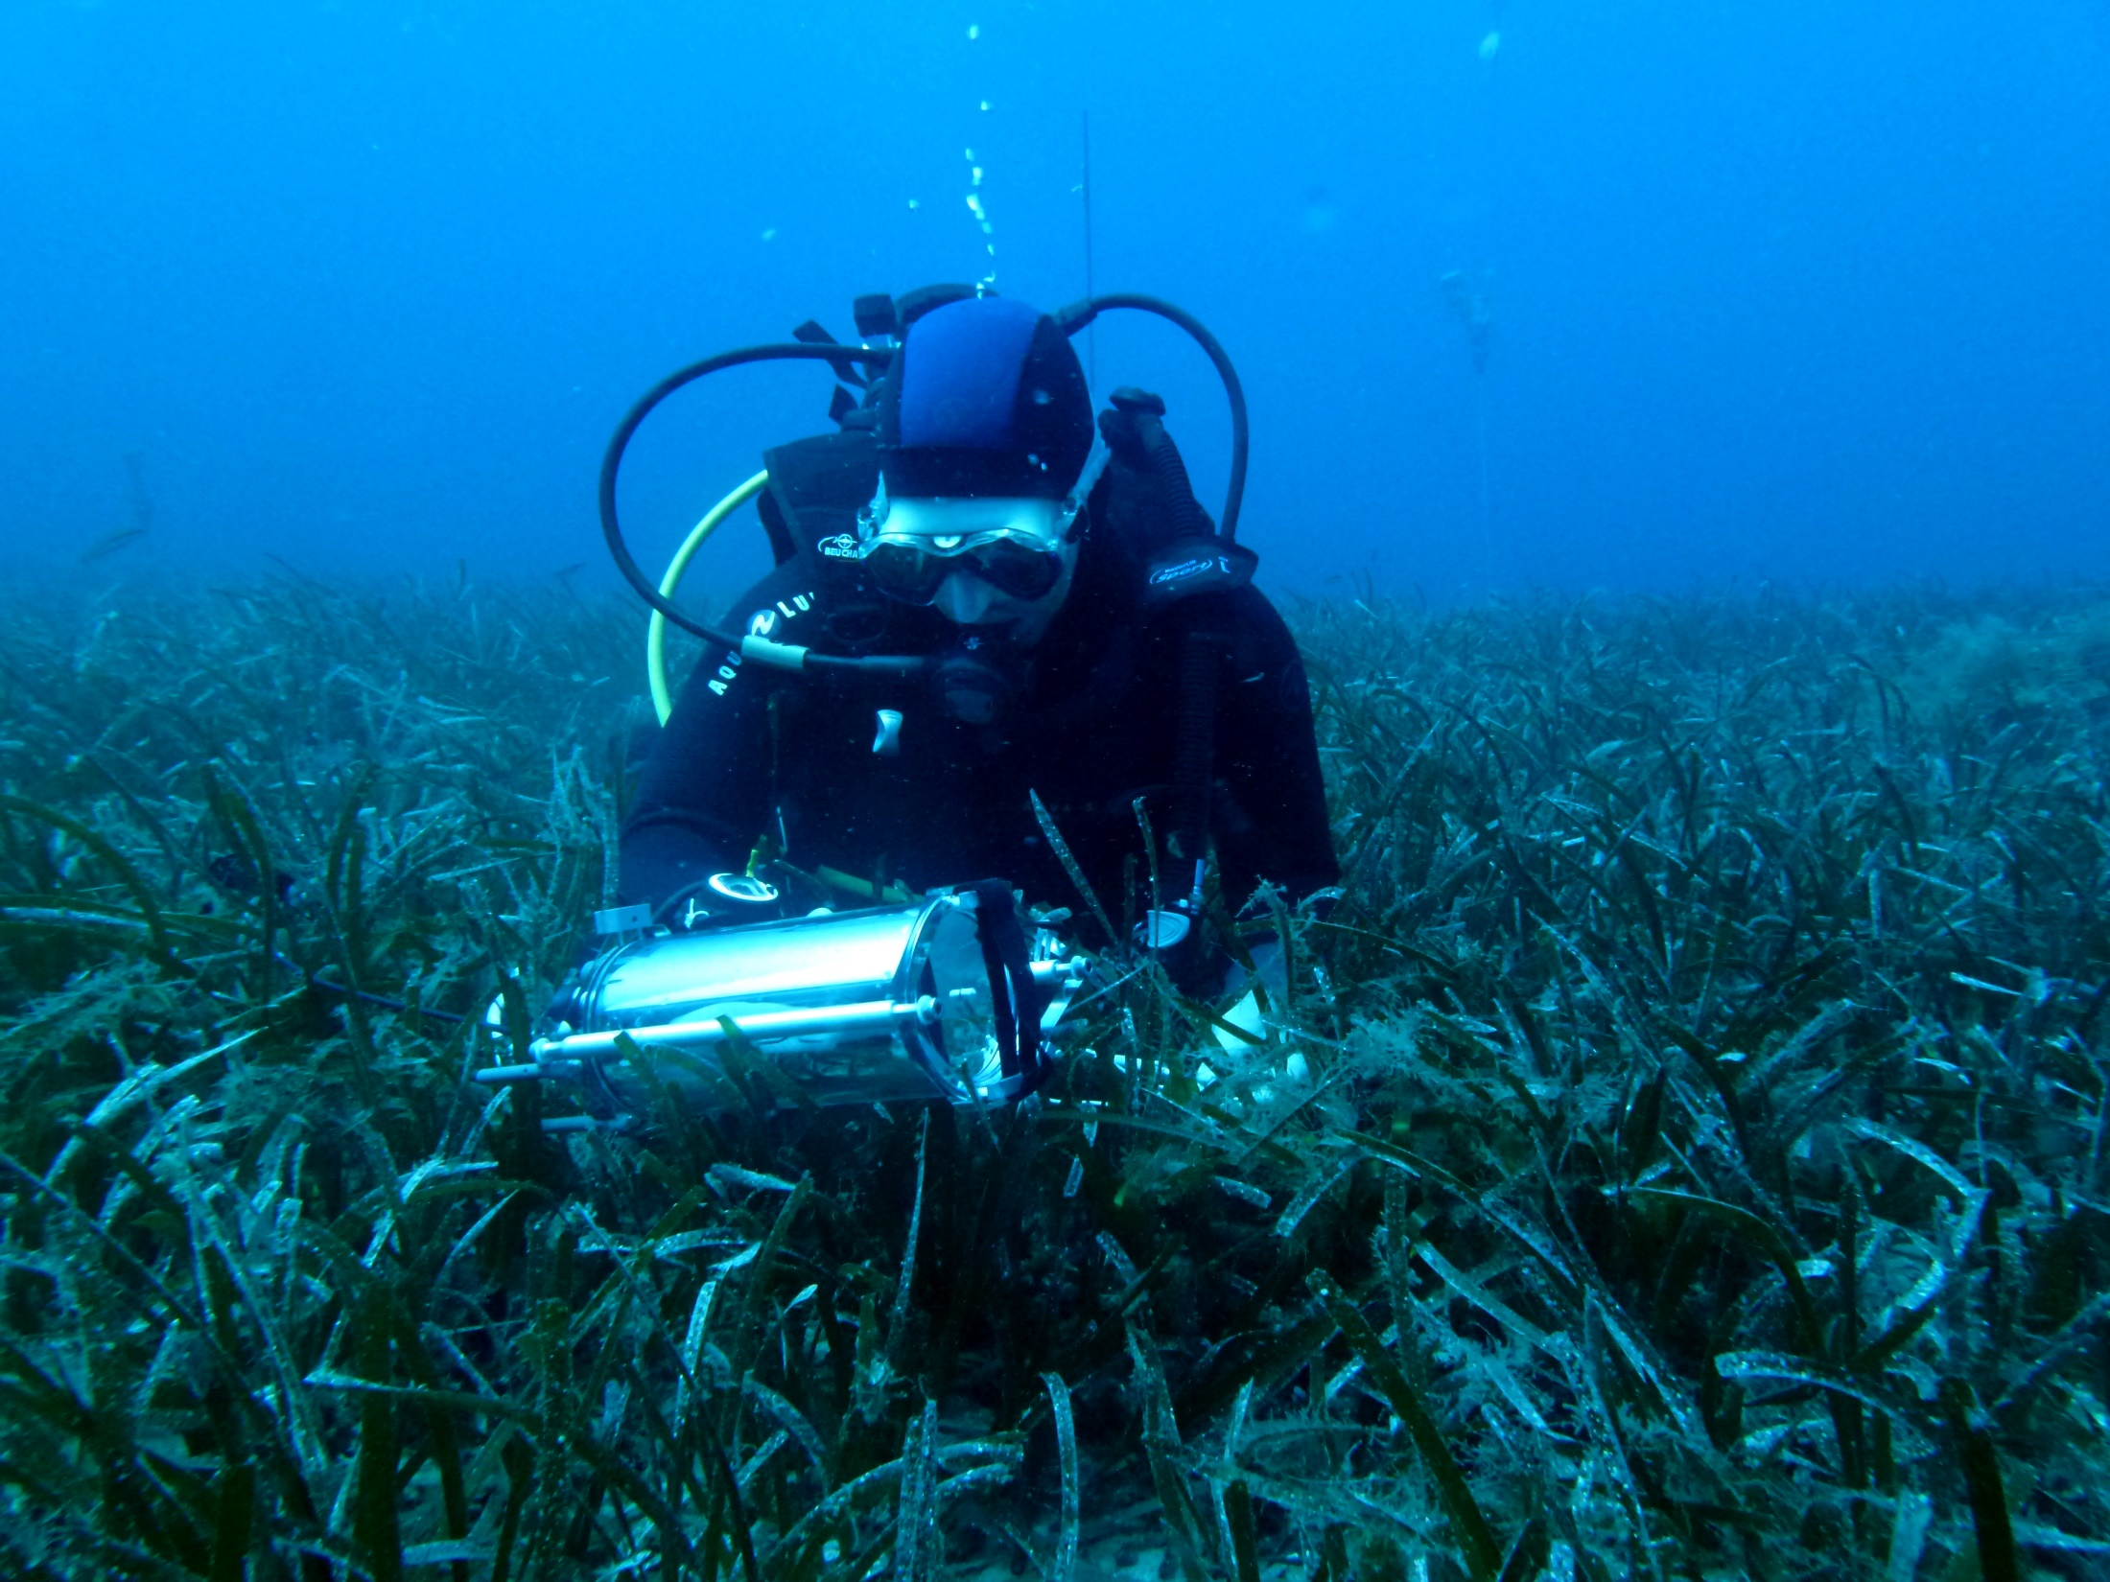
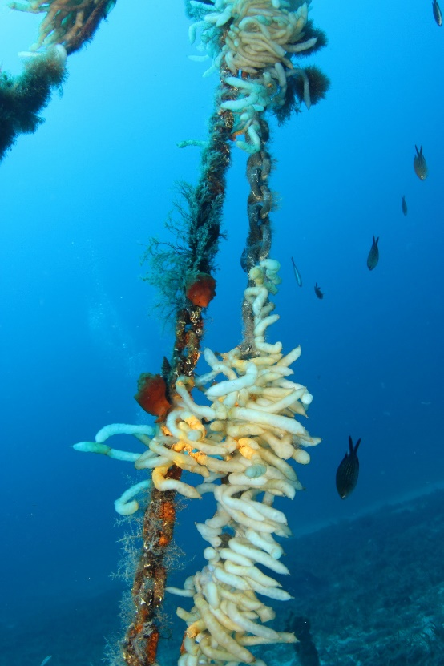
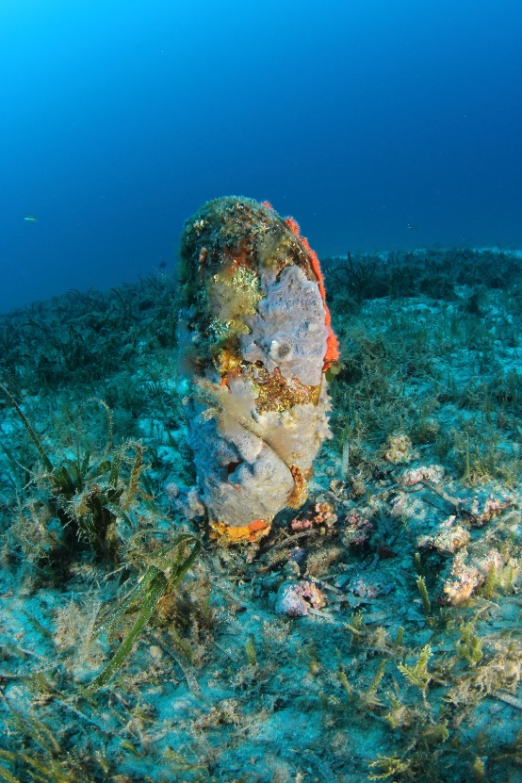
One-year survey (2015-2016)

Slide 10
ETR = YIELD x PAR x 0.5 x ETR-factor
Evolution of leaf light absorptance at 10 m depth
Absorptance
Evolution of leaf light absorptance with depth
Absorptance

Slide 11
Effective photochemical efficiency

Slide 12
Effective photochemical efficiency

Slide 13
Effective photochemical efficiency

Slide 14
Effective photochemical efficiency

Slide 15
Rapid Light Curve

Slide 16
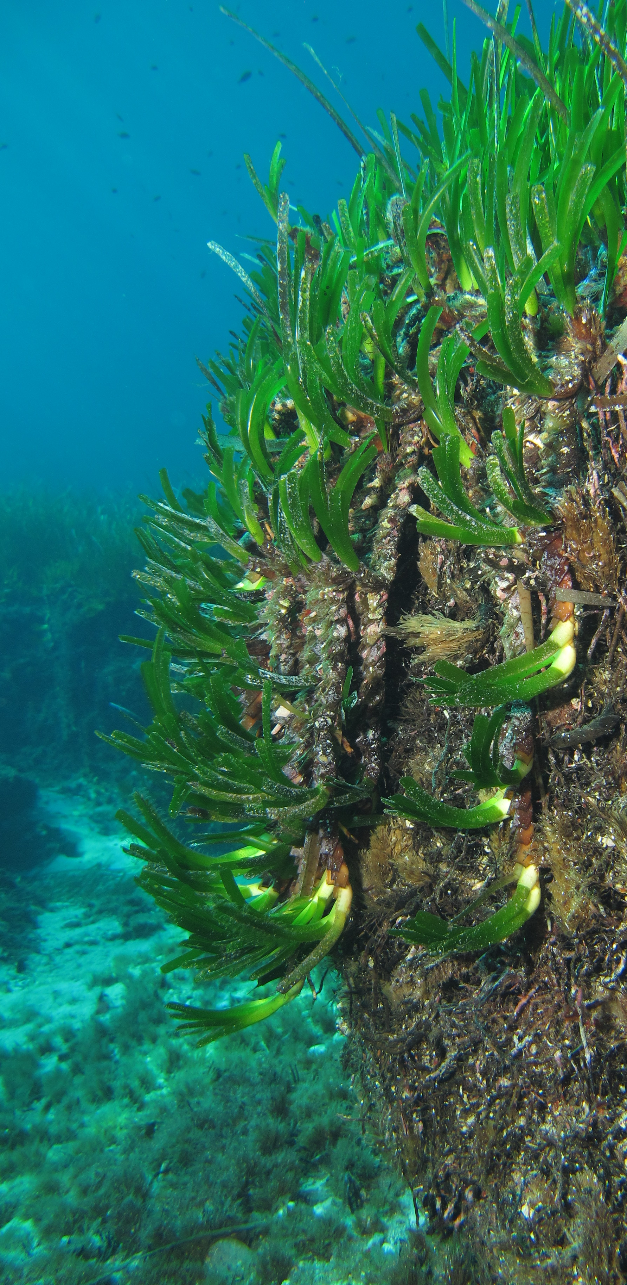
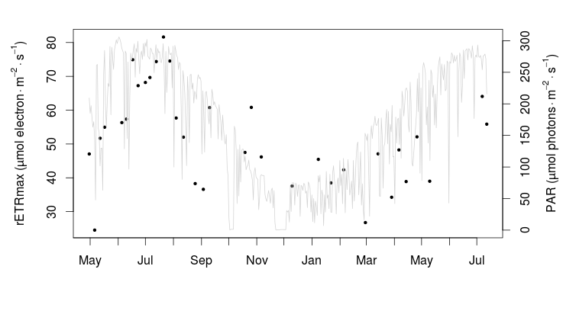
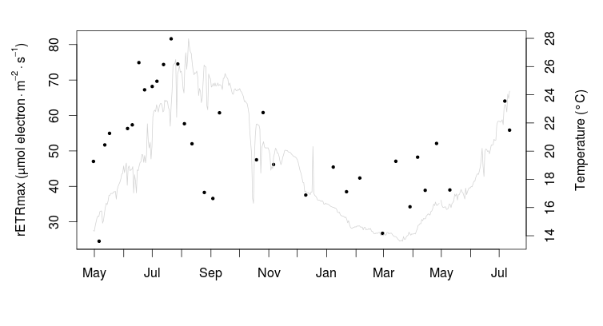
rETRmax vs PAR
rETRmax vs temperature

Slide 17
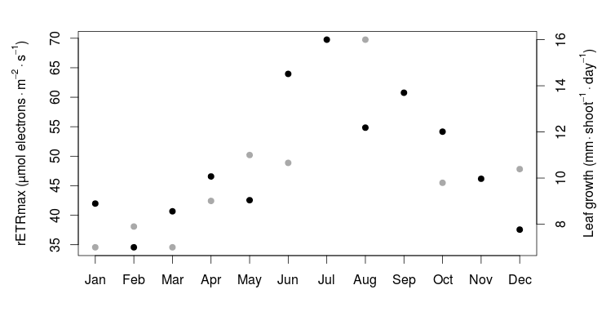
rETRmax = leaf growth proxy ?

Slide 18
Rapid Light Curve

Slide 19
Light and Temperature

Slide 20
Conclusion et perspectives
Etude de la photosynthèse de Posidonia oceanica par fluorimétrie modulée …
méthode rapide et peu couteuse pour :
études écophysiologiques.
études écotoxicologiques?
La suite:
- relations photosynthèse vs croissance foliaire,
- relations photosynthèse et PP (O₂),
- biomarqueur de terrain.

Slide 21
