Slide 1



Experimentation and driving cycle performance of three architectures for waste heat recovery trough Rankine cycle and organic Rankine cycle of a passenger car engine.
Olivier Dumontª, Mouad Diny^{b} & Vincent lemortª
ª University of Liege (Belgium)
^{b} PSA Groupe, Direction Recherche et Dévelopement (France)

Slide 2
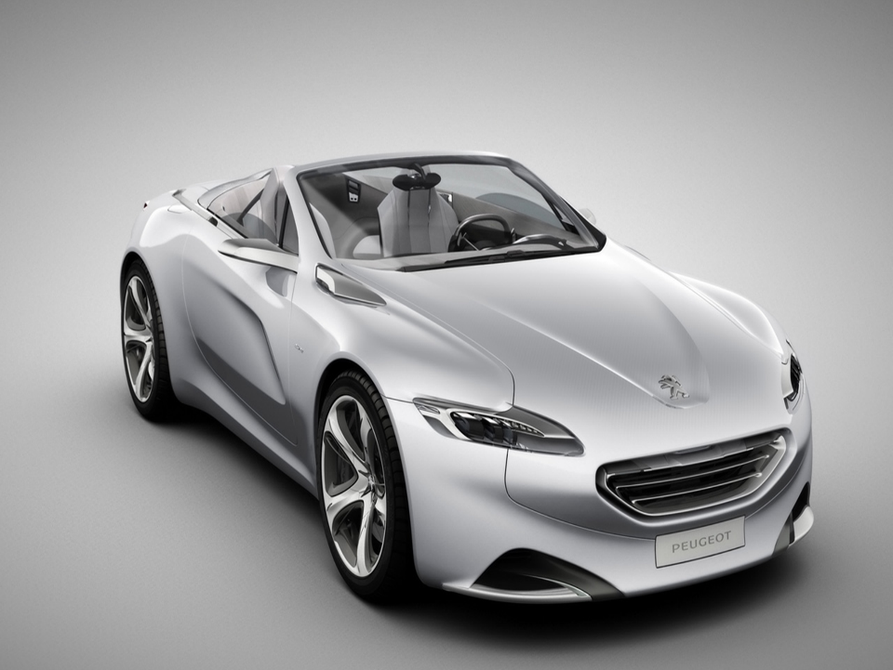
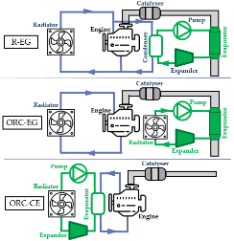
Introduction Table of content
Introduction
Conclusions and prospects
Experimental investigation
Driving cycle performance

Slide 3
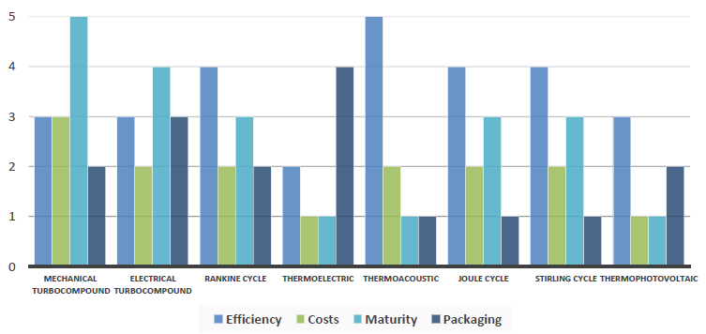
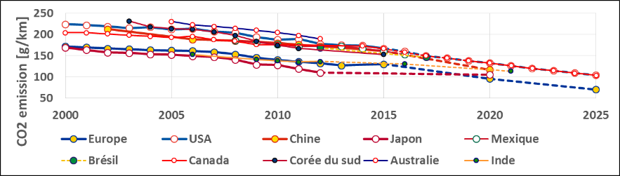
Introduction Context
Energy transition in the transport sector
World convergence on CO2 emissions limitations
Interest for the Rankine cycle
[] Energies;ISSN 1996-1073 4, Comparison and impact of waste heat recovery technologies on passenger car fuel consumption on a normalized driving cycle. 8 Legros Arnaud Guillaume Ludovic , Diny Mouad , Zaïdi Hamid and Lemort Vincent

Slide 4
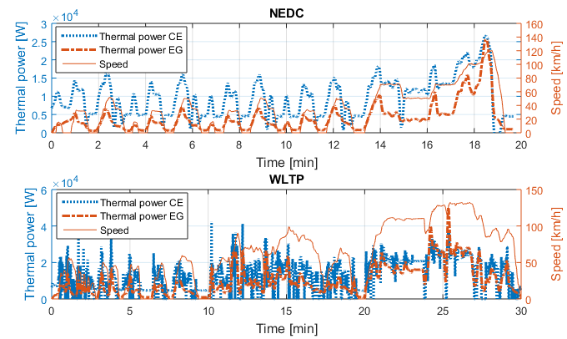
Introduction Driving cycle
WLTP more favorable to high speed and to EG

Slide 5
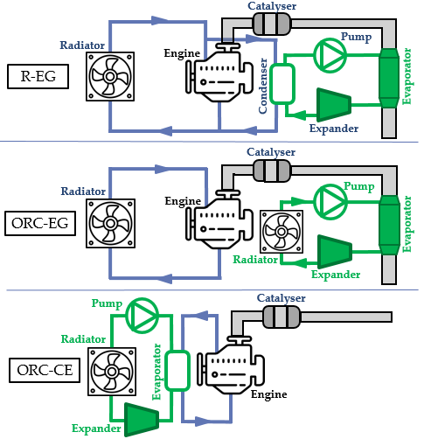
Introduction Considered architectures
Rankine
Exhaust Gas
Organic Rankine Cycle Exhaust Gas
Organic Rankine Cycle Cooling engine

Slide 6
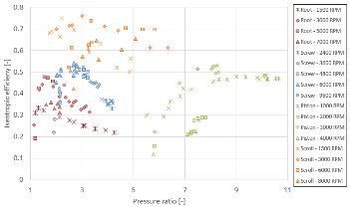
Table of content Experimental investigation
Introduction
Conclusions and prospects
Experimental investigation
Driving cycle performance

Slide 7

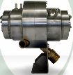
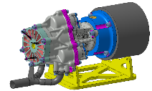
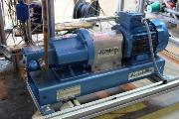
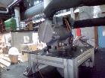

Experimental investigation Experimental set-up
Component | Characteristics | R-EG |  | ORC-CE | ORC-EG
Working fluid | Rankine | Water |  | R245fa
Evaporator | Type | HC | CC | Plate heat exchanger
 | Mass [kg] | 3.7 | 6.54 | 52 | Confidential
 | Volume [m³] | 2.37 | 1.96 | 0.009 | Confidential
 | Exchange area (wf) [m²] | 0.708 | 0.254 | 9.8 | Confidential
Expander | Type | Scroll | Turbine | Scroll 1 | Scroll 2
 | Volume ratio [-] | 3 | - | 2.19 | 2.23
 | Swept volume [cm³] | 8 | - | 12.74 | 19.05
 | Maximal temperature [°C] | 250 | 220 | 130 | 130
 | Maximal pressure [bar] | 20 | 10 | - | -
 | Nominal power [kW] | ~ 4 | 1.5 | ~1 | ~1
 | Maximal shaft speed [RPM] | 15 000 | 30 000 | [1000:8000] | [500:5000]
Pump | Type | Gear |  | Diaphragm
 | Swept volume [cm³] | 0.5 |  | 6.8e-6
 | Maximal mass flow rate [g/s] | 20 (5000 RPM) |  | 130
 | Maximal pressure [bar] | 20 |  | 40
Condenser | Type | Brazed plate |  | Air-cooled
 | Number | 1 | 2 | 3
 | Mass [kg] | 1.05 | 2.2 | -
 | Volume [m³] | 1.088 | 2.05 | 14
 | Water exchange area [m²] | 0.628 | 0.88 | 4.66
Green turbine
www.greenturbine.nl

Slide 8
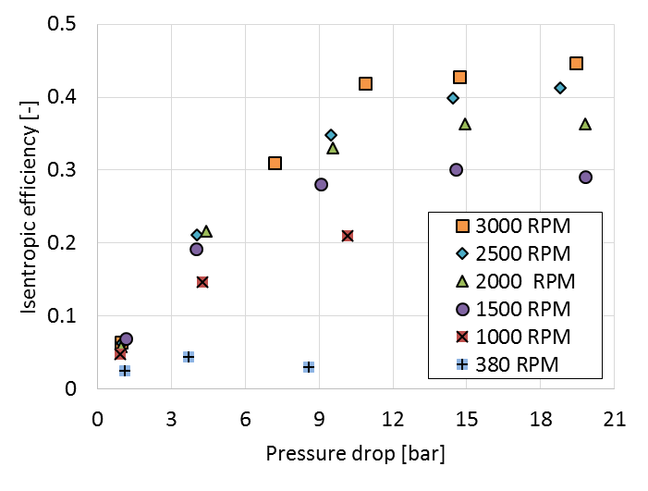
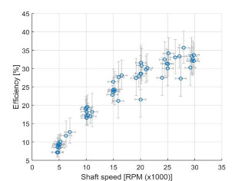
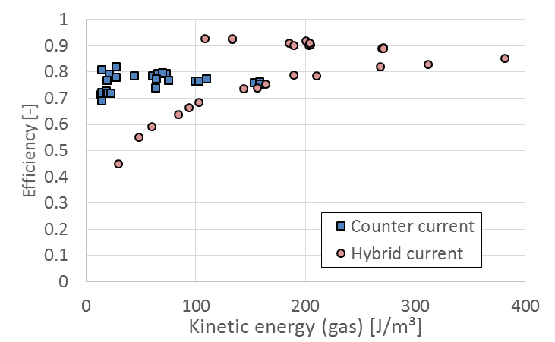
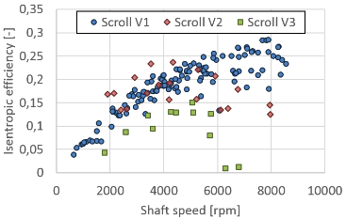

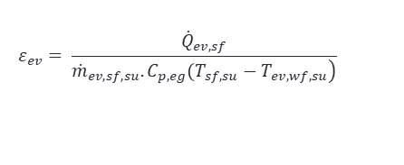
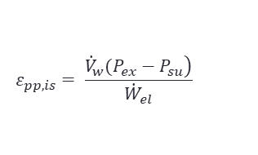
Experimental investigation Rankine – Exhaust gas (R-EG)
Gear pump ➔ mature
Green turbine ➔low efficiency
$$ε_{pp,is}= \frac{\left.{\dot{V}}_{w}(P_{ex}−P_{su}\right)}{{\dot{W}}_{el}}$$
$$ε_{exp,is}=\frac{{\dot{W}}_{el}}{{\dot{m}}_{wf}(h_{su}−h_{ex,is})}$$
$$ε_{ev}= \frac{{\dot{Q}}_{ev,sf}}{\left.{\dot{m}}_{ev,sf,su}.C_{p,eg}(T_{sf,su}−T_{ev,wf,su}\right)}$$
Scroll prototype ➔ leakages
Evaporators ➔ mature
Dumont, O., Diny, M., Lemort, V., Experimentation and modelling of a 1.5 kW axial turbine for waste heat recovery on a passenger car through the use of a RANKINE cycle, 4th EORCC Workshop, Detroit 2017.

Slide 9
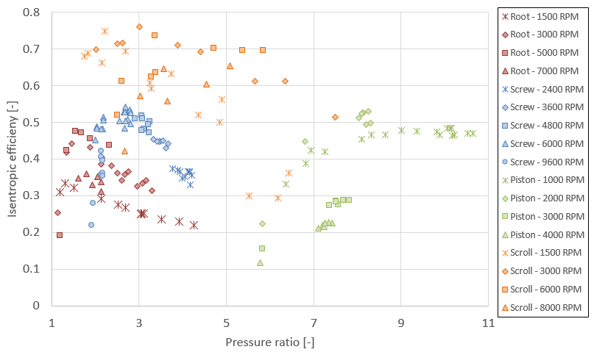
Experimental investigation ORC – Cooling engine (ORC-CE)
Expanders
Dumont, O., Dickes, R., Lemort, V., Experimental investigation of four volumetric expanders, Energy Procedia 2017, Volume 129, Pages 856
Efficiency
Flexibility
Extreme conditions
Low rv
No optimal expander (depends of the application)

Slide 10
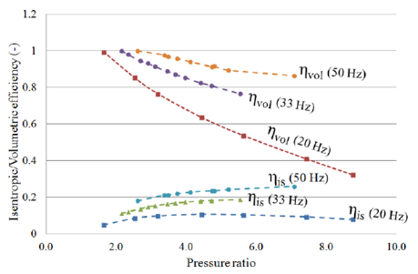
Experimental investigation ORC – Cooling engine (ORC-CE)
Diaphragm pump
Mature but rather low efficiency

Slide 11
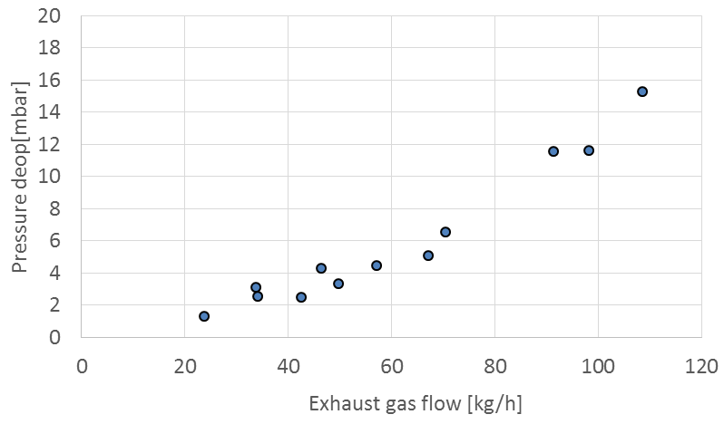
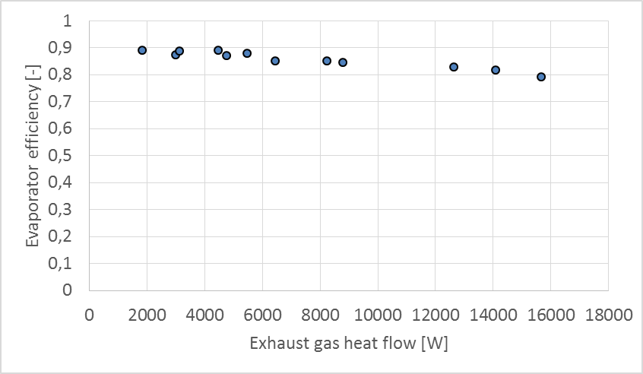
Experimental investigation ORC – Exhaust gas (ORC-EG)
Evaporator
Mature & efficient

Slide 12
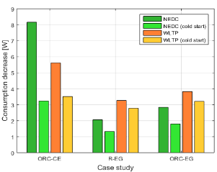
Table of content Driving cycle performance
Introduction
Conclusions and prospects
Experimental investigation
Driving cycle performance

Slide 13
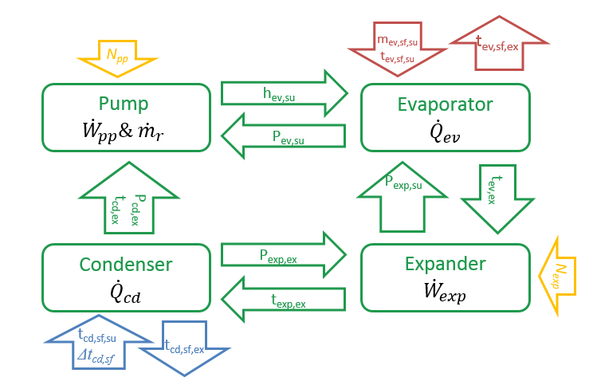
Driving cycle performance Semi-empirical modeling
Low CPU time, robust, extrapolability
OH = 5 K
N_{exp} optimized
SC = 5 K
Validated & accurate models

Slide 14
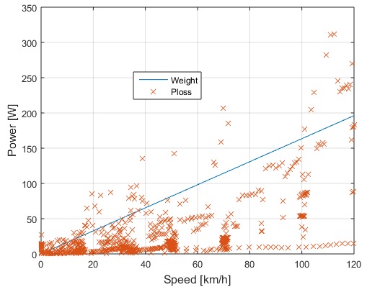


Driving cycle performance Hypothesis
Steady state
Cold start (EG=100s, CW=800s)
Weight losses (30 kg)
Pumping losses ($\dot{V}ΔP$)
All energy useful (maximum)
$${Δ\dot{W}}_{WHRS}=\frac{{\dot{W}}_{WHRS}−{\dot{W}}_{weight}−{\dot{W}}_{Ploss}}{{\dot{W}}_{mec}}$$

Slide 15
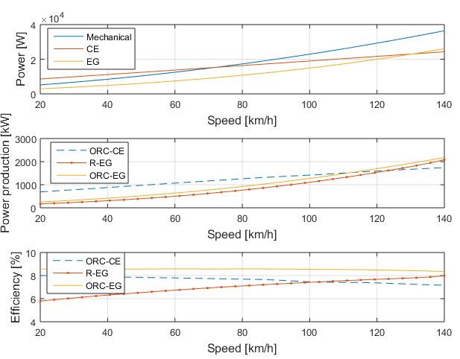
Driving cycle performance Performance
EG more performant at high speeds

Slide 16
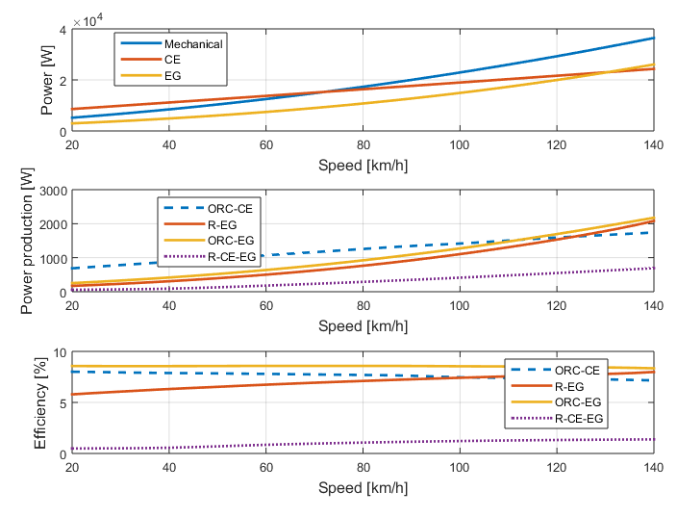
Comparison

Slide 17
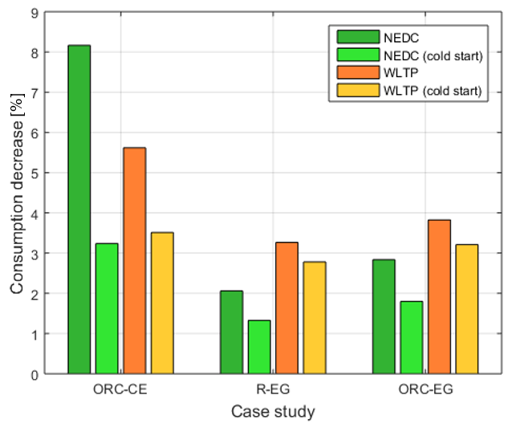
Driving cycle performance Comparison
NEDC more favorable to CE
1
2
3
[2.8:3.5] % consumption decrease in a realistic case

Slide 18
Driving cycle performance Summary
Architecture | EG | CE
Energy on a driving cycle | - | +
Pumping losses produced with the additional heat exchanger in the exhaust gases | - | +
Higher temperature (exergy/efficiency) | + | -
Cold start | + | -
Architecture | R-EG | ORC-EG | ORC-CE
Maximum performance | ++ | +++ | +
Part load performance (driving cycle) | - | - | ++
Working fluid stability | ++ | - - - | ++
Influence of ambient conditions | + | + | -
Low investments/maturity/simplicity | - | - | ++
Control | -- | - | ++
ORC-CE looks promising but only for >15min journeys

Slide 19

Table of content Conclusion
Introduction
Conclusions and prospects
Experimental investigation
Driving cycle performance

Slide 20
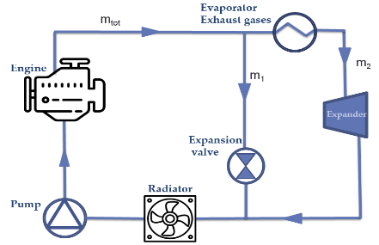

Conclusions
3 architectures considered for WHR on a passenger car
ORC-EG: refrigerant chemical stability
R-EG: lower performance+non mature
ORC-CE: simple, cheap, performance but high inertia
Perspectives
New architecture? Fluids?
More expansion machines

Slide 21



Thank you!
olivier.dumont@ulg.ac.be
Open source papers ➔ http://orbi.ulg.ac.be

