Slide 1
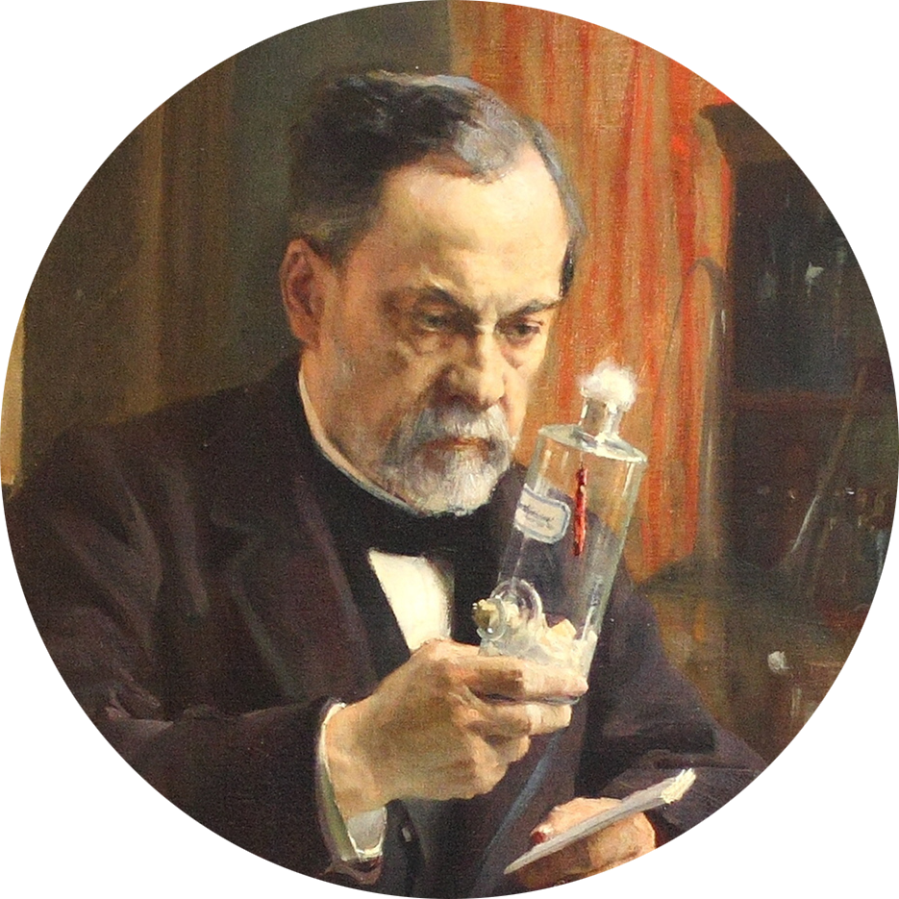
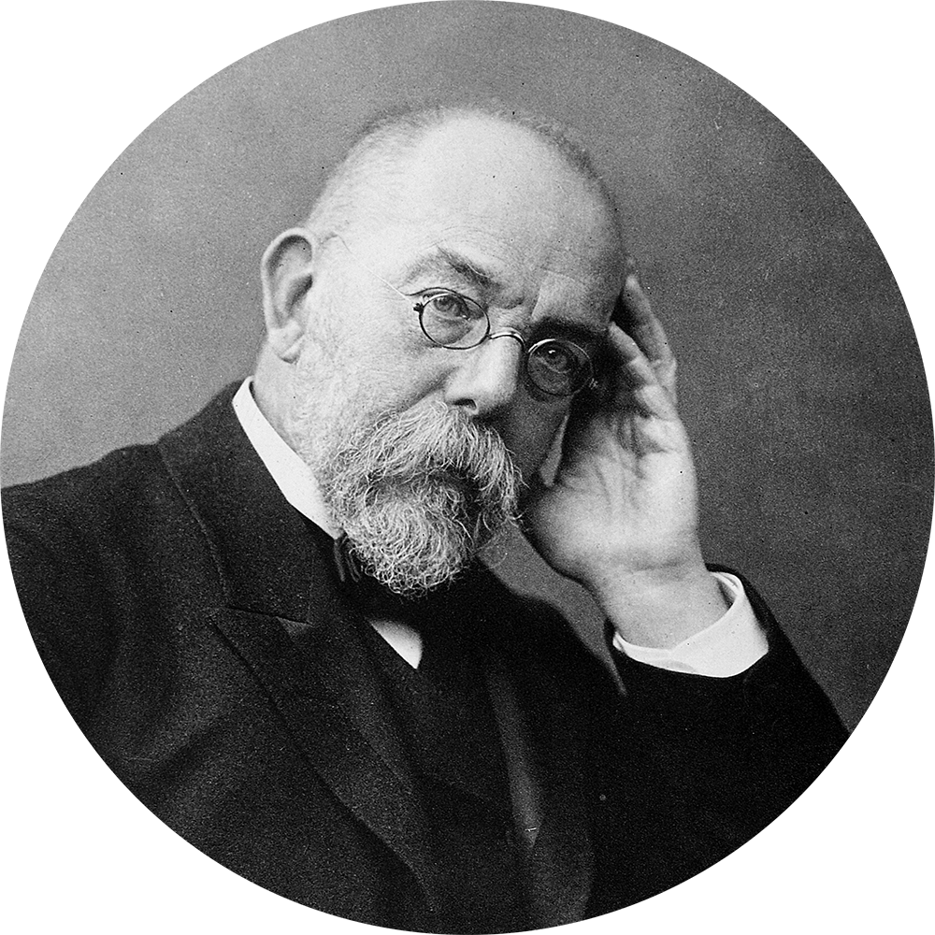
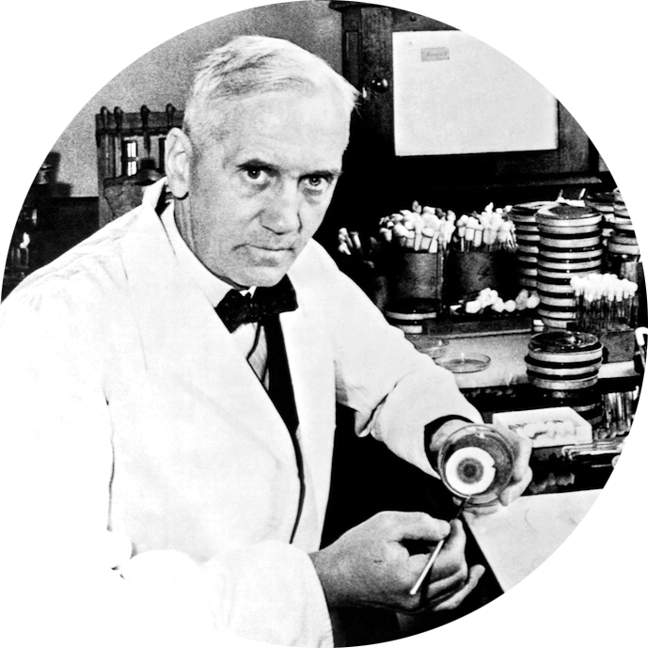
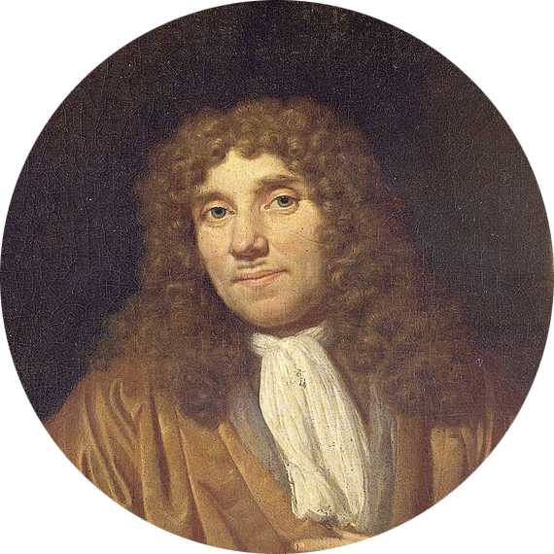


Synthesis of Stable and Radioactive
Isotope-containing Peptidoglycan Fragments
A thesis submitted by Nicolas Lamborelle
Guided by Professor André Luxen
11 juin 2018
1670’s
1864
1882
1929
1943
1929
1947
1952
1953
1954
1962
1964
1980
1990
2000
2010
2020
D I S C O V E R Y V O I D
A. Van Leeuwenhoek
observes bacteria for the first time “animalcula”
L. Pasteur
Explains the fermentation process
R. Koch
Discovers Mycobacterium tuberculosis
A. Fleming
Discovers penicillin
Notes:
Pasteur explique de phénomène de fermentation 1864
Koch découvre que la tuberculose est due à une bactérie 1882
Flemming découvre la pénicilline 1929

Slide 2
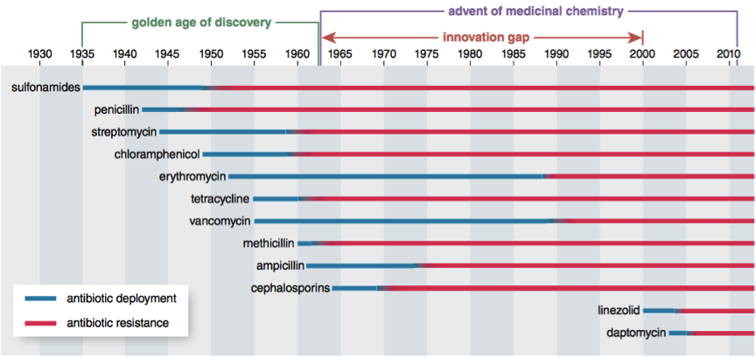
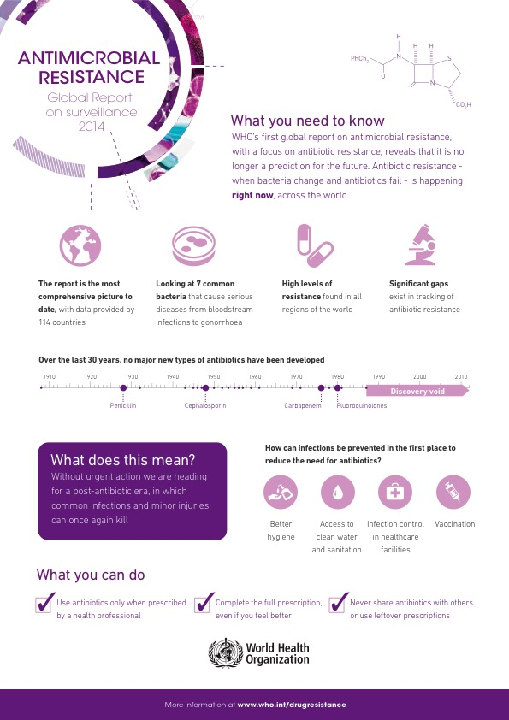
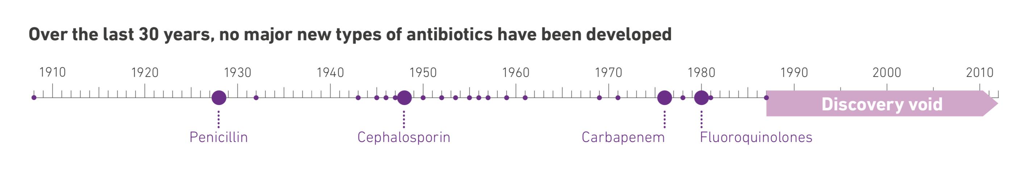
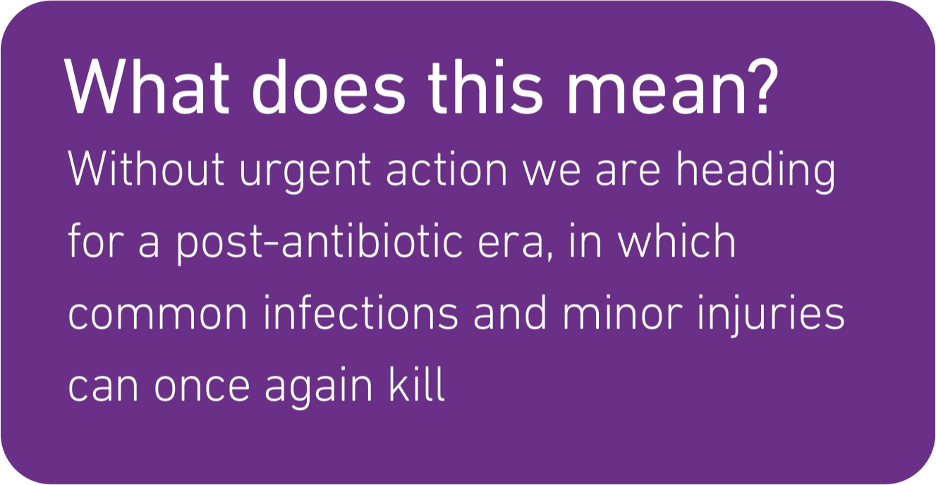
Stakes
In the European Union:
25 000 deaths / year
1.5 billion € / year
A paradox:
Pharmaceuticals companies, which became so powerful thanks to the antibiotics development, are now neglecting it.
Antimicrobial resistance: global report on surveillance 2014. URL: http://www.who.int/drugresistance/documents/surveillancereport/en/
Lowy FD. Antimicrobial resistance: the example of Staphylococcus aureus. J Clin Invest. 2003 May 1;111(9):1265-1273.

Slide 3
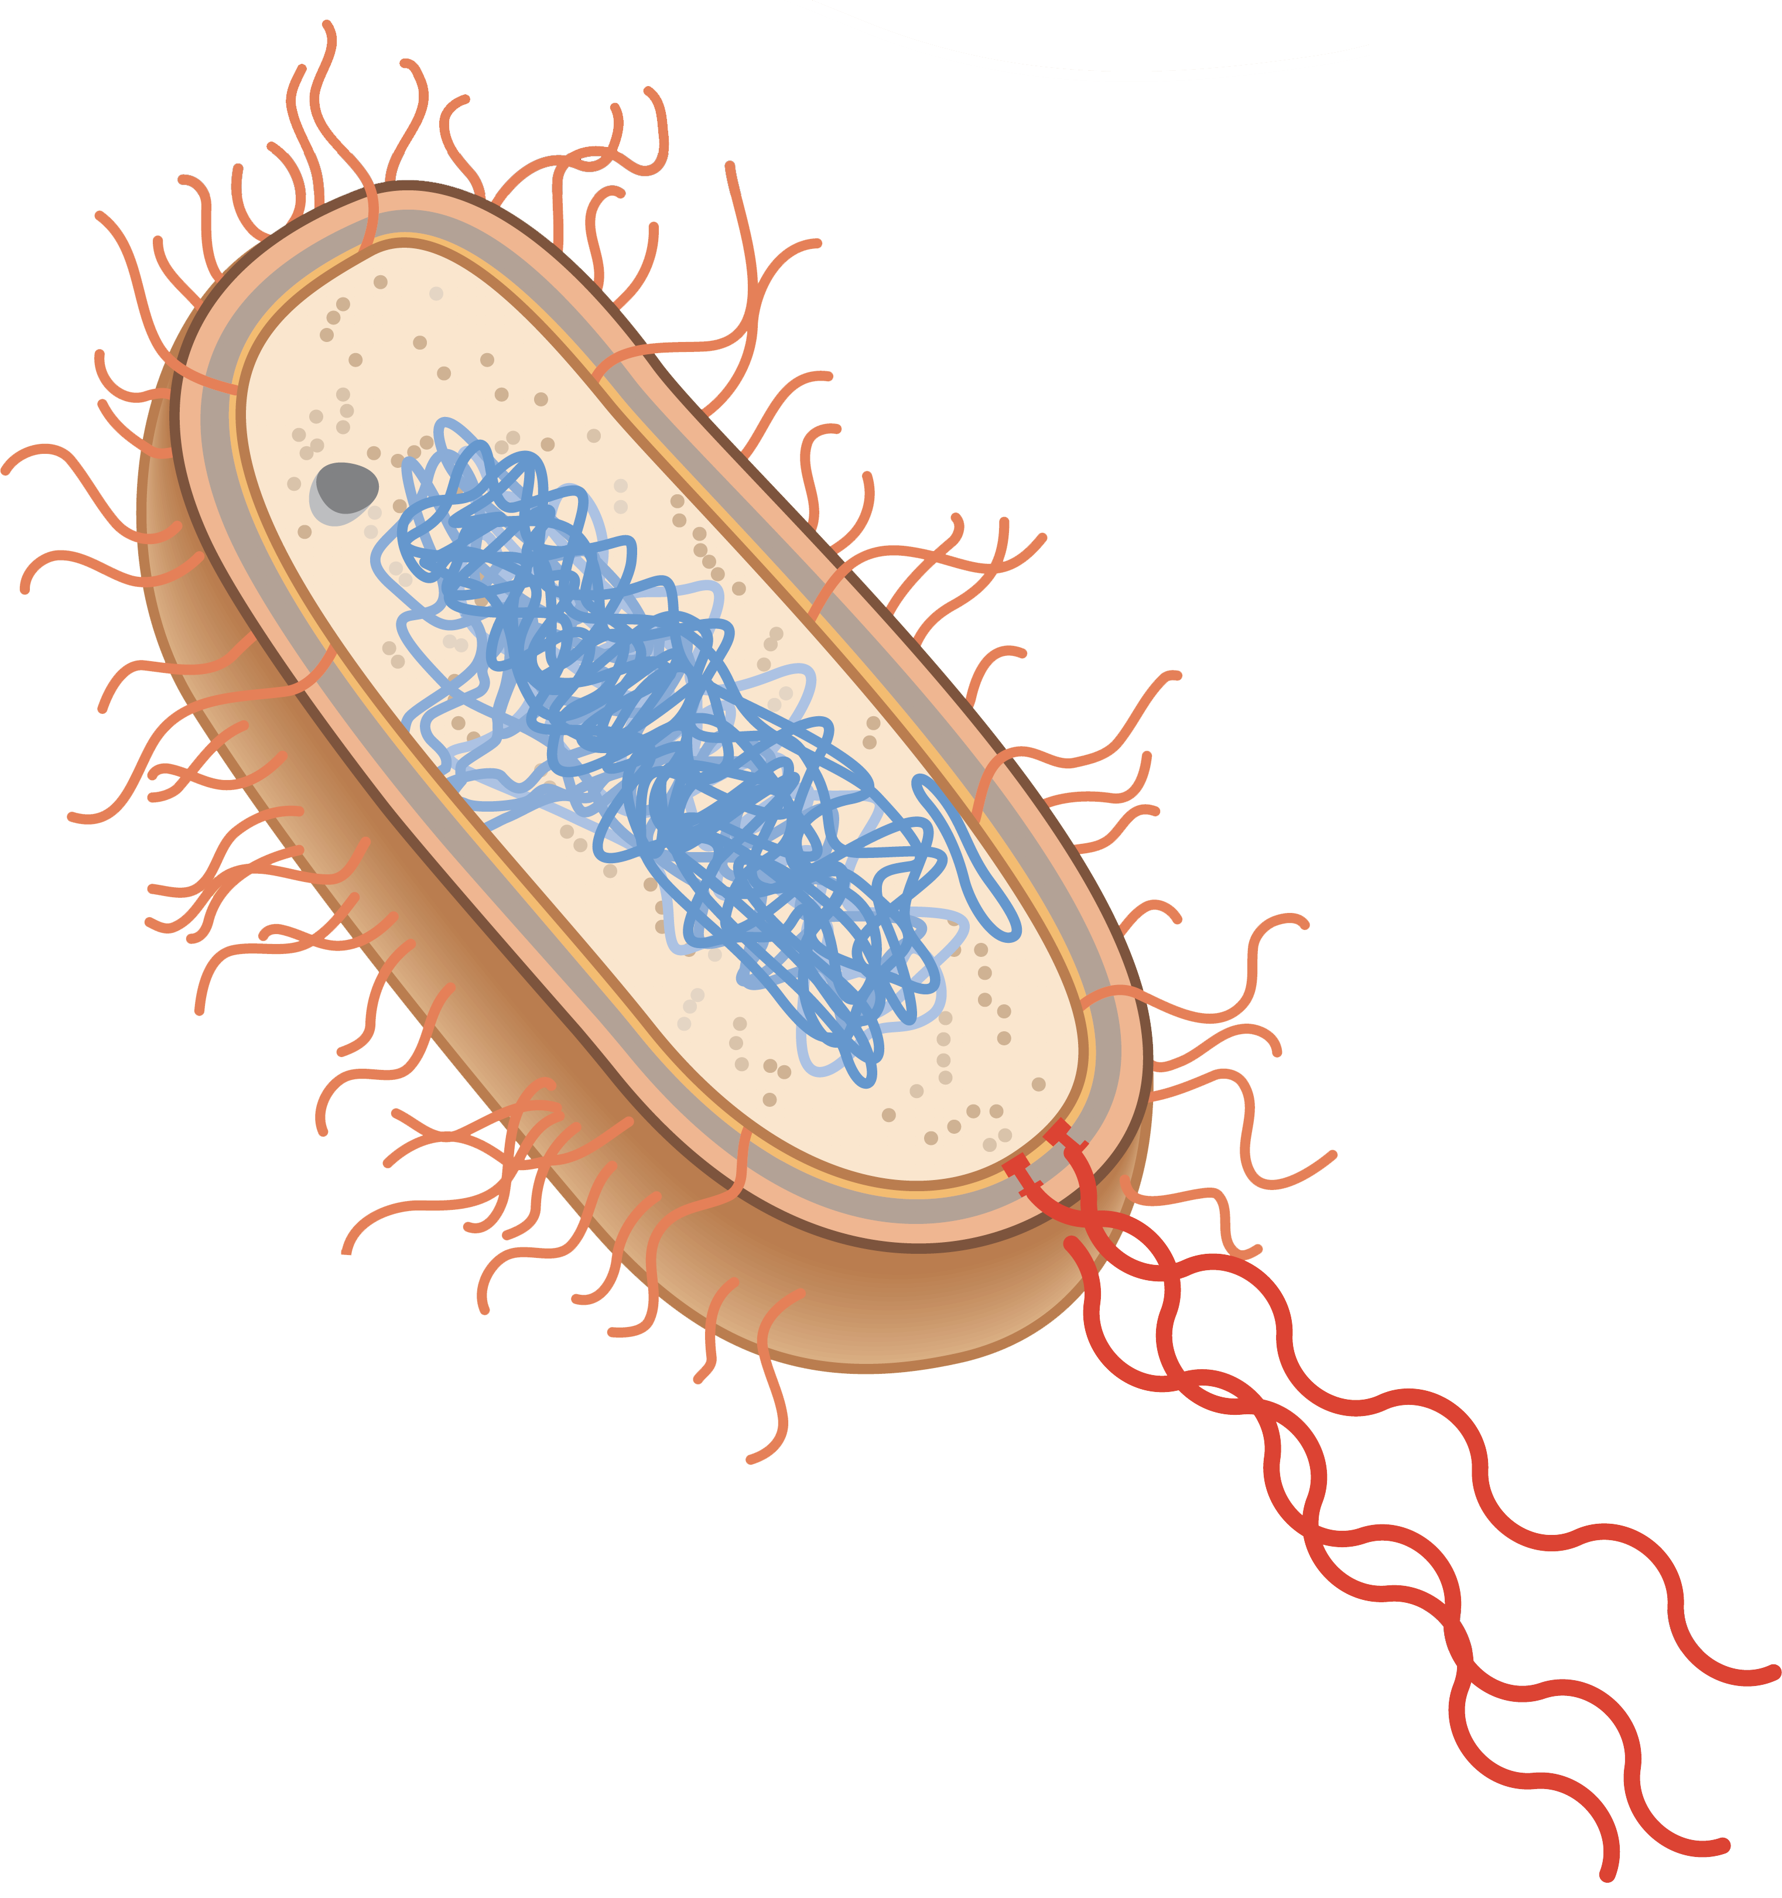
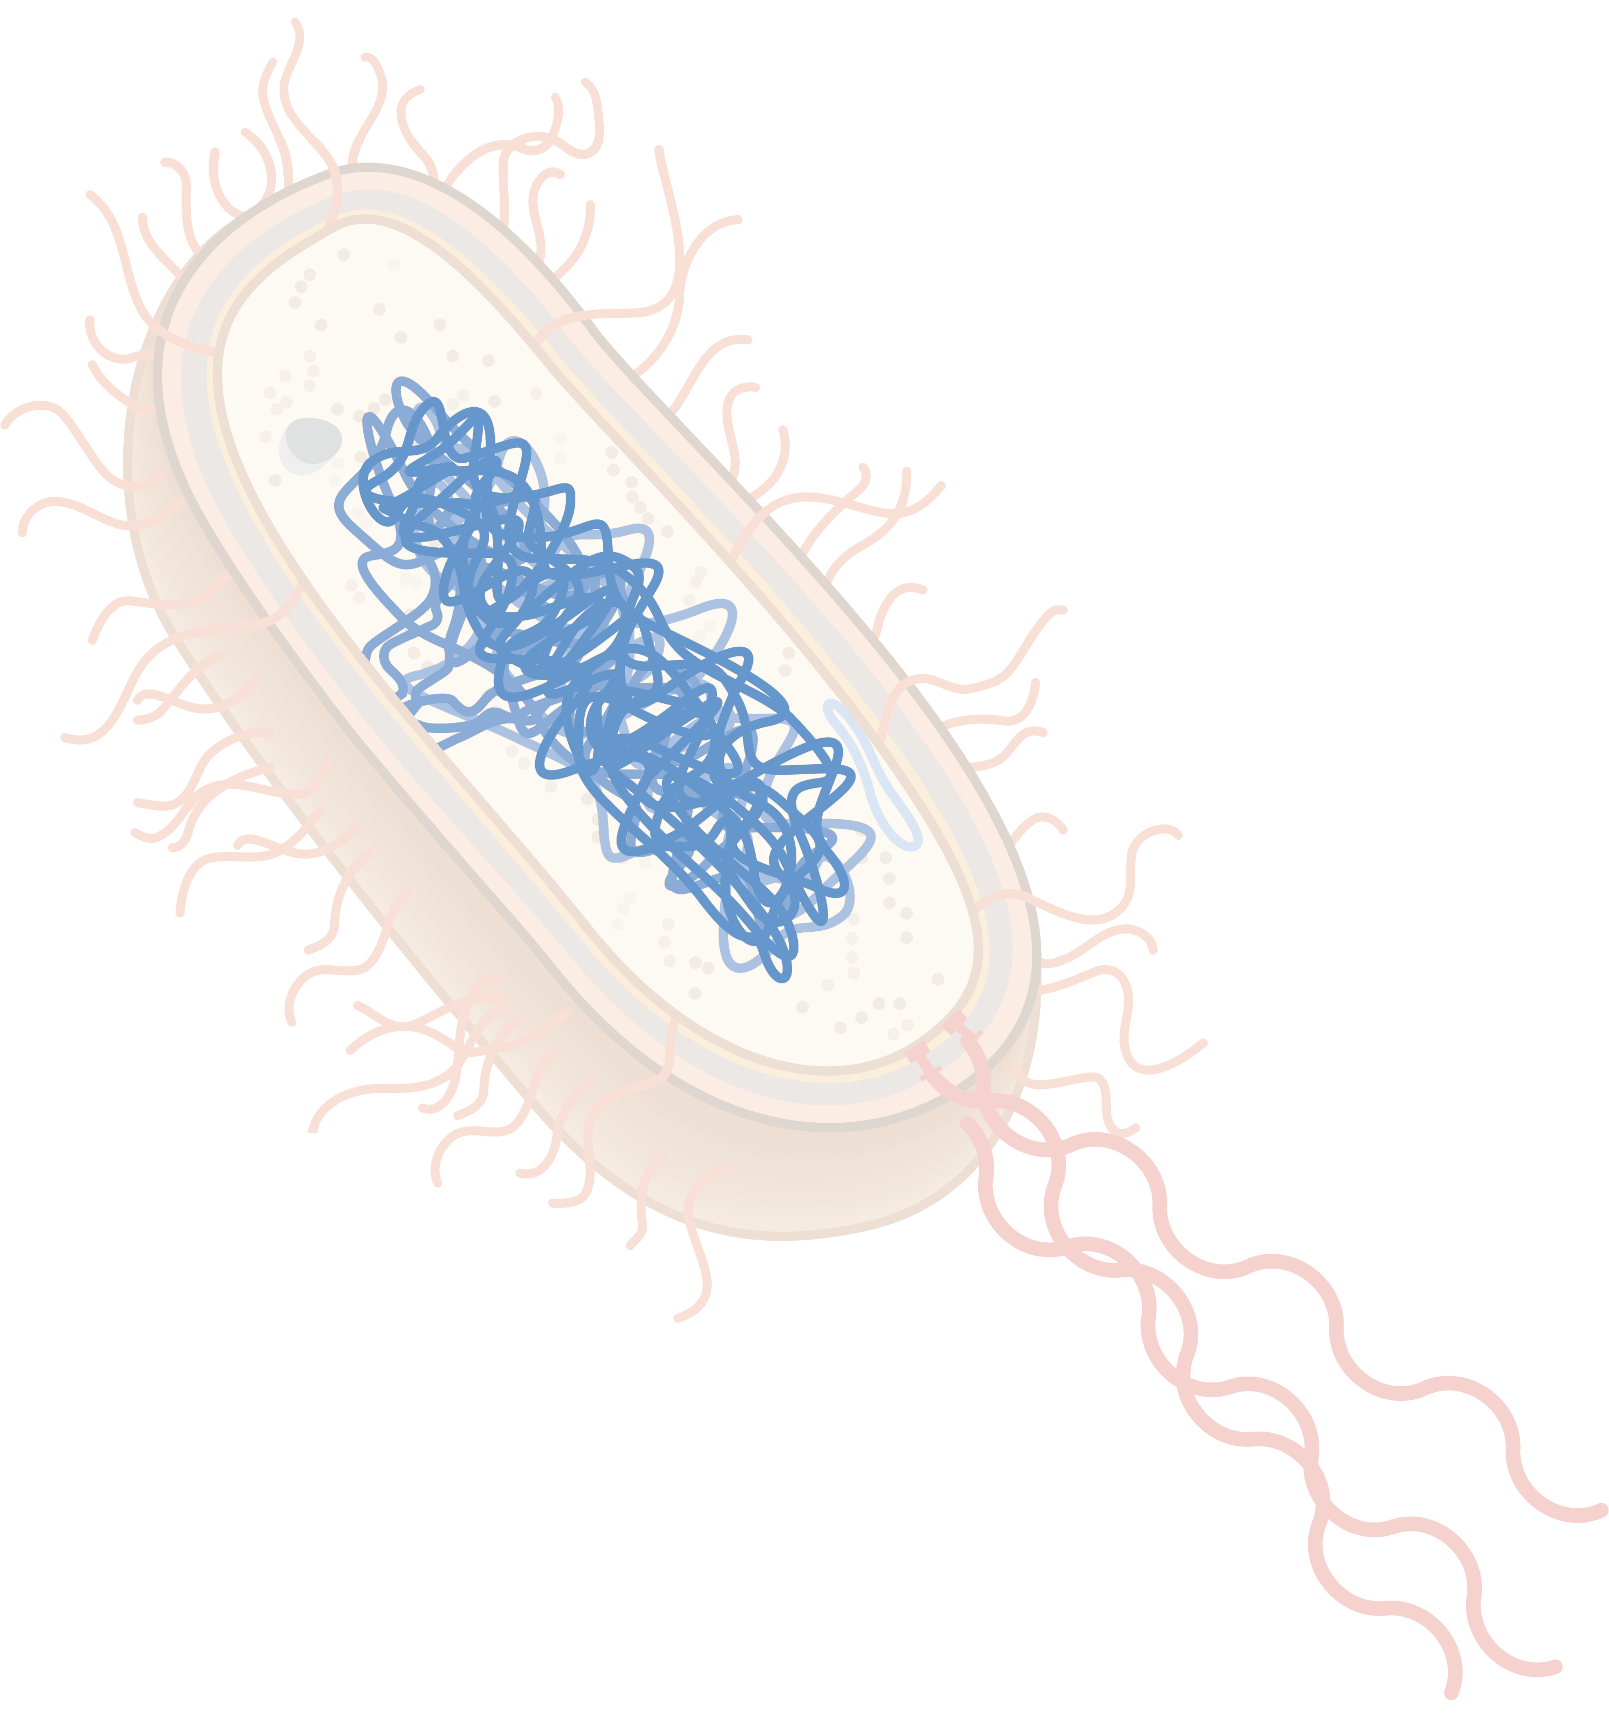



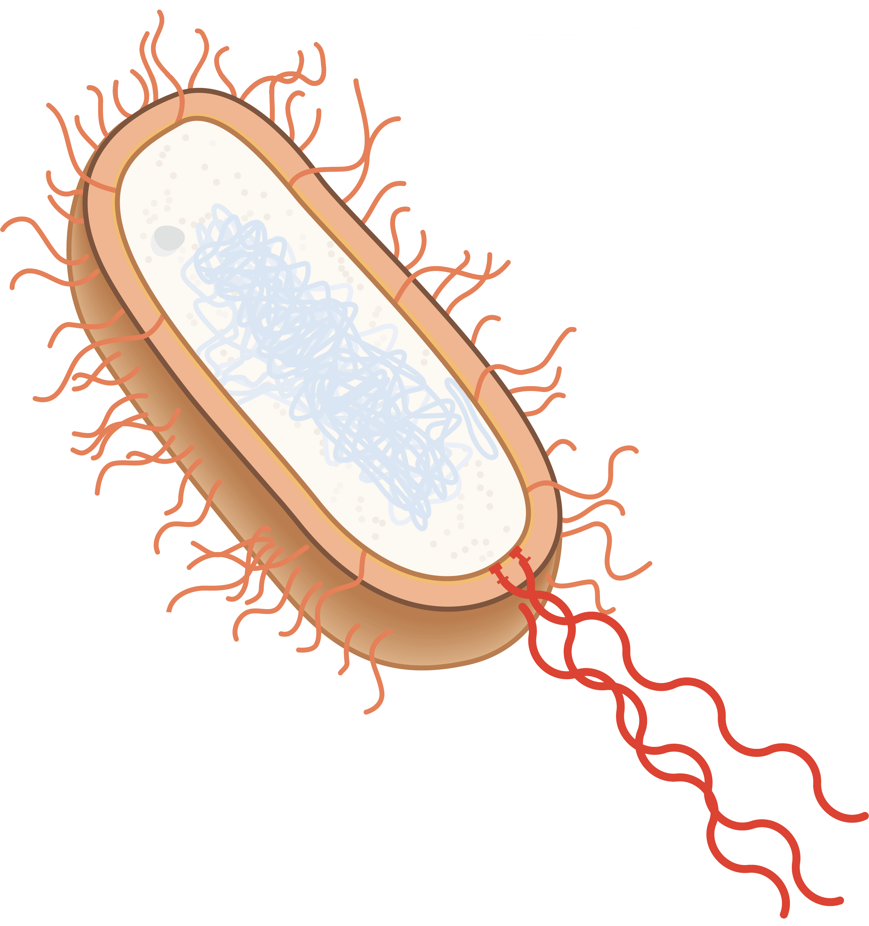
Bacteria
Prokaryotic
microorganisms
vesicle
vesicle
nucleoid
nucleoid
plasmid
plasmid
ribosomes
ribosomes
fimbriae
flagella
Campbell NA, Reece JB, Urry LA, et al. Campbell Biology. Pearson; 2014, 94.

Slide 4


Bacteria
peptidoglycan layer
vesicle
→ antibiotic target
nucleoid
plasmid
ribosomes
fimbriae
flagella
Campbell NA, Reece JB, Urry LA, et al. Campbell Biology. Pearson; 2014, 94.

Slide 5
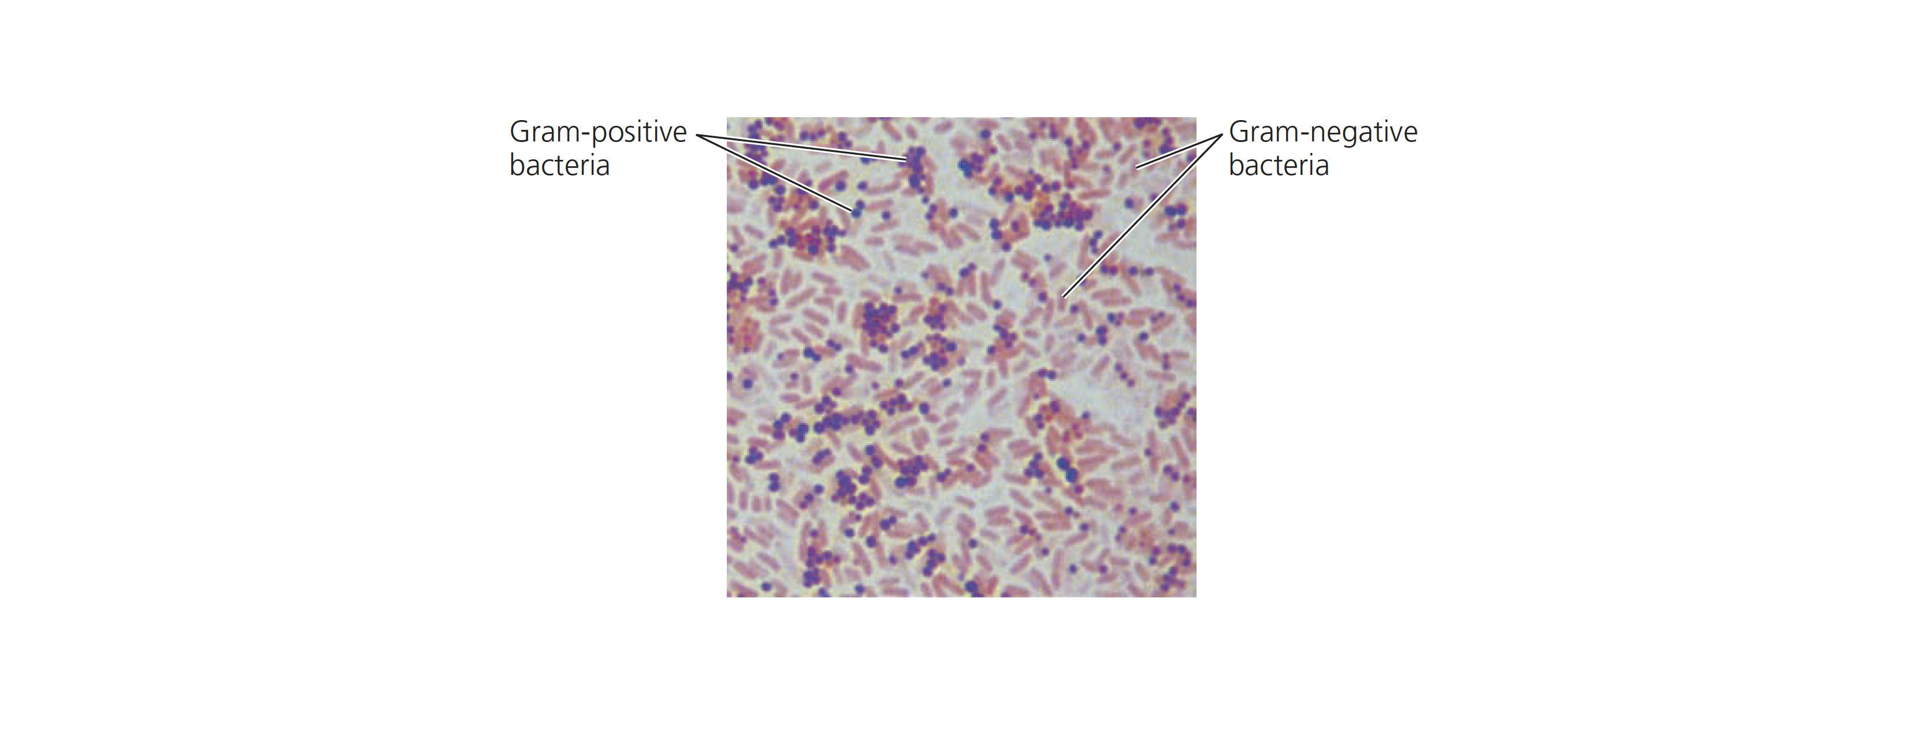
Bacterial cell wall
Two categories of bacteria: Gram+ and Gram-
Campbell NA, Reece JB, Urry LA, et al. Campbell Biology. Pearson; 2014, 569.

Slide 6
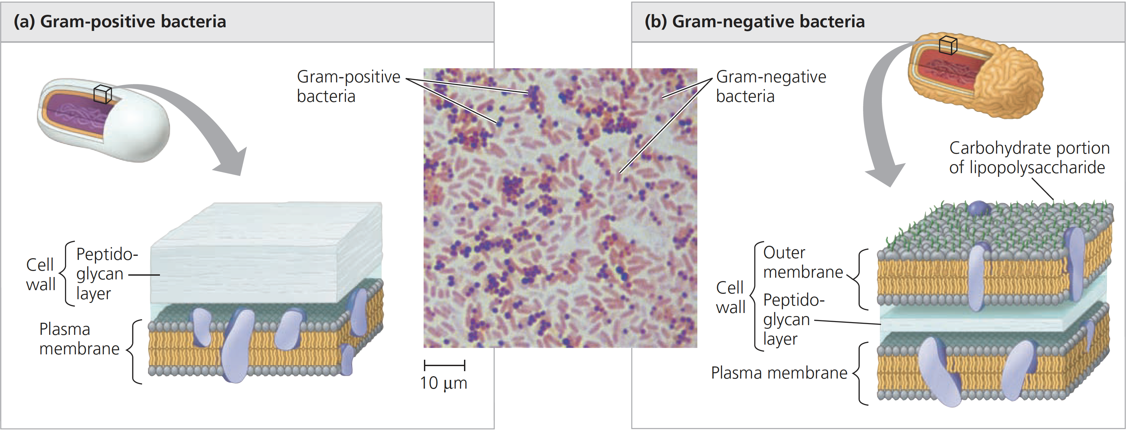
Bacterial cell wall
Two categories of bacteria: Gram+ and Gram- → structural differences
Campbell NA, Reece JB, Urry LA, et al. Campbell Biology. Pearson; 2014, 569.

Slide 7
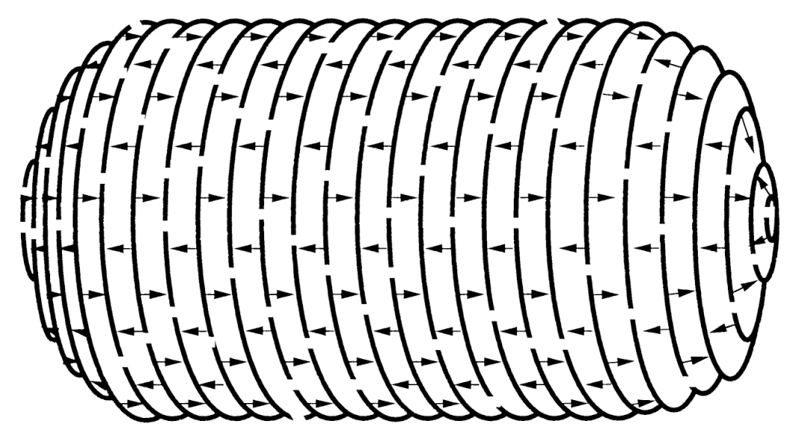
Peptidoglycan
Structure
Holtje J V. Growth of the stress-bearing and shape-maintaining murein sacculus of Escherichia coli. Microbiol Mol Biol Rev. 1998;62(1):181-203.

Slide 8
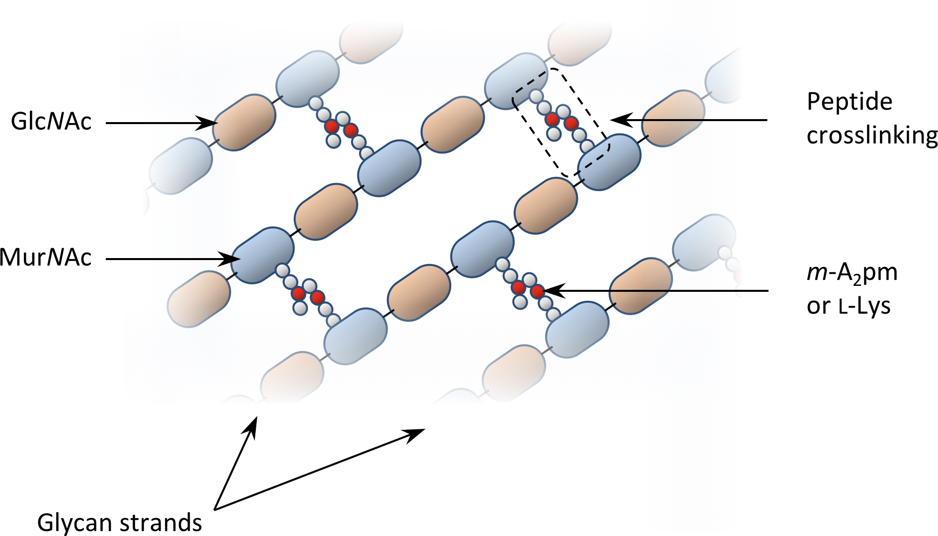
Peptidoglycan
Structure

Slide 9
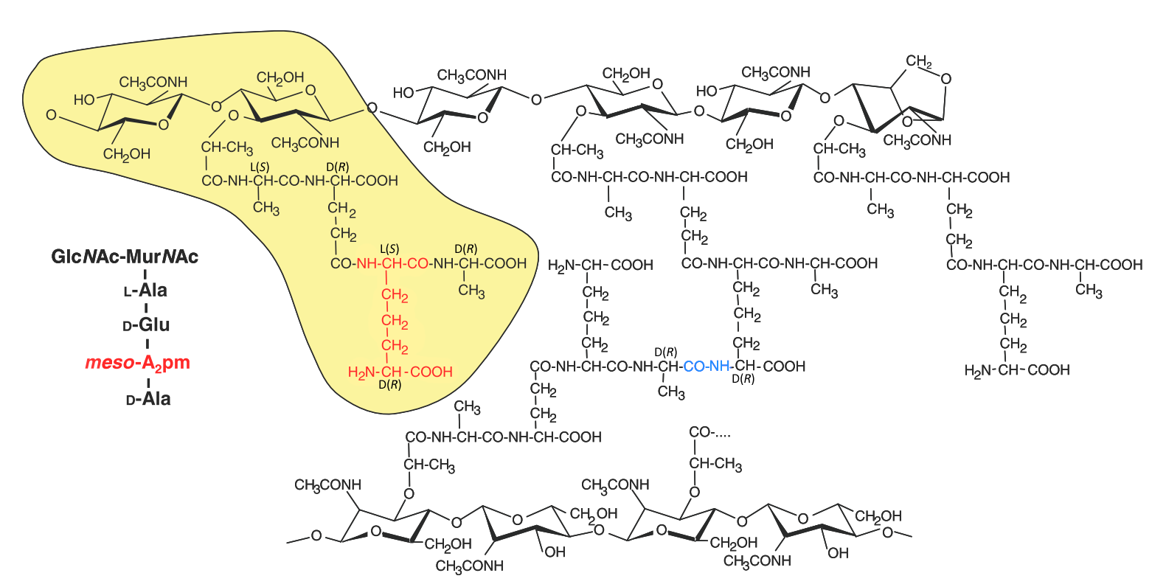
Peptidoglycan
Structure
Mengin-Lecreulx D, Lemaitre B. Structure and metabolism of peptidoglycan and molecular requirements allowing its detection by the Drosophila innate immune system. J Endotoxin Res. 2005;11(2):105-111.
Notes:
dire que les deux cotés sont liés à des parties différentes !
Liaisons glycosidique beta 1-4 compté à partir de l’anomérique (=lié à 2 O)
Beta = configurations opposes de l’anomérique du premier sucre et du dernier C de l’autre sucre (ici S et R)

Slide 10

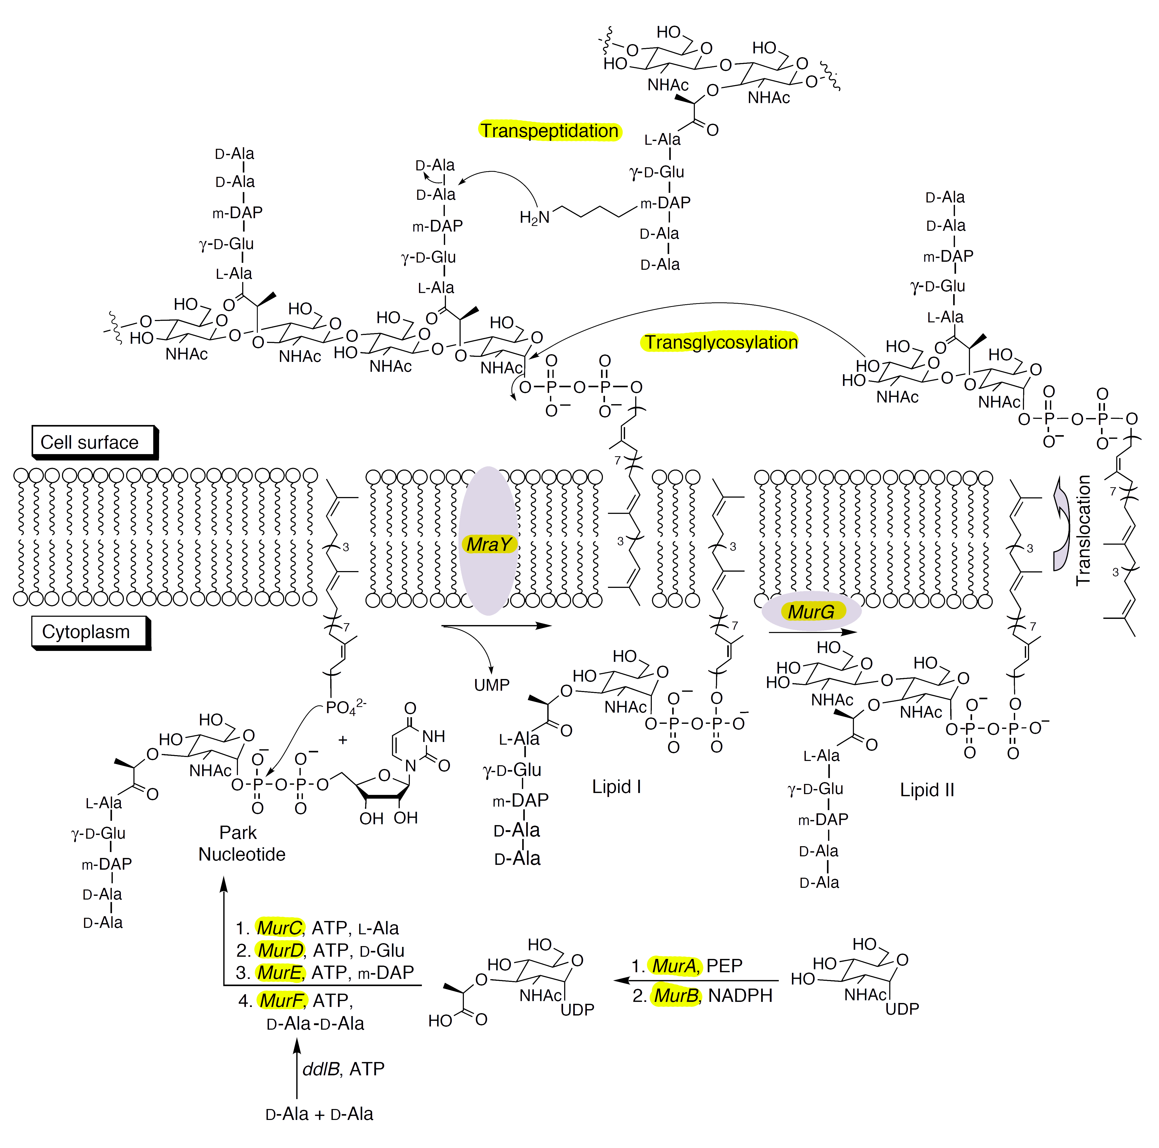
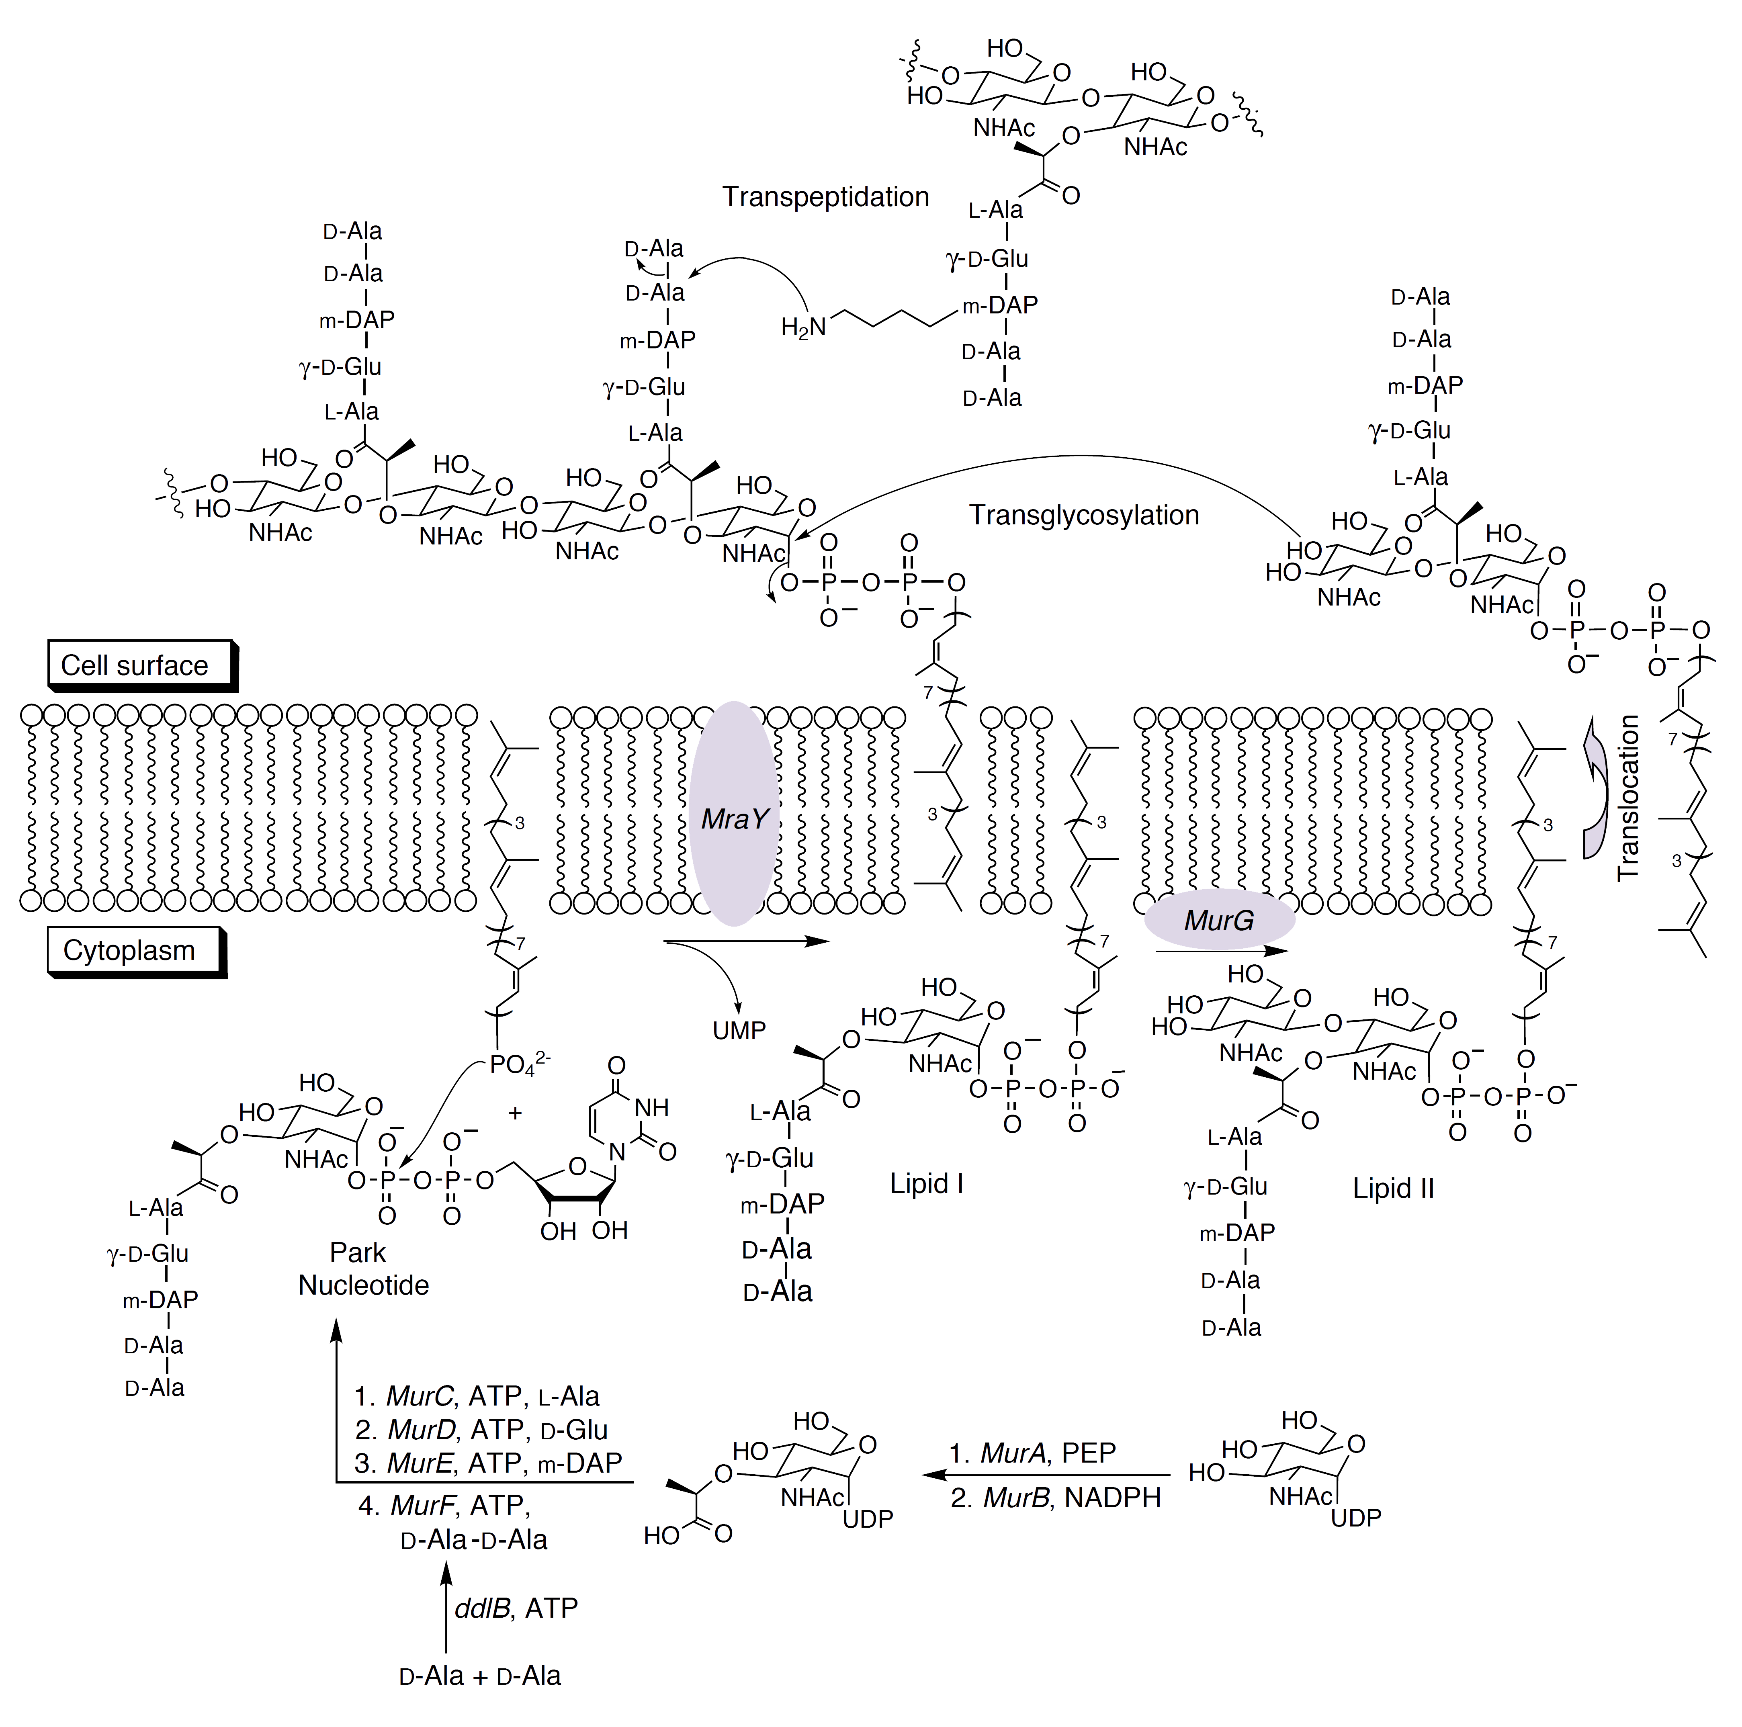
Peptidoglycan
Structure
Biosynthesis is catalyzed by
Penicillin-Binding Proteins
All PBPs display some kind of DD-peptidase activity
Transpeptidation is particularly affected by penicillin
Structure
Biosynthesis
Lazar K, Walker S. Substrate analogues to study cell-wall biosynthesis and its inhibition. Curr Opin Chem Biol. 2002;6(6):786-793.

Slide 11
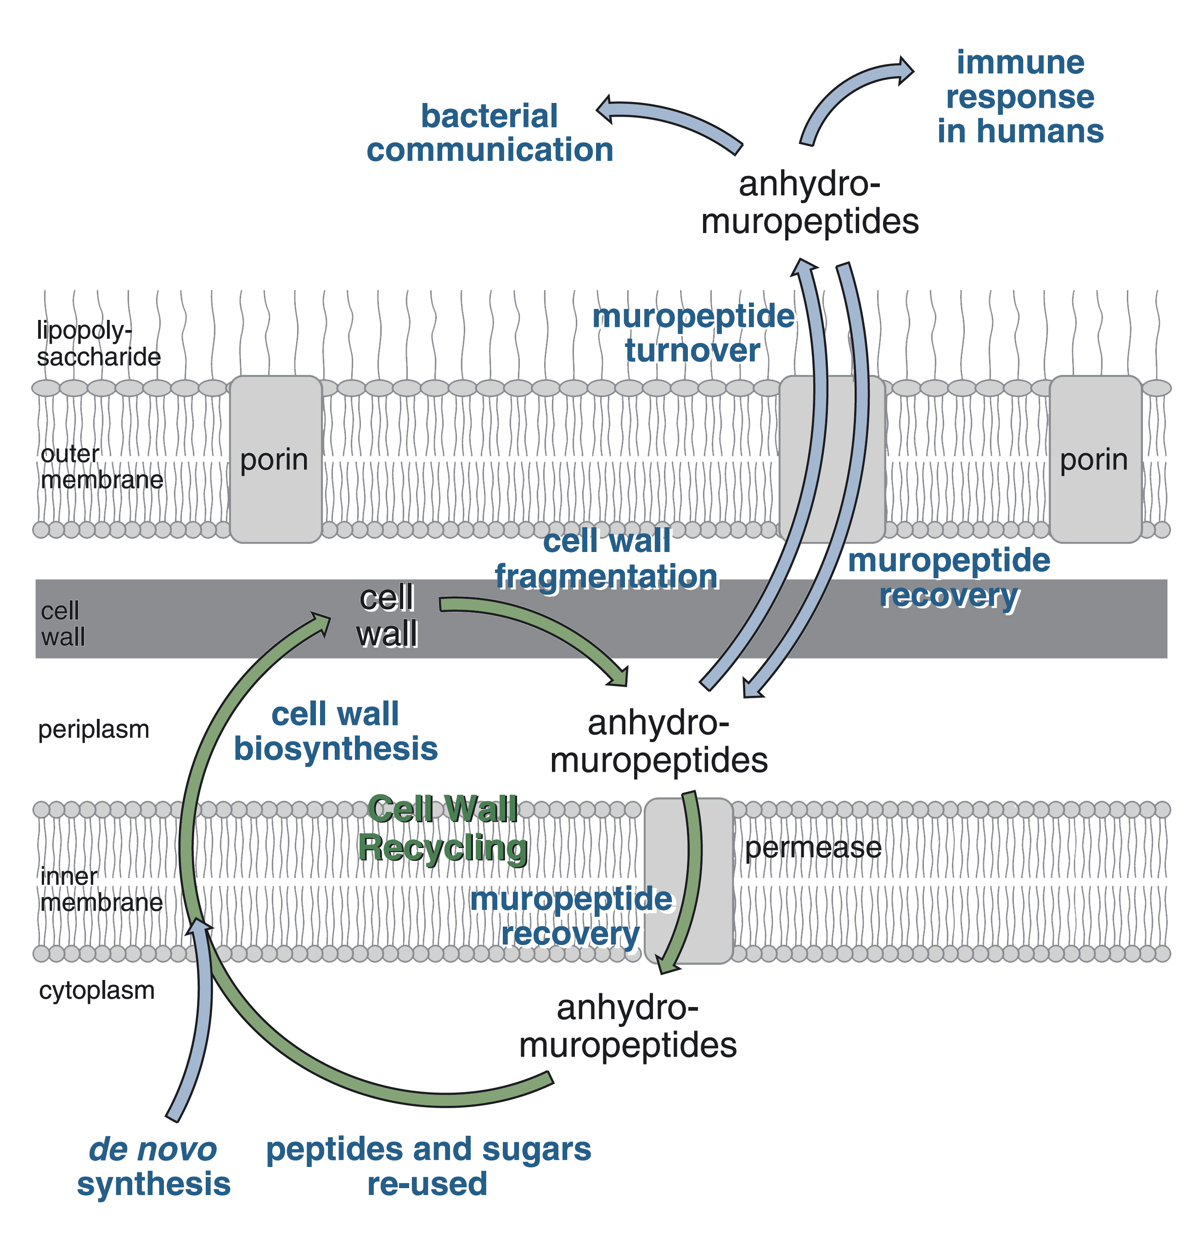
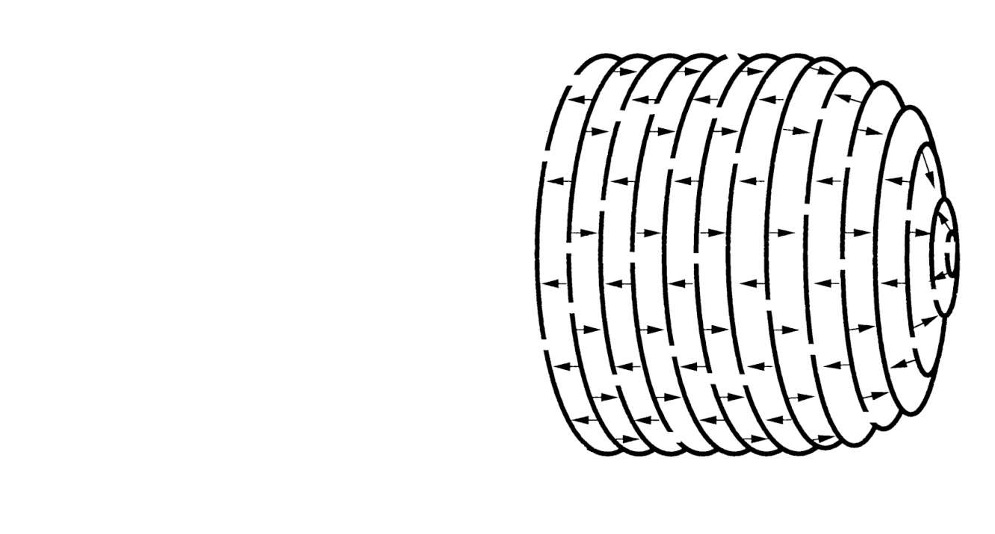
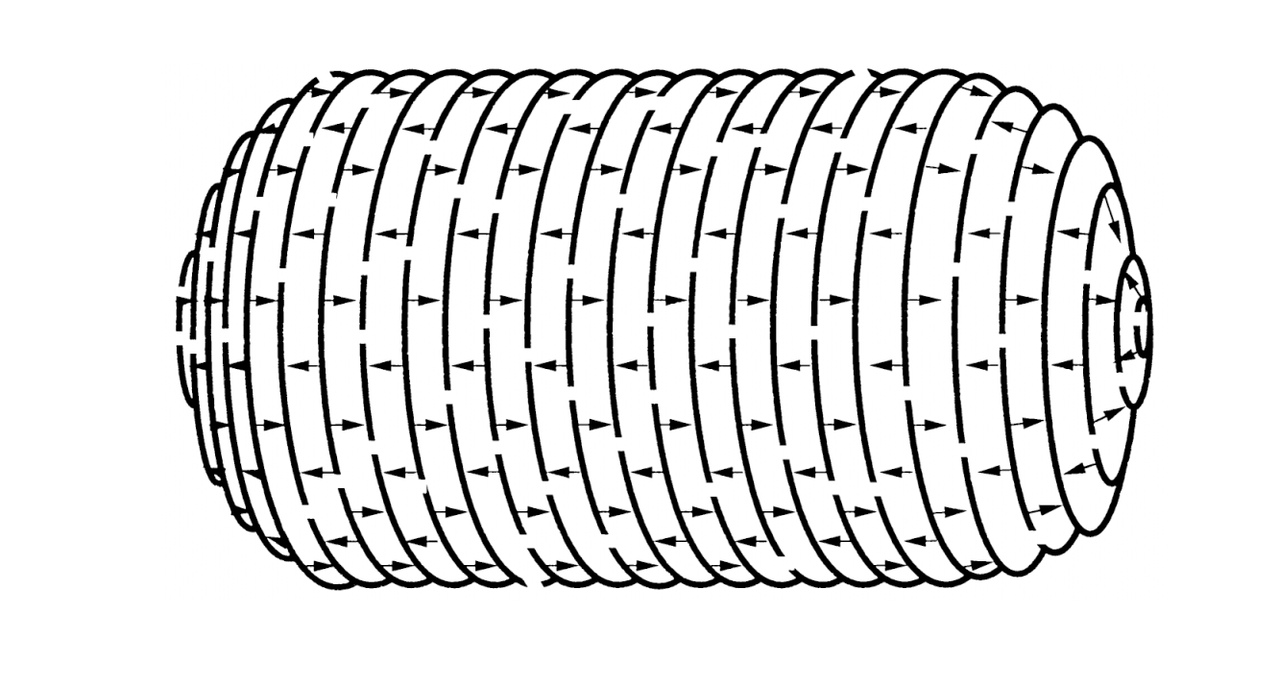

Peptidoglycan
Structure
Biosynthesis
Turnover and recycling
Peptidoglycan metabolism is intimately
bound to bacterial cycle.
Catabolism and anabolism must be concerted
Lost fragments are recycled
Equilibrium between catabolism and anabolism is essential to the bacteria survival
Catabolism
Anabolism
(backed by recycling)
Holtje J V. Growth of the stress-bearing and shape-maintaining murein sacculus of Escherichia coli. Microbiol Mol Biol Rev. 1998;62(1):181-203.
Johnson JW, Fisher JF, Mobashery S. Bacterial cell-wall recycling. Ann N Y Acad Sci. 2013;1277(1):54-75.

Slide 12
Peptidoglycan
Structure
Biosynthesis
Turnover and recycling
Penicillin impairs PG metabolism by binding to PBPs (transpeptidation is compromised)
Anabolism
(backed by recycling)
Catabolism
Campbell NA, Reece JB, Urry LA, et al. Campbell Biology. Pearson; 2014, 94.

Slide 13
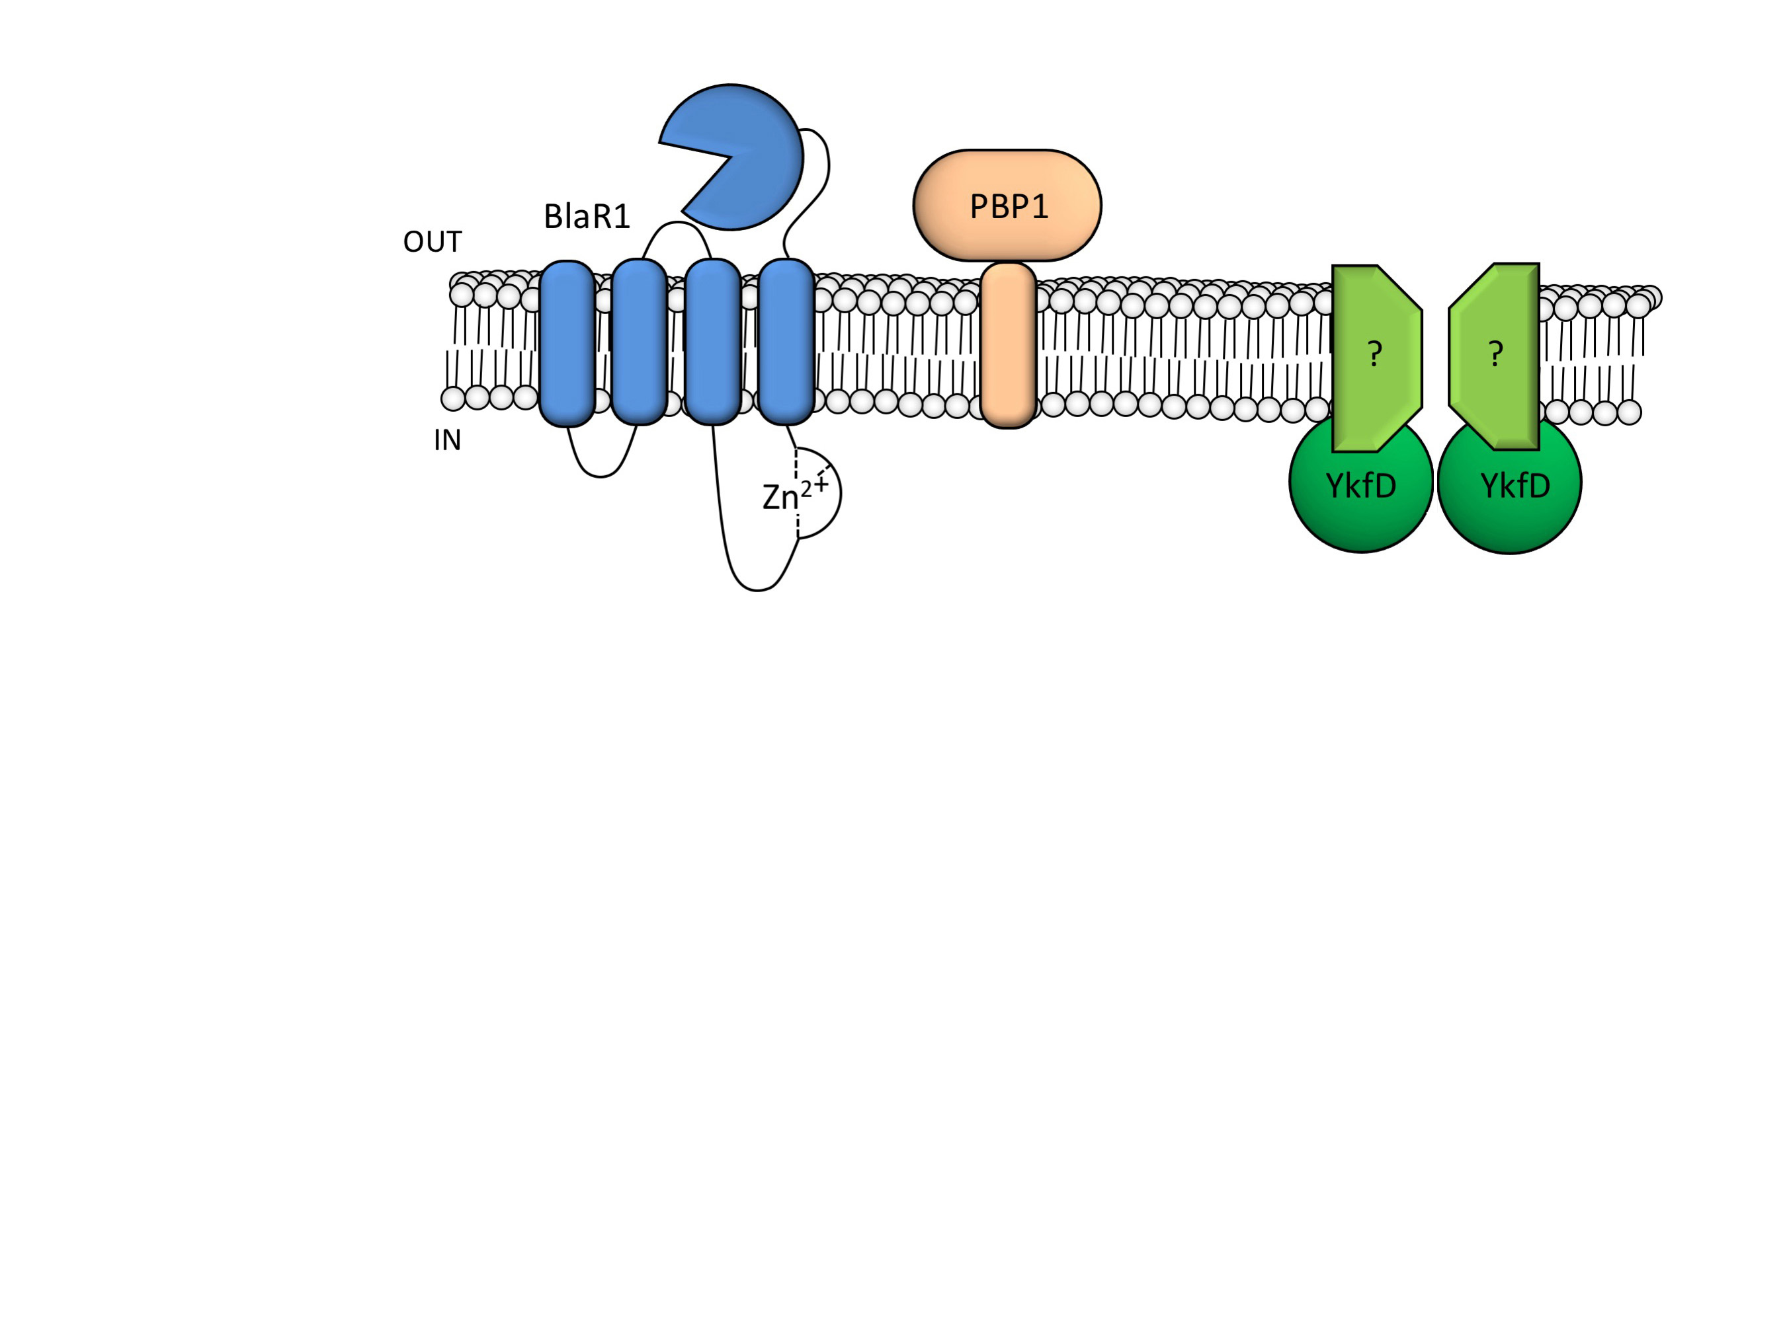
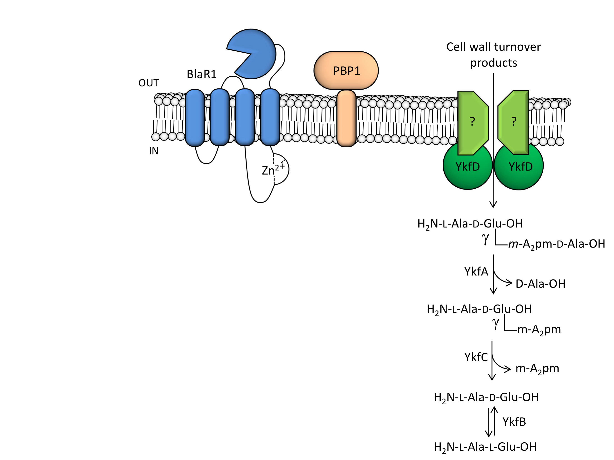
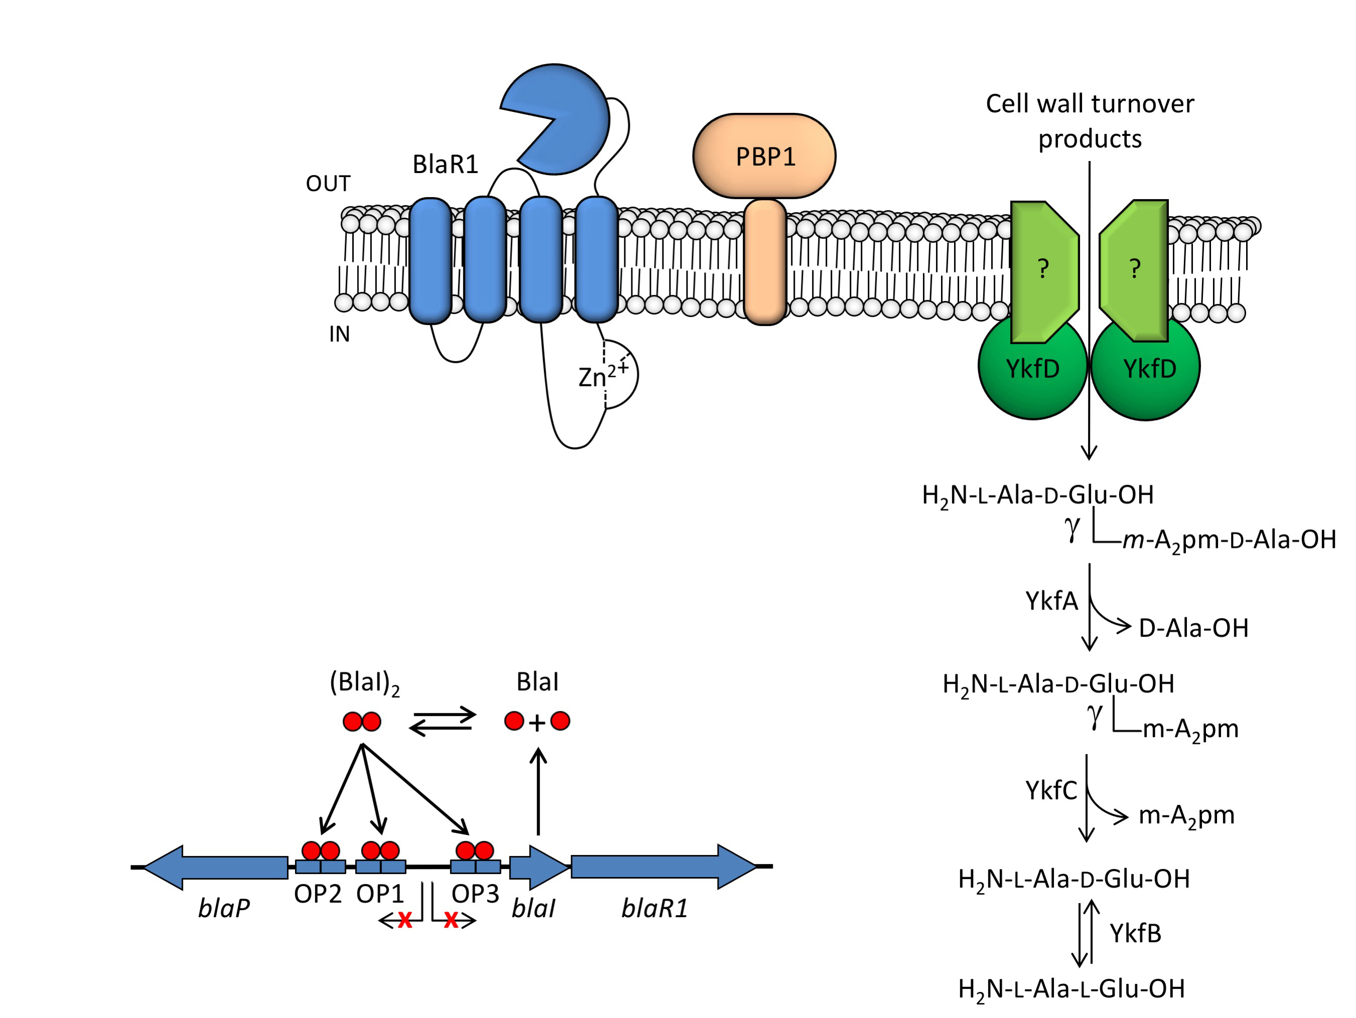
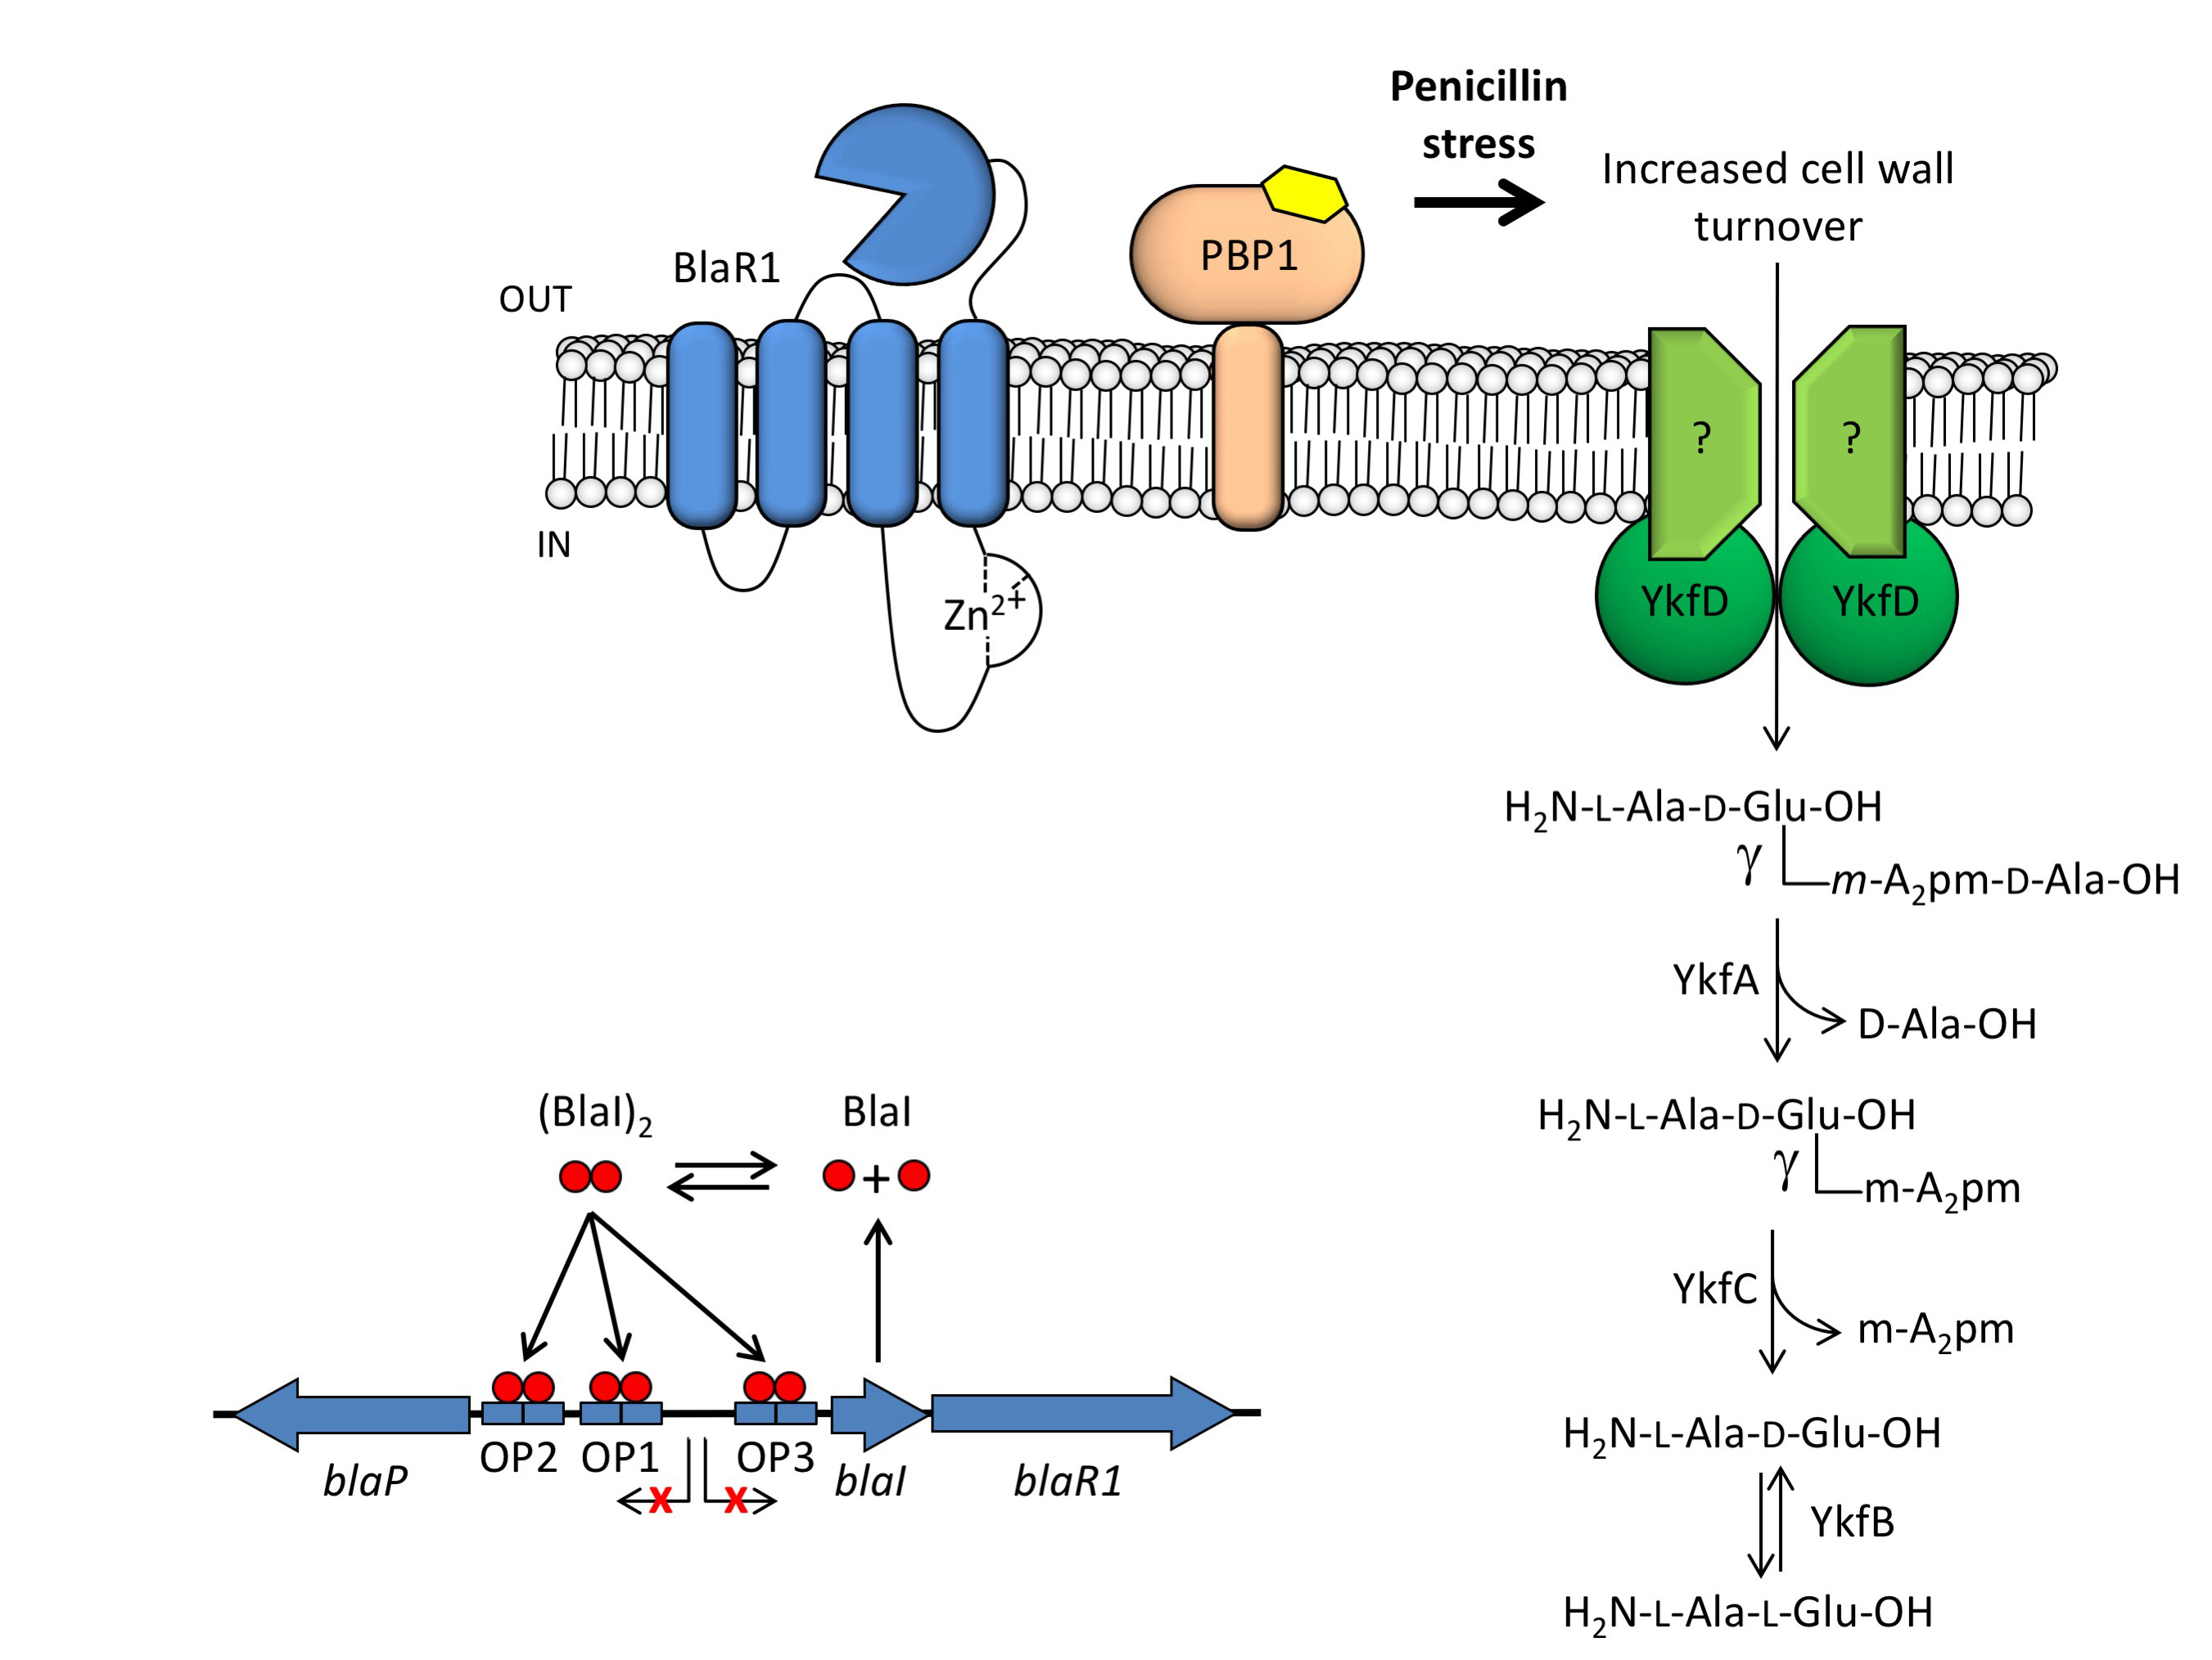

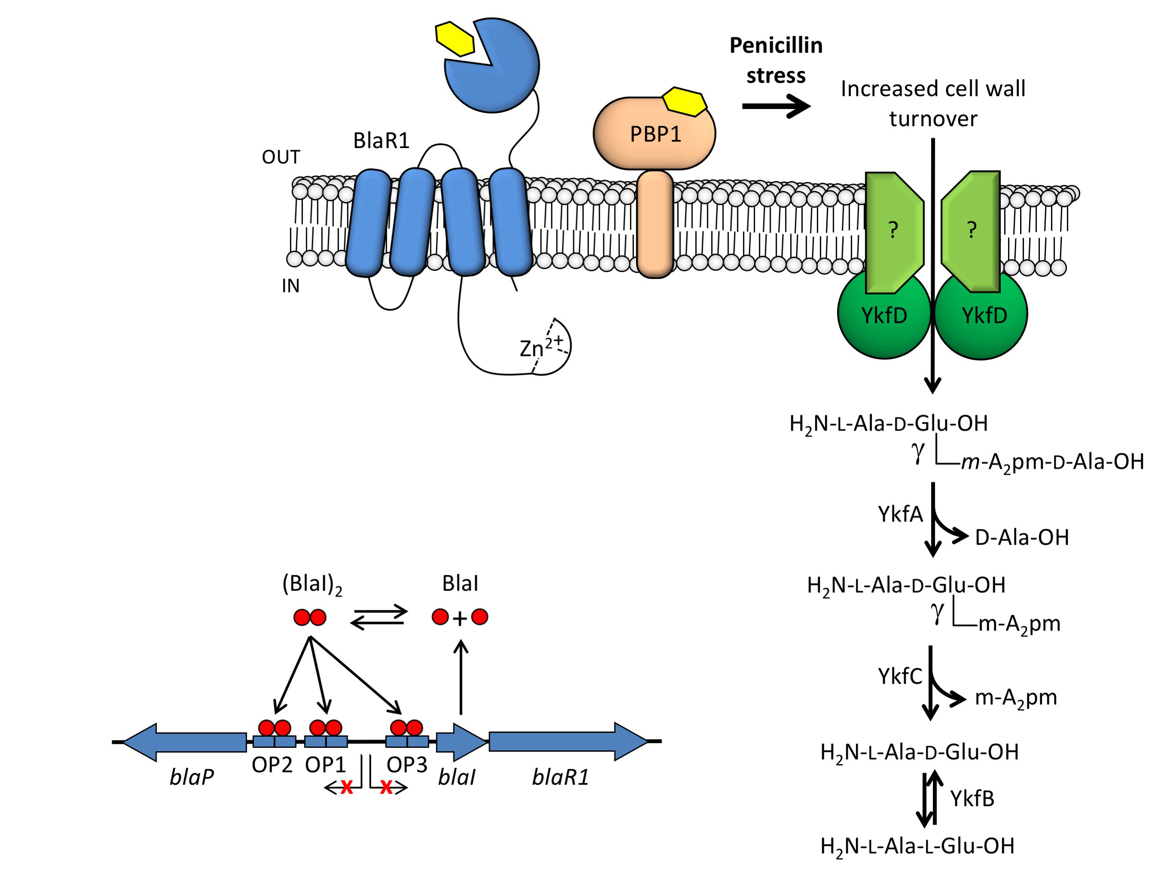
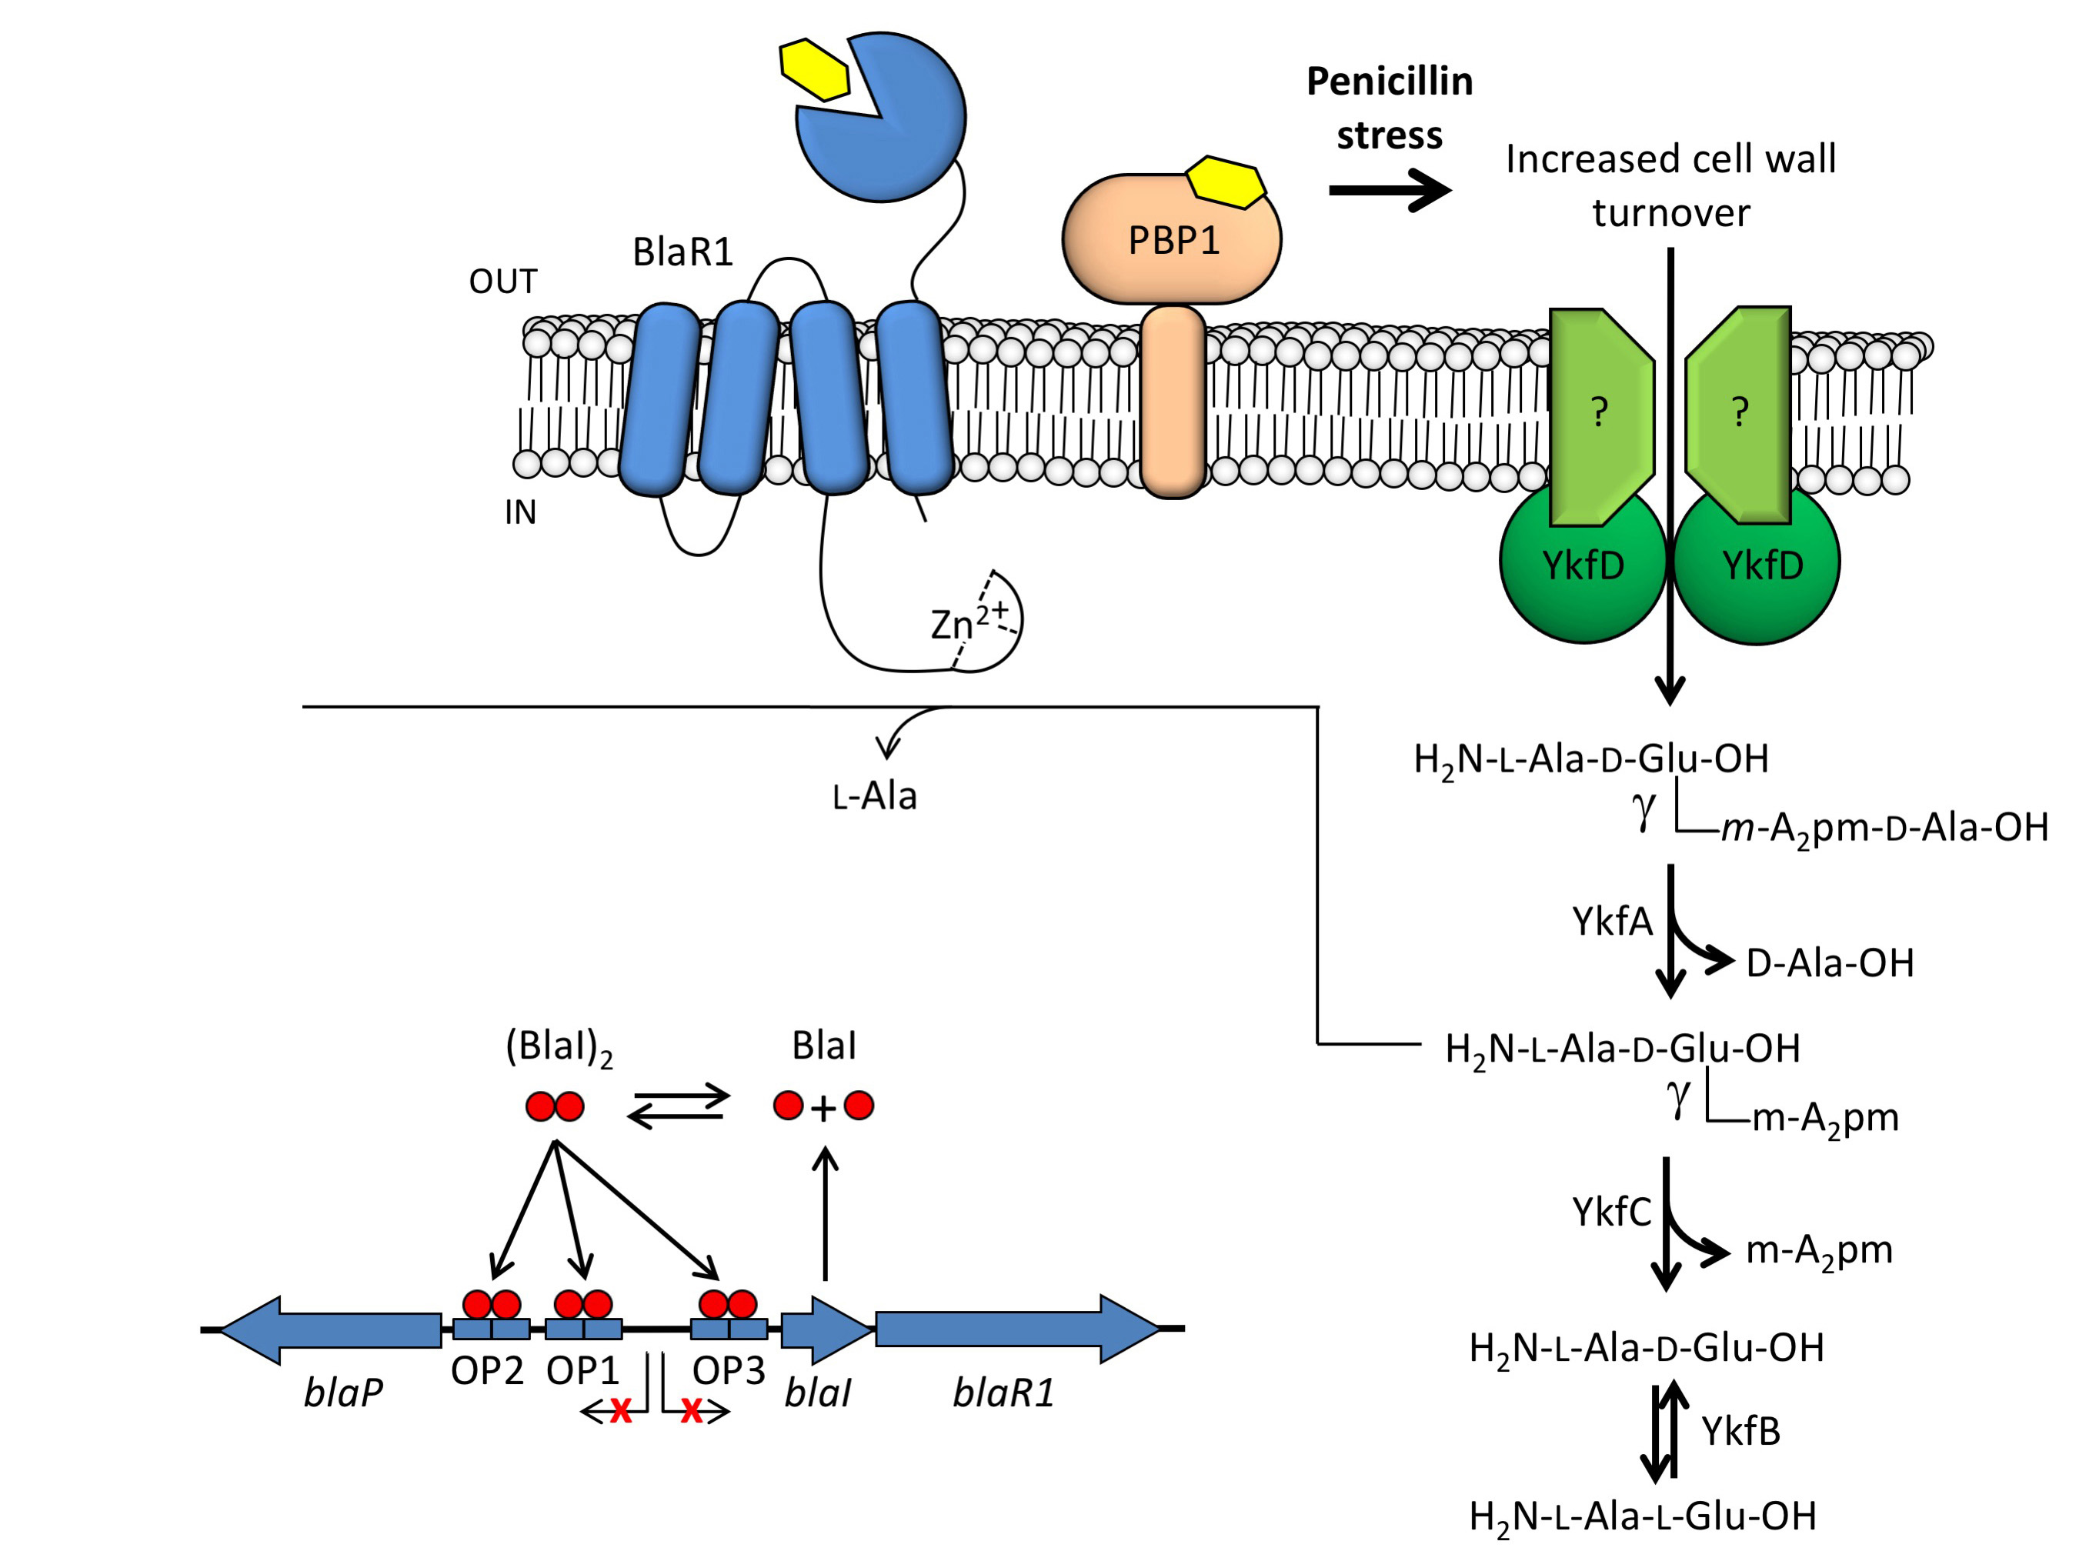
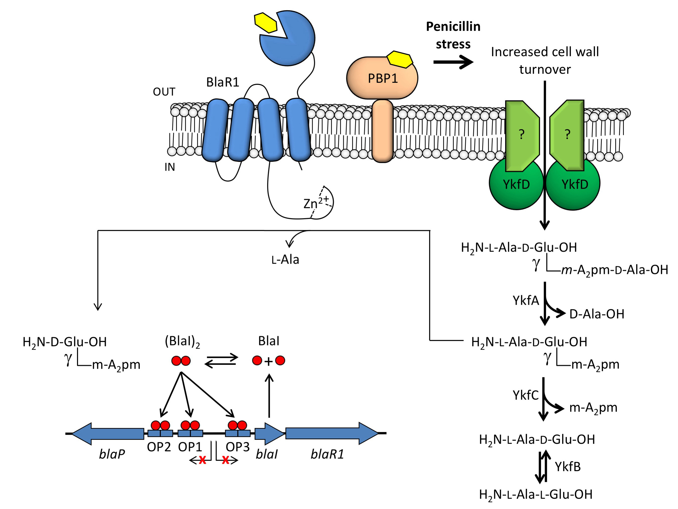
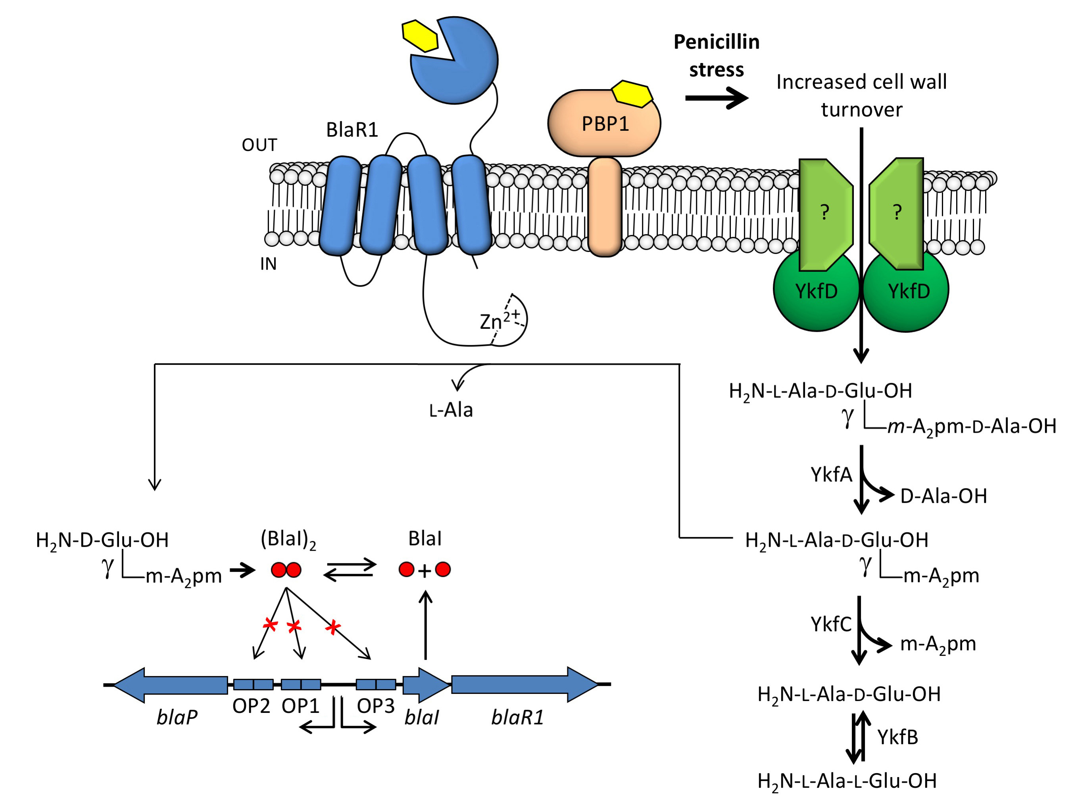
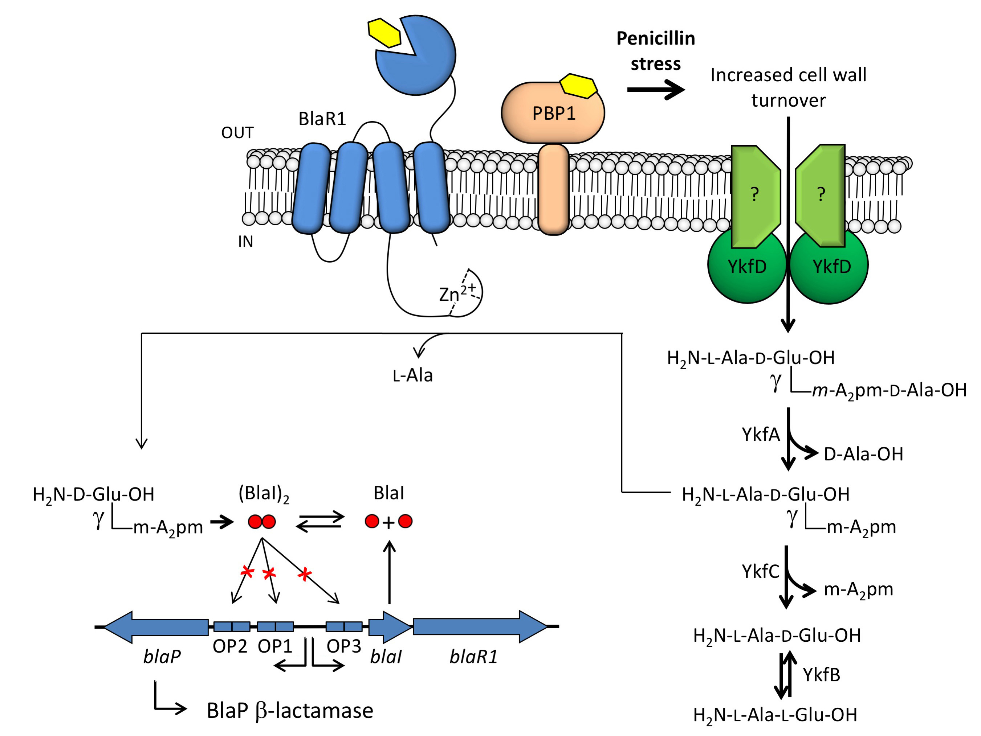
Resistance: β-lactamase induction model (B. licheniformis)
Amoroso A, Boudet J, Berzigotti S, et al. A peptidoglycan fragment triggers β-lactam resistance in Bacillus licheniformis. PLoS Pathog. 2012;8(3).

Slide 14
Objectives
Fundamental research on bacteria, antibiotics and resistance
is crucial at dawn of a post antibiotics era.
There are many challenges to address:
Proving PG recycling in Gram+ bacteria
Determine sacculus 3D structure
Provide compounds useful to the human innate immune system study
Understand antibiotics resistance phenomenon to better fight it.
Find new antibiotics

Slide 15
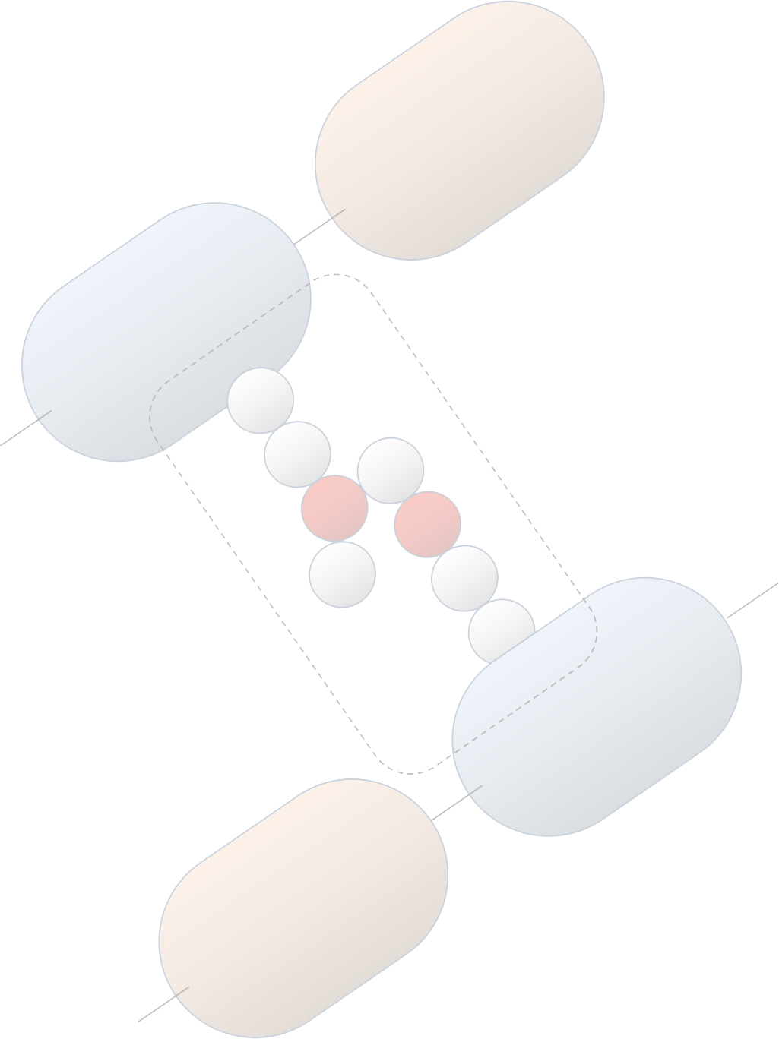

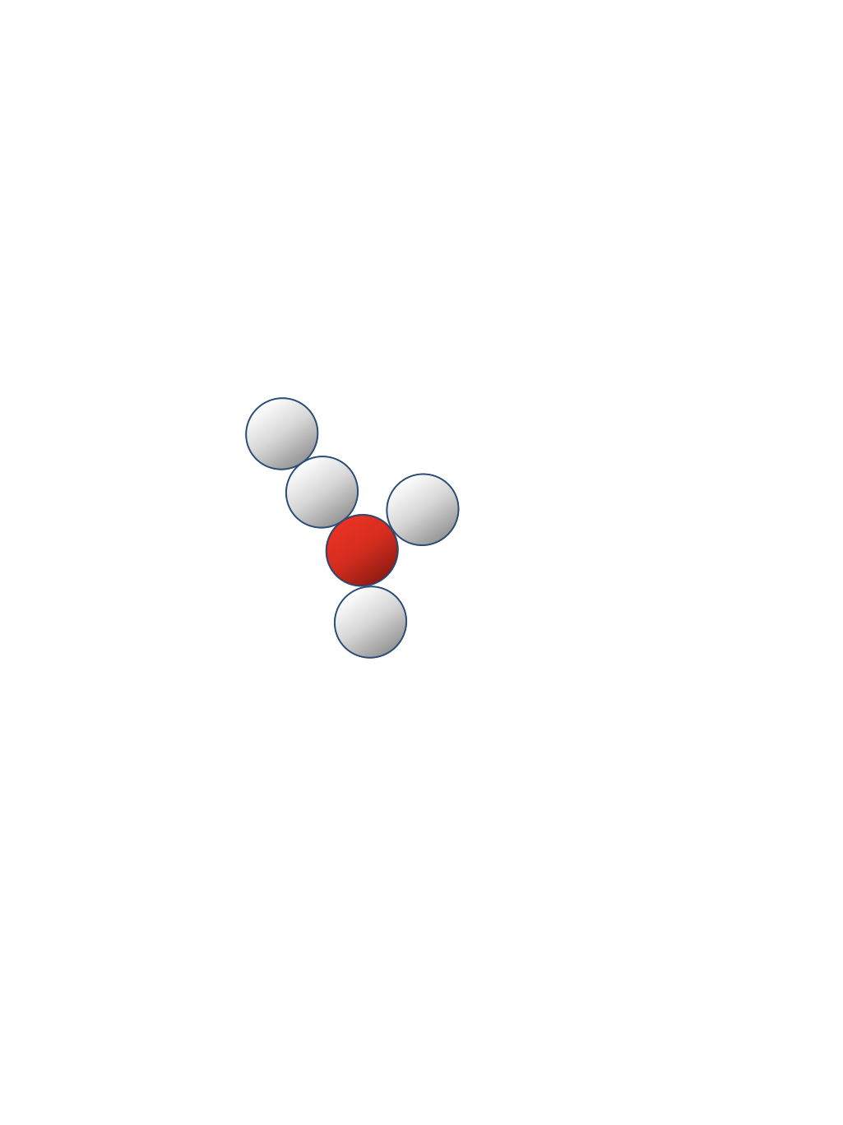
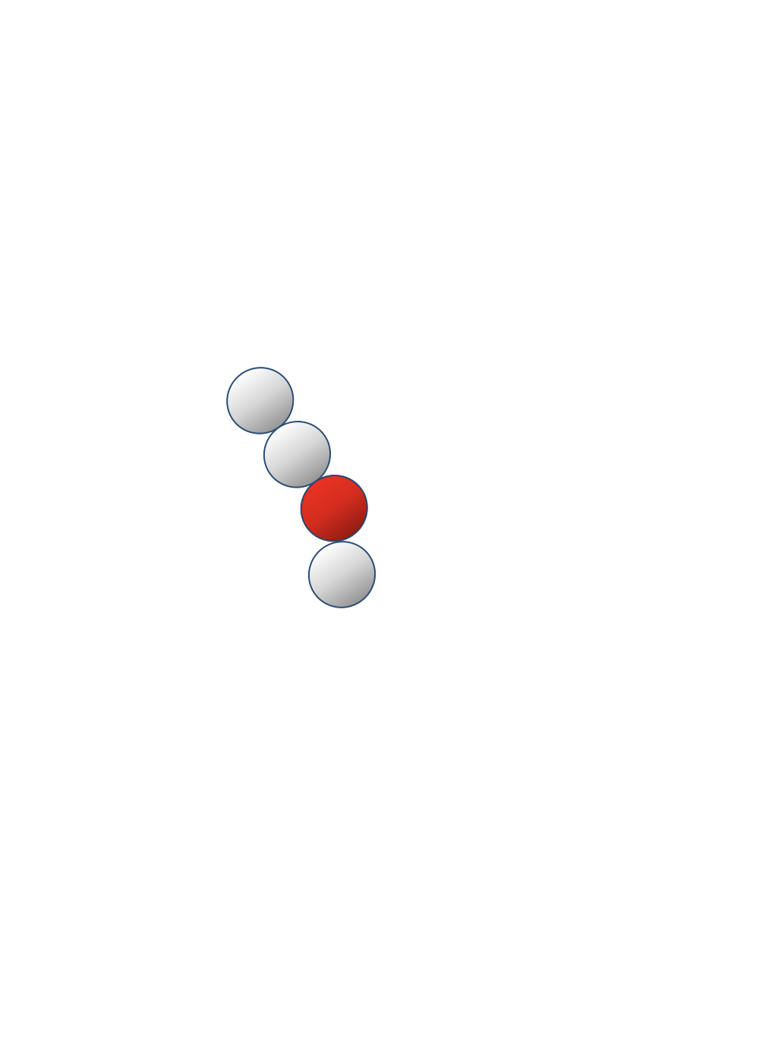
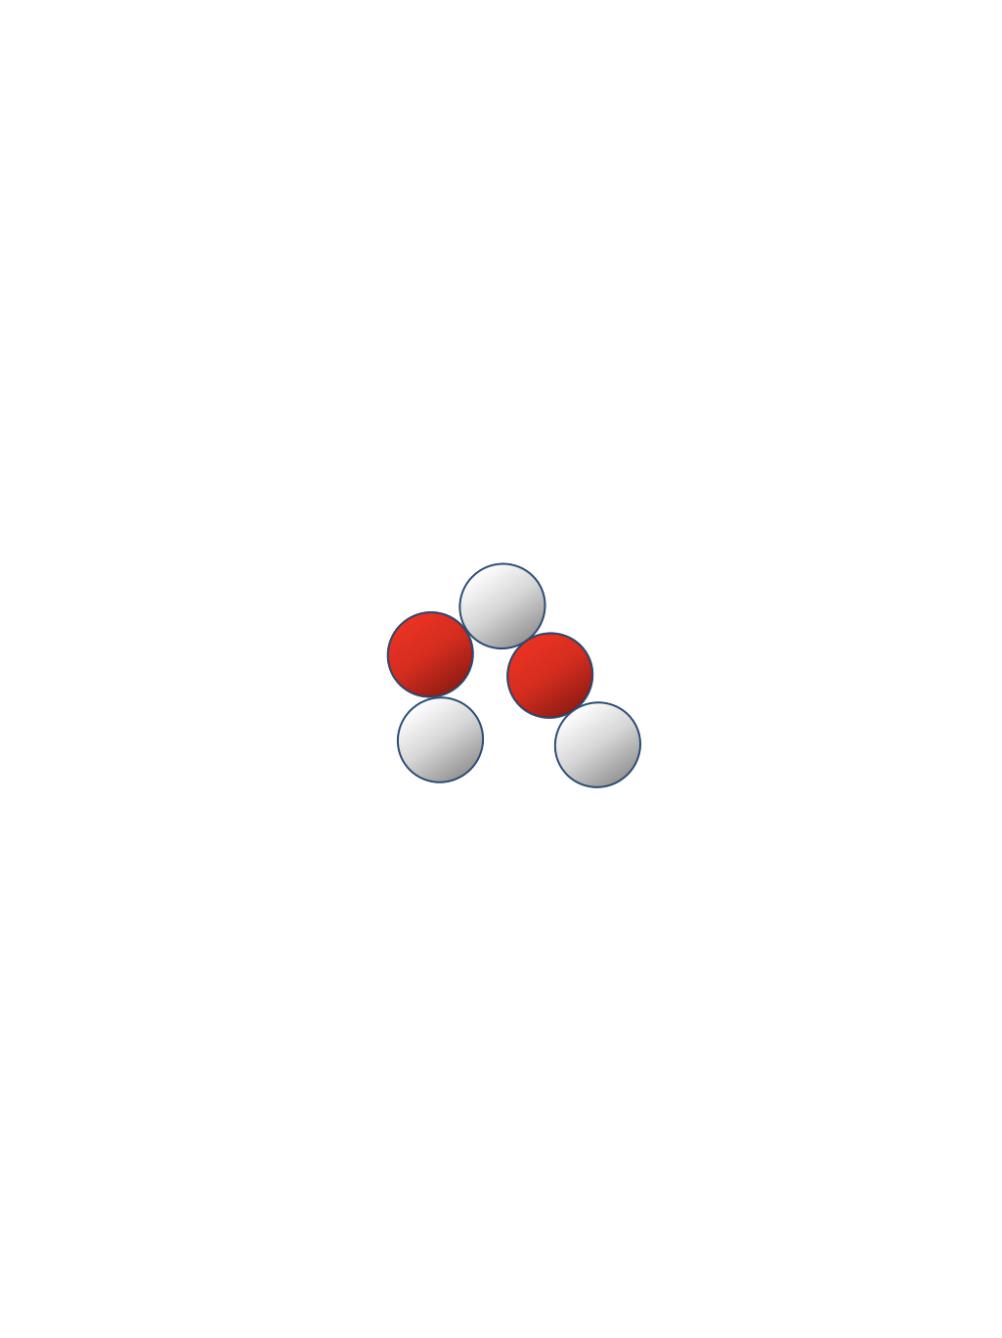
Objectives
Target fragments
m-A₂pm is the perfect probe to study the PG metabolism and structure
m-A₂pm
Chromatography reference
(¹³C)m-A₂pm
NMR experiments to study PG structure
(²H)m-A₂pm
Mass spectrometry reference
[³H]m-A₂pm
Radioactive probe to study PG turnover and recycling
PEP2 is part of the β-lactamase induction model and could also be useful to the study of human innate immune system
PEP2
Chromatography reference
(²H)PEP2
Mass spectrometry reference
PEP1 being a large part of peptide cross-linking, could be useful to
Enzymatic studies (DD-transpeptidase)
Human innate immune system studies
PEP1
Chromatography reference
(²H)PEP1
Mass spectrometry reference
PEP3 being a large part of peptide cross-linking, could be useful to
Enzymatic studies (DD-transpeptidase)
Human innate immune system studies

Slide 16
Strategy
Variety of target molecules calls for
a versatile strategy.
Flexibility over protecting groups
Easy introduction of ²H or ³H
via catalytic reduction
Cross-metathesis (VG + AG)
¹³C compatibility
Protecting groups choice
SPPS is the most challenging
Notes:
Allyl plus reactive que vinyl → exces de VG
Pas présenté des formes zwitterioniques pour la clarté de l'exposé

Slide 17


Strategy
PGs set choice depends of the target molecule
↓
Can be used for the synthesis
of PEP1, PEP2 and PEP3

Slide 18
Strategy
A versatile set of PG (PEP1, PEP2, PEP3 and free m-A₂pm)
Must remain protected during
the whole synthesis
Me ester
LiOH treatment
Deprotection for coupling
with W-D-Ala-NH₂ resin
t-Bu ester
Acid treatment
Deprotection for peptide growth #2
Cbz
Hydrogenation
Deprotection for peptide growth #1
Fmoc strategy
Piperidine treatment

Slide 19
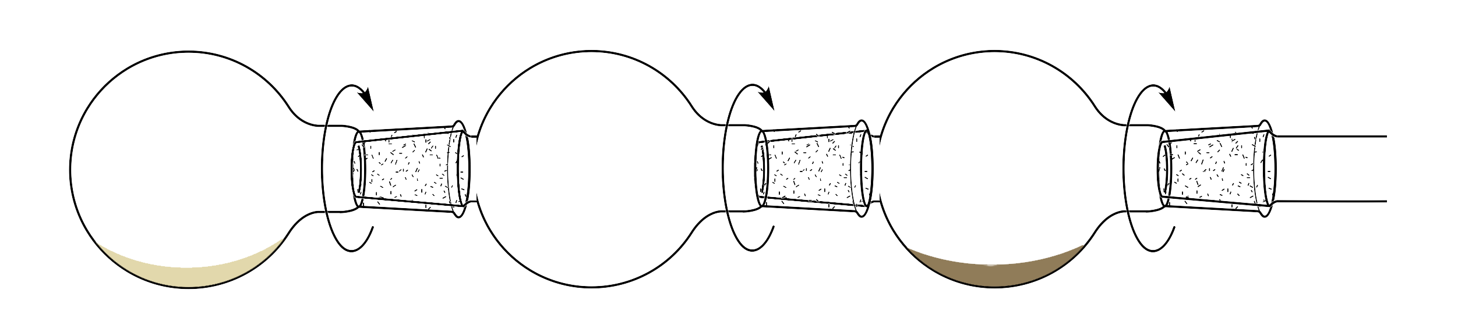
Precursors synthesis
Most straightforward strategy reported:
5g - 998 $
Two thermolysis means reported:
Conventional reflux
universal glassware
long reaction time @ high T
T limited by solvent
unusual solvents
high quantities of DHB
low ee
Kugelrhor apparatus
High ee
Low amount of DHB
No solvent
Low yields
Poor reproductibility (difficult to control vacuum and T)
Not scalable
vacuum
Evaporation
190 – 210 °C
Thermolysis
450 – 600°C
Condensation
0 °C
Lumbroso A, Coeffard V, Le Grognec E, Beaudet I, Quintard JP. An efficient and scalable synthesis of N-(benzyloxycarbonyl)- and N-(methyloxycarbonyl)(S)-vinylglycinol. Tetrahedron Lett. 2010;51(24):3226-3228.
Afzali-Ardakani A, Rapoport H. L-Vinylglycine. J Org Chem. 1980;45(9):4817-
4820.
Notes:
sulfone (R-SO2-R) marcherait ?
Oui, mais pas aussi bien et oxidation supplémentaire par MCPBA necessaire. Sous produit: acide sulfinique

Slide 20
Precursors synthesis
Flow Chemistry
A solution found:
Pressure control
Temperature not limited by the solvent
Usual solvents (toluene)
Precise control of residence time (flow rate)
As soon as VG is formed, it is no longer exposed to high T
Promote formation of VG (kinetic product) over DHB (thermodynamic product).
Parameters:
Residence time (via flow rate)
Temperature
Addition of DMAD as a scavenger of MeSOH
Best conditions:
1.7 min (1 mL.min⁻¹)
270 °C
1.0 equiv. DMAD
ee = 95%
→ Production of up to 10 g of (R)-CbzNH-VG-Ome in 7.5 h.
Lamborelle N, Simon JF, Luxen A, Monbaliu JM. Continuous-flow thermolysis for the preparation of vinylglycine derivatives. Org Biomol Chem. 2015:11602-11606.
Notes:
DMAD : dimethyl acetylenedicarboxylate

Slide 21
Precursors synthesis
(1-¹³C)glycine: 172 €/g → optimization on glycine (0.1 €/g)
Siebum et al. proposed this strategy for the preparation of (¹⁵N)leucine in 2003.
Siebum et al.: 49%
Optimized synthesis: 84%
Siebum AHG, Woo WS, Lugtenburg J. Preparation and Characterization of [5-13C]-(2S,4R)-Leucine and [4-13C]-(2S,3S)-Valine− Establishing Synthetic Schemes to Prepare Any Site-Directed Isotopomer of L-Leucine, L-Isoleucine and L-Valine. European J Org Chem. 2003;2003(23):4664-4678.
Notes:
production glycine c13:
methyl magnesium carbonate 13C fait à partir de Mg(OMe)2 et de 13CO2 Vs Nitromethane
Puis réduction du nitro en amine avec H2 Pd/C

Slide 22
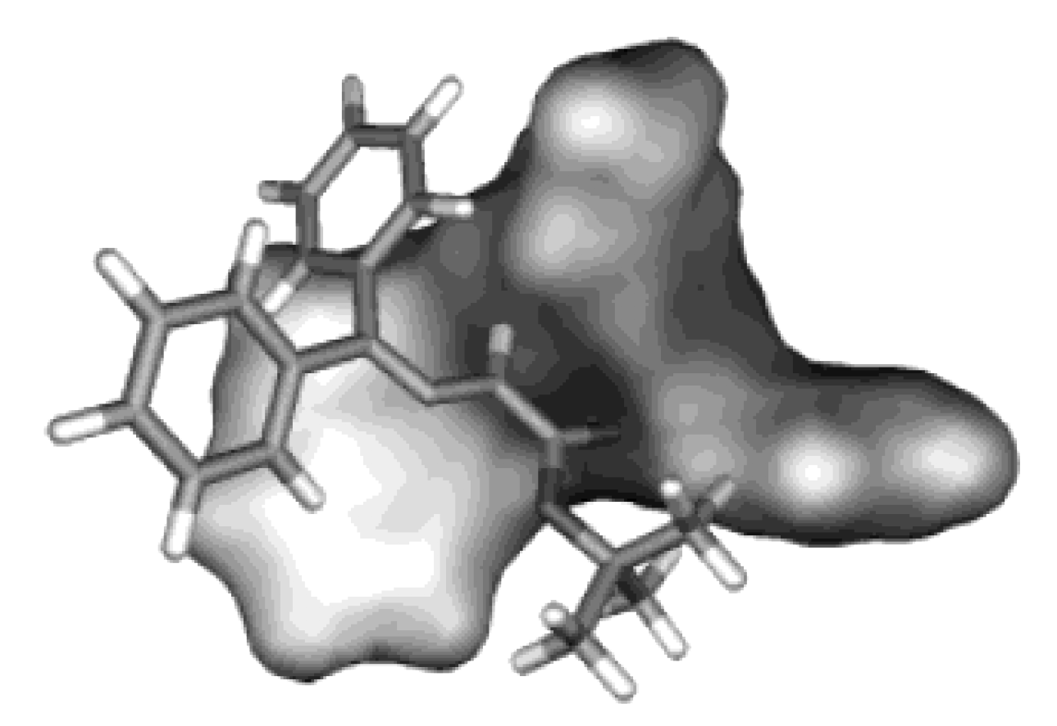
Precursors synthesis
Lygo B, Andrews BI. Asymmetric Phase-Transfer Catalysis Utilizing Chiral Quaternary Ammonium Salts : Asymmetric Alkylation of Glycine Imines Alkylation of Glycine Imines. Acc Chem Res. 2004;37(8):518-525.
Lygo B, Wainwright PG. Phase-transfer catalysed asymmetric epoxidation of enones using N- anthracenylmethyl-substituted cinchona alkaloids. Tetrahedron. 1999;55(20):6289-6300.
Notes:
Enolate E ou Z plus stable ? (Lipkowitz 1990)
If a small metal ion like lithium had been included in the calculation the 2 enolate would be more stable. These small ions can associate with both the N and O⁻ atoms simultaneously to stablize the 2 form by orbital interactions and/or coulombic attractions. For large ammonium counter ions, which have a diffuse charge distribution, it is unlikely that such chelation of the enolate is important.
(…)
Generally, but not always, the Z enolate surfaces have lower minima than the E enolates.
Ils montrent ensuite que c’est l’énolate Z qui est actif
Interaction majoritairement coulombique (charge delocalisée)
18.7 et 22.8 contre 18.8 et 19.2 (dans DMSO)

Slide 23
Precursors synthesis

Slide 24
Precursors synthesis
ee = 95%
ee = 94%
ee = 95%
Fmoc protected AG: Daicel Chiralcel OD-H, n-hexane/iPrOH 85:15, 0.65 mL/min, rt, 265 nm
Cbz protected AG: Daicel Chiralcel OD-H, n-hexane/iPrOH/TFA 65:35:0.1, 0.65 mL/min, 30 °C, 210 nm
Notes:
spécifier colonne et conditions

Slide 25
Cross-metathesis
 | Reactants |  |  | Crude composition
# | AG (mmol) | VG (mmol) | GII (mol%) | AG | AG-AG | VG-AG | Yield
1 | 1 | 2.0 | 20 | 12% | 8% | 80% | 58%
2 | 1 | 3.0 | 20 | 11% | 4% | 85% | 75%
3 | 1.75 | 5.25 | 20 | 10% | 4% | 86% | 78%
4 | 6.13 | 17.78 | 20 | 14% | 4% | 82% | 73%
 | Reactants
 | AG (mmol) | VG (mmol) | GII (mol%) | Yield
¹³C | 6.17 | 12.34 | 20 | 66%

Slide 26
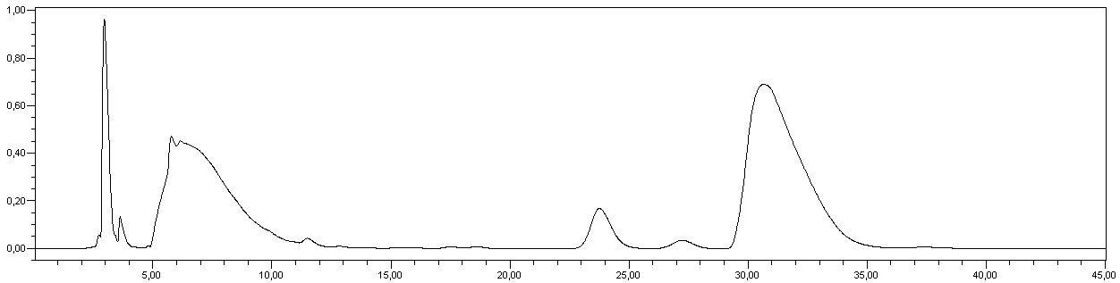
Dehydro-m-A₂pm #1 → free m-A₂pm
Observed by Simon et al. in 2015
Reduction should be the last step
(³H)
Reduction stops before completion
Addition of catalyst has no effect
Catalyst poisoning ?
  Extraction of byproducts
  ³H compatibility lost
(¹³C)m-A₂pm
dr = (S,S)/(R,R)/(R,S) = 8/2/90
(S,S)
(R,R)
(R,S)
Waters Xterra RP18, CH₃CN/phosphate buffer (0.05M, pH=7.2) 12:88, 0.4 mL/min, rt @ 320 nm
Simon JF, Lamborelle N, Zervosen A, Lemaire C, Joris B, Luxen A. Development of solid-supported methodology for the preparation of peptidoglycan fragments containing (2S,6R)-diaminopimelic acid. Tetrahedron Lett. 2015;57(14):1572-1575.
Notes:
pKa piperidine = 11.2
pKa amine de l’acide glutamique = 9.6

Slide 27
Dehydro-m-A₂pm #1 → protected m-A₂pm (PEP1, PEP2, PEP3)

Slide 28
Cross-metathesis
Reactants
AG (mmol) | VG (equiv.) | GII (mol%) | Yield
1 | 2.0 | 10 | 40%

Slide 29
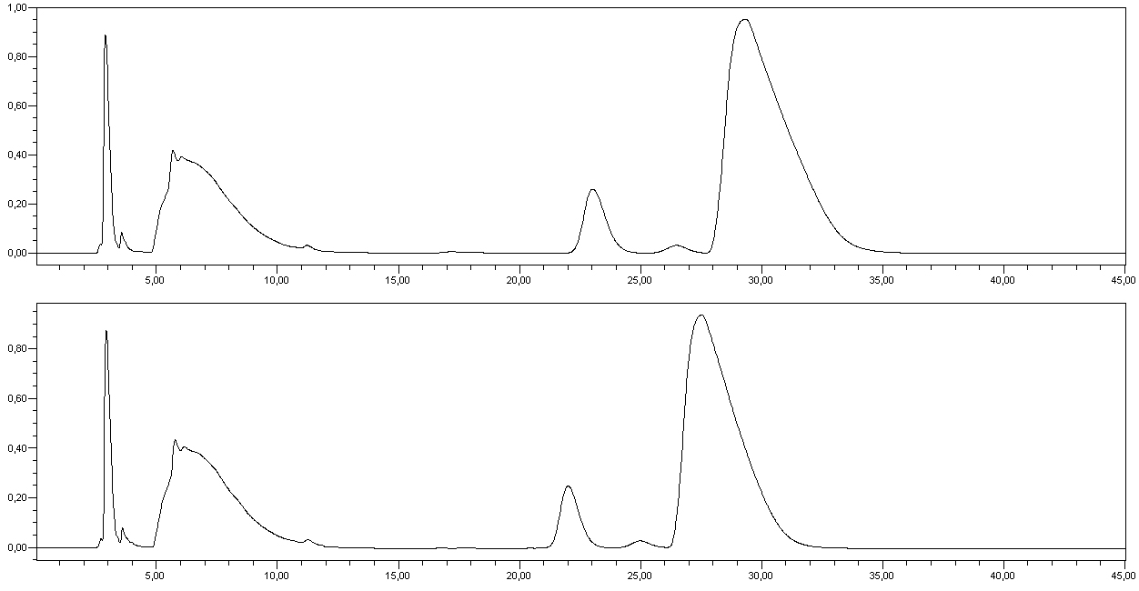
Dehydro-m-A₂pm #2 → free m-A₂pm
Tritium reduction imperatives:
1 bar max
24 h max
Water should be avoided if possible
Adjustments needed
Reduction should be the last step
(³H)
m-A₂pm
dr = (S,S)/(R,R)/(R,S) = 9/1/90
Isotopic exchange between D₂ gas and H₂O
HD and H₂ reductions
Replace H₂O by D₂O
# | P(H₂) | Solvent | V_{solvent} | Catalyst | Time | Cbz removal | Alkene reduction
1 | 5 bar | THF | 5 mL | Pd black | 2 h | 0/2 | none
2 | 5 bar | THF/H₂O 4:1 | 5 mL | Pd black | 2 h | 1/2 | none
3 | 5 bar | THF/H₂O 1:1 | 5 mL | Pd black | 2 h | 1/2 – 2/2 | partial
4 | 5 bar | THF/H₂O 1:4 | 5 mL | Pd black | 2 h | 2/2 | total
(S,S)
(R,R)
(R,S)
(²H₂)m-A₂pm
dr = 9/1/90
(S,S)
(R,R)
(R,S)
Notes:
Sur acide glutamique pka COOH lateral à 4.2 et COOH à 2.2

Slide 30
Dehydro-m-A₂pm #2 → free m-A₂pm
 | # | Solvent | V_{solvent} | P(²H₂) | Catalyst | Time | Cbz removalª | Alkene reductionª | Labelling level^{b}
CRC tests | 1 | DMA | 1.5 mL | 1 bar | Pd/C 10% | 1 h | 0/2 | none | 0
 | 2 | DMF | 1.5 mL | 1 bar | Pd/C 10% | 1 h | 0/2 | none | 0
 | 3 | DMF | 1.5 mL | 1 bar | Pd blackª | 1 h – 24h | 0/2 | none | 0
 | 4 | MeOH^{c} | 1.5 mL | 1 bar | Pd/C 10% | 1h | 0/2 | none | 0
 | 5 | THF | 1.5 mL | 1 bar | Pd/C 10% | 1 h | 0/2 | none | 0
 | 6 | THF | 1.5 mL | 1 bar | Pd blackª | 1 h – 24h | 0/2 | none | 0
 | 7 | THF/H₂O 4:1 | 1.5 mL | 1 bar | Pd/C 10% | 1 h | 0/2 | none | 0
 | 8 | THF/H₂O 4:1 | 1.5 mL | 1 bar | Pd blackª | 1 h – 24h | 1/2 | none | 0
 | 9 | THF/H₂O 1:1 | 1.5 mL | 1 bar | Pd/C 10% | 1 h | 1/2 | none | 0
 | 10 | THF/H₂O 1:1 | 1.5 mL | 1 bar | Pd blackª | 1 h – 4h | 1/2 | none | 0
 | 11 | THF/H₂O 1:1 | 1.5 mL | 1 bar | Pd blackª | 24 h | 2/2 | total | 0.82 D
 | 12 | THF/H₂O 1:4 | 1.5 mL | 1 bar | Pd/C 10% | 1 h | 1/2 | none | 0
 | 13 | THF/H₂O 1:4 | 1.5 mL | 1 bar | Pd blackª | 1 h | 1/2 | none | 0
 | 14 | THF/H₂O 1:4 | 1.5 mL | 1 bar | Pd blackª | 4 h | 2/2 | total | 1.04 D
 | 15 | THF/H₂O 1:4 | 1.5 mL | 1 bar | Pd blackª | 24 h | 2/2 | total | 1.04 D
CEA tests | 16 | THF/H₂O 1:4 | 1.5 mL | 1 bar | Pd blackª | 4 h | 1/2 – 2/2 | partial | 0.54 D
 | 17 | THF/H₂O 1:4 | 1.5 mL | 1 bar | Pd black^{b} | 4 h | 1/2 – 2/2 | partial | 0.82 D
 | 18 | THF/H₂O 1:4 | 0.75 mL | 1 bar | Pd black^{b} | 4 h | 1/2 – 2/2 | partial | 1.00 D
 | 19 | THF/H₂O 1:4 | 0.75 mL | 1 bar | Pd black^{b} | 24 h | 2/2 | total | 0.92 D
 | 20 | THF/H₂O 1:4 | 0.75 mL | 1 bar | Pd black^{b} | 22.5 h | (1/2) 2/2 | total | 1.10 D
Reduction tests with deuterium gas
Goal: 1.11 TBq/mmol (30 Ci/mmol) specific activity
(= 1T/molecule)
CRC
P(²H₂) = 1 bar
Alternate solvents
  H₂O needed
  (T₂O cannot be used to reach higher activities)
  CEA
  Better catalyst
  Higher concentration
    24 h needed
Notes:
Environ 15 Ci dans FP + adaptateur
A = 2,55 . P(bar) . V(mL)

Slide 31
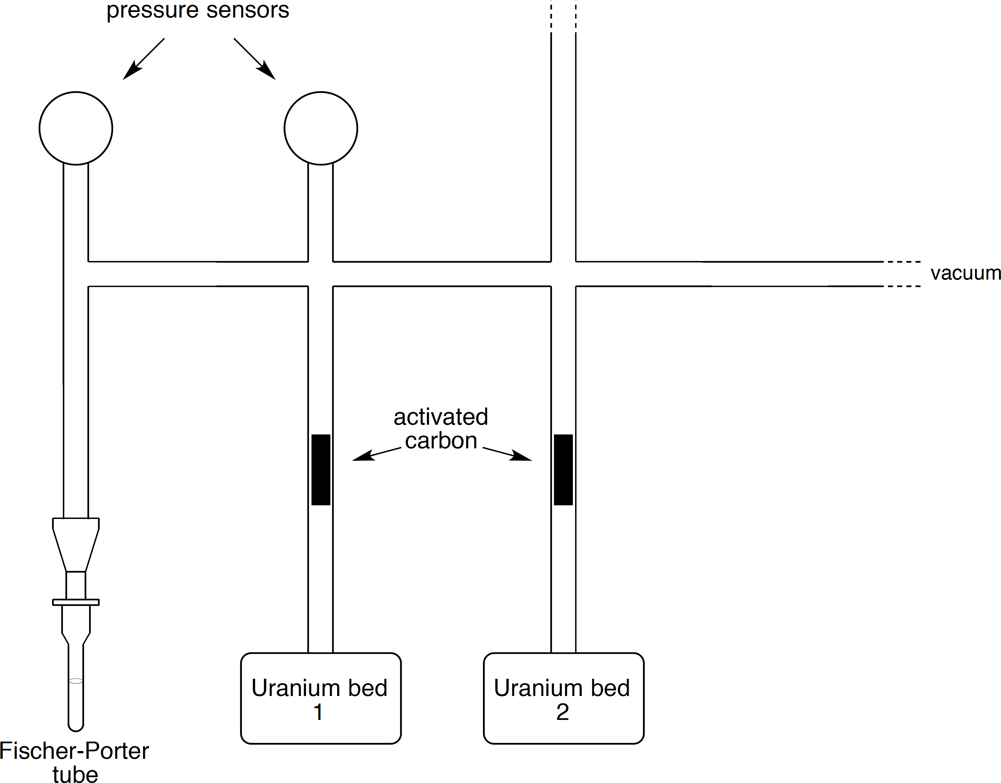
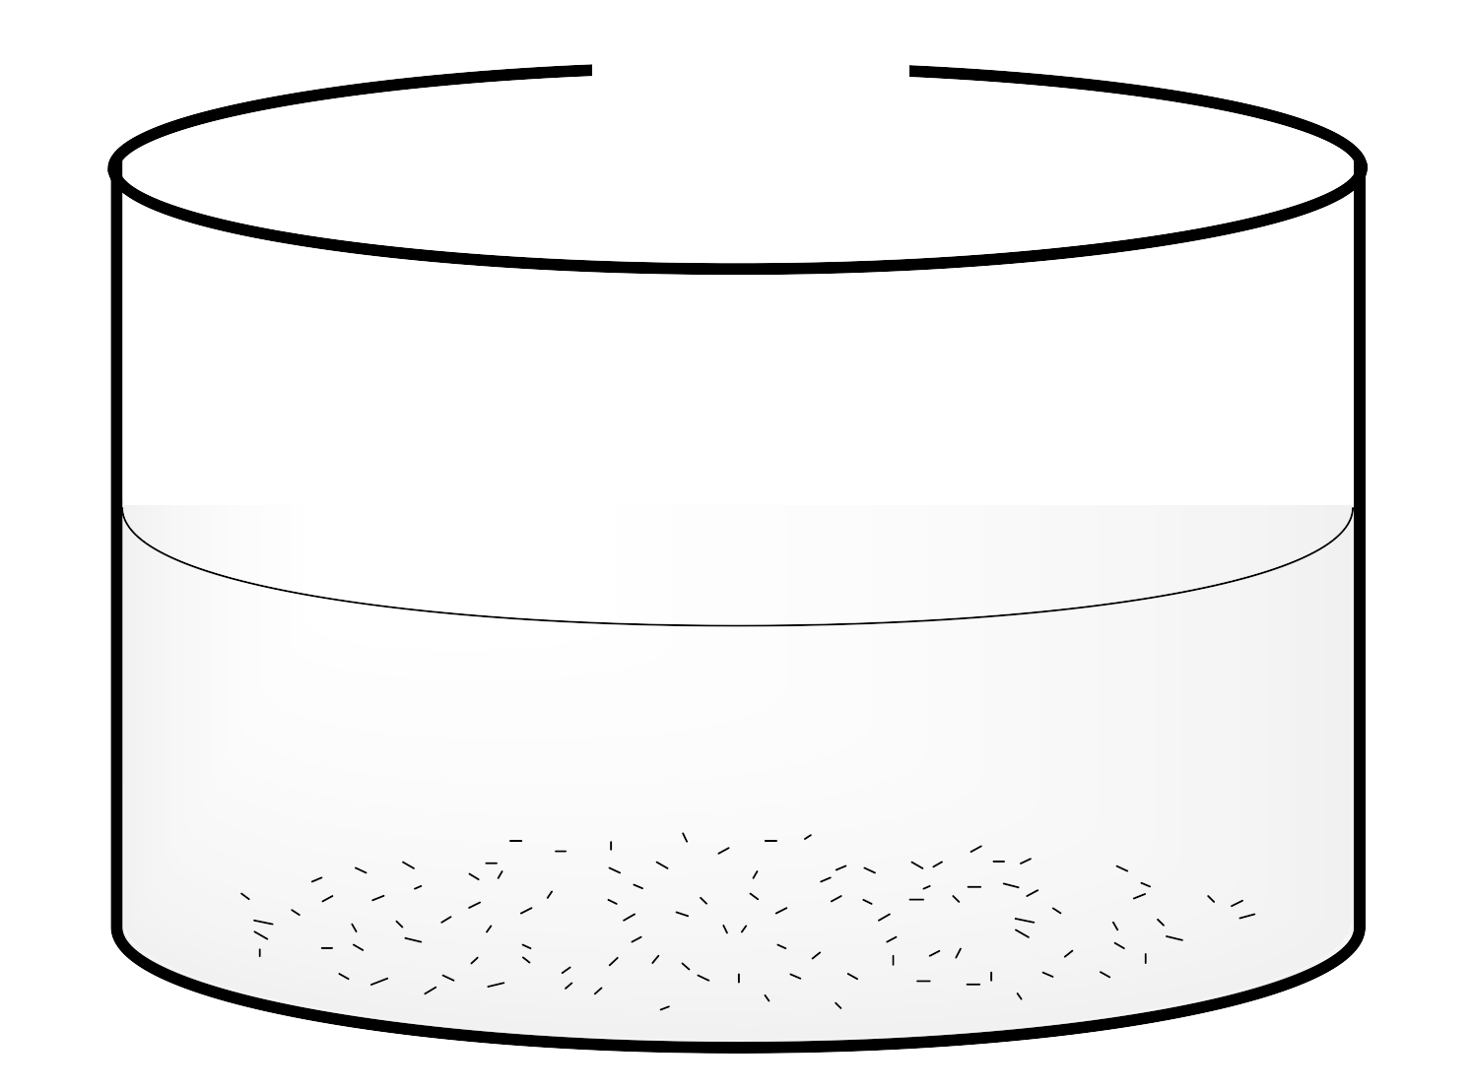

Dehydro-m-A₂pm #2 → free m-A₂pm
  Procedure:
  Freeze the solution and apply vacuum
  Check airtightness
  Heat up uranium bed 1 → tritium pressure rises
  Cool down uranium bed 1 → tritium gas trapping
  Eliminate residual tritium gas
  Remove liquid nitrogen and start agitation → 24 h
  !!! Isotopic exchange during reaction !!!
  Prepare uranium bed 2 for contaminated tritium gas trapping
  Freeze the solution and trap contaminated gas on uranium bed 2
  Eliminate residual tritium gas
  Close all valves, remove liquid nitrogen and disconnect Fischer-Porter tube
  Work-up:
  Filtration of the catalyst
  Evaporation cycles with H₂O/MeOH to remove labile tritium atoms
    No further purification needed 👍
N_{2(l)}
Notes:
tritium, four tritium, désintégrations

Slide 32
Dehydro-m-A₂pm #2 → free m-A₂pm
  Analysis
  Specific activity was determined by HPLC-ESI-MS
  1.04 T/molecule → 1.12 TBq/mmol (30.2 Ci/mmol)
  Total activity was determined by a liquid scintillation counter
  8.84 GBq (239 mCi)
  Conservation
  [³H]m-A₂pm is currently conserved as a 2 mCi/mL solution in EtOH/H₂O 1:1 to minimize radiolysis and bacterial development
  Precursor is stable
 | M+1 | M+2 | M+3 (1T) | M+4 | M+5 (2T) | M+6
m/z | 191 | 192 | 193 | 194 | 195 | 196
%area | 0 | 1.5 | 45.9 | -1.4 | 29.1 | 2.0
 |  |  | 1.04T/molecule |  | 30.2 Ci/mmol

Slide 33
Cross-metathesis
Reactants
AG (mmol) | VG (equiv.) | GII (mol%) | Yield
3.27 | 2.0 | 20 | 50%

Slide 34
Dehydro-m-A₂pm #3 → protected m-A₂pm (PEP3)

Slide 35
SPPS
  An alternative to Cbz: ivDde
  Preparation:
  Cleavage: hydrazine 2% in H₂O/DMF
  Stable to the removal of Fmoc
Chhabra SR, Hothi B, Evans DJ, White PD, Bycroft BW, Chan WC. An Appraisal of New Variants of Dde Amine Protecting Group for Solid Phase Peptide Synthesis. Tetrahedron Lett. 1998;39:1603-1606.
Notes:
1-(4,4-Dimethyl- 2,6-dioxocyclohex-1-ylidene)-3-mehtylbutyl
Acide de meldrum vérifier prepratin du composé
Vérifier mecanisme activation

Slide 36
SPPS
Notes:
stratégie compatible avec amidations pour préparation de fragments de peptidoglycan amidé

Slide 37
To conclude…
Highly optimized enantioselective synthesis of (¹³C)AG
First stereoselective synthesis of (1-¹³C)m-A₂pm
New synthesis of VG (published in Org. Biomol. Chem.)
Stereoselective synthesis of m-A₂pm
First stereoselective synthesis of (3,4-²H₂)m-A₂pm
First total stereoselective synthesis of [3,4-³H]m-A₂pm

Slide 38
To conclude…
Synthesis of 5 differentially protected m-A₂pm
Introduction of four of these compounds in SPPS

Slide 39
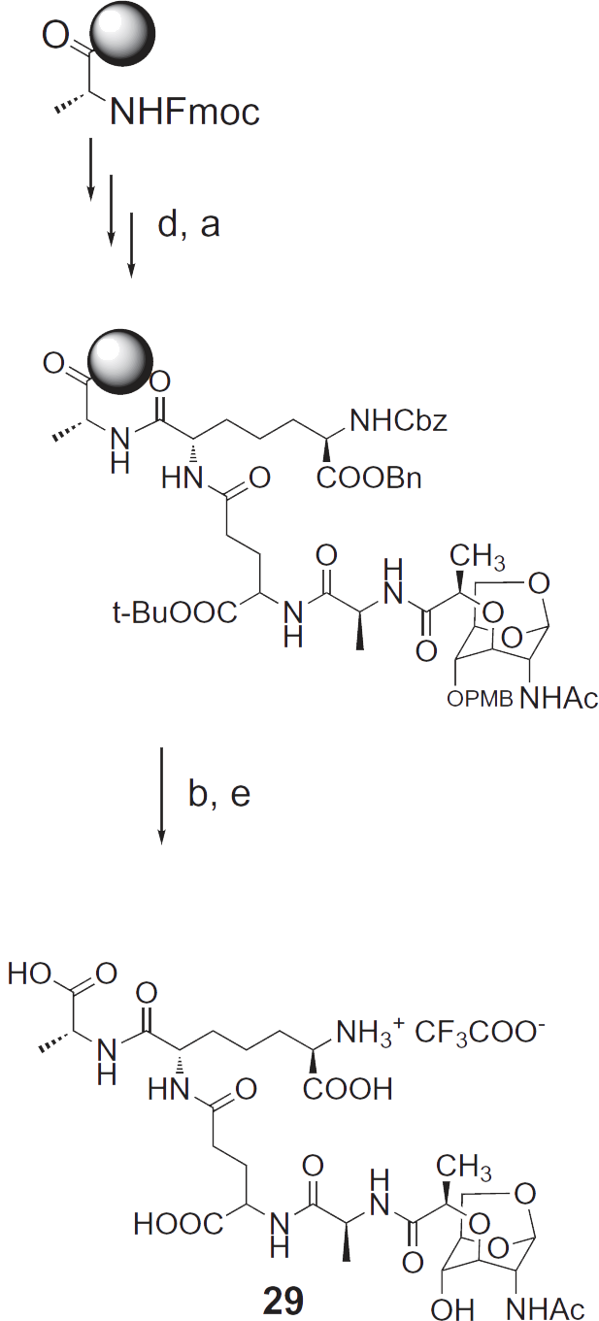
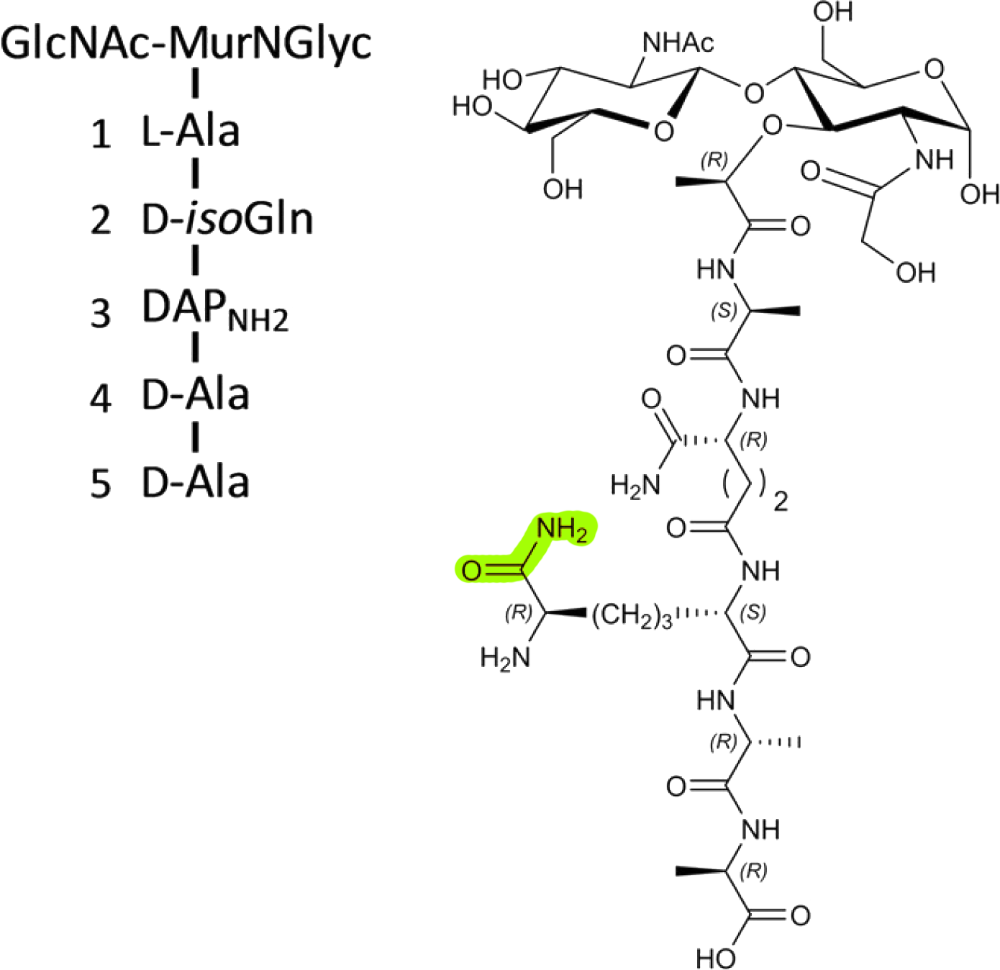
Perspectives
Publication of the synthesis of m-A₂pm, (3,4-²H₂)m-A₂pm and (1-¹³C)m-A₂pm
Two groups expressed their interest in [3,4-³H]m-A₂pm to study PG metabolism
A new set of protecting groups has been found for the preparation of PEP1
Peptides made accessible though the development of this strategy will be used as
  Chromatography and MS references for the study of the β-lactamase induction in B. licheniformis
  Substrates for the study of the human innate immune system
  Substrates for enzymatic and crystallographic studies of PBPs
This strategy is also usable for
  The preparation of modified (amidated) peptidoglycan fragments
  The preparation of anhydromuropeptides via SPPS
Ngadjeua F, Braud E, Saidjalolov S, et al. Critical Impact of Peptidoglycan Precursor Amidation on the Activity of L,D-Transpeptidases from Enterococcus faecium and Mycobacterium tuberculosis.
Chem Eur J. 2018;(24):5743-5747.
Mercier F, Zervosen A, Teller N, et al. 1,6-AnhMurNAc derivatives for assay development of amidase AmiD. Bioorganic Med Chem. 2010;18(21):7422-7431.

Slide 40
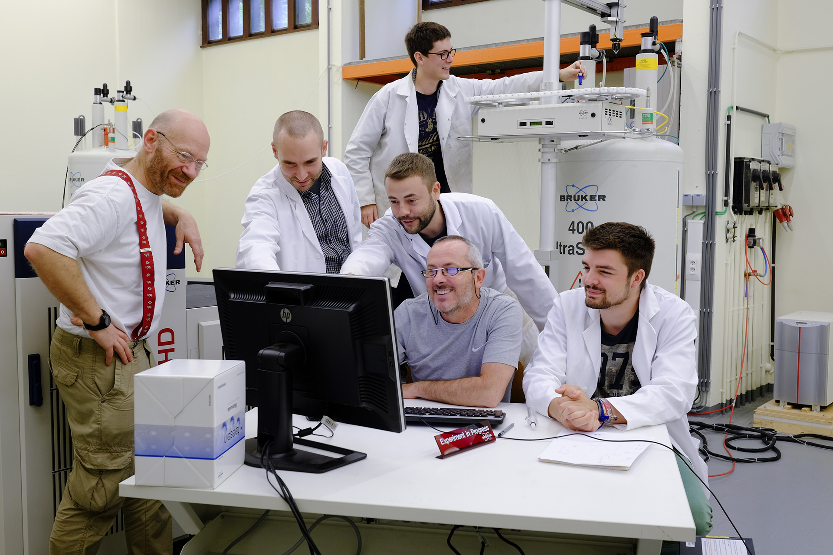
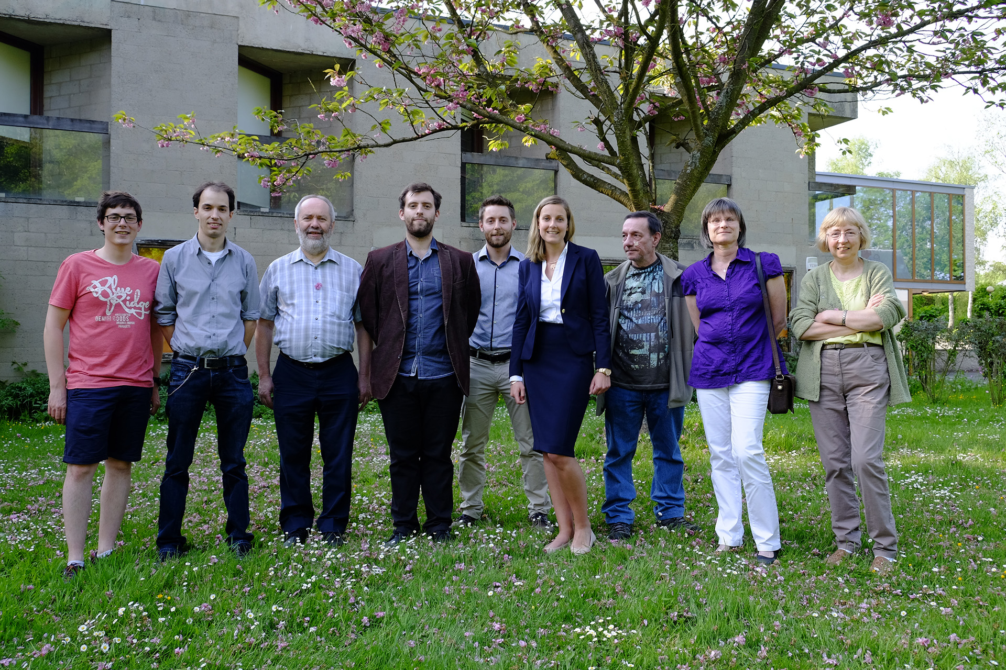
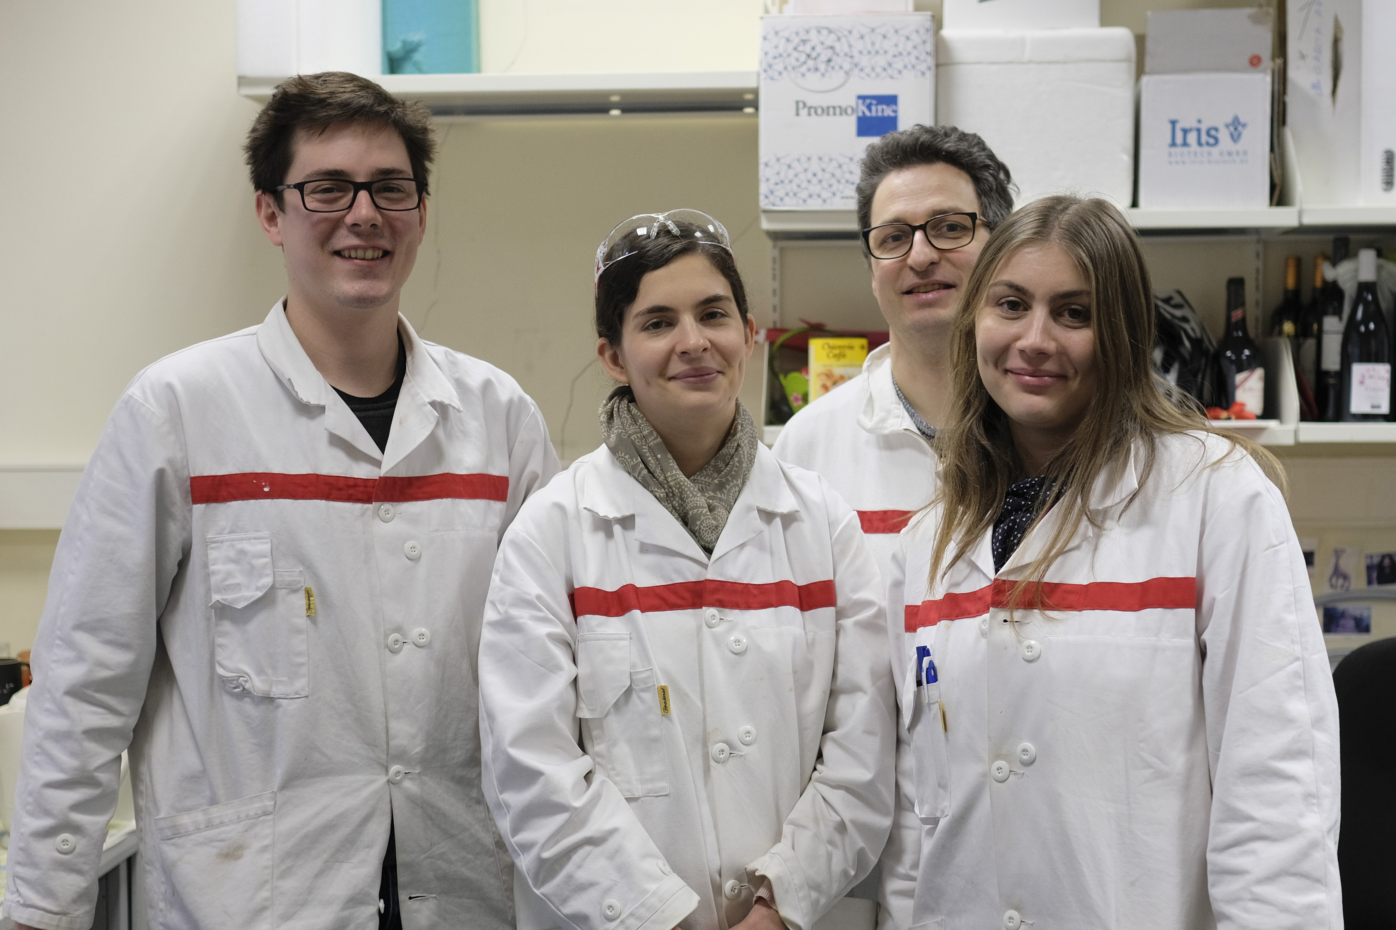
Thank you !

