Slide 1
Raw GNSS Measurements under Android : Data Quality Analysis
*René Warnant, ⁺Quentin Warnant
*University of Liege-Geodesy and GNSS
⁺Augmenteo, Plaine Image, Lille (France)
Raw GNSS Measurements Task Force, Prague, 30 May 2018.

Slide 2
Background
Laboratory Geodesy and GNSS of the University of Liege is mainly involved in the Geodetic Community.
Research on:
multi-GNSS/multi-frequency precise positioning mainly with geodetic receivers but also with low-cost devices (UBLOX).
GNSS-based ionosphere monitoring
Assessing the potential of (dual frequency) smartphones for these 2 research topics.

Slide 3
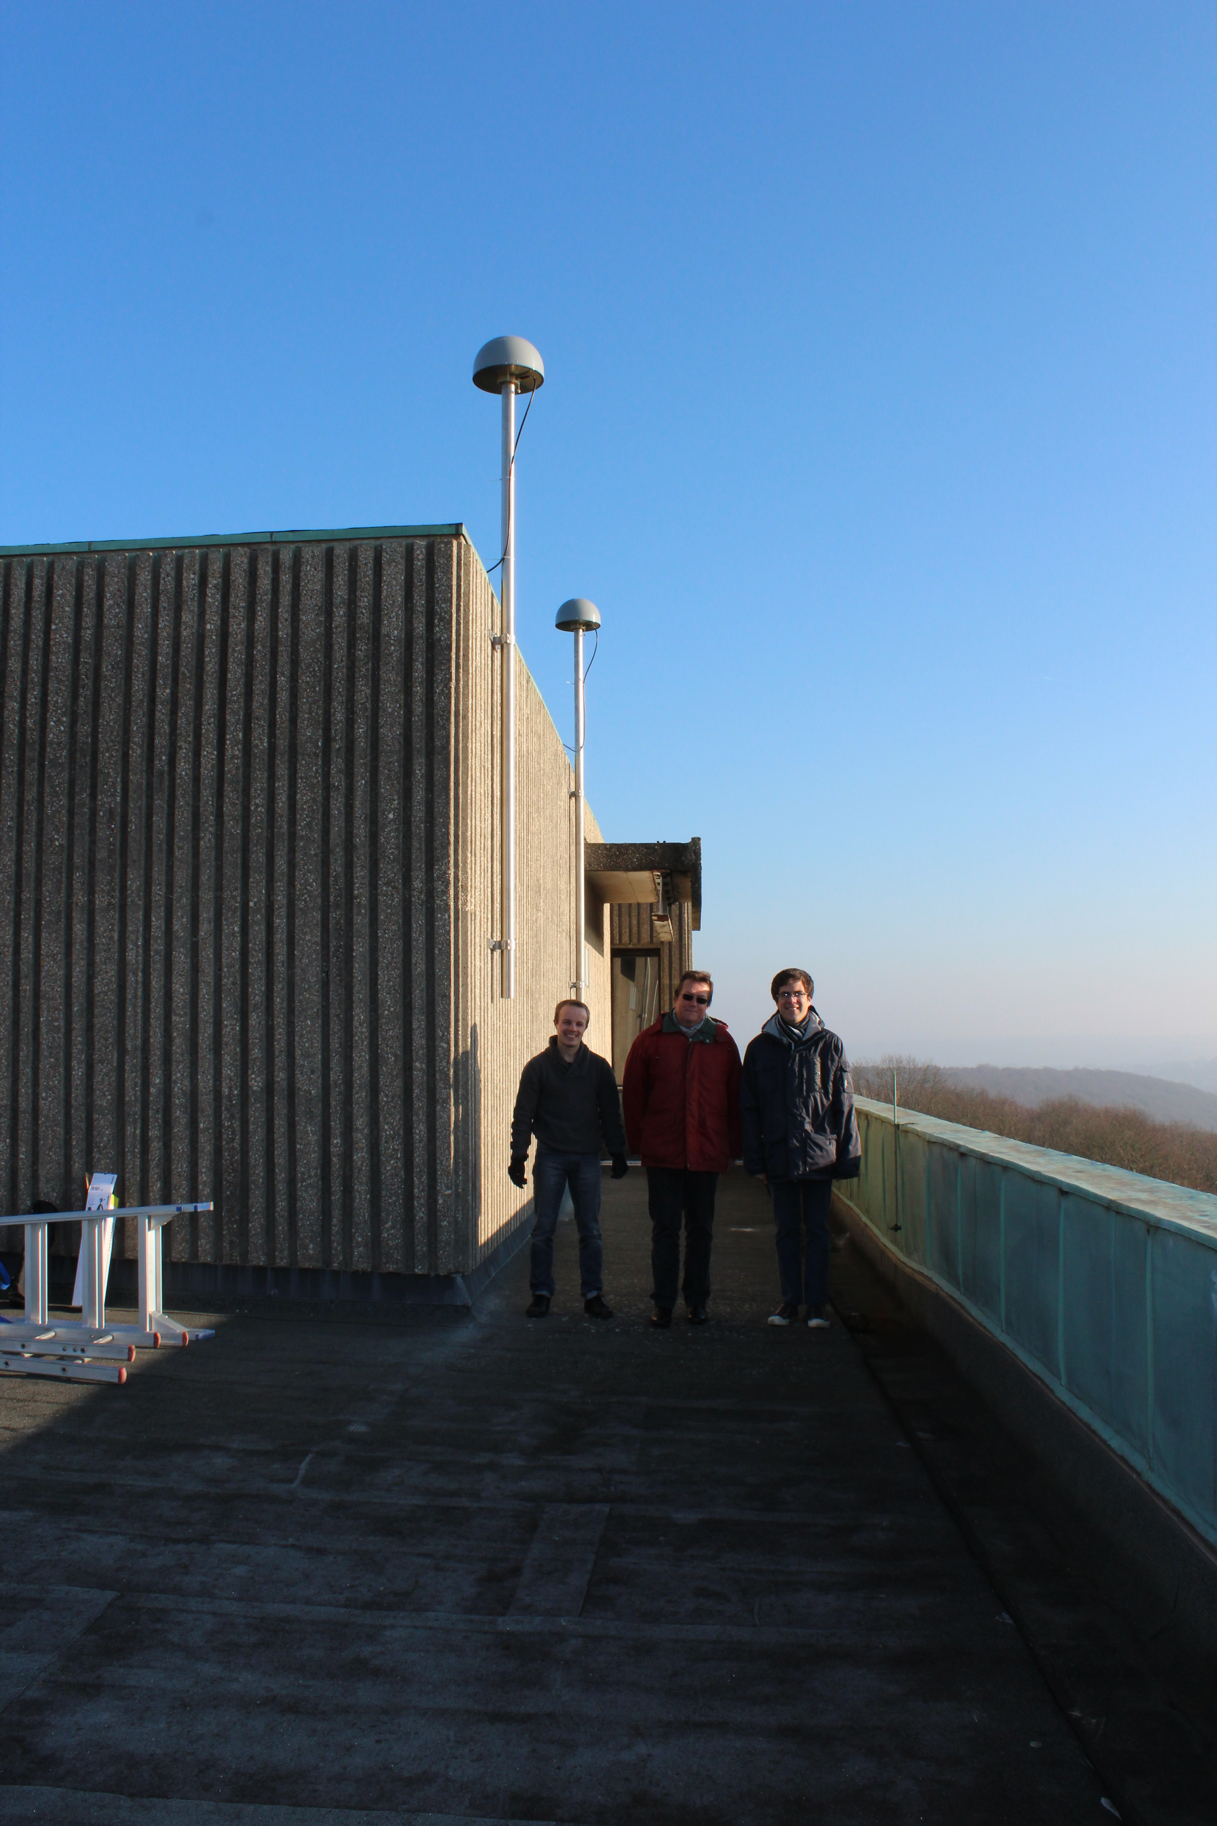
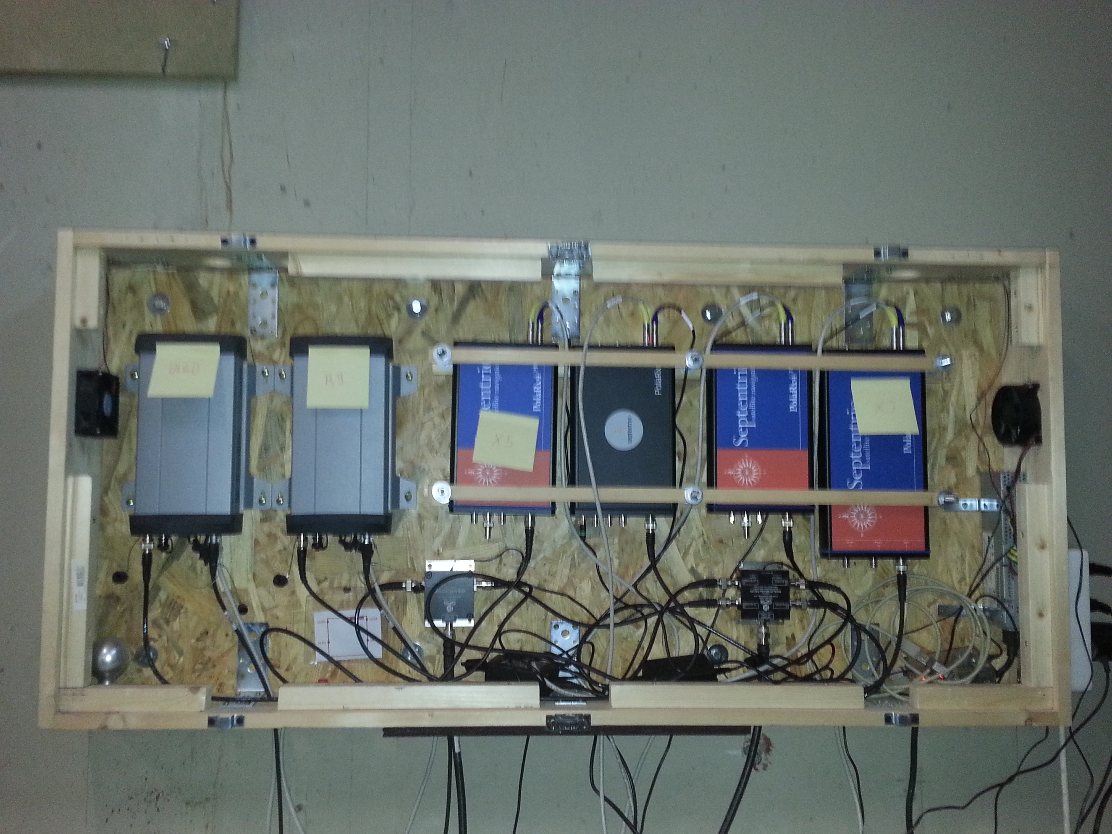
GNSS equipment: Geodetic receivers
Located in Liege (Belgium) – open sky.
2 Trimble GNSS choke ring antennas on a short baseline (5,352 m).
6 multi-GNSS/multi-frequency receivers :
2 Trimble NetR9 receivers
2 Septentrio PolaRx4 receivers
1 Septentrio PolaRxS scintillation receiver
1 Septentrio PolaRx5 (new model).
1 Multi-GNSS/multi-frequency field receiver:
1 Trimble R10

Slide 4
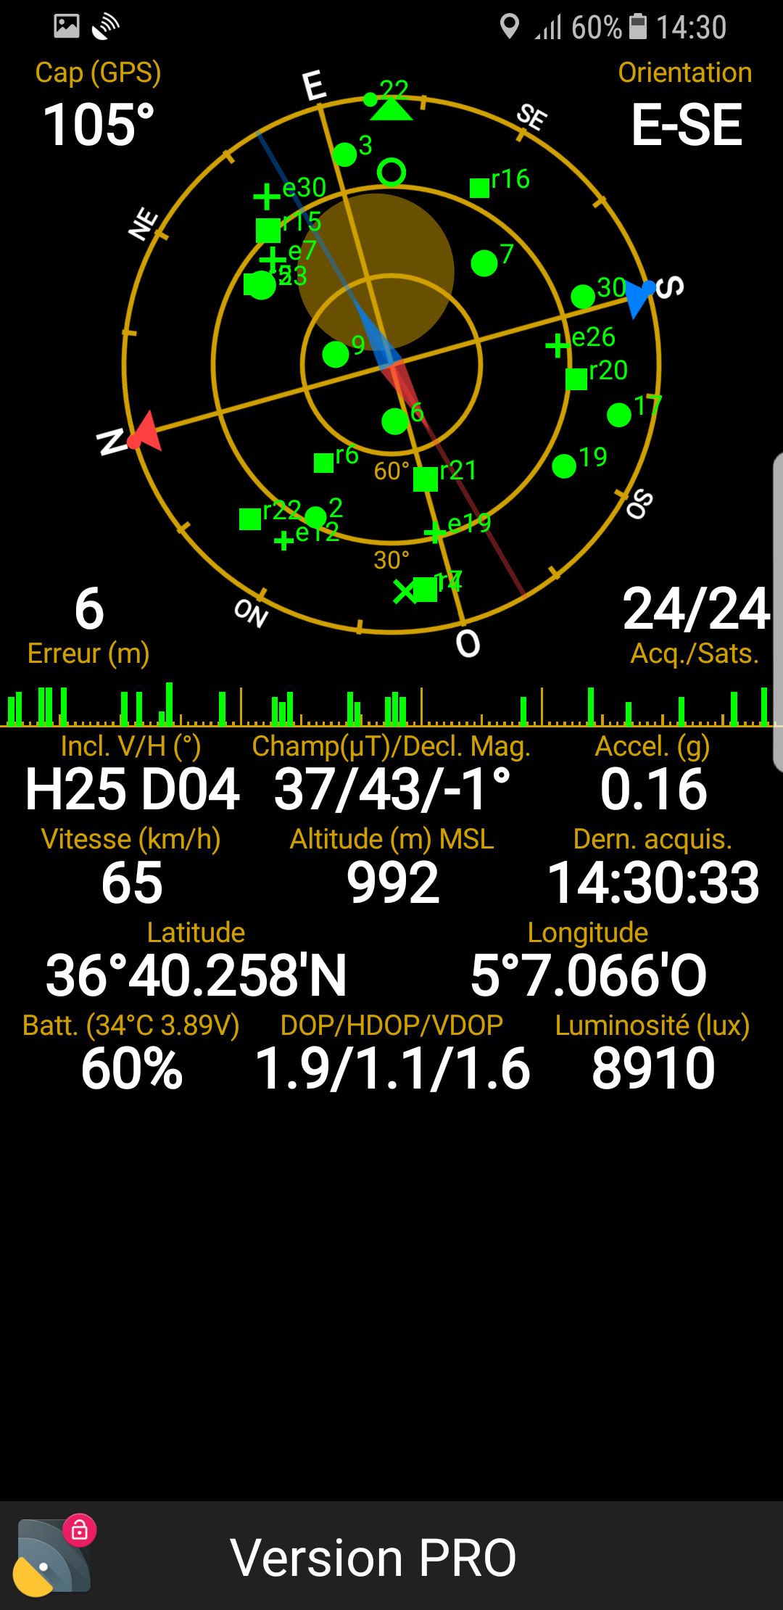
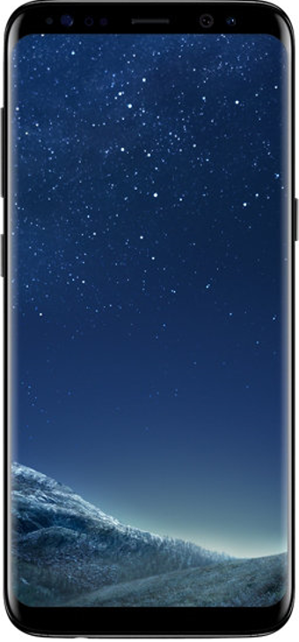
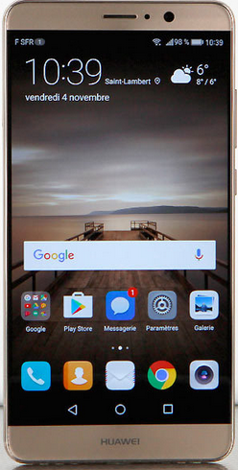
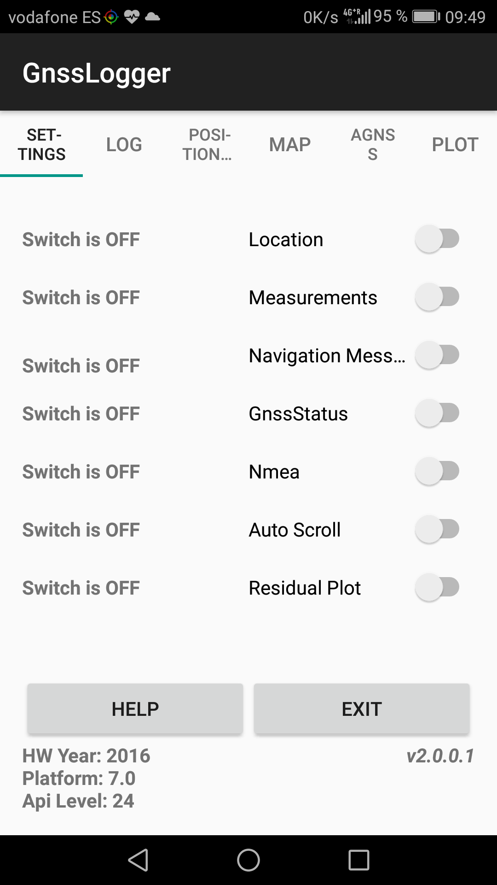
GNSS equipment: Smartphones
4 smartphones running Android 7 (2017) and Android 8 (2018):
Huawei Mate 9 and P10
Samsung Galaxy S8 and S8+
Multi-constellation:
GPS, GLONASS, Galileo, Beidou, QZSS (available but not processed so far)
Raw Data acquisition using GNSSLogger (Google).

Slide 5
The data set
Data collected in different situations (static, pedestrian, car) and environments (open sky, trees and buildings, highways, …) in Belgium, Spain and Japan
~ 350 data files.
We are using our own software fully dedicated to Smartphone data processing (still under development !).
At the moment we focus on the “best achievable” results with smartphones.
In this talk, results are mainly (but not only) based on five 10 minute-sessions on the roof of our building in Liege (open sky) close to the geodetic receivers.
More complete statistics will be presented at ION GNSS.

Slide 6
Data quality and positioning
It is important to assess data quality as:
In addition, Smartphone Raw GNSS measurements have “particular” characteristics meaning that the “usual” data processing strategies might not be optimal.

Slide 7
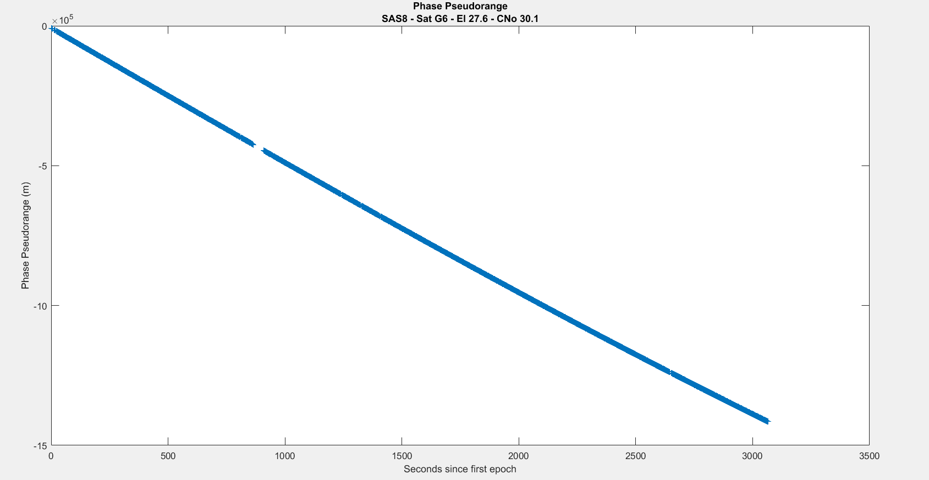
Phase measurements and duty cycle
At the present time, only the HTC Nexus 9 is not affected by the duty cycle.
Nevertheless, using our 4 smartphones, we have been able to regularly collect periods of 3 to 4 minutes of continuous phase measurements after a “cold” start.
Sometimes, longer periods are available: up to 50 minutes of (nearly) continuous phase pseudoranges !

Slide 8
Tracking of Galileo satellites
All smartphones used in our study are Galileo compatible, nevertheless, Galileo tracking is not always “straightforward”.
Usually, the tested smartphones are NOT able to track all Galileo satellites in view (not considering unhealthy satellites).
Under Android 7, it was very difficult to track simultaneously 4 Galileo satellites mainly with Huawei Mate 9 and P10.
Partly du to lack of Galileo-aided data ?
Under Android 8, the situation has improved:
TOW can be injected from an external source.
Nevertheless, even if Galileo satellites are tracked, most Code pseudorange remain ambiguous.

Slide 9
Code “Ambiguity” (1/2)
Receivers need to synchronize with satellite signals.
This is done in several steps.
When the receiver code is locked to the satellite code, the code pseudorange measurement is still ambiguous
For example, 1 ms ambiguous for GPS C/A Code.
It remains ambiguous until the TOW is decoded (using the navigation message).

Slide 10
Code “Ambiguity” (2/2)
For GPS, GLONASS and Beidou, “the ambiguity resolution” is usually performed in a short time.
It is NOT the case for Galileo : most collected measurements are ambiguous on the tested devices !
The ambiguity can be (rather) easily solved:
Get approximate values of the receiver position and clock error.
Compute a modelled code pseudorange
Solve the ambiguity if the accuracy of the modelled pseudorange is better than the ambiguity

Slide 11
Proportion of ambiguous code pseudoranges
Proportion of ambiguous code pseudoranges wrt all available data (Samsung Galaxy S8) during five 10-minute sessions.
In our software, code ambiguity resolution is activated ONLY for Galileo.
Pseudoranges flagged “Millisecond ambiguous” are NOT corrected (so far).
Samsung Galaxy S8 | Unambiguous data (%) | Available data after code AR (%)
GPS | 82 | -
Galileo | 6 | 60
Beidou | 69 | -

Slide 12
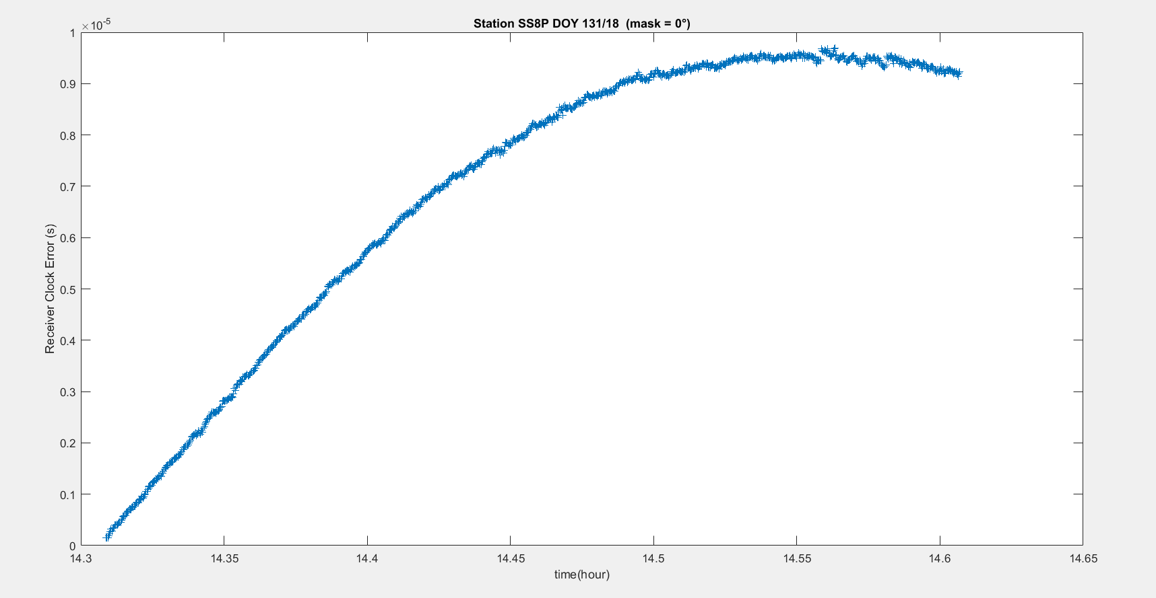
Clock behaviour
On all available data (~350 files), only a few clock jumps (requires further analysis).
Usually very regular linear drift:
~300-400 ns/s for Huawei Mate 9, P10 and Samsung Galaxy S8.
~3-8 ns/s for Samsung Galaxy S8+ (not always linear).
Clock error can be larger than 1 ms during longer sessions.

Slide 13
Combinations used to assess data quality
Three different combinations to assess data quality:
Code Minus Phase
Code Range Rate Minus Phase Range Rate (less “sensitive” to multipath).
Code Double Differences on a short baseline (smartphones close to each other).
The consistency of the results has been controlled by comparing the 3 combinations
The comparison also helps to separate noise and multipath.

Slide 14
Precision, CNo and elevation (1/3)
When using Geodetic receivers, CNo and GNSS measurement precision increase with satellite elevation.
In data processing techniques, this characteristic is often exploited in the variance-covariance matrix.
Raw GNSS Smartphone data do not behave in the same way meaning that data processing strategies must be modified accordingly.

Slide 15
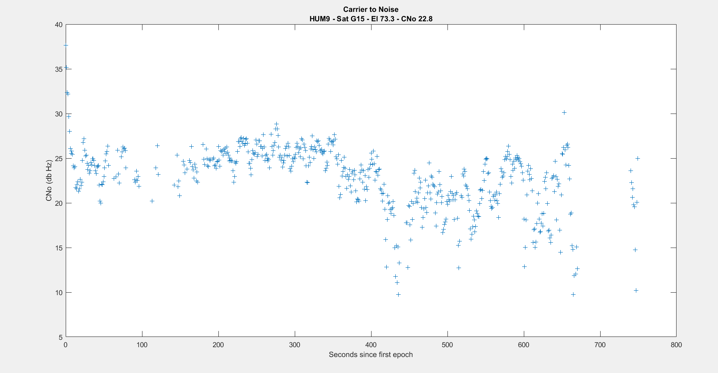
Precision, CNo and elevation (2/3)
Precision: 8,0 m Mean CNo: 22,8 Mean elevation: 73,3°

Slide 16
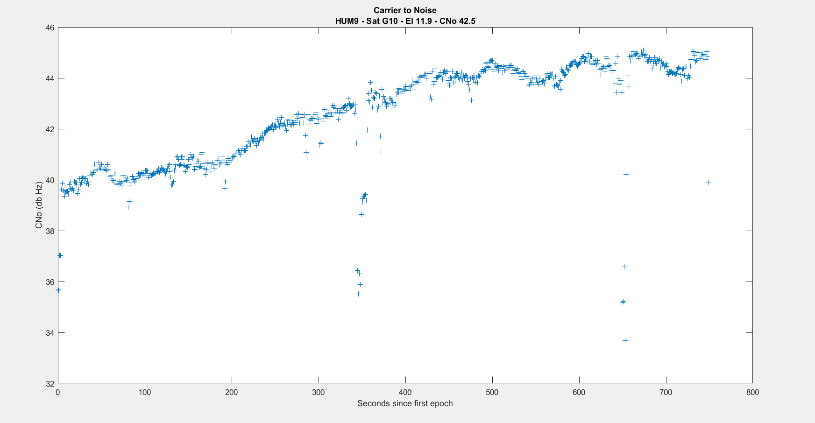
Precision, CNo and elevation (3/3)
Operator touching the phone
Precision: 2,0 m Mean CNo: 42,5 Mean elevation: 11,9°

Slide 17
Code pseudorange precision depending on CNo
Samsung Galaxy S8: Code precision as a function of mean satellite CNo computed based on five 10-minute sessions using Code Range Rate Minus Phase Range Rate
Galaxy S8 | CNo ≥ 37,5 | 30 ≤ CNo < 37,5 | 22,5 ≤ CNo < 30 | 15 ≤ CNo < 22,5 | Mean
GPS | 2,550 | 4,272 | 6,302 | 8,439 | 3,729
GLONASS | 4,876 | 7,386 | 12,368 | 13,337 | 7,694
Galileo | 2,188 | 2,855 | 2,993 | - | 2,638
Beidou | 0,912 | 2,063 | 2,967 | - | 2,208
! More data necessary !

Slide 18
Code pseudorange precision depending on CNo
Huawei Mate 9: Code precision as a function of satellite mean CNo (same conditions).
Huawei Mate 9 | CNo ≥ 37,5 | 30 ≤ CNo < 37,5 | 22,5 ≤ CNo < 30 | 15 ≤ CNo < 22,5 | Mean
GPS | 2,372 | 5,176 | 7,429 | - | 4,089
GLONASS | 4,598 | 7,503 | 12,319 | - | 5,231
Galileo | 2,080 | 2,584 | 3,449 | - | 2,439
Beidou | - | 2,039 | 3,002 | - | 2,499
! More data necessary !

Slide 19
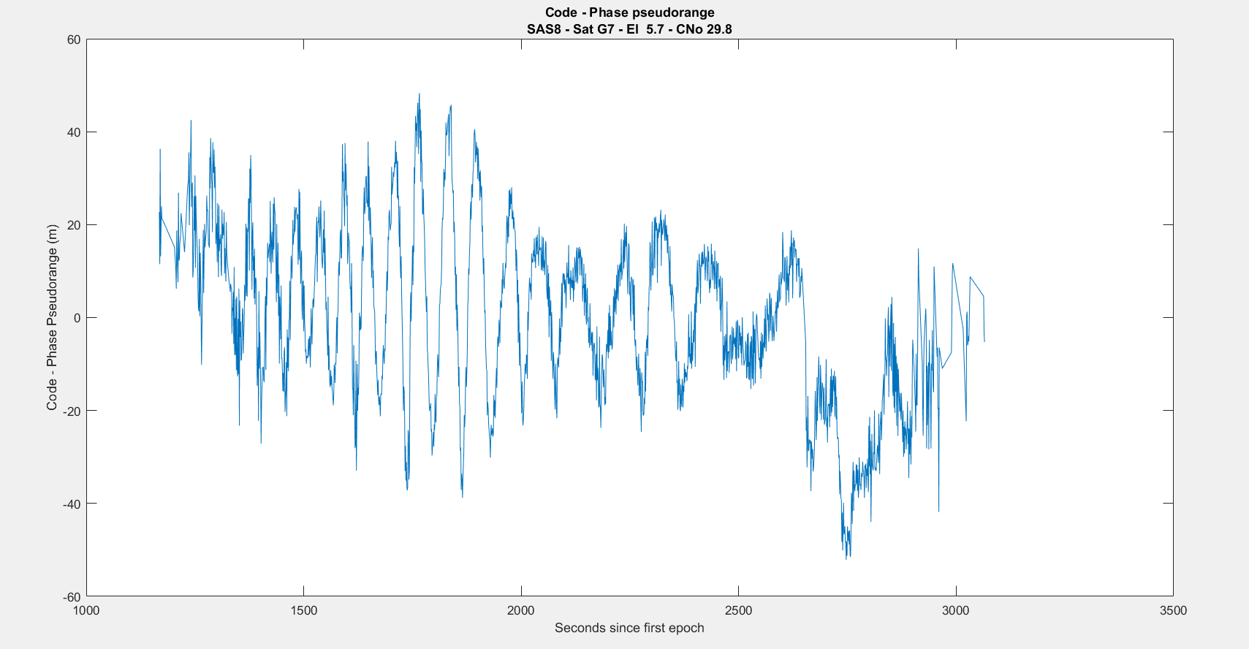
Multipath
An example of strong multipath (Complete statistics not yet available).

Slide 20
Conclusions
The tested Smartphones clocks have a regular drift and only few jumps have been experienced (short sessions).
Most Galileo Code pseudoranges are ambiguous but the ambiguity can be easily solved.
CNo and Code pseudorange precision have no clear relationship with satellite elevation.
Huawei Mate 9 and Samsung Galaxy S8 have the same level of accuracy.
Mean Code Pseudorange precision is better for Beidou and Galileo than for GPS and GLONASS.

Slide 21
Code Minus Phase
Neglecting:
Hardware biases variability (short periods)
Phase multipath and noise wrt code multipath and noise
The Code-Phase combination depends on:
Two times the ionosphere error
Code multipath and noise
Phase ambiguity and possible cycle slips.
When removing the mean value of the combination (period of about 240 s):
Ionosphere variability (usually negligible on a short period)
Code multipath (variability) and noise
Cycle slips

Slide 22
Code Range Rate Minus Phase Range Rate
Under the same assumptions, the Code Range Rate Minus Phase Range Rate combination depends on (1 sec sampling rate):
Ionosphere rate of change (negligible)
Code multipath rate of change
Noise
Cycle slips (➔ outliers)

Slide 23
Double difference of Code
On a short baseline (smartphones close to each other):
Code multipath (combination of multipath on 4 code pseudoranges)
Noise
Residual geometry (coordinates of the 2 smartphone antennae not precisely known) but negligible wrt code noise.
Residual term due to the fact that the measurement are not collected exactly at the same (GPS) time.

