Slide 1
Usage of blockchain for peer-to-peer energy exchanges: design, simulation and recommendations
David Vangulick, Bertrand Cornélusse, Damien Ernst
University of Liège
PSCC 2018 Session: S26: Decentralized coordination and control of DER

Slide 2
Agenda
Introduction
Problem Statement
Proof of work ?
Proposal for a time synchronized blockchain
ULIEGE / D. Vangulick
PSCC 2018 Session: S26: Decentralized coordination and control of DER

Slide 3
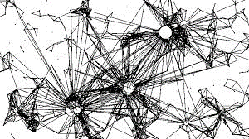
Definitions
Agenda:
Introduction – Problem Statement – Proof of Work ? - Proposal
Blockchain is
An open, distributed ledger that can record transactions between two parties efficiently and in a verifiable and permanent way.(*)
(*) M. Iansiti and K. R. Lakhani, “The truth about blockchain,” Harvard Business Review, vol. 95, no. 1, pp. 118–127, 2017.
A set of cryptography and information technologies put together to create a robust system based on game theories and consensus.
Blockchain is not to be confused with crypto currencies
ULIEGE / D. Vangulick
PSCC 2018 Session: S26: Decentralized coordination and control of DER

Slide 4
Concepts
Agenda:
Introduction – Problem Statement – Proof of Work ? - Proposal
A « classic » way to do a transaction:
an official who has the (legal) authority to say that transactions are correctly signed, true and to make an oath (= promise) official
=> “The man in the middle” records these transactions in a book / a ledger
Notary – Bank - meter reading company …
ULIEGE / D. Vangulick
PSCC 2018 Session: S26: Decentralized coordination and control of DER

Slide 5
Concepts
Agenda:
Introduction – Problem Statement – Proof of Work ? - Proposal
These « classical » practices have a lot of drawbacks :
Trust « the man in the middle »
The process is as good as its weakest point: human
E.g. Bank crisis 2008 => the very start of Bitcoin
Risk of tampering/cheating the records
Risk of manipulation/destruction of the ledger
To avoid these drawbacks: « A pack of fish is less vulnerable than a fish alone»
Decentralisation
ULIEGE / D. Vangulick
PSCC 2018 Session: S26: Decentralized coordination and control of DER

Slide 6
Concepts
Agenda:
Introduction – Problem Statement – Proof of Work ? - Proposal
What if these transactions are managed in a decentralized and digital way:
CONSENSUS that transactions are correctly signed, true and to make an oath (= promise) official and immutable , in a digital manner
Know the recipient = a public key
Sign = private key + public key (RSA like)
The next slides will explain how to make the consensus in order that the promise will be official and immutable in a digital manner:
=> Create a block and Role of the miner
ULIEGE / D. Vangulick
PSCC 2018 Session: S26: Decentralized coordination and control of DER

Slide 7
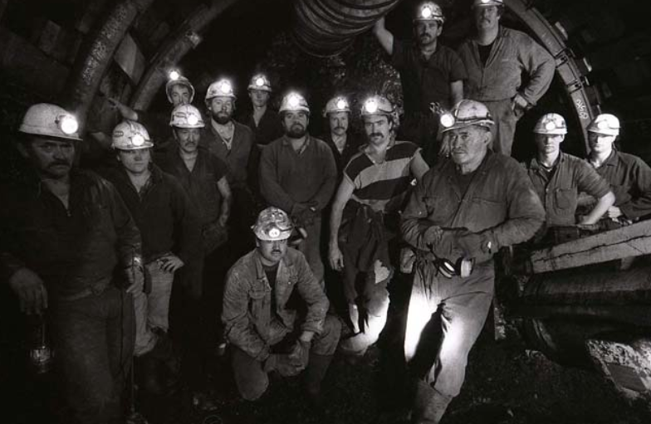
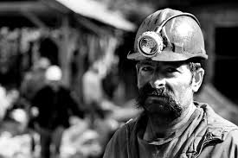
Create a block
Agenda:
Introduction – Problem Statement – Proof of Work ? - Proposal
Ledger of a specific miner
Block H
POOL
Block I
Block J
Block K
Charlotte
Victoria

Slide 8
Problem Statement
Agenda:
Introduction – Problem Statement – Proof of Work ? - Proposal
Energy Exchange
SCHOOL
ULIEGE / D. Vangulick
PSCC 2018 Session: S26: Decentralized coordination and control of DER

Slide 9
Problem Statement
Agenda:
Introduction – Problem Statement – Proof of Work ? - Proposal
SCHOOL
This is obviously only a data exchange. Power flow on the network doesn’t change at all.

Slide 10
Problem Statement
Agenda:
Introduction – Problem Statement – Proof of Work ? - Proposal
SCHOOL
Energy coming from wholesale market
Market period
(e.g. 1/4h)
ULIEGE / D. Vangulick
PSCC 2018 Session: S26: Decentralized coordination and control of DER

Slide 11
Problem Statement
Agenda:
Introduction – Problem Statement – Proof of Work ? - Proposal
We want to record the energy exchange into a blockchain
Blockchain
eco-system
Wholesale electicity market
ULIEGE / D. Vangulick
PSCC 2018 Session: S26: Decentralized coordination and control of DER

Slide 12
Problem Statement
Agenda:
Introduction – Problem Statement – Proof of Work ? - Proposal
Precision and accuracy of measurements
Trade and exchange traceability
Respect for private life: that is to say, offer enough defence so that an external attack can not access personal information
Split "pairwise" exchanges perfectly with what comes from the market on the same time base (the market period)
Provide to the market and / or customer information close to real time.
Depends on the interface between the physical world and the blockchain but also the speed of transactions
Ok, that's intrinsic to the very concept of blockchain
Ok, if we admit that anonymity is sufficient
Not ok with Proof of Work
Develop Specific Time synchronized Blockchain
Develop Specific Time synchronized Blockchain

Slide 13
Proof of work
Agenda:
Introduction – Problem Statement – Proof of Work ? - Proposal
Way of working = Hash
TX n
TX …
TX 2
HASH
TX 1
Hash bloc -1
Hash between
0000000000000000000000000000000000000010000000000000000000000
0000000000000000000000000000000000001000000000000000000000000
1 Th/s ~ 1 kW
Bitcoin (total hash rate power):
35,366,943 Th/s
Nonce
no
yes
Ok create a block

Slide 14
Proof of work
Agenda:
Introduction – Problem Statement – Proof of Work ? - Proposal
Why PoW is not suitable for Peer to Peer electricity exchange?
The time to solve the mathematical puzzle is not a constant and depend on the computation power (hash rate)
Energy consumption
most computers can achieve at least 4 Gh/s
Special devices(e.g. AntS3) reaches 450 Gh/s
There is a competition: Hash rate for bitcoin is 26.146.927 Th/s (and it is exponential growing)
PoW could be used if the market period is long (e.g. year or month as it is residential customers)
ULIEGE / D. Vangulick
PSCC 2018 Session: S26: Decentralized coordination and control of DER

Slide 15
Proposal for a Time synchronized blockchain
Agenda:
Introduction – Problem Statement – Proof of Work ? - Proposal
Voting token
For each Tx a token E (of a given value) is created and is assigned to the transmitter (k)
Candidates Announcement
Each candidate sends the #E that he/she is ready to use
Computation of the Stake/Wealth
For each candidate :
Generation of random numbers
Selection of the best k
Winner = k with arg max Wk / Uk
For each candidate Uk between ]0;1]
He/she receives all the voting token sent by candidates
Wk =
Selection done by current Miner
$$αE_{T_{i}−1}^{k}+$$
$$βA_{T_{i}−1}^{k}+$$
$$γR_{T_{i}−1}^{k}i$$
A = Age of the last block created by the candidate
R = reputation of the candidate (e.g. # of her/his block in the main chain )
ULIEGE / D. Vangulick
PSCC 2018 Session: S26: Decentralized coordination and control of DER

Slide 16
Proposal for a Time synchronized blockchain
Agenda:
Introduction – Problem Statement – Proof of Work ? - Proposal
Each candidate creates a block with all transactions done during the market period and broadcasts it
Market period t-1
Market period t
Market period t+1
ULIEGE / D. Vangulick
PSCC 2018 Session: S26: Decentralized coordination and control of DER

Slide 17
Proposal for a Time synchronized blockchain
Agenda:
Introduction – Problem Statement – Proof of Work ? - Proposal
Each candidate, meanwhile, sends its voting tokens to the current miner.
The voting period :
Market period t-1
Market period t
Market period t+1
Candidate
gate opening
Candidate
gate closing
Candidates Announcement
Selection of the best candidate
Broadcast winner
ULIEGE / D. Vangulick
PSCC 2018 Session: S26: Decentralized coordination and control of DER

Slide 18
Proposal for a Time synchronized blockchain
Agenda:
Introduction – Problem Statement – Proof of Work ? - Proposal
The consensus is created by:
All nodes (candidates or not) add the winner's block to their own chain if
They agree about the validity of the transactions contained in the block or,
This block is equal to the block that a candidate has been mined.
This is transparent and therefore verifiable by all nodes.
The longest chain is the "truth".
ULIEGE / D. Vangulick
PSCC 2018 Session: S26: Decentralized coordination and control of DER

Slide 19
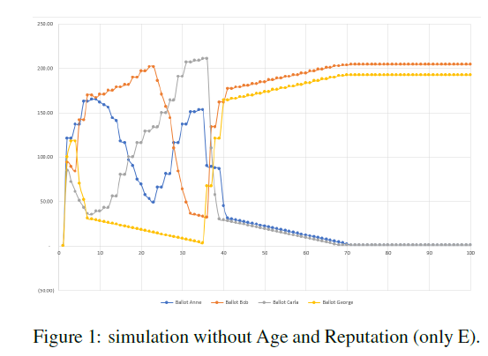
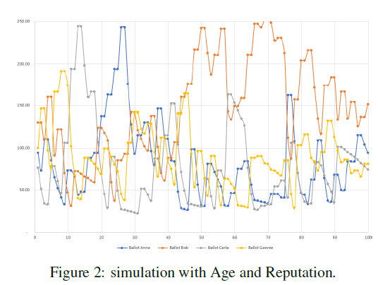
Proposal for a Time synchronized blockchain
Agenda:
Introduction – Problem Statement – Proof of Work ? - Proposal
Complement: simulations of the importance of wealth factor
ULIEGE / D. Vangulick
PSCC 2018 Session: S26: Decentralized coordination and control of DER

Slide 20
Conclusion
The block contains all the transactions of a market period and is compatible with the wholesale market.
The motivation of the minor is related to the value of the vote token
The validation of the block is the time between the end of the market period and the opening of the next block.
ULIEGE / D. Vangulick
PSCC 2018 Session: S26: Decentralized coordination and control of DER

Slide 21
References
Blockchain for peer-to-peer energy exchanges: design and recommendations
Blockchain for peer-to-peer energy exchanges: design and recommendations (additional work)
E-CLOUD, the open microgrid in existing network infrastructure

