Slide 1
How investigative journalism infiltrates video game press
Boris KRYWICKI (@Bkrywicki)
Liege Game Lab + LEMME
Liege, Belgium

Slide 2
Points of interest
Specialized medias about video games (paper and online, past and present)
Journalists’ work conditions and experience
Investigative journalism’s (調査報道) appearance in video game press’ subfield
Video game press’ economical history (as an explantation of this progressive professionalization)

Slide 3
Hypothesis
Today french specialized journalists writing about videogames are sensibilized to traditional investigative journalism (調査報道) automatisms and keep them in mind as they do their job, using these investigative techniques not daily but only when when a case presents itself.
This enrichment of video game journalists’ occupational ideology might be the result of a transmission from generalist journalists and a professionalization, leading specialized reporters to become more and more polyvalent and multi-skilled.

Slide 4
Method
Unstructured interviews (FONTANA & FREY, 2005)
with specialized reporters (11 currently) using investigative techniques in their work
Grounded theory analysis (Lejeune, 2014)
Discourse analysis studying game reviews’ modele reader (Eco, 1979) and specialized medias’ reading contract (Veròn, 1988)

Slide 5
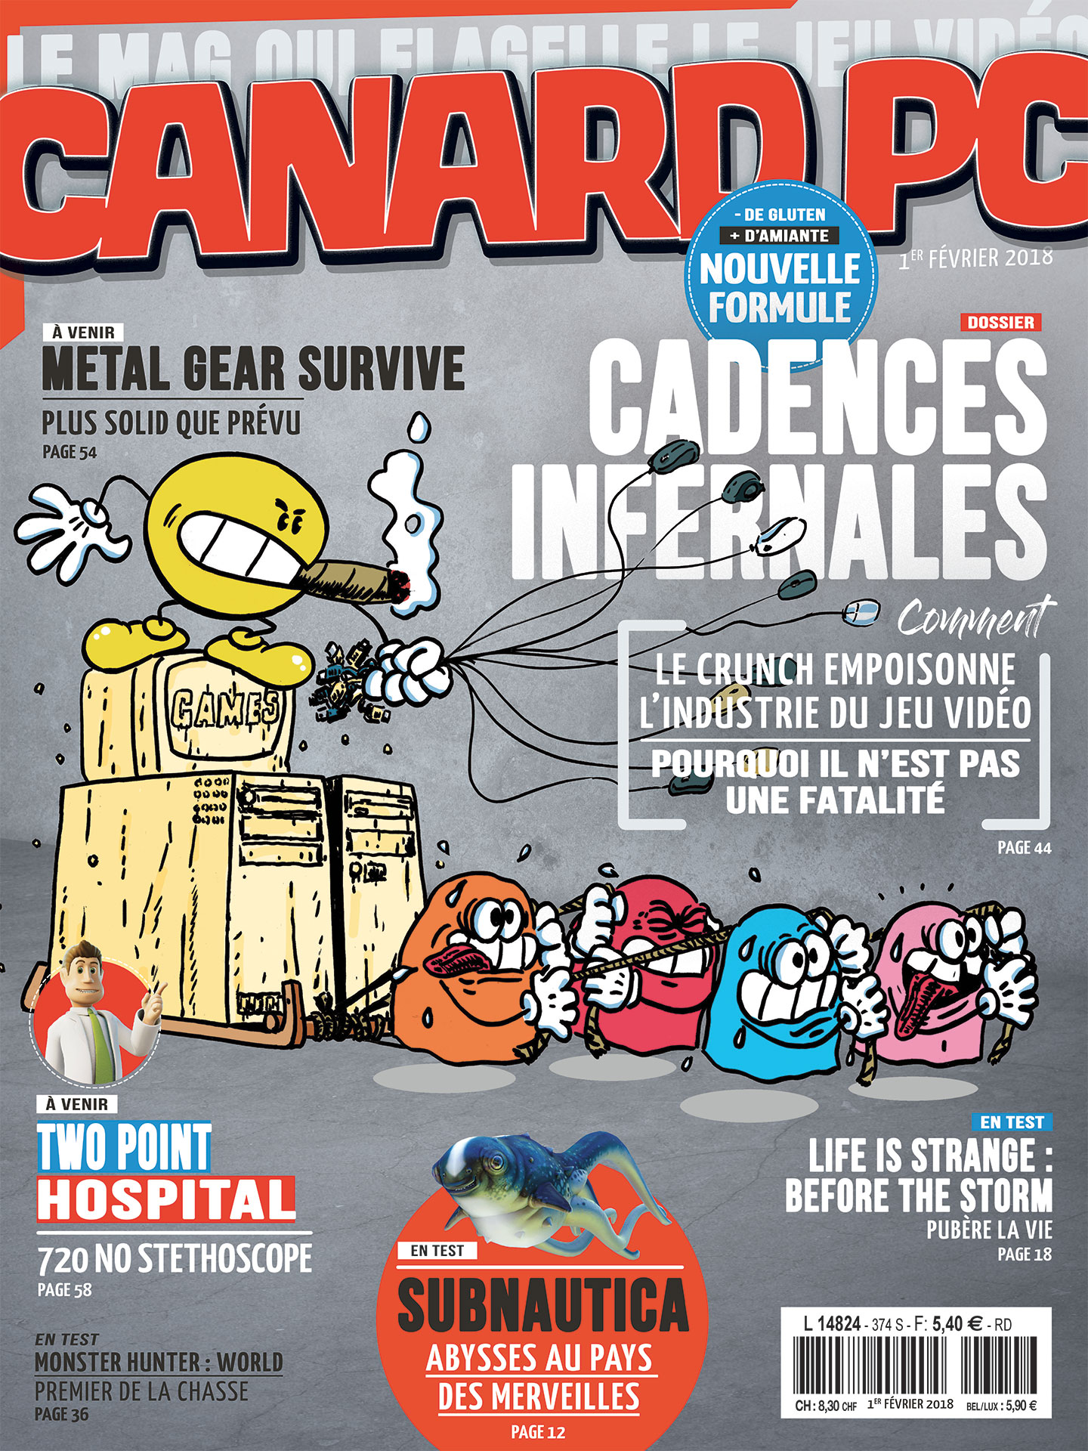
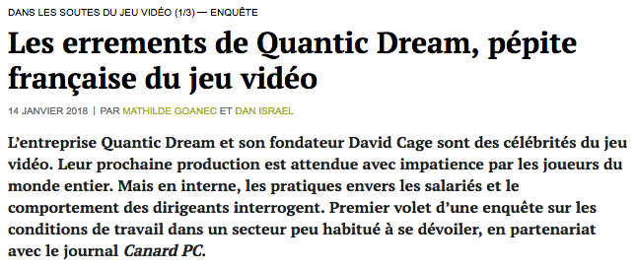

The Quantic Dream affair
Canard PC, Mediapart and Le Monde in january 2018

Slide 6

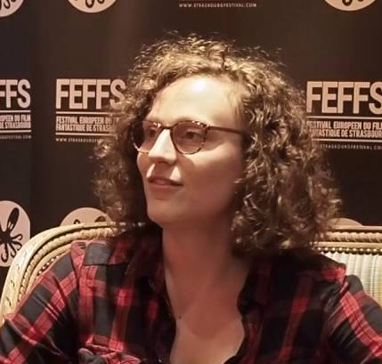

Investigative techniques used by specialized journalists
Sources’ identity protection
Multiple and long interviews
Working secretly
William Audureau, Le Monde
Cécile Fléchon (aka Maria Kalash) and Sébastien Delahaye (aka Netsabes), Canard PC

Slide 7



Investigative work about japanese game creators
William Audureau, 2014 Daniel Andreyev, 2017 Nicolas Turcev, 2018

Slide 8
Bringing something new
These specialized reporters have the goal to bring some previously unknown information and reveal something new to the readers.
Exclusive information are a way to materialize the time and effort spent in research by journalists, eventually justyfing and legitimating the price readers always need to pay to access investigative stories.

Slide 9


Investigation brings exclusive news… staying cold

Slide 10
Close relationship with the industry
It can be observed within two different fields :
Journalists’ stories and texts
Direct interactions between journalists and video game companies (PR, publishers, developers…)

Slide 11


Texts : celebrative reviews
Authors of celebrative reviews try to federate using « a strong consensus on readership’s values transforming the buying/subscription/reading act in a communitarian gesture » (Bergala, 1996).
« With this new episode of Crash Bandicoot trilogy, discover what fun and ultime beauty truely mean ! Glory to Crash ! […] You think you’ve seen everything ? […] Well, open your eyes because Crash 3 might leave you amazed ! Naughty Dog’s team decided to become Santa claus to fulfill you beyond all your hopes » (Joypad n°81, french game magazine, December 1998, personal traduction)

Slide 12
The « product culture »
« It’s, I think, a legacy from 1990’s press, back when first efficent PR grounded and magazine covers stopped to be centered on players or drawings to become more and more illustrated with upcoming games. It’s also the moment when the automatism « news – previews – tests » setteled […]. This product obsession is completly brainless. Meaning, when you arrive in specialized press you don’t ask yourself what you’ll talk about. It seems obvious : you’ll talk about commercial products that always are there, ready and set » (interview with William Audureau, journalist for Le Monde, 19th january 2018).

Slide 13


Less celebrative reviews today ?
« God of War : a game blessed by gods », Jeuxvideo.com, Yannick Le Fur, 2018.
20/20 and really minor flaws depicted by the journalist

Slide 14
Professional automatisms of « product culture »
Mutual dependency with the industry : getting review copies, going to press tours, interviewing only when it’s chosen by the publisher
Always relaying what the industry communicates (also see HUNTER Mark, 2008 and « conventional journalism »
Negociating with Press Relation services.

Slide 15



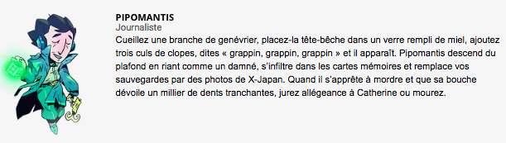
The mediatic context
Large audience is globaly more interested in entertainment and direct advice online videasts provide. Specialized press is not seen as fun and indespensable as before.
Several reporters tired of being deemed unprofessional want to differenciate themselves from Youtubers and claim their journalistic role and function.

Slide 16
Investigate intermittently
Investigative stories are a way for video game journalists to claim their independance and offer readers an added value (meaning some informations they won’t read elsewhere)
Occasions to do such an investigative work are rare for specialized journalists : you need a case, time and money
There are different degrees of investigation. Journalists can investigate intermittently (meaning not always – for example they work for 2 months and then come back to their daily work)) regarding their schedule and the news feed’s hotness.

Slide 17

« Initiative journalism » ?
« I’m wondering if we could call that practice ‘initative journalism‘ [rather than investigative‘]. A sort of cold journalism versus a news feed. By ‘initiative journalism‘, I mean trying to create a subject from scratch, to build it rather than treating every piece of information that come to us » (Interview with Ivan Gaudé, Publishing director of Canard PC, 21st september 2017).

Slide 18
Comparaison with Japanese specialized press ?
Is there investigation in Japanese video game press ?
Is Japanese video game press dependent on the video game industry ? How much ? More or less than in 1990’s ?
Do Japanese specialized publications have different editorial lines ? Do they try to differentiate themselves from one another ?
Other response elements ?

Slide 19
ありがとうございます
Many thanks for your attention !
@Bkrywicki
Boris.krywicki@uliege.be
http://labos.ulg.ac.be/

