Slide 1
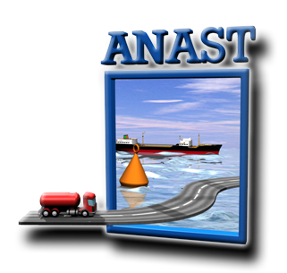
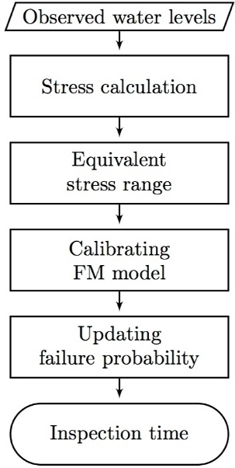
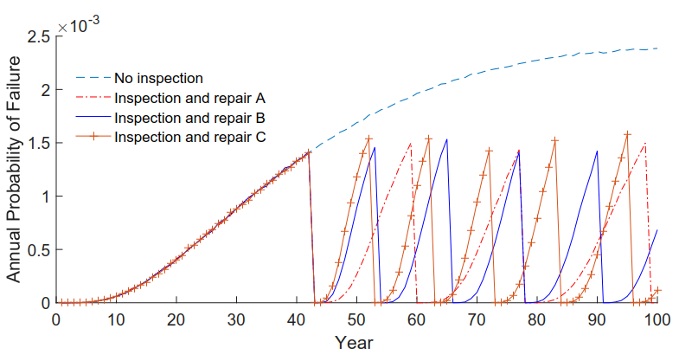
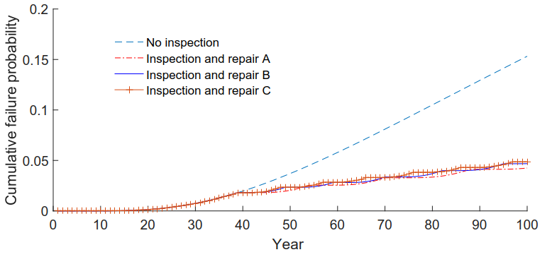
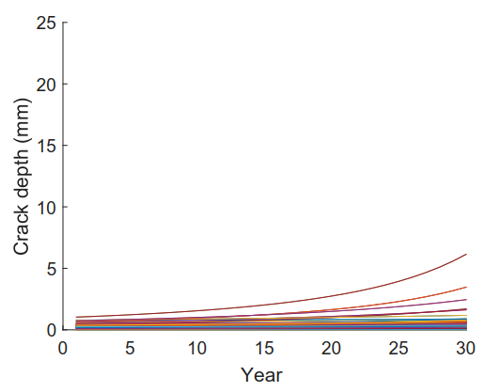
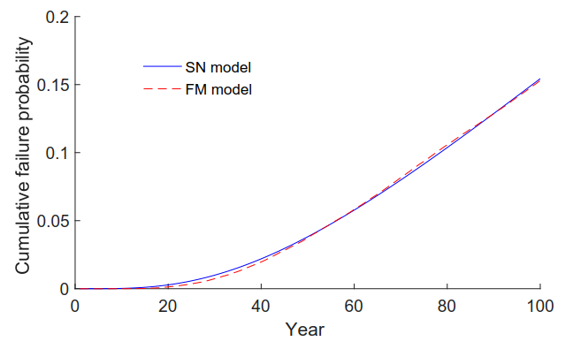
Updating the failure probability of miter
gates based on observation of water levels
Thuong Van DANG, Quang Anh MAI, Pablo G. MORATO, Philippe RIGO
dangvanthuong@doct.uliege.be +32 488 613309
PARTNERS
ABSTRACT
Hydraulic steel structures, especially lock gates play a significant role in keeping navigation traffic uninterrupted. After a few decades of operation, many of the welded joints may suffer various degrees of deterioration, primarily due to fatigue. To economically combining crack inspection with a scheduled maintenance of the movable parts of the gate, it is valuable to predict inspection time of the welded joints using the observed water levels of the operational history. The updating of the failure probability is done for three inspection techniques, considering annual probability and repair decisions.
1. INTRODUCTION
Basically, miter gates are inspected at approximately 5-10 years intervals. The results of the inspection provides data to update failure probability. This study introduces another technique that updates failure probability based on critical annual probability, considering probability of detection and repair decisions.
2. EQUIVALENT STRESS RANGE
4. UPDATING FAILURE PROBABILITY
The simulation method is used to update the failure probability (P_{f}), considering POD and repair policies. It is assumed that all detected cracks are repaired. The maximum allowable annual probability of failure P_{f} =1.4x10⁻³ (equivalent to a target reliability index after 50 years is 1.5 in EN1990) and 90% POD in three inspection techniques A, B, C are used. The POD curves are represented by the Log-Odds-Log scale model:
$POD\left(a\right)= \frac{αa^{γ}}{1+αa^{γ}}$ (4)
where a (mm) is the detectable crack and α, γ are regression parameters of A, B, C.
For practical fatigue design with the use of nominal stress S-N curves, welded joints are divided into several classes, each with a corresponding design S-N curve.
In this study, stresses are calculated for each observed water level by using analytical formulas.
The properties of welded joint can be found in the detail category state $∆σ$ = 40 N/mm² with slop m = 3 in Eurocode NEN EN 1993.1.9 C2, Table 8.3.
The different stress-ranges occurs during the year are represented by an equivalent stress-range value, as follows Eq. (1).
$∆σ= \sqrt[m]{\frac{D_{tot}C}{nT}}$ (1)
Where $D_{tot}$ is total accumulated damage, C is material parameter, n = 7048 is the number of levelling per year and T = 50 years is the time of observations.
Fig. 1. Updating procedure
Fig. 4. Updating failure probability P_{f}
3. CALIBRATING FRACTURE MECHANIC MODEL
To incorporate the crack inspection results into assessing failure probability, a fracture mechanic (FM) model is used for crack propagation. The most widely used model is the Paris-Erdogan law:
$\frac{da}{dN}$ $= C(Y∆σ\sqrt{πa})^{m}$ (2)
where da/dN is the rate of crack growth, C and m are material parameters, Y is geometry function, Δσ is the equivalent stress-range.
The calibration algorithm is carried out by a least-squares fitting in cumulative failure probability space (Pc), as shown in Eq. (3).
$$min\sum_{t=1}^{T}{({Pc}_{SN}\left(t\right)−{Pc}_{FM}\left(t;x_{1}…x_{N}\right))^{2} (3)}$$
where ${Pc}_{SN}\left(t\right)$ is the cumulative failure probability at time t, evaluated using the S-N model; ${Pc}_{FM}\left(t;x_{1}…x_{N}\right)$ is the cumulative failure probability at time t, evaluated using FM model with a set of parameters $\left(x_{1}…x_{N}\right)$ representing initial crack size, C, uncertainty of geometry function. T is the service life of the considered structures.
Fig. 5. Updating cumulative failure
probability Pc
CONCLUSIONS
Fig. 2. Crack propagation
1
Different stress-ranges occuring during the year are represented by an equivalent stress-range value.
The calibration algorithm is carried out by a least-squares fitting in cumulative probability space.
This study presented efforts to update probability of failure for a miter gate based on critical annual probability and inspection techniques.
2
3
Fig. 3. Calibrated result

