Slide 1














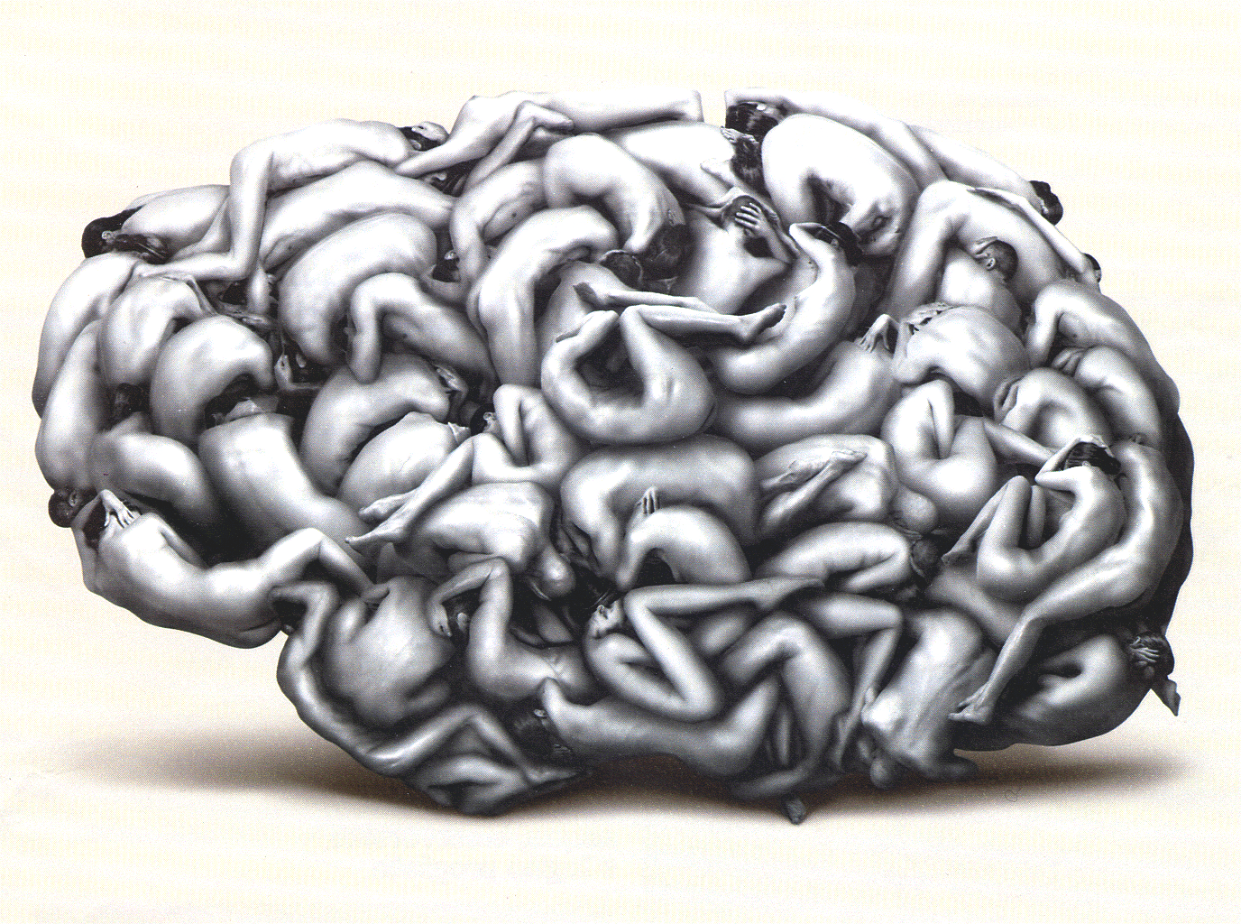
Dynamic inter-regional coordination patterns as specific predictors of consciousness
A. Demertzi, E. Tagliazucchi, S. Dehaene, G. Deco, P. Barttfeld, F. Raimondo, C. Martial, B. Rohaut, H. U. Voss, N. D. Schiff, A. M. Owen, S. Laureys, L. Naccache, J.D. Sitt
4th Congress of the European Academy of Neurology
17 June 2018 Lisbon
Session EPR217 Neuroimaging 2
www.comascience.org
Notes:
1
Background and aims
To date, specific signatures of conscious states in humans remain elusive. Contemporary theories concur that such markers can be traced to temporally evolving brain processes instead of static descriptions of brain activity.
Methods
Dynamic fMRI connectivity patterns (states) by means of clustering of phase-based coherence was estimated on 47 healthy and 112 patients diagnosed in vegetative
state/unresponsive wakefulness syndrome (VS/UWS) or in a minimally conscious state (MCS). To validate whether the patterns captured properties of awareness, out-ofsample generalization was performed on patients with cognitive-motor dissociation (i.e. lacking overt conscious behaviour yet evidenced using functional neuroimaging), and on anesthetised patients, under the premise that complex signatures would disappear uniformly across all subjects.
Results
A pattern of long-range positive/negative coherence had a higher probability of occurring in healthy and MCS patients. A pattern of low inter-areal coordination, mostly
similar to anatomy, was more likely to occur in VS/UWS. Inter-state transitioning was flexible for healthy and MCS and more rigid for VS/UWS patients. Unconscious patients
were more likely to avoid the exploration of the complex connectivity state. The generalization to cognitive-motor dissociation predicted the occurrence of the complex connectivity state. The generalization to propofol anaesthesia showed an equalization of occurrence probabilities of all patterns regardless of clinical diagnosis.
Conclusion
The dynamics of inter-areal coordination contain information specific to conscious awareness. The rigid and less metastable dynamics in VS/UWS could account for the
limited mental capacities in these patients. The minute identification of these patterns and their external manipulation could account for non-invasive restoration of
consciousness.

Slide 2
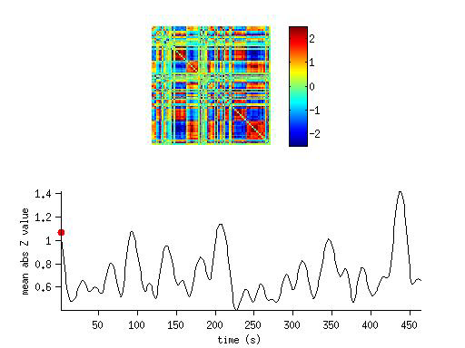
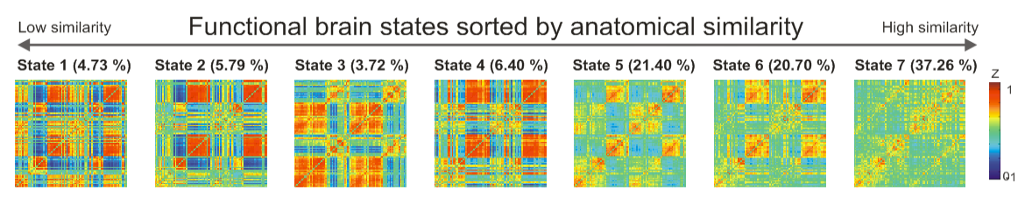
Objectives | Methods | Results | Discussion
Dynamic brain activity and cognition
Typical wakefulness
important for task performance, emotion and cognition
(Alavash et al., Neuroimage 2016; Shine et al., Neuron 2016; Friston, Neuroimage 1997; Thompson et al., Hum. Brain Mapp 2013)
Unconsciousness
Rigid spatiotemporal organization
sleep (Tagliazucchi et al., PNAS 2013; Wang et al, PNAS 2016; Wilson et al., Neuroimage 2015; Chow et al., PNAS 2013)
anesthesia
in humans (Tagliazucchi et al, J. R. Soc. Interface 2016; Kafashan, et al, Front. Neural Circuits 2016; Amico et al., PLoS One 2014)
in animals (Barttfeld PNAS . 2014); Grandjean et al., Neuroimage 2017; Liang et al, Neuroimage 2015)
Barttfeld*, Ulhrig*, Sitt*, et al, PNAS 2015
The brain cannot map the complexity of
the internal and external world
(Dehaene, et al Trends Cogn. Sci. 2006; Tononi et al, Nat. Rev. Neurosci. 2016)

Slide 3
Objectives | Methods | Results | Discussion
The aim
To use spontaneous brain dynamics
to detect generalizable signatures of consciousness in
wakeful noncommunicating conditions

Slide 4
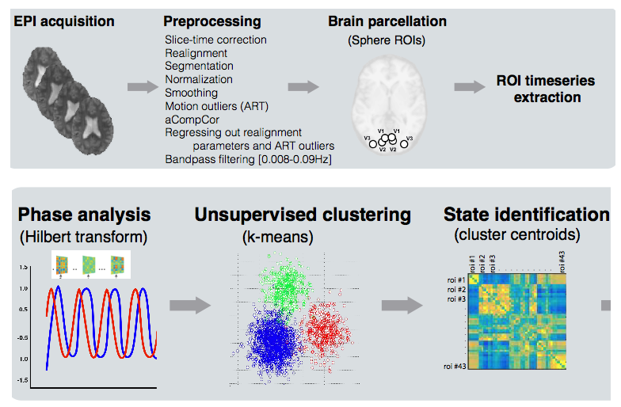
Objectives | Methods | Results | Discussion
Methods
Study cohort (n=159)
Analysis pipeline
Main dataset- awake
 | UWS | MCS | CTR | Total
LIEGE | 17 | 23 | 21
PARIS | 13 | 9 | 15
NY | 6 | 10 | 11
Total | 36 | 42 | 47 | 125
Validation datasets
sedated MCS*/CMD
LIEGE
EMCS | 3
MCS | 14
UWS | 6
Total | 23
ONTARIO
UWS-t | 6
UWS+t | 5
Total | 11

Slide 5
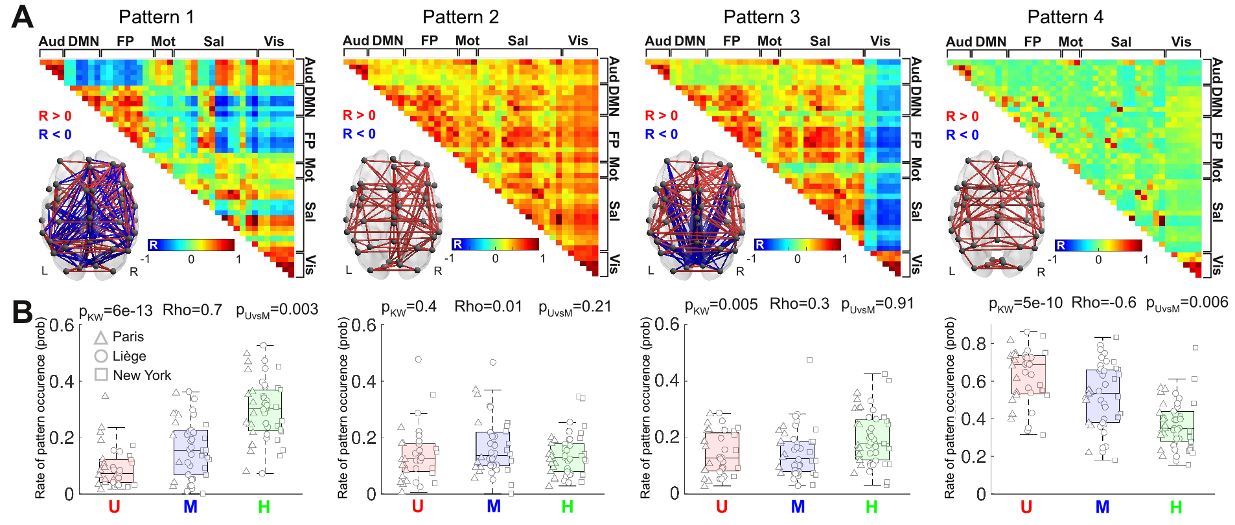
Objectives | Methods | Results | Discussion
(1) Four brain patterns
The inter-areal coordination of ongoing brain dynamics is differentially orchestrated in distinct states of consciousness

Slide 6
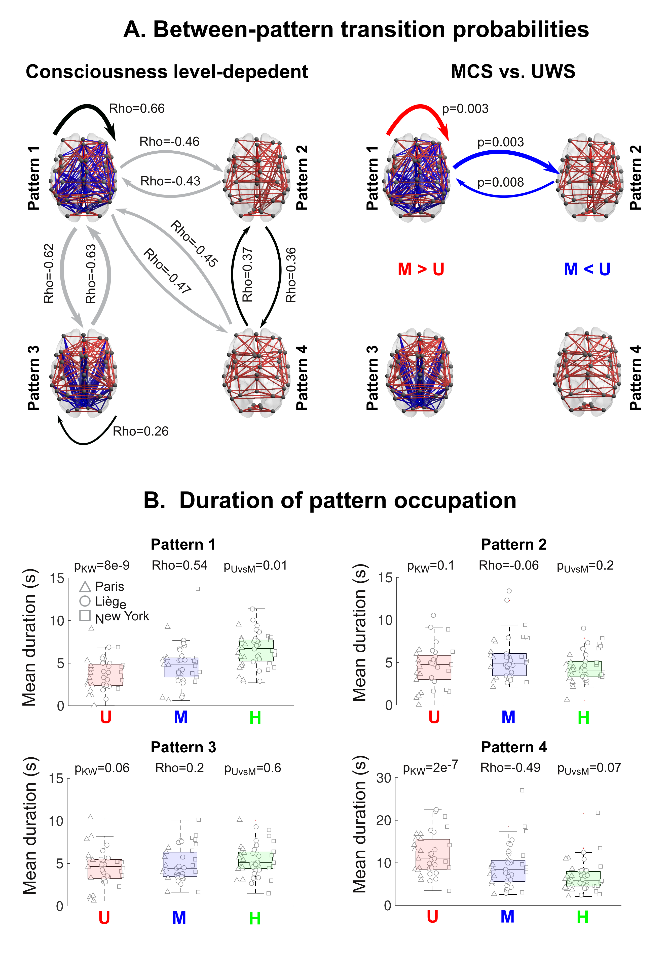
Objectives | Methods | Results | Discussion
(2) Pattern dynamics
Transitions
Duration
The exploration of the identified coordination patterns differs with respect to distinct
states of consciousness

Slide 7
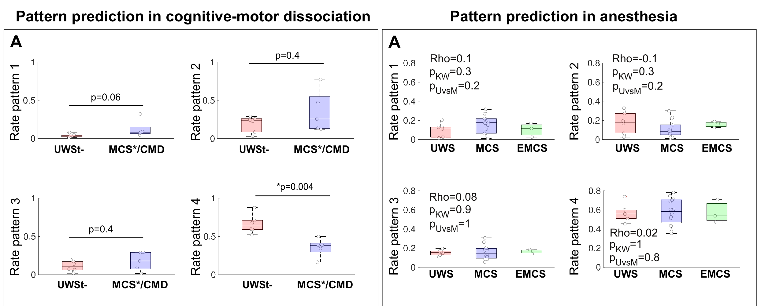
Objectives | Methods | Results | Discussion
(3) Generalization
The coordination patterns are selectively predicted in states of
preserved and diminished consciousness

Slide 8
Objectives | Methods | Results | Discussion
Conclusions
The dynamics of inter-areal coordination contain information specific to conscious awareness
Results align with theoretical frameworks on the mechanisms of consciousness
The rigid and less metastable dynamics in UWS could account for their limited mental capacities
The minute identification of these patterns and their external manipulation could account for non-invasive restoration of consciousness

Slide 9















Thank you!
Coma Science Group & PICNIC Lab
…and mostly patients and their families!
a.demertzi@uliege.be

