Slide 1
Measuring planning cultures for co-housing development
Perrine Dethier et Jean-Marie Halleux
AESOP 2018
Special Session: Comparing Planning Cultures

Slide 2
Co-housing
Definition
« Co-housing is a type of collaborative housing in which residents actively participate in the design and operation of their own neighbourhoods. Co-housing residents are consciously committed to living as a community. The physical design encourages both social contact and individual space » (The Cohousing Association of the United States, n.d.)
2 notions: building together and sharing spaces
Increasing all over Europe since the 2000s .
French-speaking Belgium (Wallonia and Brussels): the evolution there remains limited.
Manny obstacles: land acquisition, planning permission, time investment…
Planning culture is important: Acceptability of consultants and cooperation between co-owner

Slide 3
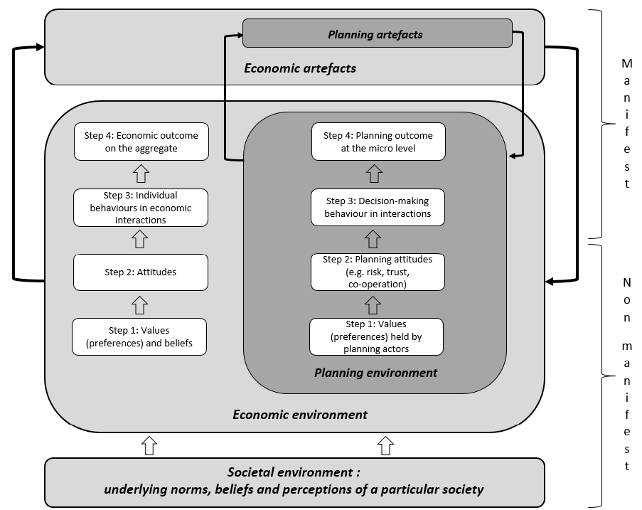

Slide 4
Experimental economics
Definition: Experiments motivated by economics questions
2 experiments + 1 survey
    Trust game (Acceptability of consultants)
    Minimum-effort game (Cooperation for co-housing development)
    Survey (Co-housing perception)
3 Regions:
  French-speaking Belgium
  North of Europe
  South of Europe
Participants
  422 students

Slide 5
Demographic
 | Number | Percentage of women
Belgian | 273 | 63%
North Europe | 55 | 52%
South Europe | 94 | 67%
Other | 25

Slide 6
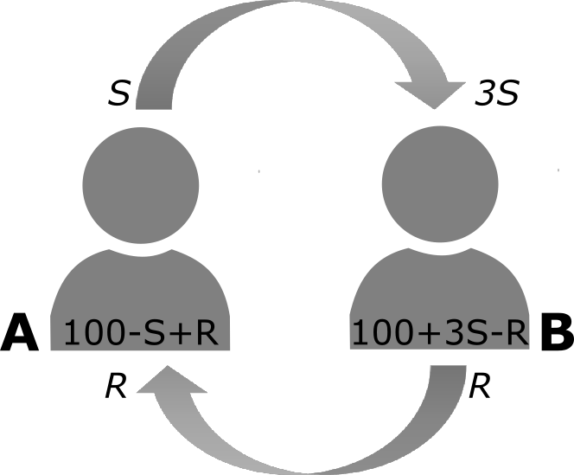
Trust GAME
Berg. J.. Dickhaut. J.. & McCabe. K. (1995)

Slide 7
Trust GAME
 | With a consultant | With a co-owner | Total
Belgian | 42.18 | 45.48 | 43.80
North Europe | 48.03 | 49.36 | 48.56
South Europe | 44.32 | 47.44 | 45.68
Total | 43.54 | 46.32 | 44.84

Slide 8
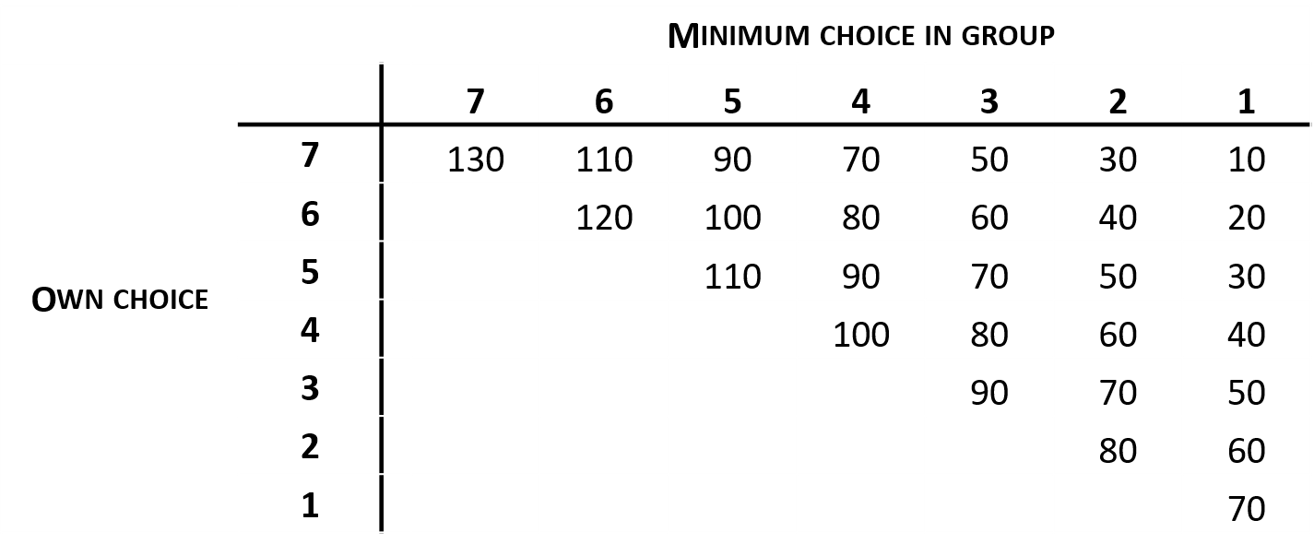
Cooperation GAME
Minimum-effort game
Van Huyck. J. B.. Battalio. R. C.. & Beil. R. O.. 1990

Slide 9
Cooperation GAME

Slide 10
Survey
 | 1. | 9. Most people can be trusted | EVS (2008)
Belgian | 41% | 27% | 26 %
North Europe | 62% | 55% | 75% ~ 39%
South Europe | 64% | 45% | 26% -30%
Total | 51% | 34%
1. Have you heard about cohousing before?
9. Generally speaking. would you say that most people can be trusted or that you can’t be too careful in dealing with people?

Slide 11
3. For the housing of your future family. you see yourself rather
1
2
3
4
5
Collectively
Individually

Slide 12
ConclusioN
Methodology
  Difficulties:
    To recruit participant: issues of data privacy and security (Maastricht, Nijmegen, Liverpool, Aachen, Dortmund, Paderborn and Bielefeld)
    Balance between contextualization and complexity
  Results are in line with others studies and with other surveys
Co-housing
  Lack of knowledge
  Distrust of consultants

