Slide 1
Reinforcement learning: a generic tool for solving sequential decision-making problems for electrical systems
Prof. Damien ERNST

Slide 2
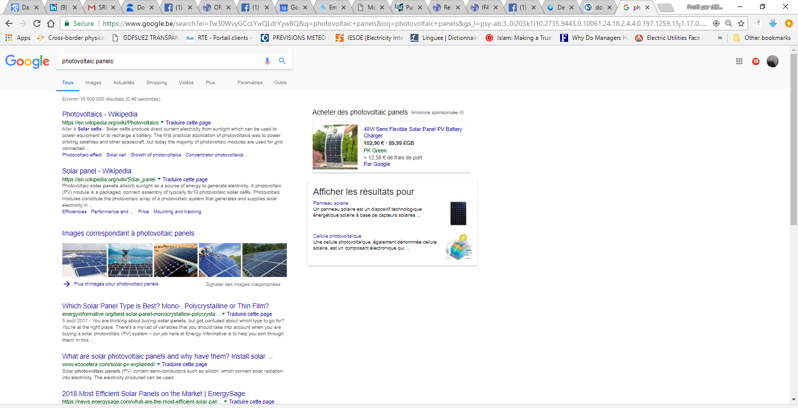

Slide 3
Reinforcement learning agent
Environment
state
reward
action
numerical value
Agent

Slide 4
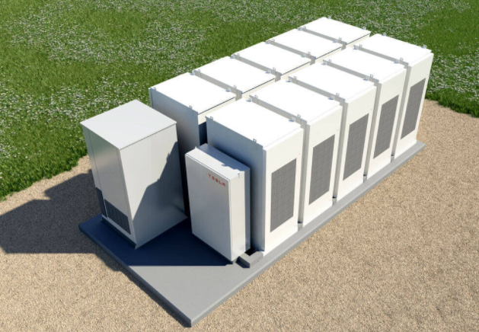
+ the energy
market
State: (i) the battery level (ii)
Everything you know about the market
Reward: The money you make during the market period.
The battery setting
for the next market period.
The battery
controller

Slide 5
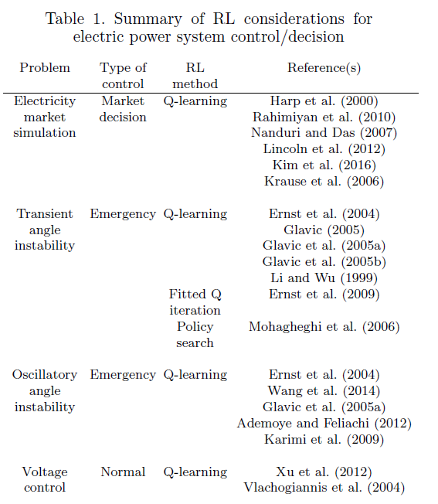
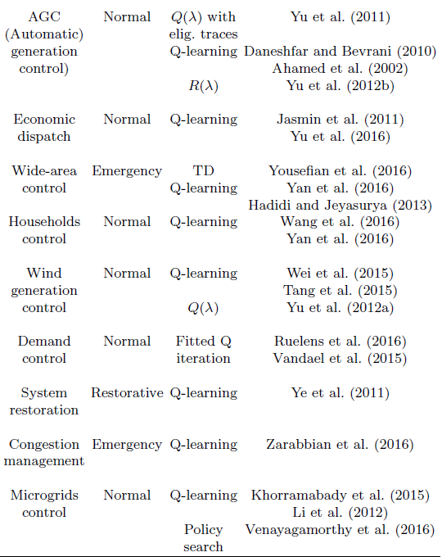
Table taken from: “Reinforcement Learning for Electric Power System Decision and Control: Past Considerations and Perspectives”. M. Glavic, R. Fonteneau and D. Ernst. Proceedings of the 20th IFAC World Congress.

Slide 6
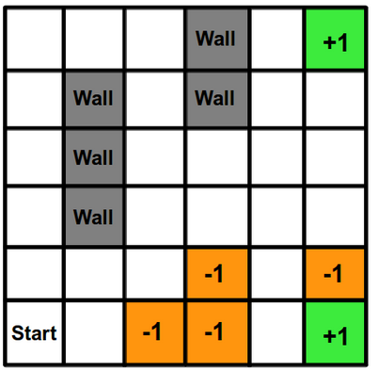
Learning:
Exploration/exploitation: Not always take the action that is believed to be optimal to allow exploration.
Generalization: Generalize the experience gained in some states to other states.

Slide 7
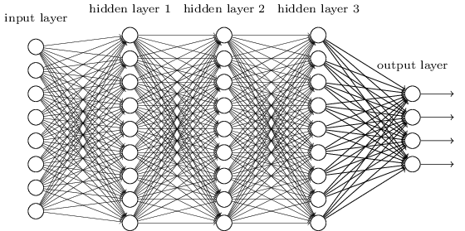

Slide 9
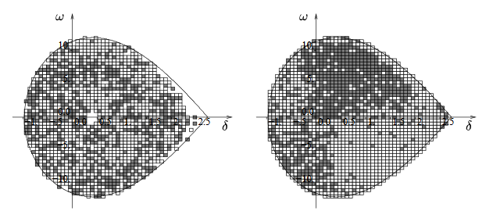
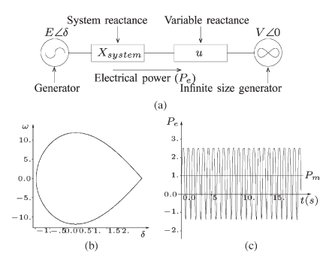
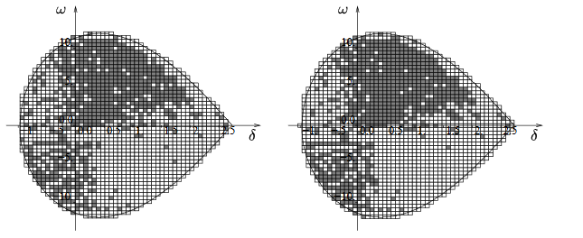
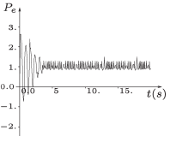
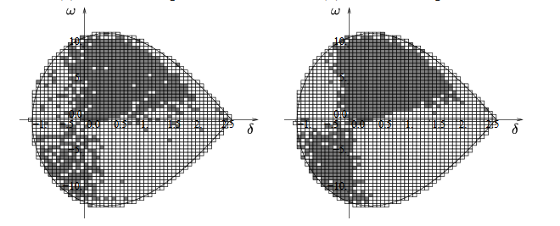
Learning
phase
Effect of the
resulting control
policy
First control law for stabilizing power systems every computed using reinforcement learning. More at: “Reinforcement Learning Versus Model Predictive Control: A Comparison on a Power System Problem”. D. Ernst, M. Glavic, F.Capitanescu, and L. Wehenkel. IEEE Transactions on Syestems, Man, An Cybernetics—PART B: Cybernetics, Vol. 39, No. 2, April 2009.

Slide 10
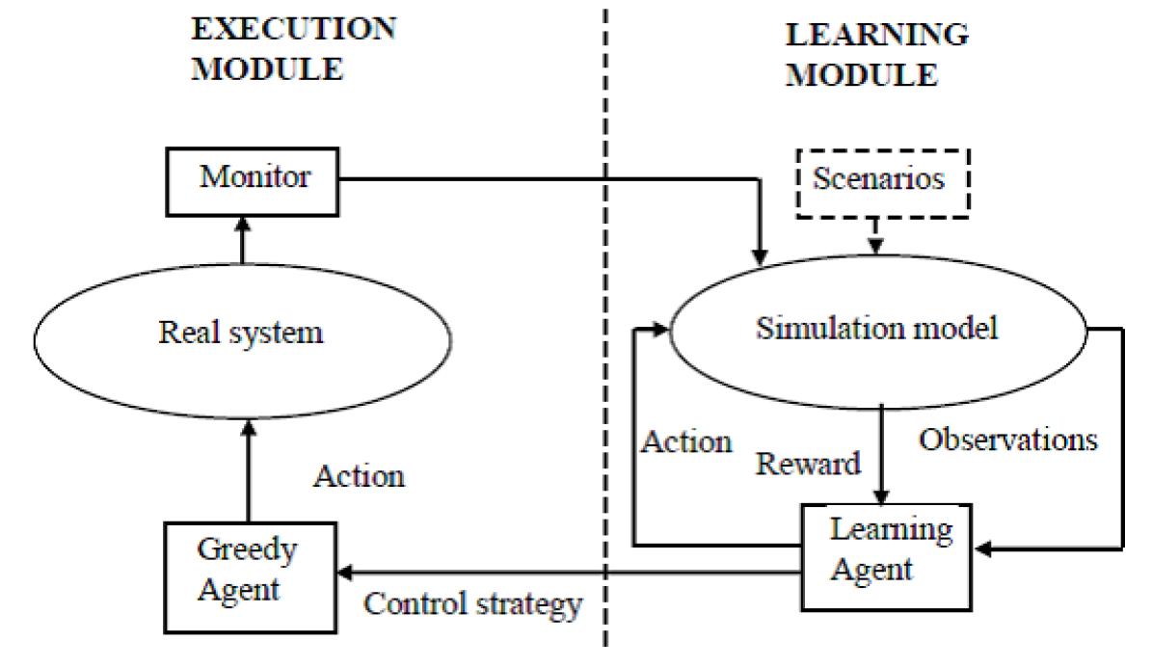

Slide 11
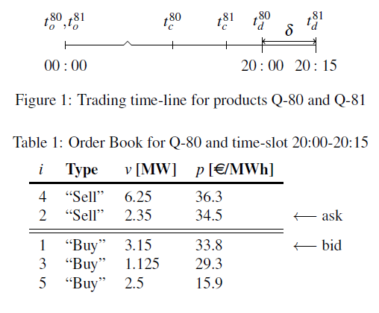
Reinforcement learning for trading in the intraday market
Complex problem:
Adversarial environment
Highly dimensional
Partially observable
Best results obtained with optimisation
of strategies based on past data together with supervised learning to learn from the optimised
strategies (imitative-learning type of approach)
More: “Intra-day Bidding Strategies for Storage Devices Using Deep Reinforcement”. I. Boukas, D. Ernst, A. Papavasiliou, and B. Cornélusse. Proceedings of the 2018 15th International Conference on the European Energy Market (EEM).

Slide 12
