Slide 1




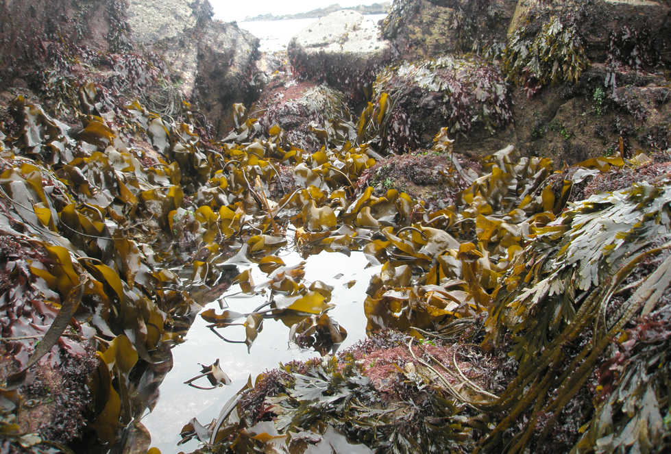
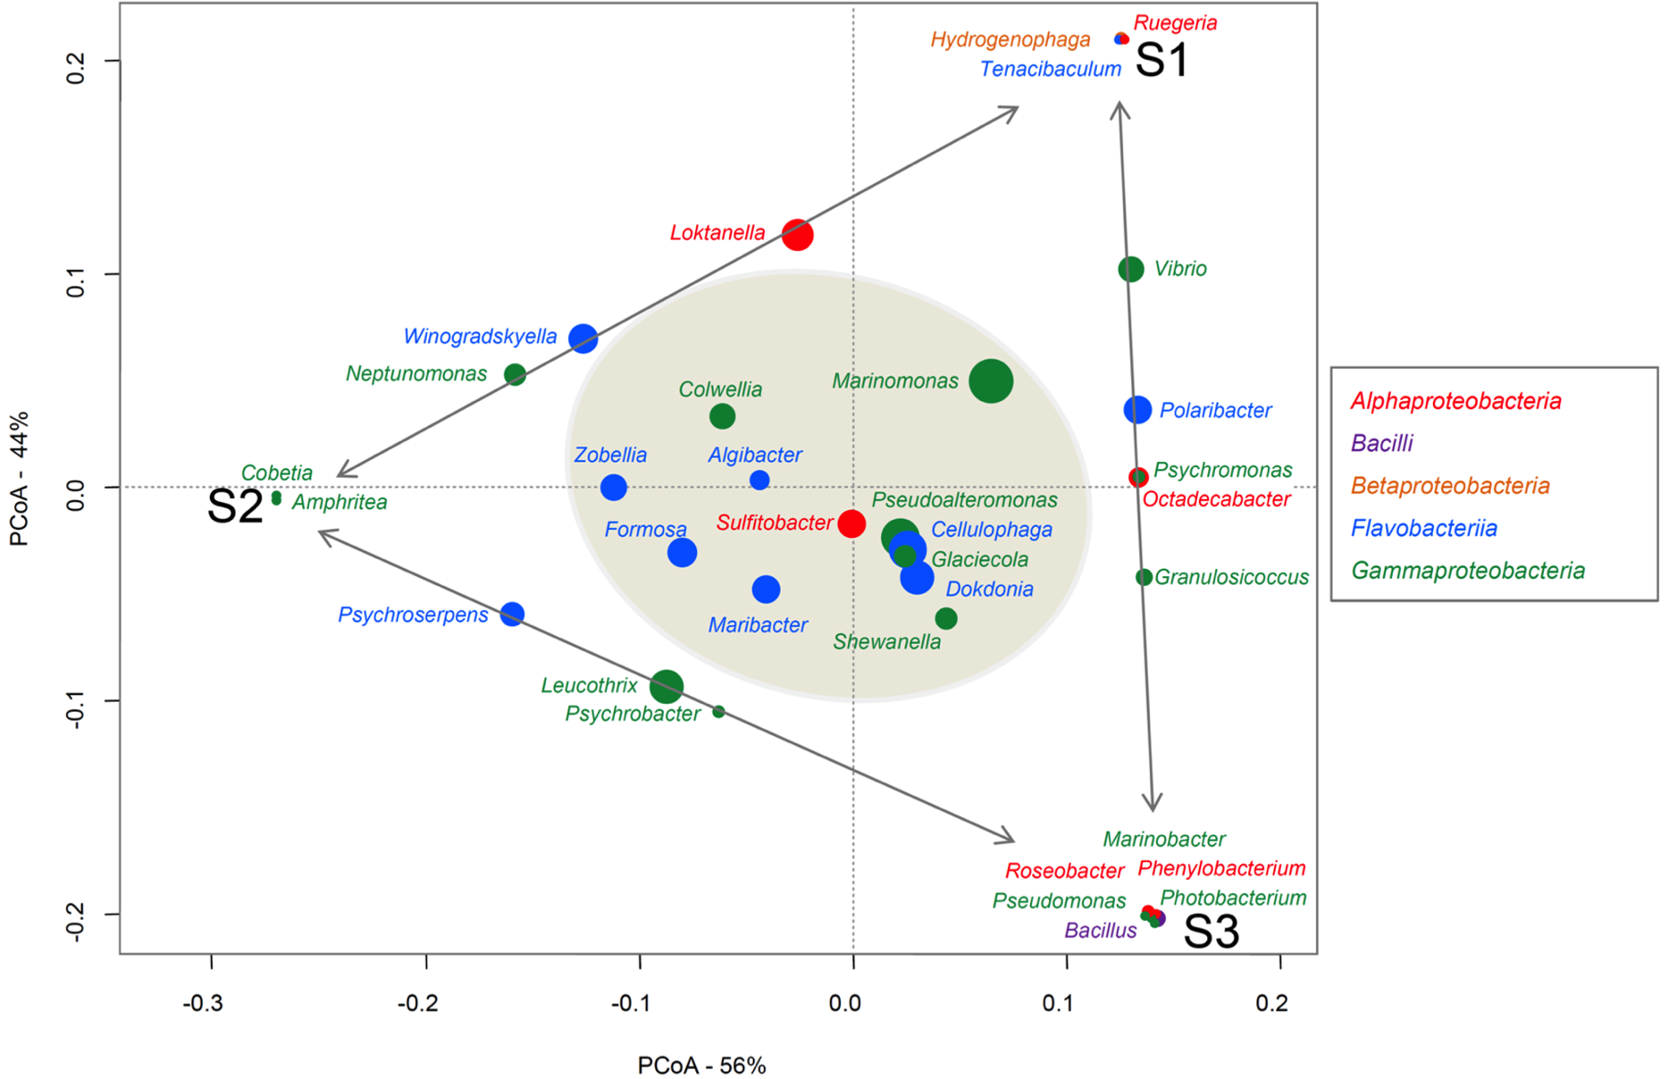
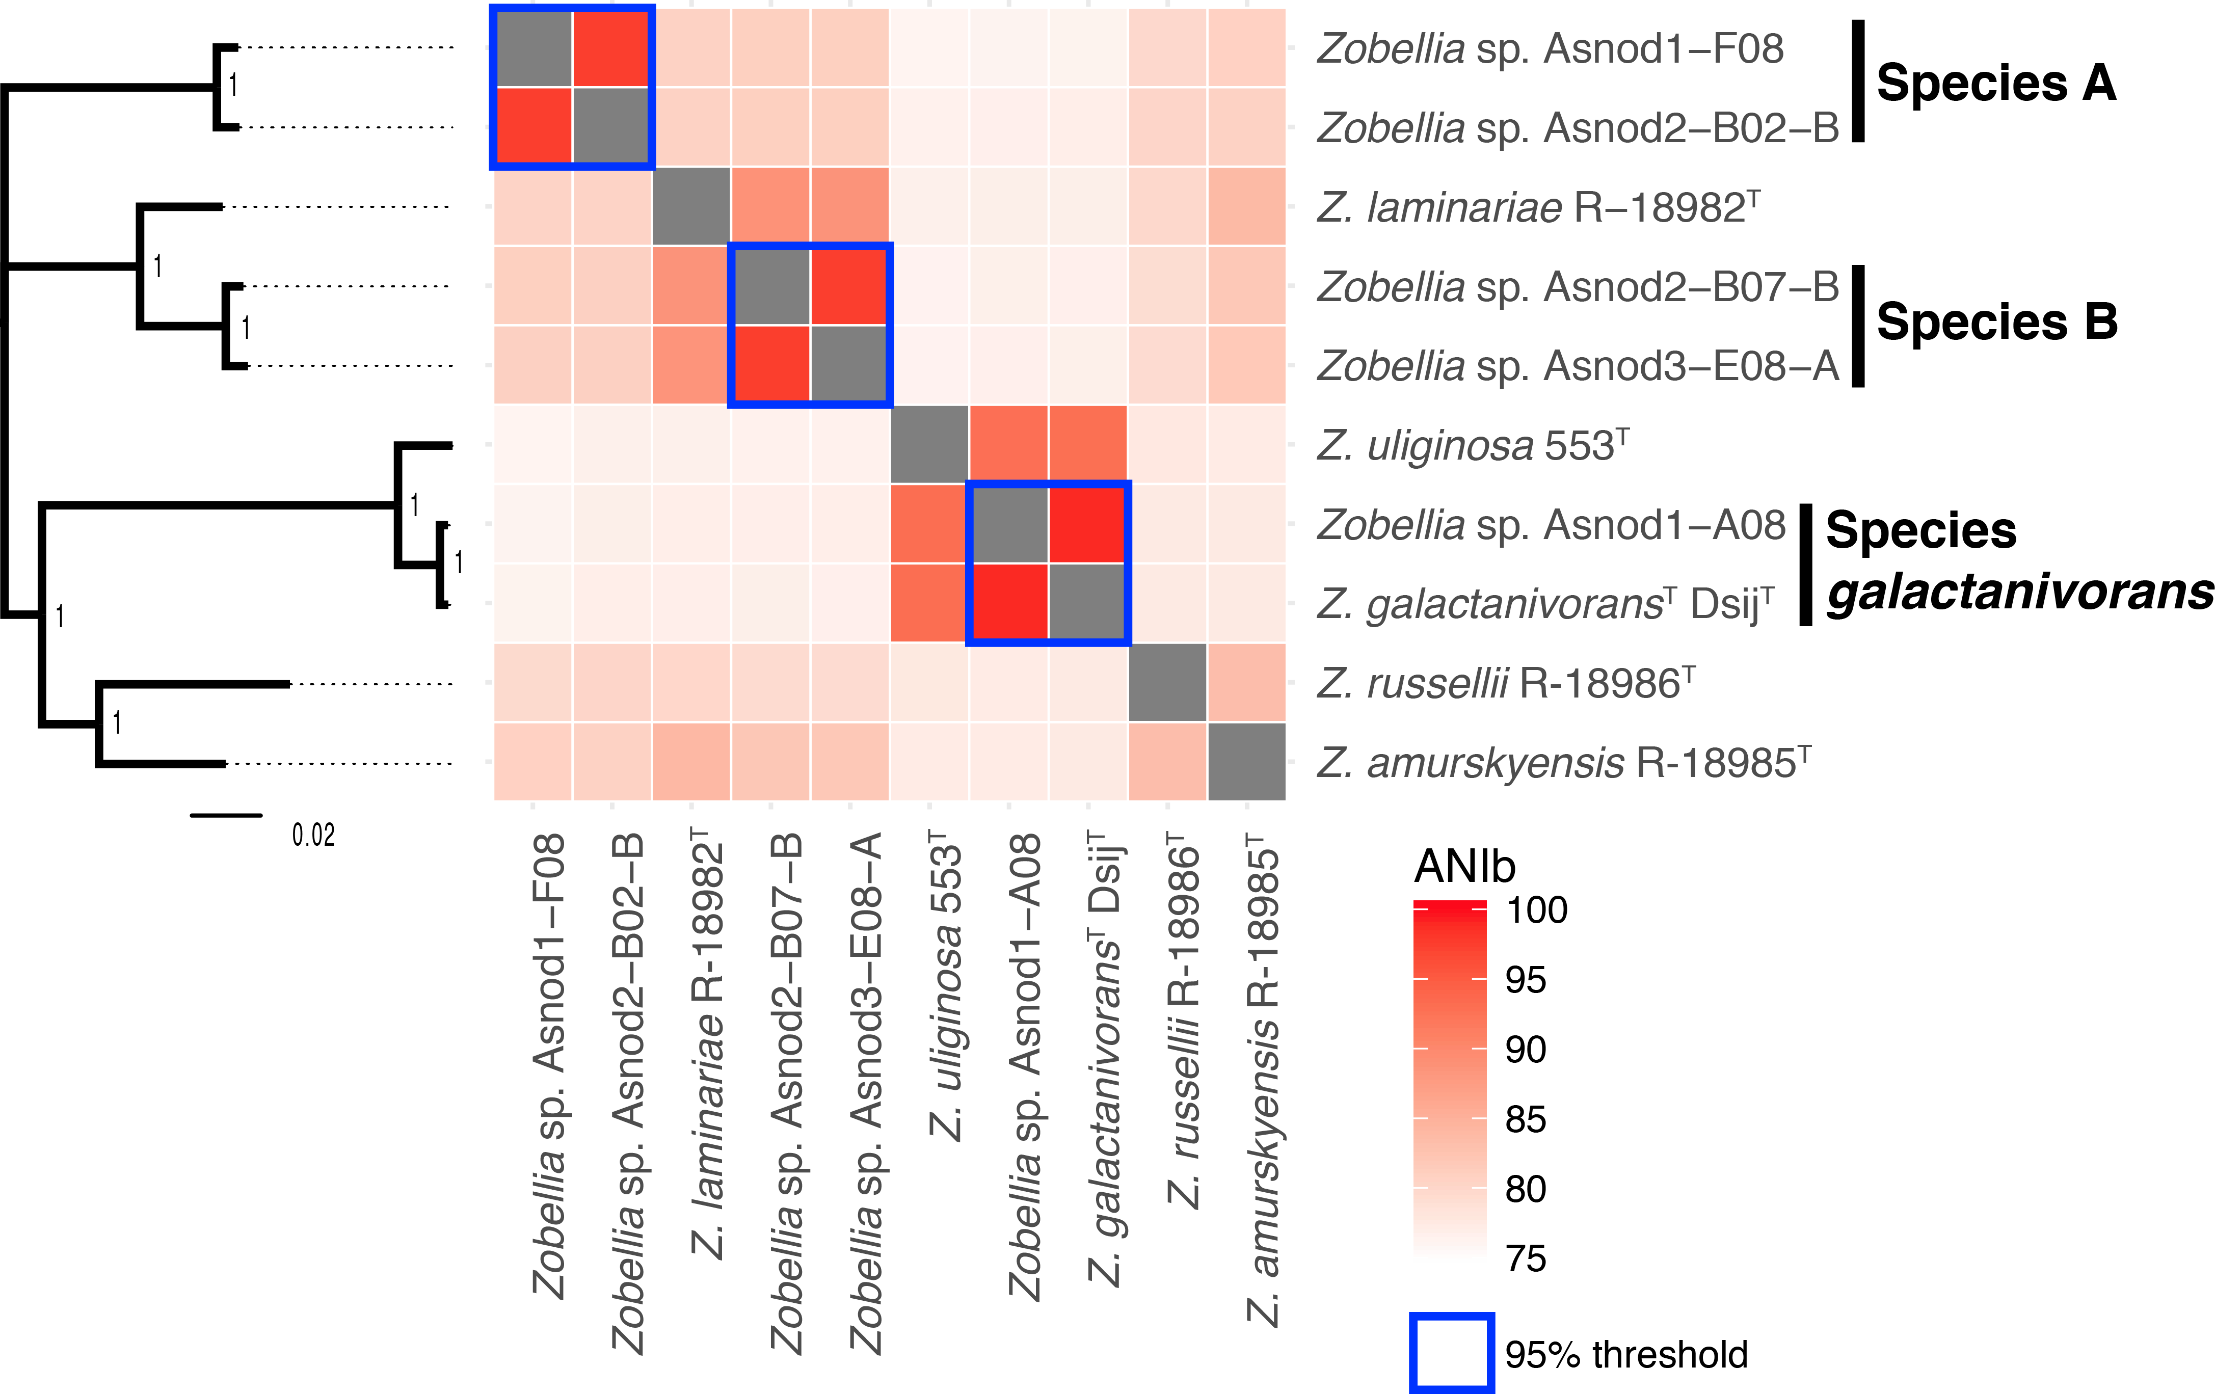
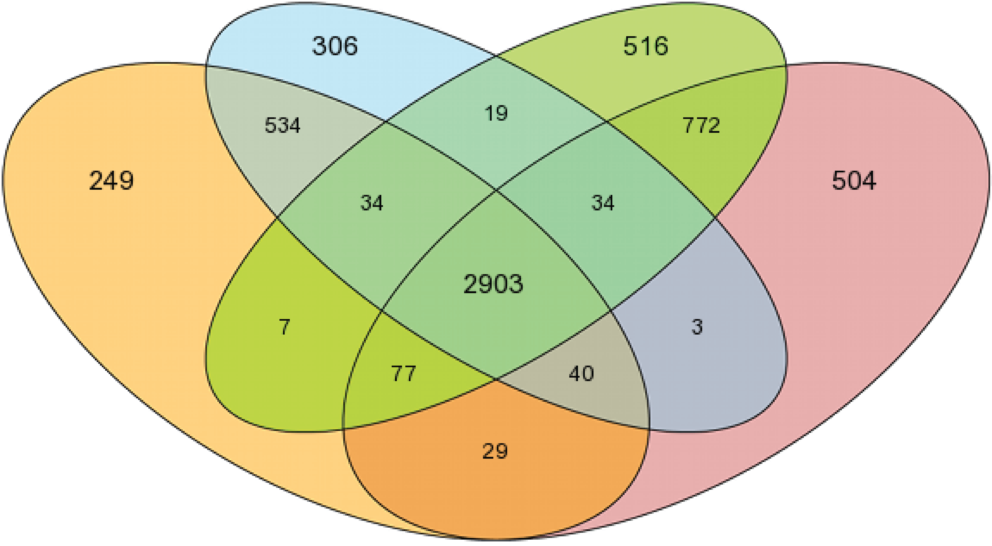
Novel genomes of macroalga-associated Flavobacteriaceae to gain insights
into the evolution and ecological strategies of marine polysaccharide degraders
François Thomas¹, Marjolaine Martin², Erwan Corre³, Gwenn Tanguy⁴, Tristan Barbeyron¹, Micheline Vandenbol² & Gurvan Michel¹
¹ Sorbonne Université, CNRS, Integrative Biology of Marine Models (LBI2M), Station Biologique de Roscoff, France; ² Microbiology and Genomics Unit, Gembloux Agro-Bio Tech, University of Liège, Gembloux, Belgium
³ CNRS, FR2424, ABiMS, Station Biologique de Roscoff, France; ⁴ CNRS, FR2424, Genomer genomics core facility, Station Biologique de Roscoff, France
Flavobacteriaceae on brown macroalgae Ascophyllum nodosum
Brown macroalgae are abundant in coastal habitats and host diverse bacterial communities. Among these, Flavobacteria are recognized as key players for biomass recycling ^{[1]}.
We previously studied cultivable bacteria from the surface of the alga Ascophyllum nodosum ^{[2]}. In total, 324 strains were isolated from triplicate samples. Flavobacteria accounted for 43% of the isolates and belonged to the core microbiome found on the 3 algal specimens.
We selected 50 Flavobacteria isolates for genome sequencing and catabolic profiling
?
Diversity, evolution and niche speciation
of alga-associated Flavobacteria?
PCoA of the genera found on algal samples S1-3, where spot area depicts the genus relative abundance. The closer a spot is to a sample name, the more abundant the genus is in that sample. Genera found on the 3 samples (i.e. core microbiome) are shadowed in grey ^{[2]}.
Sequencing strategy
Diversity of isolates
Case study: Genus Zobellia
50 isolates
Phylogeny of 16S rRNA genes
(1429 nt, K2 model, Neighbor-Joining)
Species delineation
Phylogenetic tree inferred using FastTree MP from a concatenated alignment of 2573 genes in the core genome of Zobellia
Heatmap of Zobellia Average Nucleotide Identities (ANIb)
gDNA extraction
commercial kit
A.
B.
Library preparation
Nextera XT DNA kit
746-1523 bp mean fragment size
Library sequencing
4 runs Illumina
MiSeq v3 PE300
1.6-7.8 million reads per sample
Assemby
SPAdes v3.11 ^{[3]}
0.47-2.24 Mb max. contig size
6-108 contigs >1kb
Scaffolding
MeDuSa v1.6 ^{[4]}
use closed genomes
as backbone
Catabolic profiling
Growth in minimum medium + algal polysaccharide
λ-carrageenan
κ-carrageenan
ι-carrageenan
Porphyran
laminarin
fucoidan
1.38-5.00 Mb max. contig size
1-71 scaffolds >1kb
2-24 gaps
Agar
alginate
xylan
Z. galactanivorans
Asnod1-A08 | + | + | + | + | + | + | + | + | +
Dsij^{T} | + | + | + | + | + | + | + | + | +
Asnod1-F08 | + | + | - | - | - | - | - | + | +
Asnod2-B02-B | + | + | - | - | - | - | - | - | -
versatile degraders
Zobellia species A
poor degraders
in silico gap filling
GapCloser v1.12 ^{[5]}
rescue unassembled reads
1.38-5.00 Mb max. contig size
1-71 scaffolds >1kb
0-12 gaps
3.16-5.52 Mb total residues
Comparative genomics
Venn diagram of shared vs. strain-specific genes between selected Zobellia strains (80% aa identity, 80% align. coverage)
Zobellia species A
poor degrader
Z. galactanivorans
versatile degrader
Check completeness
CheckM v1.0.11 ^{[6]}
search for 457 marker genes
conserved in Flavobacteriaceae
>99.7% complete
Zobellia sp. Asnod2-B02-B
Zobellia sp. Asnod1-F08
Zobellia sp. Asnod1-A08
Gene prediction
& annotation
Microscope platform ^{[7]}
Zobellia galactanivorans Dsij^{T}
772
Genes specifically shared by versatile degraders,
absent from poor degraders
Including:
41 glycoside hydrolases (GH), 7 polysaccharide lyases (PL)
6 carbohydrate esterases (CE), 7 sulfatases
22 tandems TonB-dependent receptor / SusD-like (TBDR/SGBP)
On-going work…
Examples:
Test Nanopore sequencing on a selection of isolates to obtain closed genomes
Expert annotation of CAZymes, census of polysaccharide utilization loci
Catabolic profiling and comparative genomics for all strains
Systematic description of new bacterial species
GH16
laminarinase lamB
GH16
laminarinase lamA
PL7
alginate lyase alyA2
κ-carrageenase GH16 cgkA
ι-carrageenase GH82 cgiA & cgiA2
β-porphyranase GH16 porA, porB, porC & porE
β-agarase GH16 agaA & agaD
α-L-fucosidase GH95 afcA1
endo-1,3-β-glucanase GH16 lamC & lamD
endo-1,3-β-glucanase GH64 lamE
alginate lyase PL7 alyA1
alginate lyase PL14 alyA7
polysaccharide lyase PL9 dssA
endo-1,4-β-glucanase GH5 bglC
endo-1,4-β-xylanase GH10 xynA2
GH105
SGBP
TBDR
TBDR
SGBP
SGBP
TBDR
SGBP
TBDR
Regul
GH95 fucosidase afcA4
GH95 fucosidase afcA5
GH2 βgal'ase bgaC
GH29 fucosidase
Transport
TBDR
SGBP
GH31
TBDR
SGBP
GH130
CE6
Evolution, interaction and metabolic strategies
of co-occurring Flavobacteria ecotypes
from brown algal microbiomes
[1] Thomas et al. Environmental and gut Bacteroidetes: the food connection. Front Microbiol 2, 93 (2011).
[2] Martin et al. The cultivable surface microbiota of the brown alga Ascophyllum nodosum is enriched in macroalgal-polysaccharide-degrading bacteria. Front Microbiol 6, 1-14 (2015).
[3] Bankevich et al. SPAdes: a new genome assembly algorithm and its applications to single-cell sequencing. J Comput Biol 19, 455-77 (2012).
[4] Bosi et al. MeDuSa: a multi-draft based scaffolder. Bioinformatics 31, 2443-51 (2015).
[5] Luo et al. SOAPdenovo2: an empirically improved memory-efficient short-read de novo assembler. Gigascience 1, 18 (2012).
[6] Parks et al. CheckM: assessing the quality of microbial genomes recovered from isolates, single cells, and metagenomes. Genome Research 25, 1043-55 (2015).
[7] Vallenet et al. MicroScope in 2017: an expanding and evolving integrated resource for community expertise of microbial genomes. Nucleic Acids Research 45, 517-28 (2017).

