Slide 1
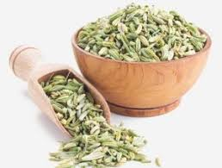
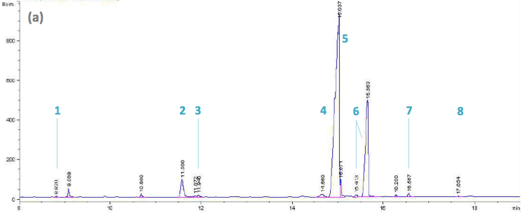
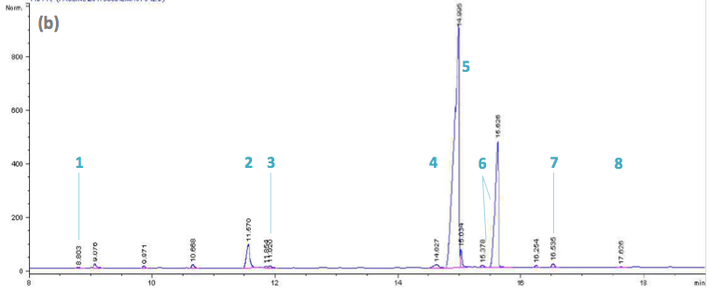
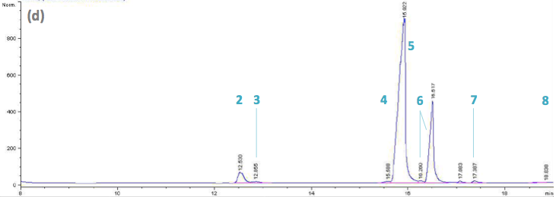
Eco-extraction of fennel (Foeniculum vulgare Mill.) seed oil
Iness BETTAIEB REBEY^{a,b}, Soumaya BOURGOUª, Pauline DETRY^{b} , Ibtissem Hamrouni Sellamiª, Riadh KSOURIª, Marie Laure FAUCONNIER^{b}
ªLaboratory of Medicinal and Aromatic Plants, Center of Biotechnology of Borj Cedria, B.P. 901, Hammam-Lif 2050, Tunisia
^{b}General and Organic Chemistry-Volatolomics, Gembloux Agro-Bio Tech, University of Liège, Passage des Déportés, 2- 5030 Gembloux- Belgique
Context and objectives
Fennel (Foeniculum vulgare Mill.) is a commercially important Apiaceae species from the Mediterranean area and is among the most widespread medicinal plant worldwide, being extensively grown in arid and semi-arid regions as one of the oldest spice plants. It is recommended traditionally for gastrointestinal and neurological disorder, kidney stones, vomiting and diarrhea, it has also antispasmodic, antiseptic, carminative and antiulcer properties). Recently much attention has been focused on fennel due to the nutritional and health protective value of their seeds that are rich in vegetable and volatile oils. Petroselinic acid was the most prevalent fatty acid in fennel seed oil. This one also presents several properties. Nowadays, fixed oils are extracted with the help of petrosolvents. This raise issues regarding environment and security, but also public health. Regulations are more and more strict and alternative more and more searched. In general, those ones consist in the use of substitution solvents. Hence, the purpose of this work was devoted to evaluating and comparing the efficiency of using conventional (hexane) and alternative method (green solvent) to obtained oil from fennel seeds.
Foeniculum vulgare Mill
Materials and methods
1. Oil extraction
2. Oil yield
Conventional methods
warm extraction by soxhlet method with hexane .
cold extraction by Folch method .
Alternative method
Soxhlet method with a green solvent.
Yield (%)=
Mass of extract (g)
*100
4. DPPH radical scavenging assay
Mass of initial plant material (g)
DPPH methanolic solution Radical-scavenging activity was determined according to Hanato et al. (1998).
3. Fatty acid analysis
Fatty acids analysis was achieved by gas chromatography using a CP- Select CB 3800 chromatograph with a capillary column (CP Select CB, 50m x 0.25mm, 0.25µm film thickness).
Results
Oil yield (%)
Fig 1. Oil extraction yields from the different extraction methods .
Fig.2 Fatty acid profiles of fennel seed oils as extracted by (a) n-hexane (b) Folch method and (d) green solvent; (1) C14:0, (2) C16:0, (3) C16:1, (4) C18:0, (5) C18:1, (6) C18:2, (7) C18:3 et (8) C20:0.
Table 1. Fatty acid composition (%) of fennel seed oils as affected by extraction methods
% | n-Hexane | Folch | Green solvent
14:00 | 0,11 | 0,11 | 0
16:00 | 4,31 | 4,77 | 4,12
16:01 | 0,50 | 0,60 | 0,72
18:00 | 0,95 | 1,11 | 0,65
18:01 | 70,22 | 69,66 | 70,42
18:02 | 23,25 | 22,98 | 23,36
18:03 | 0,54 | 0,55 | 0,54
20:00 | 0,12 | 0,12 | 0,16
IC 50 (µg/ml)
Fig 3. Antiradical activity (test DPPH) of the different fennel seed extracts expressed by IC50 (g/ml).
Conclusion
The aim of the present study was to investigate an alternative procedure for the determination of fennel seed oils using green solvent as alternative solvents. This aim was achieved with good results in terms of oil yield, fatty acid composition and antioxidant activity. The promising results allowed to conclude that green solvent can be a non toxic alternative to n-hexane extraction with higher lipid yield and good selectivity.

