Slide 1
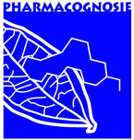
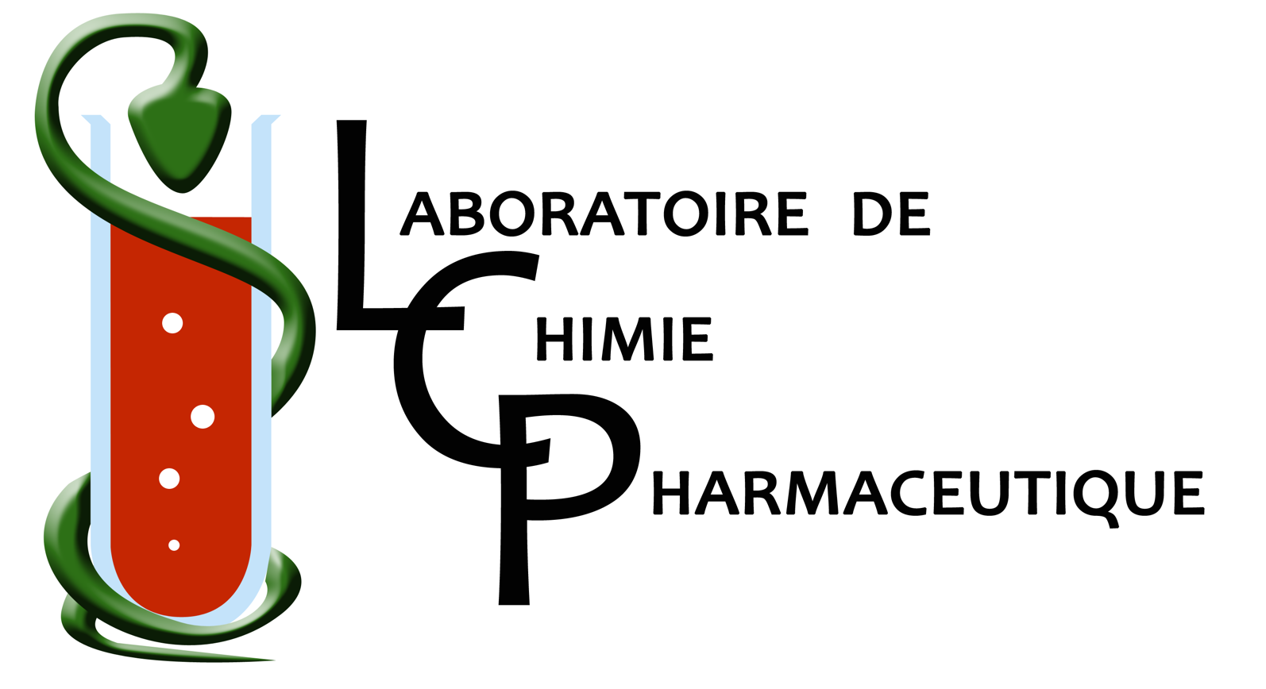


Antiplasmodial activity of polyphenolic derivatives.
G. DEGOTTE^{1,2} ; S.G. ALSON^{1,3,4} ; A. HANS² ; O. JANSEN¹ ; E. CIECKIEWICZ¹ ; H. RAKOTOARIMANANA³ ; H. RAFATRO³ ; F. RANDIMBIVOLOLONA⁴ ; P. FRANCOTTE² ; M. FREDERICH¹
¹ Laboratoire de Pharmacognosie, Centre Interdisciplinaire de Recherches sur le Médicament (CIRM), Université de Liège – Belgium
² Laboratoire de Chimie Pharmaceutique, Centre Interdisciplinaire de Recherches sur le Médicament (CIRM), Université de Liège – Belgium
³ Laboratoire d’Evaluation Pharmaco-Clinique (LEPC), Institut Malgaches de Recherches Appliquées (IMRA) BP- Madagascar
⁴ Laboratoire de Pharmacologie Générale, de Pharmacocinétique et de Cosmétologie (LPGPC), Faculté des sciences, Université d’Antananarivo BP - Madagascar
Context
For nearly 2 decades, the progresses against malaria are still due to the development of artemisinin derivatives, such as artesunate or artemether. But this parasitic infection remains a major issue in public health especially in Africa where 90 % of cases occurs¹ and continues to kill an under-five child every 2 minutes². Moreover, the efforts to launch a vaccine have been unsuccessful up to now .
Unfortunately in 2016, the number of people infected by Plasmodium did not decrease, for the first time in 15 years, with 216 million of cases. This could be one of the first red flags indicating that our current management reaches its limits. In addition, the appearing and spread of resistant Plasmodium’s strains even to artemisinin and the development of insecticides resistant mosquitoes is observed¹. Thus, the research of new antiplasmodial compounds is highly need and constituted one of the great challenge of this decade at the same level of the discovery of new antibiotics.
With this in mind, evaluation of the effect of polyphenols as antimalarial is explored since a few years³; driven by the multiple activities known for this class of compounds : antioxidant ⁴, antitumor⁵, anti-inflammatory⁶ or immunomodulatory⁷. Due to its abundance in plants and notably in traditional medicine, in addition with its nontoxicity, caffeic acid and its derivatives seem to be good candidates for screening of anti-Plasmodium effect through in vitro and in vivo assays.
Pharmacomodulation
The targeted derivatives are short esters of caffeic acid and its dehydroxylated analogs. They are synthetized through a Fischer’s reaction combining a large excess of the appropriate alcohol, concentrated H₂SO₄ and the corresponding phenolic acid.
For compound 2g , a transesterification method with acidified EtOH was employed after a classical methylation protocol giving 3.
Pharmacolocical assays
1) In vitro : The in vitro evaluation of the derivatives was performed following the procedure described by Frederich et al. (2002)⁸ on a 3D7 chloroquine-sensitive strain of Plasmodium falciparum, performed in triplicates (n = 3-5). The measure of growth inhibition was realized through the decreased of lactate dehydrogenase activity⁹.
2) In vivo : Considering the results in vitro, the most active compound was tested in vivo on a P. berghei strain resistant to artemisinin. These parasites were developed at the LEPC through oral treatment of infected mice with infra-therapeutic doses of artemisinin. These assay was performed with intraperitoneal injection on 5 groups with 5 mice.
3) Stage selectivity: The same caffeic analog was employed with mice infected by P. vinckei petteri to determine the stage specificity on the Plasmodium’s growth. Thus the product was injected intraperitoneally at different time (0h; 3h; 6h and 12h) of the parasitic cycle to determine the most sensitive form by evaluation of the parasitaemia level (H₀ +3; +6; +12; +18 and +24h).
Results
1) In vitro
2) In vivo
Compound | R | R₃ | R₄ | IC₅₀ (µg/mL)
1a | H | OH | OH | 14.50 ± 4.12
2a | methyl | OH | OH | 5.24 ± 0.66
2b | ethyl | OH | OH | 4.55 ± 1.95
2c | isopropyl | OH | OH | 4.86 ± 4.39
2d | ethyl | H | OH | 34.87 ± 4.42
2e | ethyl | OH | H | 18.33 ± 4.17
2f | ethyl | H | H | > 50
2g | ethyl | OCH₃ | OCH₃ | 46.4 (n=1)
Groups/Doses (mg/kg) | Repetition
 | 1 |  | 2 |  | 3
 | % Parasitaemia | %I | % Parasitaemia | %I | % Parasitaemia | %I
Control | 57.92 | - | 55.81 | - | 53.4 | -
Artemisinin | 41.86 | 27.72 | 49.77 | 10.81 | 56.33 | -5.48
25 | 46.8 | 19.19 | 41.29 | 26.01 | 42.2 | 20.35
50 | 36.7 | 36.63 | 35.82 | 35.81 | 35.96 | 32.65
100 | 32.46 | 43.95 | 24.21 | 56.61 | 25.66 | 51.9
Considering the IC₅₀, the formation of esters from caffeic acid is related to an increase of the antiplasmodial effect and the most active compound is the ethyl caffeate ( 4.55 ± 1.95 µg/mL) as the same level of the other short esters. But the presence of the phenols seems to be essential for this action, look at 2g compound, even if this methylated analogs conserved a lower activity.
Based on the mean of parasitaemia level and its decrease (%I), the definition of ED₅₀ for the ethyl ester of caffeic acid is realized based on doses-effect curves : 87.63 ± 8.22 mg/kg in this murine model. The reduction of parasitaemia is bigger than in the artemisinin group, confirming the effect of ethyl caffeate on resistant strains. Its activity is thrice than methyl ester (232,68 ± 10,81 mg/kg).
3) Stage sensitivity : Observing a reduced parasitaemia (- 8%) in the group treated just after infection against the control group. The conclusion is, that as artemether, ethyl caffeate acts preferentially on the young trophozoite and thus impaired the early stage of the shizogonic cycle.
Group | Control | H₀ | H₀+3 | H₀+6 | H₀+12
Parasitaemia (%) | 24.28 | 18.08 | 21.12 | 26.16 | 20.60
Conclusion and prospects
Based on the in vitro results, the short esters are more active probably thanks to an easier penetration into the red blood cells. The inhibitory effect on the growth of Plasmodium could also be linked to the antioxidant effect of the compound. Moreover these results are transposable in vivo with a stage preference for the young trophozoites. The next step will be the evaluation of the pharmacokinetic properties of these compounds and their potential in combination with other antimalarials. Due to the promising activities found for this series and particularly the ethyl ester analog, other polyphenols could be investigated for a potential effect against Plasmodium falciparum. Among these molecules, ellagic acid is known for years to have a potent activity in vitro against varied Plasmodium’s strains (IC₅₀= 0.175 µg/mL) and in vivo, but only after intraperitoneal injection¹⁰. This lack of oral activity could be explained by a very poor water solubility (9.7 µg/mL) which finds its origin notably in the planar aspect of the molecule, and intermolecular interactions¹¹. Thus, the synthesis of crowded analogues could improve the pharmacokinetic parameters.
1. World Health Organisation. World Malaria Report 2017.; 2017. doi:http://www.who.int/malaria/publications/world-malaria-report-2017/report/en/
2. Bellanger AP, Faucher JF, Robedat P, Schmitt A, Millon L, Hoen B. Malaria outbreak in French troops returning from Côte d’Ivoire. Scand J Infect Dis. 2011. doi:10.3109/00365548.2010.538857
3. Roberts L. Drug-resistant malaria advances in Mekong. Science (80- ). 2017;358(6360):155-156. doi:10.1126/science.358.6360.155
4. Wright JS, Johnson ER, Dilabio GA. Predicting the Activity of Phenolic Antioxidants: Theoretical Method, Analysis of Substituent Effects, and Application to Major Families of Antioxidants. doi:10.1021/ja002455u
5. T. O. Structure-Activity Relationship of Antioxidant and Antitumor Polyphenols. In: Food Factors for Cancer Prevention. Springer. Tokyo; 1997.
6. Xu S, Zuo A, Guo Z, Wan C. Ethyl Caffeate Ameliorates Collagen-Induced Arthritis by Suppressing Th1 Immune Response. J Immunol Res. 2017;2017. doi:10.1155/2017/7416792
7. Gangan VD, Jazly L, Chakraborty CT, et al. Ethyl caffeate ether derivatives as future potential drug. J Pharm Res. 2014;88(66):818-821. http://jprsolutions.info/files/final-file-56c153afcf48f3.25743472.pdf. Accessed April 4, 2018.
8. Frédérich M, Jacquier M-J, Thépenier P, et al. Antiplasmodial Activity of Alkaloids from Various Strychnos Species. doi:10.1021/np020070e
9. Makler MT, Ries JM, Williams JA, et al. Parasite lactate dehydrogenase as an assay for Plasmodium falciparum drug sensitivity. Am J Trop Med Hyg. 1993;48(6):739-741. doi:10.4269/ajtmh.1993.48.739
10. Soh PN, Witkowski B, Olagnier D, et al. In vitro and in vivo properties of ellagic acid in malaria treatment. Antimicrob Agents Chemother. 2009;53(3):1100-1106. doi:10.1128/AAC.01175-08
11. Bala I, Bhardwaj V, Hariharan S, Kumar MNVR. Analytical methods for assay of ellagic acid and its solubility studies. J Pharm Biomed Anal. 2006;40(1):206-210. doi:10.1016/j.jpba.2005.07.006
Thanks to FNRS and Fonds Léon Fredericq for financial support. Thanks to all the people who take part to this project.

