Slide 1



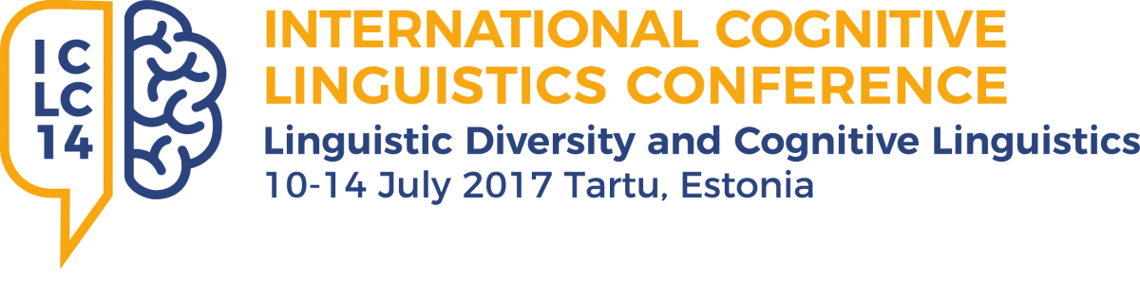
Do metaphors really matter politically?
On the role of political knowledge on the framing effect of metaphors
Julien Perrez (ULg)
Pauline Heyvaert (ULg, UCLouvain)
Audrey Vandeleene (Lund University)
Jérémy Dodeigne (UCLouvain, ULg)
Min Reuchamps (UCLouvain)
Notes:
multidisciplinary project – linguistics and political science
combination of approaches

Slide 2
Introduction
Interdisciplinary project
  Linguistics & political science
  Metaphors in political discourse
    Context: Belgian federalism
  Use of metaphors
    Different kinds of political corpora
  Production and reception
    Political impact of metaphors?
Notes:
Why are these metaphors used, and to what end?
If you think of it, linguists are really interested in political discourse (Lakoff, Musolff, Köller, and many others), but when you work with political scientists you realize they don’t raelly care about language, , at least the forms of language.
What they are interested is to what extent language structure could influence political representations and eventually political attitudes and behaviors

Slide 3
Research question
What political impact(s) could metaphor have on the people to which it is addressed.
Crucial question in CL
  CMT (Lakoff & Johnson 1980)
  Metaphors have the ability of highlighting and hiding specific aspects of a target concept
  Metaphors as rhetorical and conceptual tools carrying ideologies
Framing
  “[…] select[ing] some aspects of a perceived reality and mak[ing] it more salient in a communicating text, in such a way as to promote a particular problem definition, causal interpretation, moral evaluation, and/or treatment recommendation for the described item” (Entman, 1993: 52)
  “Metaphor helps construct particular aspects of reality and reproduce (or subvert) dominant schemas (Koller 2009: 121)
Notes:
One of the most important theoretical claims about metaphor is that it can influence reasoning, for example via the process of highlighting and hiding: metaphorical source domain concepts can lead us to pay attention to specific aspects of a target concept while other aspects are left aside or hidden
So logically, framing Belgian federalism as a Tetris game (on the production side) should have an effect / an impact on the reception

Slide 4
Towards an impact of metaphors on political preferences?
METAPHORS – heuristic process of knowledge transfer
POLITICAL PREFERENCES – depend on our understanding of the political arena
Framing
… but under which conditions ?
Notes:
“cognitive mechanism [which] enables citizens to make sense of the political world by drawing from previous knowledge and experience in non-political domains”
Used for complex and abstract concepts
metaphor stimulates analogies by only highlighting some elements of the concepts, the remaining elements are inevitably hidden by the metaphor, what could induce a biased vision of the debate on which to make a decision
Flooding - drown VS fresh air

Slide 5
Do metaphors influence reasoning?
Framing effect of metaphors
  From the perspective of production, but not of reception
  Taken for granted
    The use of a given metaphor would automatically trigger given representations
Literature => mixed results
  Thibodeau & Boroditsky (2011, 2013, 2015)
    Crime = virus => more social integration
    Crime = beast => more repression
    « even minimal metaphors can significantly shift people’s representations and reasoning about important real-life domains »
  Steen, Reijnierse & Burgers 2014; Reijnierse, Burgers, Krenmayr & Steen (2015)
    Reading about crime increases people’s overall preference for enforcement, regardless of the metaphorical frame
    => Under which circumstances do metaphors influence reasoning?
Notes:
These conditions should be understood as a series of parameters related (i) to the nature of the metaphorical mapping itself – for instance the degree of conventionality or deliberateness (see Reijnierse et al., 2015) or the aptness of the mapping (see Thibodeau and Durgin 2011) –, (ii) to its realization in a given discourse – for instance its degree of extendedness, i.e. to what extent the mapping is supported by different linguistic realizations in one single text (see Reijnierse et al., 2015) – and (iii) to frequency the citizens have been exposed to a metaphorical mapping.

Slide 6

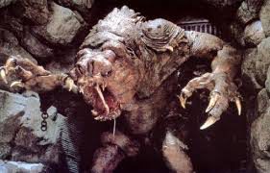
CRIME
Thibodeau & Boroditsky 2011, 2013
MORE SOCIAL INTEGRATION
MORE REPRESSION
Notes:
crime were found to lead to different policy proposals by the citizens. When crime was described as a “contagious virus”, measures were proposed to foster social integration; when crime was described as “ravaging beast”, repression is favoured. This was explained as different images of crime resulting from the two different metaphorical frames.

Slide 7
CRIME
Thibodeau & Boroditsky 2011, 2013
MORE SOCIAL INTEGRATION
« even minimal metaphors can significantly shift people’s representations and reasoning about important real-life domains »
MORE REPRESSION
Notes:
crime were found to lead to different policy proposals by the citizens. When crime was described as a “contagious virus”, measures were proposed to foster social integration; when crime was described as “ravaging beast”, repression is favoured. This was explained as different images of crime resulting from the two different metaphorical frames.

Slide 8
Do metaphors influence reasoning?
  Thibodeau & Boroditsky 2011, 2013
    Crime = virus => more social integration
    Crime = beast => more repression
  Steen, Reijnierse & Burgers 2014; Reijnierse, Burgers, Krenmayr & Steen (2015)
    Reading about crime increases people’s overall preference for enforcement, regardless of the metaphorical frame
    => Under which circumstances do metaphors influence reasoning?
Notes:
+ point to some methodolgical problems of the study
Yet, a recent extended replication by Steen et al. (2014) did not come to the same conclusions. The authors pointed to some methodological issues, inlcuding the fact that initial frame was supported by other lexical units of the text, suggest that the impact might be due to simple exposure to textual information, rather than metaphors per se. Simply reading about crime would increase people’s overall preference for enforcement, regardless of the presence or absence of a specific metaphorical frame.
Reframe the question of the influence of metaphors on reasoning to

Slide 9
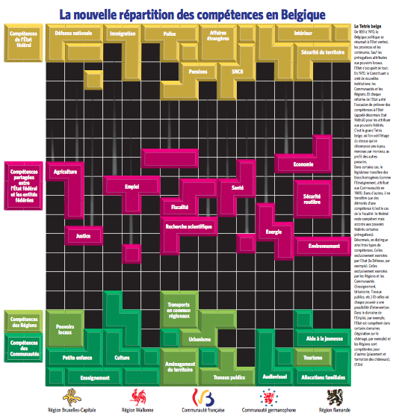
Case study 1: Belgian federalism is a Tetris game
Perrez & Reuchamps (2015)
Notes:
Background for two experiments we conducted about Tetris metaphors

Slide 10
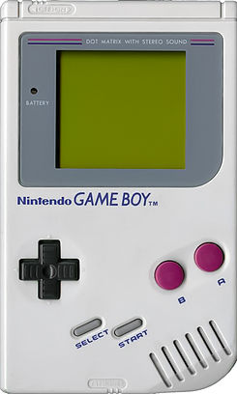
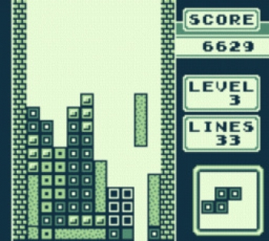
Notes:
By the way, when playing these some 25 years ago, I would never have thought this could become a subject discussed at scientific conference, but whatever.

Slide 11
The Belgian tetris
From 1831 to 1970, Belgium came down to the central state, the provinces and the municipalities. Except for the prerogatives devolved to the local authorities, the State took care of everything. In 1970, the constituent power created new institutions: communities and regions. And every state reform has been the occasion to take competences from the state (from there on called the federal state) to redistribute them to federal authorities. This is the big Belgian Tetris, where we see the upper floor that is falling apart (decomposing) , block by block, at the benefit of other authorities. In certain cases, the legislator is transferring homogeneous blocks (like education, handed over to the communities in 1989). In other cases, what is involved is just transferring some elements of a competence (it’s the case of the tax system: the federal state remains competent but assigned certain prerogatives to the federal entities). From now on, we therefore make a distinction between three types of competences. The ones that are exclusively exercised by the federal state (like Defense, for example). The ones that are exclusively exercised by the Regions and Communities (Education, Town planning, Public works, and so on). An the ones for which each power has some possibility of intervention. In the area of employment, for instance, the (federal) State is competent for certain domains (unemployment legislation, for instance) and the Regions are in charge of other ones (training courses of unemployed people).

Slide 12

3 XP Conditions
TETRIS CONDITION
NEUTRAL CONDITION
CONTROL CONDITION
FREE DESCRIPTION TASK
POLITICAL KNOWLEDGE QUESTIONS
ATTITUDE
PERSONAL INFO
Notes:
400 hparticipants

Slide 13
Main findings
Subject who have been submitted to the textual stimulus tend to:
  Highlight different aspects of Belgian federalism
    System vs. Identity
  Neutral vs. tetris conditions
    Description task: no differences
    Main effect: tetris metaphor does not lead the participants to have different political preferences regarding regional autonomy

Slide 14
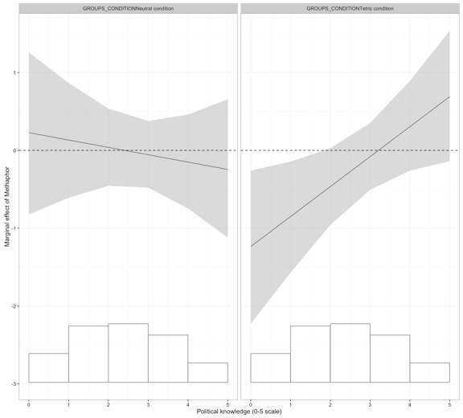
Political knowledge*xp condition
Notes:
Y: marginal effects
X: political knowledge (bar charts: N of cases)
Ligne pointillée: estimates = 0
Below the line: negative effect of the interaction
Above the line: positive effect of the interaction
There is an effect of the text condition (group 4) depending on the level of political knowledge: low level of political knowledge => more regionalist when the have been exposed to the Tetris metaphor

Slide 15
Main findings
Subject who have been submitted to the textual stimulus tend to:
  Highlight different aspects of Belgian federalism
    System vs. Identity
  Neutral vs. tetris conditions
    Main effect: tetris metaphor does not lead the participants to have different political preferences regarding regional autonomy
    Mediating effect of political knowledge: people with a lwoer level of PK seems to be influenced by the presence of the metaphor (DV: regional autonomy)

Slide 16
Case study 2: basic income
Role of political knowledge on the framing effect of metaphors?
  Influential in shaping citizens’ preferences and behavior
  May structure individuals’ reaction to political information
Basic income
  “A basic income is a periodic cash payment unconditionally delivered to all on an individual basis, without means-test or work requirement” (basicincome.org)
    Unconditionality (determined only by group membership)
    Freedom (lead one’s own life without taking care of financial issues)
Notes:
Shift to basic income => away from Tetris, other domain than institutional politics
Uncond : merely through membership, no condition to receive the BI – as pocket money in a family
Liberty : thanks to the BI, possibility to organize one’s own life without taking care of financial issues

Slide 17
Design
Control

Slide 18
Design
Some people propose the idea of a universal allocation, also called basic income, unconditional basic income or Citizen’s income (depending on the country). This can be defined as: “an income payed by a political community to all its members, on an individual basis, without means-test or work requirement”.
Although this idea has long been connected to an utopia entertained by intellectuals (but defended by numerous Nobel Prizes in Economic Sciences), it has slowly gained ground. It has punctually been tested in Canada, the United States, India; has been launched by Lula in Brazil; in Alaska, it exists by means of a redistribution of energetic benefits of the state.
In our country, the debate is under way. And you, what do you think?
Control
Neutral

Slide 19
Design
Some people propose the idea of a universal allocation, also called basic income, unconditional basic income or Citizen’s income (depending on the country). This can be defined as: “an income payed by a political community to all its members, on an individual basis, without means-test or work requirement”. We could see it as pocket money that citizens receive from the State like children receive it by the very fact that they are members of the family.”
Although this idea has long been connected to an utopia entertained by intellectuals (but defended by numerous Nobel Prizes in Economic Sciences), it has slowly gained ground. It has punctually been tested in Canada, the United States, India; has been launched by Lula in Brazil; in Alaska, it exists by means of a redistribution of energetic benefits of the state.
In our country, the debate is under way. And you, what do you think?
Control
Neutral
POCKET MONEY
Notes:
Hereby controlling for deliberateness and extendedness

Slide 20
Design
Some people propose the idea of a universal allocation, also called basic income, unconditional basic income or Citizen’s income (depending on the country). This can be defined as: “an income payed by a political community to all its members, on an individual basis, without means-test or work requirement”. We could see it as an income that citizens receive from the State by the very fact that they are members of it.
Although this idea has long been connected to an utopia entertained by intellectuals (but defended by numerous Nobel Prizes in Economic Sciences), it has slowly gained ground. It has punctually been tested in Canada, the United States, India; has been launched by Lula in Brazil; in Alaska, it exists by means of a redistribution of energetic benefits of the state.
In our country, the debate is under way. And you, what do you think?
Control
Neutral
Inconditionality
POCKET MONEY

Slide 21
Design
Some people propose the idea of a universal allocation, also called basic income, unconditional basic income or Citizen’s income (depending on the country). This can be defined as: “an income payed by a political community to all its members, on an individual basis, without means-test or work requirement”. We could see it as a base frame supplied by the State so that the citizens can build their life freely without having to be concerned about material constraints.
Although this idea has long been connected to an utopia entertained by intellectuals (but defended by numerous Nobel Prizes in Economic Sciences), it has slowly gained ground. It has punctually been tested in Canada, the United States, India; has been launched by Lula in Brazil; in Alaska, it exists by means of a redistribution of energetic benefits of the state.
In our country, the debate is under way. And you, what do you think?
Control
Neutral
BASE

Slide 22
Design
Some people propose the idea of a universal allocation, also called basic income, unconditional basic income or Citizen’s income (depending on the country). This can be defined as: “an income payed by a political community to all its members, on an individual basis, without means-test or work requirement”. We could see it as an income supplied by the State so that citizens can freely live their life without having to be concerned about material constraints.
Although this idea has long been connected to an utopia entertained by intellectuals (but defended by numerous Nobel Prizes in Economic Sciences), it has slowly gained ground. It has punctually been tested in Canada, the United States, India; has been launched by Lula in Brazil; in Alaska, it exists by means of a redistribution of energetic benefits of the state.
In our country, the debate is under way. And you, what do you think?
Control
Neutral
Freedom
BASE

Slide 23
Design
Some people propose the idea of a universal allocation, also called basic income, unconditional basic income or Citizen’s income (depending on the country). This can be defined as: “an income payed by a political community to all its members, on an individual basis, without means-test or work requirement”. We could see it as a springboard supplied by the State so that the citizens can freely launch themselves into life without any material constraints.
Although this idea has long been connected to an utopia entertained by intellectuals (but defended by numerous Nobel Prizes in Economic Sciences), it has slowly gained ground. It has punctually been tested in Canada, the United States, India; has been launched by Lula in Brazil; in Alaska, it exists by means of a redistribution of energetic benefits of the state.
In our country, the debate is under way. And you, what do you think?
Control
Neutral
SPRINGBOARD

Slide 24
Design
Some people propose the idea of a universal allocation, also called basic income, unconditional basic income or Citizen’s income (depending on the country). This can be defined as: “an income payed by a political community to all its members, on an individual basis, without means-test or work requirement”. We could see it as an income supplied by the State so that citizens can freely live their life without having to be concerned about material constraints.
Although this idea has long been connected to an utopia entertained by intellectuals (but defended by numerous Nobel Prizes in Economic Sciences), it has slowly gained ground. It has punctually been tested in Canada, the United States, India; has been launched by Lula in Brazil; in Alaska, it exists by means of a redistribution of energetic benefits of the state.
In our country, the debate is under way. And you, what do you think?
Control
Neutral
Freedom
SPRINGBOARD
Notes:
Hereby controlling for deliberateness and extendedness

Slide 25
DESIGN
Control group
Neutral text
Income-unconditionality
Pocket money
Income-freedom
Base frame
Springboard
Text
Argument
Metaphor
Notes:
Online survey
Students - first year – 2015-2016
N = 748 (about 100/group)
Groups (randomly)
Uncond : merely through membership, no condition to receive the BI – as pocket money in a family
Liberty : thanks to the BI, possibility to organize one’s own life without taking care of financial issues

Slide 26
TASKS
Questionnaire
  Free description task
  Specifc questions about the basic income
    Should we introduce the BI in Belgium?
  Political knowledge
  Interest in politics
  Political preferences

Slide 27
TASKS
Questionnaire
  Free description task
  Specific questions about the basic income
    Should we introduce the BI in Belgium? (Likert-scale) => Dependent Variable
  Political knowledge
  Interest in politics
  Political preferences

Slide 28
PARTICIPANTS
XP GROUP | N
Control | 98
Neutral text | 98
Pocket money | 95
Income-unconditionality | 97
Base Frame | 95
Springboard | 99
Income-freedom | 104
TOTAL | 686

Slide 29
Results: impact of metaphors?
Mother Occupation (no profession) | 0.43 | (0.33)
Mother Occupation (worker) | -0.18 | (0.48)
Mother Occupation (senior executive) | -0.35 | (0.29)
Mother Occupation (accredited profession) | 0.23 | (0.32)
Father Occupation (no profession) | -0.31 | (0.49)
Father Occupation (worker) | -0.24 | (0.36)
Father Occupation (senior executive) | -0.04 | (0.27)
Father Occupation (accredited profession) | -0.04 | (0.32)
No prior knowledge of the basic income | 0.36* | (0.21)
Political Interest | -0.05 | (0.05)
Evaluation of the Economy | 0.05 | (0.06)
Salary as reward | -0.10** | (0.04)
State Intervention | 0.03 | (0.05)
Left-Right self-positioning | -0.15*** | (0.05)
Group: Neutral text | -1.25 | (1.06)
Group: Pocket money | -0.96 | (1.01)
Group: Income-Unconditionality | -1.90** | (0.97)
Group: Base frame | -2.26** | (1.02)
Group: Springboard | -1.57 | (1.02)
Group: Income-Freedom | -2.00** | (0.97)
Political Knowledge | -0.60** | (0.25)
Group: Neutral text + Pol. Knowledge | 0.64* | (0.35)
Group: Pocket money + Pol. Knowledge | 0.27 | (0.31)
Group: Income-Uncond. + Pol. Knowledge | 0.50 | (0.31)
Group: Base frame + Pol. Knowledge | 0.90*** | (0.34)
Group: Springboard + Pol. Knowledge | 0.58* | (0.33)
Group: Income-Freedom + Pol. Knowledge | 0.56* | (0.32)
Constant | 4.01*** | (0.97)
Observations | 599
Log Likelihood | -299.85
Akaike Inf. Crit. | 655.70
Note: *p<0.1; **p<0.05; ***p<0.01
Notes:
Logistic regression : disagree with BI versus neutral and agree with BI

Slide 30
Do arguments and/or metaphors impact the political preferences ?
Compared to the control group,
  Neutral text (NS)
  ARGUMENTS
    Unconditionality (-1.90) **
    Freedom (-2.00) **
  METAPHORS
    Base frame (-2.26) **
    Pocket money (NS)
    Springboard (NS)
Notes:
Extended versions of the neutral text

Slide 31
Results: impact of metaphors?
Mother Occupation (no profession) | 0.43 | (0.33)
Mother Occupation (worker) | -0.18 | (0.48)
Mother Occupation (senior executive) | -0.35 | (0.29)
Mother Occupation (accredited profession) | 0.23 | (0.32)
Father Occupation (no profession) | -0.31 | (0.49)
Father Occupation (worker) | -0.24 | (0.36)
Father Occupation (senior executive) | -0.04 | (0.27)
Father Occupation (accredited profession) | -0.04 | (0.32)
No prior knowledge of the basic income | 0.36* | (0.21)
Political Interest | -0.05 | (0.05)
Evaluation of the Economy | 0.05 | (0.06)
Salary as reward | -0.10** | (0.04)
State Intervention | 0.03 | (0.05)
Left-Right self-positioning | -0.15*** | (0.05)
Group: Neutral text | -1.25 | (1.06)
Group: Pocket money | -0.96 | (1.01)
Group: Income-Unconditionality | -1.90** | (0.97)
Group: Base frame | -2.26** | (1.02)
Group: Springboard | -1.57 | (1.02)
Group: Income-Freedom | -2.00** | (0.97)
Political Knowledge | -0.60** | (0.25)
Group: Neutral text + Pol. Knowledge | 0.64* | (0.35)
Group: Pocket money + Pol. Knowledge | 0.27 | (0.31)
Group: Income-Uncond. + Pol. Knowledge | 0.50 | (0.31)
Group: Base frame + Pol. Knowledge | 0.90*** | (0.34)
Group: Springboard + Pol. Knowledge | 0.58* | (0.33)
Group: Income-Freedom + Pol. Knowledge | 0.56* | (0.32)
Constant | 4.01*** | (0.97)
Observations | 599
Log Likelihood | -299.85
Akaike Inf. Crit. | 655.70
Note: *p<0.1; **p<0.05; ***p<0.01
Notes:
Logistic regression : disagree with BI versus neutral and agree with BI

Slide 32
The varied impact of political knowledge
Disagree
Do not disagree
Notes:
NEUTRAL: NO DIFF
Low level of PK: Disagree less with the M

Slide 33
Conclusions
Importance of introducing arguments
  Unconditionality
  Freedom
Impact of metaphors?
  Not all metaphors played the same role => aptness
    Base frame: positive impact
    Pocket money: negative impact
Confirmation of the mediating role of political knowledge
    Interaction with presence of metaphor
Notes:
We cannot state that metaphors matter – but some may matter (further research) – connoted positively or negatively ?
Label of BI widely accepted in English but its not the case in all languages (e.g. French). may impact its attractiveness in the eyes of decision–makers and voters (TETRIS vs FAMILY, DIVORCE)
Target group : language can pull citizens towards one direction on a given political topic but the effect might vary depending on the audience (e.g. PK)

Slide 34

Thank you for your attention !
Notes:
Language matters for political preferences but other variables are worth being taken into consideration in this relationship.

