Slide 1
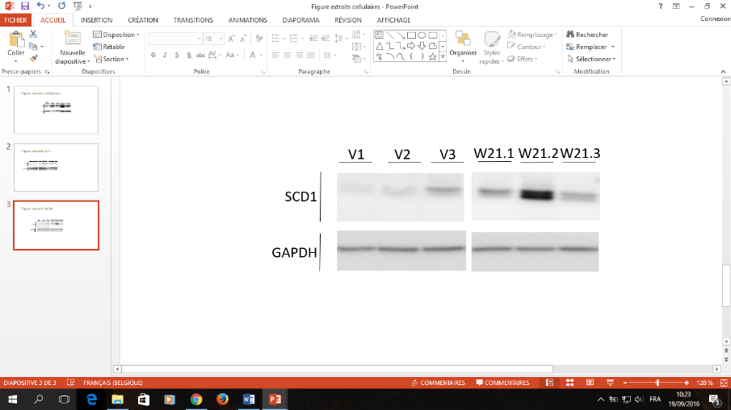
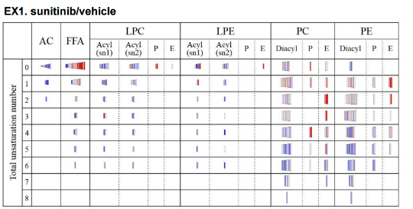
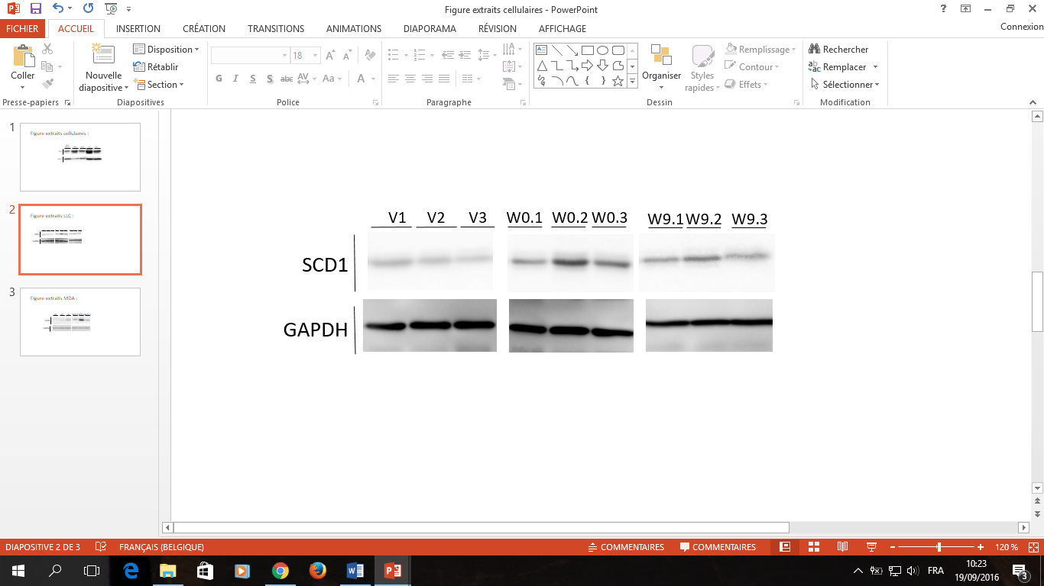
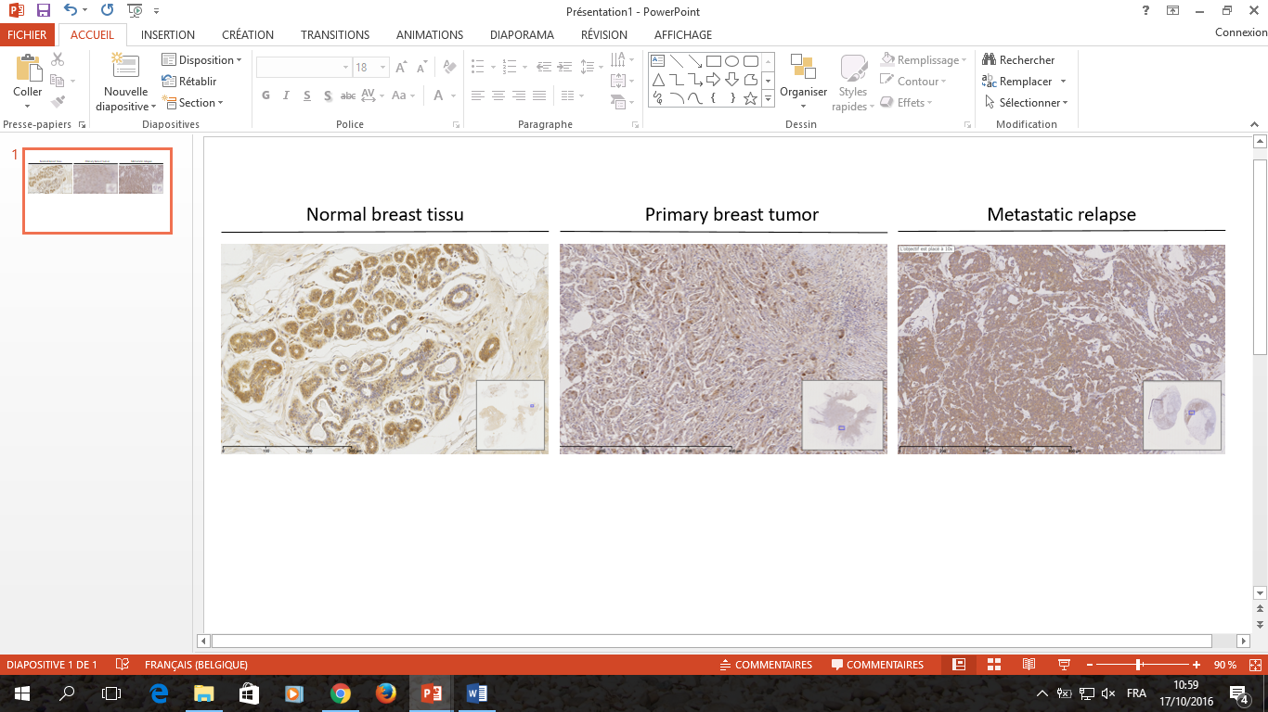
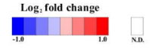
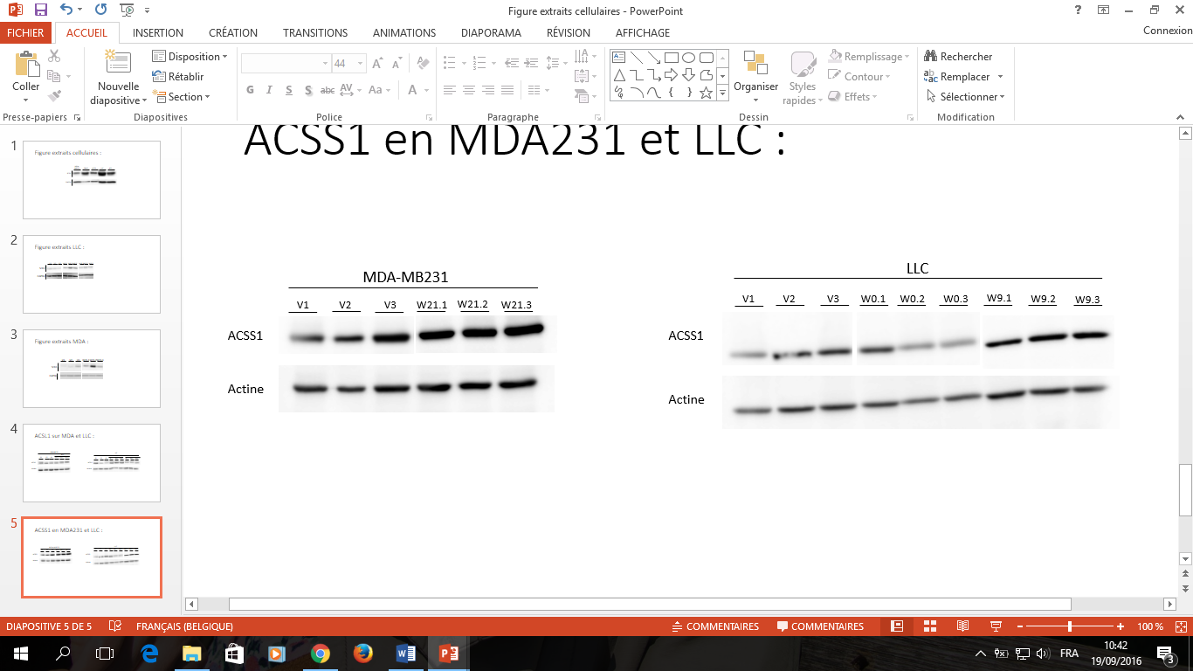
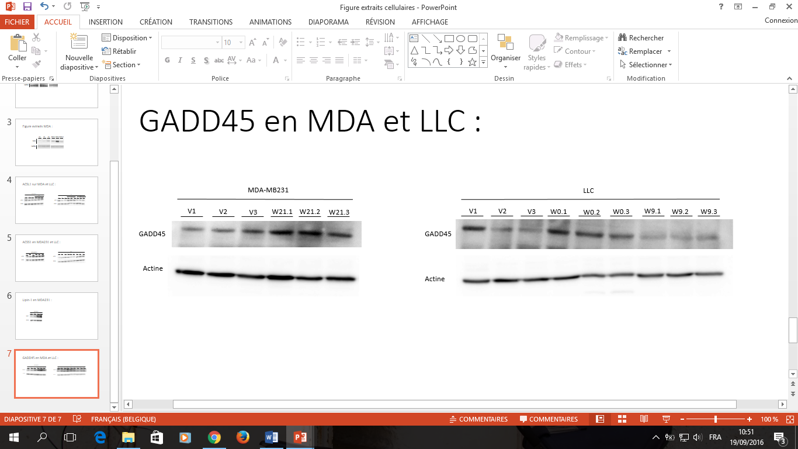
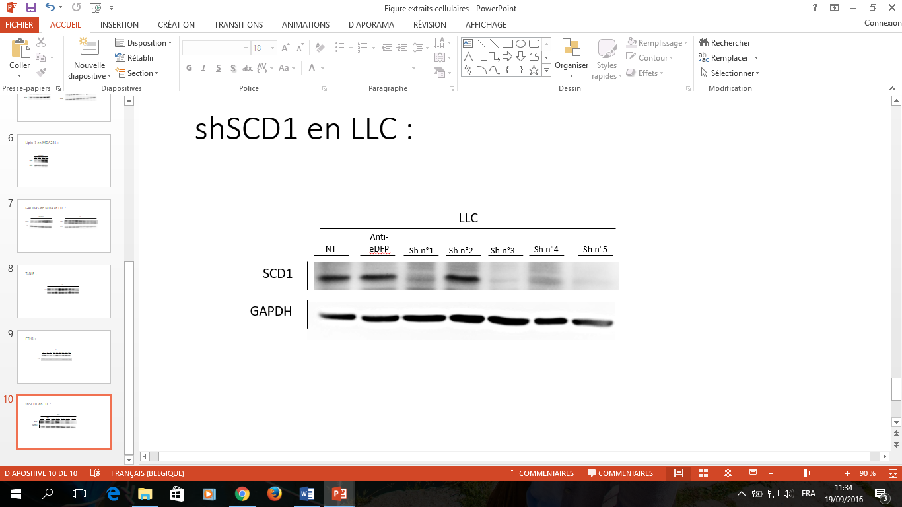
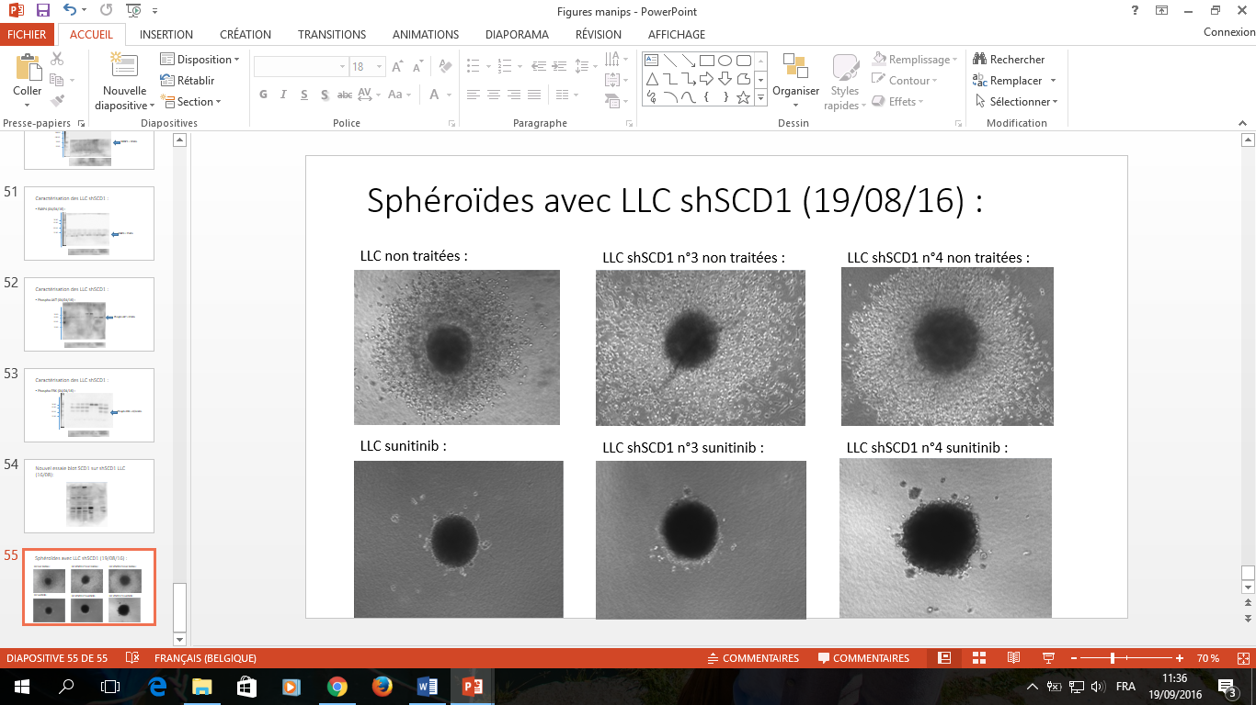
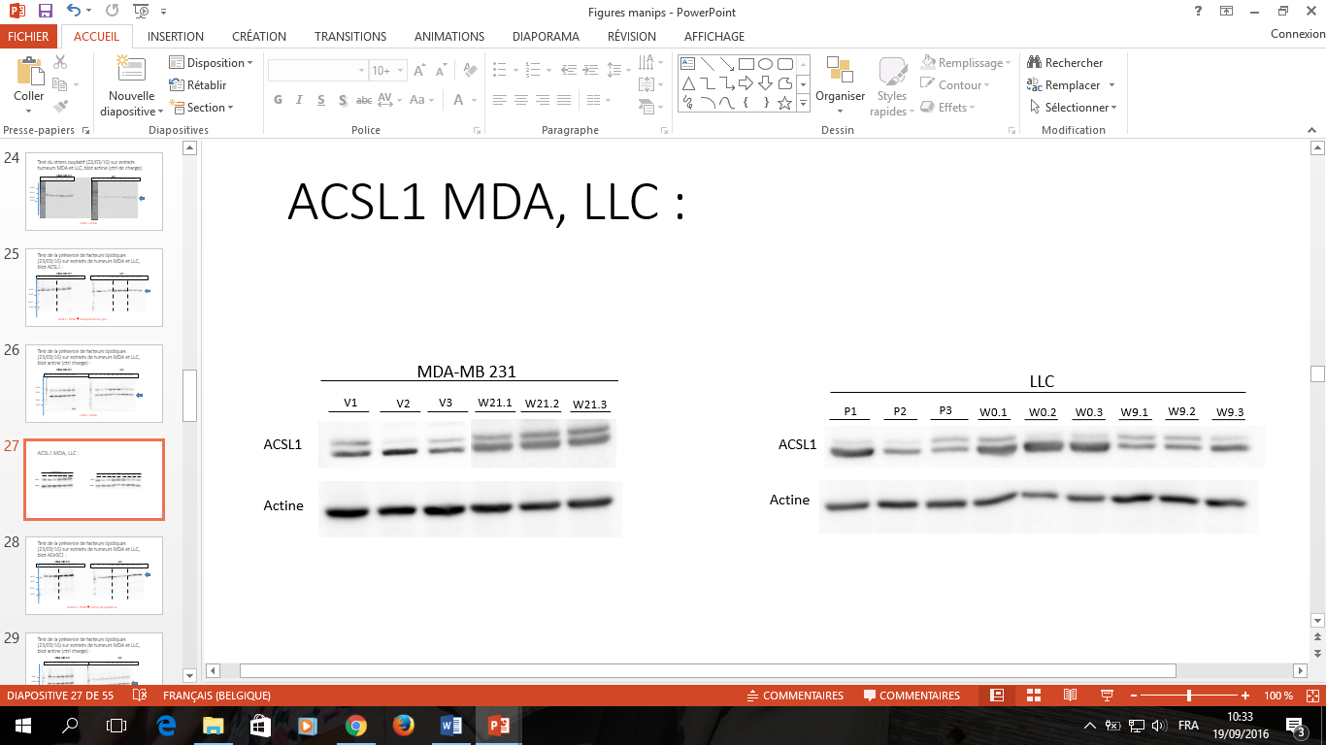
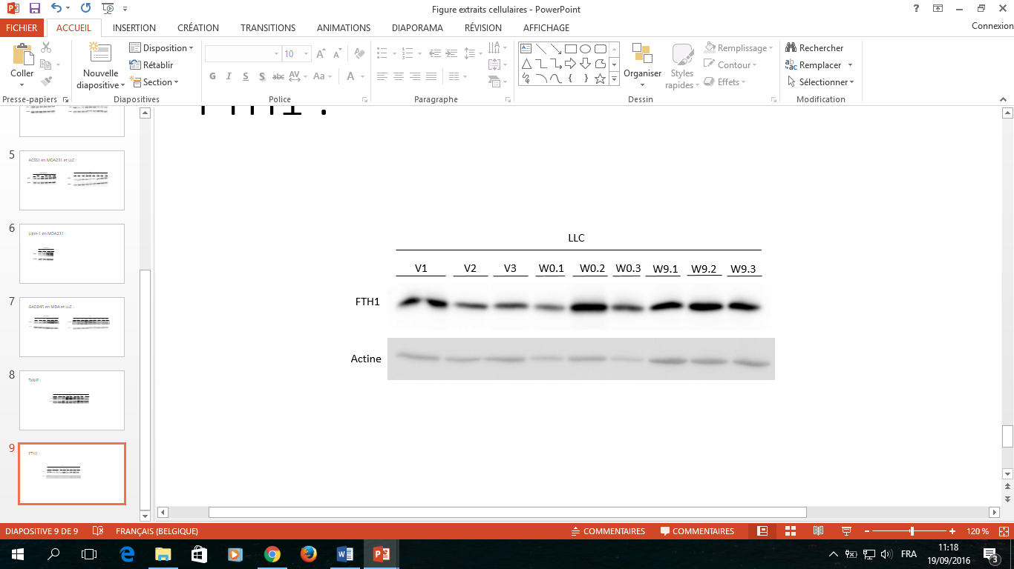
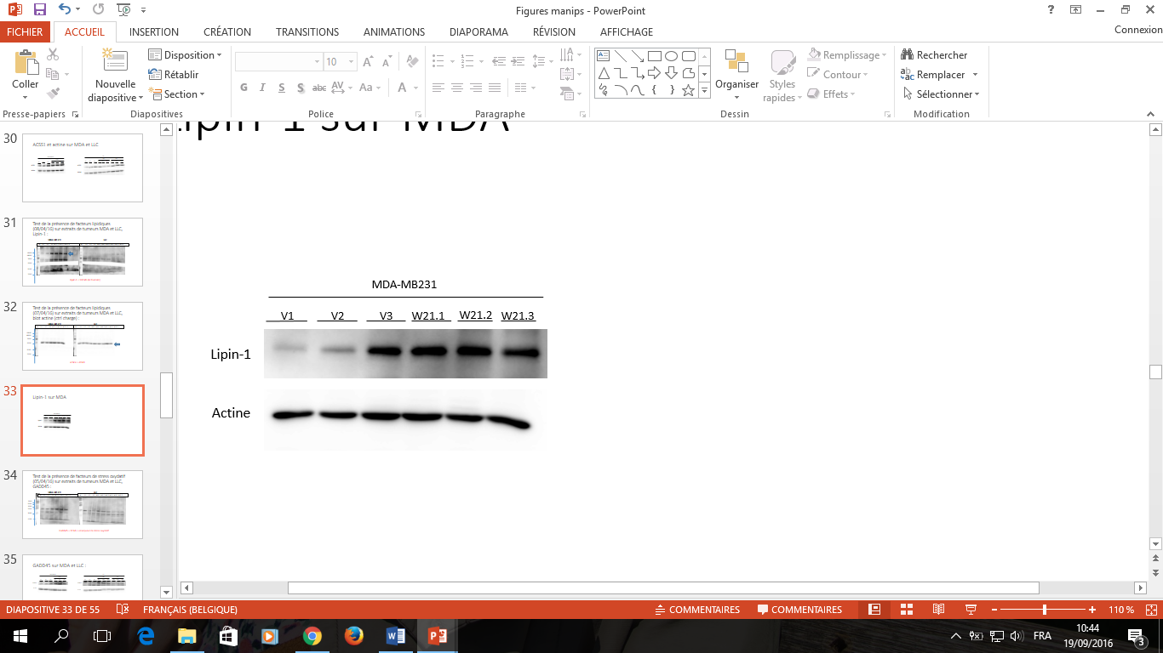
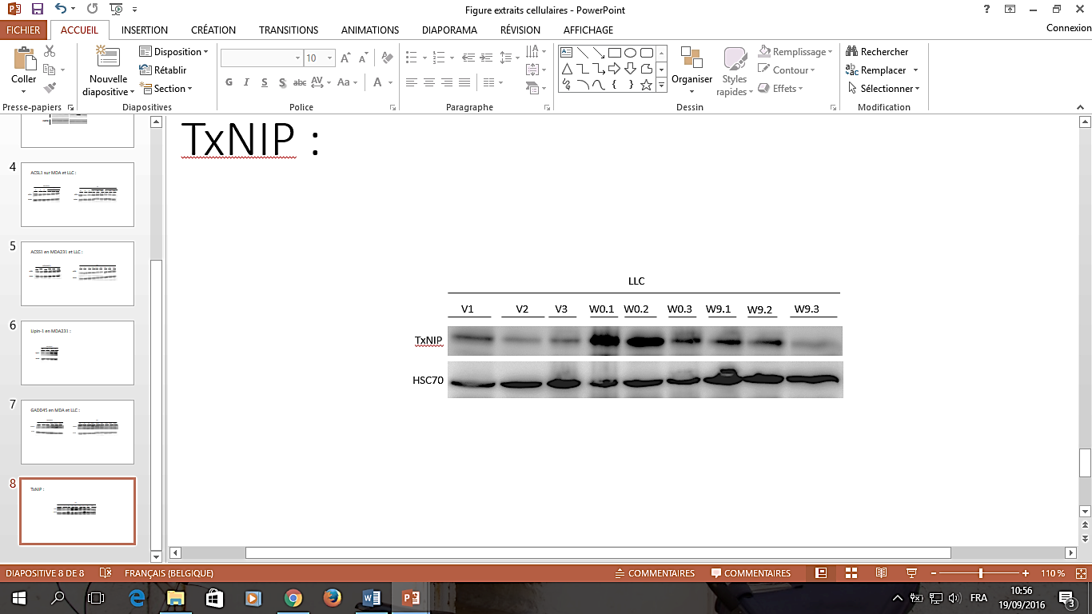
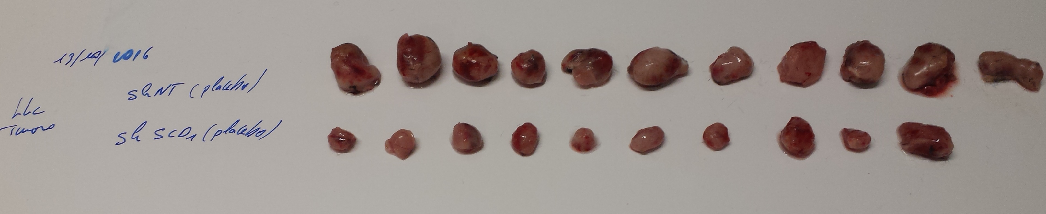
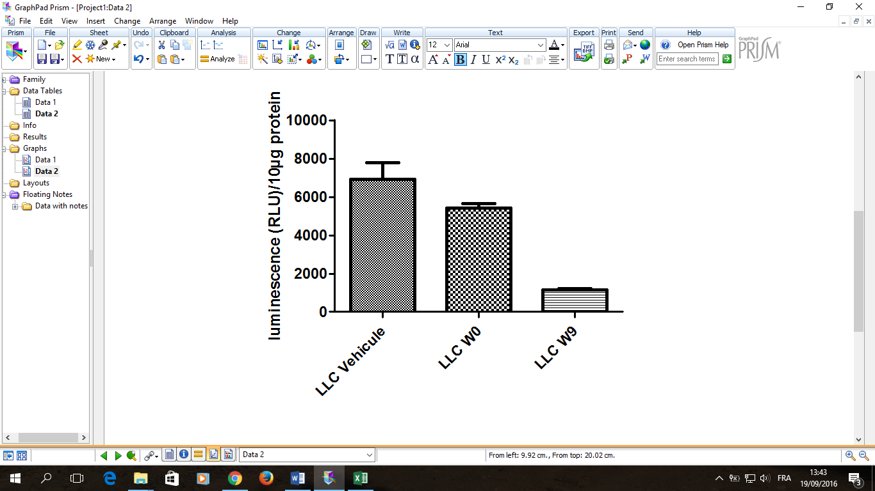
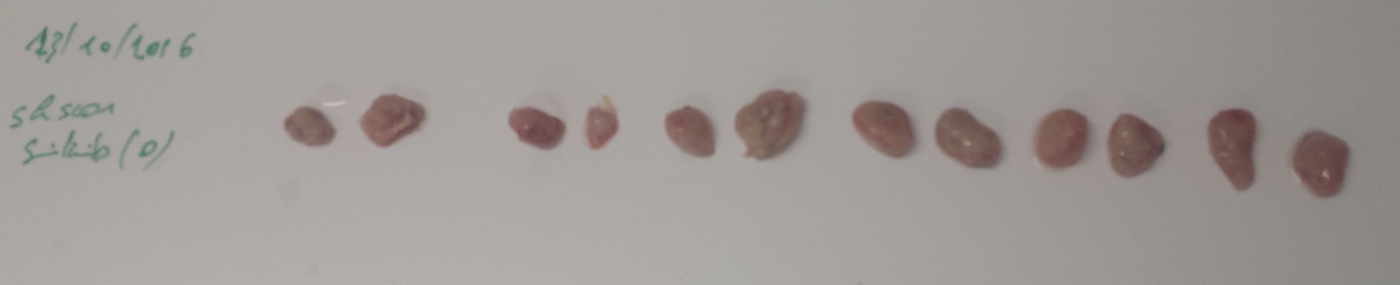
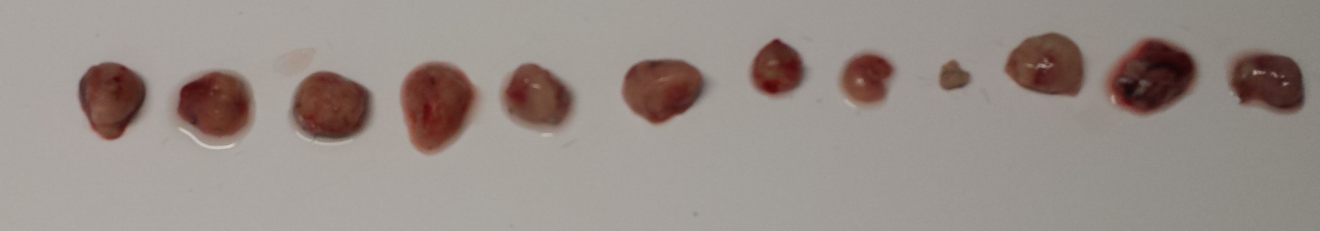
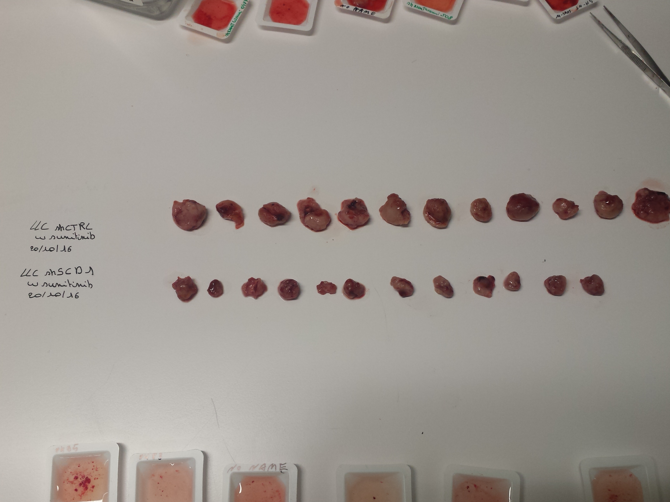





Fatty acid desaturation promotes tumor growth and aggressiveness after hypoxia and oxygenation
Géraldine Luis ¹, Adrien Godfroid¹, Jonathan Cimino¹, Shin Nishiumi ² ,Masaru Yoshida ², Agnès Noel¹ and Nor Eddine Sounni¹.
¹ Laboratory of Tumor and Development Biology, GIGA-Cancer, University of Liège. Belgium;
² Division of Gastroenterology, Department of internal medicine, Kobe University, Japan
Introduction
Targeting the metabolic pathways of cancer is actually the most contemporary topic of drug discovery. In this regard, we have contributed to the emergence of new facet of cancer metabolism in cancer adaptation and evasion to therapeutics. The concept of targeting lipid metabolism to improve efficacy of targeted therapy has been validated by sequential targeting VEGF pathway and FASN inhibition in cancers. Whereas FASN is recognized as an important target in the development of anticancer drug for many types of human cancers, its complete inhibition has showed poor pharmacokinetics with heavy side effects, highlighting the need for the identification of other therapeutic targets that inhibit lipid metabolism.
Results
SCD1 expression
Lipidomics analyses
SCD1 was found to be up-regulated after tumor re-oxygenation.
SCD1 expression increase in both primary tumors and metastases.
A lipidomic approache (LC-MS and MSI) was applied for lipids on tumor sections after treatment cessation and revealed an increase in mono- and poly-unsaturated FAs in the most aggressive tumors.
Oxidative stress in response to RTKI
Downregulation of SCD1 in tumor cells reduces tumor growth in vivo
MDA-MB 231 tumors
Vehicle
LLC tumors
Reox
SCD1-shRNA :
NT-shRNA
SCD1-shRNA_1
SCD1-shRNA_2
Vehicle
Reox
RTKI
In vivo tumor growth :
NT-shRNA
SCD1-shRNA
Vehicle
NADPH
SCD1-shRNA
+ RTKI
RTKI
Reox
NT-shRNA
+ RTKI
NT-shRNA Reox day 7
We measured the expression levels of lipid metabolism enzyme and oxidative stress markers and found an increase in TxNiP and GADD45 during drug administration in LLC tumors and GADD45 at day 21 in MDA-MB231 tumors.
SCD1-shRNA Reox day 7
Downregulation of SCD1 expression in cancer cells did not affect cell proliferation in spheroid in normoxia and 10 % FBS culture in vitro, but it strongly inhibited tumor growth in vivo and blocks tumor regrowth after oxygenation dependent RTKI treatment withdrawal.
Conclusion
Differential isobaric lipid distribution and composition were detected by MSI, between treated and untreated tumors. Lipidomics analysis revealed an increase in mono- and poly-unsaturated in the most aggressive tumors. Interestingly, SCD1, a key Stearoyl-Coa Desaturase enzyme that inserts double bonds into acyl-CoA chains was found to be up-regulated after tumor re-oxygenation and correlates with increased aggressiveness of lipogenic tumors. Furthermore, these unsaturated FAs are mainly engaged in PC and PE, the main known components of lipid rafts in cells. Unsaturated lipids are known to play a role in cell membrane fluidity and cell proliferation and migrating. Interestingly , by inhibiting SCD1 in tumor cells we block the primary tumor growth in vivo and the regrowth after tumor reoxygenation and relapse.
Presenting authors: Géraldine Luis and Nor Eddine Sounni. University of Liège, avenue Hippocrates 13 4000 Liège Belgium, Geraldine.luis@ulg.ac.be
nesounni@ulg.ac.be

