Slide 1

Open Access discovery
Erasmus Week Open Access
March 12-16, 2018
ULiège experience with aggregators and discovery tools providers. Be proactive and apply best practices (if you can...)
Myriam Bastin, University of Liège Library
François Renaville, University of Liège Library
http://hdl.handle.net/2268/221340

Slide 2
Let’s start with an assertion
Your repository must be visible
Your repository CONTENT must be visible
Why?
Don’t expect many people going to your IR and search for items (except maybe your own researchers)…
They will use other channels (Google Scholar, MS Academic, OA harvester, discovery tool…)
ULiège experience illustrated with ORBi (https://orbi.uliege.be) and PoPuPS (https://popups.uliege.be)

Slide 3
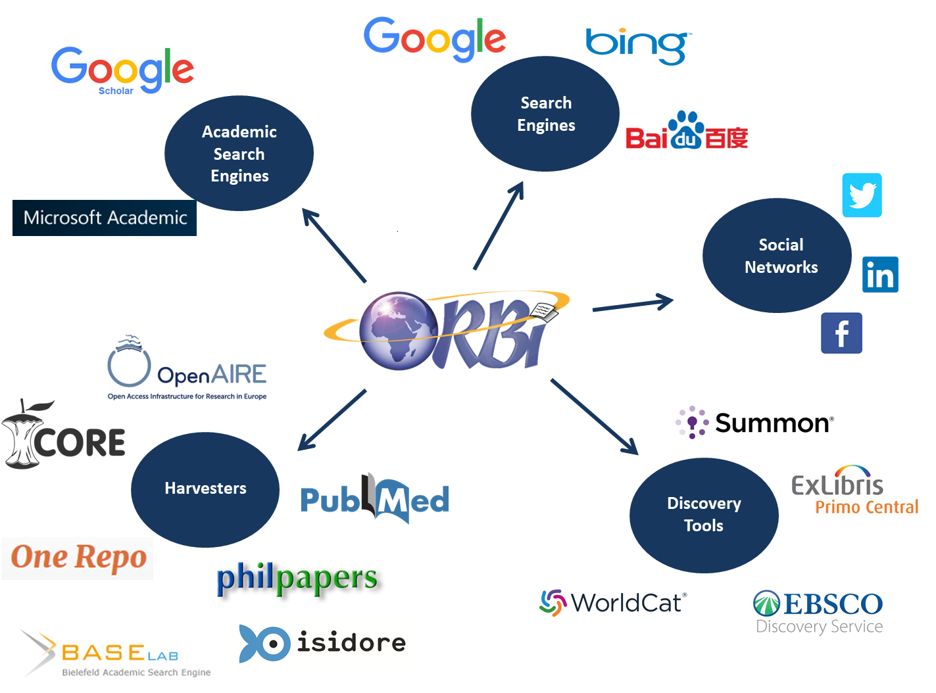

Slide 4
Agenda
ULiège experience with:
Google Scholar
Primo Central Index
Summon
Ebsco Discovery Service
CORE
BASE
PubMed LinkOut
Some tips and tools

Slide 5
Agenda
ULiège experience with:
Google Scholar
Primo Central Index
Summon
Ebsco Discovery Service
CORE
BASE
PubMed LinkOut
Some tips and tools

Slide 6
Google Scholar: Inclusion Guidelines
Content: Two basic criteria
Scholarly articles
The content hosted on your website must consist primarily of scholarly articles - journal papers, conference papers, technical reports, or their drafts, dissertations, pre-prints, post-prints, or abstracts. Content such as news or magazine articles, book reviews, and editorials is not appropriate for Google Scholar. Documents larger than 5MB, such as books and long dissertations, should be uploaded to Google Book Search; Google Scholar automatically includes scholarly works from Google Book Search.
Showing abstracts
Users click through to your website to read your articles. To be included, your website must make either the full text of the articles or their complete author-written abstracts freely available and easy to see when users click on your URLs in Google search results. Your website must not require users (or search robots) to sign in, install special software, accept disclaimers, dismiss popup or interstitial advertisements, click on links or buttons, or scroll down the page before they can read the entire abstract of the paper. Sites that show login pages, error pages, or bare bibliographic data without abstracts will not be considered for inclusion and may be removed from Google Scholar.
https://scholar.google.com/intl/en/scholar/inclusion.html#content

Slide 7
Google Scholar: Inclusion Guidelines
Indexing:
Configuring the meta-tags
If you're using repository or journal management software, such as Eprints, DSpace, Digital Commons or OJS, please configure it to export bibliographic data in HTML "<meta>" tags.
Google Scholar supports
Highwire Press tags (e.g., citation_title)
Eprints tags (e.g., eprints.title)
BE Press tags (e.g., bepress_citation_title)
PRISM tags (e.g., prism.title)
Other recommendations at https://scholar.google.com/intl/en/scholar/inclusion.html#indexing

Slide 8
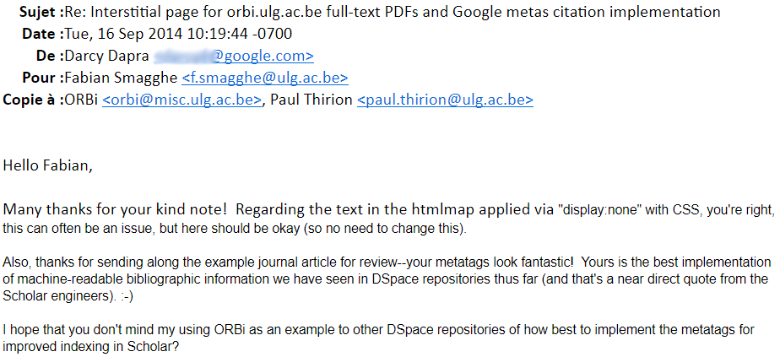
Google Scholar: ORBi
A message from Google Scholar our IT manager is proud of… ☺

Slide 9
Agenda
ULiège experience with:
Google Scholar
Primo Central Index
Summon
Ebsco Discovery Service
CORE
BASE
PubMed LinkOut
Some tips and tools

Slide 10
Primo Central Index
Primo Central Index (PCI) = name for Ex Libris’ mega-index of “hundreds of millions of scholarly e-resources of global and regional importance. These include journal articles, e-books, reviews, legal documents and more that are harvested from primary and secondary publishers and aggregators, and from open-access repositories.”
records are mainly provided by publishers, who provide the metadata from their publication platforms, and by aggregators (Gale, ProQuest) and their databases.
In addition: large collections and archives of free scholarly materials: ArXiv.org, HAL (Hyper Article en Ligne), OAPEN: Open Access Publishing in European Networks, SwePub, Norwegian Open Research Archives.
Early 2013: Ex Libris started to add institutional repositories into Primo Central Index, see Ex Libris Institutional Repository Program https://knowledge.exlibrisgroup.com/Primo_Central/Product_Documentation/Institutional_Repository_Program

Slide 11
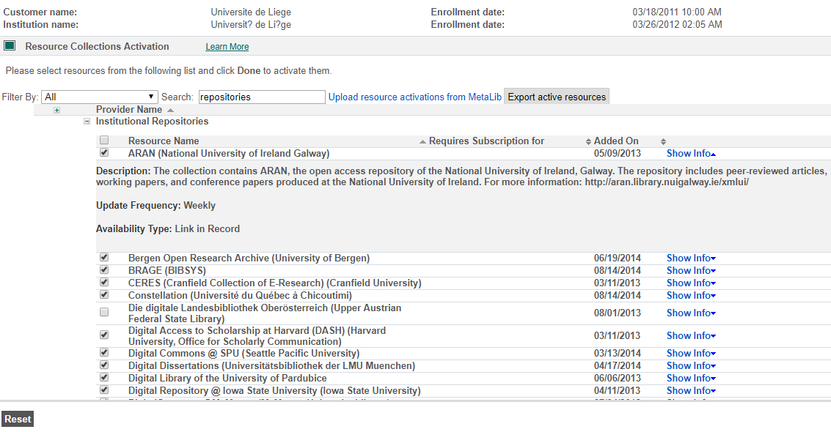
Update frequency is not always respected…

Slide 12
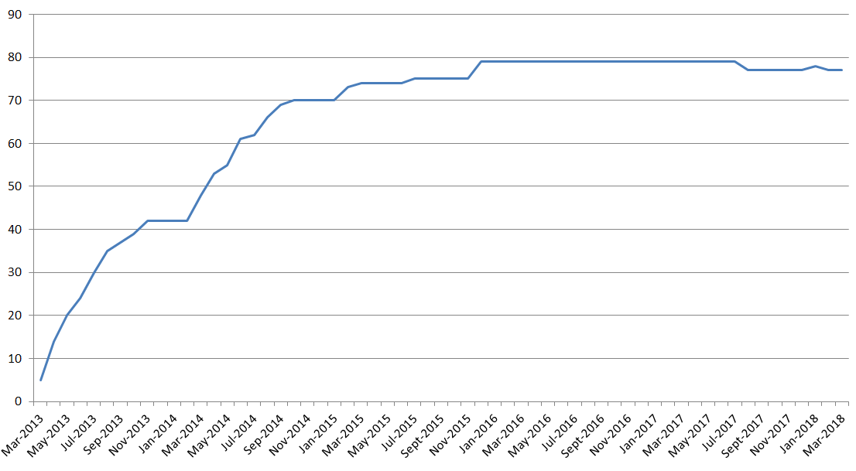
Growth of IRs in PCI
???
Not very active…
Note: There are currently less that 77 IRs in the PCI ‘Institutional Repositories’ section (73). Some IRs have been removed or moved to another section without any notification.

Slide 13
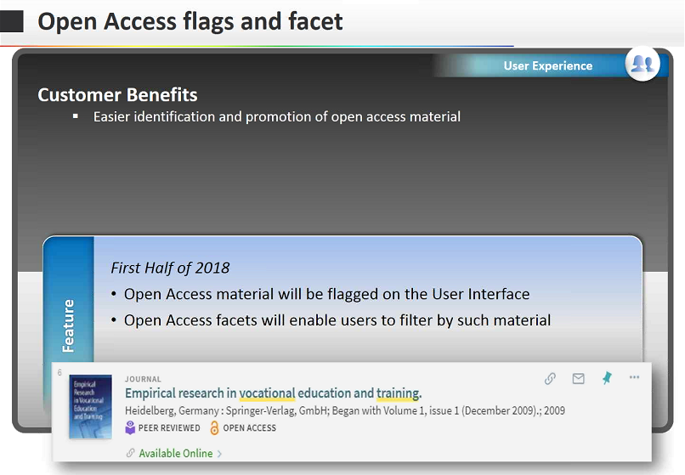
But Ex Libris is still working on OA…
https://knowledge.exlibrisgroup.com/@api/deki/files/60464/Primo_2018_Roadmap_Highlights.pdf?revision=2

Slide 14
PCI: ORBi
ORBi was added to PCI in March 2013.
Update Frequency: Weekly
Too many records!
Not only OA records had been harvested and added to PCI, but also records with no full text or with a campus access
We asked Ex Libris to run a full reload on OA records only
Nowadays:
More than 57,000 ORBi records with OA content are in PCI and can be activated by other libraries
Activated by more than 3,000 PCI customers

Slide 15
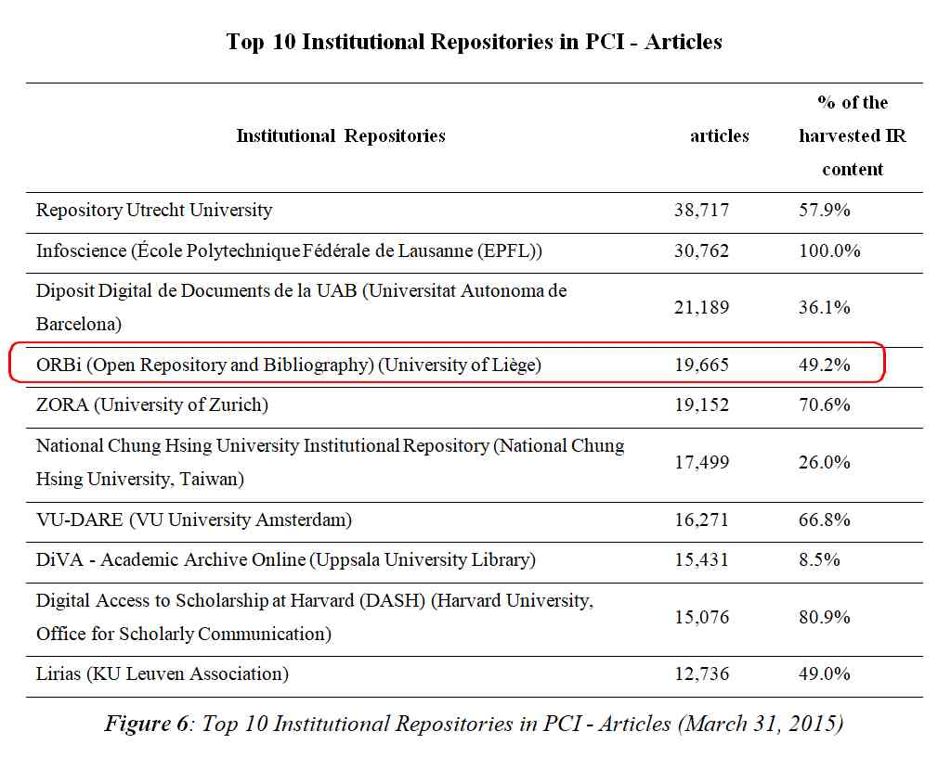
PCI: ORBi in the top 10 of IRs for articles
(Renaville, 2016)

Slide 16
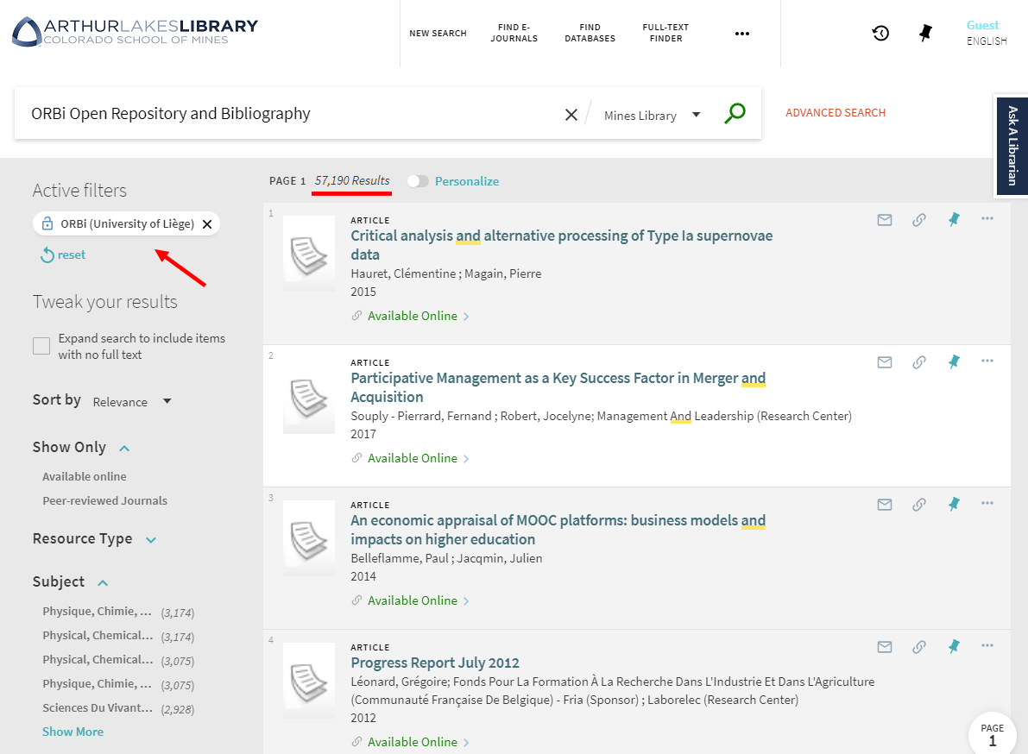

Slide 17
OA Repositories and PCI
2015 Survey: How do Primo Libraries manage Green Open Access collections?
Enhancement requests from the respondents:
Providing only OA contents: Too many false positives: some IRs are not 100% (no full text, embargo, login required) → bad experience and end-users are frustrated
Providing more detailed information about each OA repository
Adding more OA contents (more repositories)
Requiring OA content providers to provide good metadata quality
Better collaboration between Ex Libris and data providers
Allowing richer and more extended record formats for harvesting purposes
(Renaville, 2016)

Slide 18
PCI: PoPuPS
PoPuPS was added to PCI in May 2012
Update Frequency: Weekly
Nowadays:
More than 5,600 PoPuPS journal articles
And Knowledge Bases?
PoPuPS journals are also listed in KBs and journal finders:
A-to-Z (Ebsco)
Alma Community Zone (Ex Libris ProQuest)
SFX KB (Ex Libris ProQuest)
360 KB (Ex Libris ProQuest)
(Pochet, 2017)

Slide 19
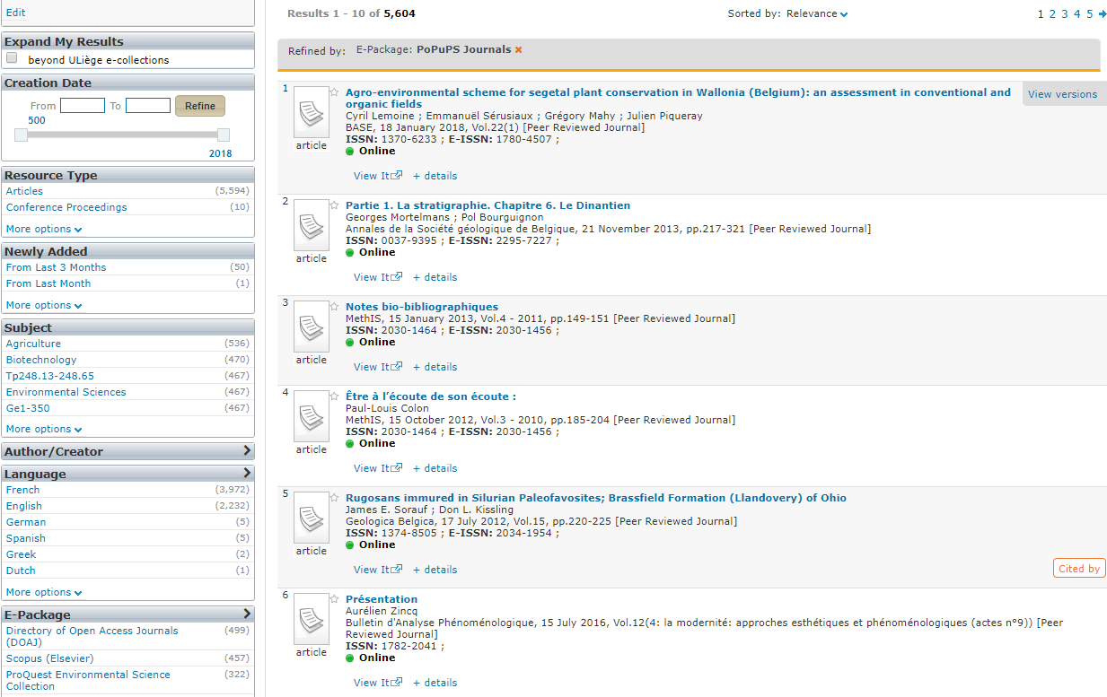
PCI: PoPuPS

Slide 20
Agenda
ULiège experience with:
Google Scholar
Primo Central Index
Summon
Ebsco Discovery Service
CORE
BASE
PubMed LinkOut
Some tips and tools

Slide 21
Summon
Summon = ProQuest’s discovery tool
Summon and Open Access
Libraries can enhance resource discovery by making freely available Open Access content, outside of their own collection, more accessible and visible through a series of user interface enhancements.
More than 200 million items identified as Open Access available through Summon
icon to indicate Open Access content appearing on the Summon results page
filter for Open Access content

Slide 22
Summon: ORBi
ORBi was added to Summon in 2017.
Update Frequency: ?
Integrated, but not identified as being OA!
Summon team will be contacted by ULiège Library to fix this

Slide 23
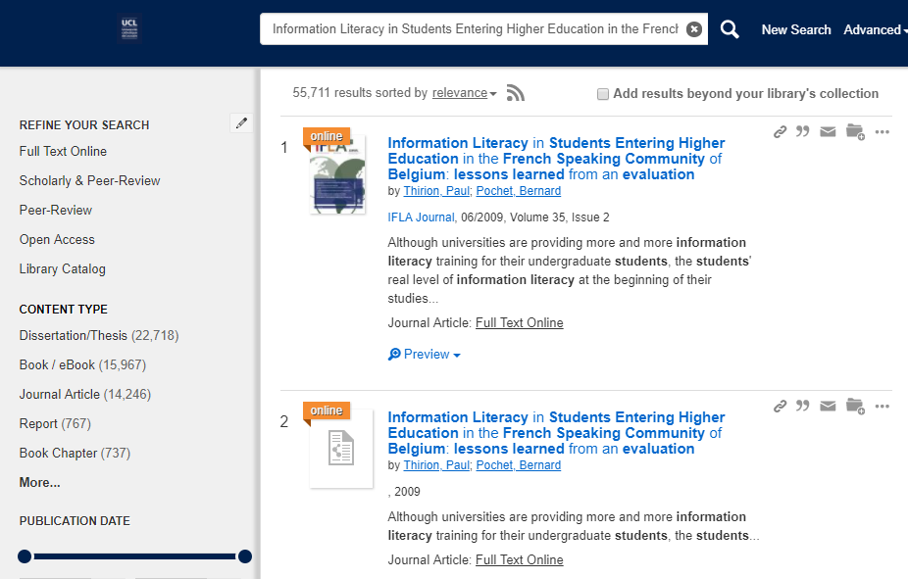
< Sage record
< ORBi record ☹
not flagged as OA

Slide 24
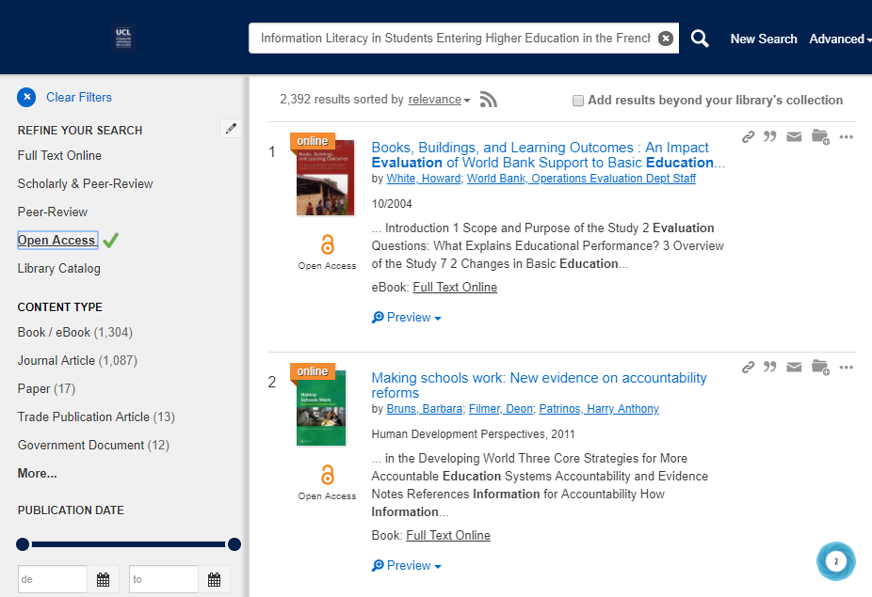
ORBi record has gone! Not considered as Open Access by Summon!

Slide 25
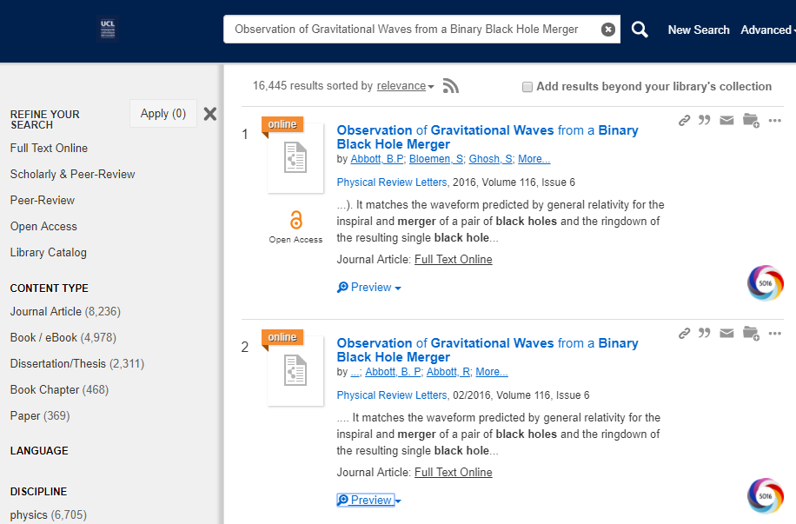
Another example with HAL (national French OA repository)
< ArXiv record ☺
< HAL record ☹

Slide 26
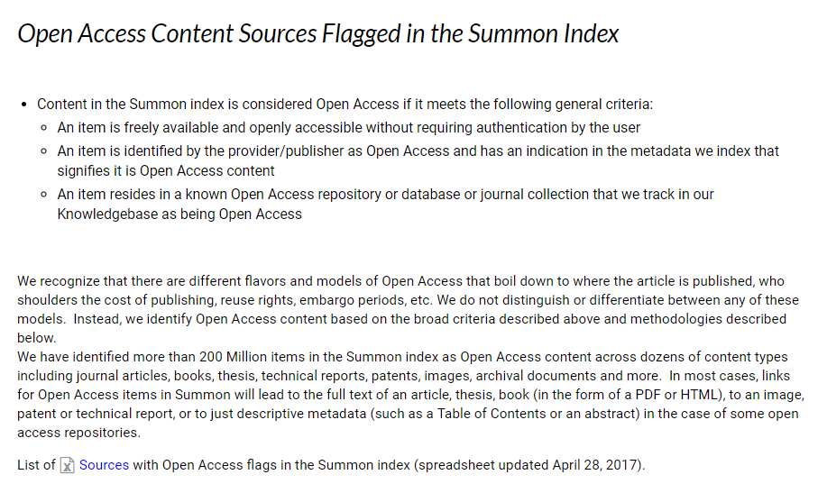
https://knowledge.exlibrisgroup.com/Summon/Product_Documentation/Summon%3A_Open_Access_Filter

Slide 27
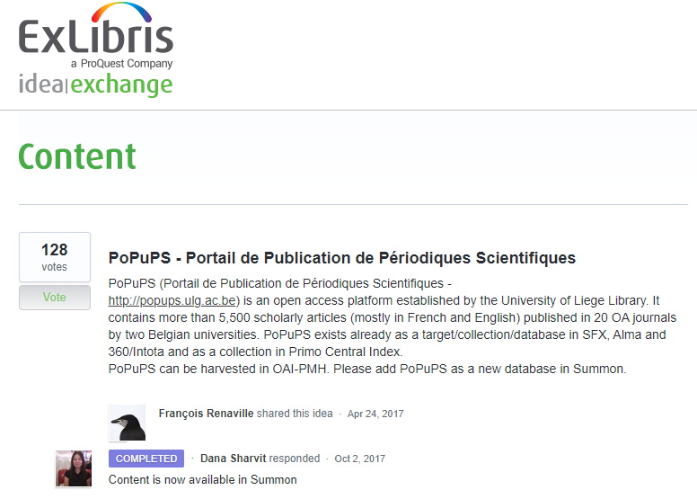
Summon: PoPuPS
PoPuPS was added to Summon in October 2017.
Request via Idea Exchange Content forum https://ideas.exlibrisgroup.com/forums/574345-content/

Slide 28
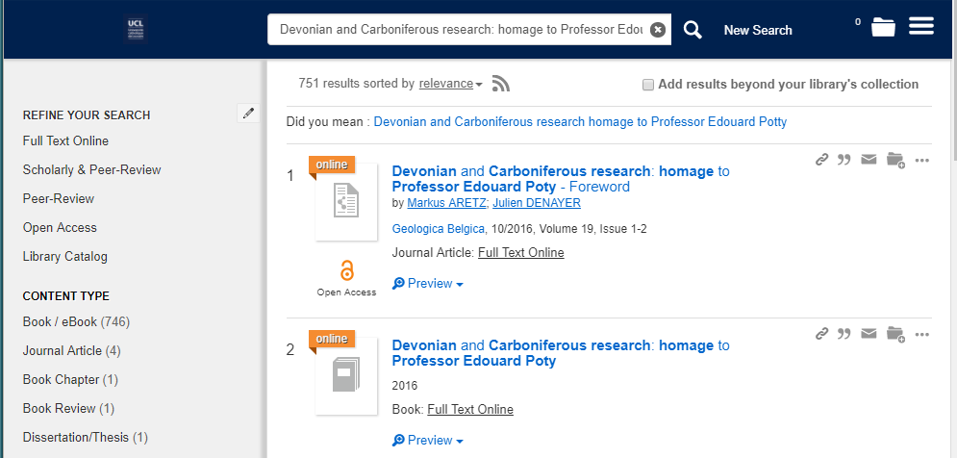
Summon: PoPuPS
PoPuPS is identified as being OA
< PoPuPS record ☺
< ORBi record ☹

Slide 29
Agenda
ULiège experience with:
Google Scholar
Primo Central Index
Summon
Ebsco Discovery Service
CORE
BASE
PubMed LinkOut
Some tips and tools

Slide 30
Ebsco Discovery Services
Ebsco Discovery Services (EDS) = Ebsco’s discovery tool
EBSCO supports harvesting IRs via OAI-PMH (Dublin Core, Dublin Core qualified, EAD, Junii2, METS, MODS) or FTP
Institutional Repository Database Questionnaire https://help.ebsco.com/interfaces/EBSCO_Discovery_Service/EDS_Catalogs_IRs

Slide 31
EDS: ORBi
ORBi was added to EDS in March 2016
OA pdf full texts delivered for indexing purposes only
Nowadays:
More than 57,000 ORBi records with OA content are in EDS and can be activated by EDS customers
Activated by more than 2,700 customer (March 2017)

Slide 32
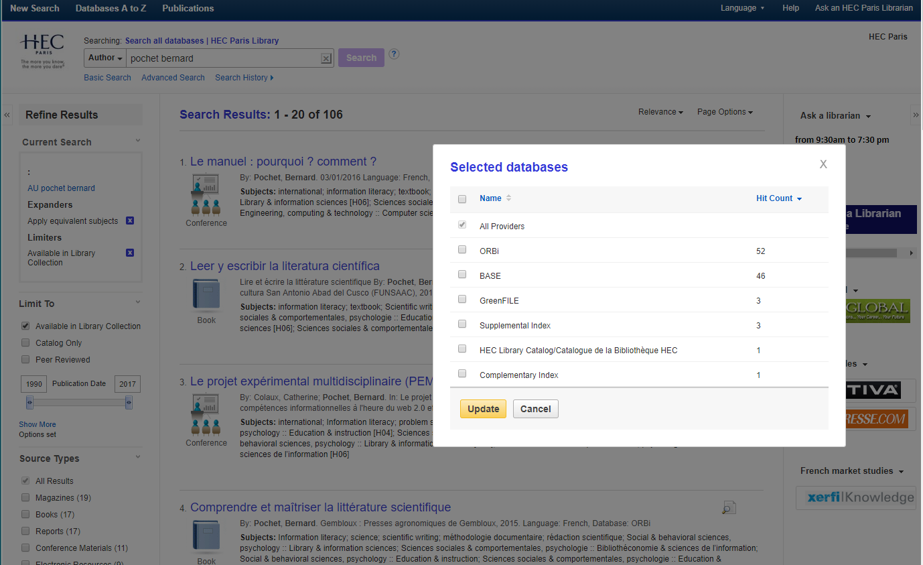
EDS: ORBi

Slide 33
Agenda
ULiège experience with:
Google Scholar
Primo Central Index
Summon
Ebsco Discovery Service
CORE
BASE
PubMed LinkOut
Some tips and tools

Slide 34
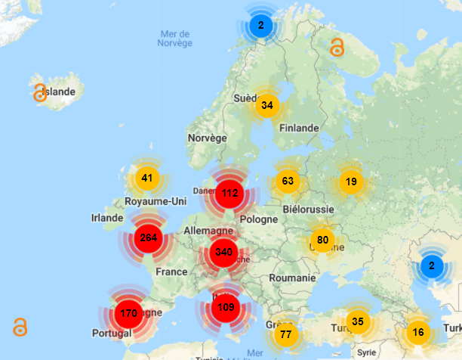
CORE
Currently contains more than 125,747,000 open access articles, from over tens of thousands journals
Collected from over 3,673 repositories around the world
Becoming a data provider? https://core.ac.uk/join

Slide 35
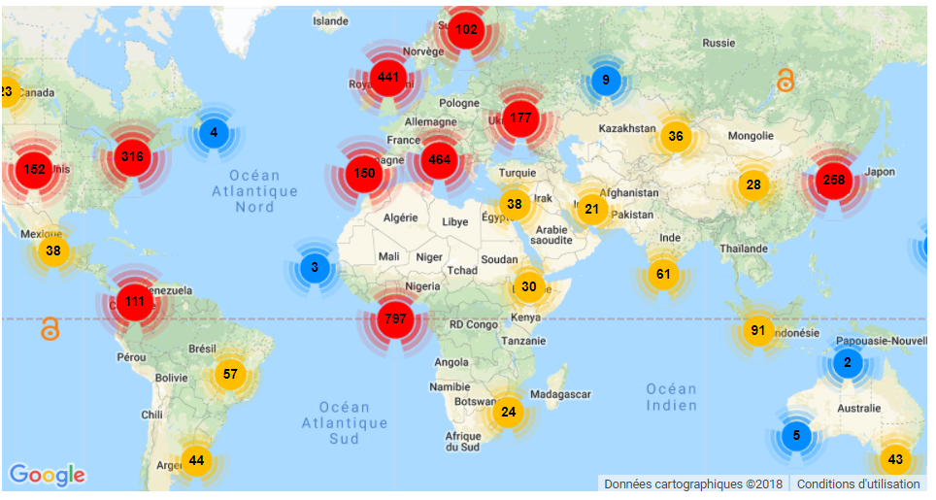

Slide 36
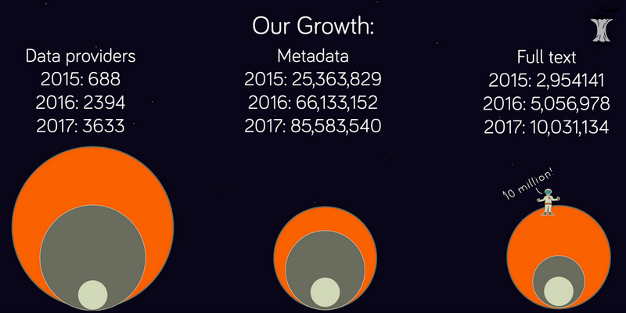
But searches on CORE may be very sloooowww…
and results surprising…

Slide 37
CORE
CORE Recommender: provides research article recommendations across the global network of repositories and journals (Knoth et al, 2017)
Not only on CORE:
The plugin that can be installed in repositories and journal systems to suggest similar articles.
Purpose is to support users in finding articles relevant to what they read.
The current version of the plugin recommends full-text items in Open Access repositories that are related to:
a metadata record
a full-text item in pdf
any piece of text
any combination of the above
Currently not on the roadmap for ORBi2

Slide 38
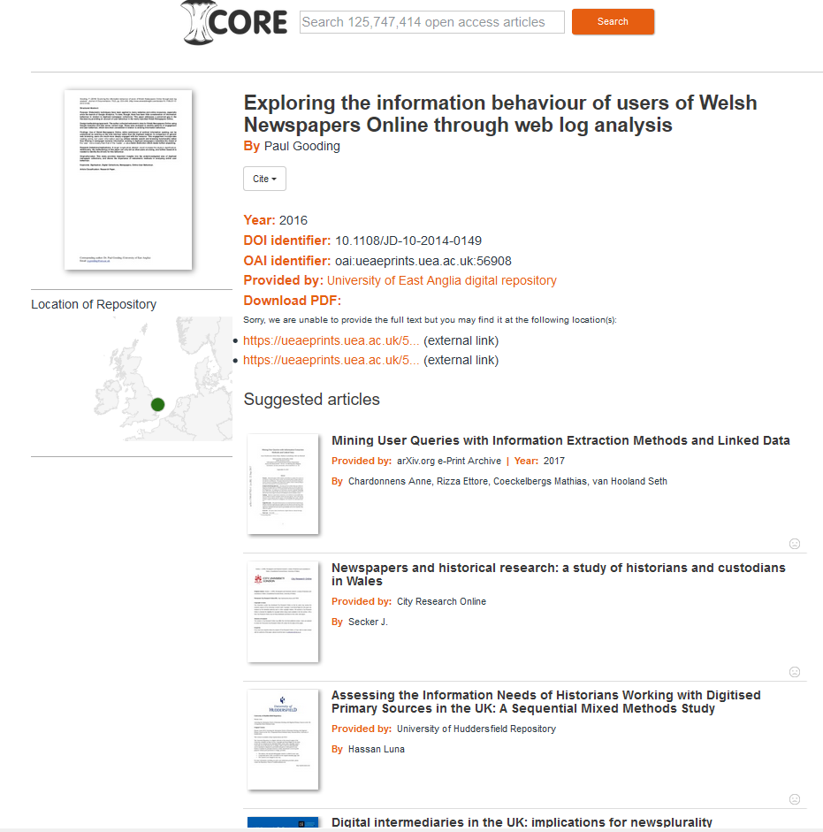

Slide 39
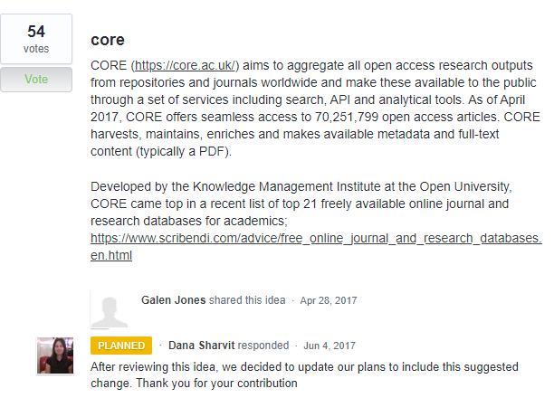
CORE
CORE is on the roadmap to be added to Primo Central Index and Summon
https://ideas.exlibrisgroup.com/forums/574345-content/suggestions/19079788-core

Slide 40
Agenda
ULiège experience with:
Google Scholar
Primo Central Index
Summon
Ebsco Discovery Service
CORE
BASE
PubMed LinkOut
Some tips and tools

Slide 41
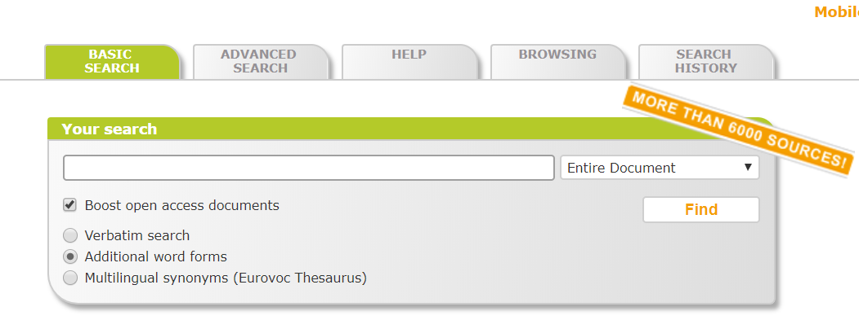
BASE
BASE (Bielefeld Academic Search Engine)
one of the leading global aggregator of open access content (journals, subject and institutional repositories) in the world.
claims to be the 2nd biggest academic search engine behind Google Scholar by size easily exceeding over 123 million records and indexing over 6,100 sources.
Boost option for OA records
Has been indexed in EDS since Dec. 2015 → if your IR contents are indexed properly in BASE, libraries using EDS who turn on BASE in EDS will expose your content to their users ☺
(Tay, 2018)

Slide 42
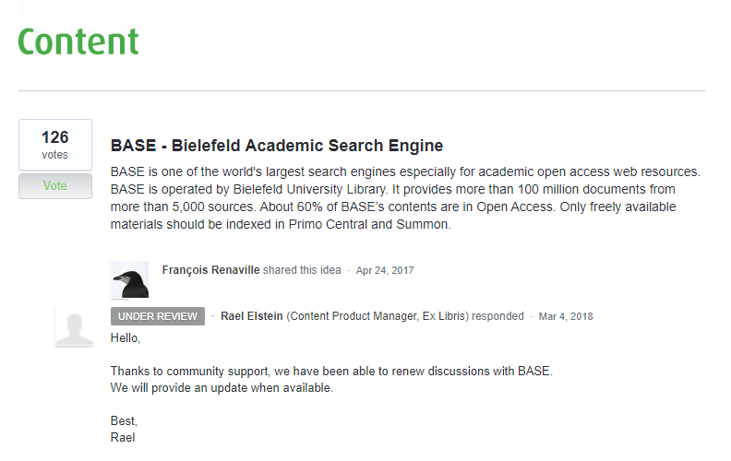
BASE
Note that BASE is also requested by the Summon and Primo Central Index community
https://ideas.exlibrisgroup.com/forums/574345-content/suggestions/19027240-base-bielefeld-academic-search-engine

Slide 43
BASE: ORBi
ORBi was added to BASE in 2008
Recent full reload of ORBi records
https://www.base-search.net/Search/Results?q=dccoll:ftorbi&refid=dctableen

Slide 44
Agenda
ULiège experience with:
Google Scholar
Primo Central Index
Summon
Ebsco Discovery Service
CORE
BASE
PubMed LinkOut
Some tips and tools

Slide 45
PubMed LinkOut
LinkOut is a service that allows you to link directly from PubMed and other NCBI databases to a wide range of information and services beyond the NCBI systems.
LinkOut aims to facilitate access to relevant online resources in order to extend, clarify, and supplement information found in NCBI databases. Examples of LinkOut Resources include full-text publications, biological databases, consumer health information, research tools, and more.
How do Institutional Repositories(IR) join LinkOut? https://www.ncbi.nlm.nih.gov/projects/linkout/doc/IR-application.shtml
Currently only 26 IRs participating in LinkOut https://www.ncbi.nlm.nih.gov/projects/linkout/journals/htmllists.cgi?type_id=16#institutional&20repository

Slide 46
PubMed LinkOut
ORBi was added to LinkOut in May 2017

Slide 47
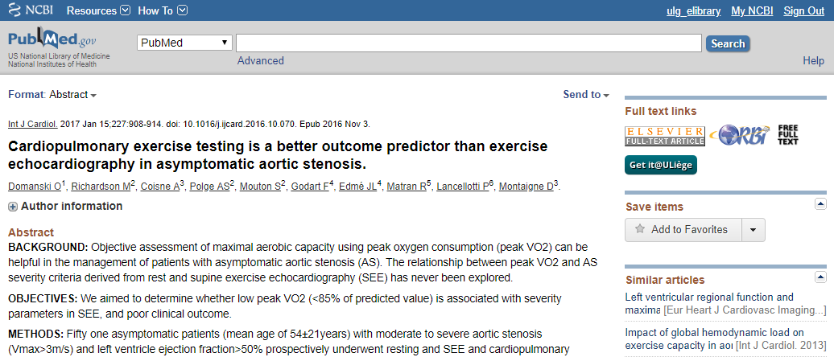
https://www.ncbi.nlm.nih.gov/pubmed/27916346
Direct Access to the Open Access ORBi record

Slide 48
Agenda
ULiège experience with:
Google Scholar
Primo Central Index
Summon
Ebsco Discovery Service
CORE
BASE
PubMed LinkOut
Some tips and tools

Slide 49
Starting blocks
Be proactive and monitor the harvesters, search engines and discovery tools
The big ones, but not only
The new ones (stay tuned!)
The one you use and do not use:
Objective: Pushing your OA content into the search environments of other researchers
Have a list of harvesters… and update it (ULIège Library has a 26 page document with admin data, repositories we are in contact with, update notes…)
Time consuming, but important!
Follow standards (there are many) and be inspired (ODI…)
Some harvesters may have some specific requirements,
Be ready to adapt, but never forget the KISS principle!
Have some harvesting sets ready to be used
All records vs records with full text vs OA records
By discipline, by document type ?

Slide 50
Open Discovery Initiative (ODI)
A technical recommendation for data exchange including data formats, method of delivery, usage reporting, frequency of updates and rights of use
A way for libraries to assess content providers’ participation in discovery services
A model by which content providers work with discovery service vendors via fair and unbiased indexing and linking
Recommendations: Open Discovery Initiative: Promoting Transparency in Discovery, NISO RP-19-2014 http://www.niso.org/publications/rp/rp-19-2014
Section 3.3.1: “Discovery service providers should make available to prospective and current customers sufficient information about the content of their repositories to ensure an adequate evaluation of that content against the customers’ needs.”

Slide 51
Open Discovery Initiative (ODI)
Definition of Core metadata:
minimum metadata record that must be provided by Content Providers (CPs) to Discovery Service Providers (DSPs)
based on the KBART (NISO RP-9-2014) metadata encoding schema:
primarily for serial and monograph titles to improve A-Z lists, link resolution, and OpenURL, but
extended to capture elements for subject, abstract/description, content type, and content format
Examples:
Open Access Designation
To comply with the NISO Open Access Metadata and Indicators (OAMI) group’s recommendations, if an item is open access, this status should be indicated with “free_to_read”.
Full Text Flag
A yes/no statement describing whether the content provider makes this item available in full text (or for non-print media, a full-length or high-resolution version) to the DSP for the purpose of indexing. It is expected that this will be disclosed by DSPs to libraries in future when describing indexing coverage for a title or collection.

Slide 52
Some best practices
BASE has published Golden Rules for Repository Managers https://www.base-search.net/about/en/faq_oai.php focusing on structure, encoding, ISO standards…
OAI interface working
Comprehensive metadata
Identifier (URLs) working
Providing access information (Open Access)
Providing information concerning re-use / licence (Creative Commons)
Character encoding
Publication date
Document language
Source / Suggested citation
Items per page
Contact person
Changes / Updates
Spread the word!

Slide 53
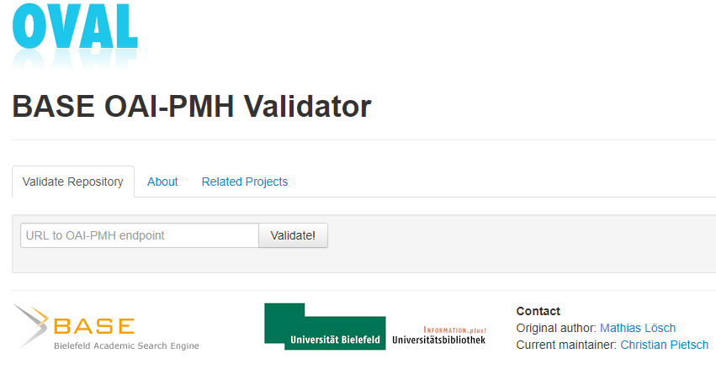
Some best practices
and an OAI-PMH validator OVAL http://oval.base-search.net/
See also http://validator.oaipmh.com

Slide 54
References
Chalono, D., & Thirion, P. (2017, August 09). ORBi : an institutional repository to promote Open Access. Paper presented at World Humanities Conference 2017 - Humanities and knowledge as a public good, Liège, Belgium. http://hdl.handle.net/2268/213502
Ebsco. EDS - Catalogs and Institutional Repositories Guide https://help.ebsco.com/interfaces/EBSCO_Discovery_Service/EDS_Catalogs_IRs
Ex Libris. Primo 2018 Roadmap Highlights https://knowledge.exlibrisgroup.com/@api/deki/files/60464/Primo_2018_Roadmap_Highlights.pdf?revision=2
Ex Libris. Primo Central Index http://www.exlibrisgroup.com/category/PrimoCentral
Ex Libris. Summon: Open Access Filter https://knowledge.exlibrisgroup.com/Summon/Product_Documentation/Summon%3A_Open_Access_Filter
NISO. (2014, June 25). Open Discovery Initiative: Promoting Transparency in Discovery. NISO RP-19-2014. Baltimore, MD: National Information Standards Organization. http://www.niso.org/publications/rp/rp-19-2014
Knoth, P., Anastasiou, L., Charalampous, A., Cancellieri, M., Pearce, S., Pontika, N., & Bayer, V. (2017). Towards effective research recommender systems for repositories. Paper presented at Open Repositories 2017, Brisbane, Australia. https://arxiv.org/abs/1705.00578
Neuwirth, E., Stohn, C. (2017). Discovery and Beyond: Leveraging Content and Big Data Analytics for Better Discovery. Paper presented at IGeLU 2017 Conference, St Petersburg, Russia. https://knowledge.exlibrisgroup.com/@api/deki/files/58325/IGeLU_2017_-_Leveraging_Content_and_Big_Data_Analytics_for_Better_Discovery_-_Christine_Stohn_Eddie_Neuwirth.pdf?revision=1
Pietsch, C. (2018, January 31). All about that BASE. Paper presented at PIDapalooza 2018, Girona, Spain. https://doi.org/10.6084/m9.figshare.5831619.v3
Pochet, B. (2017, October 25). PoPuPS, portail de publication de périodiques scientifiques. Paper presented at L'Open Access à Liège: où en est-on? Liège, Belgium. http://hdl.handle.net/2268/216256
Renaville, F. (2016). Open Access and Discovery Tools: How do Primo Libraries Manage Green Open Access Collections? In K. J., Varnum (Ed.), Exploring Discovery: The Front Door to Your Library's Licensed and Digitized Content (pp. 233-256). Chicago, IL: ALA Editions. http://hdl.handle.net/2268/185329
Tay, Aaron (2018). Enhancing the discovery of institutional repository contents - 6 sources to consider. Musings about librarianship, http://musingsaboutlibrarianship.blogspot.be/2018/03/enhancing-discovery-of-institutional.html
Varnum, K. J. (2017). A brief history of the Open Discovery Initiative. Learned Publishing, 30: 45–48. https://doi.org/10.1002/leap.1078

Slide 55

http://hdl.handle.net/2268/221340

