Slide 1
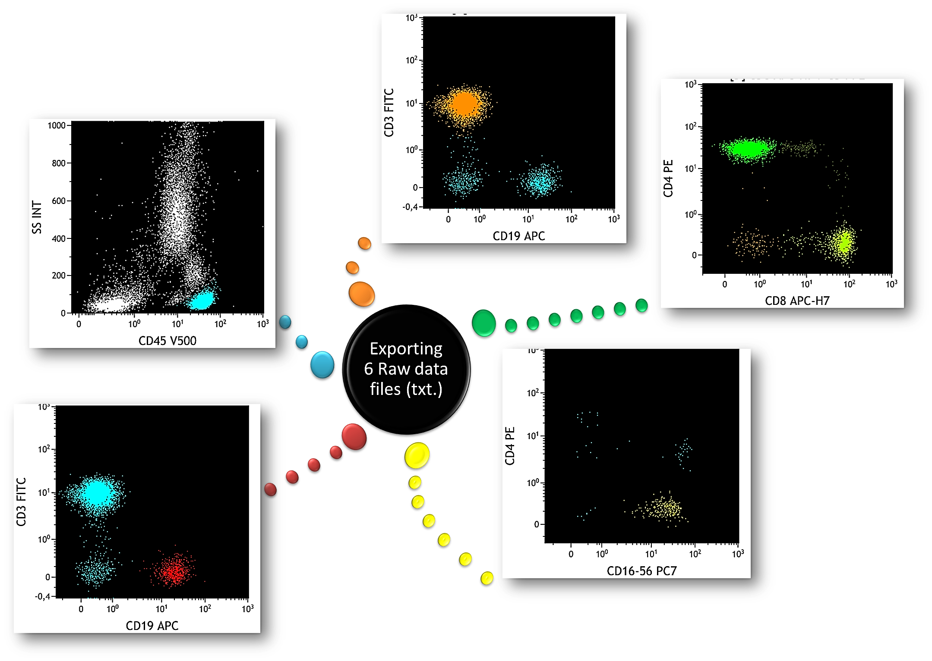
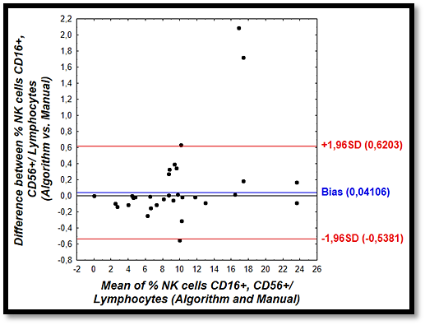
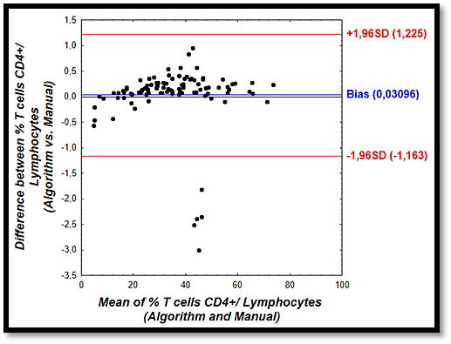
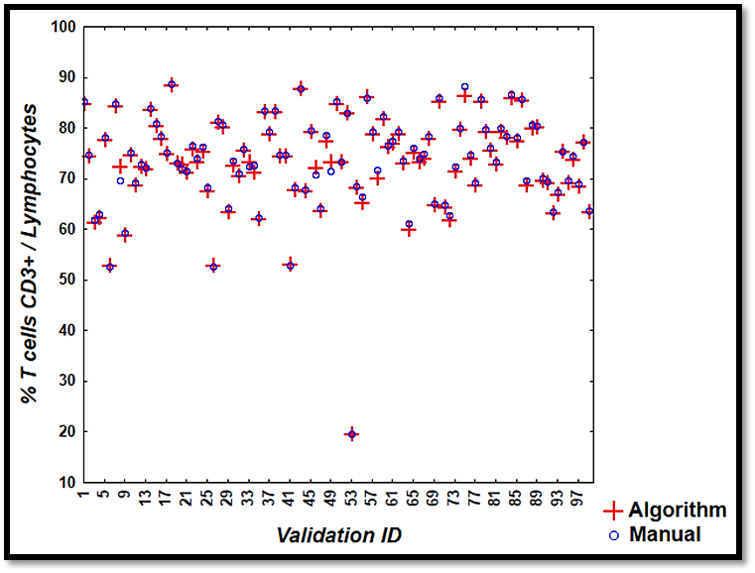
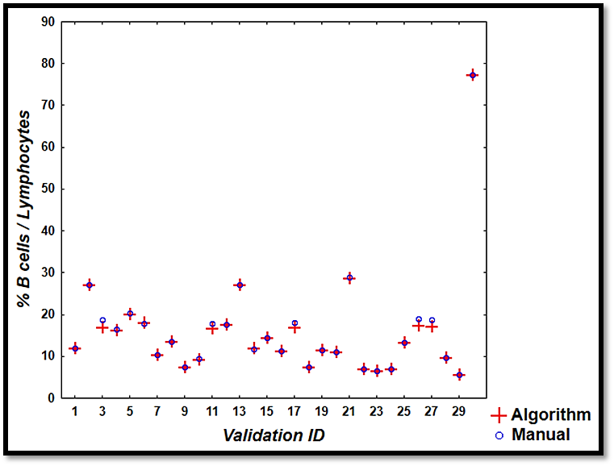
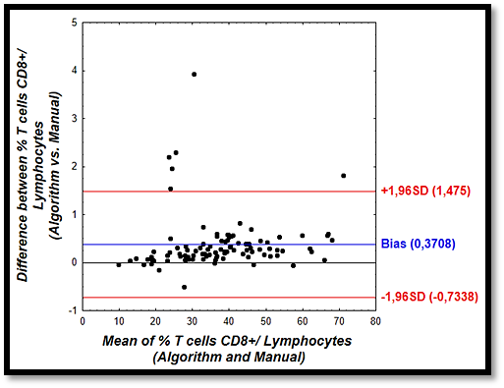
Introduction
Purpose
Treenet construction
Discriminating cell populations by flow cytometry has always been carried out by visual inspection of plots.
Replace human gating by a classification algorithm for flow cytometric data analysis.
Methods
We used an association of SSC, FSC, CD3 FITC, CD4 PE, CD8 APC-H7, CD16-56 PE-Cy7, CD19 APC and CD45 V500 antibodies.
Manual gating is still considered a gold standard in cell population recognition, although it is yet being considered as subjective and time-consuming, demonstrating the need for different approaches.
Objective
T, B and NK cell populations
Here, we aim to fully automate clustering workflow as an alternative to manual gating in a T, B, NK-cell panel within a comparative cohort.
After manual gating, raw data was extracted for each cell population comprised in an FCS. file with Infinicyt and stored in txt. format comprising a cell subset identifier
(0 or 1).
Recently, with the availability of powerful data processors, clustering techniques may be developed to provide an automated way of cell population identification in flow cytometric data, which could outperform human analysis.
Goal
Automatically assign individual cell events to a defined cell population based on previous supervised learning procedure.
The workflow to learn the clustering algorithm was constructed based on 500 sample computations representing 11 million events. Combined with Statistica supporting multi-core computations, a TreeNet Gradient Boosting algorithm was generated and to objectively evaluate clustering performance, a validation procedure
was integrated and composed of 100 new
samples.
What you need ?
TreeNet data mining tool
Flow cytometry software
Label
CD19+ vs. NOT CD19+
Flow Cytometry
Gating Design
CD4+ vs. NOT CD4+
CD16,CD56+ vs. NOT (CD16,CD56+)
CD8+ vs. NOT CD8+
Lymphocytes vs. NOT Lymphocytes
CD3+ vs. NOT CD3+
Identifier «NOT» = 0
Identifier «NOT (NOT) »= 1
File Template
Example:
Automatic clustering of cell populations
characterized by immunophenotyping
6 cells
CD4+
6 cells
NOT CD4+
Christian Gosset¹, Jacques Foguenne², Mickael Simul², Aurore Keutgens²,
Françoise Tassin², André Gothot¹,²
¹ University of Liege
² Department of Laboratory Medicine, Unilab Lg, CHU Liege
Tree Net algorithm contruction
Validation
Bland-Altman
Graphical inspection
NK cells CD16+CD56+
Results
Correlation between manual and algorithmic gating showed a nearly perfect linear relationship
T cells CD4+
T cells CD3+
B cells CD19+
References
Correlation coefficient (r) of 0.9982, 0.9992, 0.9991, 0.9988, 0.9995 for CD3+, CD4+, CD8+, NK and B cell percentages respectively.
[1] Y. Saeys, S.V. Gassen, B.N. Lambrecht
T cells CD8+
Computational flow cytometry: helping to make sense of high-dimensional immunology data
Nat. Rev. Immunol., 16 (2016), pp. 449–462
Conclusion
[2] N. Aghaeepour, G. Finak, H. Hoos, T.R. Mosmann, R. Brinkman, R. Gottardo, R.H. Scheuermann, FlowCAP Consortium, DREAM Consortium
Critical assessment of automated flow cytometry data analysis techniques
Nat. Methods, 10 (2013), pp. 228–238
Furthermore, the differences between manual and algorithmic gating represented on Band-Altman plots displayed excellent agreement. Indeed, CD3+, CD4+, CD8+, NK and B cell percentages showed a bias of 0.34, 0.03, 0.37, 0.04 and 0.07 respectively.
The study suggests a promising tool for automated gating, allowing for more objectivity and standardization than manual gating. The reliability of automated gating should now be assessed on cell fractions with complex and/or abnormal phenotypes.
What ’s next ?
[3] F. Mair, F.J. Hartmann, D. Mrdjen, V. Tosevski, C. Krieg, B. Becher
The end of gating? An introduction to automated analysis of high dimensional cytometry data
Eur. J. Immunol., 46 (2015), pp. 34–43
Out of range samples are stabilised blood controls
Assessing complex populations and or abnormal phentypes
Automatic clusters in identifying pathologies
BHS 32nd General Annual Meeting
10-11 February 2017

