Slide 1


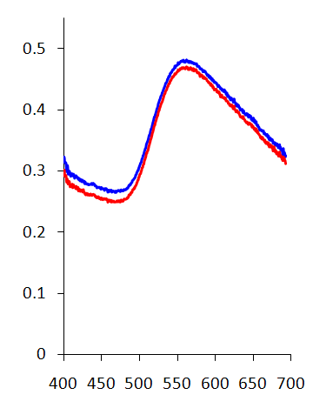
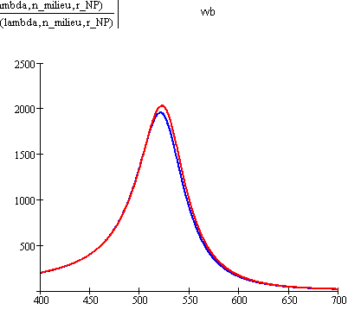

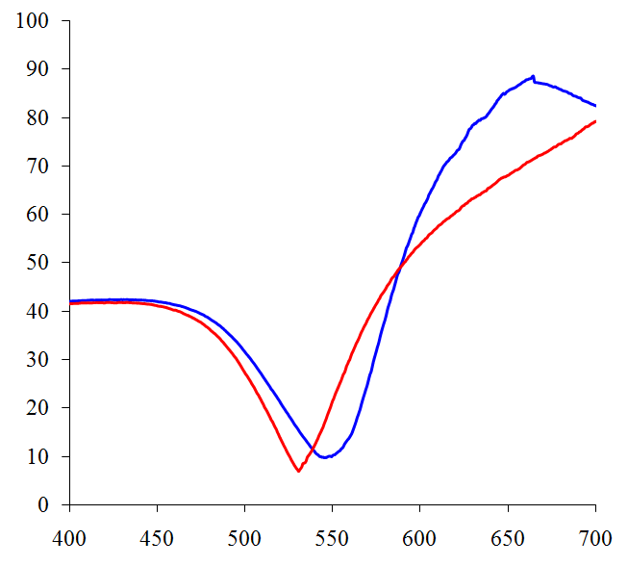
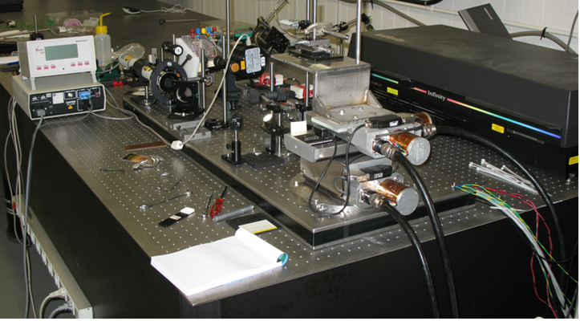
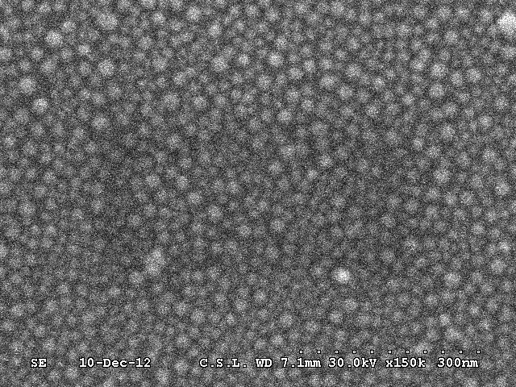
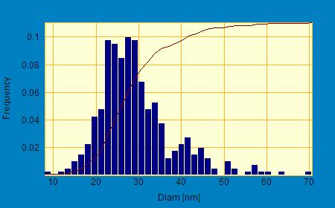
Hybrid plasmonic multichannel spectroscopic sensor platform
J. Hastanin, C. Lenaerts, P. Gailly and K. Fleury-Frenette
Abstract: we present a hybrid plasmonic sensor concept, as well as the first proof-of-concept experimental investigations, demonstrating its practical feasibility. The proposed approach gives access to two detection formats on the same lab-on-chip device: surface plasmon resonance (SPR) and localized surface plasmon resonance (LSPR) biosensing . The developed instrumental platform is dedicated to multichannel biosensing. In order to implement the proposed sensing approach, we developed a specific microfabrication technique involving gold nanoparticles (Au_NPs) synthesis by pulsed laser writing followed by annealing. This technology provides powerful tools for flexible patterning of the microfluidic sensor chips with array of different SPR and LSPR probes.
The optical properties of synthesized NPs have been investigated using specially developed equipment involving total internal reflectance ellipsometric spectroscopy (TIR_ES). We experimentally demonstrate that the use of the TIR-based optical readout can significantly enhance the LSPR sensor sensibility to refraction index variations of the liquid sample.
3.3. LSPR spectra measured for different liquid samples:
NPs free space excitation via propagating wave:
Transmission and extinction spectra for two test liquids :
Experiment
n_{D} = 1.332
n_{D} =1.3469
δλ~2 nm
Theory (Mie)
δλ~2 nm
1. What is our instrumental concept?
Normalized absorption
Extinction coefficient
Two detection formats on the same lab-on-chip device: SPR & LSPR
LSPR detection spots locally synthesized using laser direct writing
LSPR detection in Total Internal Reflectance (TIR) mode
Microfluidic channels
Plasmonic detection spots (SPR / LSPR)
Wavelength, nm
Wavelength, nm
Inlet
Refractive index sensitivity of LSPR sensor ~ 90 nm/RIU
Polychromatic readout light beam
Experiment in good agreement with theory
Multichannel fiber spectrometer
NPs excitation via evanescent optical field in Total Internal Reflectance (TIR):
One biosensor channel = SPR / LSPR sensor + Fiber Spectroscopic channel
Ellipsometric angle Ψ, °
Ellipsometric data acquired at a fixed incidence angle of 73°
2. What is the goal of our instrumental approach?
Since different detection formats are combined in the same sensor chip
δλ~16 nm
    Large amount of information on the liquid sample
    High degree of miniaturization for the plasmonic multichannel sensor
    Relative simplicity of fabrication in large bi-dimensional array of LSPR sensors adapted to microfluidic system architecture
3. First proof-of-concept experimental investigations
Wavelength, nm
3.1. Experimental set-up for Au_NPs local synthesis
Optical focusing system
Laser
The wavelength interrogation in TIR mode is very promising alternative to enhance the LSPR biosensing sensitivity
XYZ translation stage
  Additional advantages: the wavelength spectrum is not perturbed by light reflection/refraction at the inner walls of the microfluidic channel and in the liquid sample
4. First sketch of the sensor design
3.2. Laser synthesized NPs properties:
SPR / LSPR sensor spots
Microfluidic sensor chip
Monitored wavelength spectra
SEM image
NPs size distribution
Collimators
Intensity
Index changes
Optical coupler (embossed micro-prisms, … )
Wavelength
Polychromatic TM-polarized light wave source (s)
Multichannel Fiber Spectroscope
Fine metrology involving SEM & AFM reveals:
High reproducibility of the NPs shape and density
NPs typical size ~30 nm, max range : 10-70 nm
Conclusion:
Concept of the biochemical hybrid multichannel sensing platform is under development;
Bio-sensing involving LSPR_TIR detection format is proposed and experimentally investigated
First experimental results are obtained : an enhanced sensitivity of LSPR_TIR sensing in comparison to LSPR in transmission mode is experimentally demonstrated
Extinction cross section ≈ Absorption cross section
!
The most appropriate format for LSPR sensor interrogation:
Specular light intensity monitoring
ACKNOWLEDGEMENTS: This research is conducted in the framework of the “BIOSENS" project (SMARTBIOCONTROL portfolio) in the INTERREG program involving financial support from the European Union and the Walloon region.
Centre Spatial de Liège (ULiège) / Surface Micro & Nano Engineering
Liège Science Park, Avenue du Pré-Aily; B-4031 ANGLEUR (Belgium), Tél: +32.4.382.46.00; Fax: +32.4.367.56.13; e-mail: kfleury@ulg.ac.be ; http://www.csl.uliege.be

