Slide 1
Social Sciences and Humanities: what roles in innovation?
Prospective thoughts
Björn-Olav Dozo – ULiège
bo.dozo@uliege.be

Slide 2
A word on myself
Liège University (Belgium)
PhD in Belgian literature, with a sociostatistical point of view : Humanities and Social Sciences
Actual fields of research
Digital Humanities
+
Popular Cultures
➔ Digital Culture, especially Video Games
Notes:
Hello. My name is Björn-Olav Dozo and I am a researcher from the University of Liège. I hope my input will be useful for you. I’ve got a Phd in literature. I used in it sociostatistical methods to study literary life : so I’ve crossed different perspectives in Humanities and Social Sciences. My actual fields of research are the digital humanities and the popular culture. I focus especially on videogames and digital culture.

Slide 3
A small model to understand innovation
Words to share a point of view
Notes:
Before we start talking about innovation, I would like to define some words, to propose a small model just to be sure of what we are talking about.

Slide 4
3 kinds of research
Research
Fundamental research
Disciplinary research
Development
Applied research
Interdisciplinary research
Innovation
Problem focused / Market horizon
Antidisciplinary ?
Notes:
I think we can divide research in three main components : fundamental research, mostly focused on disciplinary perspective ; development, or applied research, to develop ideas out of the theoretical point of view, to produce proof of concept, etc. This kind of research is already more interdisciplinary ; and innovation, which is focused on solve problem, with a market horizon. We maybe can qualify this research of antidisciplinary.

Slide 5
Innovation
Each one comes with his own background to solve a problem
Ex. :
Architects
Robotics
Care
Problem :
ageing population
Sociology of organisations
Transports
Entertainment
Psychology of family
Necessary quality : open-mindedness
Notes:
Here is a example of challenge of our time : the ageing of population. To develop multiple solutions to this problem, we need competences from everywhere, and above all, we need researchers who talk to each other, who can be understood and who can understand. One obvious quality to do so is open-mindedness

Slide 6
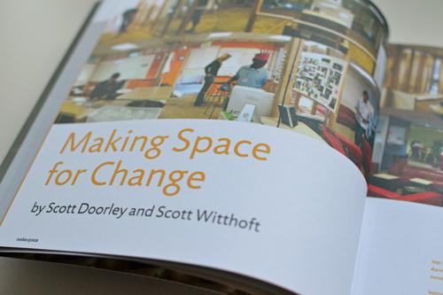
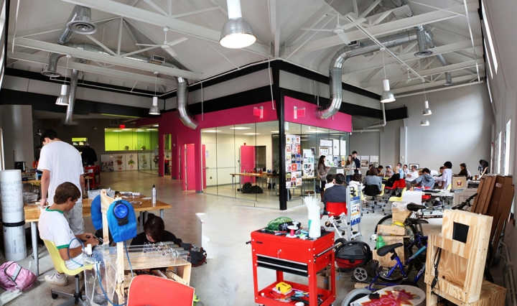
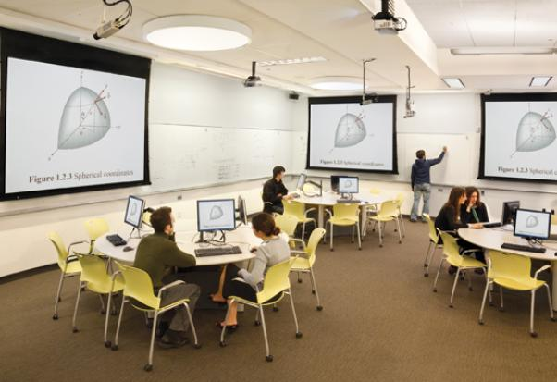
Challenges : to find
Physical locations that allow such crossings and mixings
Notes:
To succeed such challenges, we need three kind of resources : physical locations that allows crossing and mixings

Slide 7
Notes:
For example, this book is very interesting in this kind of perspective, because it suggests a lot a thoughts about make people talk to each other, exchange, and collaborate, with a vision of the space that promote this goal.

Slide 8
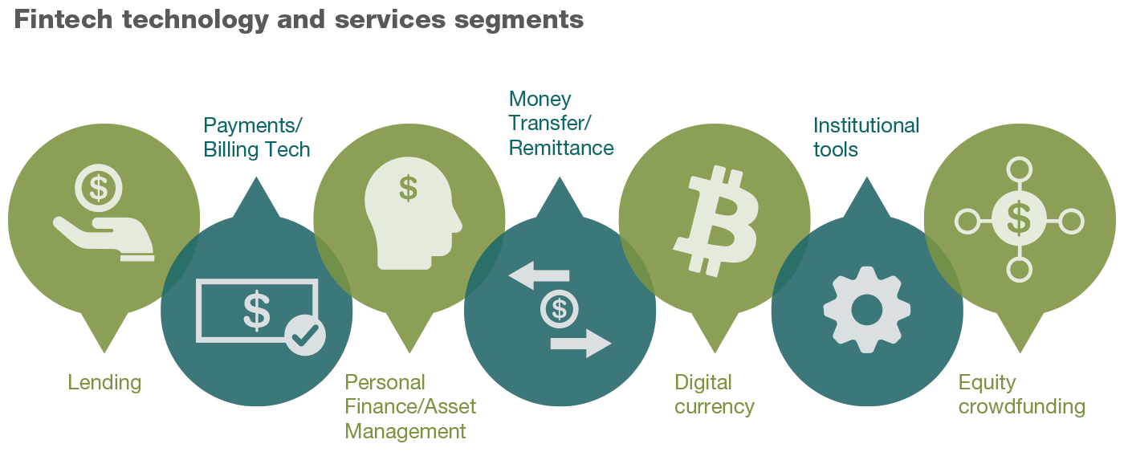
Challenges : to find
Financing tools that encourage problem-driven approaches
Notes:
A second resource, which can be obvious, is money. But not only money : different tools to agile and sustainable projects. Not big money at the beginning and nothing after, but financial tools that follow the growing of the project, with different sources (fundamental research agencies, development agencies, innovation agencies). Innovation could be in financial tools too.

Slide 9
Challenges : to find
People that are motivated to be out of their comfort zone in interaction with others
Notes:
The most important thing is to find people who wants to collaborate. Going out their comfort zone, interact with others, discuss and find a solution together.

Slide 10
Roles of Social Sciences and humanities
Why, what and how
Notes:
So, what’s my views on the role of social sciences and humanities in innovation?

Slide 11
How SSH can be used in innovation
Reflexivity
Management
Document / discourses specialists
Human being focus ➔ users and uses
Notes:
I will structure this part of the speech in four slides : reflexivity, management, discourses and users

Slide 12
1. Reflexivity
Baseline of SSH
Self-criticism
What are the implications of an innovation?
➔ In a collective work, give perspectives on the project
This is the WHY
Reflexivity even on the concept of innovation. But it is not the point…
Notes:
Reflexivity is the baseline of SSH. When I talked about this speech to colleagues, they insist on the role of questioning the purpose of innovation. They insist on self-criticism about innovation, to think about the implications of an innovation. To be disruptive is perhaps cool to earn millions, but there always is a social impact of innovation. And taking account of this impact is crucial to prevent abuses and to help people to accommodate with the innovation. So thinking about the implications at the start of the process seems to be important.
But it is not only about criticism : in a collective work, it gives perspectives on the why of the project. Why are we doing that ? To motivate people, finding the why is very important.

Slide 13
2. Management
Used to auxiliary sciences
Ex : literary studies = philology, text analysis, history of literature, paleography, textual genetics, etc.
Used to case studies, crossing approaches on an object
➔ Used to collaborations between disciplines
This is the HOW
Notes:
The motivation is the key of management, as we’ve seen it. But it is not all : you have to find ways to make people collaborate. And humanities and social sciences have a kind of expertise on that. They used to collaborate between disciplines. Take the case of literary studies : it is a object-focused discipline. When you study a text, you need a lot of auxiliary sciences : how the text has been redacted (you need textual genetics), how the text was spread (you need reception inquiries), how it was preserve through ages (you need codicology, the science of manuscripts), and so on. So SSH researchers can easily work in team with researchers from other disciplines.

Slide 14
3. Discourses
Humanities deal with documents
In different languages
From different locations
From different times
Production of documents and discourses are the core business of humanities : storytelling, argumentation, speeches to publicize research between researchers and beyond
This is one of the WHAT
Notes:
But what can add SSH researchers to innovation? Let’s begin with humanities. They deal with documents, it is their core business. Documents in different languages, from different times, from different locations. They are interested in the context of production and reception of texts, and in how texts and discourses work. They can analyse and produce texts of different kinds, argumentative or persuasive texts, but also narrative texts (whatever is the text : images, video, videogames, everything could be a text or a discourse). They are able of produce and deconstruct storytelling, and can communicate about a project. They are language specialists, with the deepness of history.

Slide 15
4. Users and uses
Social sciences place human behaviour (alone or together) in their focal point
Without focus on human and his uses, technology is meaningless
This is one of the WHAT
Notes:
Social sciences researchers work on human behaviour. Human being as a isolated body, like psychologists, and in society, like sociologists. In a perspective of innovation, not consider humans, at least as users of the innovation, is a mistake. The uses of technology are, for me, the core of innovation in the technology field.

Slide 16
Innovation = process
From idea to market
Where in the process could SSH be relevant ?
My position : everywhere
And if it is possible, since the beginning.

Slide 17
Some Examples

Slide 18
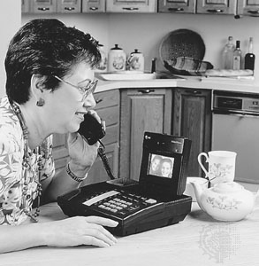
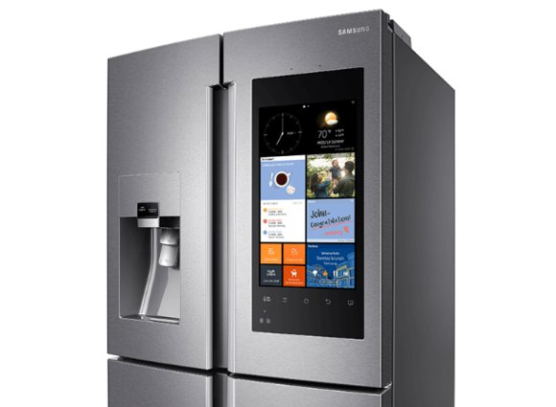
Examples of failures
Videophones
Smart fridges
Notes:
Because without consider users and what they do, it will not work. Here are some examples of failures, or deceptions, about technology.
Videophones should have been the dead of telephones. In the nineties, commercials show people replacing phones by videophones. But this vision forget that when we speak, sometimes, we can do a lot of other things. And sometimes we don’t want that people see what we are doing.
Other example : smart fridges. I’ve heard about smart fridges since ten years, even more. But nobody has one. Technically, the thing work. But it adds difficulties to your life instead of helping you.

Slide 19
Examples of failures
3D televisions
E-readers
Notes:
This year, the production of 3D televisions has been cancelled. The technology is fine. But watchers, even if they bought one, don’t use it. Because the product comes with a lot of limitations : first of them, the glasses.
Last example of failures, the ereaders. I’ve bought one (the first one) in 2007, in New York, a Sony. For 10 years, the industry of print was very concerned by this innovation. But after all, statistics show that only big readers of print books use ereaders. It is only a niche market.
A good book about these failures is the one of Nicolas Nova, “Les flops technologiques”. Understanding failures to innovate.

Slide 20
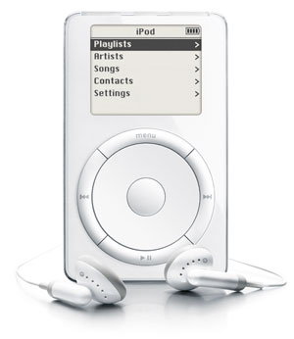
Tech examples of success
= success thanks to the design
In competition with
Success thanks to the community =
Notes:
Now three examples of success. These three cases, in my opinion, succeed thanks to other properties than their tech qualities. The first Ipod was a success in design, Tesla sell images and symbols, they sell good storytelling to its community : they are the brand which can make the industry shift to electricity, even if the most sold electric car is the Nissan Leaf…

Slide 21
Not the tech which does the difference
VS.
VS.
Winner
Gameplay
Fictional characters
Community
Why ?
Notes:
Last example : in the nineties, in Occident, there were three main portable videogame consoles. It is the more low tech which wins : because of its games and their gameplay, because of the fictional characters of its games and because of the community. The others (Sega Game Gear and Atari Lynx) disappear quickly.

Slide 22
Sooner would have been better…
Big data
Notes:
A word on big data is not the easy answer to cultural challenges : when some researchers published the analysis of millions digitized books thanks to Google, after the buzz, a lot of humanities researchers explain that there were a lot of limitations in this study (on the constitution of the corpus particularly), and that if humanities methods have been consider while the research was done, the results would have been better.
So don’t hesitate to implicate SSH researchers at the beginning…
https://en.wikipedia.org/wiki/Culturomics for the critics

Slide 23
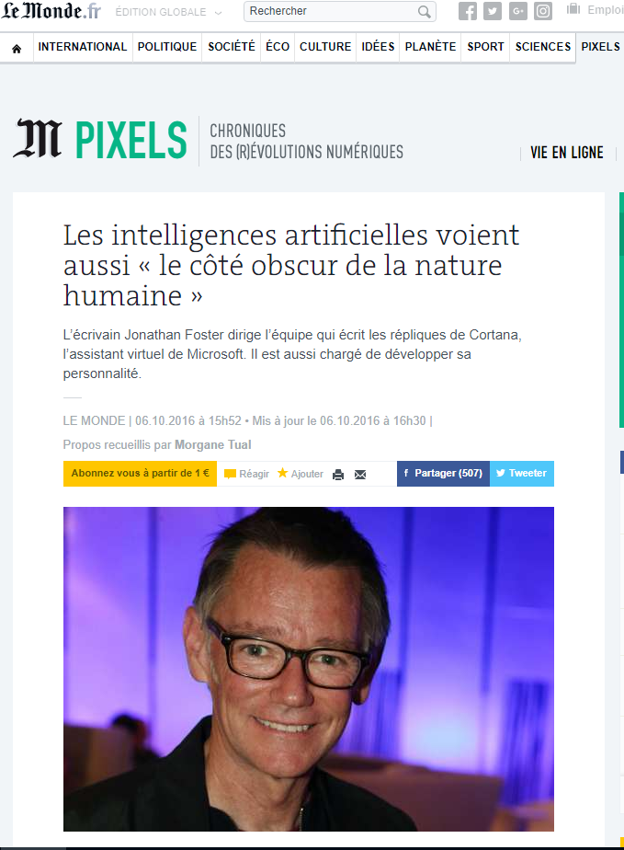
AI
Notes:
AI needs also SSH researchers. A brief example : it is a writer (Jonathan Foster) who leads a team of researchers who write what Cortana, the virtual assistant of Microsoft, says. And it implies a lot of balance and very different knowledge.

Slide 24
One of our challenges in U.Liège
Notes:
A brief focus on one of our challenges in Liège

Slide 25
Challenge in teaching
More students
Less financial resources ➔ less teachers
Imagine how the digital can help
Notes:
We have more students each year but our resources decrease. So we try to imagine how the digital can help

Slide 26
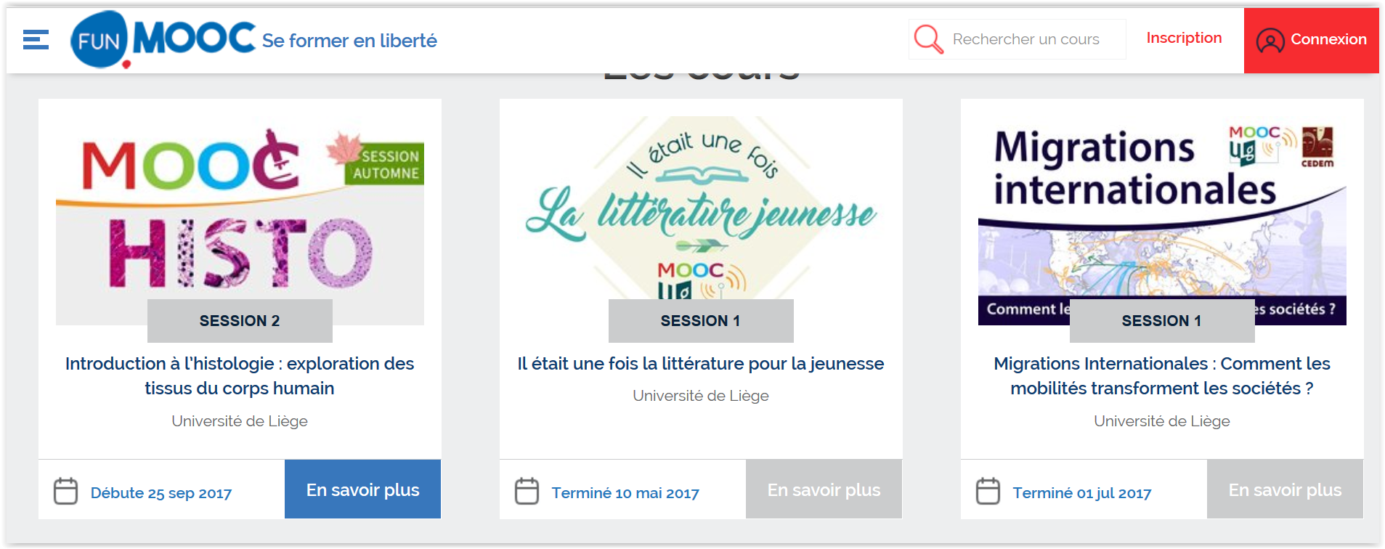
First results
25.000
registered
935
students ULiège
3200 certifications
Completion rate 12,8%
6.000
13,5%
13.000
14,2%
6.500
10,5%
450
800
250
1.800
235
600
Notes:
The first experience in MOOC, last year, was in this way : with the ambition to free time for discussions and explanations between teachers and students, some courses were transformed in MOOCs. The students follow the MOOC, and the classroom became a place of exchange about what students learned online.
One of the difficulty was the cost of the production of good MOOCs. They can be reused some years, but the solution is possible only for big courses with many students.

Slide 27
Teaching with VR
Development of virtual environment to help teaching
Collaboration between 4 faculties
Notes:
Virtual reality is another option that we explore. We want to develop environment that could be used in different courses with minimal adaptations. It is a difficult challenge, but we are producing a first virtual environment (with the scan in 3D of a castle near Liège), which will be used in psychology to treat phobias and in architecture to observe the evolution in time of the building. It is really the beginning but we have great hopes to complete this challenge.

Slide 28
Thanks for your attention
bo.dozo@uliege.be
@bjornolav

