Slide 1
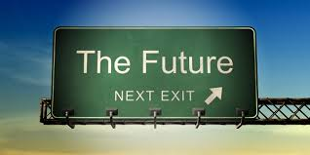


CALP3 University of Texas at Austin – February 2018
CONSTRUCTING FUTURITY:
A CONTRASTIVE APPROACH
TO L1 AND L2 DUTCH AND FRENCH
Paul Sambre¹, Julien Perrez², Pascale Van Keirsbilck¹, Cornelia Wermuth¹
University of Leuven¹
University of Liège²
Belgium
Notes:
Julien intro 1-11 4min
Paul theorie 12-19 4 min
Julien TIME 6 min
Paul MODALITY to END 6 min

Slide 2
Outline
Context
Objectives
Corpus
Framework
Descriptive typology
Conclusions
Notes:
Ladies and gentlemen, here’s the outline of my talk.

Slide 3
Outline
Context
Objectives
Corpus
Framework
Descriptive typology
Conclusions

Slide 4
1. Context – relevance of future for cogling
Conceptual relevance TIME
Cognition: projecting/planning the future is human capacity
(Schacter & Addis 2007, Ferretti & Cosentino 2011, Klein 2013, Georgakopoulou 2001)
Function: future orientation of social action
(Martin & Wodak 2003, Bell & Olick 1989, Scollon & Scollon 2000)
Semantics of future time is as complex as present/past
time, modality and aspect
(Dahl 2000, Fleischman 1982: 22, 153, Bybee et al. 1991, De Brabanter et al 2014)
Grammatical TENSE unexplored
Typology: future(less) languages
(Dahl 2000, Dahl &Vellupillai 2013)
DA: ideological features
(Dunmire 2011: 193)
CL: diachronic development
in ENG/GER
(Fleischman 1982, Hilpert 2008)
Romance languages and NL: future mainly taught as morphological marking (inflectional or periphrastic)
Notes:
Two short notes on the future
Dutch gaan zullen choice fo auxiliairy
Gaan e.g. not combine with modal verb

Slide 5
Outline
Context
Objectives: L2 FUT CxG
Corpus
Framework
Descriptive typology
Conclusions

Slide 6

2. Objectives: Unravel semantics of futurity
2.1 General objective: L2 FUT CxG
how improve use L2 language patterns of futurity
based on corpus analysis of L2 and L1 authentic language use
zooming in on constructional aspects
using a conceptual template for the future
2.2 Specific objectives
analyze constructions
which Dutch/French L2 cx for future talk?
what relation between L2 and L1 Cx and vice versa?
teach constructions better / differently
guidelines improvement of L2 Cx teaching

Slide 7
Outline
Context
Objectives
Corpus: L2-L1 interviews
Framework
Descriptive typology
Conclusions

Slide 8

3. Corpus Future talk
previous work (Sambre)
on written L1 ITalian corpora
on elicited spoken Italian L1 and L2
Today: exploratory study on elicited spoken NL and FR
sample: Belgian BA2 students
10 interviews: 5 students * 2 NL-L2 and FR-L1 (Liège)
10 interviews: 5 students * 2 FR-L2 and NL-L1 (Leuven)
video recordings with face-to-face questions
about 10’ per interview/language
20 open questions about future
different conceptual entities for FUTure: V, N, Adj, Adv-satellite
answers: transcription and breakdown of
turns > intonation units > clauses > subclauses
Notes:
Will explain this later on

Slide 9
3. Corpus Future talk

Slide 10
3. Corpus Future talk

Slide 11
3. Corpus Future talk
    85% of FUT
    balanced for NL-FR

Slide 12
Outline
Context: dynamics
Objectives
Corpus
Framework:
conceptual epistemic CG model
structural variation
Descriptive typology
Conclusions

Slide 13
4. Framework: form-meaning pairings
4.1 Meaning: Epistemic time model
4.2 Form: Structural variation in epistemic model

Slide 14
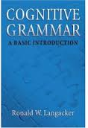
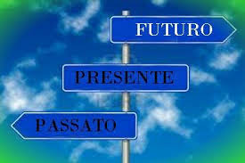
4.1 Meaning: epistemic time model
Metaphorically, we can picture reality as a “growing” cylinder, labeled current reality, it is the place where growth is occurring. Here matters are still in flux, whereas the past is fixed and the future is free to take whatever form it might. (Langacker 2008: 301)
CxG:
connect conceptual apparatus
with flexible
structural patterns:
Notes:
So then, let’s move to that future.

Slide 15
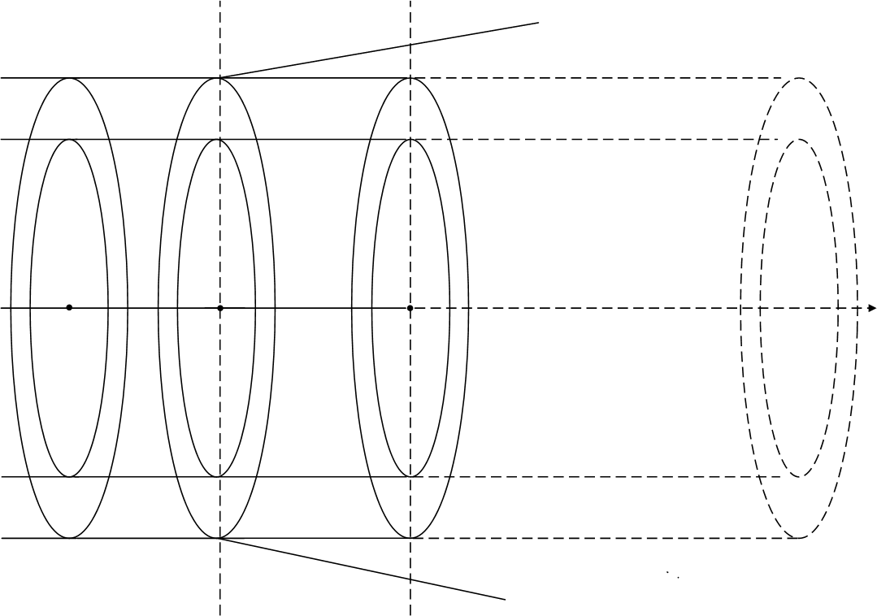
past
present
future
unknown
reality
known
conceived
current
projected
potential reality
non-reality: impossible and unknown
Notes:
Conceptualization sets up three time zones, represented on a horizontal axis CLICK : past, present and future.
Part of our reality is CLICK conceived of as real, since it belongs to our own and therefore CLICK known experience, but obviously, we cannot know and conceive of every aspect in the conceptual world, so there is a large portion of CLICK unknown reality. The known world is mapped on the time zones: the CLICK conceived past reality, CLICK current present reality (immediate or not), and then, the CLICK future, as a zone on which we may project the extension of present reality. Apart from realis, we dispose of modal variations on a “diagonal” axis: where we think of the world not in terms of reality but of CLICK potentiality, on the right side of the diagonal line, a potentiality which belongs to both present and future, and on the other side CLICK irrealis, the zone of the unreal, left of the diagonal and outside of the real and potential spheres. Note that fur the future non-reality contains both the impossible, as well what what we do yet not know, for we do not know what is going to happen in the future.

Slide 16
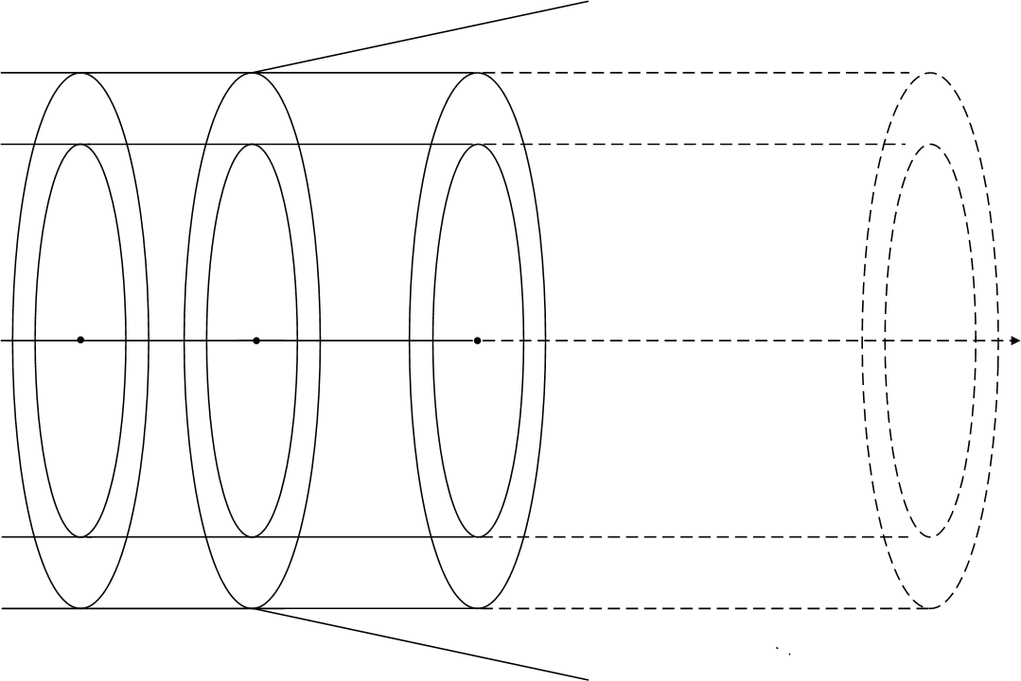
EVALUATIVE
future
TEMPORAL
neutral
past
present
close
remote
real
potential
source
unreal
MODAL
Notes:
Here’s the composite
Kubus toevoegen 3D representation

Slide 17
4 from conceptual meaning to form in L2-CxG:
towards operational analytical features
Meaning is functional, it integrates structural and semantic properties.
Constructions (rather than ‘rules’) are the primary objects of description.
Constructions are form-meaning pairings (‘assemblies of symbolic structures’).
Lexicon and grammar are not distinct components, but form a continuum of constructions.
Linguistic knowledge comprises vast numbers of constructions, a large proportion of which are ‘idiosyncratic’ in relation to ‘normal’, productive patterns.
Little attention devoted to structural variation in the description of tense
Limited attention to discourse in constructions
Sambre (2010: 3-4) following Langacker 2005, Lakoff 1987, Fillmore, Kay, O’Connor 1984: Harder 1996: 499)
n forms
including
tense,
lexicon,
morphosyntax
1 function
= future talk
grammatical constructicon
of future time

Slide 18
4.2 Form: structural variation within 3D model
4.2.1 Epistemic aspects
Time (pres, fut, cond)
Modality (real, pot, irr)
close / neutral / remote
4.2.2 Morphosyntax
V
N (the future)
Adj (future)
Adv
4.2.3 Evaluation
neutral
pos
neg
    Ben je onzeker om de arbeidsmarkt binnenkort te betreden of niet? Leg uit.
    Are you uncertain to enter the job market in the short run?
    Comment pourras-tu convaincre tes employeurs de tes atouts? Explique.
    How will you be able to convince your employers of your strengths?
Notes:
The conceptualization of the future takes places at the interplay of three major dimensions
GOOI EVA ER OVERAL UIT

Slide 19
4.2 Form: structural variation within 3D model
4.2.1 Epistemic aspects
Time
(tense: pres, fut, cond)
Modality (real, pot, irr)
close / neutral / remote
4.2.2 Morphosyntax
V
N (il futuro)
Adj (futuro)
Adv
    Ben je onzeker om de arbeidsmarkt binnenkort te betreden of niet? Leg uit.
    Are you uncertain to enter the job market in the short run?
    Comment pourras-tu convaincre tes employeurs de tes atouts? Explique.
    How will you be able to convince your employers of your strengths?
Notes:
The conceptualization of the future takes places at the interplay of three major dimensions

Slide 20
Outline
Context
Objectives
Corpus
Framework
Descriptive typology of “future” Cx
Conclusions

Slide 21
5. An exploratory classification of FUTURE Cx
5.1 Time
5.2 Modality
Three steps
a. Global
b. L1<>L2
c. FR/NL-L2<>NL/FR-L1

Slide 22
5.1 FUTURE Cx - TIME
5.1.1 F time
5.1.2 V tenses
5.1.3 FUT subtypes
5.1.4 Tense combinations
5.1.4 FUT N, Adj, Adv
    Future tense relevant
    But
    present much more salient
    Conditional part of future time
    NEW: Infinitive part of future

Slide 23
5.1 FUTURE Cx - TIME
5.1.1 F time
5.1.2 V tenses
5.1.3 FUT subtypes
5.1.4 Tense combinations
5.1.4 FUT N, Adj, Adv
    Future tense relevant
      At first sight balance
      periphrastic (GO) – inflectional
      (je vais travailler – ik ga werken)
      je travaillerai / ik zal werken)
      Cause: overuse of L1 Cx in L2
      NL2: inflectional
      FR2: periphrastic

Slide 24
5.1 FUTURE Cx - TIME
5.1.1 F time
5.1.2 V tenses
5.1.3 FUT subtypes
5.1.4 Tense combinations
5.1.4 FUT N, Adj, Adv
    Traditional teaching: FUT tense in isolation P000 = I will work
    We see frequent combinations
      P00I = pres + Inf
      I hope (now) to work (then)
      PF00 = present + fut
      I think that I will become x

Slide 25
5.1 FUTURE Cx - TIME
    Combinationations of tenses mentioned before more productive than
    Combinations of basic tense with non-verbal FUT marks
    To be explored…
5.1.1 F time
5.1.2 V tenses
5.1.3 FUT subtypes
5.1.4 Tense combinations
5.1.4 FUT N, Adj, Adv

Slide 26
5.1 FUTURE Cx - TIME
5.1.1 F time
5.1.2 V tenses
5.1.3 FUT subtypes
5.1.4 Tense combinations
5.1.4 FUT N, Adj, Adv
    xxxxx

Slide 27
5.1 FUTURE Cx - TIME
What have we learned?
1. Future time is more than future tense
2. L2 overcompensates for NL1 periphrastic and FR1 inflectional
3. Combinations PRES+FUT PRES+INF interesting L2 pathway

Slide 28
5. An exploratory classification of FUTURE Cx
5.1 Time
5.2 Modality
Three steps
a. Global
b. L1<>L2
c. FR/NL-L2<>NL/FR-L1

Slide 29
5.2 FUTURE Cx - MODALITY
5.2.1 epistemic
5.2.2 dynamic
5.2.3 deontic
5.2.4 combinations

Slide 30
5.2 FUTURE Cx - MODALITY
5.2.1 epistemic
  realis
  potentialis
  irrealis
5.2.2 dynamic
5.2.3 deontic
5.2.4 combinations
    Then I work / I’ll work
    I could work
    I cannot imagine to do…
    I hope to work
    I think people work
    I should change attitude
    I would like to work
    I should like to think I work as…

Slide 31
5.2 FUTURE Cx - MODALITY
5.2.1 epistemic
5.2.2 dynamic
5.2.3 deontic
5.2.4 combinations
    Starting point:
    Future time implies other modalities than realis
    What will be possible (potentialis)
    Future talk requires expressing ignorance, i.e. irrealis of present
    (e.g. don’t know, can’t tell you)
    Epistemics is where most grammars stop, and yet…

Slide 32
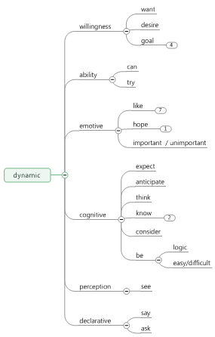
5.2 FUTURE Cx - MODALITY
5.2.1 epistemic
5.2.2 dynamic
5.2.3 deontic
5.2.4 combinations
    Epistemics is where most grammars stop, and yet…
    Massive presence of dynamic modality in the corpus
    e.g. I hope (PRES) to work (FUT) as
    e.g. I think (PRES) that I will work (FUT)

Slide 33
5.2 FUTURE Cx - MODALITY
5.2.1 epistemic
5.2.2 dynamic
5.2.3 deontic
5.2.4 combinations
    At first sight dynamic modality
    seems due more to FR1 than to NL1
    But in fact is due to L2,
    independent of language:
    compensation strategy?

Slide 34
5.2 FUTURE Cx - MODALITY
5.2.1 epistemic
5.2.2 dynamic subtypes
5.2.3 deontic
5.2.4 combinations
    Semantics of dynamics depends on
    lexical subtypes in present such as
    Cognitive (I think that V FUT)
    Emotive (I hope that V FUT)
    Willingness (I want to INF FUT)
    + subordinate clause for FUT
    Cx = syntax + lexicon + morphology

Slide 35
5.2 FUTURE Cx - MODALITY
5.2.1 epistemic
5.2.2 dynamic
5.2.3 deontic
5.2.4 combinations
5.2.5 modalities and time
    Necessity, obligation
    Rather unfrequent, but…

Slide 36
5.2 FUTURE Cx - MODALITY
    Three modalities do not only appear in isolation, but may be combined (45%)
    Cx = (syntax +) lexicon + morphology
    e.g. j’aimerais faire qqch avec l’italien
    e.g. I would like to do sth with Italian
    Vconditional =epist potential like =dyn)
    + INF Pres for FUT)
5.2.1 epistemic
5.2.2 dynamic
5.2.3 deontic
5.2.4 combinations
a. of modalities in that/to clauses

Slide 37
5.2 FUTURE Cx - MODALITY
5.2.4 combinations
FUT in ARG subclause
FUT in main clause + ADJUNCT PRES subclause
    VALENCY
    = [V PRES dynamic + ARG subclause FUT [to/that]]
    I hope that I will find a nice job
    I hope to be a good teacher
    V FUT + ADJUNCT PRES subclause (conditional, causal, …) [FUT (goal)]
    I will do an ERASMUS stay, since it is in line with my current studies
    [in order to become an interpreter]

Slide 38
5.2 FUTURE Cx - MODALITY
5.2.4 combinations
a. FUT in ARG subclause
b. FUT in main clause + ADJUNCT PRES subclause
    Subclauses in samples are distributed evenly for a. and b.

Slide 39
Outline
Context
Objectives
Corpus
Framework
Descriptive typology
Conclusions

Slide 40
6. Conclusions: FUTURE Cx = TIME + MODALITY
6.1 Time
Future time is more than future tense
L2 overcompensates for NL1 periphrastic and FR1 inflectional
Combinations PRES+FUT PRES+INF: interesting L2 pathway
6.2 Modality: single and combined
Teaching FUT implies teaching epistemic modality:
  Potential
  Irrealis for expressing ignorance
!! Integrate dynamic modality teaching Cx for FUT
  In valency and in adjuncts
  i.e. VALENCY
  [V PRES dynamic + ARG subclause FUT [to/that]]
  + ADJUNCT
  [PRES subclause (conditional, causal, …) [FUT (goal)]

Slide 41
7. References (partim)
Berghs, A. 2010. Expressions of futurity in contemporary English: a Construction Grammar perspective. English Language and Linguistics 14(2): 217-238.
Bertinetto P. M. 1991. Il verbo. In Renzi, L. & G. Salvi, Grande grammatica italiana di consultazione, 114-129. vol.II. Bologna: Il Mulino.
Bouveret, M. & D. Legallois (eds.). 2012. Constructions in French. Amsterdam & Philadelphia: Benjamins.
Dahl, Ö. & V. Velupillai. 2011. The Future Tense. In The World Atlas of Language Structures Online, chapter 67. Munich: Max Planck Digital Library. Accessed 2 November 2012. http://wals.info/chapter/67.
De Knop, S., F. Mollica & J. Kuhn (eds.). 2013. Konstruktionsgrammatik und Romanische Sprachen. Frankfurt am Main: Peter Lang.
Langacker, R. W. 2008. Cognitive Grammar. A Basic Introduction. Oxford: Oxford University Press.
Nikiforidou, K. 2011. Construction grammar and conventional discourse: A construction-based approach to discoursal incongruity. Journal of Pragmatics 43: 2594-2609.
Östman, J-O, 2004. Construction Discourse. A prolegomenon. In Östman, J.-O. & M. Fried (eds.), Construction Grammars: Cognitive Grounding and Theoretical Extensions. Amsterdam & Philadelphia: Benjamins, 121-144.
Sambre, P. 2012. Blurring boundaries of the EU (nano)future in Italian: cognitive grammar as discourse analysis. In Heynderickx P., et al. (eds.), The language factor in international business: new perspectives on research, teaching and practice. Lang: Bruxelles, 289-311.

Slide 42

Thank you… time for questions.
paul.sambre@kuleuven.be

