Slide 1
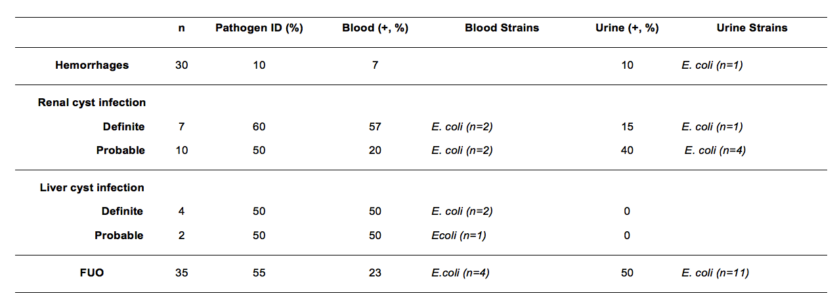
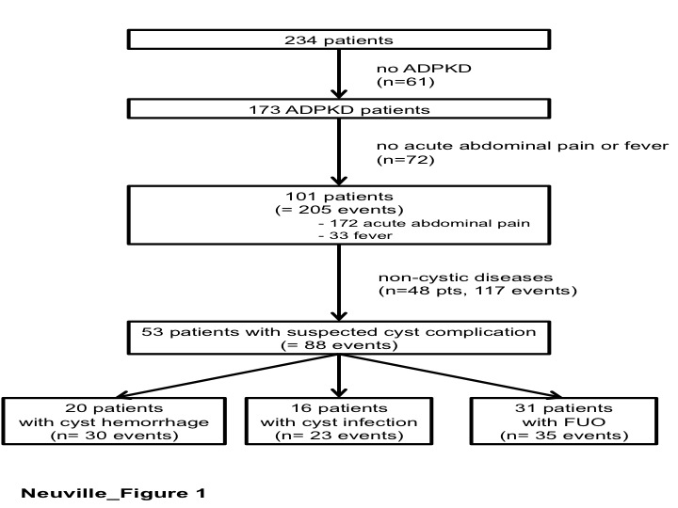
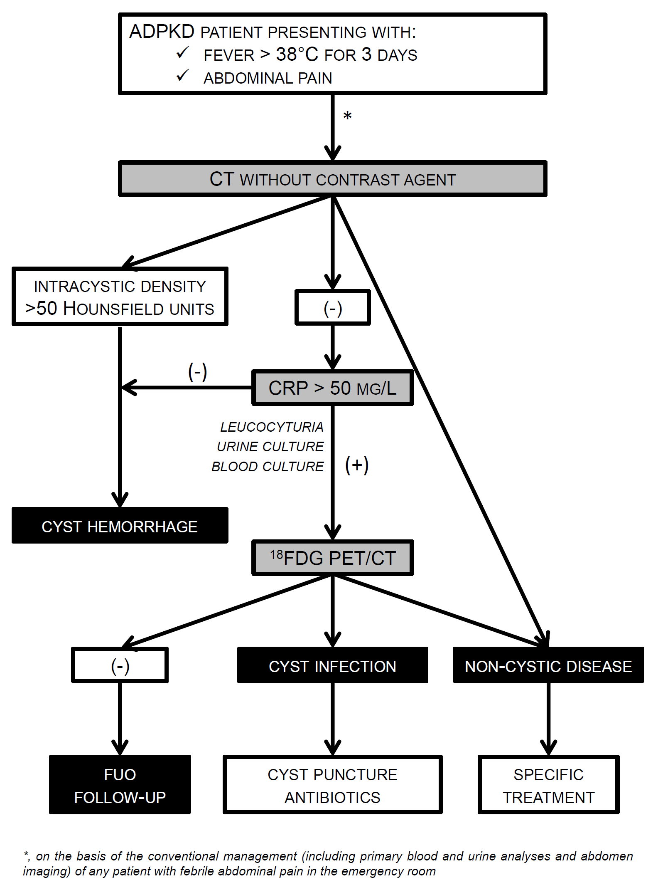
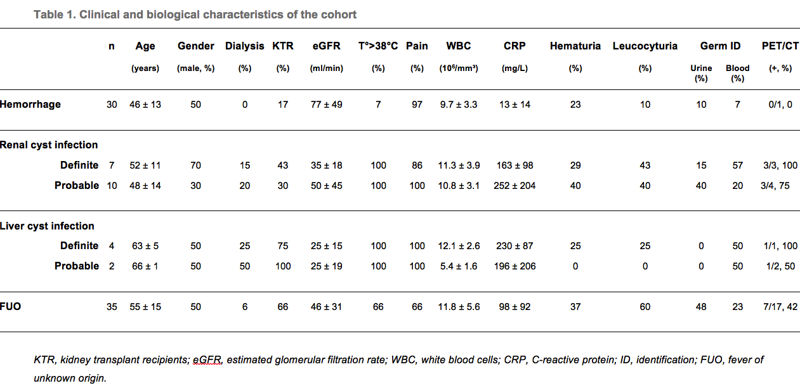
Diagnostic Management of Suspected Acute Cyst Complication
in Patients with Autosomal Dominant Polycystic Kidney Disease
Marie Neuville ¹, Roland Hustinx ², Jean-Marie Krzesinski ¹ and François Jouret ¹
Divisions of (1) Nephrology and (2) Nuclear Medicine, University of Liège Hospital (ULg CHU), Liège, Belgium
Background and Objectives
Bacteriological Documentation
Two main types of acute cyst complication in patients with autosomal dominant polycystic kidney disease (ADPKD):
cyst infection (CyI)
cyst hemorrhage (CyH)
Double diagnostic challenge :
differentiating acute cystic from non-cystic diseases
distinguishing CyI from CyH
Prominence of an accurate diagnosis to target the treatment:
CyI: 6-week antibiotic therapy (and cyst puncture)
CyH: antalgics and watchful waiting
Recent suggestion of diagnostic criteria, with unknown sensibility and specificity
This monocentric 10-year retrospective study aims at challenging clinical, biological and imaging criteria in order to propose a diagnostic algorithm in the management of suspected acute cyst complication
Demographics of the Cohort
Discussion
Retrospective identification of ADPKD patients presenting with abdominal pain and/or fever between January 2005 and June 2015 in a prospective computerized database
Stepwise and systematic review of all medical files
Diagnostic criteria:
CyH: intracystic density above 50 Hounsfield units on CT
CyI:
“definite” by cyst fluid analysis showing bacteria or neutrophils
“probable” in case of concomitant presence of:
temperature >38°C for 3 days
loin or liver tenderness
CRP plasma level >50 mg/L
no CT evidence for CyH
FUO: episodes out of criteria for CyH or CyI
This monocentric 10-year retrospective study including 88 episodes of suspected acute cyst complication in 53 ADPKD patients highlights:
the usefulness of clinical, i.e. fever, and biological, i.e. CRP levels, criteria to distinguish CyI from CyH;
the limitations of bacteriological and conventional radiological investigations;
the yield of ¹⁸FDG-PET/CT imaging in the diagnosis of CyI.
Diagnostic Algorithm
p<0.05
p<0.001
p<0.05
p<0.05
Diagnostic yields of conventional imaging techniques in CyI were:
Ultrasounds: 2.6% (1/38)
Computed tomography: 20.6% (7/34)
Magnetic resonance imaging: 16.7% (1/6)

