Slide 1
The Translator's Visibility: from the Archives to the Internet
“Current Research Perspectives on Literary Translation: A Bi-National Encounter (Brazil-Belgium)”
Vrije Universiteit Brussel, February 9th 2018
Céline Letawe

Slide 2
Invisibility as a commonplace
Juliane House’s “covert translation” (1970s)
Georges Mounin and his “verres transparents” (1950s)
a metaphor already used by Gogol to define a translational ideal (19th century):
“To become a pane of glass so transparent we in fact believe there is no glass there at all”

Slide 3
Lawrence Venuti 1995

Slide 4
Quotation from the American writer Norman Shapiro
I see translation as the attempt to produce a text so transparent that it does not seem to be translated. A good translation is like a pane of glass. You only notice that it’s there when there are little imperfections — scratches, bubbles. Ideally, there shouldn’t be any. It should never call attention to itself.

Slide 5
Venuti comments:
“Invisibility” is the term I will use to describe the translator’s situation and activity in contemporary Anglo-American culture. It refers to two mutually determining phenomena: one is an illusionistic effect of discourse, of the translator’s own manipulation of English; the other is the practice of reading and evaluating translations that has long prevailed in the United Kingdom and the United States (…). A translated text (…) is judged acceptable by most publishers, reviewers, and readers when it reads fluently, (…) giving the appearance that (…) the translation is not in fact a translation, but the “original.”

Slide 6
Three levels of (in)visibility
Intratextual
Paratextual
Extratextual

Slide 7
Research projects, past and future
exploratory research on translators’ prefaces (just finished)
past post-doc project: in the archives of Günter Grass
future project: about the website of Jean-Philippe Toussaint

Slide 8
On Translators’ Prefaces

Slide 9
Exploratory research
500 French translations of German novels
« Quand le traducteur-préfacier parle de traduction. Fonctions d’un discours entre préface allographe et préface auctoriale » (2019)

Slide 10
Visibility through the preface
increasing the probability that the translator is mentioned on the cover
offering a space of expression inside the book, beyond the translation work

Slide 11
“demystifying the illusion of transparency”?
Only potentially
because most translators present the translated work as a philologist would present the original

Slide 12
The translator’s preface in secondary literature

Slide 13
reflecting…
a lack of interest
a reality: the prefaces of translated works are rarely written by the translator

Slide 14
Results of the exploratory research
only 15% of translations are prefaced by their translator
Why?
cultural background
publishing house's policy
complexity of the source text
the translator's reputation
humility

Slide 15
To illustrate: Walter Weideli translating Walser

Slide 16
Translator’s note
Once the book is translated, one should give it a preface. Or more modestly a postscript: the author first! [...] To translate a work afflicts you with a strange myopia. To pretend to dominate Walser, or only to explain his book, seems to me presumptuous, illusory. [...] Great caution and modesty is required. I will speak of him as a translator. As someone who has redone, or tried to redo, step by step, word for word, the path of someone else. The following is given, to speak like newspapers, "without prejudice". These are remarks, reflections in the margin […]. Just additional information simply entitled with this little symbol that one sometimes reads in translated works: TN, translator’s notes.

Slide 17
To translate these passages plunges you into an indescribable euphoria. Words spring from themselves, as in dreams, love, drunkenness. Only the smallest words, the most worn words are large enough, rare enough to express this universal confusion of the senses, this vigorous and effortless swimming "out of time and out of the paths of life". And the guardian on the bank may shout, "Hey there! No further, it's forbidden!” You do not hear anything, you do not see anything, you go right on the "sun of the absence of thought" (...) where everything dissolves in the "oh" and the "ah" of the mystical ejaculation.

Slide 18
ALLOGRAPH preface
(about the work of someone else)
AUCTORIAL preface
(about one’s own work)

Slide 19
Results of the exploratory research
Less than 5% of translators’ prefaces are used to talk about translation
Several functions:
to justify choices
to recall the limits of translation
to stand out from a previous translation

Slide 20
In the Archives of Günter Grass

Slide 21
Six months in the archives
to analyze the collaboration between the author and his translators
a chapter of the book Collaborative Translation (2017) « Günter Grass and his translators: from a collaborative dynamic to a controlling apparatus? »

Slide 22
Working seminars

Slide 23
The first in 1978: five days with nine translators
an “Experiment” (Grass), both in the sense of an “experimentation” and of a daring attempt
a seminar for each novel, up until Grimms Wörter in 2011
among Grass’ “most rewarding professional experiences”

Slide 24
Enthusiastic translators
2002, on the occasion of Grass’s 75th birthday
featuring about 30 texts, in which the translators speak about their work, in a format they have chosen

Slide 25
Bruna Bianchi: “Never have translators been happier than we were”
Pilar Estelrich Arce: Grass as a new patron of translators
Recurrent image of the “family”

Slide 26
Nevertheless raising questions
What mode of collaboration was practised in these seminars?
What are the stakes of this dynamic, besides the improvement of the quality of the translations themselves?

Slide 27
retracing the process and evaluating its result
correspondences and detailed protocols kept in the archives
comparisons between Grass’s original and several translations (in English, French and Dutch)

Slide 28
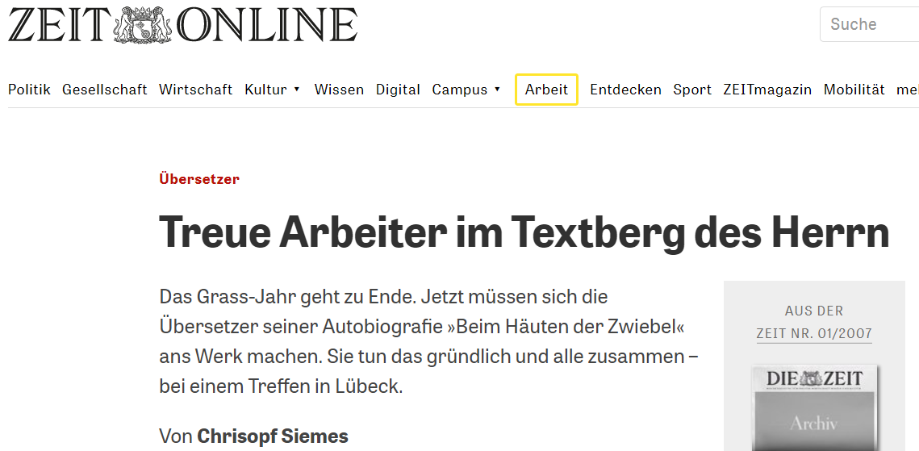
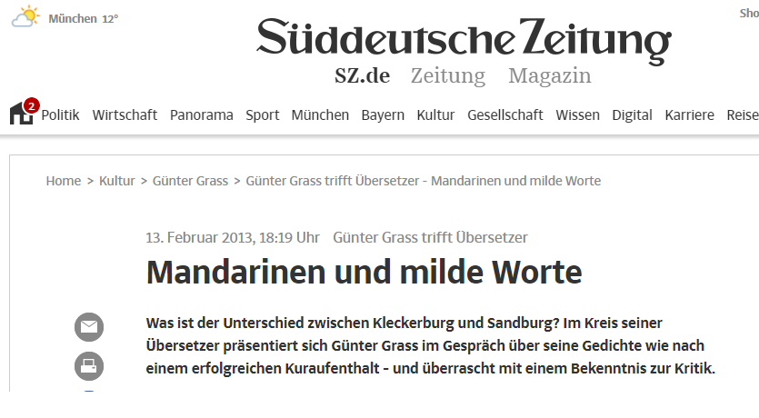
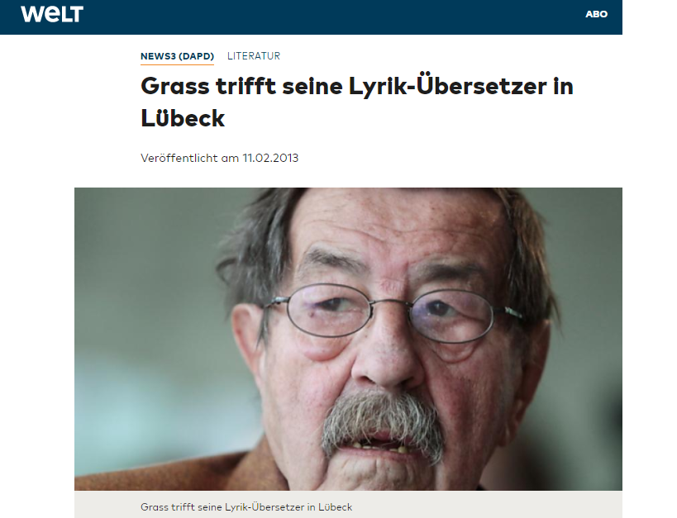
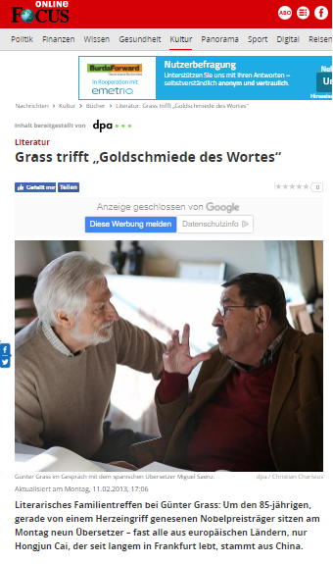
Contribution to the extra-textual visibility

Slide 29
Inspiring?
since 2007 the Europäisches Übersetzer-Kollegium in Straelen
since 2000 Jean-Philippe Toussaint in Seneffe (Belgium)

Slide 30
About the Website of Jean-Philippe Toussaint

Slide 31
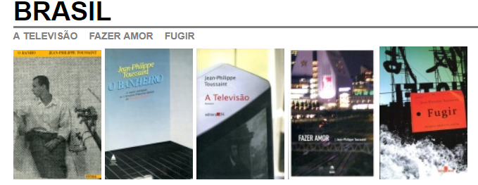
a Belgian author also published in Brasil

Slide 32
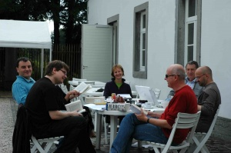
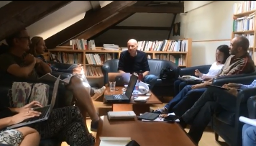
working seminars in Seneffe

Slide 33
« temps »

Slide 34
« traductions »

Slide 35
1) « rencontre »

Slide 36
2) « textes »
a round table with translators (2000)
an article of the Japanese translator (2000)
two posts from a literary blog (2009 and 2010) giving the floor to four English translators

Slide 37
3) « collège des traducteurs de Seneffe »
six working seminars (2000-2003-2006-2010-2014-2016)
about ten days, the author answering questions two hours a day (11-13 o’clock)
very brief reports (one or two pages for each session)

Slide 38
intertextuality

Slide 39
cultural specificities idiomatic expressions

Slide 40
puns

Slide 41
use of images

Slide 43
videos
of the seminars
https://youtu.be/r5UljkvtktM
on the translators
first systematic interviews (individuals)
then more spontaneous videos (interaction)
https://youtu.be/rcXzfJ8St_g

Slide 44
evolving
New in 2016
« debate of the day »
e.g. Should we translate proper names? Should we translate or adapt? Should we translate the quotes? How to translate titles? How to translate punctuation?
four students and a journalist

Slide 45
Visibility in both cases
not only for the translations (the translated texts), but also for the translators and the translation process
not only for individuals, but also for their interaction
new supports (videos, Internet): more direct expression and potentially wider reception

Slide 46
Thank you for your attention!
Céline Letawe
cletawe@uliege.be

