Slide 1


37th Annual Conference on The First-Year Experience
Supporting students' learning through
a program focusing on formative feedback
L. Leduc, D. Verpoorten
San Antonio, Texas
February 10-13, 2018
Notes:
Thank you and thank for organising this meeting
I m Mathmematician – I teach math cursus in first and second year – parametric architecture
I m the head of a very recent and small laboratory with 8 members (architects, geomatician, me of course)

Slide 2

The Feedback First-Year Project
A project
oriented towards the learning support, failure prevention and retention of freshmen at the University of Liège,
of action-research centered on a well-documented key theme in learning literature :
promoting and optimising formative feedback practices within the First-Year,
aimed to involve a group of professors from the same Faculties in a (both individual and collective) reflection about their current teaching and assessment practice and possible improvements (multiple levels and modalities of engagement),
thanks to the help of a closely supervised* pair of pedagogical advisers (a graduate in the discipline and a pedagogical counsellor) mixing individual tutoring and plenaries sessions on a one-year period
*supervised jointly by the Institute of Training and Research in Highe Education (IFRES)
and the Study Guiding Service of the University of Liège

Slide 3
The Feedback First-Year Project: final goals
General objective :
develop and integrate relevant formative feedback practices for First-Year courses of the same programmes
Benefits for First-Year students :
adaptation to college expectations or requirements, forstering freshmen’s abilities to self-regulate / adjust earlier and empowerment
Benefits for First-Year professors :
maximizing the pedagogical quality of the individual and collective offer of course designs in the involved programmes

Slide 4
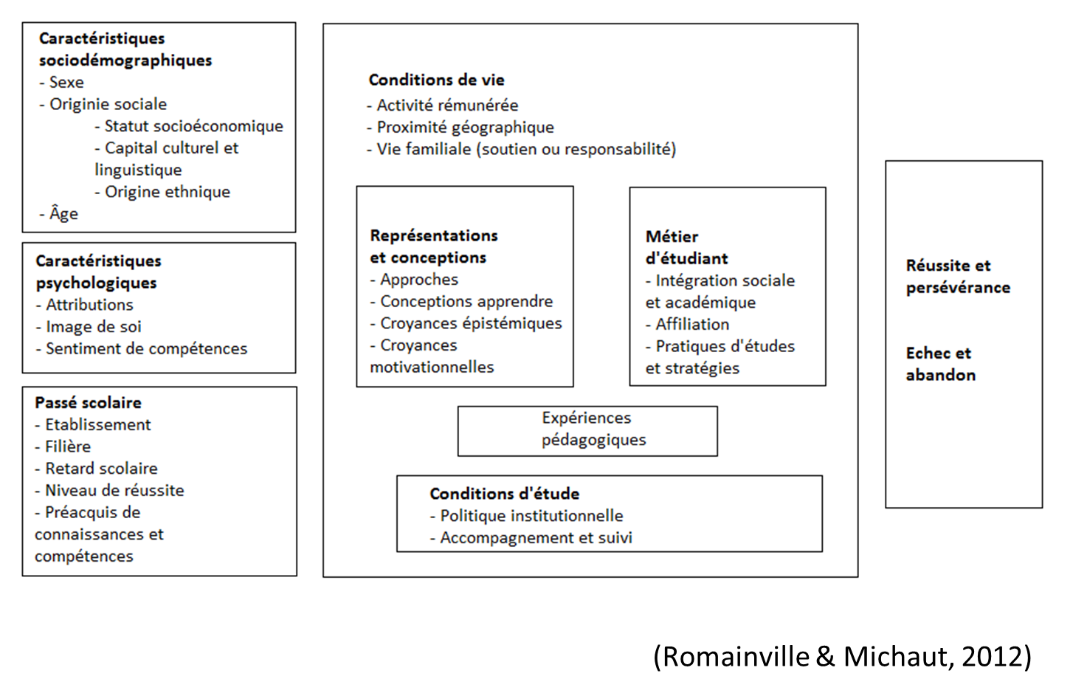
Main factors of success and failure

Slide 5
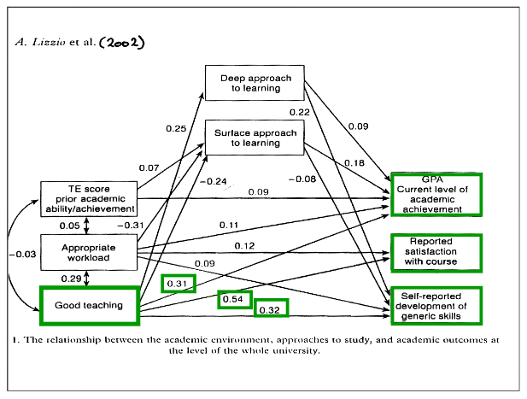
Main factors of success and failure
Student’s job
Some well-known predictors:
  In-depth study
  Regular work
  Optional activities attendance
  Handling of diverse sources of distraction
  (Zuniga Carrasco, 1989 ; Parmentier, 1994;
  Robbins et al., 2004)
Educational experience
Quality of teaching and pedagogic support as factors that allow to prevent students’ dropout (Béchard et Bédard, 2009)
One of the best predictors of success lies in the quality of teaching (Lizzio et al., 2002)

Slide 6
Promoting formative feedback practice in the First-Year
Rethinking the first year of college (Tinto, 2001):
- « Five conditions stand out as supportive of student learning and retention, namely expectations, support, involvement, relevant learning, and feedback (…) Students are more likely to succeed in settings that provide faculty, staff, and students frequent feedback about their performance ».
Five Cs of Good Practice in the First Year (Krause, 2006) :
  - At the Curriculum level : « A shared understanding of how to integrate assessment and feedback structures into the curriculum so as to enhance student learning. In other words, shifting from ‘assessment of learning’ to ‘assessment for learning’ in the first year »
  - at the Classromm level : « Use early and continuous assessment and timely feedback to: engage with your students; monitor their progress; communicate standards and expectations; encourage students to self-manage and self-assess; reward those who are succeeding; and identify early those at risk »
Key components of an ideal First-Year curriculum (Bovill, Morss & Bulley, 2008) :
  - according to the literature
  → formative assessment and feedbacks(Yorke, 2003; Nicol & Macfarlane-Dick, 2006)
  - according to professors (workshops)
  → early formative feedbacks
  - according to students (focus groups)
  → more attention paid to assessment and « timely feedbacks »
Other authors : Fisher et al. (2011), Goos et al. (2011), Donnison et Penn-Edwards (2012)…

Slide 7
Focus on the Formarive Feedback concept
Restrictive acception :
Information from the professor following the assessment of a written or oral performance from students
(Lambert et al., 2009)
Wide acception :
information provided by an agent (e.g., teacher, peer, book, self) regarding aspects of one’s performance (Hattie & Timperley, 2007)
Final goal :
… intended to modify thinking or behavior for the purpose of improving learning
(Shute, 2008)
student self-regulation : feedback’s rationale

Slide 8
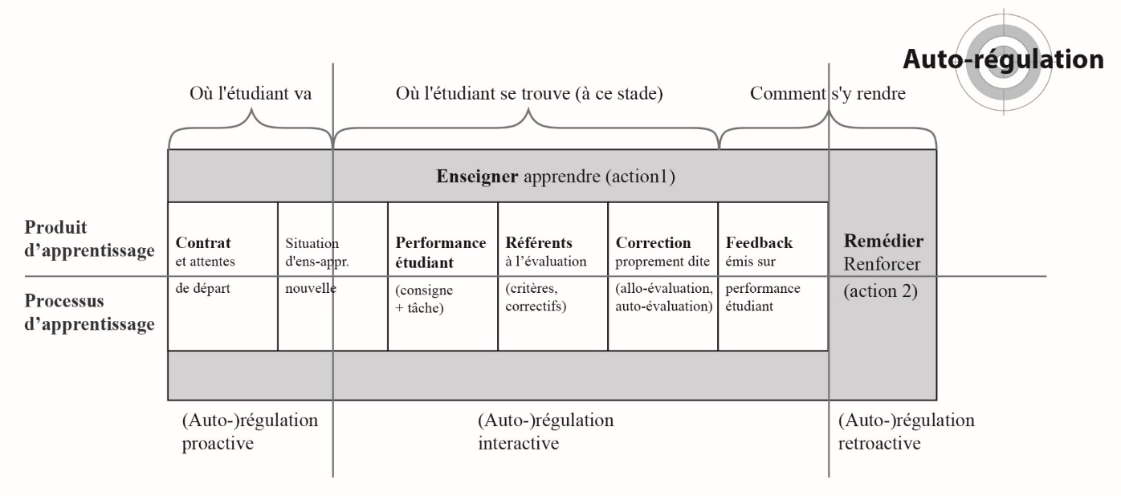
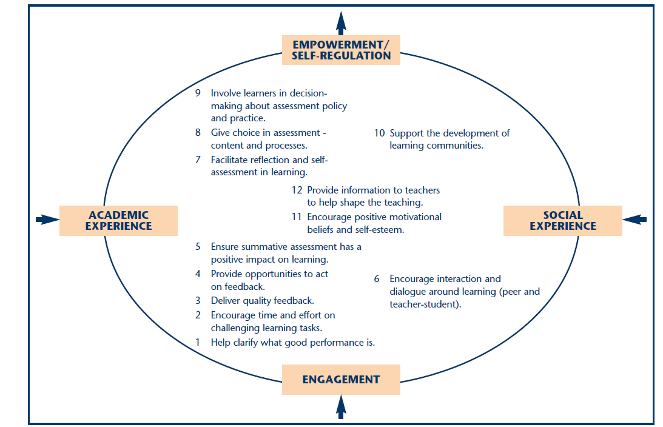
Two reference models
From Assessment for Learning to self-regulation (Leduc et al., 2016)
Global orientation :
Intentional “tight but loose” approach to the work with teachers (Nicol 2009; Thompson and Wiliam 2008)
12 principle of good assessment and feedback practice (Nicol, 2009)

Slide 9
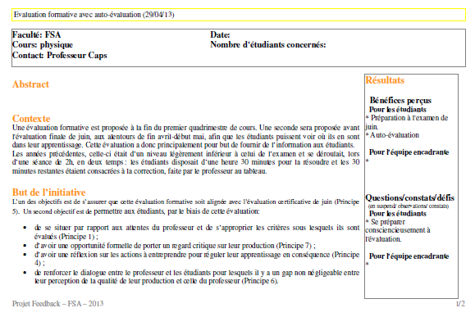
An instrumented process
Context, goals, instructional design, résults
Conceptual tooling for discussion, regulation, dissemination

Slide 10
A project developed in five faculties of the ULiège
2013 - 2014 : Faculty of Applied sciences (16 activities / pedagogical redesign implemented in 8 courses)
Team: Audrey Mohr, Christophe Dozot
2014 – 2017 : Faculty of Law, Political sciences and Criminology (16 activities / pedagogical redesign implemented in 5 courses , and a specific project in Political sciences)
Team: Eléonore Marichal, Marie Campisi, Damien Bourseau, Kevin Mangelschots, Jérôme Nossent, Jacques Mouton, Margaux Schrooten, Gabrielle Cusson
2015 - 2017 : Faculty of Sciences (20 activities / pedagogical redesign implemented in 5 courses and a large longitudinal inter-courses survey)
Team: Audrey Mohr, Jean Metzmacher
2016 - 2018 : Faculty of Architecture (more than 15 activities / pedagogical redesign implemented in 5 courses)
Team : Aude Silvestre, Nicolas Seijkens
2017 - 2018 : Faculty of Veterinary medicine (in progress)
Equipe : Céline Tonus

Slide 11
Outputs of the project
Multiple concrete interventions that “focus on improving and supporting student learning through teaching practices” (University of Glasgow, 2008).
  individual course level : creation/improvements of formative tests and mock exams, peer-assessment activities, optional/compulsory formative assessment, worked examples and rubrics to self-assess own performance, check-lists of criteria and illustrations of good/bad performances, online devices (forums, automated tests), interactive question-answer sessions (using electronic voting systems or one minute paper techniques), etc.
  group of courses level : (beyond a single course but below a genuine structured collegial decision): efforts to cover together the complete spectrum of Nicol’s 12 principles
  whole Faculty level : shared digital calendar + set-up of a training pathway for students supervising younger peers in practical training sessions

Slide 12
Examples of outcomes et data collected from 1st-Year students
Taken from :
- the Faculty of Architecture ;
- The Faculty of Veterinary medicine ;
- the Faculty of Law, Political science and Criminology ;
- the Faculty of Applied sciences.

Slide 13
Example n°1
Faculty of Architecure
Mathematics (250 First-Year students)
A four-piece integrated AfL* pedagogical redesign implemented during academic year within Math class
JANCART, S., SILVESTRE, A., SEIJKENS, LEDUC, L. (2017)
A graphic syllabus
An online prerequisite test
An intermediate evaluation based on true/false quizzes
A mock exam
aiming to :
work more specifically on freshmen’s knowledge of prerequisites
positively impact their intrinsic motivation
value mathematics through a place in a cursus more rooted in the profession
reduce the lack of transfer between courses in the Architecture program…
* Assessment for Learning

Slide 14
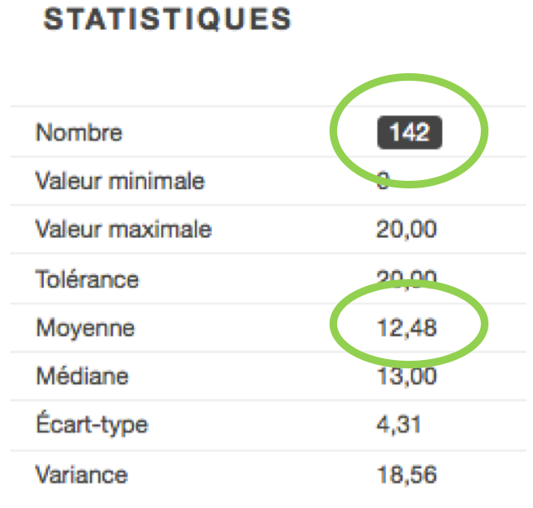
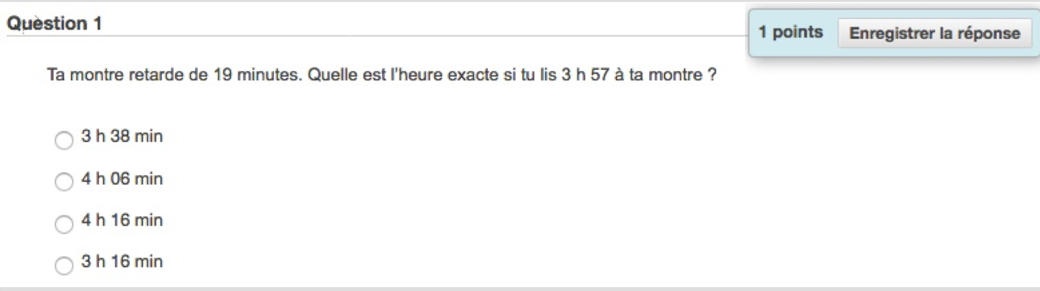
Graphic syllabus
On-line prerequisite test
+/- 150 questions
4 skills targeted :
Knowing how to calculate numbers
Knowing how to measure sizes
Knowing how to structure space
Knowing how to build logical links/
associations
Correct feedback: | correct answer
Incorrect feedback: | incorrect answer, it would be useful/helpful to revise the rules of transformation on measure calculation

Slide 15
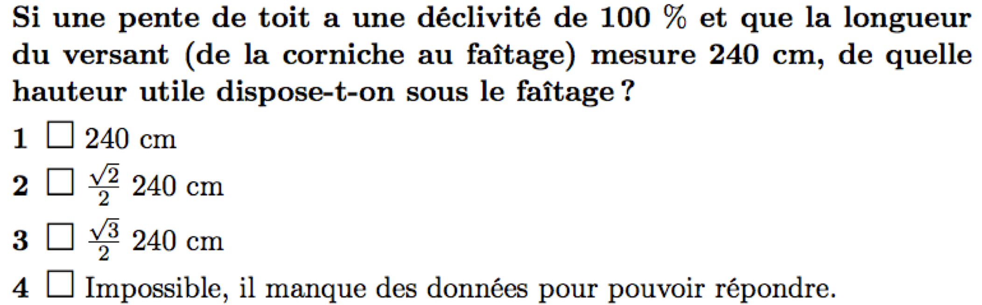
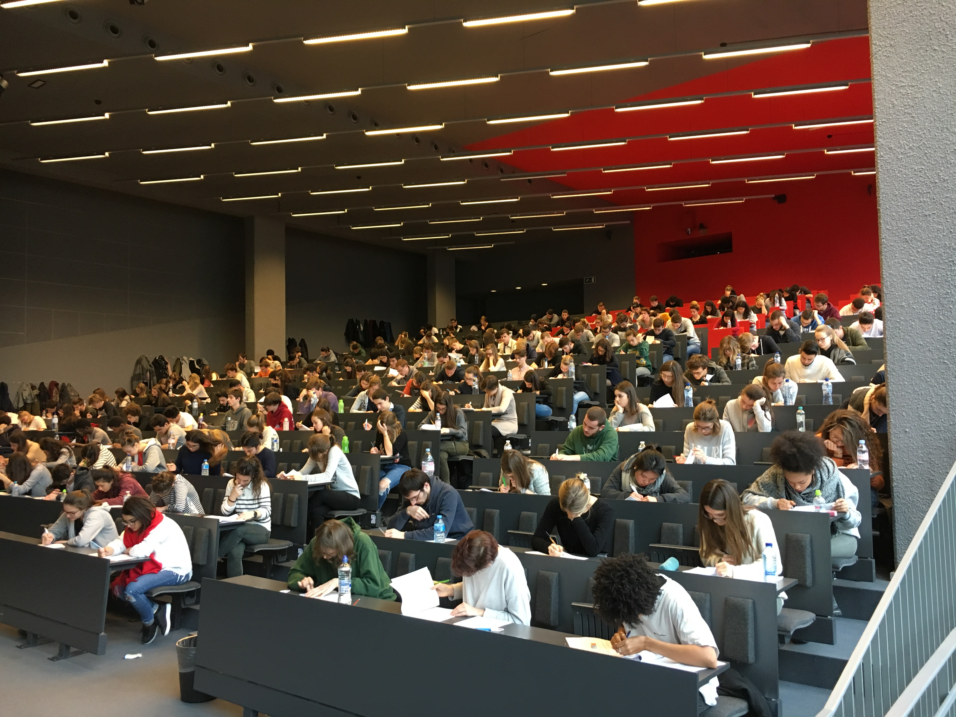
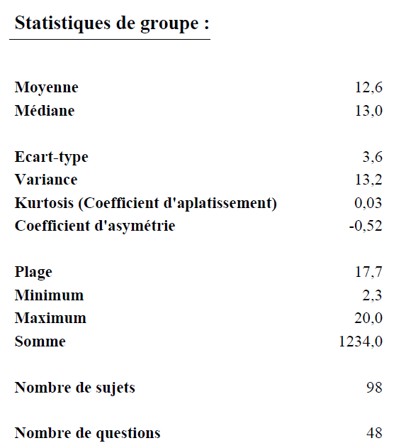
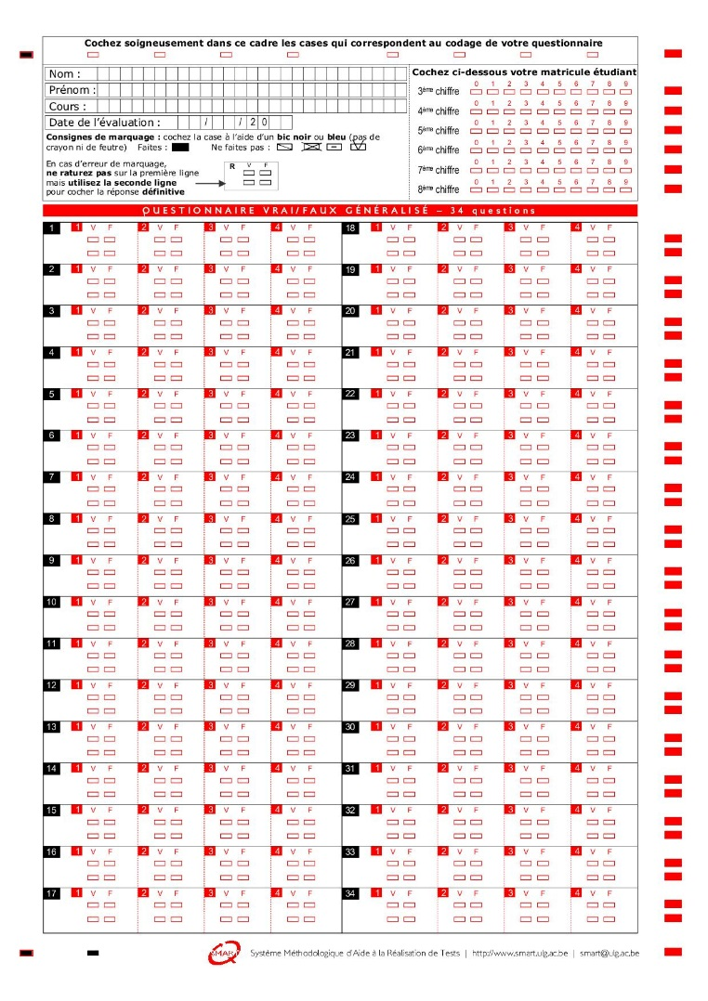

Intermediate
evaluation
Mock exam
Students more concerned
High level of participation
Good results
Same conditions as the exam’s
Last year exam
Peer grading and collective feedback + showing last year students’ (good and less good) answers

Slide 16
Survey
Very good students’ attendance at intermediate test (85% of surveyed students)
Average self-reported test preparation
Major reasons of non-preparation: lack of time (33%) ; sufficient knowledge of the subject (23%), design architecture project (19%)
Average attendance at mock exam (50% of surveyed students)
Weak mock exam preparation : design architecture project (34%) ; lack of time (27%) ; attended only to glance/take a look at the questions (14%)
Students evaluated the intermediate test (N=145; M=5.04, SD=1.99) as well as the mock exam (N=105; M=4.3, SD=1.99) as useful (on a 7 points Likert scale, 1 = not at all, 7 = totally)

Slide 17

Example n°2
Faculty of Veterinary medicine
English level B1-B2 (250 First-Year students)
A longitudinal dashboard based on multiple tests and delivering personnalized feedbacks and feed forward
TONUS, C., BOUVY, C., LEDUC, L. (2018)
v
→ Context
(Mostly) Online course with various teaching modules
with schedule suggestions
Six compulsory and recursive online tests :
  Same structure, type of questions and grading as the final exam
  Homework assignments
  Classroom correction
  Automatic institutional feedbacks
allowing the student to :
visualize his/her own results during the whole semester according to various aspects of the course (grammar, vocabulary, reading)
compare those results to the class average
actually use the automatic institutional feedback
receive personalized advices
reflect on his/her own learning strategies

Slide 18
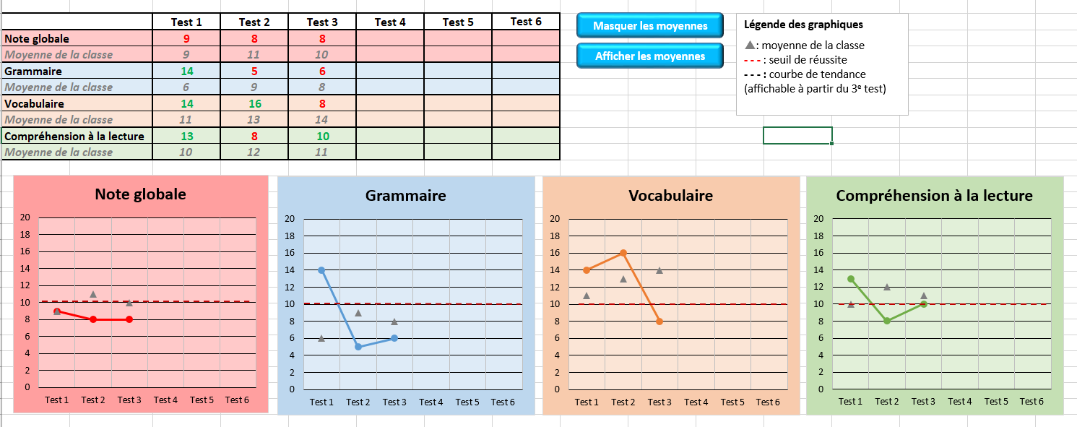
The Dashboard
Components
  Results test after test: grading and graphic formats
  Advices about the « subject » (using buttons) → self-regulation suggestions
  Advices about the « learning strategies » (starting with questions)

Slide 19
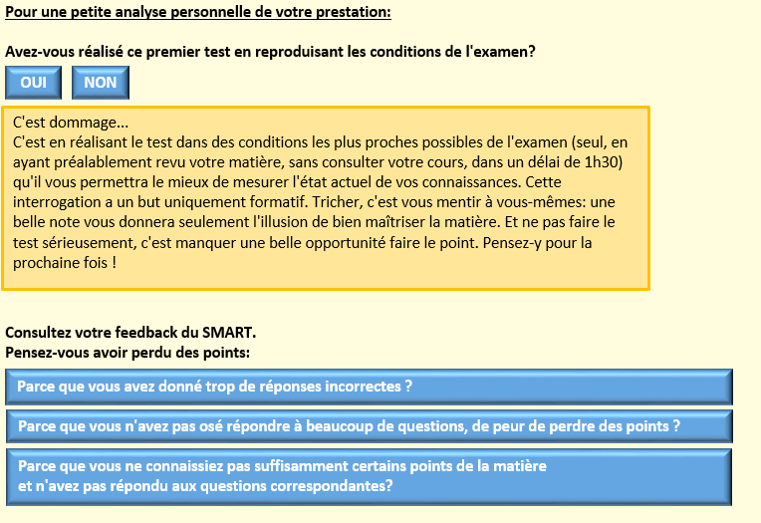
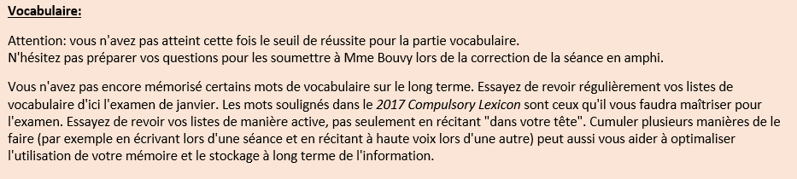
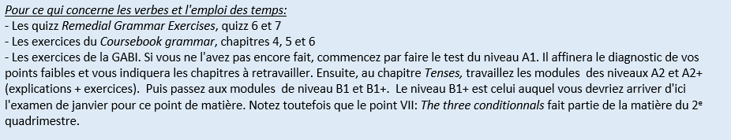
  Advices about the « subject »
Advices about the « learning strategies »
Global and related to specific subjects
Personnalized advices regarding :
  the score
  the time of the year (near the exam or not)
  Student’s progression (or not)
  => Pointing out course resources to use preferentially
First two test : dealing with the good use of the « SMART tests » (right approach to the test, how to answer…)
Next tests : performances trends
Can foster tutoring

Slide 20
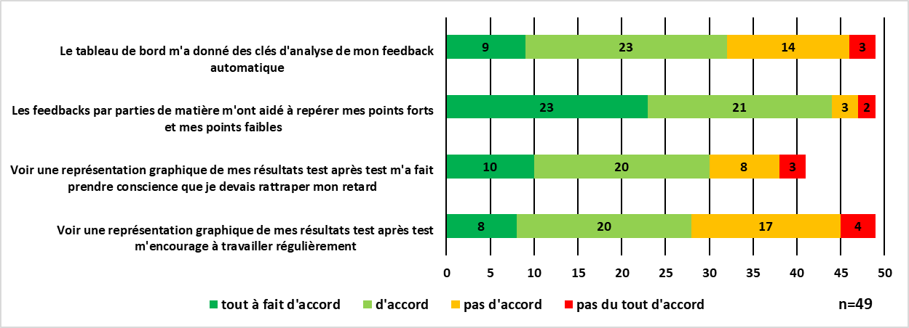
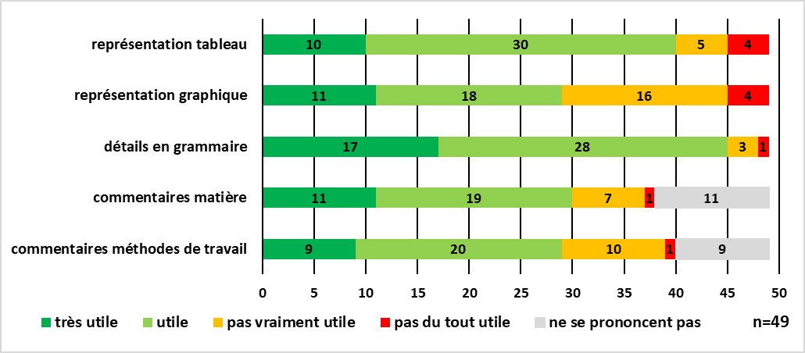
Perceived usefulness of various components of the Dashboard
Survey
Declared impact on self-reflection and self-regulation

Slide 21
Example n°3
Faculty of Law
Introduction to Public Law (500 First-Year students)
Helping students to fruitfully assess their performance at their last unsuccessful attempt to pass the exam
A three hour face-to-face training session
tutored by 2 or 3 course staff members and pedagogical advisors
in small groups (+/- 20 students)
and in five steps
helping freshmen to :
remember what happened during the oral exam step by step
analyze (« attribute ») the cause of their failure
identify the expectations and assessment criteria of the professor
define a programme of adequate / relevant learning strategies for the next attempt to pass the exam
Encourage interaction and dialogue between peers

Slide 22
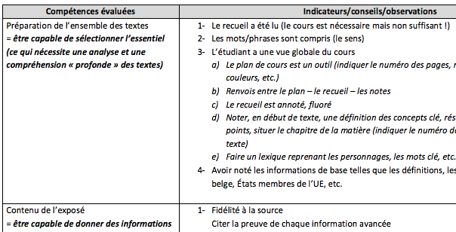
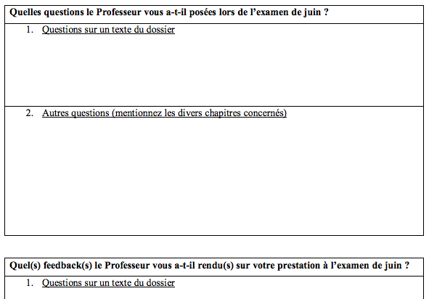
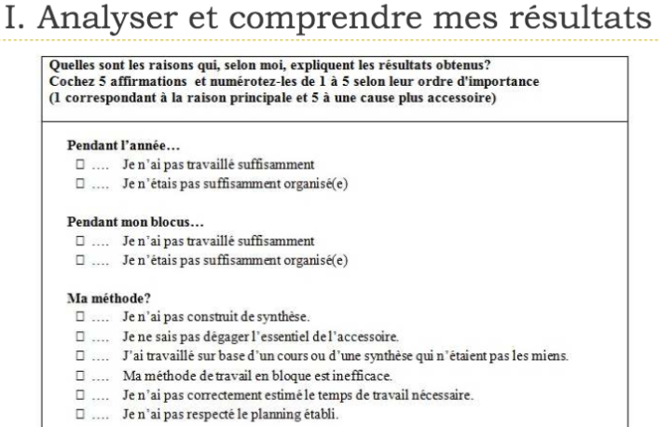
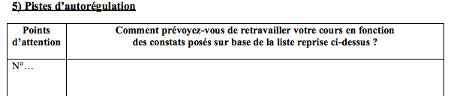

Session helping students to fruitfully assess their performance at the exam
a) Remembering what happened during the oral exam
c) Collective reflection about the professor’s expectations*
  *Observed by the FFYP team during the professor’s oral exam
b) Attributing the cause of each student’s failure
d) Defining self-regulated learning strategies for the next attempt to pass the exam
e) Debate

Slide 23
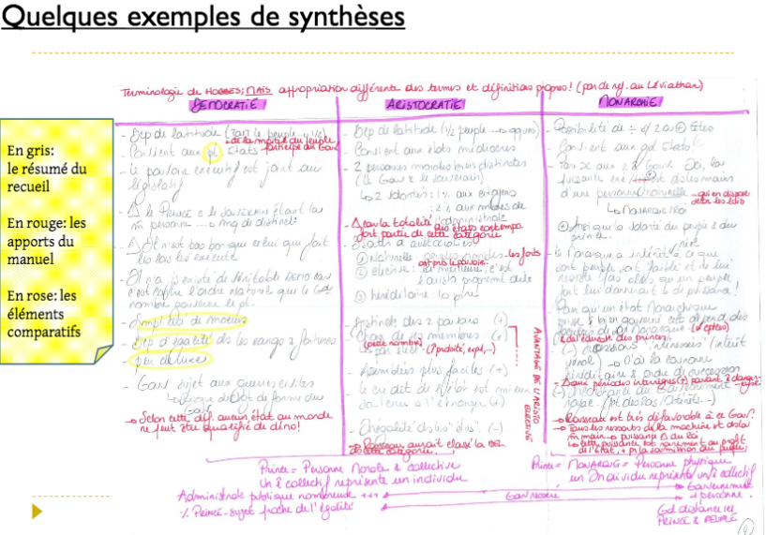
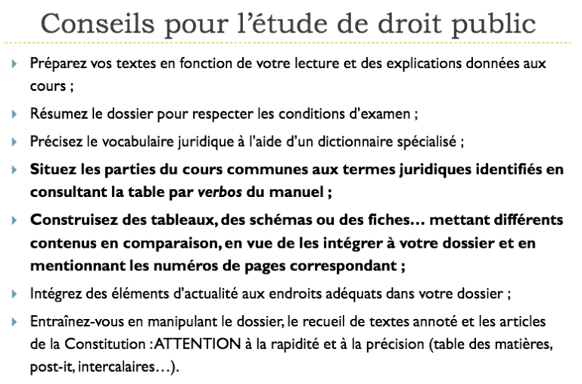
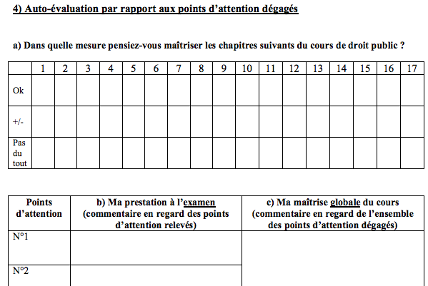
Session helping students to fruitfully assess their performance at the exam
… examples of summaries
But also…
…methodological advices
…self-assessment

Slide 24
Survey
High levels of satisfaction (N= 17)
regarding the session which :
met the participants expectations (15/17 agree);
allowed them to better understand the causes of their failure (15/17 agree);
allowed them to find a better approach to their study of the course (17/17 agree);
offered good opportunities of interacting with peers and steff (17/17 agree);
was welcomed with a high level of satisfaction by the participants (16/17 agree)
would have a concrete impact on their study methods (17/17 agree);
Decribe the main avenues that you’ve retained in order to improve your work / learning approach
(Open-ended question):
The respondents emphasized the need to :
- diversify their study tools (summaries, mindmap, etc.) regarding the course handbook and the related texts;
- deepen their strategies related memorizing and understanding the course.

Slide 25
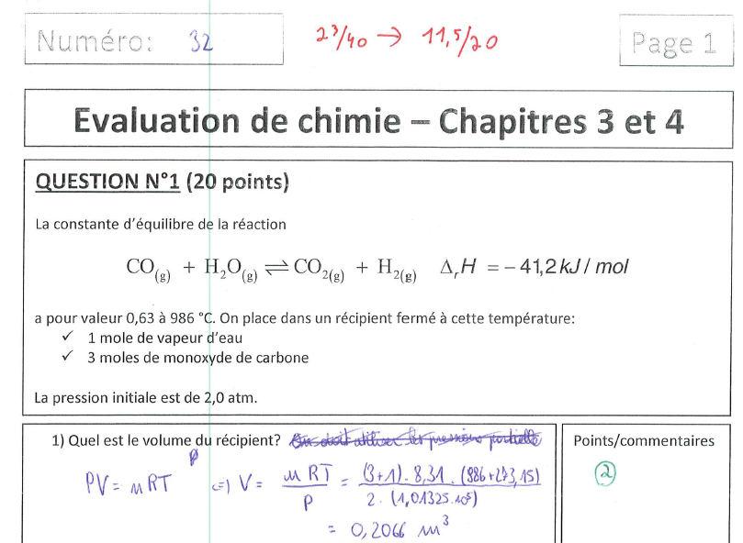
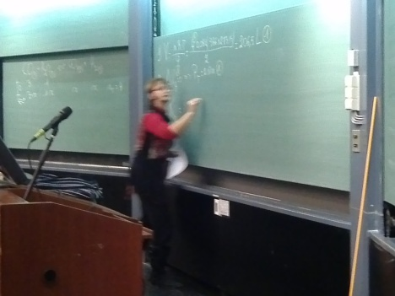
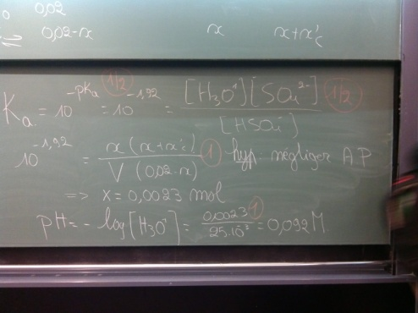
Example n°4
Faculty of Applied sciences
Chemistry (200 First-Year students)
Mock tests featuring criterion-based grading, peer and then professor assessment
1) Early formative assessment related to the first three chapters of the course (difficulty level similar to the exam)
2) Students exchanging copies for a first marking.
3) Public debriefing involving the professor explaing the right answers and assessment criteria on the blackboard
4) Second marking by the professor himself

Slide 26
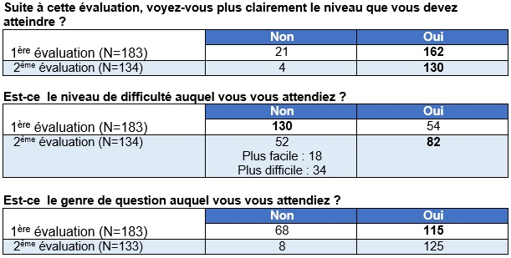
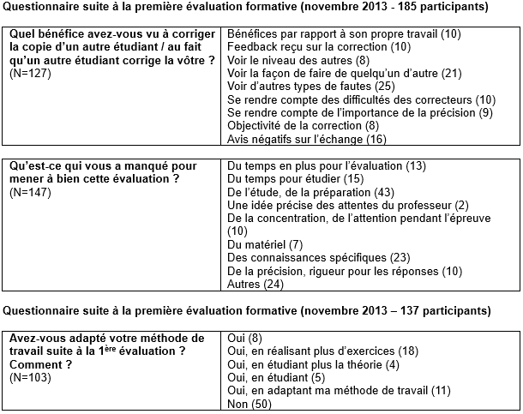
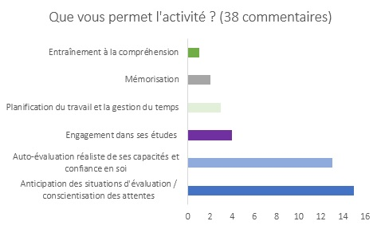
Survey

Slide 27
Data collected from 1st-Year professors
Semi-structured interviews lead with 19 participants from 3 faculties
Focus on the way those teachers perceived 4 main traits of the FFYP program :
- the effort concentrated on the First-Year courses ;
- the individual / collective dimension of the process ;
- the « formative feedbacks and Assessment for Learning » entry ;
- the availability and help of the project advisers.
Notes:
- the availability and help of the project advisers.
(and their possible effects on the professors’ willingness to actually commit to the project and regulate their teaching practices)

Slide 28
The focus on the First-Year courses
The strict focus on the First-Year teaching and learning context as a federative factor ?
For most of the respondents in the Faculties of Science and Applied Sciences, concentrating their efforts on the First-Year courses and programs actually make sense :
“it’s in the first year that we should especially look after students”,
“interventions are much more necessary in the First-Year”
“this is where we have to be the more careful”
“this is where the main problems are”…
BUT : since students empowerment is to be supported at this stage, more autonomy is expected afterwards
“since we provided them with the needed tools during the First-Year”
“they do not need our close assistance during the following year”
Professors justifying the importance to focus on the First-Year according to essential points stressed in the literature on FYE :
- the difficulties related to the transition from secondary school to university and the notion of academic integration (Tinto, 2012) → 5 X
- the need to support the autonomy or the empowerment of the freshmen (Bovill et al, 2008) → 5 X
- respondents spontaneously relating their AfL practices in the First-Year to various aspects of Nicol’s framework (attention paid to reflective or self-assessment dimension, involving peers, direct contacts…)

Slide 29
The individual / collective dimension of the process
Many respondents insisting on the diverse richness of the plenary sessions and their contents allowing :
to see what is done locally
“in the other courses or by the colleagues”
or from a more holistic or collegial perspective
“it allows to have a global view”,
“the plenary sessions are the very first opportunity to discuss about everything which is done in First-Year courses”
to exchange with each other about teaching approaches
“good to have the point of view of our colleagues”
to get theoretical inputs
“happy to hear the presentation of the theoretical framework during these meetings”
→ Positive comments toward the idea, even in the only faculty where those plenary sessions did not happen
“it could have been a positive aspect to discover what learning devices are used in other courses”
“this kind of interactions would have allowed to bring something more : exchanges between colleagues and some kind of recognition of the difficulties experienced by all of us”
BUT : reservations about the constant efficiency of those collective moments
“the plenary meetings were less focused and could digress at times”
“more a place for exchange among professors than an opportunity to solve problems”
or about their frequency as time-consuming activities
“the most important thing here is that we were working together on a project, so there’s no need for that many meetings if we go on with it”
→ Same argument of the lack of time prevalent in the decision not to organise this kind of sessions
“exchange can bring a lot in the field of education, but the collective dimension was not further developed due to the lack of available time for both professors and assistants”

Slide 30
The individual / collective dimension of the process
Usefulness of the plenary sessions to catch new ideas from colleagues and be inspired by them
“ the plenary sessions allow to see / know what the others do “
“ those meetings are places where we can discover ideas”
→ an expectation of the FFYP team that teachers would influence each other to some extent, thus making their bets on a “snowball effect”
“sustaining this kind of plenary meetings in order to see what is done in similar courses could be interesting for new faculties”
“ we had the idea of our formative assessment device from the one presented by our colleague”
More generally, beside the complementarity of the individual and collective phases,
“both are necessary”
fostering a more collective approach of their job is positive as such
“it makes sense to dedicate ourselves to such a project if everybody gets involved in it”
“I find it good not to have everyone working separately in their own corners”
and in terms of consistency of the respective actions of the different colleagues
“ the collective approach is a will to have a consistent device “
“ together, we’re stronger, we are a team towards students “
“ it’s the opportunity of a dialogue about the most important subjects to be covered “

Slide 31
The « formative feedbacks and Assessment for Learning » entry
The focus on the development of formative feedback practices well perceived,
first as such
“some colleagues do not actually deliver feedbacks. It is no self-evident practice“
“it is very important to give feedbacks, which are not disheartening“
BUT mostly as a starting point
“a good basis”
“a great gateway”
“a direction given”
“a good alibi the enter in the offices”
“it’s a good idea because it capture the interest of the professors of the faculty“
→ the diverse initiatives taken in the three faculties cover broader than the strict enhancing of the quality of feedbacks delivered, yet all relating to the Assessment for Learning practices (Leduc et al., 2016):
defining criteria of assessment grids, fostering student activity through adapted assignments, supporting self-evaluation or reflective thinking, developing opportunities of contacts with pairs and teachers, writing course syllabi, creating remediation opportunities…

Slide 32
The « formative feedbacks and Assessment for Learning » entry
About the SOTL potential of the feedbacks theme, several respondents described it as
“interesting”
“stimulating”
“asking us to open ourselves”
“allowing to break down problems”
“especially in the perspective of First-Year teaching”
and notably likely to inform the teacher on the quality of his/her teaching
“a good idea allowing to reverse the trend (of assessment)”
“an effective self-evaluation look”

Slide 33
The availability and help of the project advisers
About the duo’s contacts and contributions to their reflection, from the Faculty of Applied Sciences (and some from the Faculty of Sciences *) those who had few exchanges with the team either felt :
indifferent / undecided
“two persons who coordinate and manage the project. It was neither negative nor positive, there’s no intrusion from them: they were just additional colleagues“
“we haven’t interacted very much, given what was done, so I don’t really have an opinion“
self-sufficient
“our device was a more advanced one, so we needed less support”*
or puzzled
“it’s certainly a good thing… It’s surely interesting for you to ask questions... We had the end product, so we couldn’t feel it”
Those who were more taking advantage of the duo’s support praised :
the role of the subject expert and his ability to directly turn to practice
“it’s a good idea to have a practical look on things“
or his complementarity with the educational science expert which is
“crucial for the impact toward the colleagues : an expert in education is needed to take things further, and a subject expert is needed to help the advancements go smoother and to convince the most reluctant ones”
“necessity to dispose of a team with a lawyer and a pedagogy expert”
“It is important to have a little bit of both since it is useful to have someone from one’s own discipline so that disciplinary practice can catch up with the theoretical pedagogy”*

Slide 34
The availability and help of the project advisers
In the Faculty of Law, Criminology and Political Sciences, the tendency to focus on the contribution of the subject experts was almost systematic, the respondents praising :
their experience of the contents, allowing them to measure the expectations of the discipline
“the presence of the subject experts was necessary since they have followed the same courses and know what is expected from students in the Faculty of Law”
their ability to play an active role in the teaching activities
“the subject experts have a knowledge of law and understand the notions, they are able to measure the theoretical implications of an exercise and help to conceive a course slideshow for instance”
ability to make the educational language accessible
“since they had not studied education sciences, they could also have helped in using plain language so that we felt on familiar territory”
and, at the end of the day, to help the professors in being more reflective about their teaching
“as former students from the Faculty, the lawyers followed the same curriculum as the freshmen targeted by the project, bringing an added value for the teaching reflection”

Slide 35
The availability and help of the project advisers
Same feeling - expressed once – in the Faculty of Law
“many pedagogues have passed through here, and it goes smoother if someone is there to translate theory into practice, someone who has a similar way of reasoning as the interlocutors and serves as an intermediary”
…or in the Faculty of Sciences,
using the same language to express the need of a translater
“We need a subject expert to work onf the subject problems, otherwise some translation work has to be done“
BUT there prevails though a general opinion of a constructive work with the duo
“It’s working well since the FFYP team is not authoritative : first, they look at what’s already done and then suggests developments”
“discussions with the FFYP team were interesting and ideas were fruitfully debated ”
which was even perceived as assuming a part of the professor’s workload
“I felt guided and relieved”

