Slide 1
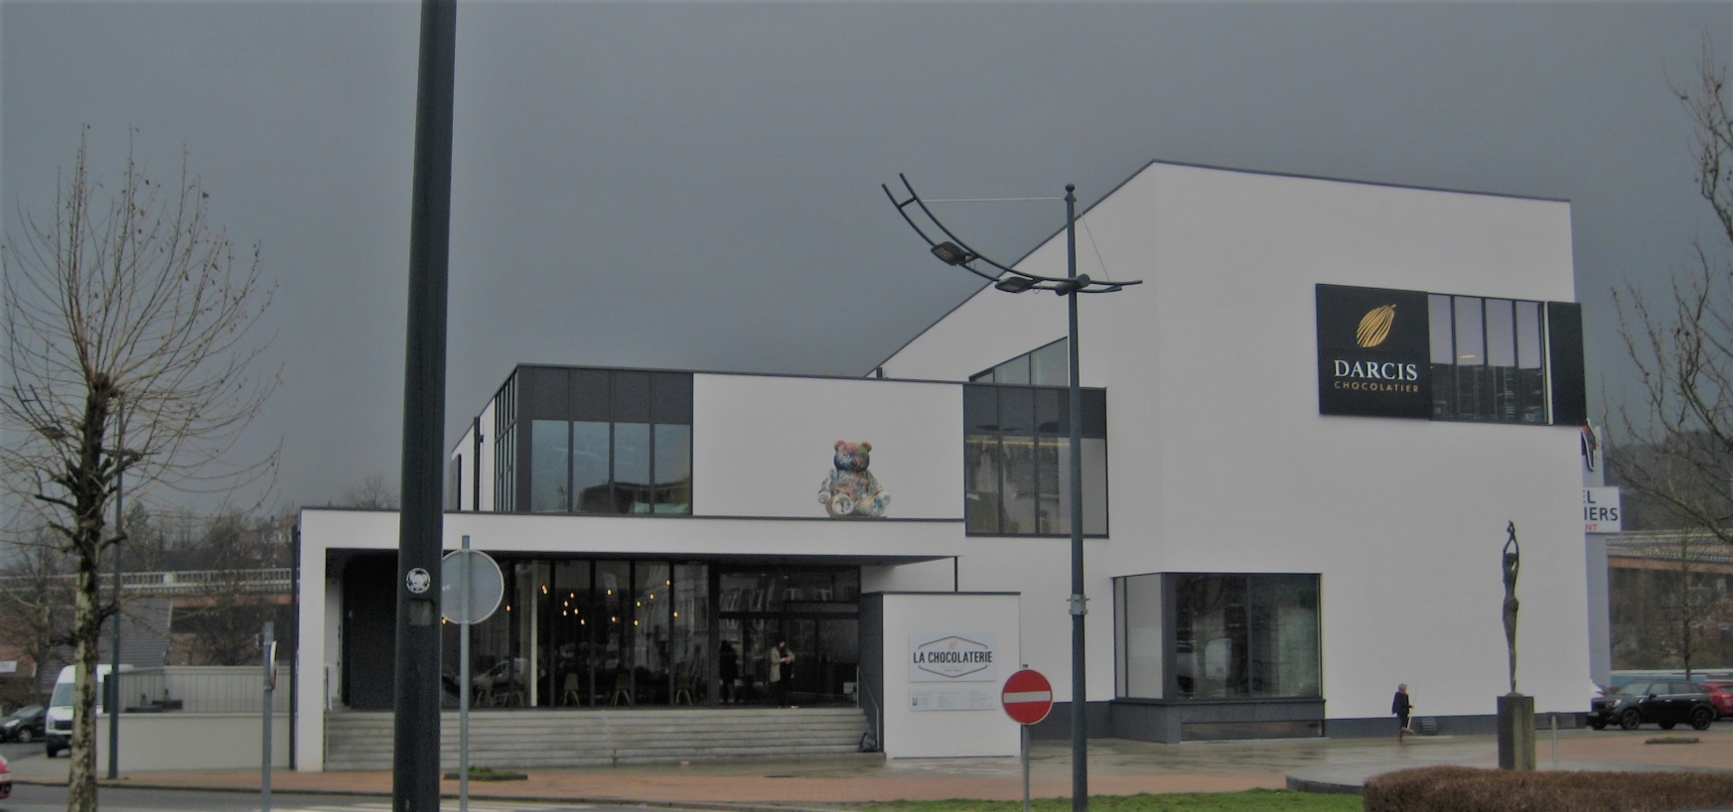
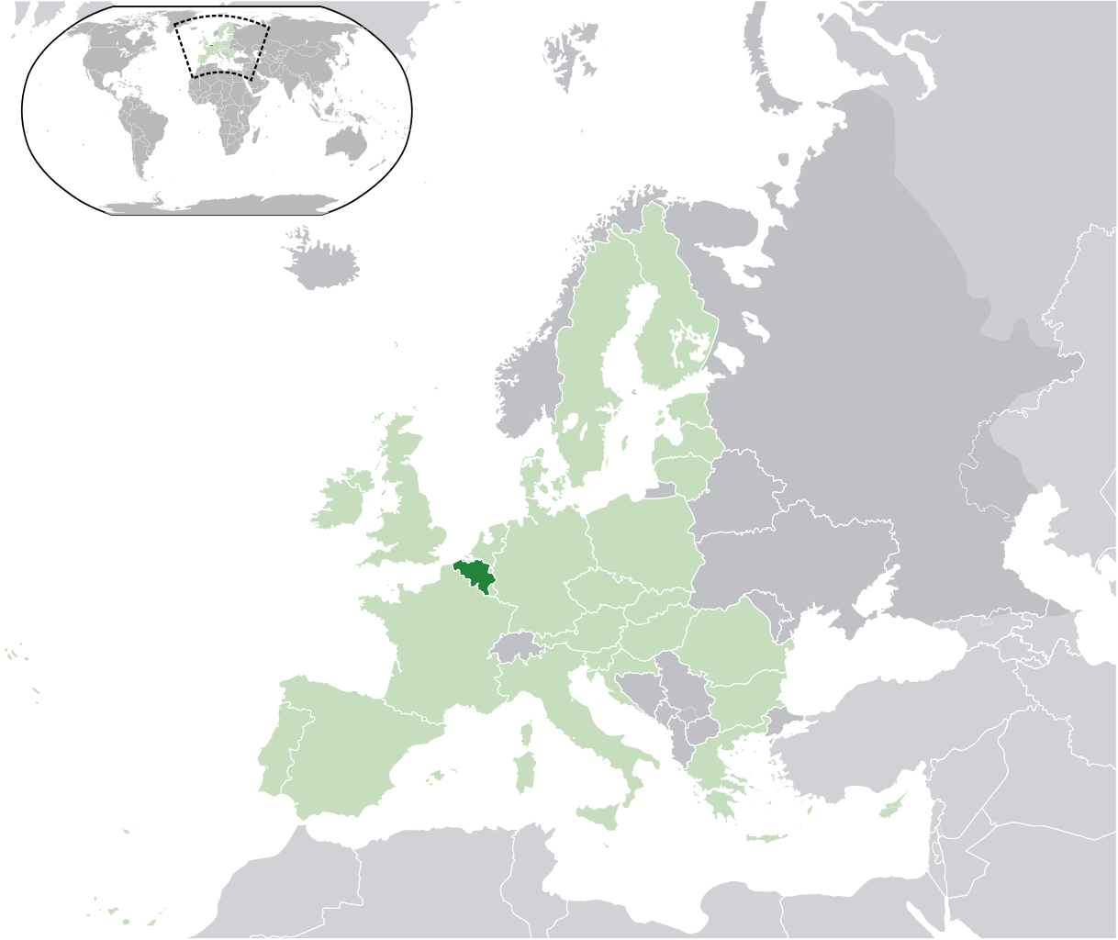
Pierre Cardol
Senior Research Associate
Belgian funds for research
(F.R.S.-FNRS)
Bioenergetics in microlagae.
Electron transfer chains : structure, function & evolution
UNAM, Mexicó, March 13th, 2017

