Slide 1
Immersion: everybody talks about it, but nobody knows what it is, hence some conceptual propositions
Björn-Olav Dozo (with Fanny Barnabé and Julie Delbouille) @bjornolav
Liège Game Lab – University of Liège – Belgium – bo.dozo@uliege.be
Notes:
READ PLEASE!
Before you open this template be sure that you have installed these fonts:
OpenSans-CondLight.ttf from: http://www.fontsquirrel.com/fonts/open-sans-condensed
Titillium-Light.otf from: http://www.fontsquirrel.com/fonts/Titillium
All fonts are free for use in commercial projects!
If you have any problems with this presentation, please contact with me from this page: http://graphicriver.net/user/Bandidos?ref=bandidos
When add image, you must sent it to back! Right Click on Image -> Send to Back -> Send to Back

Slide 2
Immersion in Video Games: A Dominant Paradigm of Research
Immersion = omnipresent concept in the field of video games: it appears in the players’ debates, in the discourses of the industry, in the press and in the academic research (it is a commonplace in all the theories about fiction)
The word carries the idea that the audiences are likely to “absorb” themselves in fictional worlds, to get lost in them. Fictions would have the power (and the danger) to make us forget about “reality” and confuse the empirical world with the representation
Notes:
When add image, you must sent it to back! Right Click on Image -> Send to Back -> Send to Back

Slide 3
In game studies, researchers use the concept of immersion to describe the playing activity as a “diving” into a video game universe, BUT:
the word immersion continues to convey negative preconceptions against play and fiction
the concept is extremely vague and shape-shifting: it can be used to describe the player’s involvement or commitment to the game, the feeling of presence, the addiction, the identification with a character, the suspension of disbelief, etc.
Notes:
When add image, you must sent it to back! Right Click on Image -> Send to Back -> Send to Back

Slide 4
Some Attempts of Typologies
Douglas and Hargadon (2001)
Ermi and Mäyrä (2005)
Make a distinction between immersion and engagement based on the critical stance of the reader or player
Distinguish between sensory immersion, imaginative immersion and challenge-based immersion
Brown and Cairns (2004)
Arsenault and Picard (2008)
Divide immersion into a three-degree scale: engagement < engrossment < total immersion
Distinguish between three types of immersion (sensory, fictional and systemic) and three degrees

Slide 5
Epistemological Issues
The word immersion conveys the idea that the “immersed state” is reached mechanically and unconsciously as soon as the player interacts with the system
Researchers rarely question the desirability of the immersion state: it is postulated as the purpose of any gaming practice
The concepts of immersion, fun, pleasure and play end up getting confused and superimposed into the theories

Slide 6
Some Contradictions Between the Concept of Immersion and the Theories of Play
Theorists define play as a reflexive attitude, as a distance that players take with their ongoing activity:
Henriot
“If we penetrate the game to the point of having no more ability to step back and to disengage ourselves, if we play to the point of forgetting that we are playing, then we are alienated: we are no longer playing” (1969: 88)
Bonenfant
“To play is to appropriate the game, that is to say, to create a distance allowing freedom in the interpretation of the rules and results [...]” (2015: 86). “This internal distance created by the player differentiates what the player does as a game, or not as one” (2013)

Slide 7
Some Contradictions Between the Concept of Immersion and the Theories of Play
Consalvo
“[…] we cannot say that games are magic circles, where the ordinary rules of life do not apply. Of course they apply, but in addition to, in competition with, other rules and in relation to multiple contexts, across varying cultures, and into different groups, legal situations, and homes” (Consalvo, 2009: 416)
(⬄ Huizinga)
Frissen et. al.
“When we engage in playful activities, we do not, as Huizinga and Caillois suggest, step outside the everyday world into the magic circle of the play-world [...]. When we play, we can enthusiastically immerse ourselves in the play-world, while at the same time keeping an ironic distance towards our playful behavior, which just for that reason can be termed ‘playful’” (2015: 19)

Slide 8
Some Contradictions Between the Concept of Immersion and the Theories of Play
The game creates a layer of meaning that is superimposed on everyday reality during the play-time: it is not a separate world, but a mediation between us and reality
Bateson
The play is a metaphoric or figurative mode of interaction, where the actions performed by the players and the objects manipulated are no longer literal, but become signs of themselves
Ex.: When a monkey playfully nips at one of its peers, its action “denotes the bite, but it does not denote what would be denoted by the bite” (1987: 186)

Slide 9
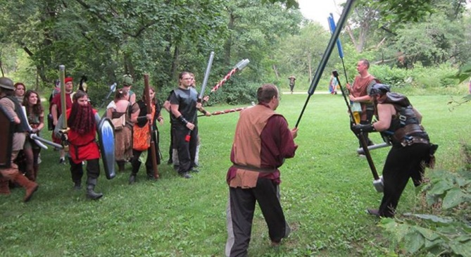
Some Contradictions Between the Concept of Immersion and the Theories of Play
Bateson
“This phenomenon, play, could only occur if the participant organisms were capable of some degree of meta-communication, i.e., of exchanging signals which would carry the message ‘this is play’” (1987: 185)
Genvo
An activity or situation must make sure to be recognized as being a game through “pragmatic markers of playability” (2011: 76)

Slide 10
Some Contradictions Between the Concept of Immersion and the Theories of Play
Schaeffer
Playing = manipulating signs, making “as if”
(// Bateson) (⬄ Immersion)
BUT Schaeffer keeps the notion of immersion:
“Any fictional immersion implies the effectiveness of one representation” (=> the fiction must be credible, and we believe it on a “pre-attentional” level)
However, immersion also implies that this brief illusion is immediately blocked by our conscious attention
“Consequently, if the existence of such moments of confusion between reality and representation is remarkable, their relative rarity and extreme brevity are equally noteworthy, since it illustrates the power of conscious control […]” (Schaeffer, 1999: 189)

Slide 11
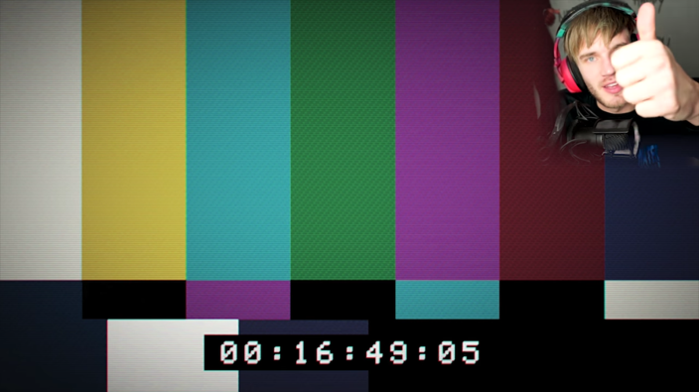
Some Contradictions Between the Concept of Immersion and the Theories of Play
Schaeffer
“As soon as our consciousness itself is deceived, we are no longer in a state of fictional immersion, but in the illusion, in the common sense of the term. As a consequence, we are no longer in the field of fiction” (Schaeffer, 1999: 192)
What Schaeffer demonstrates is, ultimately, the total domination of the moments of detachment in our consumption of fictions

Slide 12
Eventually, what is immersion ?
What remains when we leave behind all that helps immersion but is not the concept itself (as empathy, identification, attachment, etc.) ?
➔ A specific play experience, in a context of action

Slide 13
What kind of play experience ?
A vertigo that, upsetting the traditional landmarks of time and space, suspends and surprises the player in a double state: at the same time eminently present at the game, and a fascinated observer, enjoying his own playful pleasure. That a grain of sand comes to slip into the wheels of this sensory machinery and this moment of grace - which is not unlike the It of jazz or certain descriptions of the flow in positive psychology - ends.
Barnabé, Delbouille, Dozo, 2018

Slide 14
Beyond the Immersion: Other Kinds of Relationships to Game and Play
Disengagement and Low Intensity Games
(2) Secondary Play
(3) Transformative Play

Slide 15
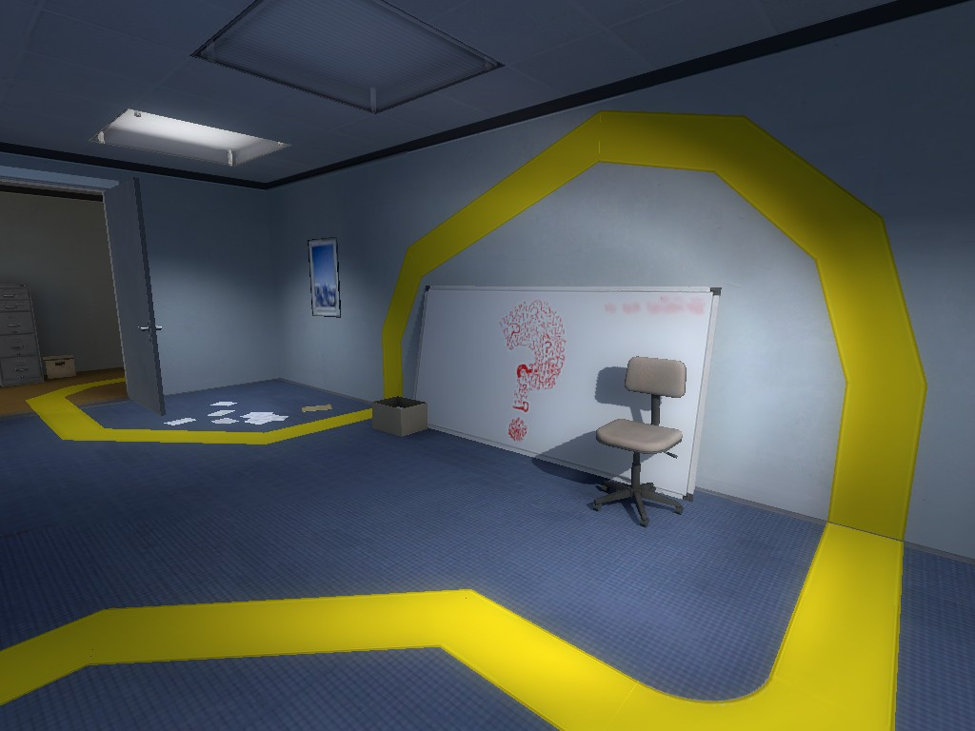
Conclusion

Slide 16
Works cited
Arsenault Dominic and Picard Martin (2008), « Le jeu vidéo entre dépendance et plaisir immersif : les trois formes d’immersion vidéoludique » [trans. : “Video game between addiction and immersive pleasure: the three forms of videoludic immersion”], in Proceedings of HomoLudens: Le jeu vidéo: un phénomène social massivement pratiqué [online]. URL: http://ludicine.ca/sites/ludicine.ca/files/arsenault,-picard---le-jeu-video-entre-dependance-et-plaisir-immersif_0.pdf
Bateson Gregory (1987) [1972], “A Theory of Play and Fantasy”, in Steps to an ecology of mind, Northvale, Jason Aronson Inc., pp. 183-198 [online]. URL: http://nomadicartsfestival.com/wp-content/uploads/2015/02/Gregory-Bateson-Ecology-of-Mind.pdf
Bonenfant Maude (2013), « La conception de la “distance” de Jacques Henriot : un espace virtuel de jeu » [trans.: “Jacques Henriot’s conception of ‘distance’: a virtual space of play”], Sciences du jeu, n° 1 [online]. URL: https://sdj.revues.org/235
Bonenfant Maude (2015), Le libre jeu. Réflexion sur l’appropriation de l’activité ludique [trans.: The free play. Reflection about the appropriation of the playing activity], Montréal, Liber
Boutet Manuel (2012), « Jouer aux jeux vidéo avec style. Pour une ethnographie des sociabilités vidéoludiques » [trans.: “Playing video games with style. For an ethnography of gaming sociabilities”], Réseaux, n° 207, pp. 173-174 [online]. URL: https://www.cairn.info/revue-reseaux-2012-3-page-207.htm
Boutet Manuel, Colón de Carvajal Isabel, Ter Minassian Hovig and Triclot Mathieu (2014), « Au-delà du virtuel : interactions sociales et spatiales dans et autour d'un univers vidéoludique » [trans. : Beyond the virtual: social and spatial interactions in and around a video game world], MEI - Médiation et information, n° 37, pp. 103-116 [online]. URL : https://halshs.archives-ouvertes.fr/halshs-00851446/file/ Ter_minassian_et_alii_A_paraA_tre_dans_MEI_37_.pdf
Brown Emily and Cairns Paul (2004), “A Grounded Investigation of Game Immersion”, in Proceeding of CHI '04 Extended Abstracts on Human Factors in Computing Systems, New York, ACM Publications, pp. 1297-1300 [online]. URL: https://www-users.cs.york.ac.uk/~pcairns/ papers/Immersion.pdf

Slide 17
Works cited
Bricout Laëtitia (2013), « Partage, singularité et création de valeur. L’expérience des jeux vidéo, en vidéos sur Youtube » [trans.: “Sharing, singularity and value creation. The video game experience in videos on Youtube”], Master’s thesis in Sociology of business and innovation, Université Paris-Est [online]. URL : http://master-communication-upem.fr/wp-content/uploads/2014/05/M2-ComUPEM-2013-Youtubers-La%C3%ABtitia-Bricout.pdf
Caïra Olivier (2016), « Les dimensions multiples de l’engagement ludique » [trans.: “The multiple dimensions of playful commitment”], Paper presented at the LabJMV conference: À quoi nous engage le jeu ?, Institut des Hautes Etudes des Communications Sociales – IHECS
Calleja Gordon (2011), In-Game: From immersion to incorporation, Cambridge, MIT Press [online]. URL: https://is.muni.cz/el/1421/podzim2016/IM082/Gordon_Calleja-In-Game__From_Immersion_to_Incorporation_-MIT_Press__2011_.pdf
Consalvo Mia (2009), “There is No Magic Circle”, Games and Culture, vol. 4, n° 4, pp. 408-417 [online]. URL: https://www.academia.edu/ 654444/There_is_no_magic_circle
Csikszentmihályi Mihály (1990), Flow: The Psychology of Optimal Experience, New York, Harper & Row
Delbouille Julie (2017), « L'avatar du jeu vidéo. De la composante ludique à l'opérateur de réflexivité » [trans. : “The video game avatar. From game component to reflexivity operator”], Class of History and analysis of video game practices, University of Liège
Barnabé Fanny et Delbouille Julie, Dozo Björn-Olav (2018), « Immersion et réflexivité. L’avatar au cœur de la construction de la posture vidéoludique», dans René Audet et Nicolas Xanthos (dir.), Le personnage contemporain, Presses de la Sorbonne nouvelle
Douglas Jane Y. and Hargadon Andrew (2001), “The Pleasures of Immersion and Engagement: Schemas, Scripts and the Fifth Business”, Digital Creativity, vol. 12, n° 3, pp. 153-166 [online]. URL: https://pdfs.semanticscholar.org/381f/7d40b668a2924e602febaaeb2977803 65a7c.pdf
Ensslin Astrid (2015), “Video Games as Unnatural Narratives”, in Fuchs Mathias (ed.), Diversity of Play, Lunebourg, Meson Press, pp. 41-72 [online]. URL: http://research.bangor.ac.uk/portal/files/7178360/PDB5367-00.pdf

Slide 18
Works cited
Ermi Laura and Mäyrä Frans (2005), “Fundamental Components of the Gameplay Experience: Analysing Immersion”, in Proceedings of the 2005 DiGRA International Conference: Changing Views: Worlds in Play, Vancouver [online]. URL: http://www.digra.org/wp-content/uploads/ digital-library/06276.41516.pdf
Frissen Valerie, Lammes Sybille, De Lange Michiel, De Mul Jos and Raessens Joost (2015), eds., Playful Identities. The Ludification of Digital Media Cultures, Amsterdam, Amsterdam University Press
Genvo Sébastien (2011), « Penser les phénomènes de “ludicisation” du numérique : pour une théorie de la jouabilité » [trans.: “Thinking the ‘ludicisation’ phenomena of digital: for a theory of playability”], Revue des sciences sociales, n° 45 [online]. URL: http://www.ludologique.com/publis/Ludicisation_Genvo_S.pdf
Held Richard and Durlach Nathaniel (1992), “Telepresence”, Presence: Teleoperators and Virtual Environments, vol. 1, n° 1, pp. 109-112
Henriot Jacques (1969), Le jeu [trans.: The play], Paris, Presses Universitaires de France
Henriot Jacques (1989), Sous couleur de jouer. La métaphore ludique [trans.: Wearing the colours of a player. The playful metaphor], Paris, José Corti
Hurel Pierre-Yves (2017), « Le passage du jeu à la création : le cas du jeu vidéo amateur » [trans. : “The transition from play to creation: the case of fannish video game”], Sciences du jeu, n° 7 [online]. URL : http://sdj.revues.org/766
Kapp Sébastien (2013), L’immersion fictionnelle collaborative. Une étude de la posture d’engagement dans les jeux de rôles grandeur nature [trans.: Fictional collaborative immersion. A study of the posture of commitment in live action role-playing games], PhD dissertation in Sociology, École des Hautes Études en Sciences Sociales (EHESS), Université Libre de Bruxelles [online]. URL: https://tel.archives-ouvertes.fr/tel-00907733/document

Slide 19
Works cited
Lombard Matthew and Ditton Theresa (1997), “At the Heart of It All: The Concept of Presence”, Journal of Computer-Mediated Communication, vol. 3, n° 2 [online]. URL: http://onlinelibrary.wiley.com/doi/10.1111/j.1083-6101.1997.tb00072.x/full
Newman James (2002), “The Myth of the Ergodic Videogame. Some thoughts on player-character relationships in videogames”, Game Studies, vol. 2, n° 1 [online]. URL: http://www.gamestudies.org/0102/newman/
Richardson Brian (2011), “What is Unnatural Narrative Theory?”, in Alber Jan and Heinze Rüdiger (eds.), Unnatural Narratives – Unnatural Narratology, Berlin, Walter De Gruyter, pp. 23-40
Salen Katie and Zimmerman Eric (2004), Rules of Play: Game Design Fundamentals, MIT Press, Cambridge
Schaeffer Jean-Marie (1999), Pourquoi la fiction ? [trans.: Why the fiction?], Paris, Seuil
Slater Mel and Wilbur Sylvia (1997), “A Framework for Immersive Virtual Environments (Five): Speculations on the Role of Presence in Virtual Environments”, Presence: Teleoperators and Virtual Environments, vol. 6, n° 6, pp. 603-616 [online]. URL: http://citeseerx.ist.psu.edu/viewdoc/download?doi=10.1.1.472.622&rep=rep1&type=pdf
Therrien Carl (2011), Illusion, idéalisation, gratification : l'immersion dans les univers de fiction à l'ère du jeu vidéo [trans.: Illusion, idealization, gratification: immersion in fictional worlds in the video games age], PhD dissertation in Semiology, Université du Québec à Montréal [online]. URL: http://www.archipel.uqam.ca/4087/1/D2185.pdf
Witmer Bob G. and Singer Michael J. (1998), “Measuring Presence in Virtual Environments: A Presence Questionnaire”, Presence: Teleoperators and Virtual Environments, vol. 7, n° 3, pp. 225-240 [online]. URL: https://nil.cs.uno.edu/publications/papers/witmer 1998measuring.pdf

