Slide 2
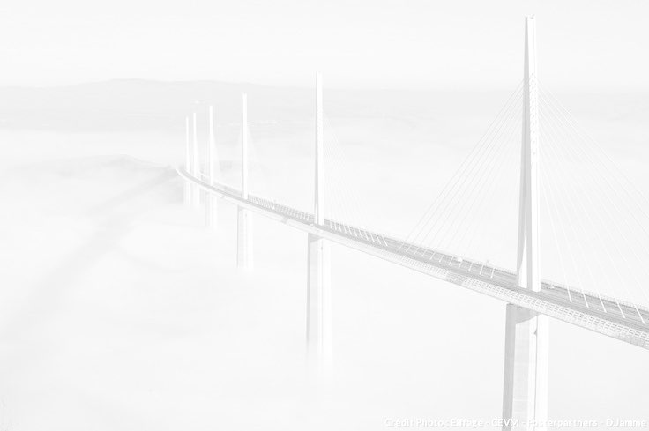
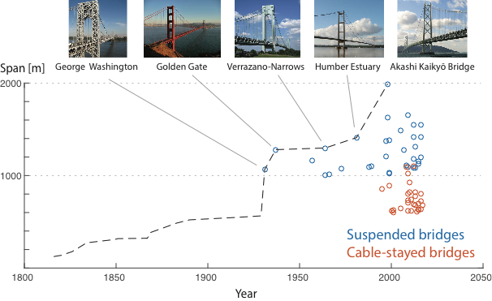
Aeroelastic modeling of bridge decks
— Good & bad practices in wind tunnel testing —

Slide 3
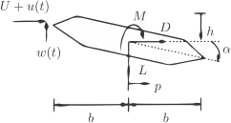
Aeroelastic modeling of bridge decks
— Good & bad practices in wind tunnel testing —
Static + Self-Excited + Buffeting
Additivity & Linearity

Slide 4
Aeroelastic modeling of bridge decks
— Good & bad practices in wind tunnel testing —
Time domain
Frequency domain
Nonlinearities
! transient regime
Simple to implement
Generation of large wind fields
Design/Extreme values
Use modal analysis
>> Easy to understand
Modal coupling
Nonlinearities
Non Gaussianity

Slide 5
Aeroelastic modeling of bridge decks
— Good & bad practices in wind tunnel testing —
Time domain
Frequency domain
Nonlinearities
! transient regime
Simple to implement
Generation of large wind fields
Design/Extreme values
Use modal analysis
>> Easy to understand
Modal coupling
Nonlinearities
Non Gaussianity

Slide 6
Aeroelastic modeling of bridge decks
— Good & bad practices in wind tunnel testing —
Thanks to: Bartosz Siedziako and Ole Øiseth (NTNU)

Slide 7
The intriguing question …
How much do we rely on
additivity and linearity
of loading models ?
Vincent DENOEL
v.denoel@uliege.be

