Slide 1
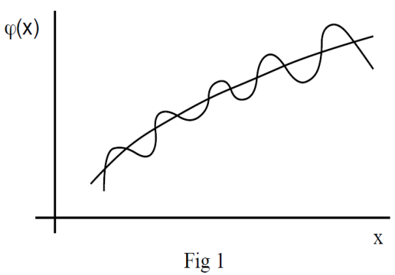
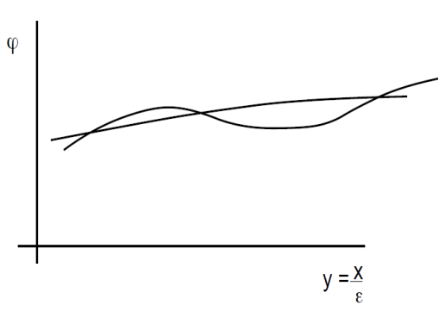
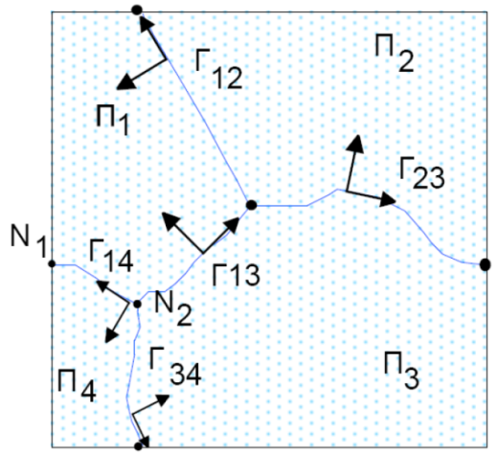
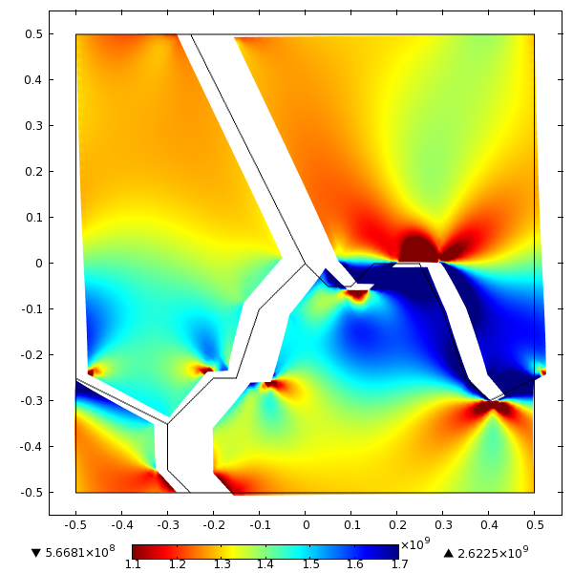
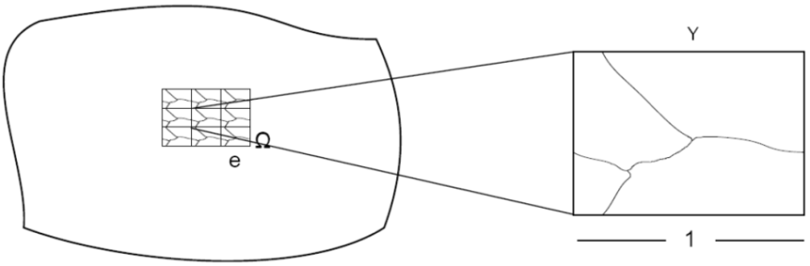
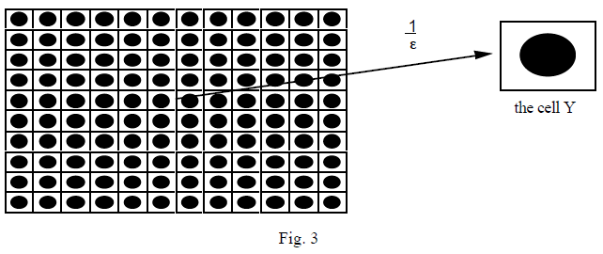




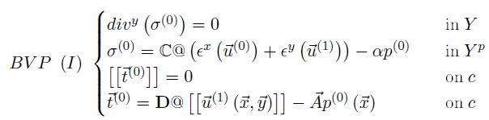
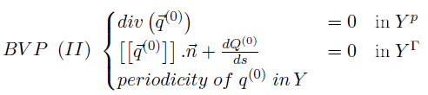
Homogenization of a Cracked Poroelastic Medium -
Numerical calculation of the coeficients and damage
Albert Argilaga Claramunt
Project advisors: Denis Caillerie, Stefano Dal Pont, Ferdinando Marinelli
Homogenization of Periodic Media
Numerical calculation: finite element method
Double scale assimptotic expansions
Homogenized coeficients (linear problem)
Case Study: Cracked poroelastic medium
Damage in the cracks:
The problem is not linear anymore, we need to use an iterative scheme in order to calculate the coeficients evolving with the opening of the cracks.

