Slide 1
Homogenization of a Cracked Poroelastic Medium -
Numerical calculation of the coefficients and damage
Albert Argilaga Claramunt
Project advisors:
Denis Caillerie
Stefano Dal Pont
Ferdinando Marinelli

Slide 2
Homogenization of a Cracked Poroelastic Medium - Numerical calculation of the coefficients and damage
Introduction

Slide 3
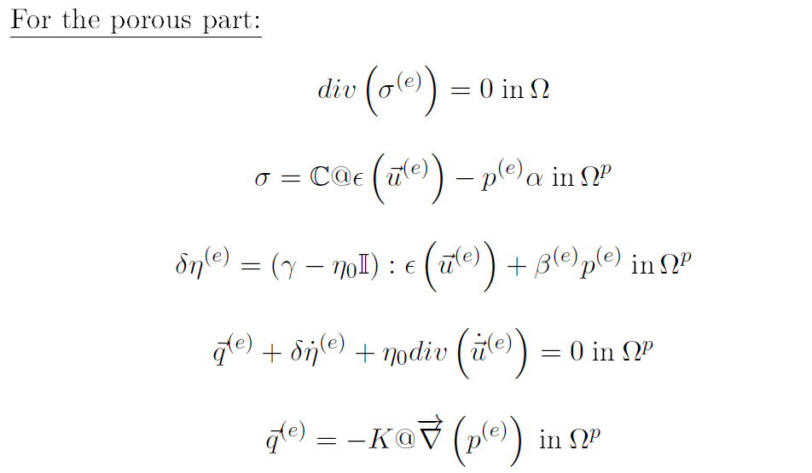
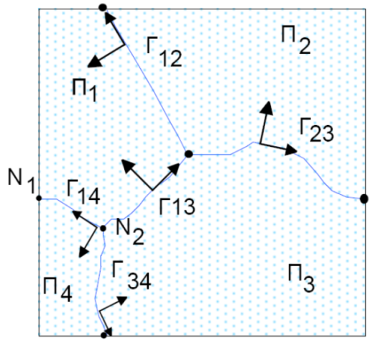
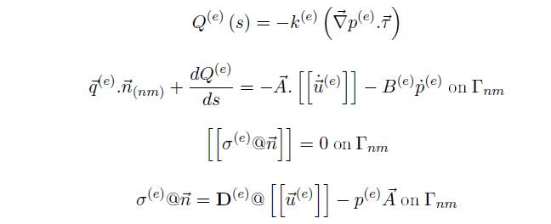
Homogenization of a Cracked Poroelastic Medium - Numerical calculation of the coefficients and damage
Case Study: Cracked poroelastic medium

Slide 4
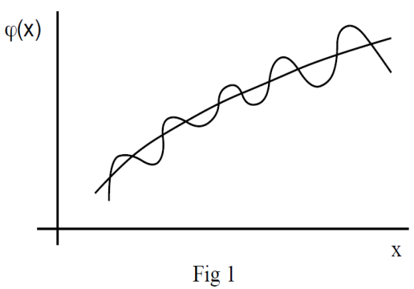
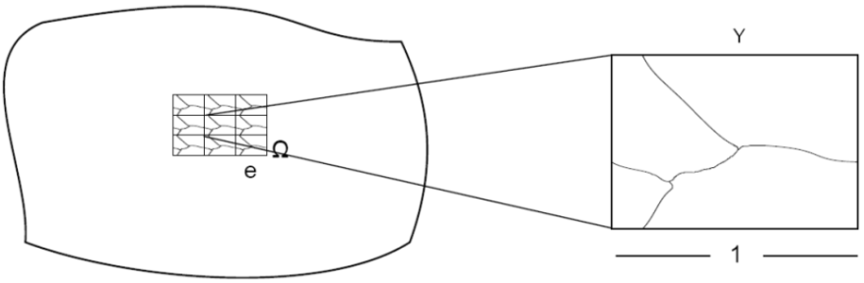
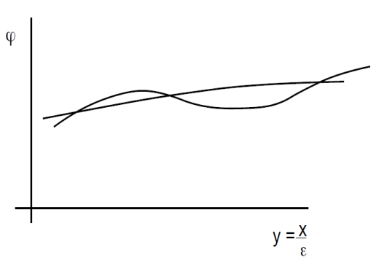
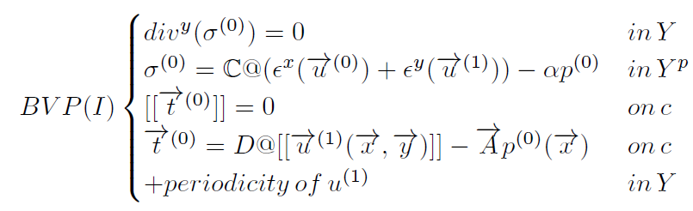
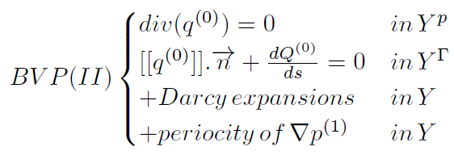
Homogenization of a Cracked Poroelastic Medium - Numerical calculation of the coefficients and damage
Homogenization of Periodic Media:
The problem splits in two uncoupled boundary value problems:

Slide 5
Homogenization of a Cracked Poroelastic Medium - Numerical calculation of the coefficients and damage
Numerical computation

Slide 6
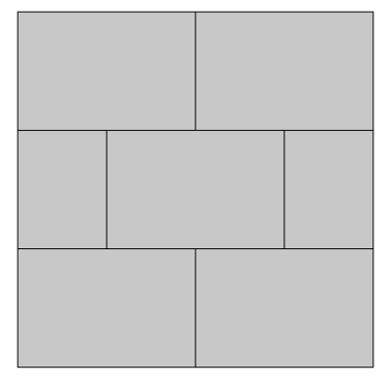
Homogenization of a Cracked Poroelastic Medium - Numerical calculation of the coefficients and damage
Calculation of the homogenized coefficients (linear problem) BVP I:
Microscale coefficients:
Microscale geometry:
 | Porous media | Cracks
Elasticity (Pa)
Biot (-)
 | Porous media | Cracks
Darcy (m/s)
Crack network
Periodic conditions

Slide 7
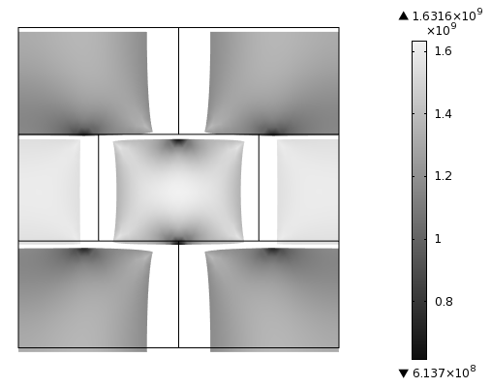
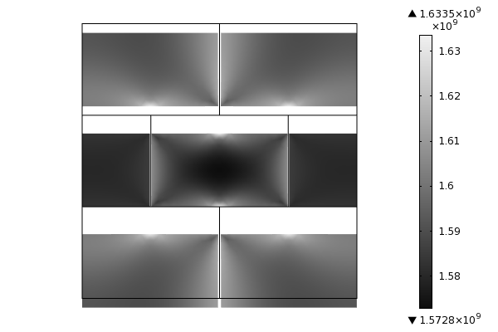
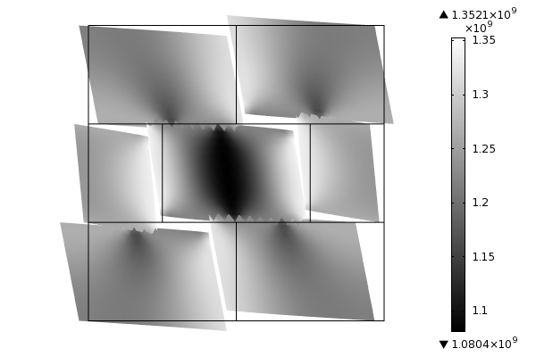
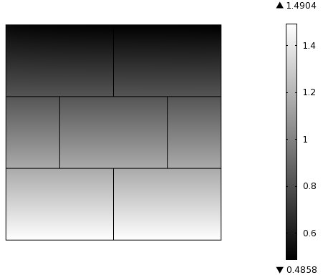
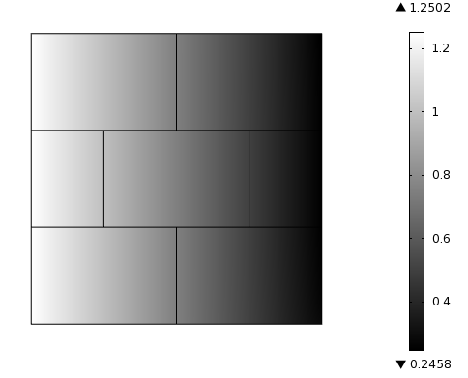
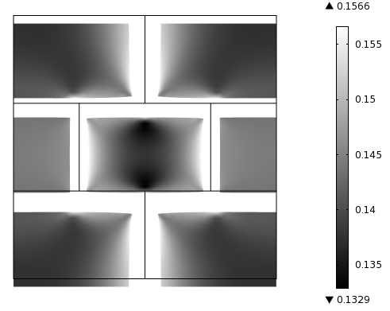
Homogenization of a Cracked Poroelastic Medium - Numerical calculation of the coefficients and damage
Calculation of the homogenized coefficients (linear problem)

Slide 8
Homogenization of a Cracked Poroelastic Medium - Numerical calculation of the coefficients and damage
Calculation of the homogenized coefficients (linear problem)
Summary:
 | Microscale |  | Macroscale
 | Porous media | Cracks | Homogenized
Elasticity (Pa)
Biot (-)
Darcy (m/s)

Slide 9
Homogenization of a Cracked Poroelastic Medium - Numerical calculation of the coefficients and damage
Damage

Slide 10
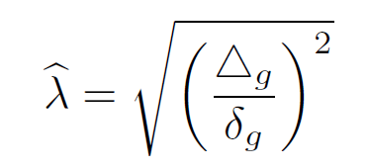
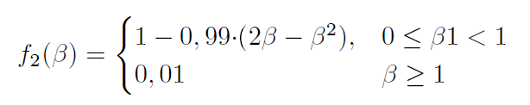
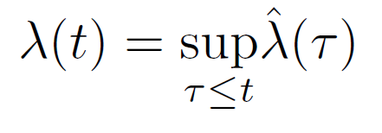
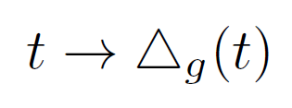
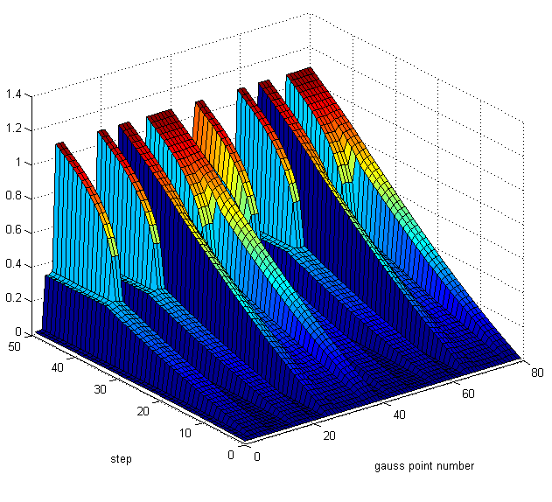
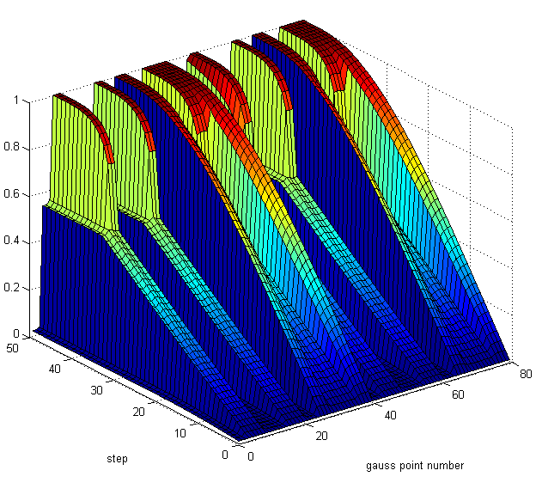
Homogenization of a Cracked Poroelastic Medium - Numerical calculation of the coefficients and damage
Damage:
Formulation of the problem and results
Lambda parameter
Damage parameter

Slide 11
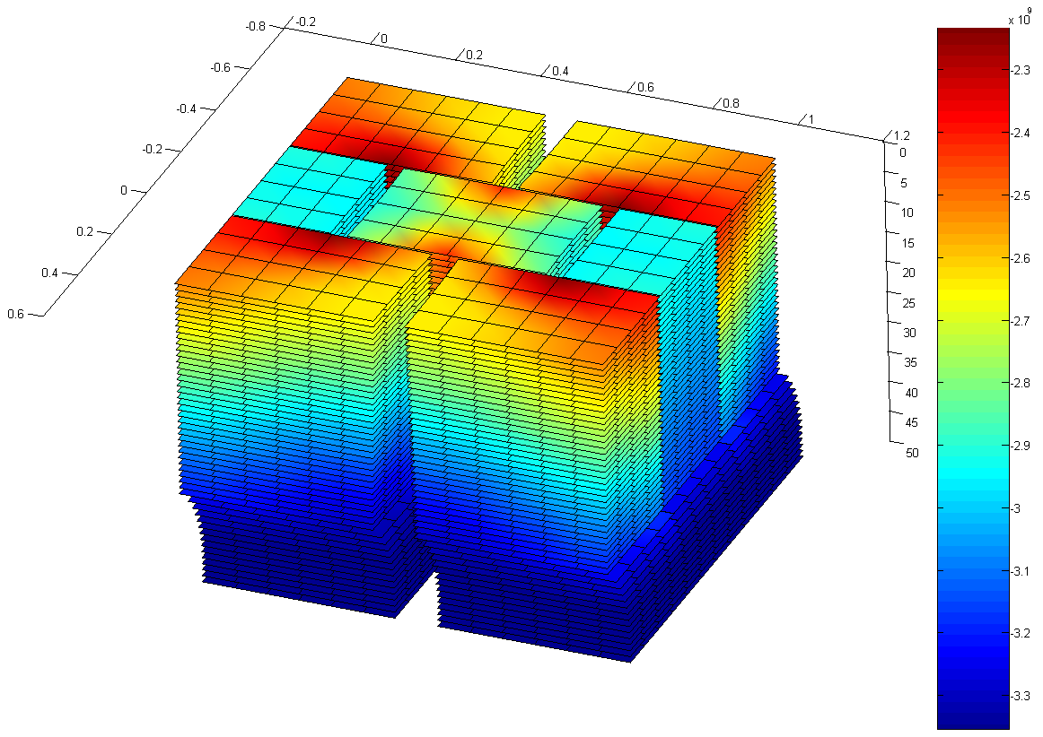
Homogenization of a Cracked Poroelastic Medium - Numerical calculation of the coefficients and damage
Damage:
Evolution of the results

Slide 12
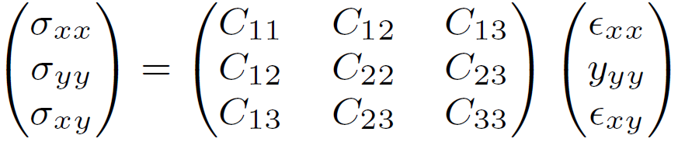
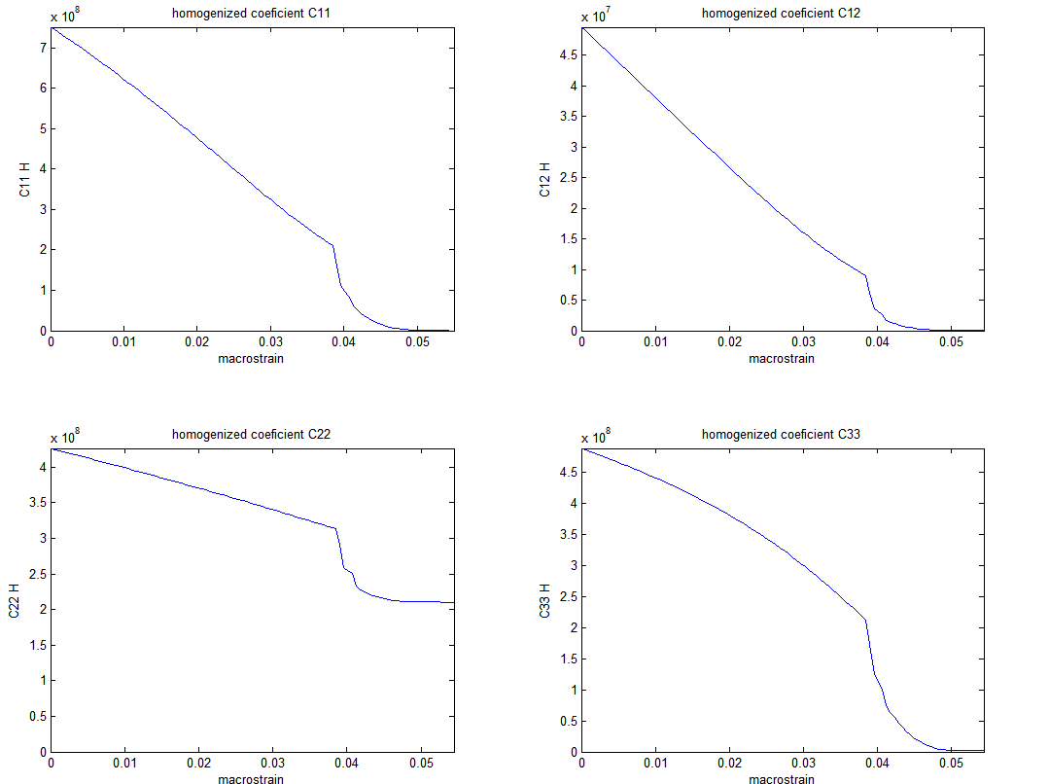
Homogenization of a Cracked Poroelastic Medium - Numerical calculation of the coefficients and damage
Coefficient evolution:
Applied time-history:

Slide 13
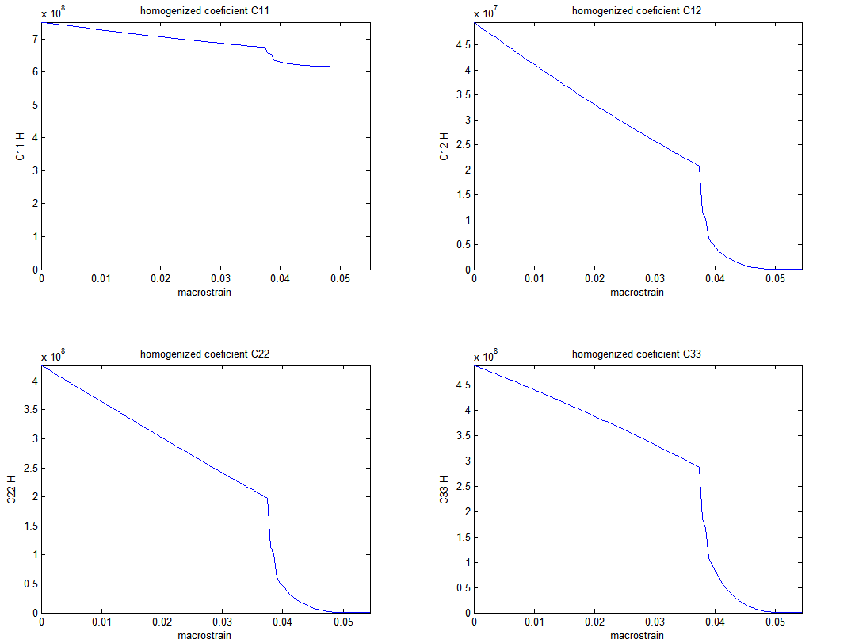
Homogenization of a Cracked Poroelastic Medium - Numerical calculation of the coefficients and damage
Coefficient evolution:
Applied time-history:

Slide 14
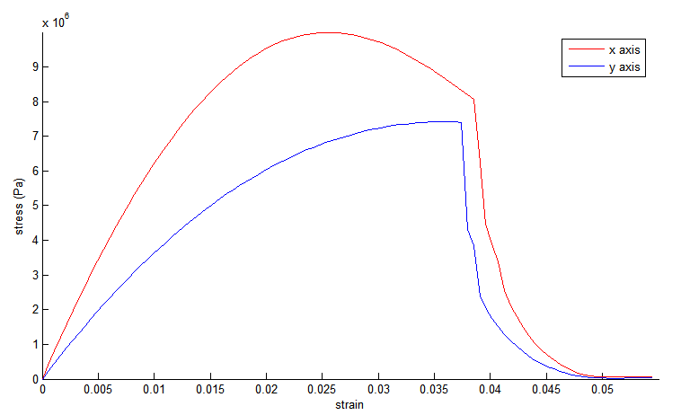
Homogenization of a Cracked Poroelastic Medium - Numerical calculation of the coefficients and damage
Damage,
Application of the results: oedometric path.

Slide 15
Homogenization of a Cracked Poroelastic Medium - Numerical calculation of the coefficients and damage
Controlability

Slide 16


Homogenization of a Cracked Poroelastic Medium - Numerical calculation of the coefficients and damage

Slide 17
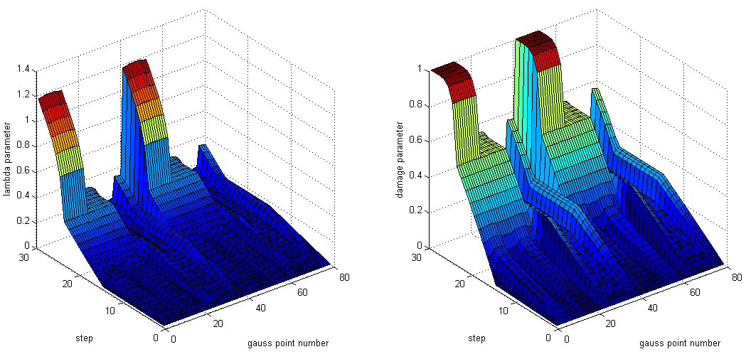
Homogenization of a Cracked Poroelastic Medium - Numerical calculation of the coefficients and damage
Lambda parameter
Damage parameter

Slide 18
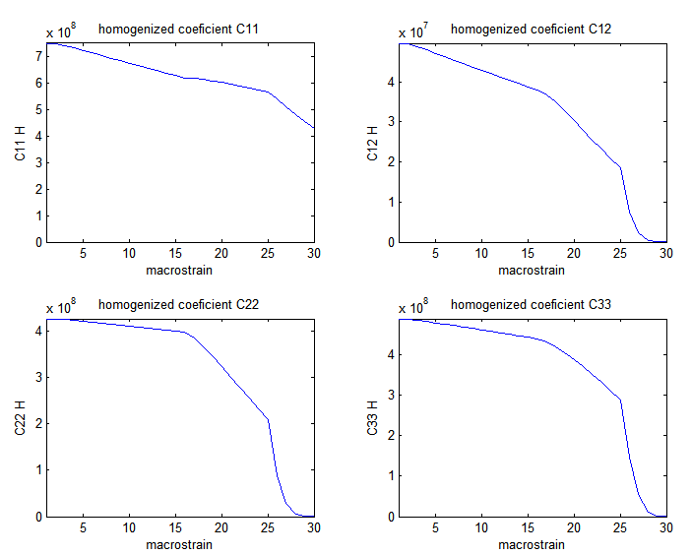
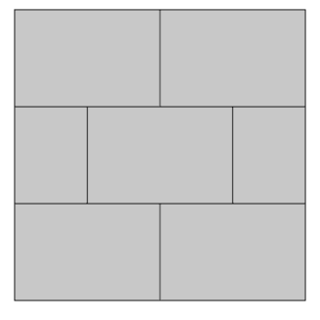
Homogenization of a Cracked Poroelastic Medium - Numerical calculation of the coefficients and damage
Coefficient evolution:

Slide 19
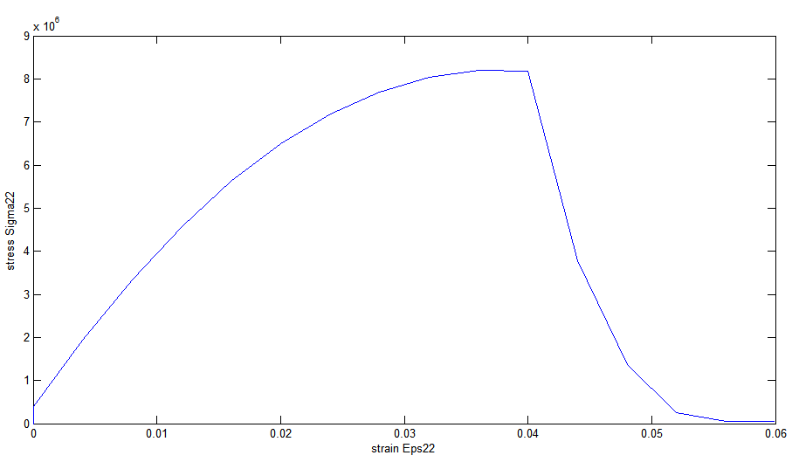
Homogenization of a Cracked Poroelastic Medium - Numerical calculation of the coefficients and damage
Damage and controlability,
Application of the results: biaxial path.

