Slide 1
Homogenization of a Cracked Poroelastic Medium -
Numerical calculation of the coefficients and damage
Albert Argilaga Claramunt
Project advisors:
Denis Caillerie
Stefano Dal Pont
Ferdinando Marinelli

Slide 2
Homogenization of a Cracked Poroelastic Medium - Numerical calculation of the coefficients and damage
Introduction: theoretical background

Slide 3
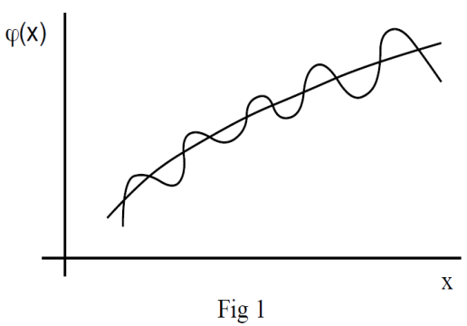
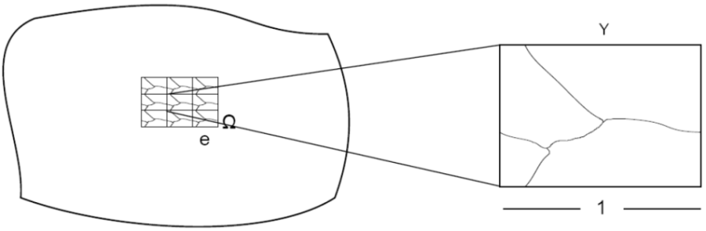
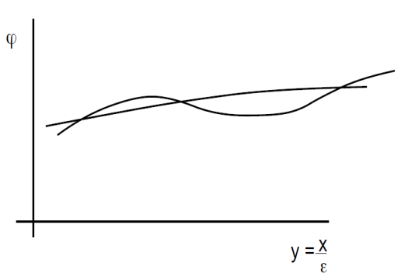
Homogenization of a Cracked Poroelastic Medium - Numerical calculation of the coefficients and damage
Homogenization of Periodic Media:
many physics problems with finely heterogeneous continuous media. In fact all the continuous media may also be considered as heterogeneous.
Two approaches are possible :
1) Ignore the microscale, a constitutive law of the medium is set up for the macroscale.
2) Deduce the macroscopic behaviour from the study of the microscopic structure.

Slide 4
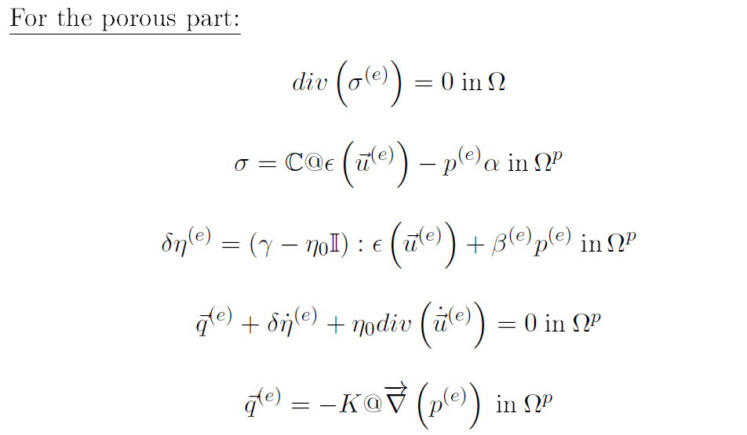
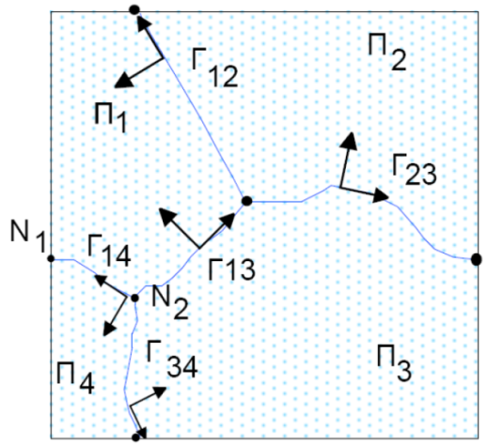
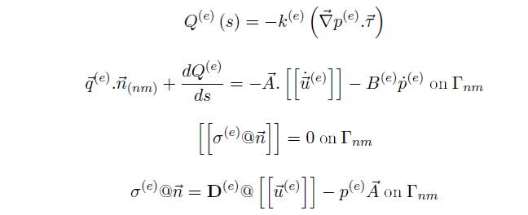
Homogenization of a Cracked Poroelastic Medium - Numerical calculation of the coefficients and damage
Case Study: Cracked poroelastic medium

Slide 5
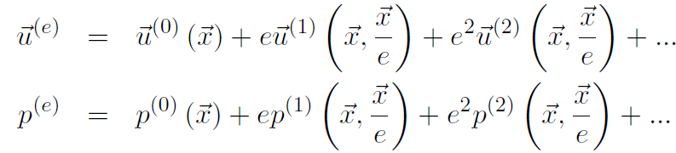

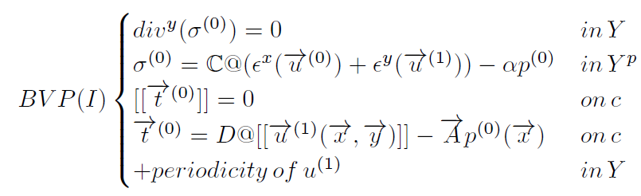
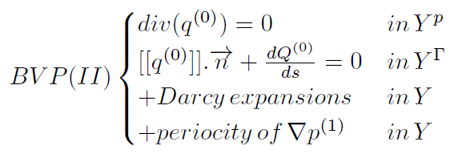
Homogenization of a Cracked Poroelastic Medium - Numerical calculation of the coefficients and damage
Homogenization of Periodic Media:
Double scale asymptotic expansions
The problem splits in two uncoupled boundary value problems:

Slide 6
Homogenization of a Cracked Poroelastic Medium - Numerical calculation of the coefficients and damage
Numerical computation

Slide 7


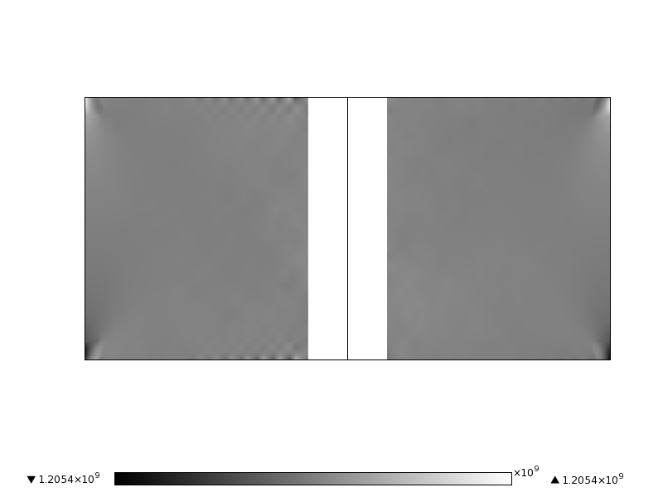


Homogenization of a Cracked Poroelastic Medium - Numerical calculation of the coefficients and damage
Numerical calculation; validation:
We solve a simple geometry case in order to validate the numerical results for the BVP (I).
An analytical solution exists.
Parameters:

Slide 8
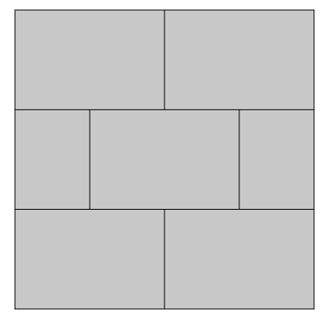
Homogenization of a Cracked Poroelastic Medium - Numerical calculation of the coefficients and damage
Calculation of the homogenized coefficients (linear problem) BVP I:
Microscale coefficients:
Microscale geometry:
 | Porous media | Cracks
Elasticity (Pa)
Biot (-)
Crack network
Periodic conditions

Slide 9
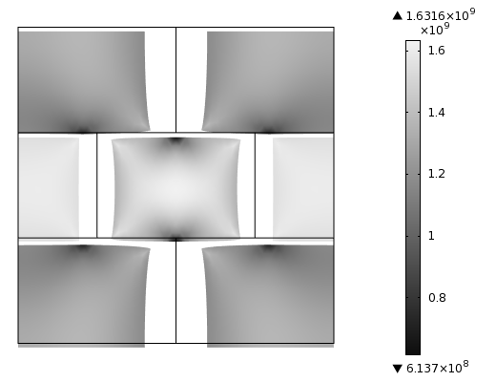
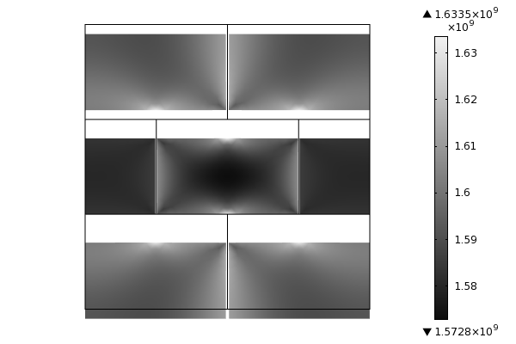
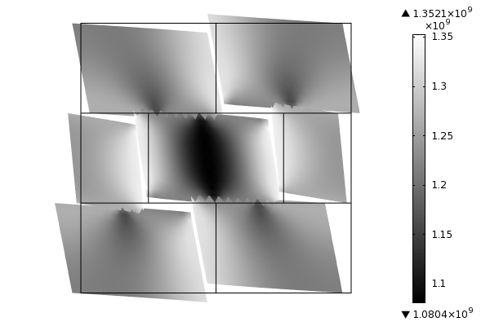

Homogenization of a Cracked Poroelastic Medium - Numerical calculation of the coefficients and damage
Calculation of the homogenized coefficients (linear problem)
BVP I, Elasticity:

Slide 10
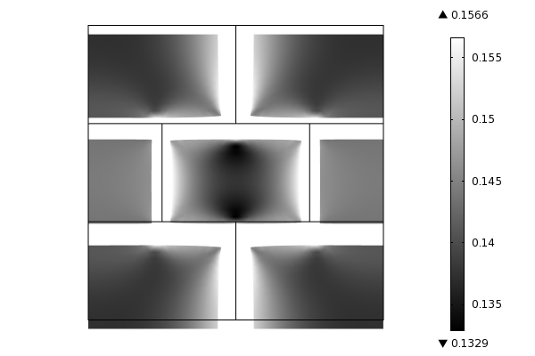
Homogenization of a Cracked Poroelastic Medium - Numerical calculation of the coefficients and damage
Calculation of the homogenized coefficients (linear problem)
BVP I, Biot:

Slide 11
Homogenization of a Cracked Poroelastic Medium - Numerical calculation of the coefficients and damage
Calculation of the homogenized coefficients (linear problem)
BVP II, flow of water:
Microscale coefficients:
Microscale geometry:
 | Porous media | Cracks
Darcy (m/s)
Crack network
Periodic conditions

Slide 12
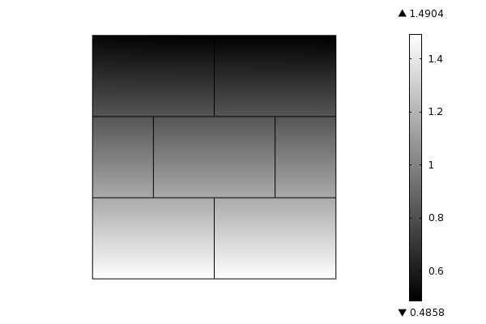
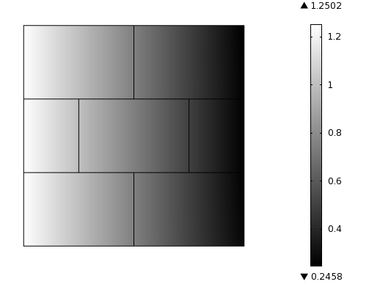

Homogenization of a Cracked Poroelastic Medium - Numerical calculation of the coefficients and damage
Calculation of the homogenized coefficients (linear problem)
BVP II: flow of water.

Slide 13
Homogenization of a Cracked Poroelastic Medium - Numerical calculation of the coefficients and damage
Calculation of the homogenized coefficients (linear problem)
Summary:
 | Microscale |  | Macroscale
 | Porous media | Cracks | Homogenized
Elasticity (Pa)
Biot (-)
Darcy (m/s)

Slide 14
Homogenization of a Cracked Poroelastic Medium - Numerical calculation of the coefficients and damage
Damage

Slide 15
Homogenization of a Cracked Poroelastic Medium - Numerical calculation of the coefficients and damage
Damage
Stepping macrostrain application
iterative method
iterative method
FEM model
FEM model
Constitutive damage law
f(lambda)
Constitutive damage law
f(lambda)

Slide 16
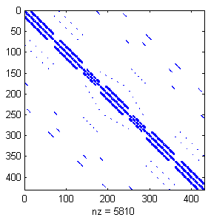
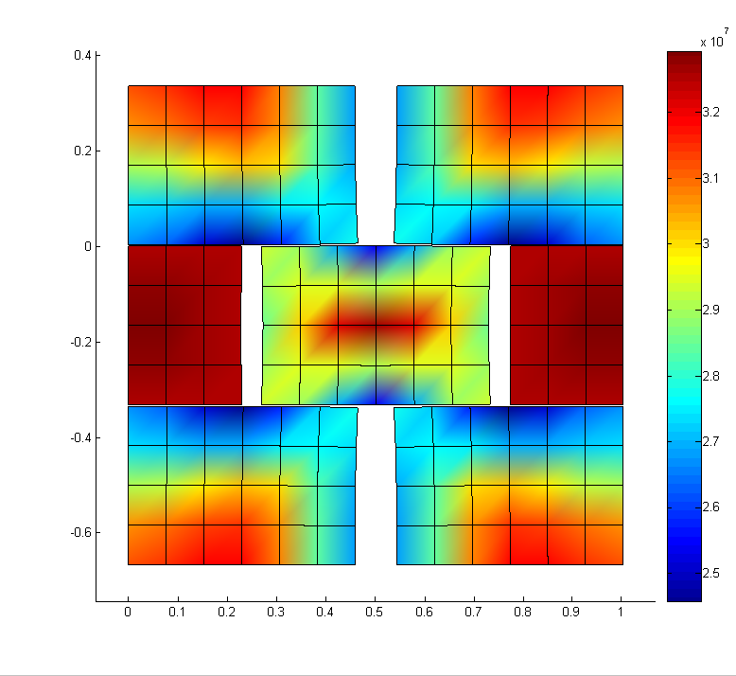
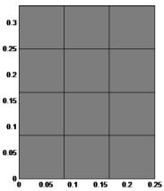
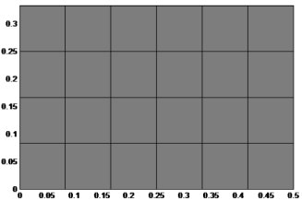
Homogenization of a Cracked Poroelastic Medium - Numerical calculation of the coefficients and damage
Damage:
numerical model
1) Building the FEM problem of the single grains.
2) Assembling in the global system matrix (plus elastic links and periodicity).
3) Validation of the solution, case without damage.

Slide 17
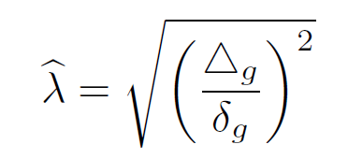
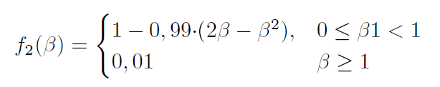
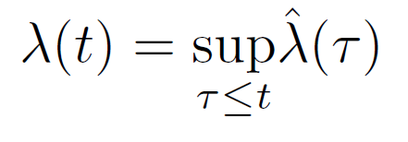
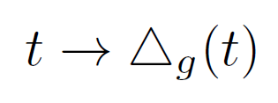
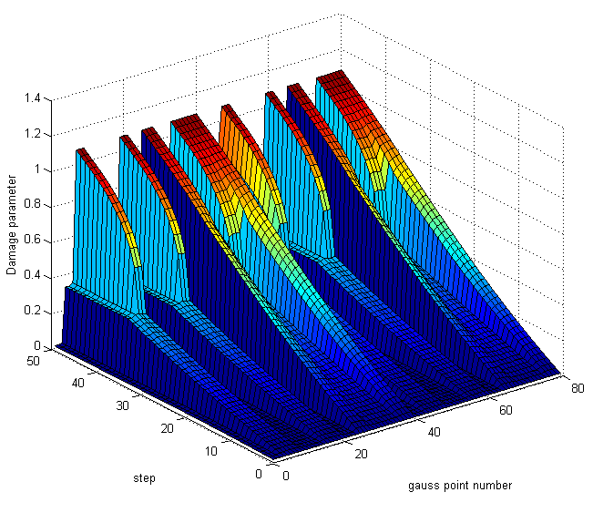
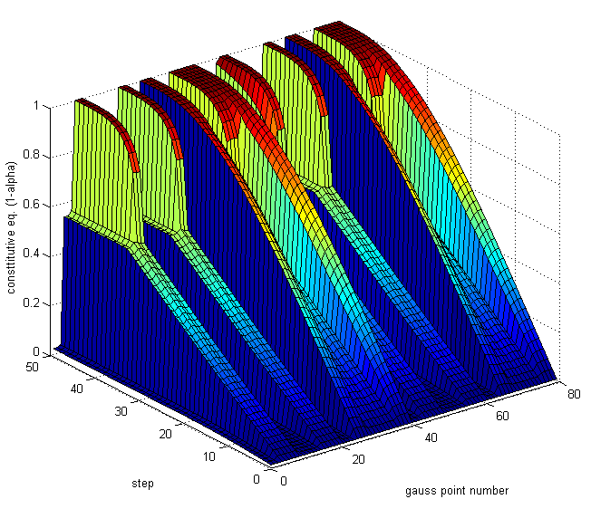
Homogenization of a Cracked Poroelastic Medium - Numerical calculation of the coefficients and damage
Damage:
Formulation of the problem and results
Damage parameter
Constitutive law

Slide 18
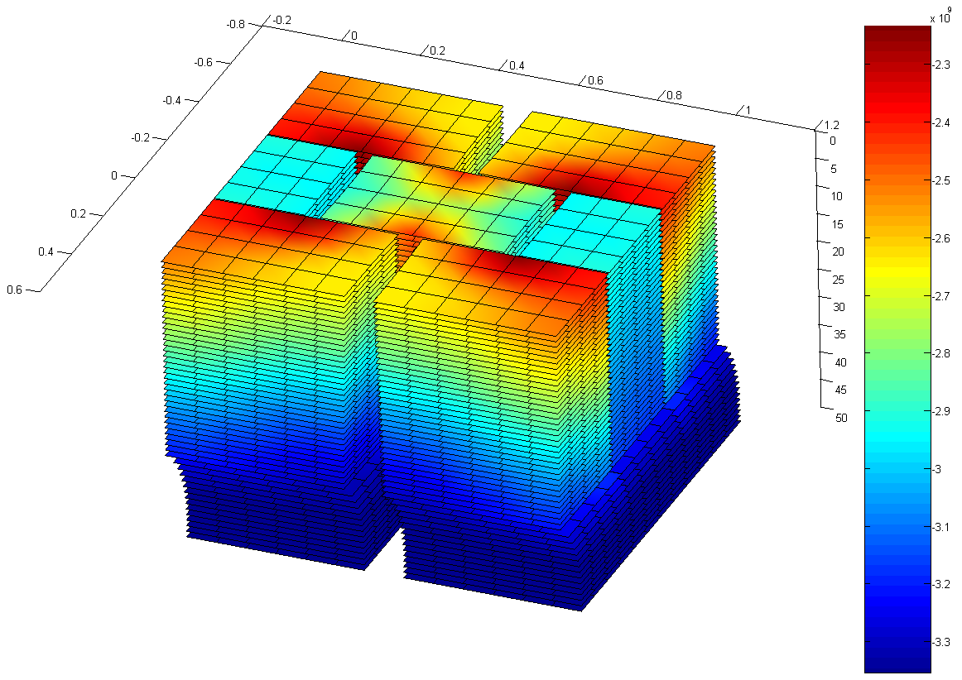
Homogenization of a Cracked Poroelastic Medium - Numerical calculation of the coefficients and damage
Damage:
Evolution of the results

Slide 19
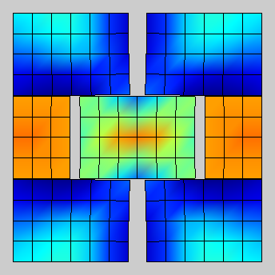
Homogenization of a Cracked Poroelastic Medium - Numerical calculation of the coefficients and damage
Damage: Evolution of the results

Slide 20
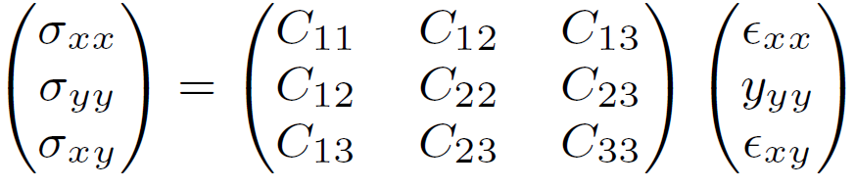
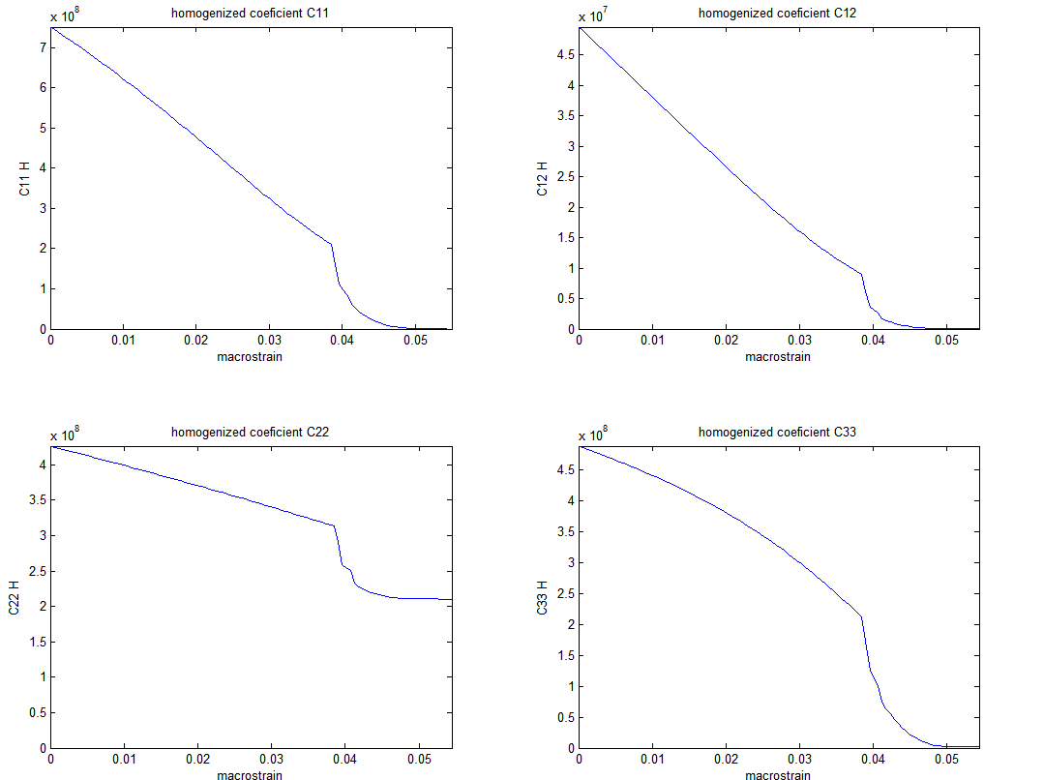
Homogenization of a Cracked Poroelastic Medium - Numerical calculation of the coefficients and damage
Coefficient evolution:
Applied time-history:

Slide 21
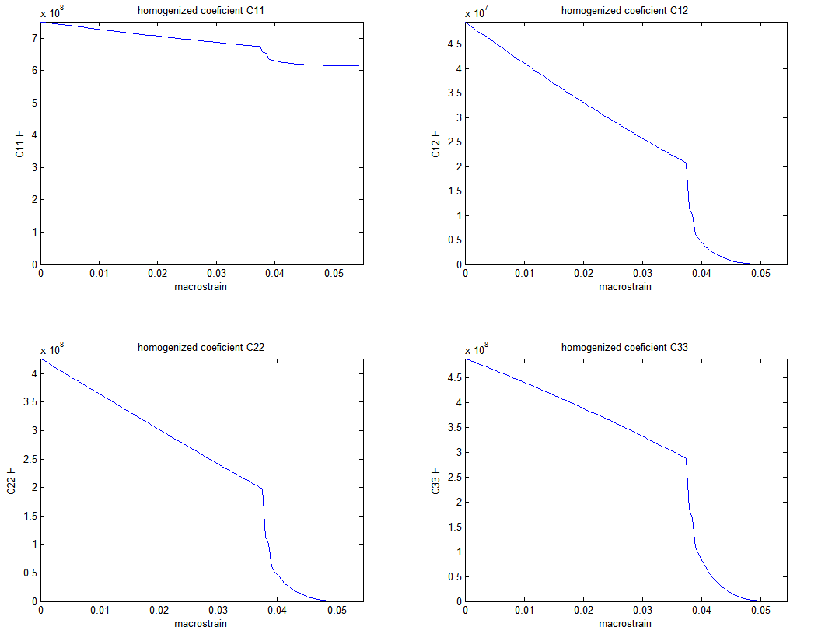
Homogenization of a Cracked Poroelastic Medium - Numerical calculation of the coefficients and damage
Coefficient evolution:
Applied time-history:

Slide 22
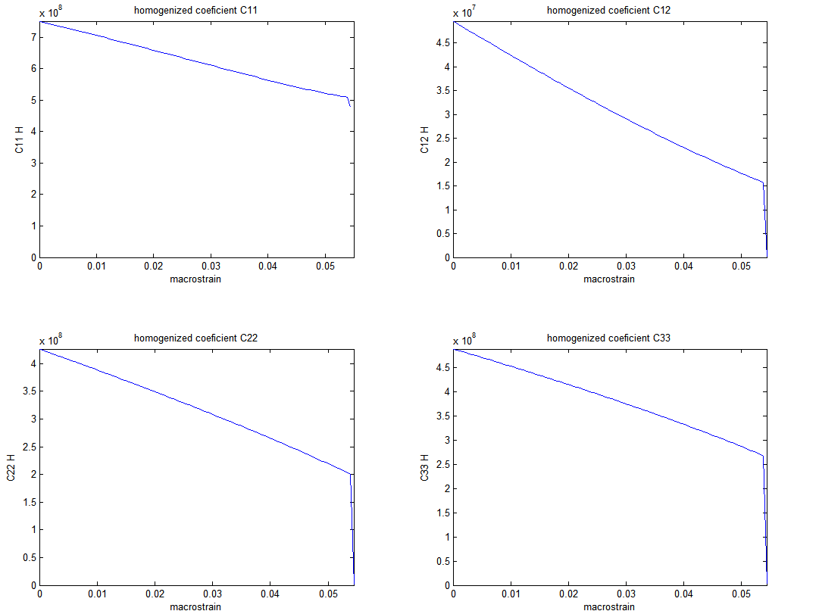
Homogenization of a Cracked Poroelastic Medium - Numerical calculation of the coefficients and damage
Coefficient evolution:
Applied time-history:

Slide 23
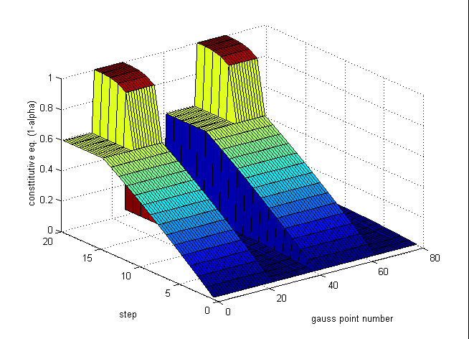
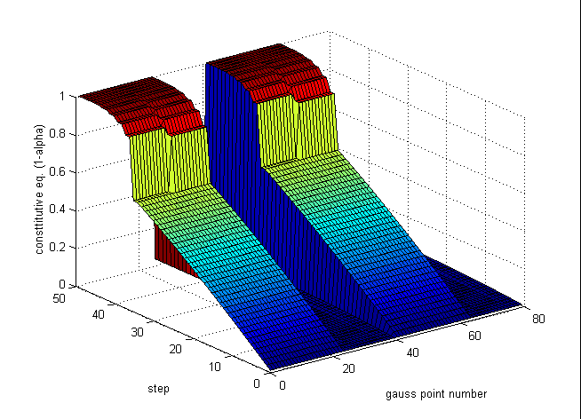
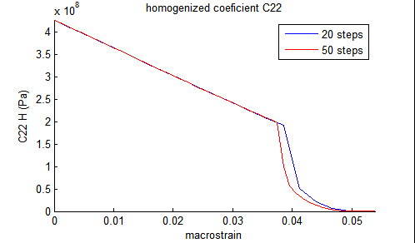
Homogenization of a Cracked Poroelastic Medium - Numerical calculation of the coefficients and damage
Bifurcation
20 steps:
50 steps:
Applied time-history:

Slide 24
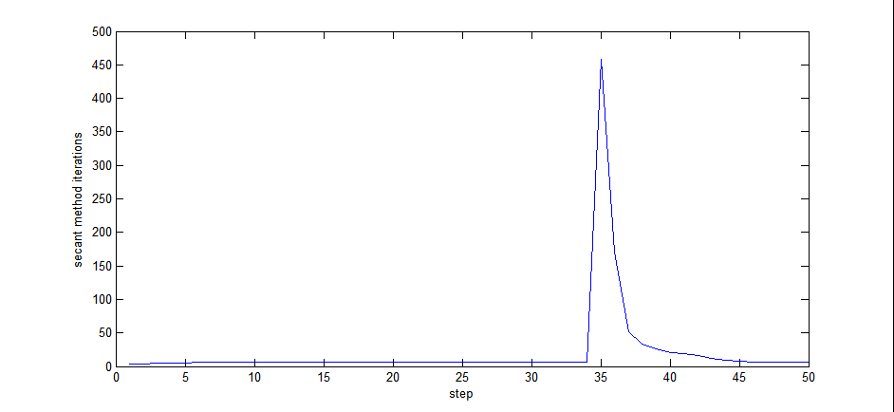
Homogenization of a Cracked Poroelastic Medium - Numerical calculation of the coefficients and damage
Bifurcation
Convergence rate is slow when bifurcation occurs
458 iterations to reach convergence in step 35

Slide 25
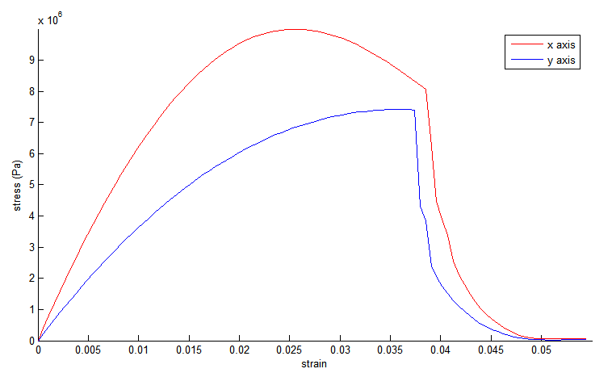
Homogenization of a Cracked Poroelastic Medium - Numerical calculation of the coefficients and damage
Damage,
Application of the results: oedometric path.

Slide 26
Homogenization of a Cracked Poroelastic Medium - Numerical calculation of the coefficients and damage
Conclusions
Macroscale homogenized coefficients can be obtained from the numerical resolution of the expanded problem.
Damage can be introduced and an evolution of the coefficients obtained from any strain history.
For high enough damage values bifurcation phenomena occurs.

Slide 27
Homogenization of a Cracked Poroelastic Medium - Numerical calculation of the coefficients and damage
Perspectives
Further research concerning the effect of the REV size on the bifurcation triggering can be done.
Application of the results in macroscale problems.

Slide 28
Homogenization of a Cracked Poroelastic Medium - Numerical calculation of the coefficients and damage
Thank you

