Slide 1
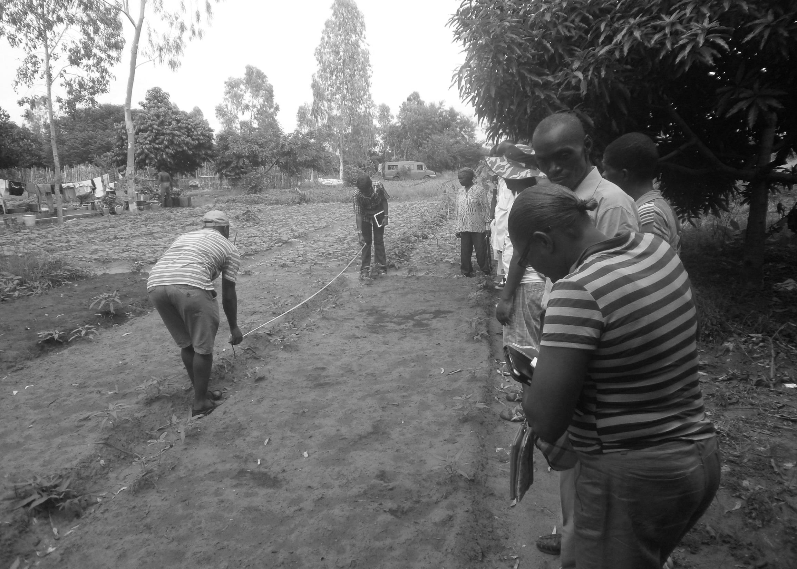
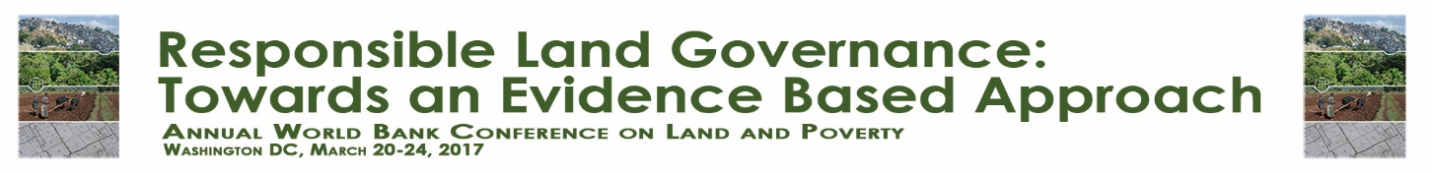





Land Status of Agricultural Concessions in Kinshasa (Democratic Republic of Congo, D.R.C): Legal Framework limitations to production incentive
By : Mabu MASIALA BODE,
Phd Student at the University of Liege (Ulg), Belgium.
Plan of the presentation
Research context
Research question
Hypothesis
Methodology
Results of analysis

Slide 2
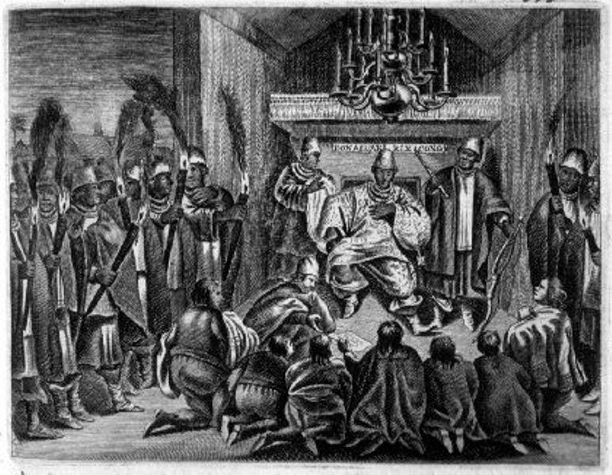
1. Research context : Dualisme of the written law and customary law on land governance in Democratic Republic of Congo
History based on three periods :
Precolonial period (Before 1885) : Single category of land / one type of customry right (usufruct) in all locals communities
Colonial period (From 1885 upto 1959) :
- Land of Local Communities / Ownership of local communities / Customary Law
Vacant lands (state-owned) / Colonial State property / written law
Registered Land / Owned by foreigners / Obtained on the basis of written rights or customary rights
After independance (From 1960 upto day) :
- all lands belong to the congolese State/ Only written law recognized
Land Status of Agricultural Concessions in Kinshasa (Democratic Republic of Congo, D.R.C): Legal Framework limitations to Production Incentive
By : Mabu MASIALA BODE, Ph.D. Student at the University of Liege (Ulg), Belgium.
Notes:
Colonial period : Three categories of land / Two types of Right (written and customary)

Slide 3


2. Research question
What is the impact of land tenure security on incentive to produce in agricultural concessions in Kinshasa ?
3. Hypothesis
Land tenure obtained on the basis of traditional and legal procedures guarantees the land tenure security, but does not have an impact to the agricultural production incentive.
Land Status of Agricultural Concessions in Kinshasa (Democratic Republic of Congo, D.R.C): Legal Framework limitations to Production Incentive
By : Mabu MASIALA BODE, Ph.D. Student at the University of Liege (Ulg), Belgium.
Land Status of Agricultural Concessions in Kinshasa (Democratic Republic of Congo, D.R.C): Legal Framework limitations to Production Incentive
By : Mabu MASIALA BODE, Ph.D. Student at the University of Liege (Ulg), Belgium.

Slide 4
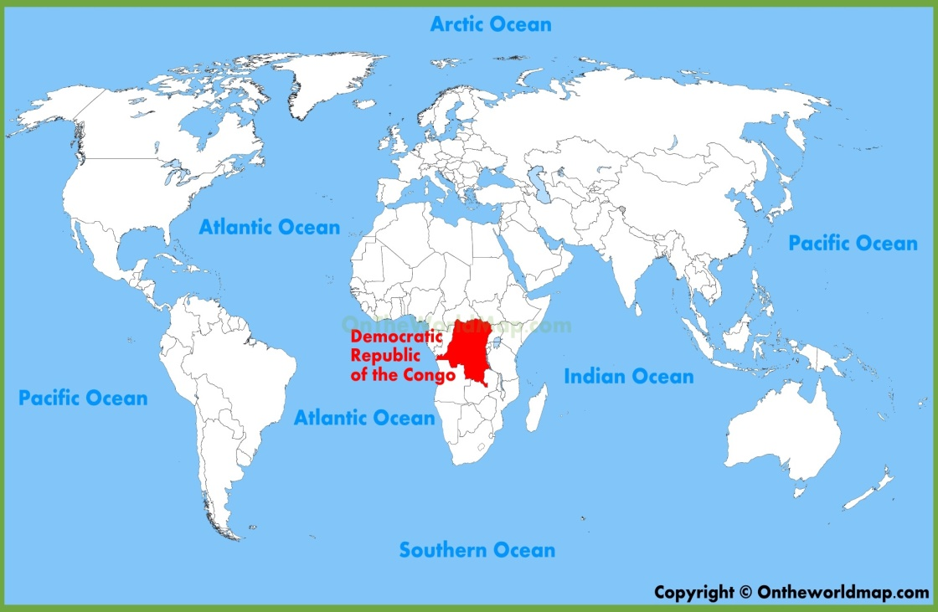
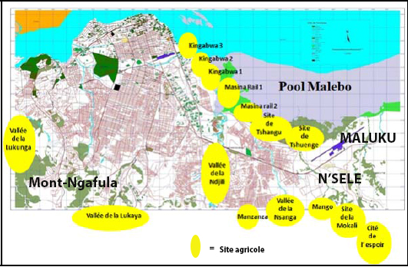
4. Methodology
Kinshasa : 21 urbans communes and 3 rurals communes;
This study concerns the rural commune of Mont-Ngafula
Land Status of Agricultural Concessions in Kinshasa (Democratic Republic of Congo, D.R.C): Legal Framework limitations to Production Incentive
By : Mabu MASIALA BODE, Ph.D. Student at the University of Liege (Ulg), Belgium.

Slide 5
5. Results of analysis
Land Status of Agricultural Concessions in Kinshasa (Democratic Republic of Congo, D.R.C): Legal Framework limitations to Production Incentive
By : Mabu MASIALA BODE, Ph.D. Student at the University of Liege (Ulg), Belgium.
Land Status of Agricultural Concessions in Kinshasa (Democratic Republic of Congo, D.R.C): Legal Framework limitations to Production Incentive
By : Mabu MASIALA BODE, Ph.D. Student at the University of Liege (Ulg), Belgium.

Slide 6
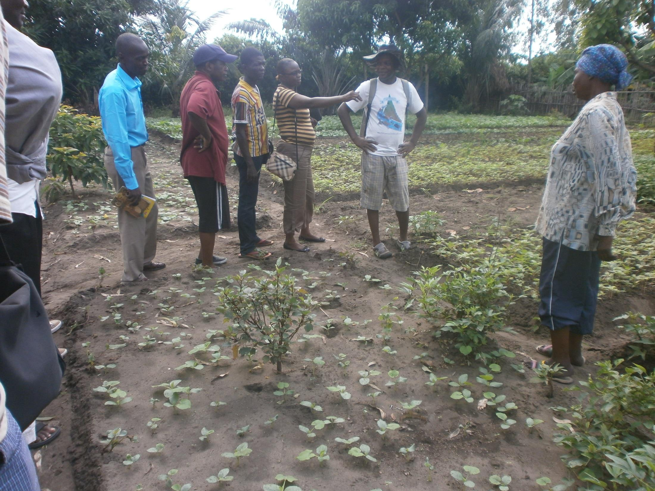
Procedure of obtaining an agricultural concession in D. R. Congo
5.1. Procedure of obtaining an agricultural concession
Ministry of Land Affairs
(8)
(10)
7
Conservator of Real estate titles
(15)
(13)
(6)
(3)
(2)
(17)
(16)
(12)
(11)
(9)
(1)
Officials (Ministries of Land business and of the Agricultural)
(14)
(5)
(4)
Farmer / Land Applicant
Customaries chiefs
Notes:
* Contact avec les chefs coutumiers : Contact between agricultural operators and traditional chiefs for the purchase of land. This step is obligatory on rural lands to prevent the preliminary investigation being blocked by native population.

Slide 7
5.2. Surface areas granted to agricultural
The share of surface of the commune of Mont-Ngafula put at the disposal of agricultural concessions is 5491.65 ha for 497 farmers = 15.3% of the total surface area of Mont-Ngafula
Land Status of Agricultural Concessions in Kinshasa (Democratic Republic of Congo, D.R.C): Legal Framework limitations to Production Incentive
By : Mabu MASIALA BODE, Ph.D. Student at the University of Liege (Ulg), Belgium.

Slide 8
5.3. Origin of famers
Land Status of Agricultural Concessions in Kinshasa (Democratic Republic of Congo, D.R.C): Legal Framework limitations to Production Incentive
By : Mabu MASIALA BODE, Ph.D. Student at the University of Liege (Ulg), Belgium.
Notes:
Refaire le graphique en utilisant la carte de Kinshasa et mettre ces chiffres sur chaque commune de Kinshasa

Slide 9
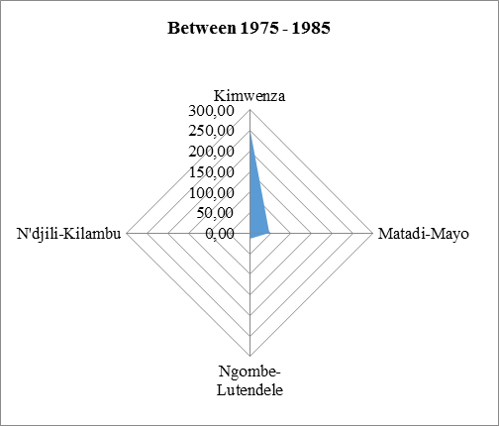
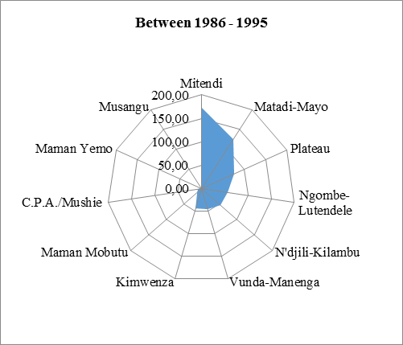
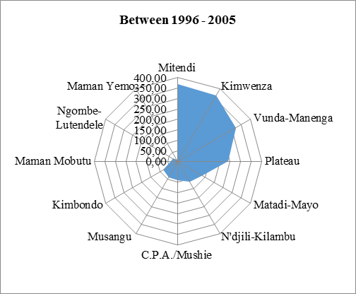
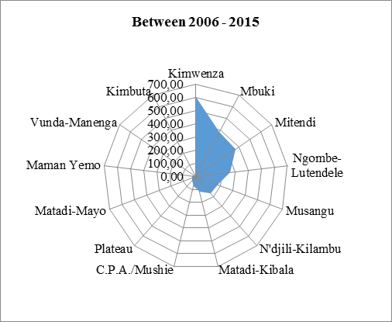
5.4. Space and temporal evolution of the agricultural concessions in Mount-Ngafula
Land Status of Agricultural Concessions in Kinshasa (Democratic Republic of Congo, D.R.C): Legal Framework limitations to Production Incentive
By : Mabu MASIALA BODE, Ph.D. Student at the University of Liege (Ulg), Belgium.

Slide 10
5.5. Destination of lands solicited by farmer
Land Status of Agricultural Concessions in Kinshasa (Democratic Republic of Congo, D.R.C): Legal Framework limitations to Production Incentive
By : Mabu MASIALA BODE, Ph.D. Student at the University of Liege (Ulg), Belgium.
Notes:
Destination as mentionned in the file of land request by farmers

Slide 11
5.6. Evolution of primary investigations
Land Status of Agricultural Concessions in Kinshasa (Democratic Republic of Congo, D.R.C): Legal Framework limitations to Production Incentive
By : Mabu MASIALA BODE, Ph.D. Student at the University of Liege (Ulg), Belgium.

Slide 12
5.7. Type of contracts obtained by agricultural operators
Land Status of Agricultural Concessions in Kinshasa (Democratic Republic of Congo, D.R.C): Legal Framework limitations to Production Incentive
By : Mabu MASIALA BODE, Ph.D. Student at the University of Liege (Ulg), Belgium.

Slide 13
Thank for your attention
Mabu MASIALA BODE,
Ph.D Student at Economics and rural development
University of Liege (Ulg), Belgium.
mabu.masialabode@doct.ulg.ac.be
escrivabode@yahoo.fr

