Slide 1



Neurophysiological Techniques for Functional Quantification and Prognosis in Multiple Sclerosis
Multimodal Evoked Potentials
Procedure and Results in MS patients
Dominique DIVE
Clinical Neuro-Immunological Unit
University Hospital of Liège
November 2017

Slide 2
Disclosures
Dominique Dive received honoraria (advisory boards and meeting presentations) and travel grants from
  Bayer
  Merck
  Teva
  Novartis
  Sanofi-Genzyme
  Roche
No specific disclosures in relation with this presentation

Slide 3
Evoked Potentials in MS
Expanded Neurological Examination
Expanded Neurophysiological Examination
Somatosensory (SEP) and Motor (MEP)
  Brain and spinal cord
Visual (VEP)
  Optic nerve and brain
Auditory (BAEP)
  Brainstem
Cognitive (ERPs)
  Brain

Slide 4
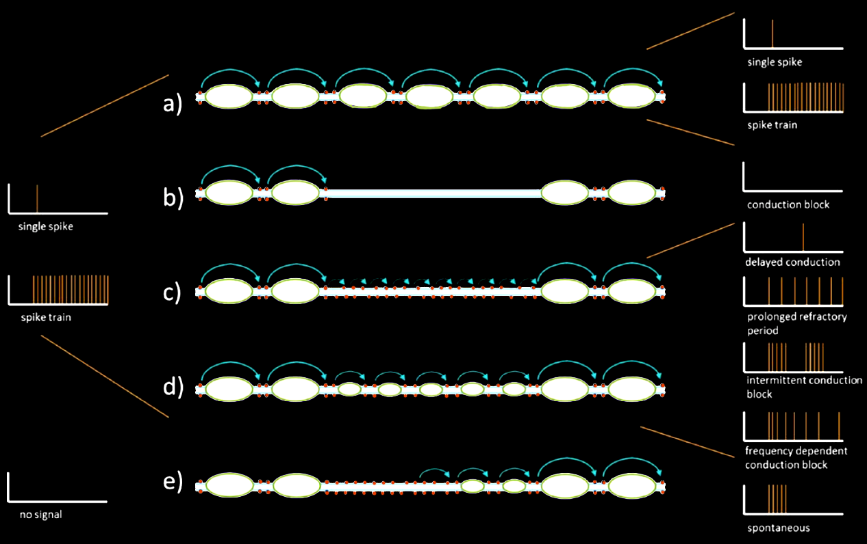
Evoked Potentials in MS
Evoked Potentials (Eps) are the only laboratory tools that directly measure the abnormal physiology resulting from the disease
Hardmeier et al., MSJ, 2017

Slide 5
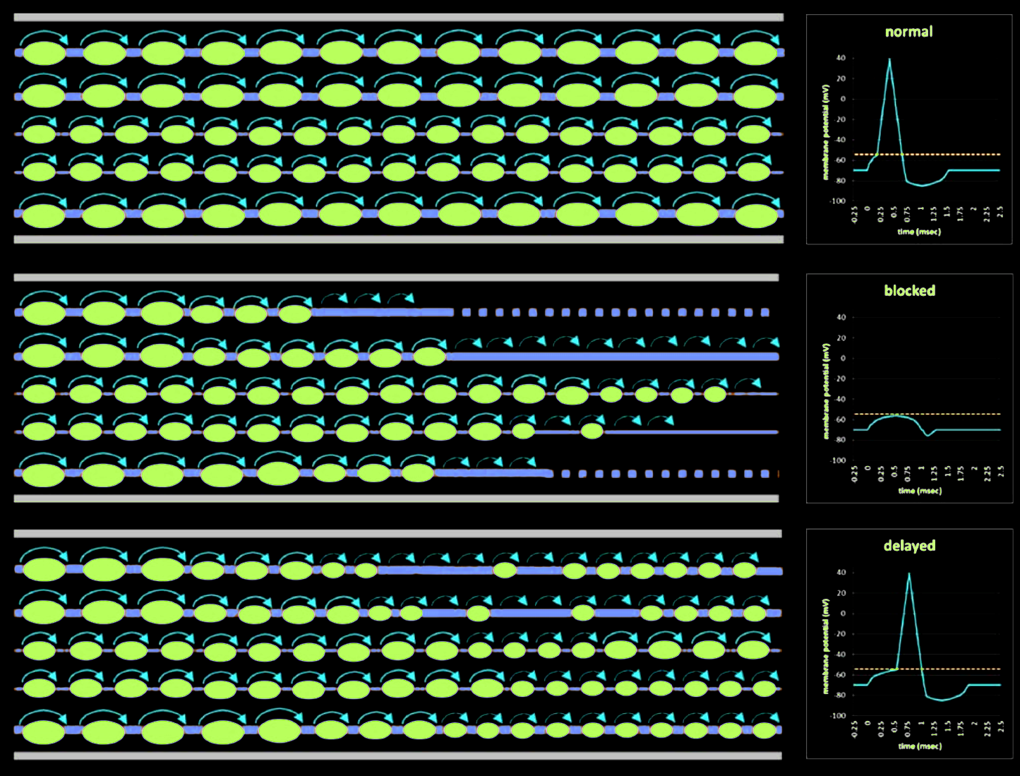
Evoked Potentials in MS
Hardmeier et al., MSJ, 2017

Slide 6
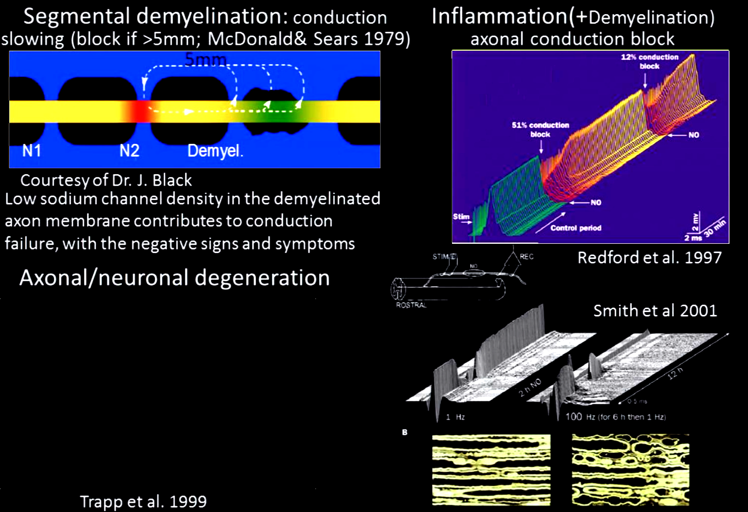


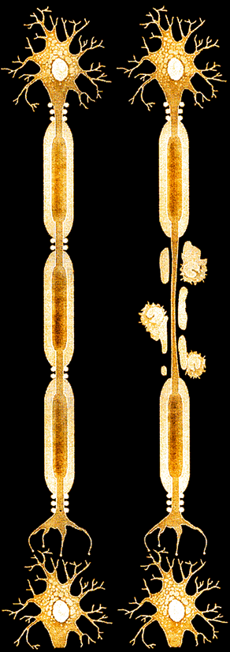

MS functional deficits: pathological substrates
Acute
Delayed, transynaptic
Leocani, ECF, 2016

Slide 7
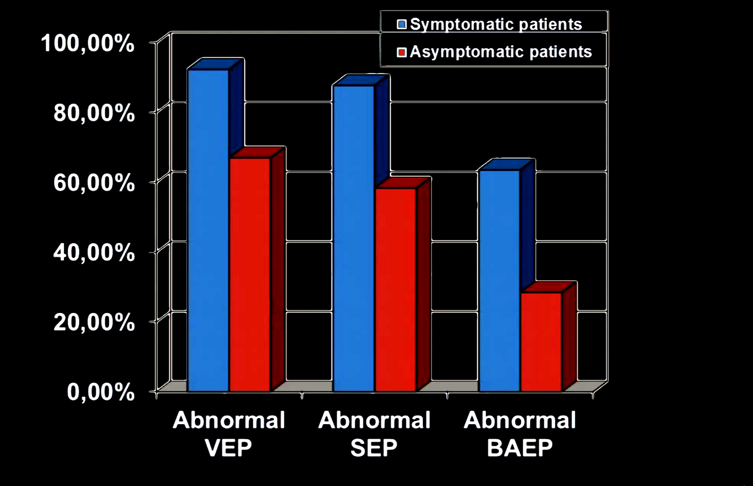
Relationship between clinical findings and EPs abnormalities in RR MS
Comi G. et al., MSJ, 1999;5:263-267

Slide 8


CNS reserve
Neurophysiology
Disability
Bad situation, but it can get worse
Cannot get worse
In the car = urgent action needed or car will stop
In the car = car stopped
In MS monitoring:
Margin for improvement
In MS monitoring:
Likely treatment failure to active drug, likely no progression to placebo

Slide 9

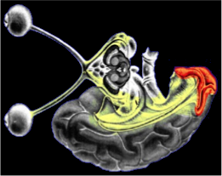
Visual Evoked Potentials (ffVEPs)
µV
St.
Oz (-) - Fz (+) 0.5 - 100 Hz
15 min.
111.0 msec.
10 µv
30 msec.
30 min.
103.8 msec.
1°
99.0 msec.
msec.

Slide 10
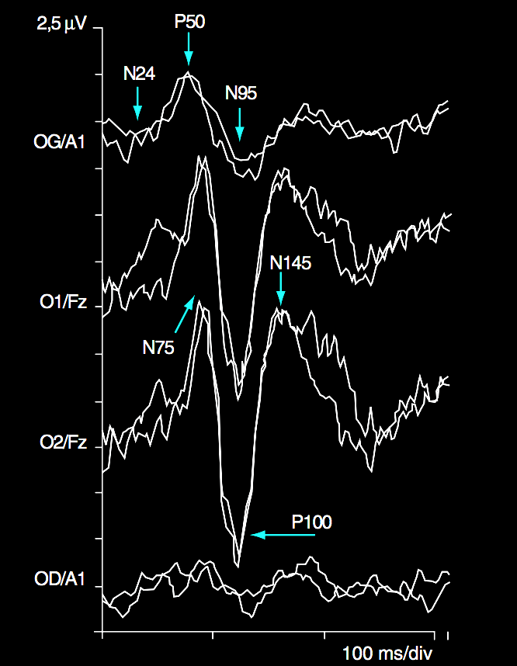
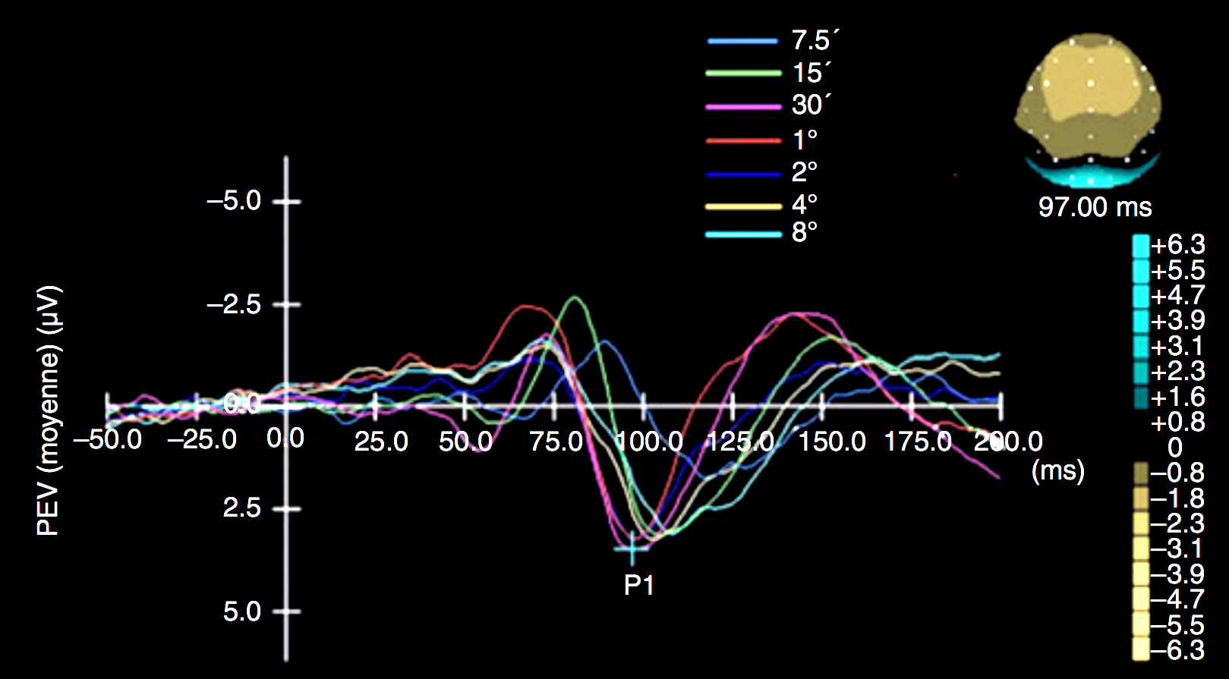
Visual Evoked Potentials (ffVEPs)
Normal responses variability following stimulation angle

Slide 11
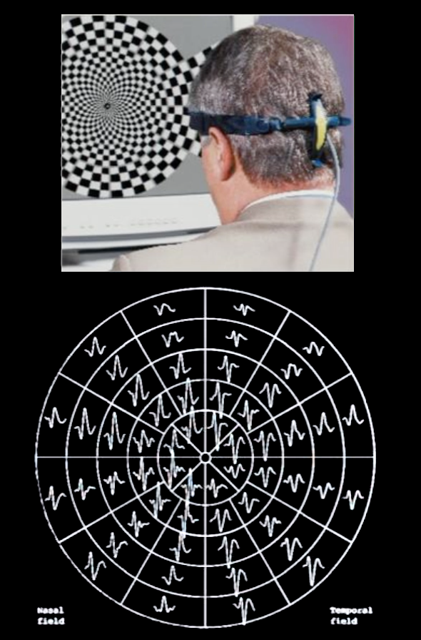
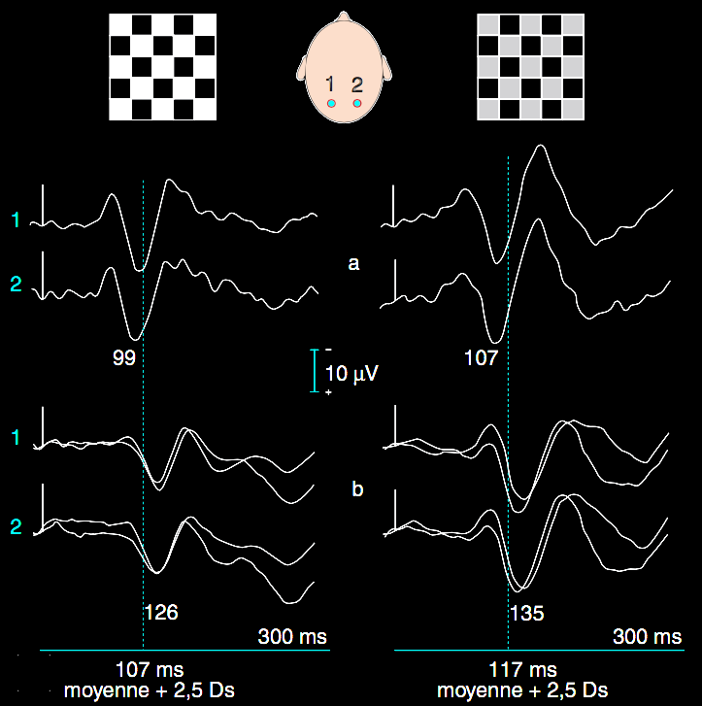
VEPs and chronic ON
Mean + 2,5 SD
Mean + 2,5 SD

Slide 12


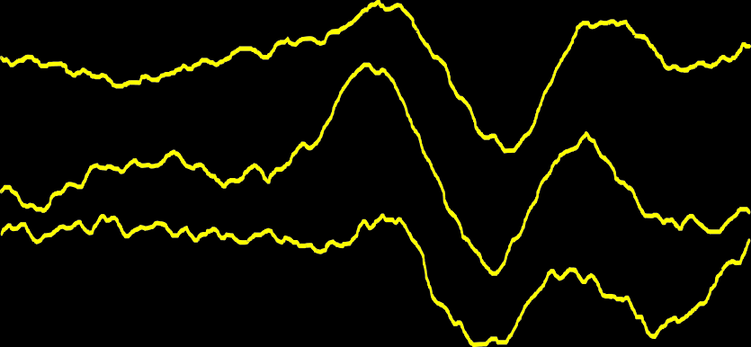

ffVEPs and chronic ON
Severe ON
Normal
15‘
30’
?
111.0
15‘
30’
103.8
152.4
1°
2.5 µV
10 µV
1°
30 msec
99.0 msec.
30 msec
154.2 msec.
Moderate ON
Flashs
118.2
15'
129.6
15'
?
30’
?
125.4
30’
2.5 µV
1°
5.0 µV
1°
?
30 msec
123.0 msec.
30 msec
Very severe ON

Slide 13
ffVEPs and ON – longitudinal follow-up
Explorations complémentaires : neurophysiologie
NORMAL : 111.0 msec.
17/04/96 : 124.8 msec.
10/05/96 : 130.8 msec.
18/05/96 : 130.2 msec.
28/05/96 : 132.6 msec.
8/06/96 : 135.6 msec.
8/07/96 : 136.2 msec.
5 µV
CORTICOTHERAPY
8/08/96 : 126.6 msec.
30/10/96 : 127.2 msec.
Juin 1993
30 msec.
Mai 1997

Slide 14
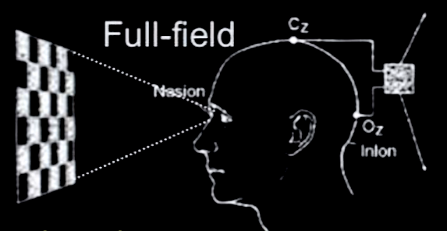
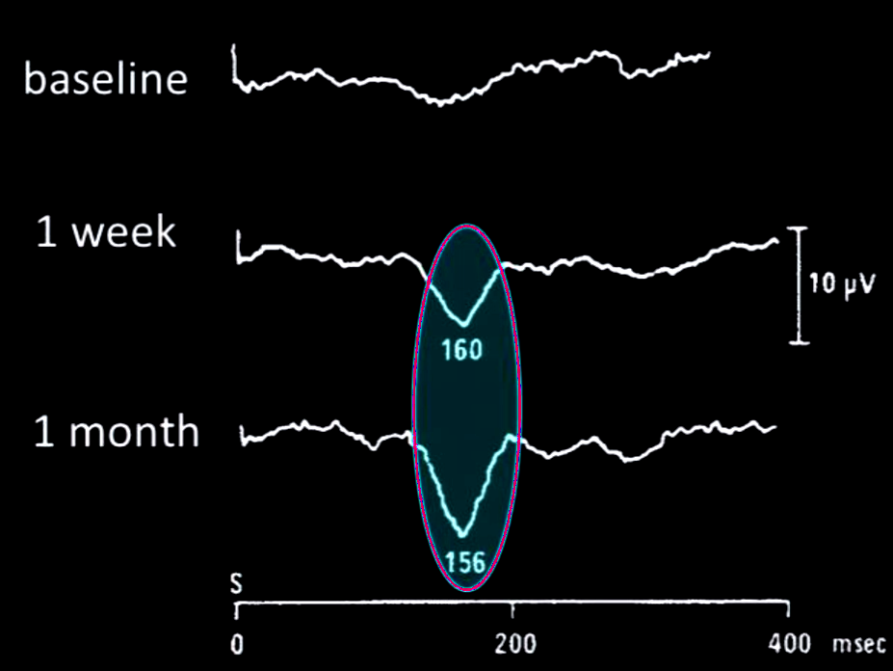
ffVEPs and ON
Acute Optic Neuritis
Reversible conduction block: rapid amplitude recovery
Take home message:
VEPs can be unreliable for the first month after ON
VEPs latency useful to detect demyelination
Smith et al., 1986 - Leocani, ECF, 2016

Slide 15
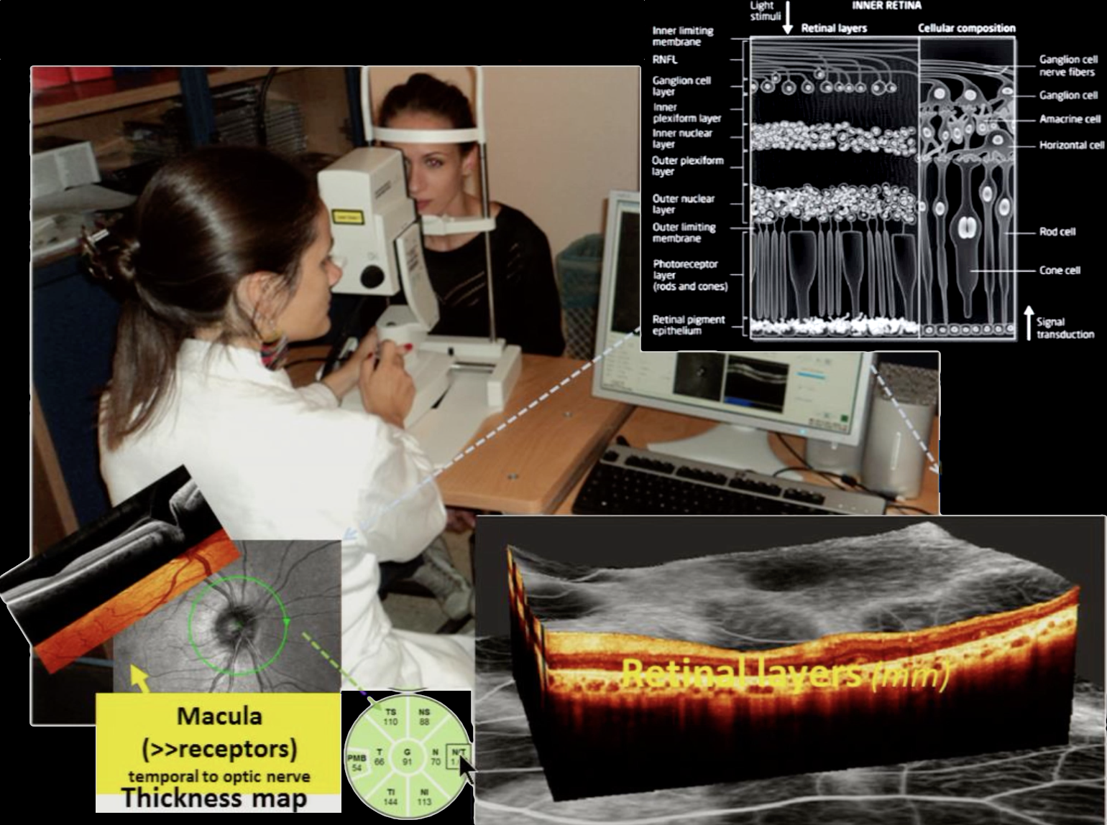
Optical Coherence Tomography (OCT)

Slide 16
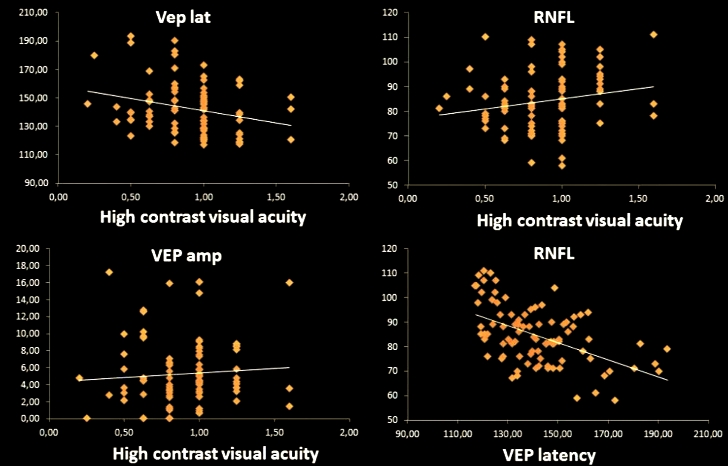
ffVEPs and RNFL correlate with each other but less with visuel function
Progressive MS (17PP, 32SP), no ON history N=49
Leocani, ECF, 2016

Slide 17
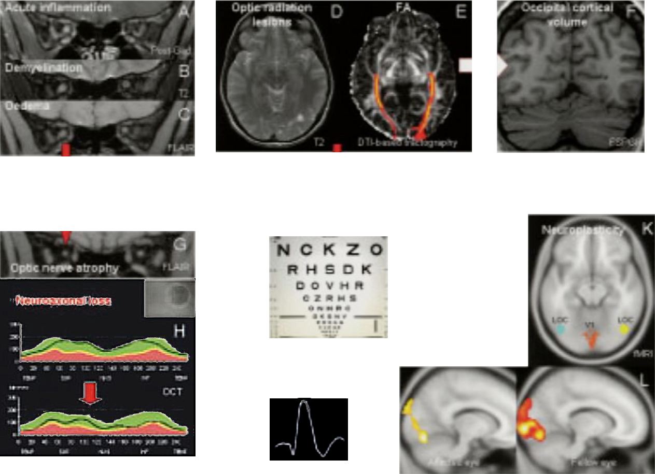
Clinical / Instrumental Paradox
Neuroplasticity Predicts Outcome of Optic Neuritis Independent of Tissue Damage
Damage
Visual Function
Recovery
Demyelination
Remyelination
Leocani, ECF, 2016 – Jenkins et al., Ann Neurol 2010;67:99-113

Slide 18
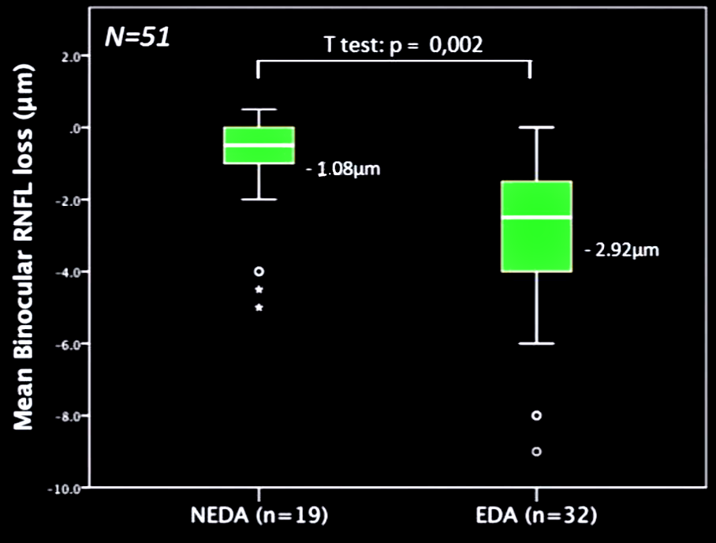
ΔRNFL & NEDA
No Evidence of Disease Activity
No relapses
No MRI activity
No EDSS progression
Logistic regression on ΔRNFL and baseline RNFL/EDSS on NEDA likelihood (𝜒2=12.06; p=0.007) explained 28.7% (Nagelkerke R2) variance and correctly classified 74.4% of cases
Leocani L. and Pisa M., ECF, 2016

Slide 19
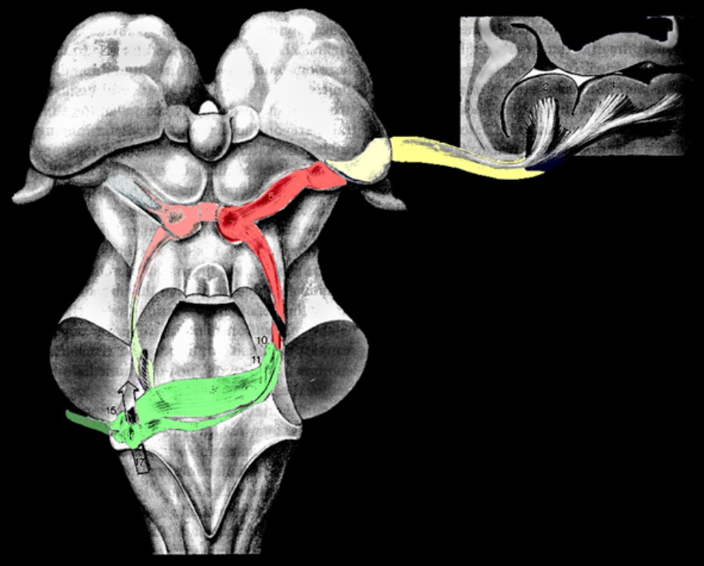

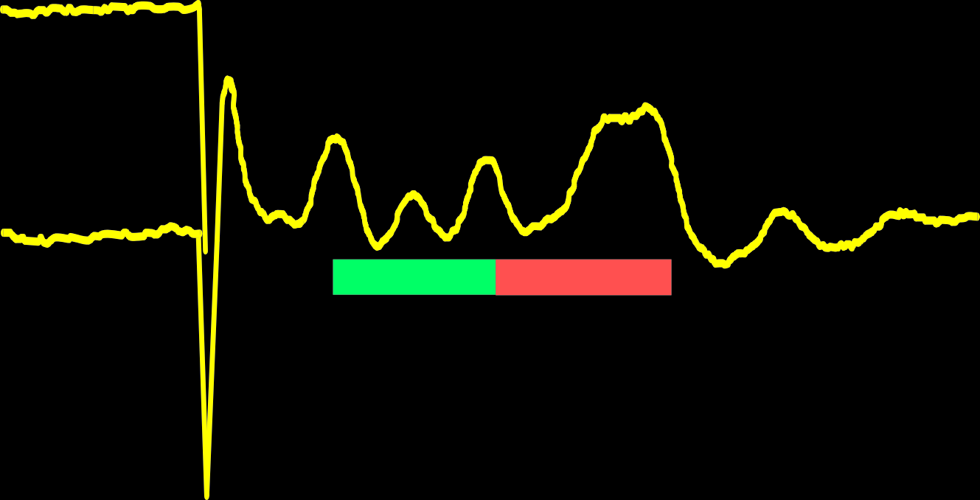
BAEPs
Vc
A2-Cz
V
I
IV
III
II
A1-Cz
VI
I-III
III-V
Click stimulation
Rarefaction - condensation Bandwith 50 - 1500 Hz
0.31 µV
1.2 msec.

Slide 20
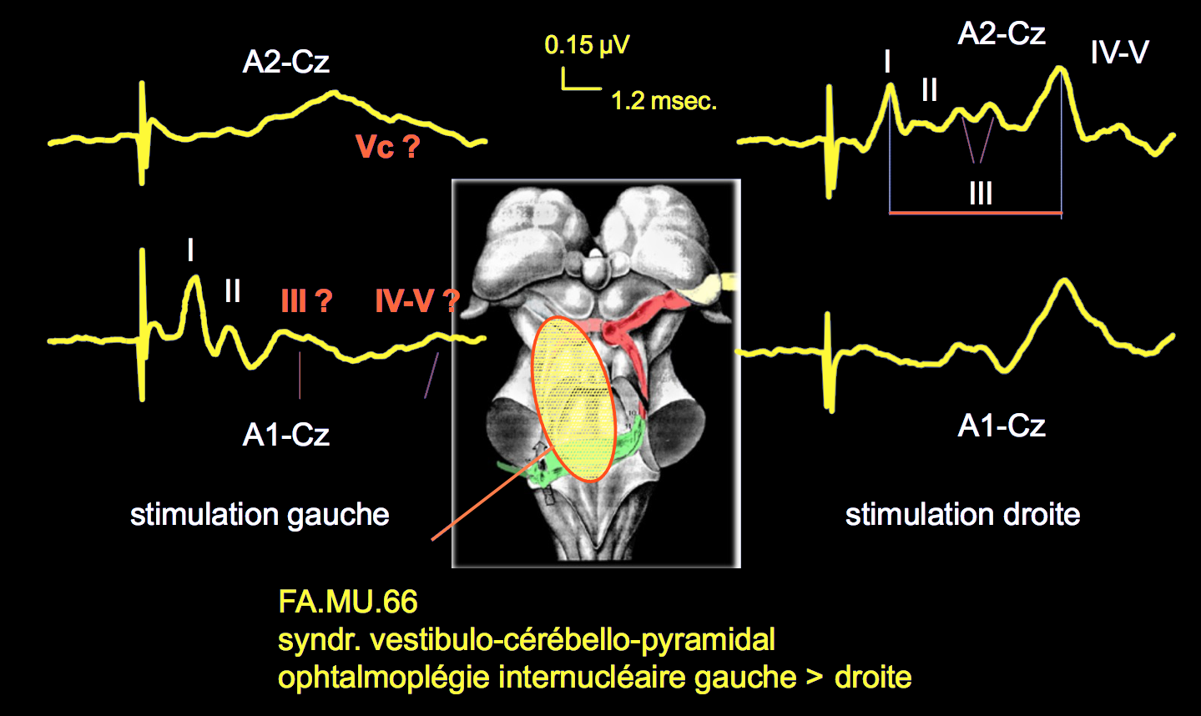
BAEPs during a brainstem relapse
Left stimulation
Right stimulation

Slide 21
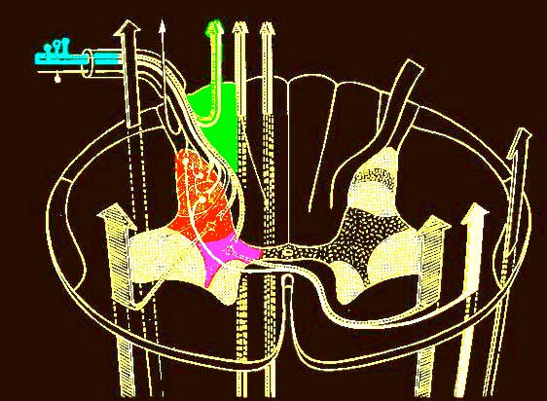
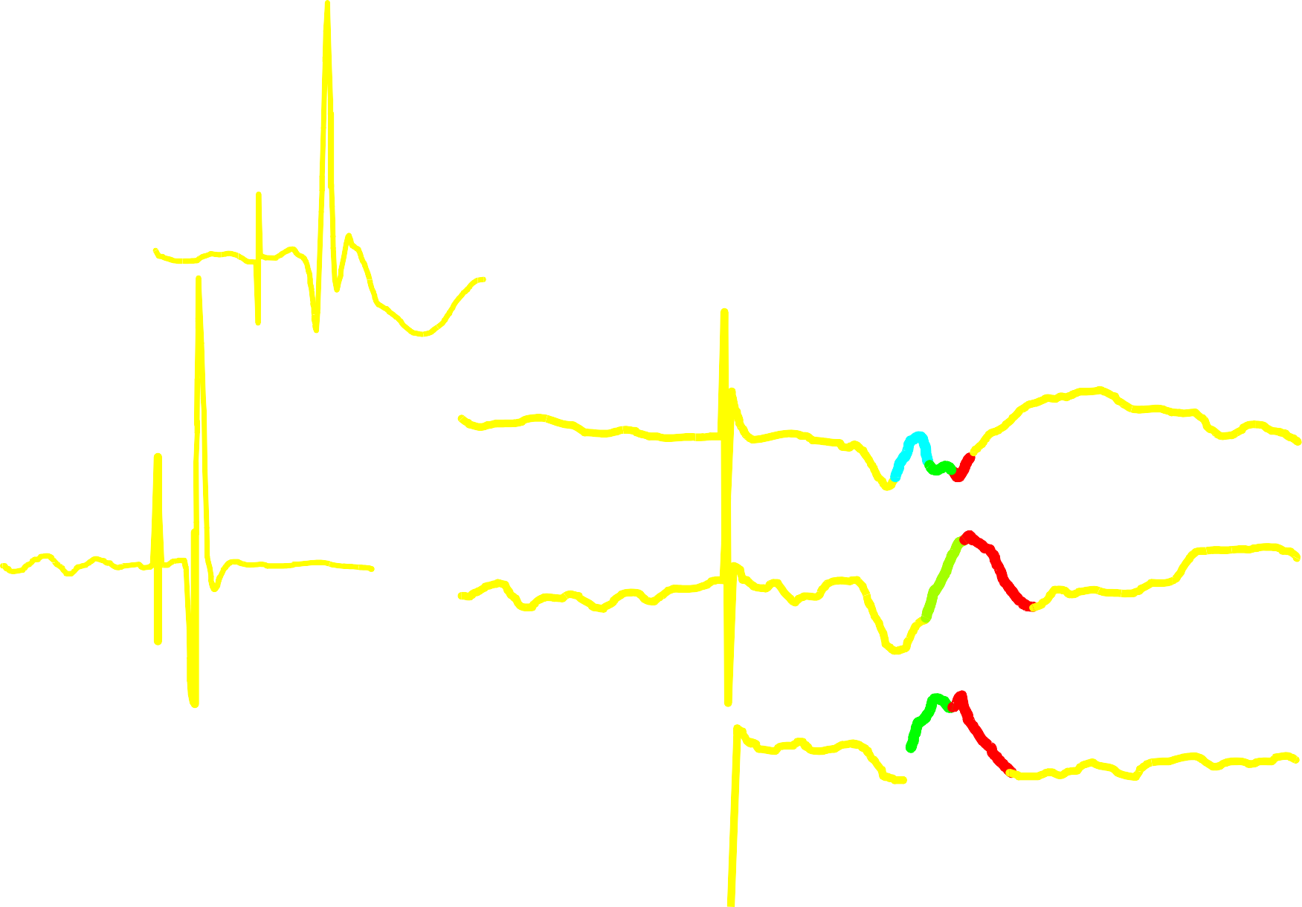
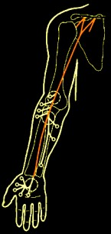

Median Nerve SSEPs
Erb’s point
N10
Ant Cerv-NCR
Elbow
N11
N13 b
C2/C3 - NCR
N11
N13 a
C6/C7 - NCR
3.12 - 1.25 µV
1.25 µV
7.0 msec.
P9
7.0 msec.

Slide 22
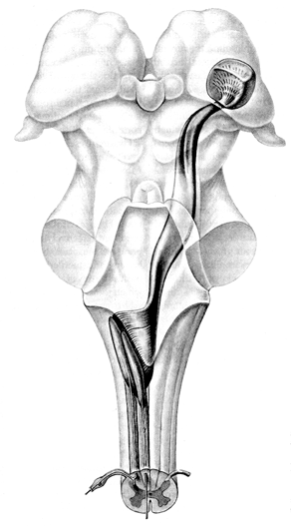

Median Nerve SSEPs
B
A
B
A = P9 - P14
B = P14 - N20
A+B = P9 - N20
1.25 µV
A
7.0 msec.

Slide 23






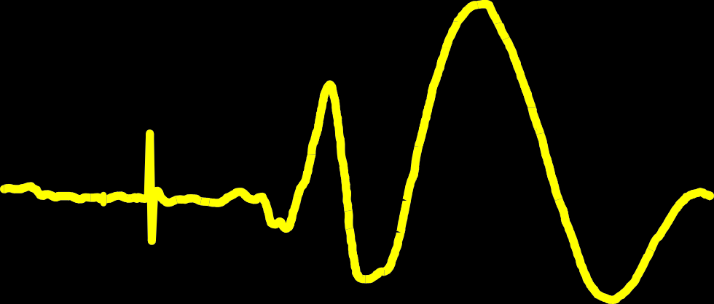

Median Nerve SSEPs
N30
P20
1.25 µV
N20
7.0 msec.
P45
N18
P27

Slide 24
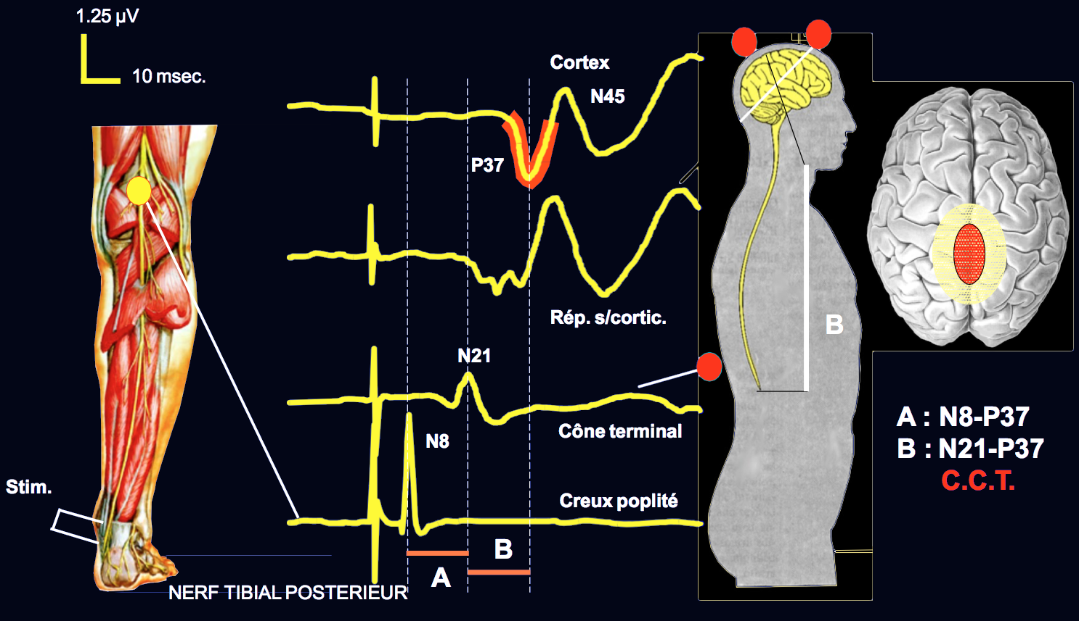
Post TN SSEPs

Slide 25
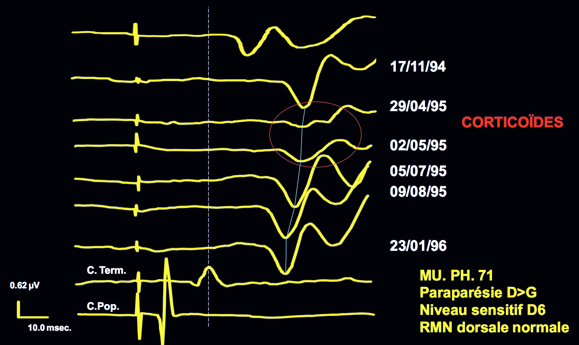
Post TN SSEPs: MS relapse

Slide 26
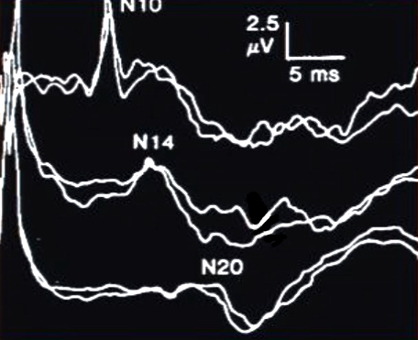
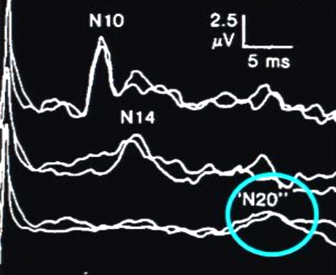
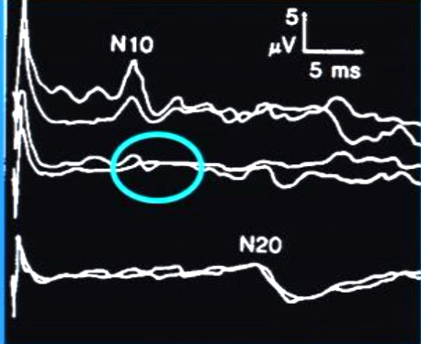
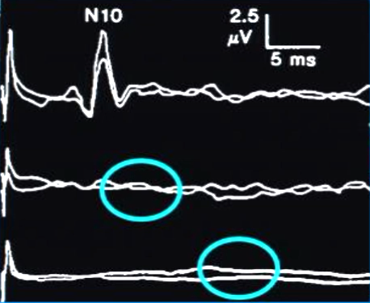
SSEPs: abnormalities
Normal
>N20 latency
Take home message:
When responses are absent, ceiling effect reached – useless for drugs halting/slowing disease progression
Still feasible for restoration/repair (cell therapies, remyelinating therapies)
Using absent EPs needs the hypothesis that they may reappear after treatment
N13 absent, N20 delayed
N13 absent, N20 absent
Leocani, ECF, 2016 – from Anderson et al., 1987

Slide 27
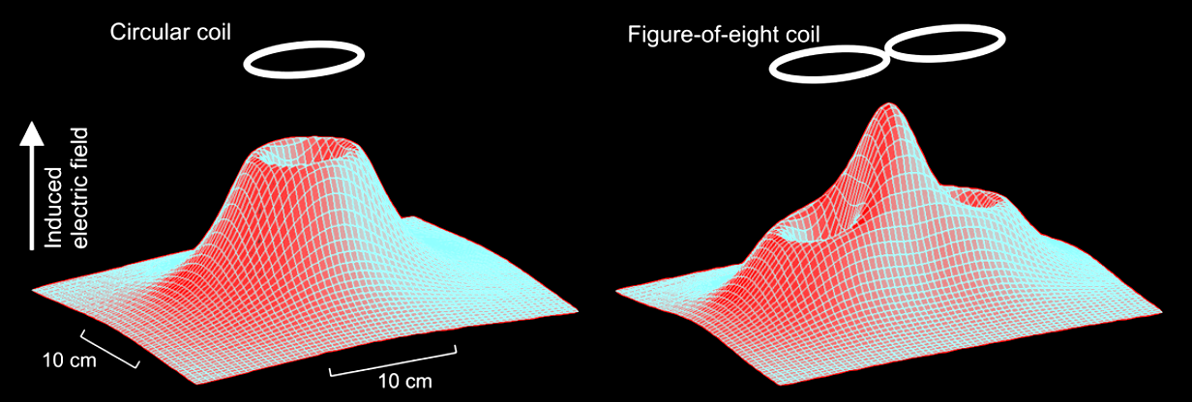
Motor Evoked Potentials – Magnetic Coils
The strength of the electric field induced below a circular (left) and an 8-shaped coil (right)

Slide 28
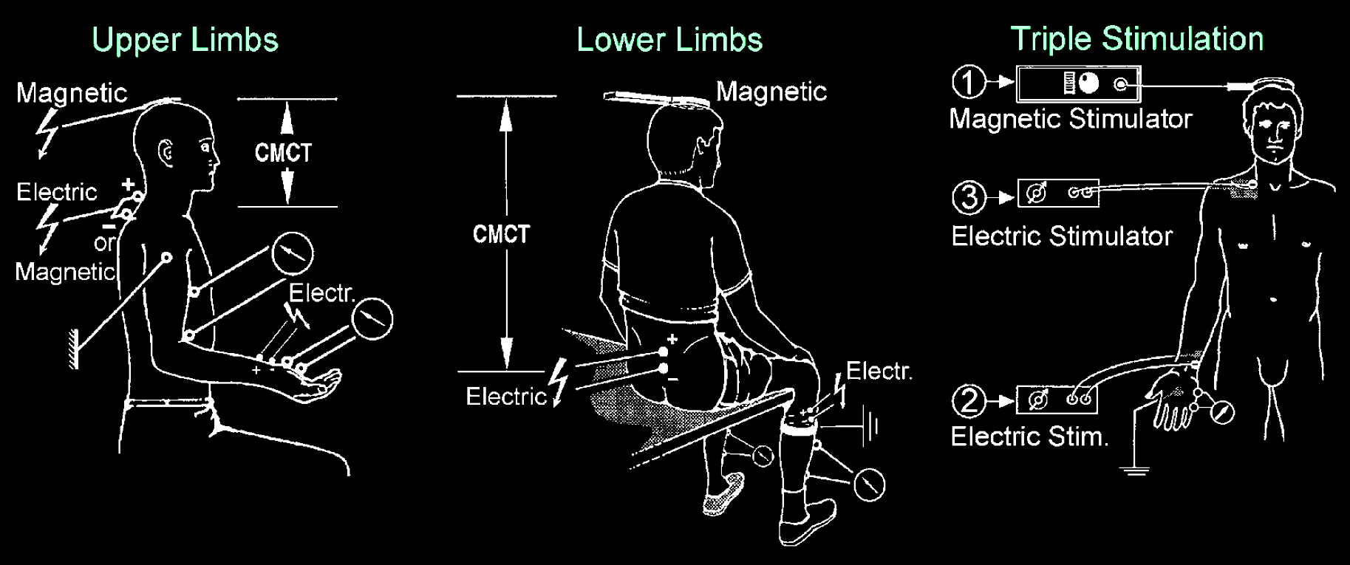
Motor Evoked Potentials

Slide 29
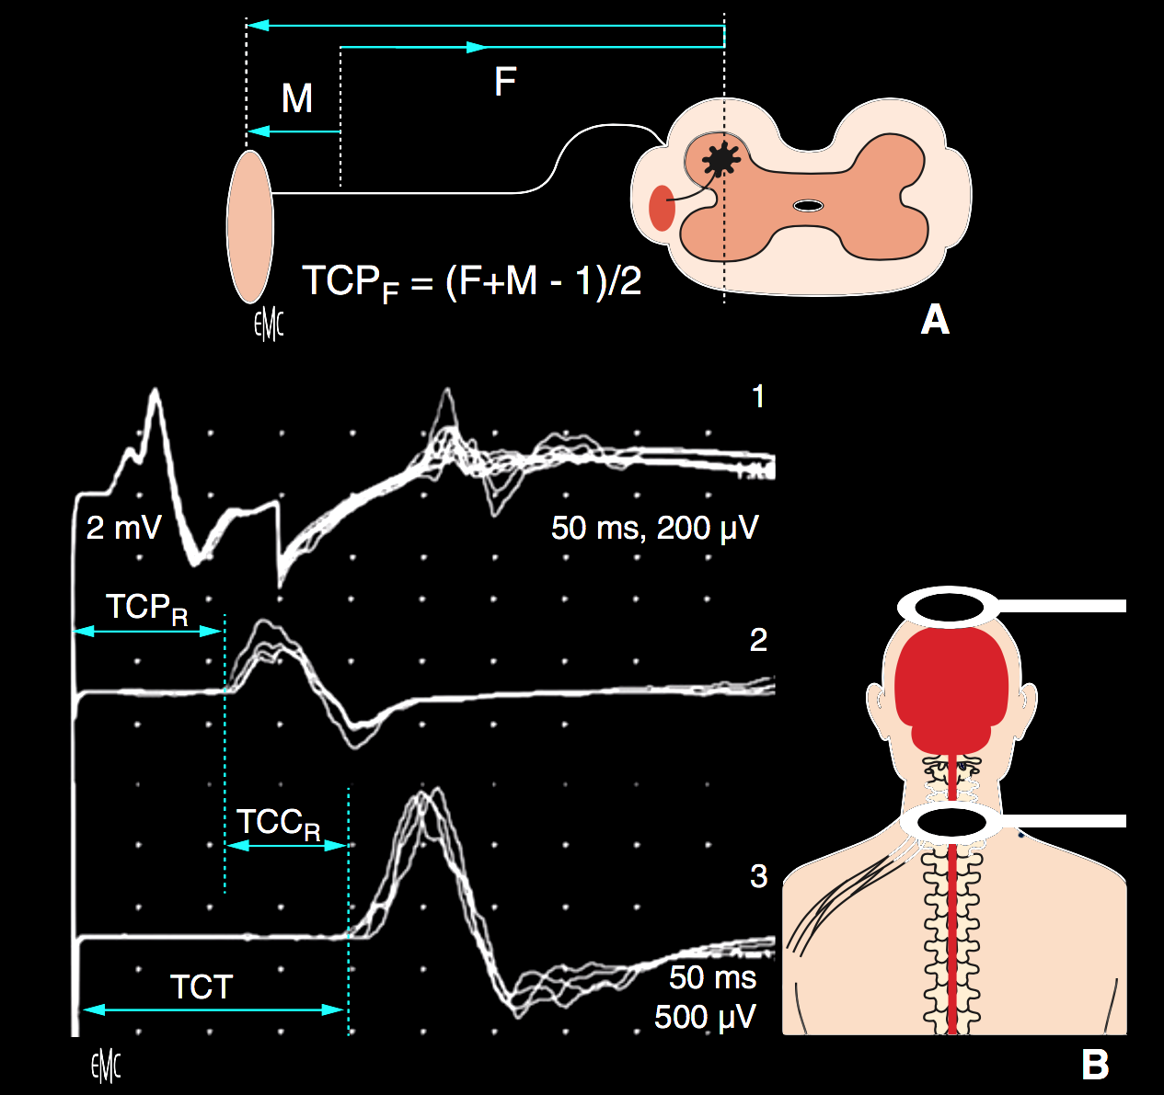
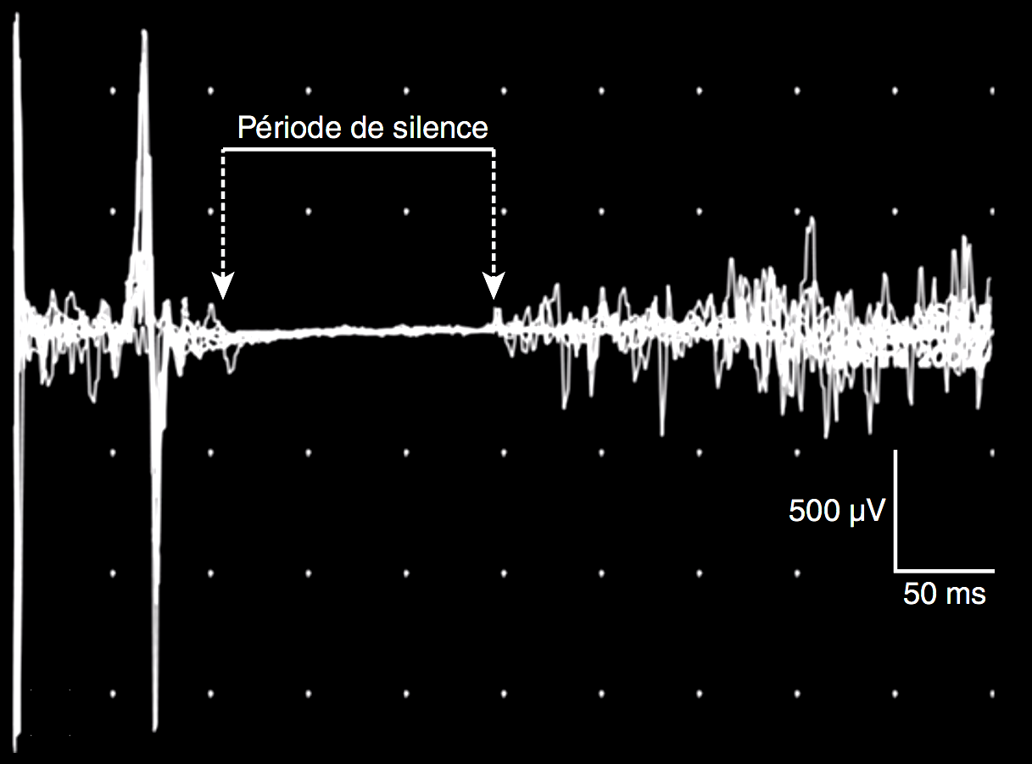
Motor Evoked Potentials
Silent Period

Slide 30
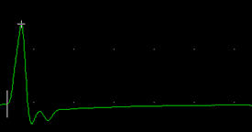
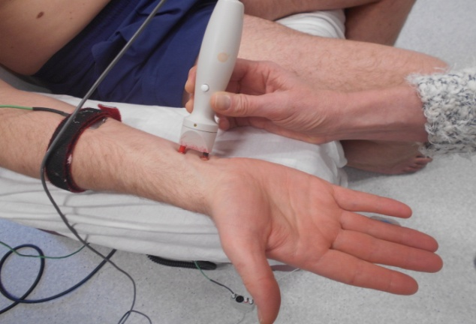
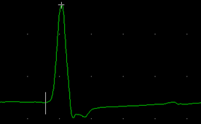
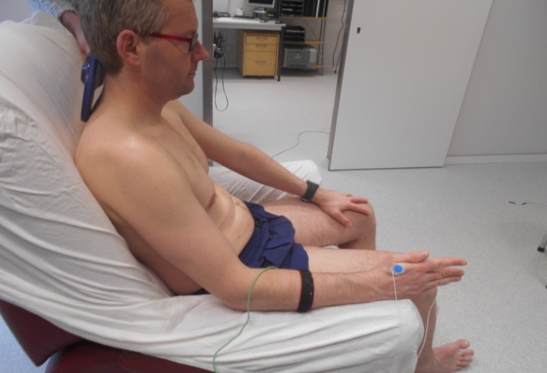
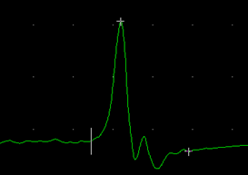
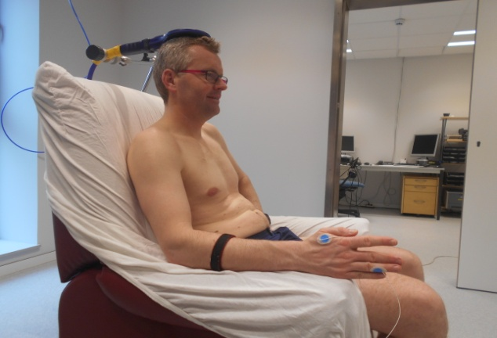
Motor Evoked Potentials
Motor Reserve
Latency
Cubital Nerve
(electrical stim.)
a
Periph
Ampl
Peripheral
Radicular
Cortical
8ms
5 mV
Wrist – 1st IO
Peroneal Head– TA
Periph. Lat.
CMCT
Cervical Stimulation
(magnetic)
b
Ctx Lat – Radic Lat
8ms
1 mV
Cervical – 1st IO
Lumbar – TA
Relative
Amplitude
Radic. Lat.
Cortical stimulation
(magnetic)
c
Ctx/periph
TCMC
CTX Ampl
Duration
8ms
1 mV
CTX – 1st IO
CTX – TA
Dur ctx
Cortical Lat.
Dur ctx

Slide 31
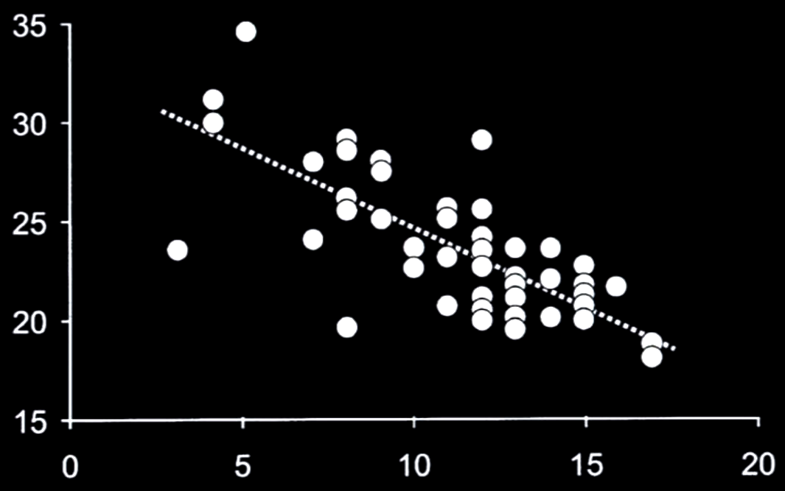
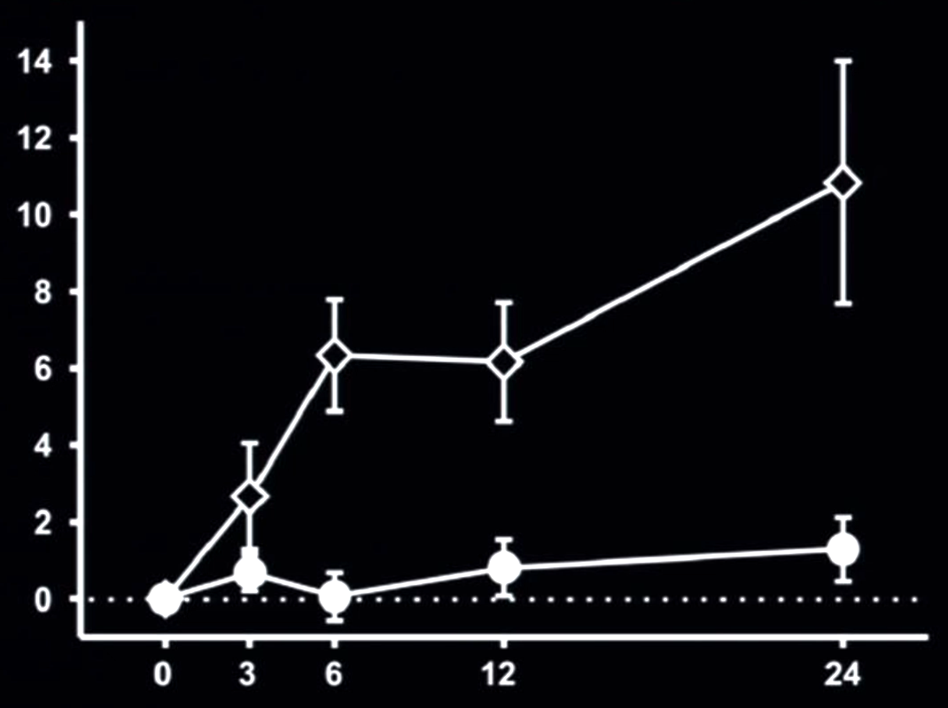
MEPs and clinical function
Latency (ms)
Correlation between CMCT and hand dexterity
Thickbroom et al., 2005
Hand functional score
Worsened
ΔmEPs
Stable
Longitudinal MEPs changes (2 yrs)
Jung et al., 2008
Time (months)

Slide 32
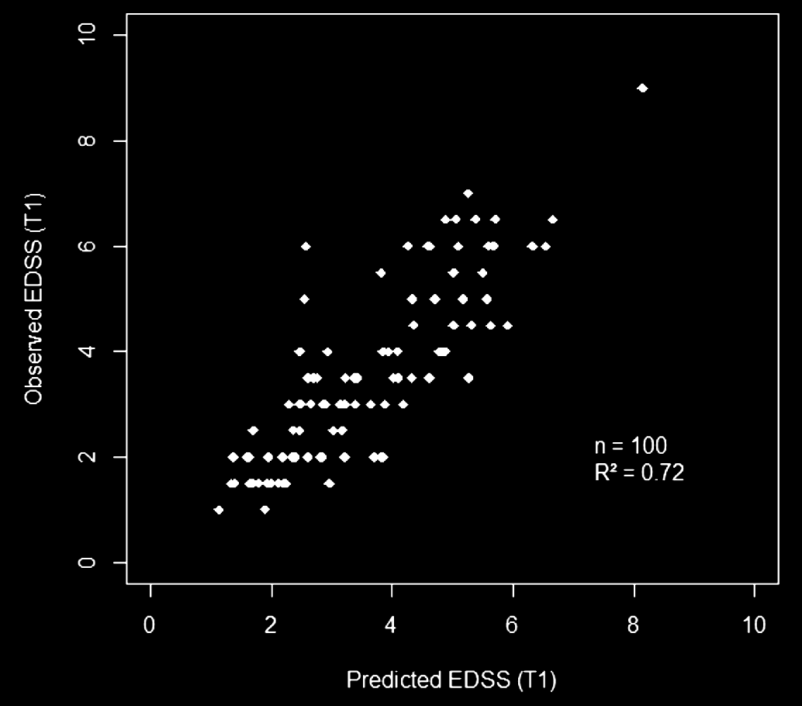
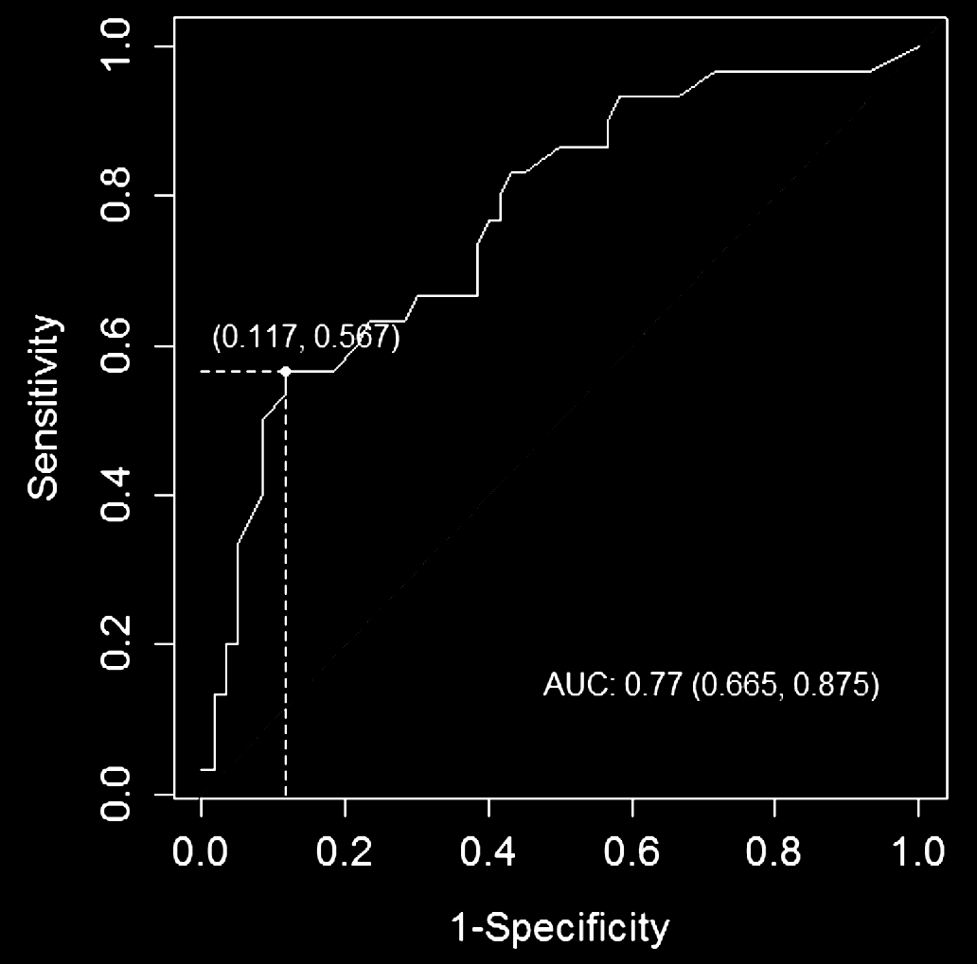
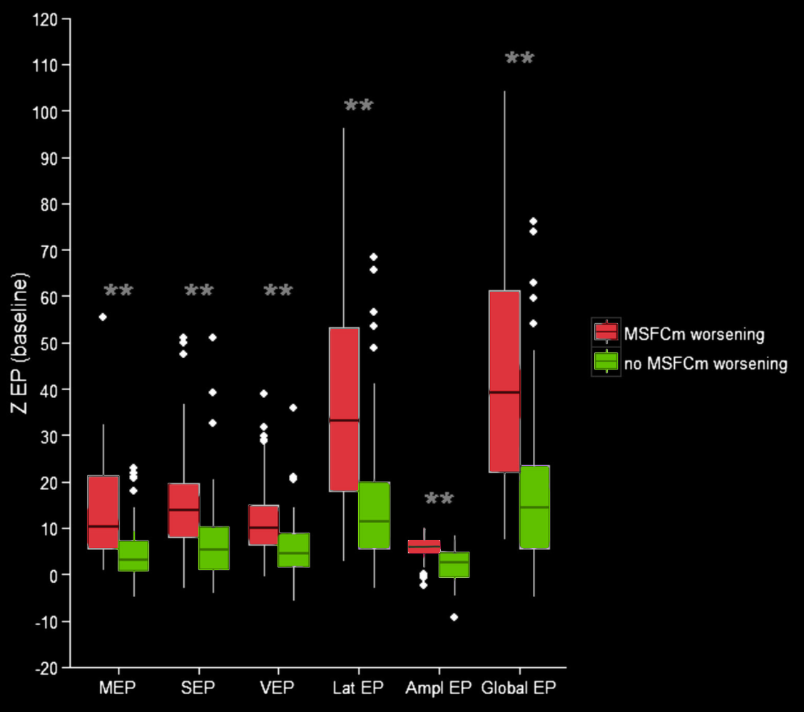
Baseline EPs predict EDSS after 7 years
Giffroy et al., Acta Neurol Belg 2016
Giffroy et al., BMC Neurology 2016
Baseline Global EP score = 17/3
Predicts future EDSS worsening(*) after 7 years
Sensitivity 56,7 %
Specificity 88,3 %
(*) : 1 point increase if baseline EDSS < 5.5 or 0,5 point if baseline ≥ 5.5

Slide 33
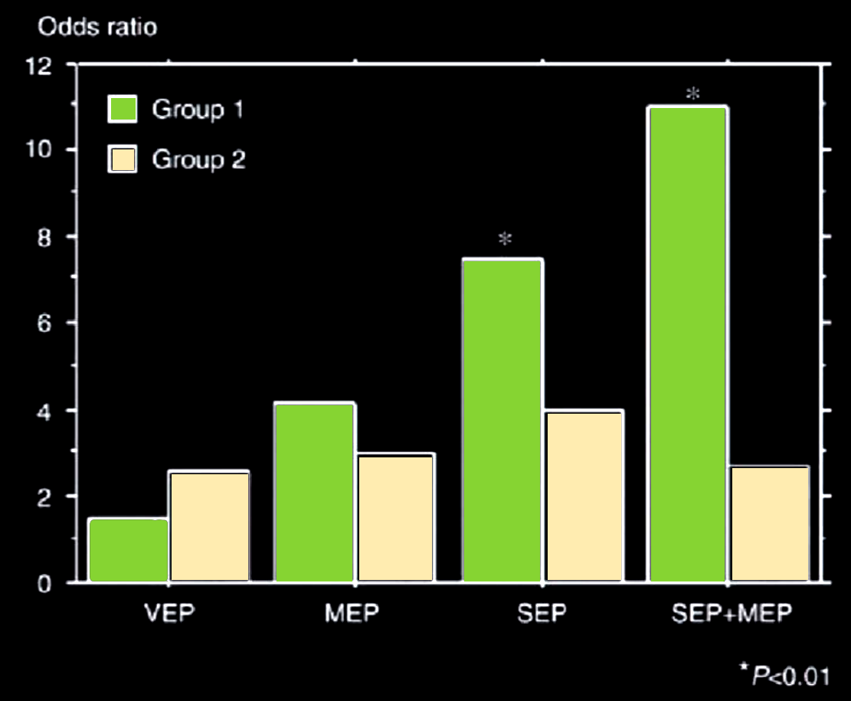
Basal Eps and EDSS worsening at follow-up (5 years)
1.5
2.7
4.2
3.0
7.5
4.0
11.0
2.7
Kallmann et al., MSJ, 2006

Slide 34
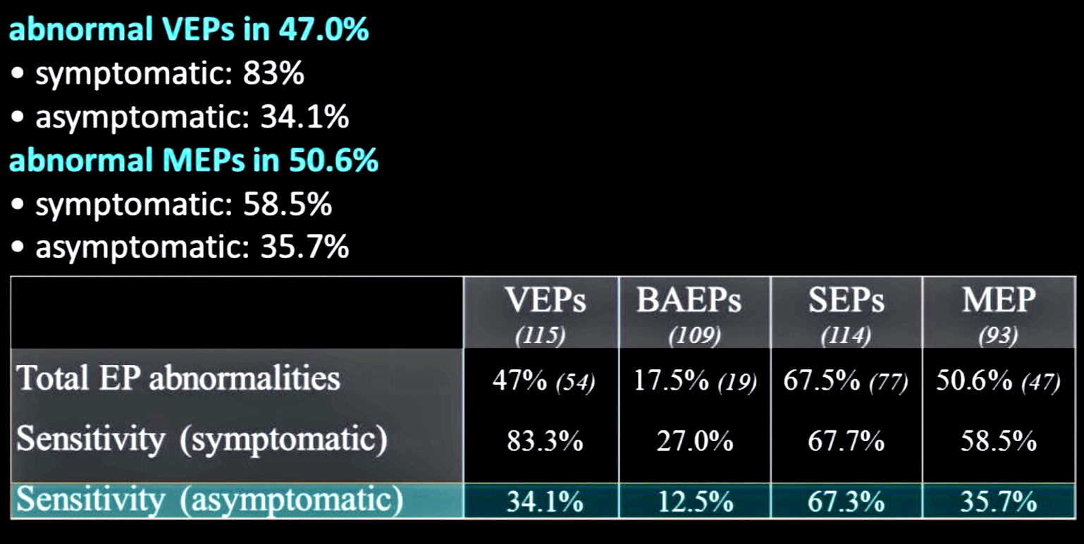
Low EPs sensitivity in CIS even if MRI+
115 CIS patients (all with ≥ 1 MRI lesion)
followed for 5 years
Leocani L., Di Maggio et al., ECF 2016

Slide 35
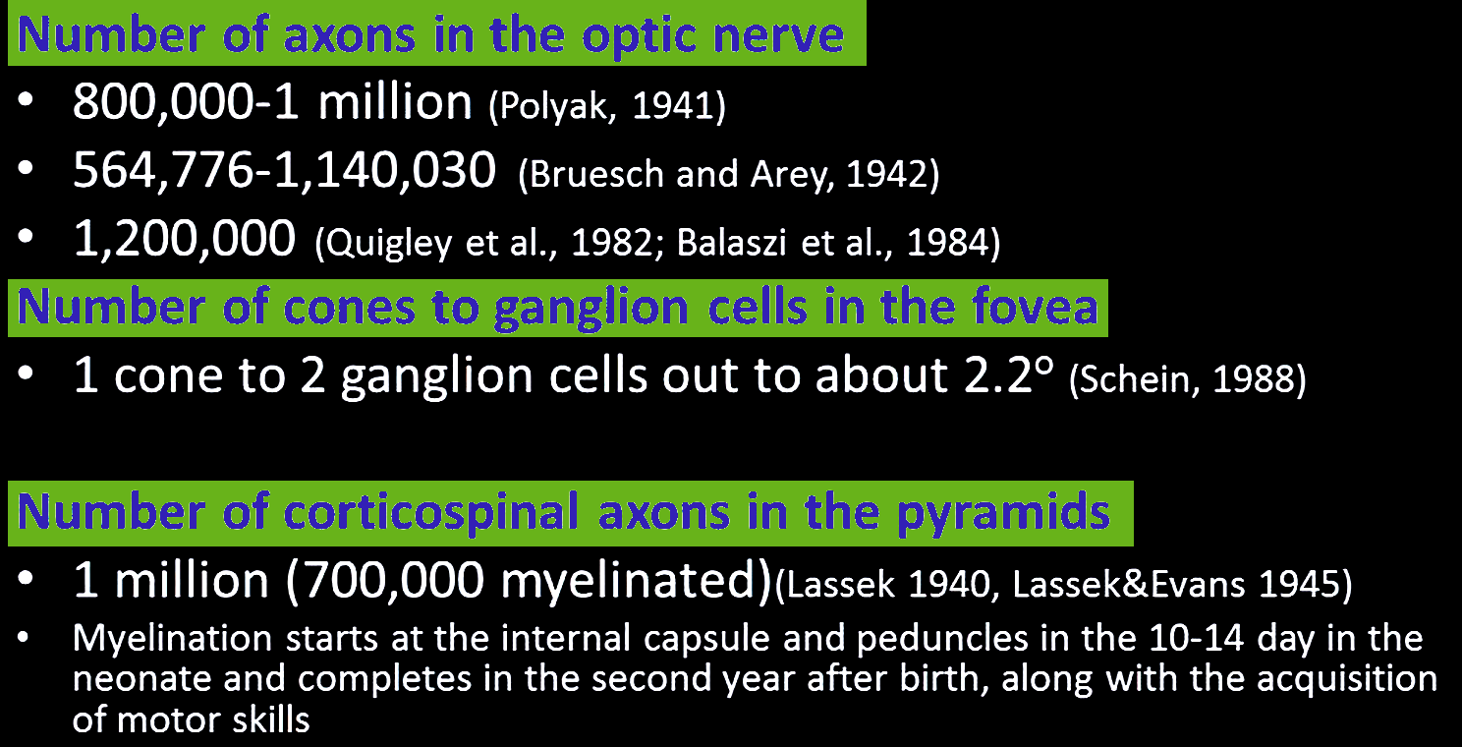
Human optic nerve vs corticospinal tract

Slide 36


Neurophysiology to show improvements
Before treatment
After treatment

Slide 37
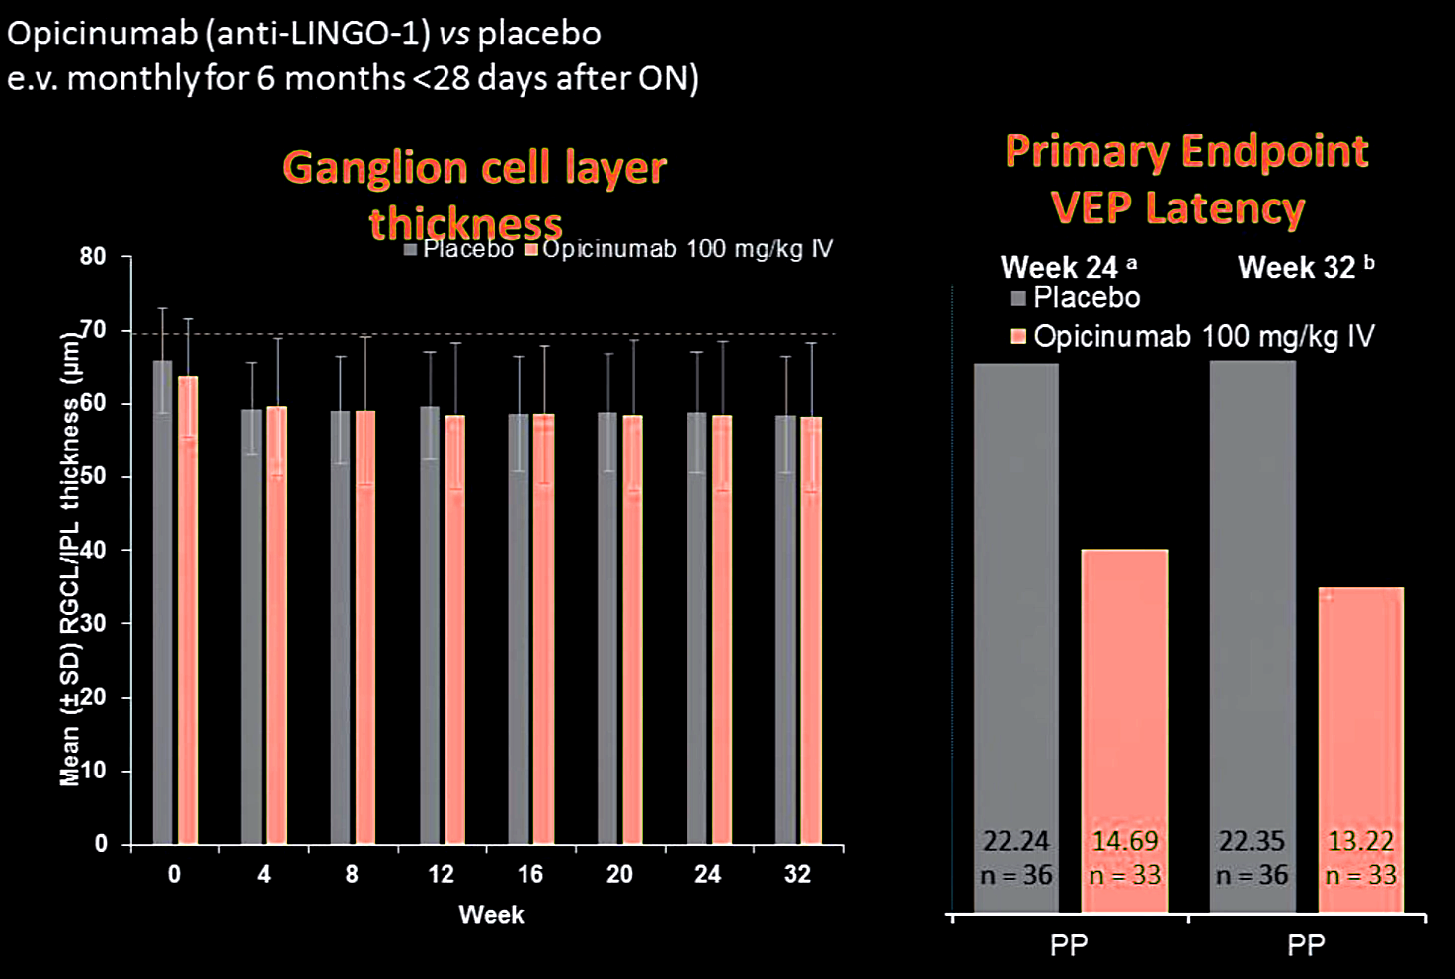
VEPs and OCT to test remyelination after ON – Renew study

Slide 38

Improvement of MEP following Alemtuzumab

Slide 39


Triple Stimulation

Slide 40
Clinical Usefulness of Eps in MS Monitoring
MONITORING (assessing treatment efficacy)
  Disease activity (lesions anywhere in CNS)
  Relapse confirmation (vague symptoms)
  Disease progression (clinically relevant pathways)
  Functional improvement (clinically relevant pathways)
  Prediction of future disability progression
  Axonal loss evaluation
NO
YES
YES
YES
YES
YES ?

