Slide 1
Congress of the DCRM, BNF-PRM and RBSPRM 2017
Parallel session 2 – Thursday 9 november 14.05 – 15.35h
2d. Neurophysiological techniques for functional quantification and prognosis in multiple sclerosis

Slide 2
NONE
F Wang

Slide 3
Triple Stimulation Technique
TST was developed by Magistris (Magistris et al., 1998)
TST allows a precise quantification of the central conduction failures
TST was already used in ALS (Banach & Rakowicz, 2010) Kennedy disease (Xu et al., 2015) spinocerebellar ataxia (Sakuma et al., 2005) multiple systemic atrophy (Eusebio et al., 2007) CIDP (Attarian et al., 2015) GBS (Taieb et al., 2015)
Notes:
The TST was developed by Magistris in 1998
This method allows a precise quantification of the central conduction failures
The TST has already been used to diagnose and monitor the functional consequences of several peripheral or central nervous conditions

Slide 4
Physiological conduction
Neurophysiological conduction
Collision procedure
Desynchronisation
TST principle - in healthy control - in central motor failure
Notes:
Prior to explain the TST principle first in healthy control and then in the case of a central motor failure, I would like to explain the difference between a physiological conduction following a central command and a neurophysiological conduction following a percutaneous nerve stimulation. I would like also to explain, what actually is desynchronisation and the collision procedure

Slide 5
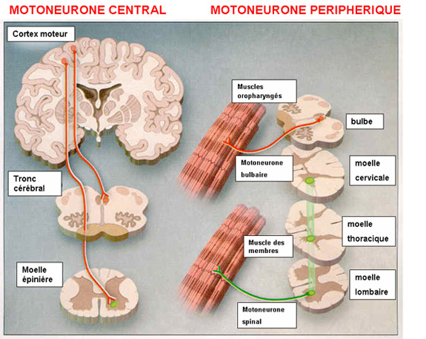
Physiological conduction
Neurophysiological conduction
Collision procedure
Desynchronisation
TST principle - in healthy control - in central motor failure
Notes:
When the upper motoneurone is voluntary activated, there is a descending volley until the anterior horn of the spinal cord where the lower motorneurone is activated through a synapse. A second descending volley reaches the muscle target through another synapse and a MUP is generated which leads to a muscle contraction.

Slide 6
Physiological conduction
C
E
W
MUP
Notes:
When the upper motoneurone is voluntary activated, there is a descending volley until the spinal cord
The lower motorneurone is activated.
A second descending volley reaches the muscle target and a MUP is generated

Slide 7
Physiological conduction
Neurophysiological conduction
Collision procedure
Desynchronisation
TST principle - in healthy control - in central motor failure
Notes:
It’s a little bit different if we consider a neurophysiological conduction

Slide 8
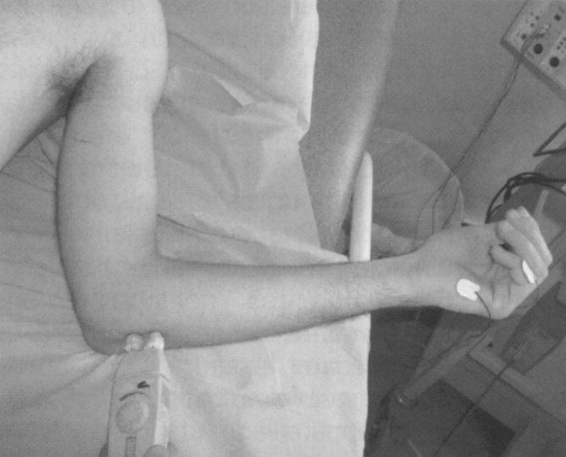
Neurophysiological conduction
Percutaneous nerve stimulation
C
E
W
MUP
Notes:
When a peripheral nerve is activated by a percutaneous nerve stimulation, for instance the ulnar nerve at the elbow, a descending volley, in green, but also an ascending volley, in red, will be generated. The descending volley, in green, once again, reaches the muscle through a synapse and a MUP is generated which can be recorded by surface electrode placed over the target muscle. For the moment, we don’t care about the ascending volley.

Slide 9
Physiological conduction
Neurophysiological conduction
Collision procedure => double stimulation => 1 response
Desynchronisation
TST principle - in healthy control - in central motor failure
Notes:
The collision procedure is characterized by a double stimulation which generates only one response

Slide 10
Collision procedure => double stimulation => 1 response
W
E
E-W
Notes:
When we apply a percutaneous nerve stimulation to the ulnar nerve at the wrist, a motor response is recorded, for instance, in the first interosseous muscle with a short latency. The latency is the time from the stimulation to the motor response onset. If the distance between stimulating electrodes and recording electrodes is short, the latency will be short, at least in healthy controls.
When we apply a percutaneous nerve stimulation to the ulnar nerve at the Erb’s point, at the supraclavicular level, a motor response with a longer latency is recorded in the first interosseous muscle
When we apply simultaneously or with a little delay a double percutaneous nerve stimulation to the ulnar nerve, one at the wrist and a second at the Erb’s point, only one motor response is recorded in the first interosseous muscle since ascending volley following wrist stimulation collides with descending volley following Erb’s point stimulation. In this condition, no response is elicited by Erb’s point stimulation because of the collision phenomenon.

Slide 11
Physiological conduction
Neurophysiological conduction
Collision procedure
Desynchronisation
TST principle - in healthy control - in central motor failure
Notes:
What is desynchronisation ?

Slide 12
C
E
W
1
2
3
4
5
Wrist stimulation W
No desynchronization
CMAP
Notes:
Of course, a peripheral nerve contains more than one motor axon, usually, several hundreds. Suppose the corticomotor tract is simplified to five upper motoneurones and five lower motoneurones. Suppose also, that the axonal diameter is larger in 1 than in 2, in 2 than in 3 etc… and is minimal in 5. Consequently, the conduction velocity is faster in 1 than in 2 etc… an is minimal in 5. In the case of a wrist stimulation, the distance between the stimulation point and the target muscle is short, therefore the differences in conduction velocity are not visible. Each motor axon generate a MUP which is synchronized to the others and the summation of the different MUP generates a maximal compound muscle action potential CMAP.

Slide 13
C
E
W
Erb stimulation E
Little desynchronization
CMAP
Notes:
In the case of an Erb’s point stimulation, the distance between the stimulation point and the target muscle is longer. Therefore the differences in conduction velocity may be seen a little and the CMAP is a little bit desynchronized with a small decreased amplitude and a small increased duration since the slower is the motor axon and the more its corresponding MUP is late.

Slide 14
C
E
W
Transcranial magnetic stimulation C
Desynchronization of the central motor volley
MEP
Notes:
When motor evoked potential MEP are generated by a transcranial magnetic stimulation TMS, there is an important desynchronization of the central motor volley. Therefore, in healthy subjects, MEP amplitude is always lower than the CMAP amplitude evoked by peripheral nerve stimulation.

Slide 15
CMAP amplitude > MEP amplitude
CMAP
MEP
desynchronization of the central motor volley ?
central axonal loss or conduction block ?
Notes:
So, how to recognize a normal desynchronization of the central motor volley from a central axonal loss or a central conduction block ? This is the goal of the TST : the resynchronization of the central motor volley to precisely quantify the central motor axonal loss

Slide 16
Physiological conduction
Neurophysiological conduction
Collision procedure
Desynchronisation
TST principle - in healthy control - in central motor failure
Notes:
If you have well understood these 4 points, we can try to understand the TST principle in healthy control

Slide 17
TST principle : resynchronization of central motor volley
TST test
C
E
W
Stim 1 : transcranial magnetic stimulation C
Notes:
Of course, the TST principle is based on a triple stimulation. The first stimulation is a transcranial magnetic stimulation. You can see here, at the peripheral level, the result of the desynchronisation of the central motor volley.

Slide 18
TST test
C
E
W
Stim 2 : wrist stimulation W
delay 1 ÷ C = conduction time C-W
=> CMAP 1 collision between desc. vol. C – and asc. vol. W
CMAP 1
Notes:
Before the descending volley reaches the muscle target a supramaximal electric stimulation of the ulnar nerve at wrist is applied.
The descending volley following the wrist stimulation reaches the muscle target and a first CMAP without desynchronisation is obtained. CMAP 1
The ascending volley following the wrist stimulation (in red) collides with the descending volley following TMS (in green). Therefore, in this condition, no response is elicited by the TMS because of a collision after wrist stimulation in all motor axons.

Slide 19
TST test
C
E
W
Stim 3 : Erb stimulation E
delay 2 ÷ C = delay 1 + conduction time E-W
=> CMAP 2
CMAP 1
TSTtest
Notes:
A third stimulation at the supra-clavicular level (Erb’s point) is applied. The descending volley following Erb’s point stimulation reaches the target muscle and a second CMAP is obtained a little bit smaller in amplitude and longer in duration. CMAP 2 or TST test

Slide 20
Physiological conduction
Neurophysiological conduction
Collision procedure
Desynchronisation
TST principle - in healthy control - in central motor failure
Notes:
Now, what happens in the case of a central disease with a central motor axonal loss ?

Slide 21
TST test
Central disease
C
E
W
Stim 1 : transcranial magnetic stimulation C
Notes:
Suppose that only 3 out 5 upper motoneurones are activated by the TMS because of a 40% central motor axon loss.
You can see here, at the peripheral level, the result of the desynchronisation of the central motor volley in the three activated motor axons.

Slide 22
TST test
C
E
W
Stim 2 : wrist stimulation W
delay 1 ÷ C = conduction time C-W
=> CMAP 1 collision between 3/5 desc. vol. C – and asc. vol. W
CMAP 1
Notes:
Once again, before the descending volley reaches the muscle target a supramaximal electric stimulation of the ulnar nerve at wrist is applied.
The descending volley following the wrist stimulation reaches the muscle target and a first CMAP without desynchronisation is obtained. CMAP 1
The ascending volley following the wrist stimulation (in red) collides with the descending volley following TMS (in green) in only 3 out 5 motor axons.
Consequently, and this is the important point, the ascending volley following the wrist stimulation in these 2 motor axons do not collide with the descending volley following the TMS.
So in this case, there is a collision after wrist stimulation in only 3 out 5 motor axons.

Slide 23
TST test
C
E
W
Stim 3 : Erb stimulation E
delay 2 ÷ C = delay 1 + conduction time E-W
=> CMAP 2 smaller than CMAP 1
CMAP 1
TSTtest
Notes:
If, before the ascending volley reaches the Erb’s point a supramaximal electric stimulation at the Erb’s point is applied, there will be a second collision phenomenon in these both motor axons between the descending volley following Erb’point stimulation and the ascending volley following wrist stimulation. Therefore, the descending volley, of the 3 other motor axons, following Erb’s point stimulation, reaches the muscle target and a second CMAP clearly smaller than the first one is obtained. CMAP 2 or TST test

Slide 24
Summarize
Healthy controls Central motor failure STIM 1 : TMS all UMN activated STIM 1 : TMS 3 out 5 UMN activated STIM 2 : wrist stimulation STIM 2 : wrist stimulation => collision in all motor axons => collision in 3 out 5 motor axons STIM 3 : Erb stimulation STIM 3 : Erb stimulation => collision in 2 out 5 motor axons => TSTtest = CMAP after Erb stim => 3 MUP contribute to the TSTtest
Notes:
So, in summarize, in healthy controls TMS activates all UMN and the collision after wrist stimulation occurs in all motor axons. Consequently, the TSTtest looks like a CMAP after an Erb’s point stimulation. Il the case of central motor failure, the TMS activates, in this example, only 3 out 5 UMN and the collision after wrist stimulation occurs in only 3 out 5 motor axons. After the Erb’s point stimulation, a second collision occurs in the 2 motor axons that escaped the first collision and the TSTtest is reduced in amplitude as only 3 MUP contribute to the motor response.

Slide 25
TST control
C
E
W
Stim 1 : Erb stimulation E
Stim 2 : wrist stimulation W
Stim 3 : Erb stimulation E
CMAP 1
TSTctl
Notes:
To quantify the central motor loss, the TST test has to be compared with a TST control where the TMS is replaced by an Erb’s point stimulation.
So, the first stimulation is an Erb stimulation.
Before the descending volley reaches the muscle target a supramaximal electric stimulation of the ulnar nerve at wrist is applied.
The descending volley following the wrist stimulation reaches the muscle target and a first CMAP without desynchronisation is obtained. CMAP 1
The ascending volley following the wrist stimulation collides in all motor axons with the descending volley following the first Erb’s point stimulation. Therefore, no response is elicited by the first Erb stimulation.
After the collision, a second Erb stimulation is delivred.The descending volley reaches the muscle target and a second CMAP is obtained. CMAP 2 or TST control

Slide 26
Central motor
axonal loss
Notes:
The central motor axonal loss is calculated by making the difference between the TST control amplitude and the TST test amplitude

