Slide 1


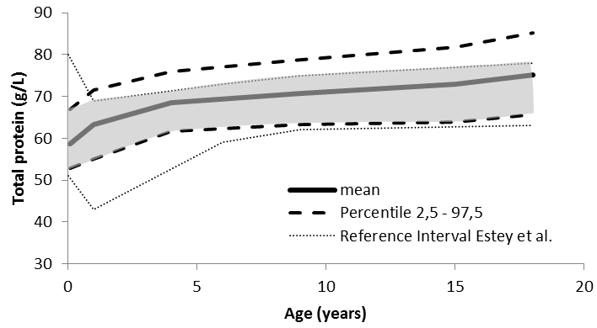
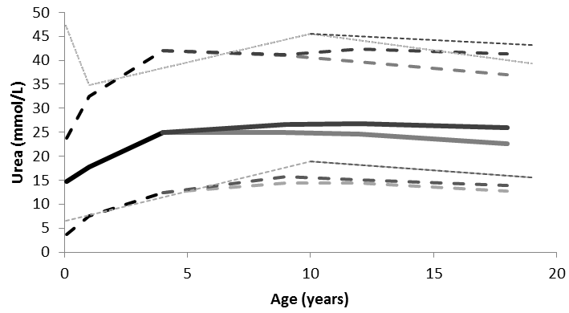
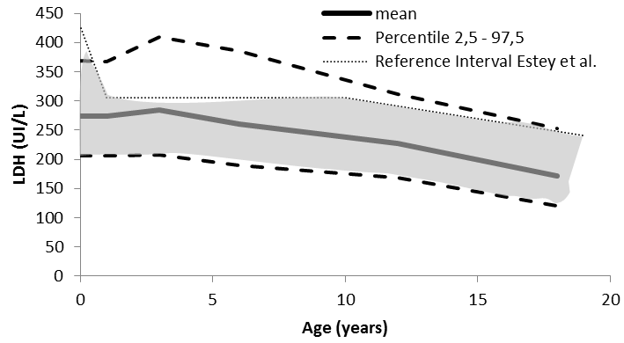
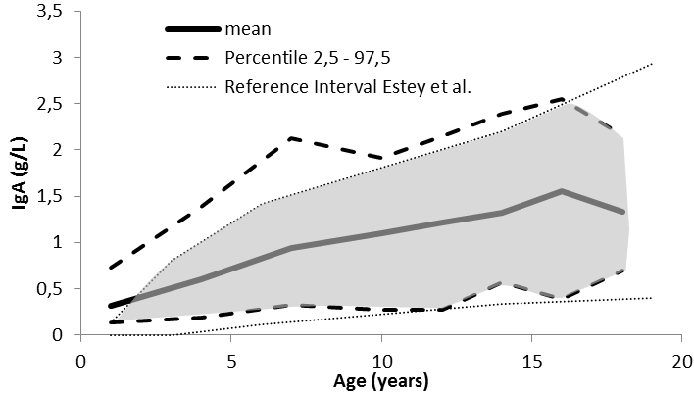
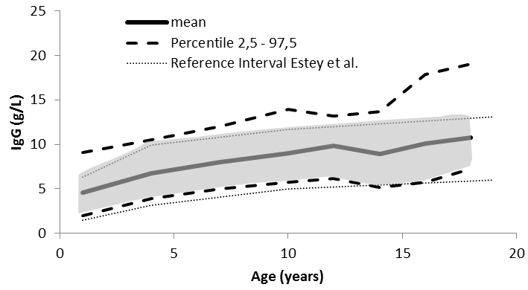
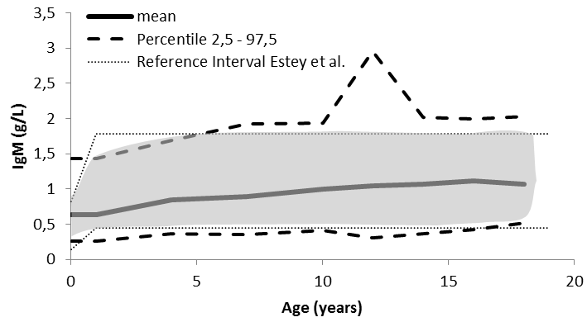
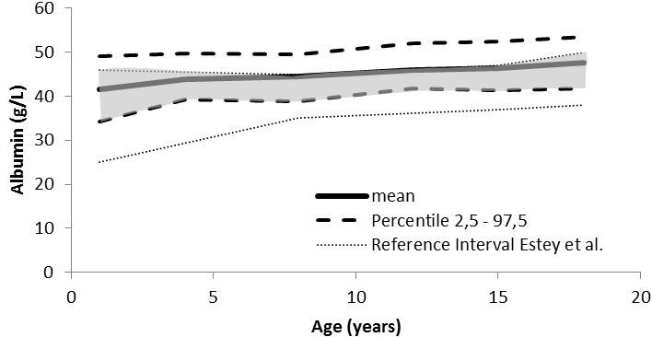
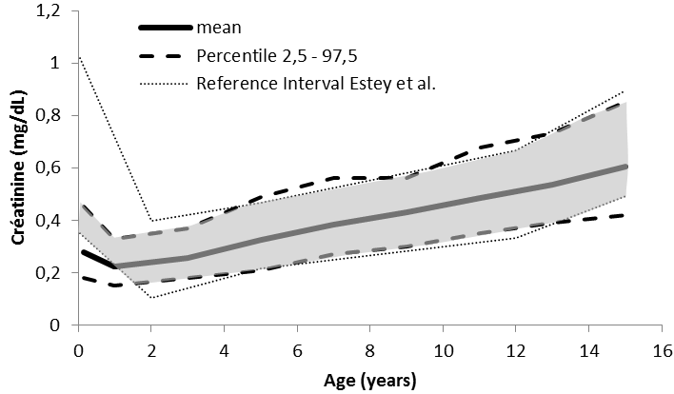
Pediatric reference intervals: Retrospective study for 8 common chemistry parameters on Cobas c6000 analyzer (Roche°).
A. Ladang¹, L. Vranken¹, E. Cavalier²
1: Clinical chemistry department / Clinical Biology; CHU de Liège; ULg
2: Head of Clinical chemistry department / Clinical Biology; CHU de Liège; ULg
Defining age and sex-specific reference range is an essential tool for diagnostic. In this study, we define new pediatric reference range for 8 common chemistry parameters: Albumin, Creatinin, IgA, IgG, IgM, Lactate deshydrogenase, Total proteins, Urea.
For the last 2 years, we collected data of 0 to 18 years old outclinic patients. Data were then partitioned according range defined by the Canadian large-scale prospective study (the CALIPER initiative) and further fused if no significant differences between two consecutive populations were observed. Reference intervals were established according to non-parametric percentile method (CLSI C28-A3). Those results were further compared to the CALIPER initiative data.
Figures: Reference range established by the CALIPER initiative compared to our population. The grey zone represent the fraction of our population covered by the CALIPER reference ranges.
Here are defined pediatric reference range for 8 common chemistry parameters on Cobas C6000 analyzer. When compared to the CALIPER initiative, our study tends to show systematic bias but also age and parameter specific discrepancies. We must highlight the specific case of albumin where CALIPER reference values do not even cover our mean population. Those data insist once again on the need of reference range adapted for your analyzer and your local pediatric population.

