Slide 1


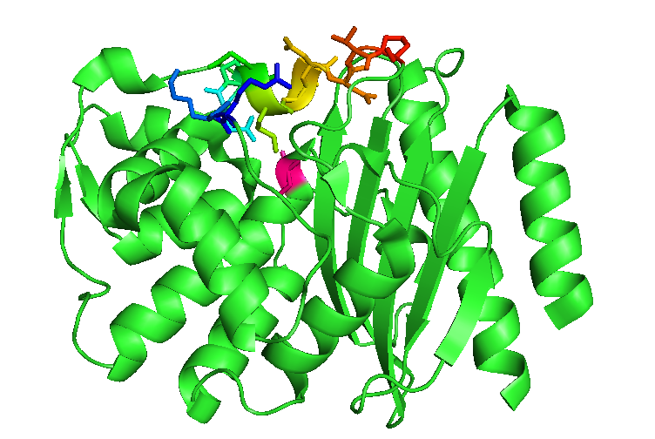
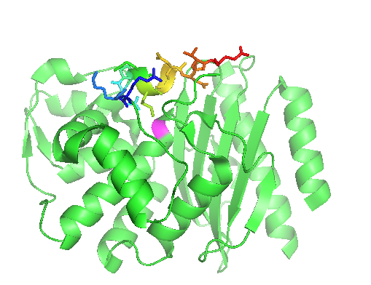
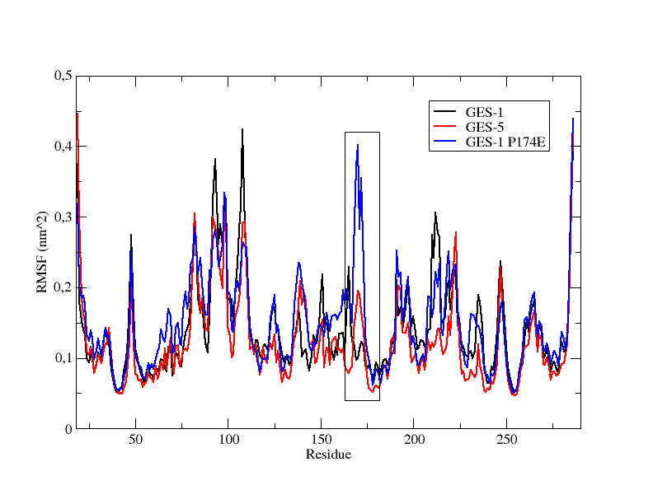
Replacement of proline 174 with glutamic acid in GES-1 enzymes improves the flexibility of Ω-loop leading to an increase of catalytic efficiency towards carbapenems
¹Piccirilli A, ¹Perilli M, ²Mercuri PS, ³Aschi M, ¹Segatore B, ²Galleni M, ¹ Celenza G, ¹Amicosante G
¹ Department of Biotechnological and Applied Clinical Sciences, University of L’Aquila, Italy
² Macromolécules biologiques InBioS-Centre for Protein Engineering, University of Liège, Belgium
³ Dipartimento di Scienze Fisiche e Chimiche, University of L’Aquila, Italy
I n t r o d u c t i o n
Figure 1. Molecular modeling of : a) GES-1 and b) GES-1^{P174E}
M e t h o d s
GES-type-enzymes are spreading in several Gram-negative bacteria, including Enterobacteriaceae and nonfermenters strains as Pseudomonas aeruginosa and Acinetobacter baumannii (1,2). To date, twenty-seven GES variants have been discovered, differing from each other by one to three amino acid substitutions (http://lahey.org/studies/). GES-1, the first representative of the GES-family, was found to confer resistance to penicillins, broad spectrum cephalosporins but not to monobactams and carbapenems. Nevertheless, carbapenemase activity has been demonstrated in GES, like GES-2, GES-4, GES-5, GES-6, GES-14, GES-18, GES-20 variants, with a substitution at position 170 were a glycine residue has been replaced by serine or asparagine.
a
P174
Overlap extension method (3) was used to generate mutants of GES-1 enzyme at position 174. Site-saturation mutagenesis was performed on bla_{GES-1} gene using degenerated primers. The bla_{GES-1} and mutated amplicons were inserted into pET-24(a) vector and transferred in Escherichia coli BL21(DE3) for enzymes expression. The recombinant plasmids were selected on LB agar plates supplemented with ampicillin and cefotaxime. The enzymes were extracted from 1,2 L of culture, grown at 37°C until to achieve an A₆₀₀ of approximately 0.7 OD. At this stage 0.4 mM IPTG (isopropyl-ß-thiogalactoside) was added and the cultures were incubated for 16 h at 22 °C, under aerobic conditions. Purification of the enzymes was made by two chromatographic step: ion-exchange chromatograpgy Sepharose Q and gel filtration Superdex 200. Steady-state kinetic experiments were performed following the hydrolysis of each substrate at 25°C in 20 mM sodium phosphate buffer (pH 7.0). Molecular dynamics (MD) simulations were performed for 100.0 ns on GES-1 and GES-1^{P174E}.
E174
b
R e s u l t s
Figure 2. MD simulations of GES-1 and GES-1^{P174E} complexed with imipenem. The black box highlights the Ω-loop region.
Table 1. β-lactams susceptibility of E. coli pET-24/GES-1^{P174E} compared with E. coli pET-24/GES-1
Ω-loop
Antibiotics | E.coli pET-24 GES-1 | E.coli pET-24 GES-1^{P174E} | E.coli pET-24
Piperacillin | >256 | >256 | 1
Piperacillin + TAZ | 256 | >256 | 1
Amoxicillin | >256 | 256 | 0.5
Imipenem | 0.5 | 0.5 | 0.0625
Ertapenem | <0.0325 | 0.5 | 0.0625
Meropenem | <0.0325 | 0.25 | 0.0625
Cefazolin | >128 | 64 | 0.125
Cefotaxime | 16 | 2 | 0.0625
Ceftazidime | 16 | 16 | <0.0625
Cefepime | 8 | 8 | 0.125
Cefoxitin | 1 | 2 | 0.125
Ceftarolin | 16 | 32 | 0.0625
Aztreonam | >128 | 32 | 0.0625
In the presence of 4 μg/mL of cefotaxime a GES-1 mutant, where proline (P) at position 174 was replaced by glutamic acid (E), has been selected. The phenotypic profile has been characterized by microdilution method using a bacterial inoculum of 5 x 10⁵ CFU/mL according to Clinical and Laboratory Standards Institute (CLSI) performance standards(4). As shown in Table 1, the GES-1^{P174E} mutant showed higher MIC values towards meropenem, ertapenem and ceftarolin.
MD simulations revealed that Ω-Loop is significantly more flexible in the core of GES-1^{P174E} this is in agreement with the observed reduction of K_{m} and an increase of k_{cat} values for carbapenems.
Table 2. Kinetic parameters calculated for GES-1 and GES-1^{P174E}
C o n c l u s i o n s
Substrates | GES-1 |  |  | GES-1^{P174E}
 | K_{m} _{(μM)} | k_{cat} ₍s⁻¹₎ | k_{cat}/K_{m} _{(μM}⁻¹ s⁻¹₎ | K_{m} _{(μM)} | k_{cat} ₍s⁻¹₎ | k_{cat}/K_{m} _{(μM}⁻¹ s⁻¹₎
Benzylpenicillin | 210±15 | 117 | 0.557 | 187±12 | 5 | 0.027
Ampicillin | 260±20 | 236 | 0.908 | 230±8 | 30 | 0.130
Piperacillin | 1400±150 | 184 | 0.131 | 608±25 | 23 | 0.038
Carbenicillin | 1250±35 | 41 | 0.033 | 3300±65 | 12 | 0.0036
Cefazolin | 1440±35 | 375 | 0.26 | 143 | 103 | 0.72
Meropenem | 0.08* | 0.007 | 0.0875 | 0.1* | 0.1 | 1
Imipenem | 0.8* | 0.006 | 0.0075 | 0.013* | 0.01 | 0.77
Ertapenem | 0.25* | 0.003 | 0.012 | 0.1* | 0.008 | 0.08
Nitrocefin | 325±20 | 168 | 0.517 | 350±20 | 122 | 0.348
The proline at position 174 is well conserved in all GES-variants and in more class A carbapenemases. The replacement of proline with glutamic acid changes the flexibility of Ω-loop. In GES-1^{P174E} the Ω-Loop is more flexible and this could explain also the reduction of K_{m} values for carbapenems.
R e f e r e n c e s
Bebrone C., 2013. Antimicrob. Agents Chemother., 57:396-401.
Bogaerts P., 2010. Antimicrob. Agents Chemother., 54:4872-4878.
Steffan NH et al. Gene 1989; 77:51-59.
CLSI. Methods for dilution antimicrobial susceptibility tests for bacteria that grow aerobically; approved standard. Seventh Edition. Document M7-A7, 26 (2). CLSI, Wayne, PA, USA, 2006.
Both GES-1 and GES-1^{P174E} were purified at the homogeneity by two chromatographic steps which yielded the enzymes as more than 90% pure, as evaluated by SDS-Page. As shown in table 2, K_{m}, k_{cat} and k_{cat}/K_{m}, were calculated for both enzymes towards several β-lactams. Compared with GES-1, the GES-1^{P174E} showed a significant increase of k_{cat} values and, consequently, of k_{cat}/K_{m} versus carbapenems. The GES-1^{P174E} showed the k_{cat}/K_{m} values for imipenem about 100-fold higher that GES-1.

