Slide 1


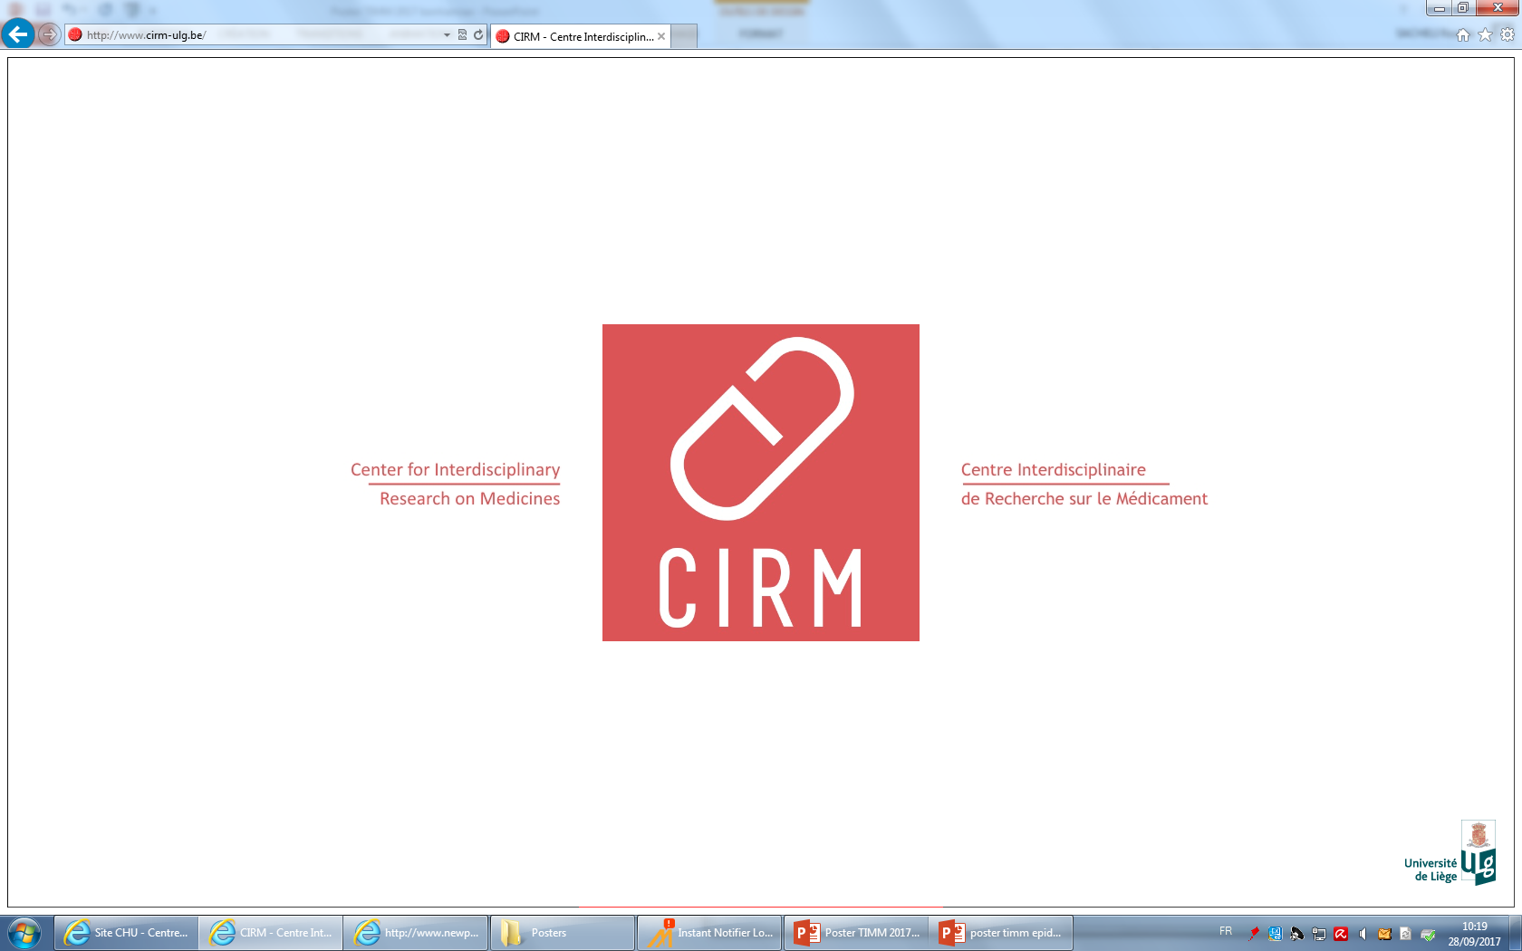
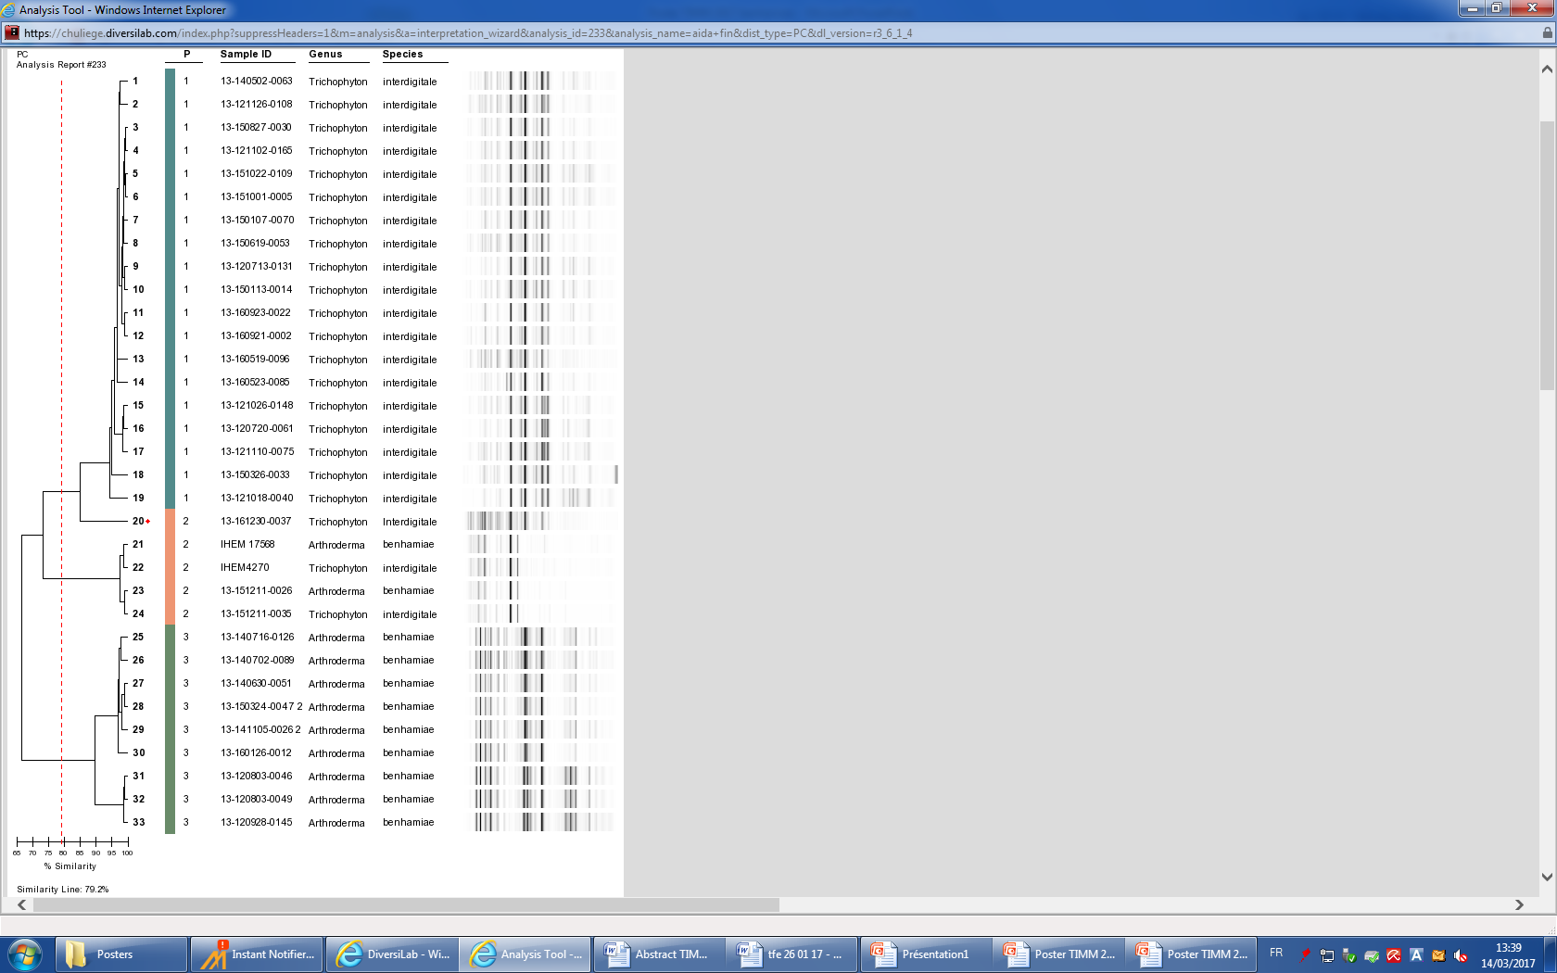
Corresponding author r.sacheli@chu.ulg.ac.be
P290
Comparison of four methods for the identification of Trichophyton benhamiae strains: Maldi-Tof MS, ITS sequencing, Diversilab and DermaGenius
Sacheli Rosalie¹, Ferrer Aida², Darfouf Rajae¹, Adjetey Caroline²,Hayette Marie-Pierre¹.
¹National Reference Center for Mycosis, ²Department of Clinical Microbiology,
Center for Interdisciplinary Research on Medecines, University Hospital of Liège Belgium
Objectives
Infections due to the zoophilic dermatophyte Trichophyton benhamiae are being more frequently diagnosed in Belgium since a few years. This species has been newly included in the T. benhamiae series together with T. concentricum, T. verrucosum and T. erinacei (De Hoog et al 2016). These strains appear with a bright yellow thallus in culture and do not easily sporulate making them difficult to identify by microscopy. Maldi-Tof MS may present an alternative to microscopic/molecular dermatophyte identification for this species. Molecular methods as ITS sequencing, Rep-PCR by Diversilab and Real time PCR by DermaGenius, have been evaluated here as identification methods.
Methods
A total of 39 strains belonging to the ancient T. mentagrophytes complex have been analyzed (Including IHEM4270 and IHEM17569 as ref. strains). All were collected by the National Reference Center for mycosis in Belgium between 2012 and 2016. The fungal strains were first identified by microscopy. Strains appearing with a yellow pigment in culture were compared to strains appearing white not pigmented in culture and presenting characteristics of T. interdigitale by microscopy. Strains were then characterized by Maldi-Tof MS, by ITS sequencing, by Diversilab rep-PCR (BioMerieux) and by DermaGenius Real Time PCR (Pathonostics).
Results
v
1. ITS sequencing
2. DermaGenius Real Time PCR
Among the 39 strains, ITS sequencing could identify 11 T.benhamiae and 28 T. interdigitale strains (including IHEM4270 and IHEM 17568). Most of the time, white strains gave rise to T. interdigitale identification while strains with yellow pigmentation were identified as T. benhamiae. However, two strains were identified as T. benhamiae but did not produce clear yellow pigmentation.
The 39 strains were submitted to Real Time PCR with the DermaGenius kit. This method was able to detect the 28 white strains as T. interdigitale but not the 9 strains with yellow pigmentation as well as the two white strains identified as T. benhamiae by ITS sequencing. Despite the fact that this method does not contain probes for T. benhamiae detection, results are 100% in agreement with ITS sequencing regarding T. interdigitale and doesn’t produce any discrepant results for T. benhamiae.
3. Diversilab
4. Maldi-Tof MS
STRAIN | MALDI-TOF | SCORE | PCR-ITS | COLOUR
1) 13-151211-0035 | T. interdigitale | 2,061 | T. interdigitale | White
2) 13-160523-0085 | T. interdigitale | 2,225 | T. interdigitale | White
3) 13-160519-0096 | T. interdigitale | 2,352 | T. interdigitale | White
4 ) 13-160601-0024 | T. interdigitale | 2,179 | T. interdigitale | White
5) 13-120713-0131 | T. interdigitale | 1,852 | T. interdigitale | White
6) 13-121110-0075 | T. interdigitale | 2,006 | T. interdigitale | White
7) 13-130620-0155 | T. interdigitale | 2,064 | T. interdigitale | White
8) 13-160122-0037 | T. interdigitale | 1,678 | T. interdigitale | White
9) 13-150820-0015 | T. interdigitale | 2,186 | T. interdigitale | White
10) 13-150827-0030 | T. interdigitale | 2,155 | T. interdigitale | White
11) 13-151001-0005 | T. interdigitale | 2,244 | T. interdigitale | White
12) 13-151022-0109 | T. interdigitale | 1,939 | T. interdigitale | White
13) 13-150708-0007 | T. interdigitale | 1,148 | T. interdigitale | White
14) 13-150619-0053 | T. interdigitale | 2,008 | T. interdigitale | White
15) 13-140702-0089 | T. benhamiae | 0,924 | T. benhamiae | Yellow
16) 13-141105-0026 | T. benhamiae | 1,447 | T. benhamiae | Yellow
17) 13-151211-0026 | T. benhamiae | 0,789 | T. benhamiae | Yellow
18) 13-160126-0012 | T. benhamiae | 2,353 | T. benhamiae | Yellow
19) 13-120803-0046 | T. benhamiae | 1,485 | T. benhamiae | White
The Diversilab system, classified 19 white strains in a unique cluster belonging to T. interdigitale. Seven strains producing yellow pigment as well as the two white strains identified as T. benhamiae by ITS sequencing belonged to a single cluster sharing only 75% of similarity with the cluster of T. interdigitale strains. An other cluster was identified including a mix of T. benhamiae and T. interdigitale strains. ITS ID (for strains n°20-24) and Maldi-tof (for strain n°23 and 24) confirmed the ID as T. benhamiae and T. interdigitale for these discrepant results. Some strains did not produce any valid fingerprints by this method.
39 strains were identified with Maldi-Tof MS. Among isolates, 14 white strains were identified as T. interdigitale, one white strain was identified as T. benhamiae (n°19) and 4 analyzed strains producing a yellow pigment were identified as T. benhamiae (49% of correct identification, 19/39 strains correctly identified). The 20 remaining strains didn’t show any peak.
Conclusion
ITS sequencing is the method of choice to identify T. benhamiae strains. The DermaGenius kit is not able to detect this emerging species but has identified correctly all T. interdigitale strains. Improvement of this method is necessary as the number of T. benhamiae isolated in Europe is significant. Rep-PCR by Diversilab is a typing method able to detect two different clusters of strains belonging to T. interdigitale and T. benhamiae, sharing few similarities justifying the change of classification of T. benhamiae outside the ancient T. mentagrophytes complex. Finally, Maldi-Tof MS in our settings, could identify only 45% of T. benhamiae strains. However, no wrong identifications were generated by this method. Improvement of methodology is necessary to increase the method efficiency and make possible the identification of dermatophytes by mass spectrometry.

